Slide 1
Fraud Detection & Customer Clustering
Industry Capstone Project
Daniele D’Avino
January 2023

Slide 2
Goal & Solution
The goals of this project are twofold:
Identify fraudolent transaction
Clusterize customers for personalized call to action (promotion, offering, etc..)
ML Web App for reaching the previous goals

Slide 3
Data
Structured mixed type dataset with fraud label (not used the dataset suggested by the industry)
Information regarding:
Transactions (amount, product, etc.)
Payments types (card type, card issuer, region, etc)
Customers behavior on the website
Customers devices (browser, os, user agent, IP proxy, etc)
Imbalance class, missing data

Slide 4
Model - Fraud Detection Overall
Bayesian average of the score computed from two separate models
Rule Based
Machine Learning
Final score

Slide 5
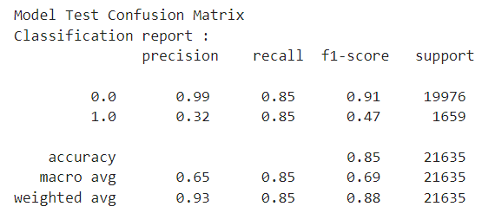
Model – Fraud Detection Machine Learning
Undersampling majority class
Pipeline Model
Imputation and scaling for continuos and categorical features
Supervised Model → Gradient Boosting Classifier
Calibration of the model
Features importance for explainability
Results:

Slide 6
Model – Fraud Detection Rule Based
Weighted average of features selected from human expert resulting in a «warning score»

Slide 7
Model – Customer clustering
K-prototype algorithm
Silhouette score (gower distance): 0.21
Identify 4 «typical customers» (based on behavior purchase, device used, etc)
4 new labels that can be used for classify new customer and determine the best action based on their behavior

Slide 8
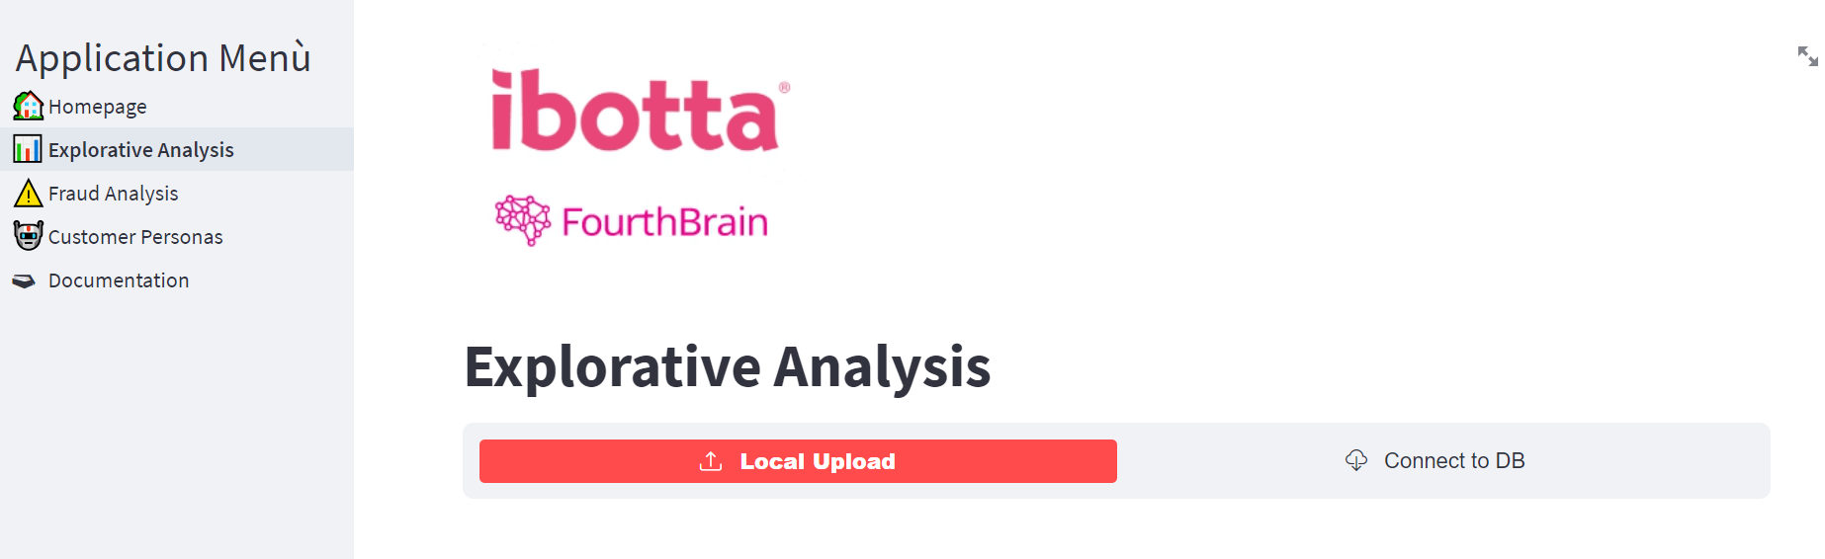
Demo (1)

Slide 9
Demo (2)
Homepage
Explorative Analysis
Pivot table
MCA (latent structure)
Fraud Analysis & Customer Personas
Per single user
Per entire DB
Retrain model
Docs

Slide 10
MLE Stack
Backend
Fast api
Ploomber (alternative to AirFlow)
Frontend
Streamlit
Deploy
GCP
Streamlit Cloud

Slide 11
Conclusion & notes
Extremely time consuming finding an appropriate dataset
Problem with the labelling of the dataset
This is more a «framework»

Slide 12
Next step
Would be nice to:
Test naive bayes (building solution for mixed dataset)
Transformer
Alternative faster boosting algorithm
To be done:
Documentation (SRS)
Final presentation
Markdown file for Github
Deploy of everything

