Slide 1
MGM Workshop
Assembly Tutorial
Bill Andreopoulos
DOE Joint Genome Institute
Walnut Creek, CA
September 26, 2016
Notes:
Introduce self.

Slide 2
Contents
Terminology introduction
Introduction to short-read genome sequencing and assembly
Short read genome assembly in practice
Improving genome assembly using long-read (3rd generation) sequencing
DIY assembly
Notes:
This presentation will be divided into 5 parts:
First, I’ll introduce vocabulary relevant to genome assembly;
Then I’ll describe the goals and theory of short-read assembly;
Then I’ll talk about assembly in practice, which is a bit different than in theory;
Next I’ll describe the use of PacBio’s 3rd generation sequencing to improve assemblies;
Finally, I’ll discuss how to apply this knowledge to your own assemblies.

Slide 3
Contents
Terminology introduction
Introduction to short-read genome sequencing and assembly
Short read genome assembly in practice
Improving genome assembly using long-read (3rd generation) sequencing
DIY assembly
Notes:
3
So now let’s introduce some basic terms.

Slide 4
Terminology 1
Read: A sequenced portion of DNA.
Library: A set of reads prepared together.
Insert: Length of the molecule being sequenced.
Fragment library: A short insert (270bp) library, possibly with overlapping ends. Aka standard library.
Chimeric Read: A read made by fusing unrelated parts of the genome.
Notes:
Discuss vocabulary
Left out: Long mate pair library: 4-8kbp insert library with ~150bp on each end sequenced.

Slide 5
Terminology 2
Assembly: A concise representation of a genome as a set of contigs.
Contig or Scaffold: A contiguous sequence of DNA.
Coverage: The number of times a base of the genome is represented in distinct reads.
Notes:
Discuss vocabulary.
You can still have scaffolds for short-read illumina if the small insert sizes suggest a small gap, but not long gaps like in LMP.
In SPADES microbial assemblies you get close numbers of contigs and scaffolds.
In long-read pacbio there are no scaffolds. You can span repeats if the long reads are long enough, but there are no gaps.
The diagram below represents and assembly containing 5 contigs (A, B, C, D, E). They are arranged as 3 scaffolds, with both captured and uncaptured gaps.
Left out:
Scaffold: One or more contigs linked together by unknown sequence.
Captured gap: A gap within a scaffold, abutted by contigs with known order and orientation.
FASTA/FASTQ: File formats containing sequence data.

Slide 6
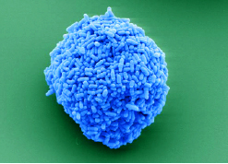
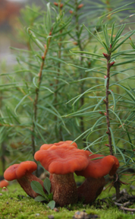
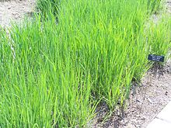
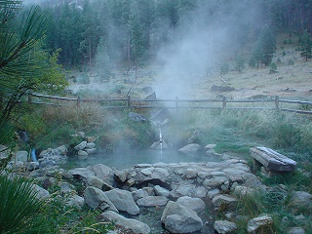
Overview of Assembly at JGI
Program | Size (MB) | Libraries | Assembler | Target genomes / year
Microbe | 5 | 1 | SPAdes / HGAP | 1,330
Fungi | 10's | 1 | Falcon | 160
Plant | 100-10000 | 3+ | Falcon | 20
Metagenome | 10-10000 | 1 | MEGAHIT | 825
Notes:
ftp://ftp.broadinstitute.org/pub/crd/ALLPATHS/Release-LG/AllPaths-LG_Manual.pdf
https://github.com/PacificBiosciences/Bioinformatics-Training/wiki/HGAP
https://github.com/PacificBiosciences/FALCON/blob/master/doc/falcon_manual.md
MEGAHIT http://www.ncbi.nlm.nih.gov/pubmed/25609793
https://github.com/PacificBiosciences/FALCON
Plant genomes are assembled at Hudson Alpha

Slide 7
Number of Metagenome Projects by Year
Number of projects
Year
Target metagenome assemblies for FY2016 - 580

Slide 8
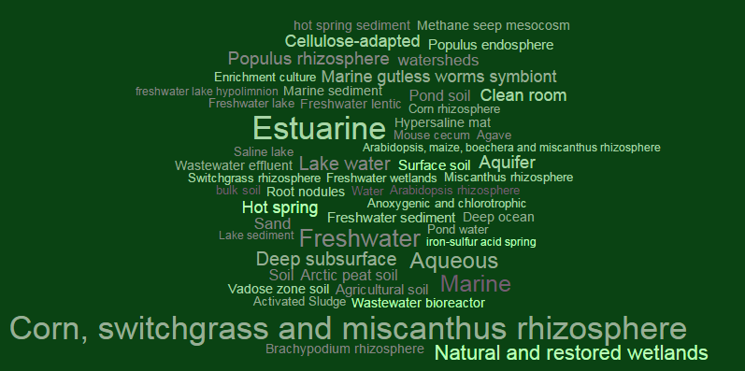
Metagenome projects come from a variety of habitats
Notes:
Word cloud of GOLD habitats for megahit assemblies

Slide 9
Contents
2. Introduction to short-read genome sequencing and assembly
Short read sequencing and assembly
Short read assembly - De Bruijn graph example
Notes:
Now I will introduce the basics of Illumina sequencing and assembly.

Slide 10
Short read genome sequencing and assembly
Genomic
DNA
Illumina
Random fragmentation
Short insert
fragment
(270bp)
Library Creation
Sequencing
Paired-end short insert reads
(millions)
Assemble reads
Notes:
We make 270bp libs because they are easdy ot make in the lab without that much dna
And we need an assembler that works well out of the box and not too much parameter tuning with a set of generic parameters
In case we need to do 1000 of these. One size fits most.

Slide 11

Assembly outline
Reads
‘De Bruijn’ assembly
Contigs
Scaffolds
Notes:
Short read assembly algorithms are mostly based on the “De Bruijn” graph.
I’ll spend a little time discussing how this works.

Slide 12
De Bruijn example
“It was the best of times, it was the worst of times, it was the age of wisdom, it was the age of foolishness, it was the epoch of belief, it was the epoch of incredulity,.... “
Dickens, Charles. A Tale of Two Cities. 1859. London: Chapman Hall
Example courtesy of J. Leipzig 2010
Notes:
Good example because it contains repeat elements.
For the purposes of illustration, we can use human readable text to explore how assemblers work.
This text was taken from Dickens’ “A tale of two cities”.
It is a useful example because like genomes, it contains strings that are repeated; in this case, “it was the” and “of times”.

Slide 13

De Bruijn example
itwasthebestoftimesitwastheworstoftimesitwastheageofwisdomitwastheageoffoolishness…
Generate random ‘reads’
How do we assemble?
fincreduli geoffoolis Itwasthebe Itwasthebe geofwisdom itwastheep epochofinc timesitwas stheepocho nessitwast wastheageo theepochof stheepocho hofincredu estoftimes eoffoolish lishnessit hofbeliefi pochofincr itwasthewo twastheage toftimesit domitwasth ochofbelie eepochofbe eepochofbe astheworst chofincred theageofwi iefitwasth ssitwasthe astheepoch efitwasthe wisdomitwa ageoffooli twasthewor ochofbelie sdomitwast sitwasthea eepochofbe ffoolishne eofwisdomi hebestofti stheageoff twastheepo eworstofti stoftimesi theepochof esitwasthe heepochofi theepochof sdomitwast astheworst rstoftimes worstoftim stheepocho geoffoolis ffoolishne timesitwas lishnessit stheageoff eworstofti orstoftime fwisdomitw wastheageo heageofwis incredulit ishnessitw twastheepo wasthewors astheepoch heworstoft ofbeliefit wastheageo heepochofi pochofincr heageofwis stheageofw fincreduli astheageof wisdomitwa wastheageo astheepoch olishnessi astheepoch itwastheep twastheage wisdomitwa fbeliefitw bestoftime epochofbel theepochof sthebestof lishnessit hofbeliefi Itwasthebe ishnessitw sitwasthew ageofwisdo twastheage esitwasthe twastheage shnessitwa fincreduli fbeliefitw theepochof mesitwasth domitwasth ochofbelie heageofwis oftimesitw stheepocho bestoftime twastheage foolishnes ftimesitwa thebestoft itwastheag theepochof itwasthewo ofbeliefit bestoftime mitwasthea imesitwast timesitwas orstoftime estoftimes twasthebes stoftimesi sdomitwast wisdomitwa theworstof astheworst sitwasthew theageoffo eepochofbe
…etc. to 10’s of millions of reads
Traditional all-vs-all assemblers fail due to immense computational resources (scales with number of reads²)
A million (10⁶ ) reads requires a trillion (10¹²) pairwise alignments
De Bruijn solution:
Represent the data as a graph (scales with genome size)
Notes:
*Animated
1) To simplify the problem, first we remove all the spaces. This string represents the genome we are going to sequence and try to assemble.
2) Next we generate sub-strings of fixed length at random from throughout the text. If this was Hi-Seq we’d have 10’s of millions of these reads. The difficult part is how we stitch them back together again in the right order.
3) One way to do this is to perform an all vs all comparison to search for overlaps, and join the overlapping reads. This is how traditional (OLC) assemblers work. But for datasets the size of Hi-Seq, this can fail miserably.
4) The solution offered by the De Bruijn approach is to represent the data as a graph.

Slide 14
De Bruijn example
Step 1:
Convert reads into “Kmers”
Kmer: a substring of defined length
Reads:
theageofwi
sthebestof
astheageof
worstoftim
imesitwast
Kmers :
(k=3)
the
sth
ast
wor
ime
hea
the
sth
ors
mes
eag
heb
the
rst
esi
age
ebe
hea
sto
sit
geo
bes
eag
tof
itw
eof
est
age
oft
twa
ofw
sto
geo
fti
was
fwi
tof
eof
tim
ast
…..etc for all reads in the dataset
Notes:
Emphasize that this is a toy example and k=3 is only for example purposes;
*Animated
1) The first step of the De Bruijn assembler is to deconstruct reads into their constituent kmers. A kmer is a substring of fixed length (in this case 3 letters).
2) To generate kmers, we move through our read in one-letter increments, from the beginning to the end, until we have recorded all possible 3 letter words.
3) We then repeat this for all reads in the dataset.
From this point on the algorithm operates on kmers rather than on the reads.
The kmers, in this case, are colored to indicate which read they came from, but in practice that information is lost.

Slide 15
De Bruijn example
Step 2:
Build a De-Bruijn graph from the kmers
the
hea
eag
age
geo
eof
ast
sth
the
hea
eag
age
geo
eof
ofw
fwi
ast
sth
the
heb
ebe
bes
est
sto
tof
sto
tof
wor
ors
rst
oft
fti
tim
ime
mes
was
esi
twa
itw
sit
Notes:
A bit misleading to imply that kmers from reads are stored per read; should point out that only the kmers are stored and all read information is typically lost.
*Animated
1) The next stage is to represent the stored “kmers” in the de Bruijn graph. This is done by searching for overlaps of length k-1 (in this case 2 letters).
2) This is what the de Bruijn graph of a single read looks like. All consecutive kmers overlap by k-1 bases - for example, “he” from “the” and “hea”.
3) Adding kmers from a second read shows how the graph can be extended. It also reveals redundancy in the data which need not be stored by the computer. This is how memory efficiency is achieved; each unique kmer is only stored once.
4) Adding a kmers from a third ‘read’ that comes from a similar but non-overlapping part of the text illustrates the effect of repeats - we get a branch in the graph.
5) We repeat this process for all kmers in the dataset.
6) Long nonbranching stretches represent unique sequence in the genome. Branches and loops are the result of repeats.

Slide 16
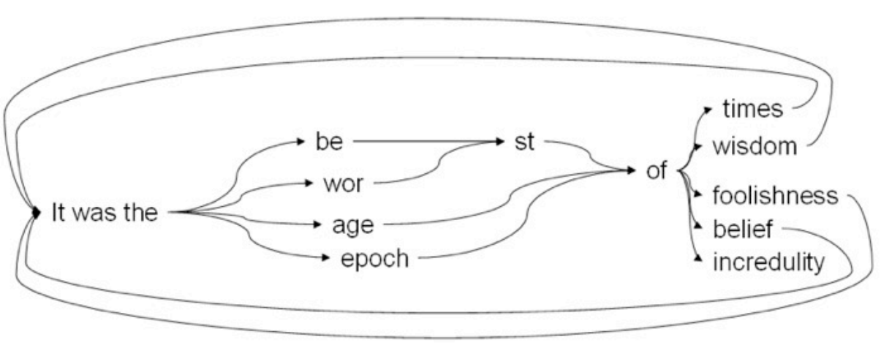
De Bruijn example
Step 3:
Simplify the graph as much as possible:
A De Bruijn Graph
De Bruijn assemblies ‘broken’ by repeats longer than kmer
“It was the best of times, it was the worst of times, it was the age of wisdom, it was the age of foolishness, it was the epoch of belief, it was the epoch of incredulity,.... “
Notes:
*Animated
1) The last step is to simplify the graph to remove redundancy, resulting in the final De Bruijn Graph representation of our genome.
From this graph, we can see examples of both the strengths and weaknesses of this approach.
The information from millions of reads is stored in computer memory in a graph that is proportional to the genome size.
Another strength is that the overlaps between reads are implicit in the graph, so all the millions of pairwise comparisons are not required.
2) On the downside, information is lost as repetitive sequences are “collapsed” into a single representation.
The connectivity between contigs is also lost when we chop the graph into a Fasta representation.
Converting the graph into fasta is a lossy process usually.

Slide 17

Step 4: Convert graph to fasta
Drawback of De Bruijn approach
No single solution!
Break graph to produce final assembly
Notes:
17
Further information (the connectivity between contigs) is lost when we ‘chop’ the graph up into fasta sequences.

Slide 18
Kmer size is an important parameter in De Bruijn assembly
The final assembly (k=3)
wor
times
itwasthe
foolishness
st
wisdom
incredulity
age
epoch
be
of
belief
Assemble with a longer kmer:
A perfect assembly (k=20)
itwasthebestoftimesitwastheworstoftimesitwastheageofwisdomitwastheageoffoolis…
Why not always use longest ‘k’ possible?
Sequencing errors:
Mostly unaffected kmers
sth
the
ebe
ent
tof
k=3
heb
ben
nto
sthebentof
k=10
sthebentof
100% wrong kmer
Notes:
*Animated
The final assembly gives you these contigs.
It is not very good because it is broken everywhere there was a repeat longer than the kmer length.
If we assemble with a longer K of 20, we get a perfect assembly.
Why not always use a very high value for K?
3 reasons:
Kmer length is limited by read length (in this case, 10)
Kmer depth is less than read depth; if K is too long, there is not sufficient coverage to assemble.
Error rate. The probability of a kmer being correct is only C^K, where C is the chance of a single base being correct.
Because DeBruijn graphs rely on exact overlaps, incorrect kmers are not useful in assembly.

Slide 19
Contents
Terminology introduction
Introduction to short-read genome sequencing and assembly
Short read genome assembly in practice
Improving genome assembly using long-read (3rd generation) sequencing
DIY assembly
Notes:
So, that was theory. Real assemblies, though, can be a bit more messy.

Slide 20
Real life assembly is messy!
Assembly in theory
Uniform coverage, no errors, no contamination
Assembly in reality
Chimeric reads (->mis-joins)
Contaminant reads
(-> incorrect + inflated assembly)
Sequencing errors
(-> fragmented assembly)
*
*
*
*
*
*
*
Biased coverage (->gaps)
*
Worse-than-predicted assemblies!
Notes:
Coverage, errors, chimeras are issues with the data.
*Animated
You can get a very good assembly from perfect, error-free data with uniform coverage and no contamination.
In reality, the coverage is uneven
uneven fragment coverage leads to gaps
uneven LMP coverage yields poor scaffolding
Sequencing errors can cause false branches in the De Bruijn graph, fragmenting the assembly.
Chimeric reads can cause misjoins between contigs.
Contaminant reads may get assembled, bloating the assembly with incorrect contigs.
6) The result is worse-than-predicted assemblies.

Slide 21
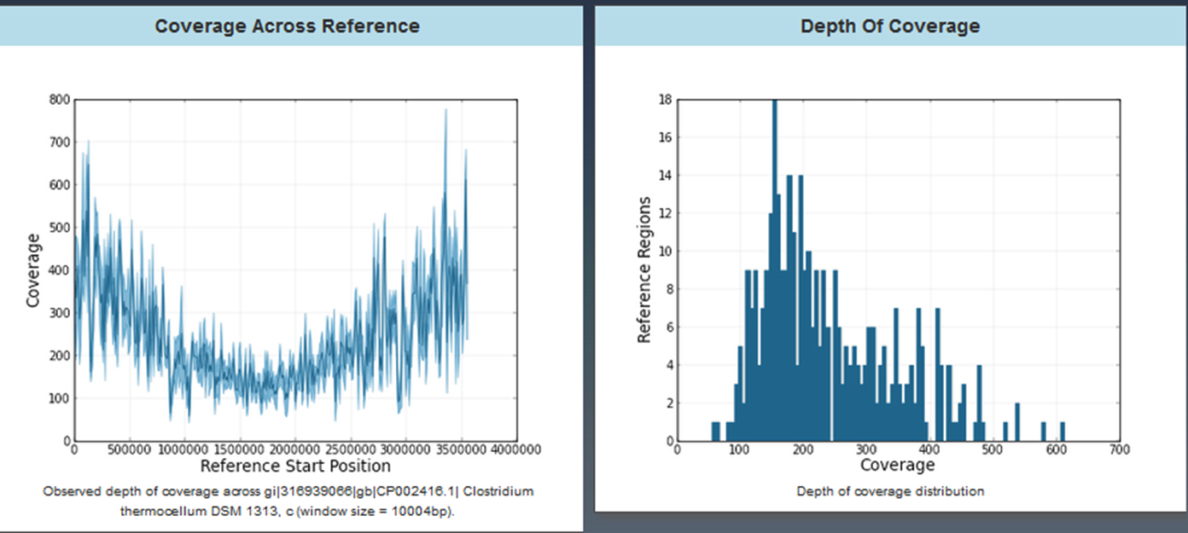
Real life assembly is messy!
Coverage Across
References
Depth of Coverage
Coverage
Reference Regions
Reference Start Position
Coverage
Notes:
This is the real coverage profile across a GC-rich microbe; the coverage varies from a few hundred X to several thousand, and it’s very spiky. Also, there is a low-frequency bias probably related to the origin-of-replication that you can see as a U-shape.
The right graph shows a green line representing the normalized coverage as a function of GC content, while the blue line indicates the theoretical flat coverage you would get if there was no GC bias. You can clearly see that the GC-poor regions get much more coverage than the GC-rich regions.

Slide 22
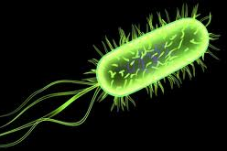
Genome properties can also make assembly difficult
High repeat content
RESULT: Misassemblies / collapsed repeats
Polyploidy
RESULT:
Large or fragmented assembly
r
r
a
a’
r
r
r
Biased sequence composition
RESULT:
incomplete / fragmented assembly
Biased sequence abundance
ACTGTCTAGTCAGCGCGCGCGCGCGCGCCCGCGCGCGCGGGCGGCGGCGCGGGCGGGCGCATGTAGTGAT
RESULT:
incomplete / fragmented assembly
Notes:
Before we discussed issues with the data and now we will discuss properties of genomes that complicate things even further.
The repeats need not be identical to cause trouble, only sufficiently similar that at our choice of k they can't be resolved.
There are also issues inherent to the organism that make assembly difficult. Organisms with multiple long repeats are especially hard to assemble, and can contain misassemblies or collapsed repeats. For example, ‘r’ may yield only one contig rather than 5. Microbes often have multiple copies of certain genes, such as ribosomes, which are notoriously problematic.
Polyploid organisms are more difficult than haploid organisms, particularly when there is a high degree of heterozygousity. Everywhere the alleles differ can cause a branch in the graph that may result in fragmentation. The assembly of a diploid may approach double the expected size, if the chromosome copies are sufficiently different.
Biased sequence composition can also cause problems; in this case, the high-GC area may have insufficient coverage for assembly, yielding a gap.
Also, the organism may physically contain different numbers of copies of features. These may be plasmids in the case of bacteria, or organelles such as mitochondria in eukaryotes. Often it is necessary to assemble them separately.

Slide 23
How fragmented are short read assemblies?
Goal: genome in 1 scaffold per replicon
Assemblies from simulated data
(7 replicons)
Short insert library only
Assemblies using only short insert libraries are acceptable (<100 scaffolds) but not ideal
Notes:
23
These are real assemblies of synthetic reads, generated from known genomes.
The goal is to produce 1 fragment per replicon. With the fragment library only, the assemblies are acceptable, but not ideal.
Repeats and GC content make microbes hard.
Strain variation and copy variation makes probem worse, so metagenomces worse than isolates
Simulated data shows the limitations based on the properties of the genome (repeats).

Slide 24
How good are short read assemblies?
Goal: genome in 1 scaffold per replicon
Assemblies from real data
Assemblies from simulated data
(7 replicons)
Short insert library only
Number of scaffolds
Assemblies using only short insert sequencing libraries are acceptable (<100 scaffolds)
Notes:
Bringing in the problems associated with real data, such as errors and coverage bias, makes the assemblies even worse, though still usable.

Slide 25
Comparison of assembly results to reference genome annotation
Average number of fragments
Average % known genes identified
Short insert library only
85
97.3%
Near-complete and highly accurate assemblies are possible using only short read data.
Notes:
So it is possible to achieve accurate, near-complete assemblies with short reads only. Note that the LMP data greatly improved the continuity, but did not have much impact on the fraction of genes identified, since the captured gaps still have unknown sequence. But it can still be useful for pathway analysis to know which genes are located near each other.
What is the best you can do in real microbial isolate genomes, with a single lib metagenomes would be worse.

Slide 26
Simulated De Bruijn assembly for six known microbial genomes
What fraction of a genome should we be able to assemble ,
at a given kmer length?
97%
At K=150, a small fraction of the genome remains unassembleable
At K=30, most of the genome can be assembled
Matt Blow
Notes:
26
Simulated data shows the limitations based on the properties of the genome (repeats).
*Animated
Knowing how assembly works, we can do simulations to investigate how successful assembly might be for a given genome.
For example, we can read through a genome and count the number of unique kmers of a given length; these should be able to assemble perfectly.
3) For these 6 microbes, most of the genome is comprised of unique kmers once K=30.
4) Increasing to K=150, the maximum possible with 150bp reads, does not really help much; there will still be gaps in the assembly caused by repeats longer than 150bp.
This graph only indicates the fraction of genome that is unique, not how continuous that fraction is. If the repetitive 3% is scattered throughout the genome, it will result in more fragments than if it was clumped together.

Slide 27
How do we get a good assembly?
Notes:
In light of all these real-world problems, who do we get a good assembly?

Slide 28
Key features of the JGI microbe sequencing and assembly pipeline
Genomic
DNA
Fragment
Overlapping paired reads for fragment library
Allows self-correction
270bp
Latest sequencing chemistry
Reduced GC bias, errors; longer reads
Sequence
2 x 150bp
Pick best software for the task
Megahit – metagenome
SPAdes – single cell
Falcon / HGAP - PacBio
http://nucleotid.es
Extensive data QC
Adapter-trimming
Artifact / contam removal
Error correct / normalize
QC
Assembler
Best Assemblies
Notes:
*Animated
A good assembly starts in the lab, with the best possible data.
Longer inserts on LMP data to improve scaffolding
Overlapping paired reads, in this case 2x150bp data with a 270bp insert size, allows self-correction and longer kmers
New chemistry versions reduce error rates and bias
Extensive quality-control removes artifacts and other junk, and ultimately, libraries may be re-sequenced if they still fail QC metrics
The best software for the project type is used.
We constantly test and develop new software in an effort to always assemble with the best available tools.

Slide 29
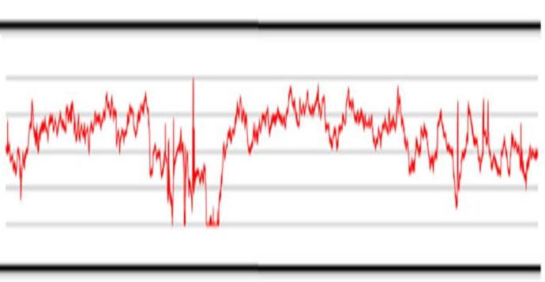
JGI microbe assembly with SPAdes
SPAdes overcomes problems associated with the assembly of single cell data:
Non-uniform coverage:
Small k in low-cov regions
Higher k in high-cov regions
Uses variable insert sizes
Identification of chimeras
Other benefits of SPAdes:
Read error correction tool, BayesHammer for Illumina data
Better assembly of 16S ribosome operons
E.coli single cell coverage
Notes:
Part of the reason we like Spades is we do lots of single cells and Spades has a --sc flag, which deals with non-uniform coverage.
We found it does a better job of assembling 16S
Error correction - IonHammer (for IonTorrent data)

Slide 30
But problems remain:
Reads
‘De Bruijn’ assembly
Contigs
Align reads to DeBruijn contigs
Join contigs using evidence from paired end data
An assembly
Uncaptured gaps caused by repeats
Notes:
How do we further improve the assembly, and fill in these gaps? Often this is fundamentally impossible with reads shorter than the gaps. So we have to turn to longer reads.

Slide 31
Contents
Terminology introduction
Introduction to short-read genome sequencing and assembly
Short read genome assembly in practice
Improving genome assembly using long-read (3rd generation) sequencing
DIY assembly
Notes:
Specifically, longer reads from 3rd-generation, single-molecule sequencing.

Slide 32
PacBio only assembly now possible for many DNA isolate products
Genomic
DNA
Illumina
Random fragmentation
PacBio
Short insert
fragment
(270bp)
Long
fragment
(10kb)
Library Creation
Sequencing
Paired-end short insert reads
(millions)
Long reads
(~100,000)
Assemble reads
Notes:
The important thing about long-read libraries is that they can span repeats.
Problems of previous LMP sequencing were poor lib construction efficiency, bias, lg input DNA requirements which is why we are trying to not use them in future.

Slide 33
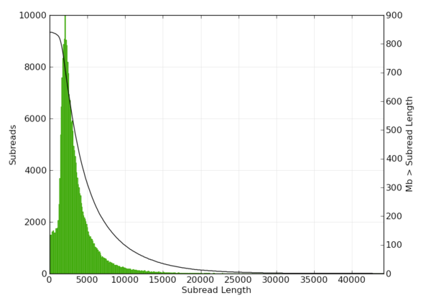
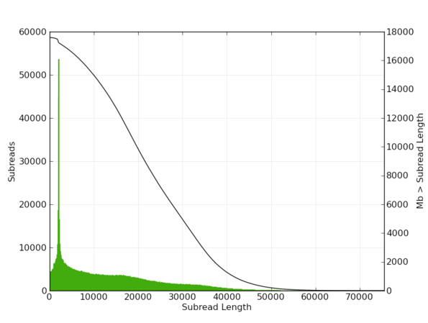
Pacific Biosciences Sequencer
For microbes and most fungi
10kb AMPure Library
For some fungi and plants
Blue pippin 30kb Library
Mean read length = ~3.5 kb
Mean read length = 13kb
Number of reads
Number of reads
Subread length
Subread length
Notes:
Blue pippin requires higher quality DNA and more of it.
3rd generation data is based on single molecules, with long read length. So far, they all have much higher error rates than prior technologies, but for example, individual PacBio sequences can be read multiple times for greater accuracy.
Read lengths are far longer than any existing or expected Illumina platform.
For PacBio emphasize error is random. We do mostly inter-molecule correction rather than intra-molecule correction.
For the left graph cost throughput and DNA requirement are some of the reasons (see more below).
Reasonable compromise between what protocol can do and cost because of tough to sequence genomes.
For some plants with high repeats can push the platform to make longer reads.
Even with 80% GC content will still work.
Error rate is part of platform but because random you can work around it with cov.
Can work around the error rate, which you cannot do with other platforms.
Key for PB data is that reads should be longer than repeats in your genome to get optimal results
The flat coverage distribution means less data is required and allows better coverage estimates.
The majority of libraries for microbes and fungi are >10kb AMPure libraries due to DNA requirements, cost and throughput. >10 AMPure data is from April 2016, the mean read length varies by library but is several kb. For plant projects we have been making some very larger insert libraries, this is from a Dec 2015 library. These libraries require much more DNA (10s of ug vs 5 ug) for > 10kb ampure. Plant projects are lower volume in terms of number of projects, getting sufficient DNA is easier, and the projects are more complicated so it is worth the additional up front cost.
The L50 is 22kb, meaning 50% of the bases are in reads at least that long. The average is continually increasing as PacBio improves their library protocols and chemistry.

Slide 34
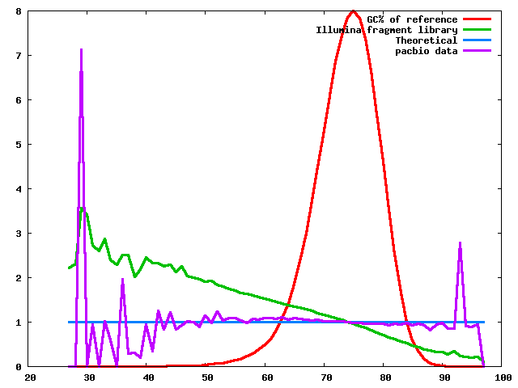
Pacific Biosciences Sequencer
Long reads from “3rd generation” Pacific Bioscience sequencer have been very useful for producing better assemblies
Low coverage bias
Reduced sensitivity to G+C rich regions compared to Illumina chemistry
GC% of reference
Illumina library
Theoretical
PacBio data
Fraction of normalized coverage
High error rate
Up to 15% error rate,
dominated by indels
(but is random and a single read can be sequenced multiple times)
GC% of 100 base windows
Notes:
3rd generation data is based on single molecules, with long read length. So far, they all have much higher error rates than prior technologies, but for example, individual PacBio sequences can be read multiple times for greater accuracy.
Read lengths are far longer than any existing or expected Illumina platform.
For PacBio emphasize error is random. We do mostly inter-molecule correction rather than intra-molecule correction.
For the left graph cost throughput and DNA requirement are some of the reasons (see more below).
Reasonable compromise between what protocol can do and cost because of tough to sequence genomes.
For some plants with high repeats can push the platform to make longer reads.
Even with 80% GC content will still work.
Error rate is part of platform but because random you can work around it with cov.
Can work around the error rate, which you cannot do with other platforms.
Key for PB data is that reads should be longer than repeats in your genome to get optimal results
The flat coverage distribution means less data is required and allows better coverage estimates.
The majority of libraries for microbes and fungi are >10kb AMPure libraries due to DNA requirements, cost and throughput. >10 AMPure data is from April 2016, the mean read length varies by library but is several kb. For plant projects we have been making some very larger insert libraries, this is from a Dec 2015 library. These libraries require much more DNA (10s of ug vs 5 ug) for > 10kb ampure. Plant projects are lower volume in terms of number of projects, getting sufficient DNA is easier, and the projects are more complicated so it is worth the additional up front cost.
The L50 is 22kb, meaning 50% of the bases are in reads at least that long. The average is continually increasing as PacBio improves their library protocols and chemistry.

Slide 35
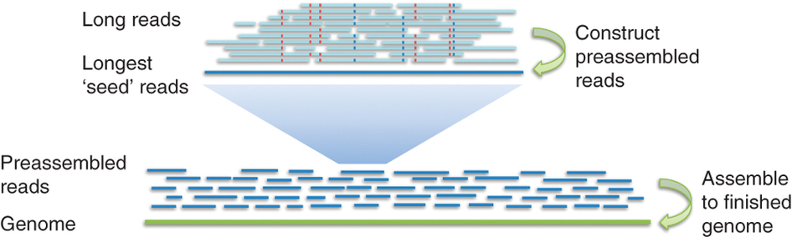
HGAP for microbial assemblies
The longest reads are selected as 'seed' reads, to which all other reads are mapped.
A preassembly converts the seed reads into highly accurate preassembled reads.
Final consensus-calling step to assemble genome.
Notes:
85% error with raw data to ~99% with preassembled reads
But because fungi are diploid pacbio developed diploid aware falcon, don’t go into details though.
Followed by a final consensus-calling step (not shown).
Can say that we developed HGAP with PacBio
Why can we use OLC assembler for PacBio
Need to define OLC

Slide 36
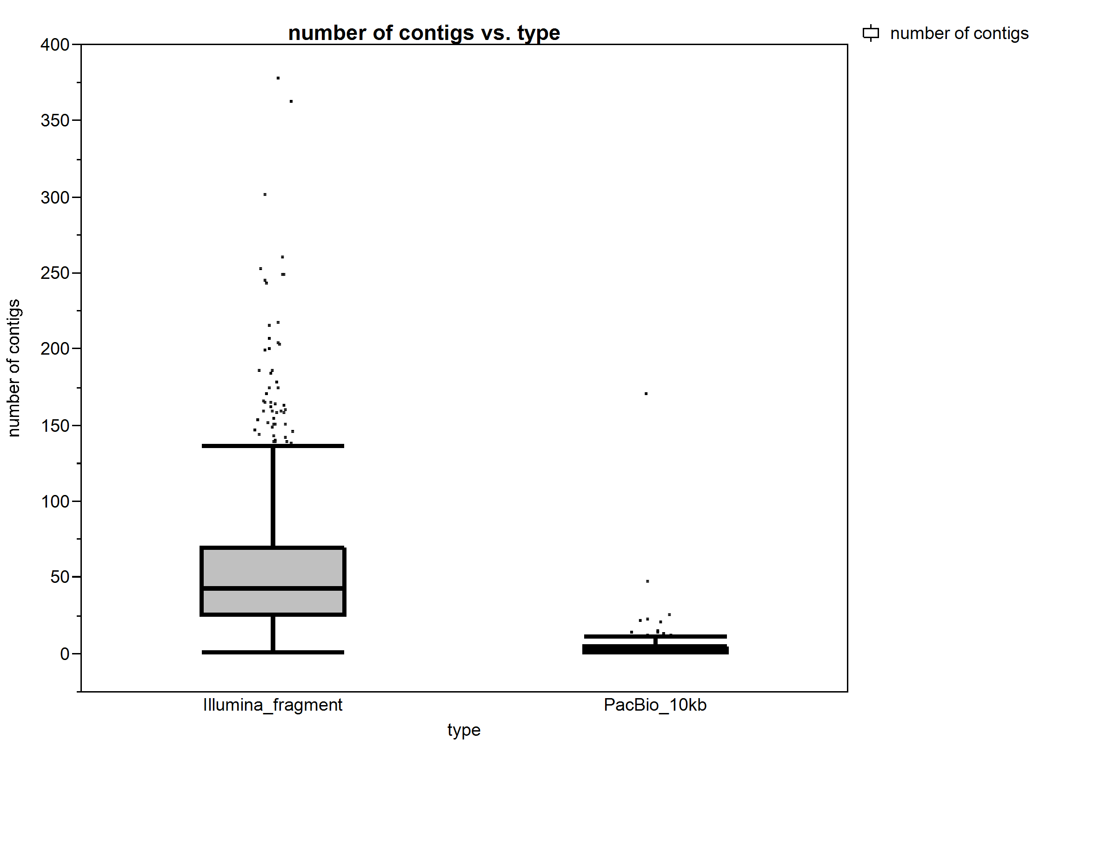
Microbial drafts- number of contigs by data type
Median=43
N=1203
Median=2
N=216
Number of contigs
Illumina
fragment
PacBio 10kb
Data Type
Notes:
Even historically difficult microbes are doable with PacBio e.g. high GC, high repeat Actinobacteria

Slide 37
PacBio assemblies produce longer contigs
Notes:
These are for fungal genomes.

Slide 38
PacBio assemblies are larger
Larger assembled genome sizes representing assembled repeat content
Notes:
These are for fungal genomes.

Slide 39
PacBio assembles more repeat content
Median difference of 7 % between how much sequence is masked in Illumina vs. PacBio
Data courtesy of the fungal annotation team
Notes:
Here is the url to a custom QC page we have put together comparing all of the PacBio to their illumina counterparts. You can look at the 'Repeat Coverage Length' row to get quick numbers on % genome masked. Typically, illumina assemblies have database IDs numbered as 1 (for example, Hesve1) while PacB assemblies have higher numbers (ie Hesve2finisherSC). Only exception is Lizem1_1 (illumina) vs Lizem1 (PacBio) and LacbiS238N_1 (illumina) and Lacbi9312_1 (PacBio).

Slide 40
State of PacBio Data
We now routinely use PacBio data for assemblies.
Microbial isolates can usually be assembled into a finished single contig with only PacBio data.
Fungal assemblies are done with PacBio only.
Notes:
We just bought a 3rd PacBio machine to allow PacBio-only Fungal assembly.
Fungal used to be done with PacBio reads filling gaps in Illumina assemblies.
- Do we still do Illumina+PacBio assemblies? I remember Fungal projects with Illumina+PacBio, just not sure if we stilll do it. No we don't do Illumina+PacBio. Due to improvements in read lengths and algorithm developments the PacBio only assemblies got to a point where they were as good or better than the mixture so the Illumina was dropped unless getting sufficent coverage is not tracktable given the throughput. Now we are at a point where for isolate microbes, fungi, and even plants this is tracktable. Not so much for metagenomes.

Slide 41
State of PacBio Data (2)
Illumina is used for:
Metagenomes (sometimes PacBio)
Metatranscriptomes
Single cells
Most non-assembly projects (ReSeq, RNASeq)
Notes:
We just bought a 3rd PacBio machine to allow PacBio-only Fungal assembly.
We do use PacBio for metagenomes for a very small subset of projects.
- We use PacBio for a small subset of metagenome projects, so what kind of metagenome projects do we use PacBio for?
So far this has mostly been driven by DNA quality and quantity. This is still very expensive and we do very shallow PacBio seqeuncing, complemented with Illumina sequencing.

Slide 42
Contents
Vocabulary introduction
Introduction to short-read genome sequencing and assembly
Short read genome assembly in practice
Improving genome assembly using long-read (3rd generation) sequencing
DIY assembly
Notes:
Now that we have covered how assembly is done at JGI, let’s move on to how you can do your own assemblies.

Slide 43
Finding the Right Tools
What type of data do I have?
How large is my genome?
What is the quality of my data?
What kind of pre-processing does my data need before assembly?
Are there known issues with the type of data I have (coverage bias, etc.)?
Notes:
There is no single recipe for assembly – you need to choose the right tools for the job. Here’s a checklist of questions you need to ask before you start.
Different assemblers require different data types. For example, AllPaths needs both a short and long insert library.
Genome size, data volume, and computer infrastructure will often decide which algorithms are viable. Some assemblers will simply take too much time and memory to use with a large genome.
The quality of the data may dictate which pre-processing steps are needed before assembly, such as quality-trimming, decontamination, and error-correction.
Other issues, such as coverage bias, may sometimes be resolved digitally through normalization.

Slide 44
Typical Preprocessing
Operation order for Illumina reads:
Trim Adapters
Filter for Contaminants and Quality
Examine quality metrics – insert size distribution, base frequency, GC plot, kmer frequency histogram, etc.
(Optional) Subsample, less data may be better
Notes:
Tie this into error rate mentioned previously:
Subsampling –there is a saturation point for genomes where you don’t need 200X if you can get genome with 100X, so less may be better.
Error rate offers a bottleneck where if you get more and more coverage the errors will pile up. So don’t use 1000X for isolate, because random errors may start to look real as more data supports the errors. Sequencing errors start to look real. Reason we normalize data for single cells, or use an assembler that knows about the coverage profile.
E.g. for metagenomes a high abundance organism may give a very fragmented assembly because of errors, while If you bin it out and subsample it to reach the expected coverage it may give a better assembly for the high abundance organism.
For Illumina data, there is an optimal order for preprocessing data, described above. Some steps, like adapter-trimming, are always recommended. Others, such as normalization, are only prudent in some cases, such as to avoid running out of memory; and may also depend on the particular assembler being used.
(Maybe) Merge reads
(Maybe) Error-correct

Slide 45
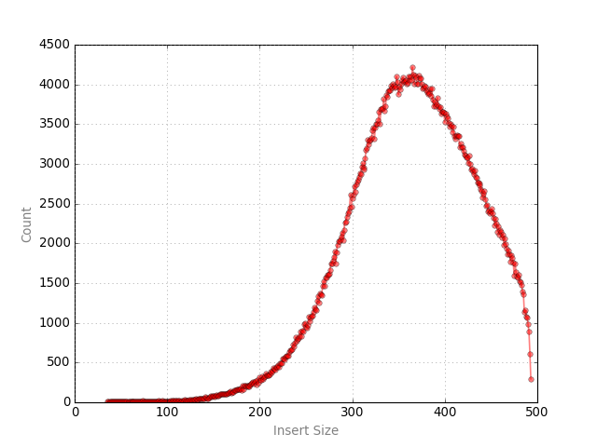
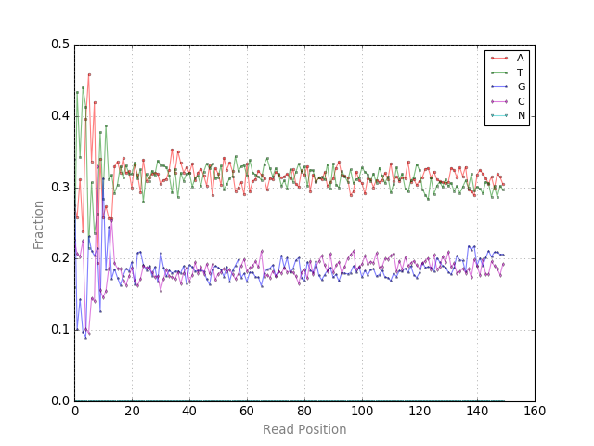
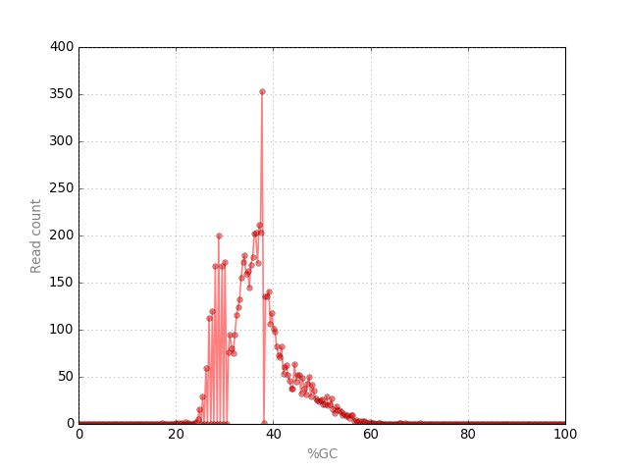
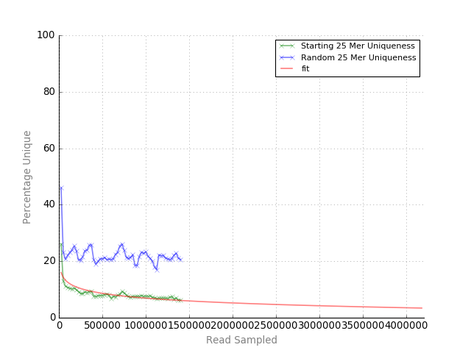
Examples of quality metrics
Examine quality metrics – insert size distribution, base frequency, GC plot, kmer frequency histogram, etc.

Slide 46
Choose the Right Assembler
Data Type | Read Length | Coverage | Assembler
Illumina (fragment) | 2x150 | ~100x | Velvet, SPAdes, Megahit
PacBio | ~5000 bp | 50-100x | HGAP for microbial, Falcon for fungal
Notes:
We are using falcon for fungal and HGAP for microbial.
Megahit is the assembler of choice because we are able to run it at scale.
This chart indicates which assemblers will work with which kinds of data, and how much coverage is typically suggested. PacBio data needs completely different assembly methodology from Illumina data.
This list is not exhaustive; there are many other assemblers out there.
- Do we still do Illumina+PacBio assemblies? I remember Fungal projects with Illumina+PacBio, just not sure if we stilll do it. No we don't do Illumina+PacBio. Due to improvements in read lengths and algorithm developments the PacBio only assemblies got to a point where they were as good or better than the mixture so the Illumina was dropped unless getting sufficent coverage is not tracktable given the throughput. Now we are at a point where for isolate microbes, fungi, and even plants this is tracktable. Not so much for metagenomes.
-You mentioned we use Spades for "hybrid" assemblies, what did you mean by hybrid?
Spades can accept both short read (illumina, ion torrent) and long read data (sanger, oxford, pacbio).

Slide 47
Summary
High quality genome sequencing and assembly using only short reads
Long-read PacBio sequencing (third-generation) provides an inexpensive path to finished genomes
The choice of assembler depends on your data
Notes:
Short-read microbial genome assemblies are minimally fragmented and contain the vast majority known genes

Slide 48
END
Email:
wandreopoulos@lbl.gov

Slide 49
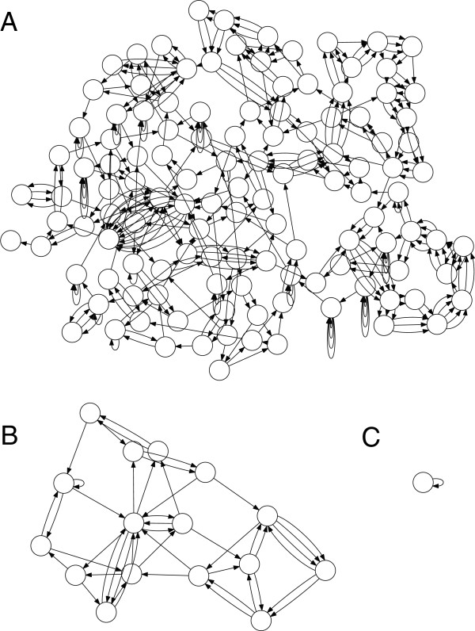
Notes:
Figure 1 Genome assembly graph complexity is reduced as sequence length increases. Three de Bruijn graphs for E. coli K12 are shown for k of 50, 1,000, and 5,000. The graphs are constructed from the reference and are error-free following the methodology of Kingsford et al.[27]. Non-branching paths have been collapsed, so each node can be thought of as a contig with edges indicating adjacency relationships that cannot be resolved, leaving a repeat-induced gap in the assembly. (A) At k = 50, the graph is tangled with hundreds of contigs. (B) Increasing the k-mer size to k = 1,000 significantly simplifies the graph, but unresolved repeats remain. (C) At k = 5,000, the graph is fully resolved into a single contig. The single contig is self-adjacent, reflecting the circular chromosome of the bacterium.

Slide 50
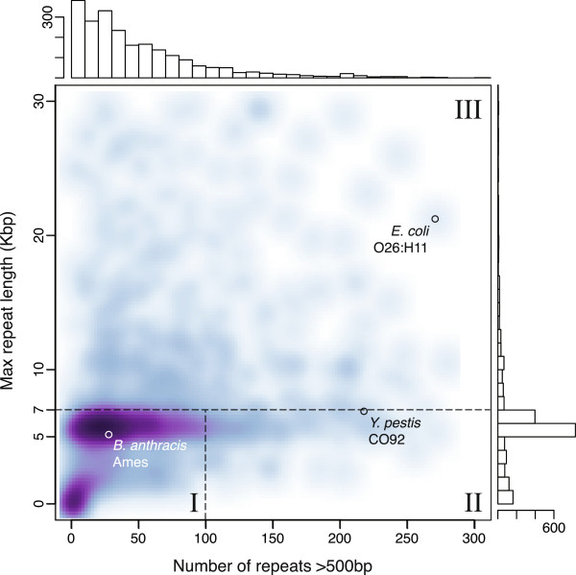
Notes:
Figure 5 Repeat count versus maximum repeat length for 2,267 complete genomes. For each genome, the number of repeat regions >500 bp is given on the horizontal axis and the size of the largest repeat in the genome is given on the vertical axis. A smoothed scatterplot of all complete genomes is in the center, with the corresponding histograms for each axis at the top and right. The figure is cropped to show only repeat counts <300 and maximum repeat size <30 kbp. This comprises 95% of the data, with the remaining 5% containing a maximum repeat >30 kbp or more than 300 repeats. In the extremes, class II genomes can reach over 800 repeat copies, and class III genome repeats can exceed 100 kbp [26, 33].

Slide 51
PacBio pilot study
For each of 20 Microbes:
Genomic DNA
+
+
2 x 150bp
270bp insert
2 x 100bp
8kb insert
5000+ bp
(Illumina HiSeq, V3 chemistry, 2x150b)
(PacBio)
Assembly 1
Assembly 2
Assembler: AllPaths V39750 (PacBio enabled)
Notes:
*Animated
To determine whether PacBio data would be useful in improving assemblies, we ran a study on 20 different microbes.
Each was assembled using short and long fragment Illumina data…
…then improved with longer PacBio reads.

Slide 52


3rd Generation sequence data improves genome assembly
Most improved genome:
53 / 71 (75%) gaps closed
Assembled using:
Illumina only
Illumina + PacBio
Least improved genomes
(.. but started out in good shape)
Notes:
The result is displayed here in terms of the number of captured gaps remaining in the assembly. In many cases, the improvement was quite dramatic, closing up to 75% of the remaining gaps.

Slide 53
PacBio assembly improvement is greatest for genomes with high GC content
MOST improved genomes
average 66% GC
LEAST improved genomes
average 56% GC
Conclusion:
3rd generation sequencing is a excellent tool for better assemblies, especially for GC-rich genomes.
Notes:
*Animated
Due to the lack of coverage bias, PacBio data is most helpful at improving the assembly of high-GC organisms, which do not assemble well with Illumina-only data. In addition to the coverage bias, extreme-GC sequences have lower information content and thus are inherently difficult to assemble with short reads.
Conclusion – 3rd generation sequencing is helpful, especially for GC-rich organisms.

Slide 54
Why sequence genomes using short reads?
20,000
650bp
$400
450bp
1,000
150bp
1
$15
$0.1
Traditional genome sequencing technology
Short-read
Notes:
As technology has advanced, reads have gotten shorter while throughput has increased. It is easier to produce high-quality assemblies with longer reads. But at present, it is possible to produce a similar quantity of short-read data for a tiny fraction of the cost. Therefore, to maintain efficiency, we must generate the bulk of our assemblies from inexpensive short reads.

Slide 55
Short read genome sequencing
Genomic
DNA
Random fragmentation
270 bp
fragments
4-8 kb
fragments
molecular biology
Sequencing
(Illumina)
Paired-end short insert reads
(10’s millions)
Long mate pair reads
(10’s millions)
How do we assemble this data back into a genome?
Notes:
*Animated
In order to sequence DNA:
1) Genomic DNA is extracted, then randomly sheared via sonication or some biochemical process.
2) For a fragment library, we target 270bp insert sizes. Then, additional chemicals are used to allow the DNA fragments to bind correctly to the sequencing machine. After sequencing, we have FASTQ files containing millions of reads.
3) The LMP library is similar, but the DNA is sheared into much longer fragments, and the chemistry for processing the fragments is different. Because the fragments are longer, it uses much more input DNA. LMP libraries are typically much more labor-intensive and expensive.
4) How de we assemble this data?

Slide 56
Genome assembly review
Genomic
DNA
fragmentation
Library creation
Sequencing
Assemble reads

Slide 57
Assembly outline
Reads
Contigs
Assembly algorithms
e.g.
Allpaths, Velvet, Meraculous
Scaffolds
Notes:
*Animated
The reads may be assembled into contigs with an assembler such as Velvet, Allpaths, or Meraculous. This will not give you perfect, full-length chromosome sequences, but rather a bunch of contigs.
The LMP library is used to stitch those contigs together into longer scaffolds, in a process called scaffolding. Some assemblers can use the LMP data automatically to scaffold their own contigs, but there are also stand-alone scaffolding programs.

Slide 58
Contents
2. Introduction to short-read genome sequencing and assembly
Short read sequencing and assembly basics
Short read assembly - De Bruijn graph example
Short read assembly – Scaffolding
Notes:
Now that the contigs are generated, we will move on to scaffolding.

Slide 59
Scaffolding
Reads
‘De Bruijn’ assembly
Contigs
Align LMP reads to contigs
Join contigs using evidence from long mate pair data
Scaffolds
Captured gaps caused by repeats or poor coverage. Represented by poly-“N” in assembly.
Notes:
*Animated
1) First, the long-mate-pair reads are aligned to the contigs, using a program such as BBMap. The goal is to find situations where paired reads each map to a different contigs. The more pairs that join two contigs, the stronger the evidence that they actually go together, and the more accurately the gap length can be estimated.
If a contig doesn’t get any reads mapped to it, it cannot be scaffolded.
2) The grey areas in the scaffolds represent captured gaps.

Slide 60
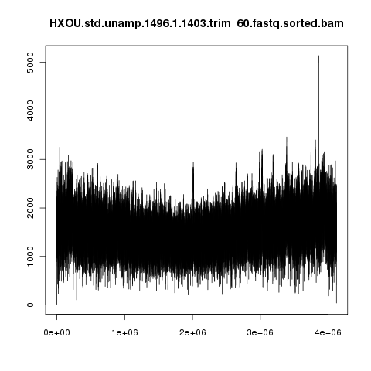
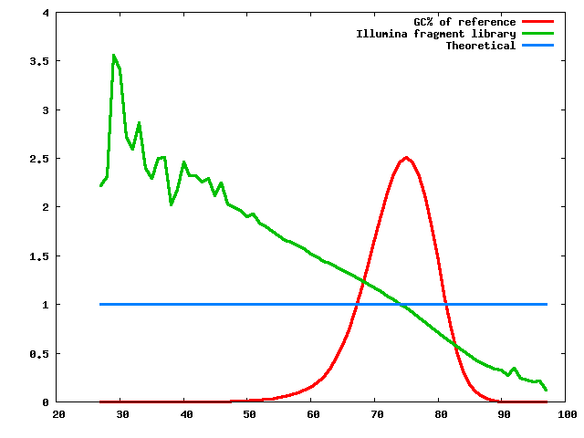
Real life assembly is messy!
Coverage (x)
Fraction of normalized coverage
Theoretical
Reference position (bp)
GC% of 100 base windows
Notes:
This is the real coverage profile across a GC-rich microbe; the coverage varies from a few hundred X to several thousand, and it’s very spiky. Also, there is a low-frequency bias probably related to the origin-of-replication that you can see as a U-shape.
The right graph shows a green line representing the normalized coverage as a function of GC content, while the blue line indicates the theoretical flat coverage you would get if there was no GC bias. You can clearly see that the GC-poor regions get much more coverage than the GC-rich regions.

Slide 61
Error-Correction
Simplifies the graph by removing kmers at low coverage caused by errors
Given the correct input data, a good assembly can be produced with default options
Overlaps the fragment data to use a longer kmer size
Produces accurate and highly contiguous assemblies
Notes:
This is an example of the effect of one type of preprocessing on assembly quality.
These graphs show the effect of error-correction on Velvet assemblies of two different organisms; the y-axis is number of contigs, so lower is better. The left pair used Allpaths’ error correction, the right pair used Masurca’s error correction, and the middle pair used the raw uncorrected reads. Both error-correction methods produced more continuous assemblies than the raw reads.
Note: Allpaths-LG is our assembler of choice for fungal genomes. It internally automates several processes such as error-correction, read-merging, and scaffolding to produce a good assembly with the default settings.

Slide 62
How good are short read assemblies?
Goal: genome in 1 fragment per replicon
Assemblies from real data
Assemblies from simulated data
(7 replicons)
Short + long insert libraries
Number of scaffolds
Assemblies using short and long insert sequencing libraries are very good (often a single fragment!)
Notes:
Once long-mate-pair data is used for scaffolding, we can approach and often achieve single-scaffold assemblies. Or in the case of H. Turkmenica, 7 scaffolds, since it has 7 independent pieces of DNA. Sometimes it’s hard to tell how good an assembly is just by counting contigs because you don’t know how many plasmids there are.

Slide 63
Comparison of assembly results to reference genome annotation
Average number of fragments
Average % known genes identified
Short insert library only
85
97.3%
3
97.4%
Short + long insert libraries
Near-complete and highly accurate assemblies are possible using only short read data.
Notes:
So it is possible to achieve accurate, near-complete assemblies with short reads only. Note that the LMP data greatly improved the continuity, but did not have much impact on the fraction of genes identified, since the captured gaps still have unknown sequence. But it can still be useful for pathway analysis to know which genes are located near each other.

Slide 64
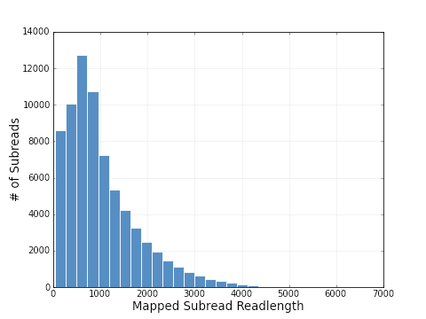
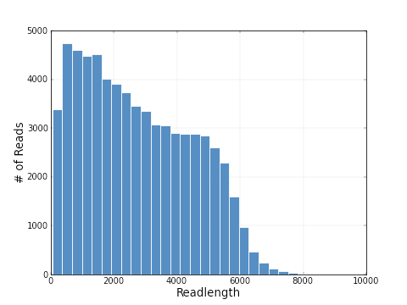
Pacific Biosciences Sequencer
Long reads from “3rd generation” Pacific Bioscience sequencer have been very useful for improving short-read based assemblies.
“Early data
Late April 2012
14,000
Mean read length = 2743 bp
12,000
Mean read length = 1080bp
10,000
Number of reads
8,000
6,000
Maximum read length >4kb
4,000
2,000
1
2
3
4
5
6
7
Read length (Kb)
Low coverage bias
Reduced sensitivity to G+C rich regions compared to illumina chemistry
High error rate
Up to 15% error rate,
dominated by indels
(but a single read can be sequenced multiple times)
Fraction of normalized coverage
GC% of 100 base windows
Notes:
64
3rd generation data is based on single molecules, with long read length. So far, they all have much higher error rates than prior technologies, but for example, individual PacBio sequences can be read multiple times for greater accuracy.
This graph is from 3 years ago, and even then, the read lengths were far longer than any existing or expected Illumina platform.
The flat coverage distribution means less data is required and allows better coverage estimates.

Slide 65
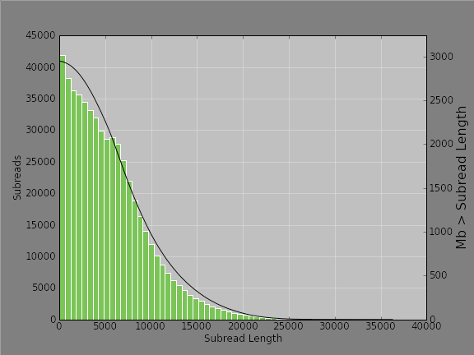
20 kb PacBio Library
Mean Subread Length | 5,427 | L50 | 7,850
Number of Bases | 2,945,151,212 | Number of Reads | 542,604
Notes:
This is the length distribution of reads from a more recent PacBio library. The L50 is 7850, meaning 50% of the bases are in reads at least that long. We have seen individual reads as long as 50kb. The average is continually increasing as PacBio improves their chemistry.

Slide 66
PacBio assemblies have fewer contigs
Notes:
These are for fungal genomes.
PacBio assemblies done with falcon/20150310. Illumina drafts use ALLPATHS-LG
*Lindgomyces ingoldianus required additional coverage (9 SMRT cells total)

