Slide 1

IMG genes, functions and pathways
Natalia Ivanova
MGM Workshop
Sept 26, 2016

Slide 2
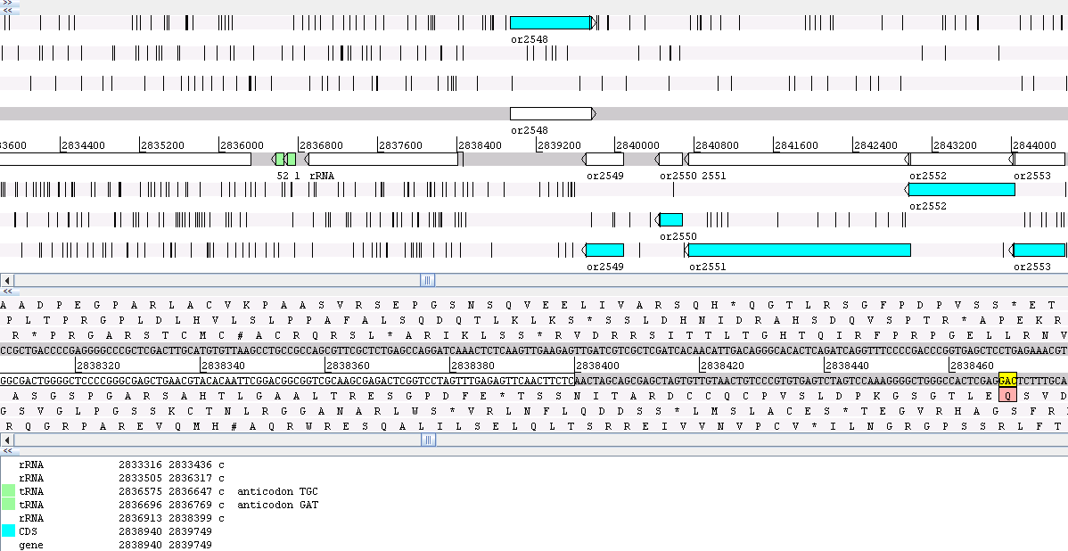
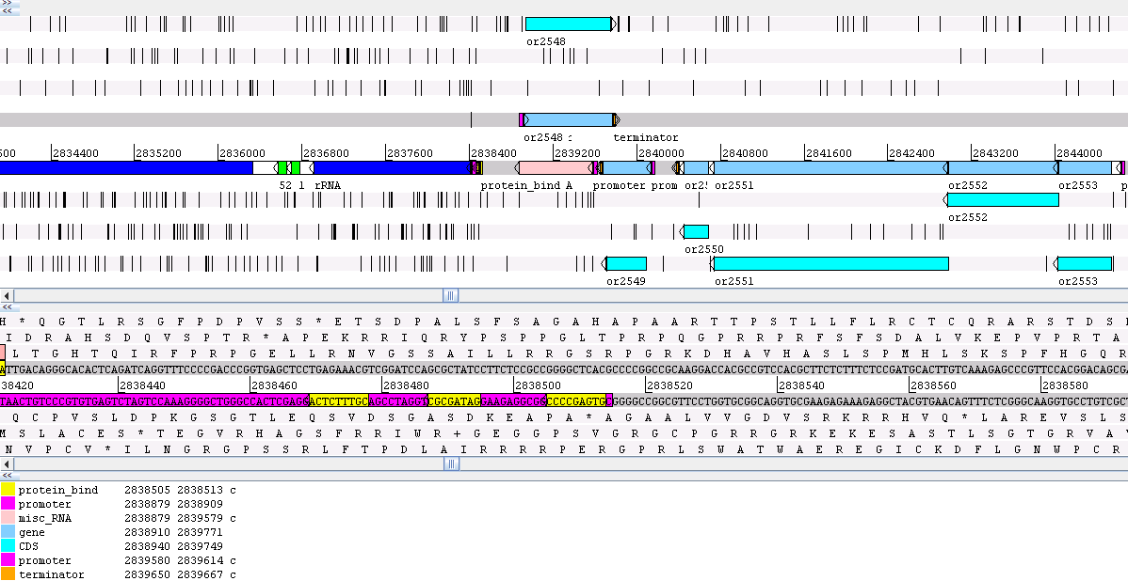
Finding the genes in microbial genomes
features
Well-annotated bacterial genome in Artemis genome viewer:
Sequence features in prokaryotic genomes:
stable RNA-coding genes (rRNAs, tRNAs, RNA component of RNaseP, tmRNA)
protein-coding genes (CDSs)
transcriptional features (mRNAs, operons, promoters, terminators, protein-binding sites, DNA bends)
translational features (RBS, regulatory antisense RNAs, mRNA secondary structures, translational recoding and programmed frameshifts, inteins)
pseudogenes (tRNA and protein-coding genes)
…
Notes:
Fairly big project in terms of number of institutes and people involved

Slide 3
Summary of annotation provided by the IMG pipeline
“Mandatory” features
“Non-coding” RNAs
23S, 16S and 5S rRNAs
tRNAs
Protein-coding genes
“Optional” features
tmRNA, RNase P RNA component
Repeats (CRISPRs, IS elements)
Regulatory RNAs (riboswitches)
Pseudogenes and frameshifts
Topological features of protein-coding genes (signal peptides, transmembrane regions)

Slide 4
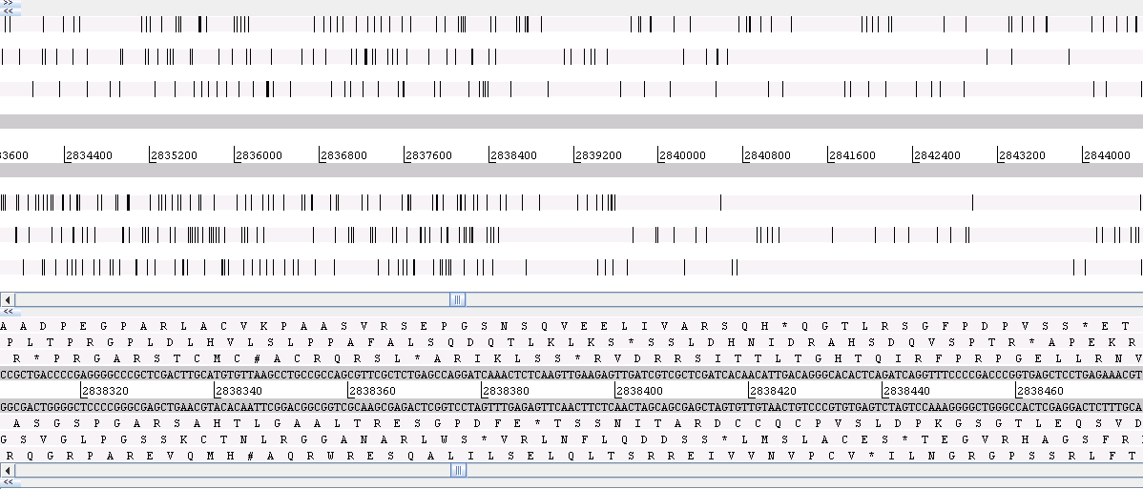
CDS (not ORF!) prediction
Reading frames: translations of the nucleotide sequence with an offset of 0, 1 and 2 nucleotides (three possible translations in each direction)
Open reading frame (ORF): reading frame between a start and stop codon

Slide 5
How ab initio tools work – very briefly
Statistical model of coding and non-coding regions
Statistical model(s) of other components (RBS)
Additional algorithms for refinement of predictions (overlap resolution, etc.)
Ribosome binding site
open reading frame
Start codon:
ATG, GTG, TTG
Stop codon:
TAG, TAA, TGA
Prokaryotic gene model used by all ab initio gene finders
Ribosome-binding site within certain distance of the start codon;
One of 3 start codons;
One of 3 stop codons;
No frame interruptions

Slide 6
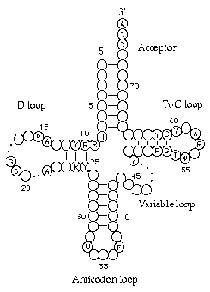
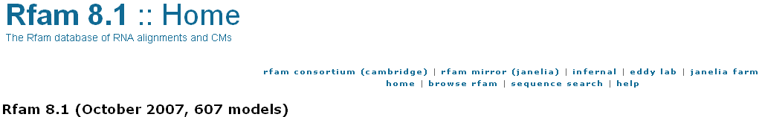


RNA prediction
Best way – covariance models (captures the secondary structure)
Rfam database, INFERNAL search tool
http://www.sanger.ac.uk/Software/Rfam/
http://rfam.janelia.org/
http://infernal.janelia.org/
tRNAScan-SE
http://lowelab.ucsc.edu/tRNAscan-SE
Alternatives:
BLASTn
Hidden Markov Models http://www.cbs.dtu.dk/services/RNAmmer/

Slide 7
Known problems of all annotation pipelines: lack of standards
Genome | Sequencing center | 16S rRNA, nt
Synechococcus sp. CC9311 | UCSD, TIGR | 1477
Synechococcus sp. CC9605 | JGI | 1440
Synechococcus elongatus PCC 7942 | JGI | 1490
Synechococcus sp. JA-2-3BA(2-13) | TIGR | 1323
Synechococcus sp. JA-3-3Ab | TIGR | 1324
Synechococcus sp. RCC307 | Genoscope | 1498
Synechococcus sp. WH7803 | Genoscope | 1497, 1464
RNAs
Incomplete rRNAs due
to incomplete models
Trans-spliced tRNA
in archaeal genomes
Small structural RNAs
not predicted at all
Protein-coding genes that don’t fit into prokaryotic gene model used by ab initio gene finders
no RBS (leaderless transcripts)
interrupted translation frame
sequencing errors or
translational exceptions
non-canonical start
Ribosome binding site
open reading frame
Start codon:
ATG, GTG, TTG
Stop codon:
TAG, TAA, TGA

Slide 8
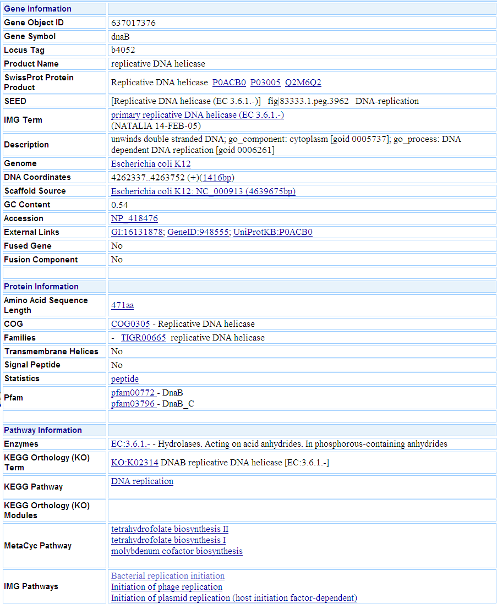
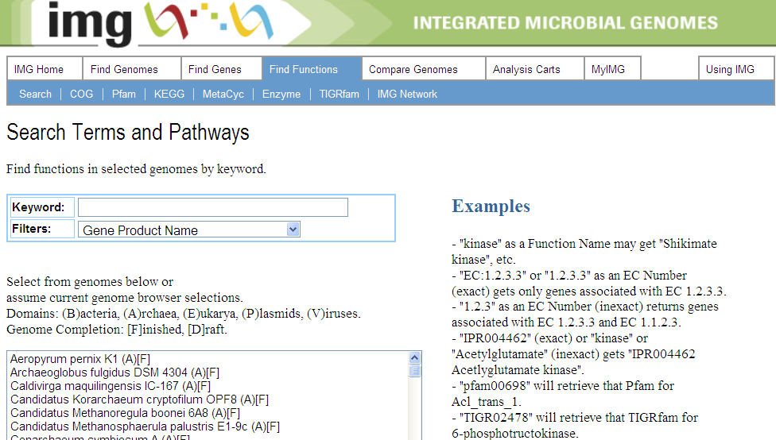
More: Transport DB, Phenotypes
Why so many?
What’s the difference?
Which one should I use?

Slide 9
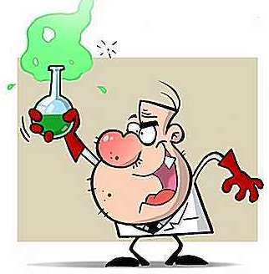

Where it all comes from
Experimental data: gene A in a genome X
catalyzes a reaction
interacts with another protein(s)
gene knock-out causes certain phenotype
…
This information is recorded in a
structured way:
ontologies (e.g. Gene Ontology)
pathway collections (metabolic and protein-protein interaction)
other (reasoning rules, like TIGR Genome Properties)

Slide 10
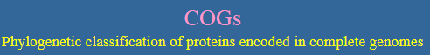
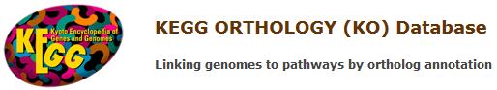
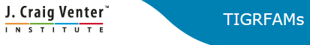
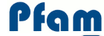
Finding sets of iso-functional proteins
Pairwise sequence similarity comparison (Smith-Waterman, BLAST, USEARCH…)
Which of these proteins have the same function as query?
Full-length homologs
Full-length orthologs
Partial homologs (“domains”)
Orthology is usually inferred by some heuristic best-hit approach

Slide 11
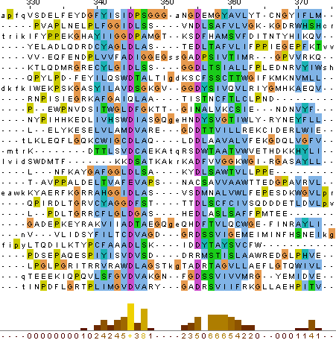
Two strategies for function assignments
Pairwise
comparisons
Profiles/models
parsing similarities
Can use additional heuristics to infer orthologous relationships
Implemented in KEGG Orthology
Represented as Hidden Markov Models (HMMs) or Position-Specific Scoring Models (PSSMs)
Used to assign COGs, Pfams and TIGRfams

Slide 12
Modeling the data properly – why nobody does that
gene
phenotype
transcript
pathway
protein
reaction
enzyme
evidence
compounds
Genes are connected to phenotypes via a multi-step process, with many parameters
We have very vague ideas about the steps/parameters for the vast majority of genes/phenotypes
We know even less about how these steps/parameters are affected by sequence changes
Corners are being cut by skipping/ignoring the steps

Slide 13


What it looks like in real life – KEGG vs MetaCyc
KEGG
http://www.genome.jp/kegg/
MetaCyc
http://metacyc.org/

Slide 14
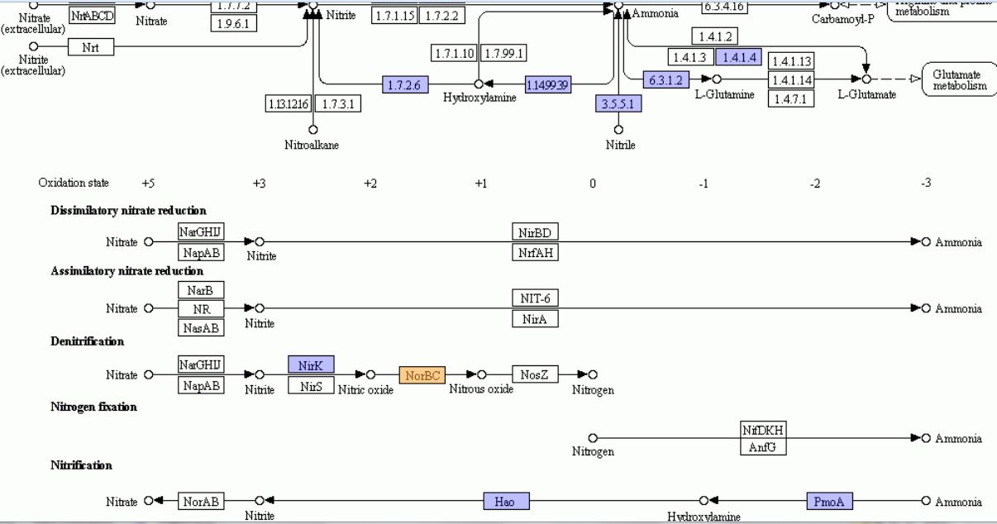
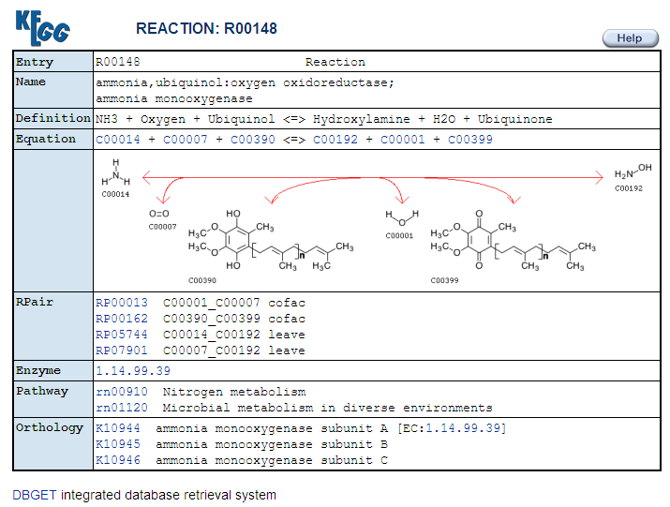
Ammonia oxidation pathway in KEGG

Slide 15
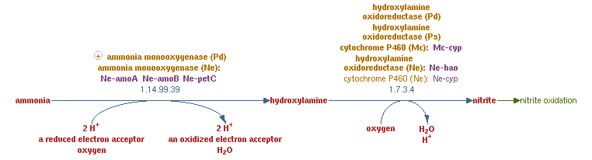
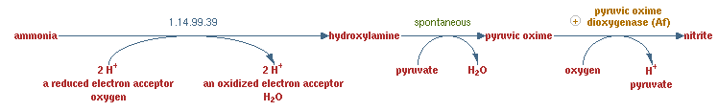
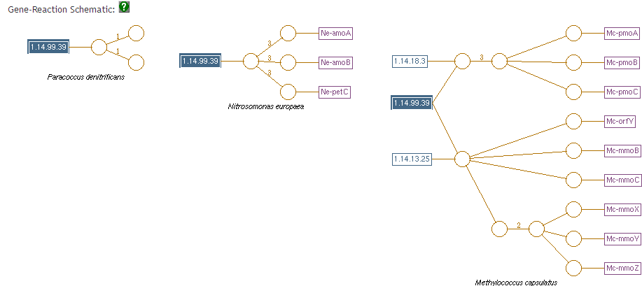


The same pathway/reaction in MetaCyc
Similar problems to KEGG:
multifunctional enzymes
multisubunit enzymes
differences in reaction recording

Slide 16
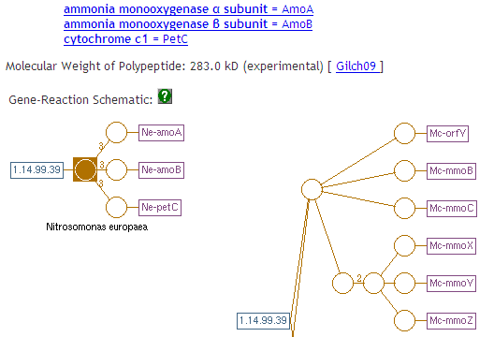

Even MetaCyc record is still incomplete
Which subunit has which cofactor?
Type of Cu2+ cluster, type of Fe2+ cluster?
Does it require any help with maturation of metal clusters?
Pseudomonas sp. PB16 was shown to have only 1 enzyme from the pathway, hydroxylamine reductase. Does it have the entire pathway?

Slide 17
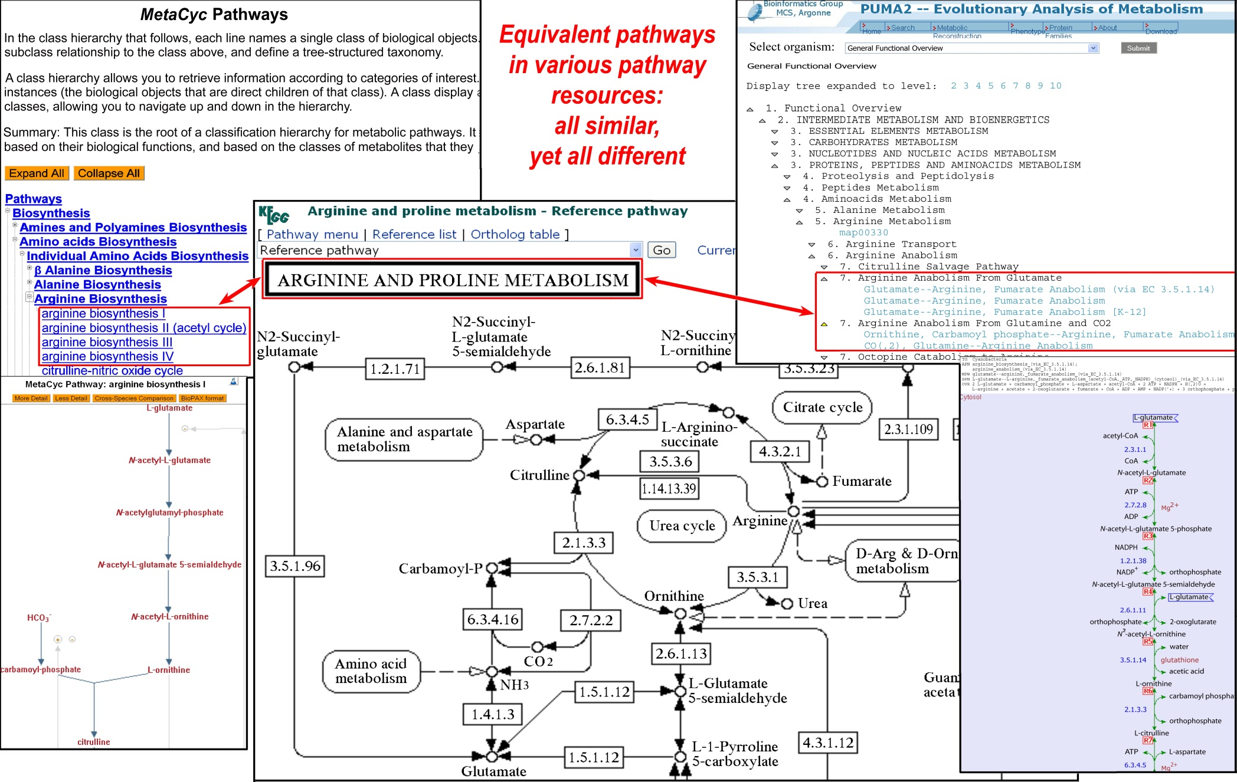
Pathway collections: KEGG, MetaCyc and others
Which particular set of interactions is a pathway? (i. e. how do we define pathway boundaries within the network?)

Slide 18
Additional functional classification systems in IMG
Functional annotations
InterPro
Functional hierarchies
TIGRfam Roles
COG Functional Categories
Transporter Classification
What about Enzymes, EC numbers and Gene Ontology?

