Slide 1

Working group suggestions
Groups are expected to work on publicly available genomes and metagenomes in IMG and IMG/M. There are more than 28,000 publicly available genomes from all 3 domains of life (plus 2800 viruses) and more than 4,100 publicly available metagenomes.
On Tuesday working groups are expected to be formed and select their target genomes/metagenomes.
Groups are expected to formulate basic research questions. Such as:
what are the dominant populations in a metagenome or a group of metagenomes?
what are the functional differences between metagenomes?
what are the gene content differences between genomes?
how is my favorite enzyme distributed in different lineages/metagenomes?
…

Slide 2
Working group suggestions - contd
4. Groups are encourage to use IMG and IMG/M data and tools. The data and tools will be presented in the next 2 days. Groups will have more than a day to work on their projects.
5. IMG developers and other JGI staff will be available all the time to assist with the projects and help with answering the questions.
6. On Thursday the groups are expected to present their projects.
The format of the presentations is up to you; preferably it should include:
the original list of questions and hypotheses
how successfully these questions could be answered
which IMG data/tools were used to answer these questions
suggestions on which tools/data should be implemented in IMG

Slide 3
Suggested working group target areas
Marine microbiology – isolate genomes Marine microbiology – metagenomes
Human microbiome – isolate genomes Human microbiome – metagenomes
Soil microbiology – isolate genomes Soil microbiology – metagenomes
Bioremediation – isolate genomes Bioremediation – metagenomes
Plant microbiology – isolate genomes Plant microbiology – metagenomes
Other – isolate genomes Other – metagenomes
(please write your suggested target area)

Slide 4
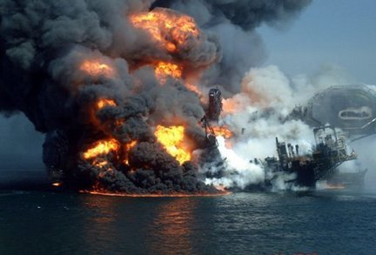
Comparative Metaganomics of the Deepwater Horizon Disaster
Phil Heller, SlavaIvanenko, Huda Mahmoud, Zhen Quian, Judson

Slide 5
Background
Spill
April 20, 2010
Collection
May 31, 2010
Depth = ???
Temperature = ???
Etc. = ???
Capped, declared dead
Sept 19, 2010

Slide 6
Initial Research Questions
How is the Deepwater Horizon biome different from a pristine environment biome
Station Aloha
How is the Deepwater Horizon biome different from an oxygen minimization zone?
Bioremediation of an oil spill (anthropogenic & natural) consumes oxygen

Slide 7
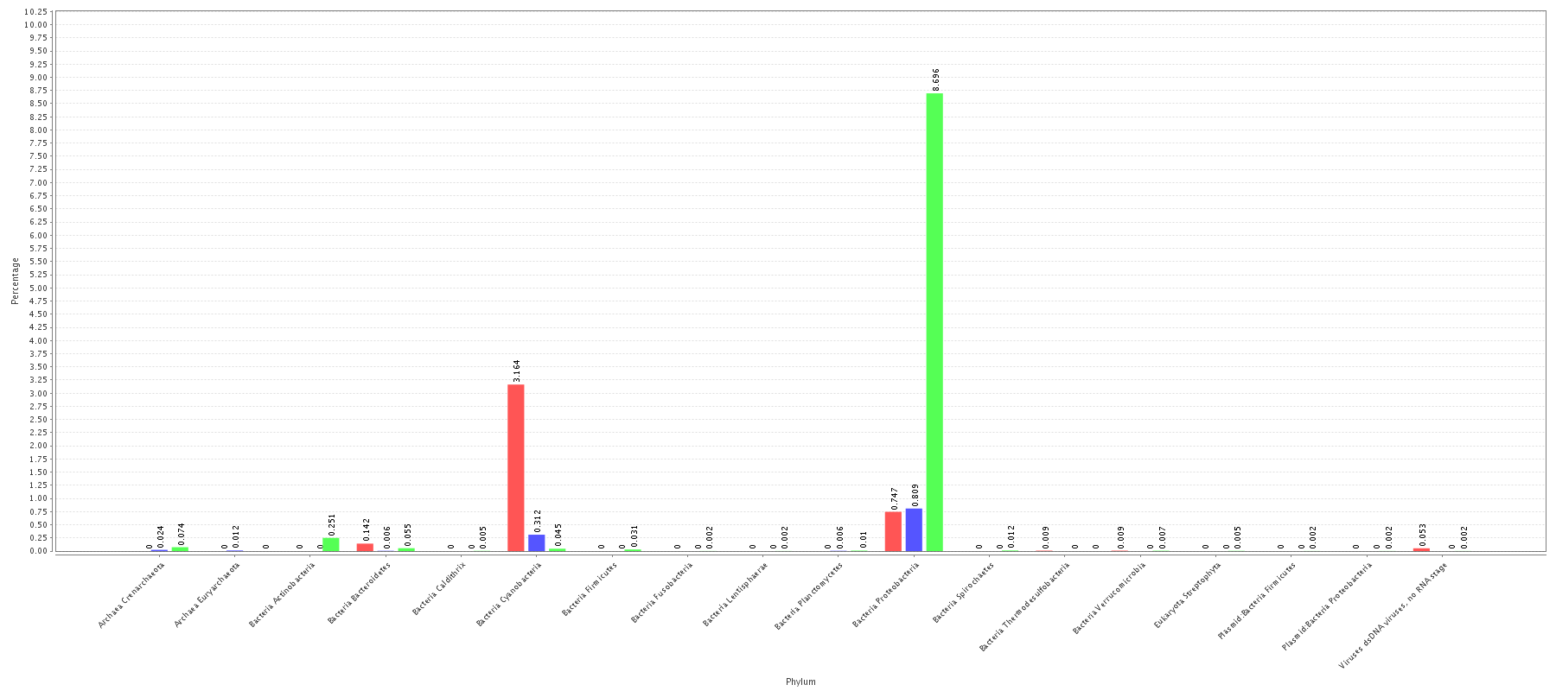
Cyanobacteria are expected
in the upper euphotic zone
Gamma Proteobacteria are known to
Degrade a wide range of organic matter
Upper Euphotic (Aloha) OMZ DWH

Slide 8
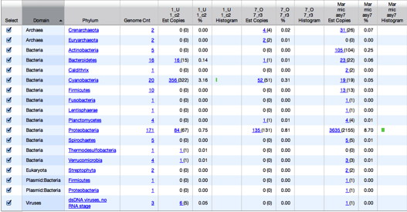
Upper eutrophic
(Station Aloha)
OMZ
Deepwater
Horizon

Slide 9
What we found
Deepwater Horizon biome isn’t much like Station Aloha
It also isn’t much like an OMZ

Slide 10
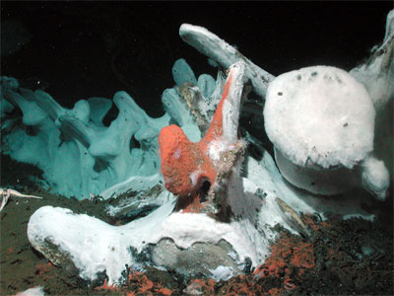
What we found
Deepwater Horizon biome isn’t much like Station Aloha
It also isn’t much like an OMZ
Need better questions
If an oil spill isn’t like an OMZ, what is it like?
Whale fall???

Slide 11
New Research Question
How does the Deepwater Horizon environment differ from a whale fall?

Slide 12
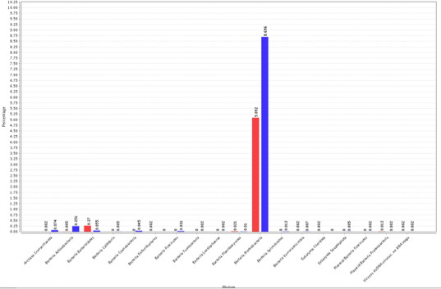
Whale & DWH both show high proteobacteria abundance

Slide 13
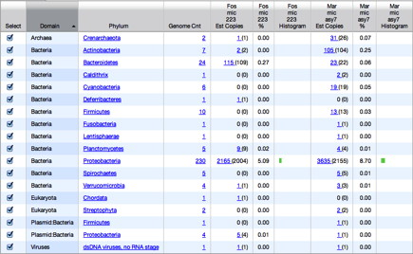
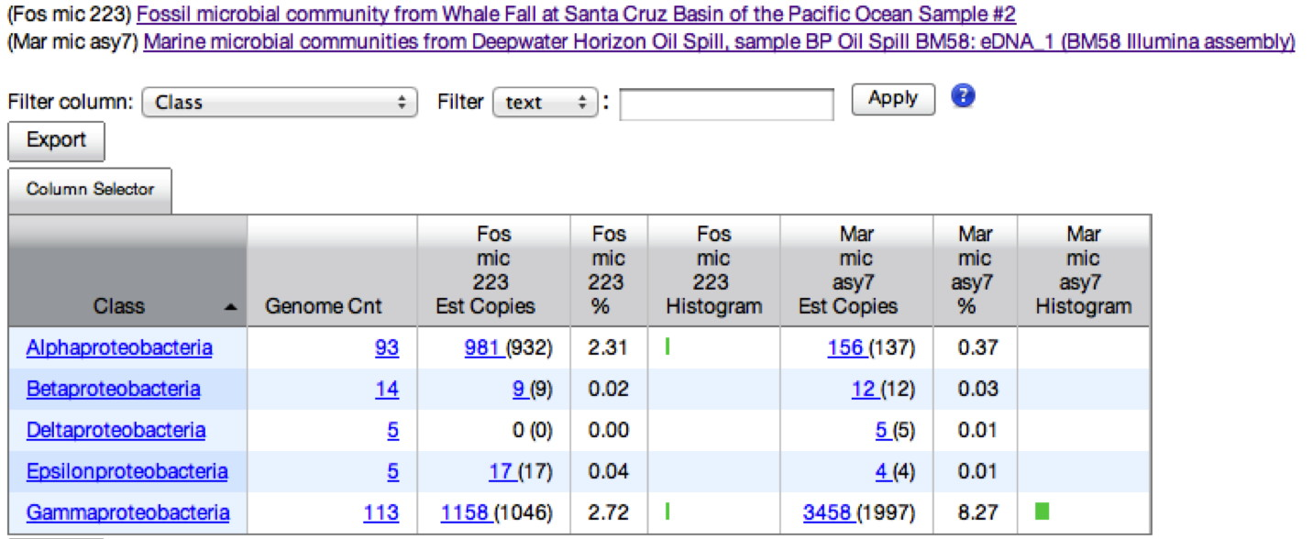
Notes:
ANIMATED
Both studies: Proteos are abundant
DWH: Proteos are alpha and gamma
Whale: gammas dominate proteos

Slide 14
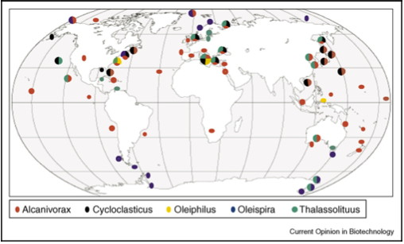
Gammaproteos, and Alcanivorax in particular, are known hydrocarbon degraders
Figure taken from Yakimov et al. Obligate oil-degrading marine bacteria. Current Opinion in Microbiology. 2007.

Slide 15
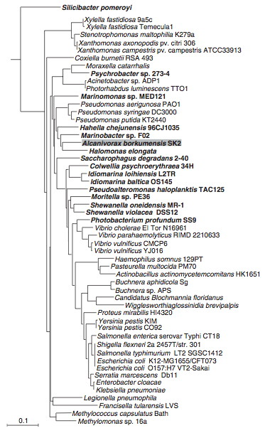
Phylogeny
Alcanivoraxborkumensis (WF)
Colwelliapyschrerythraea (DWH)

Slide 16
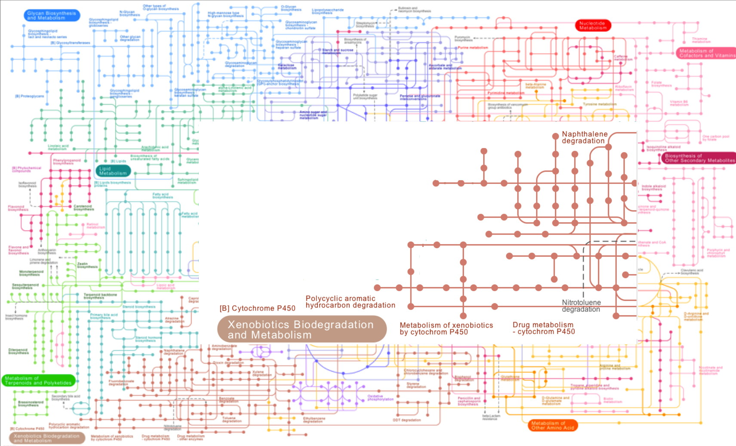
Alkanes are only C source in Alcanovorax
Metabolism of xenobiotics by cytochrome P450

Slide 17
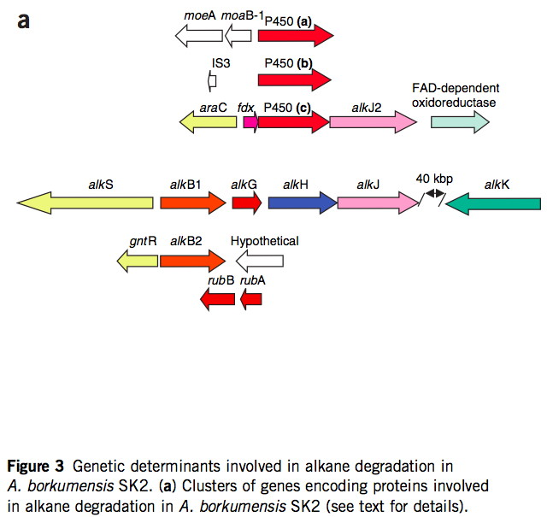
AlcanivoraxCytochrome P450 is involved in
xenobiotic metabolism
Figure from Schneikeret al.
Nature Biotechnology. 2006.
doi:10.1038/nbt1232

Slide 18
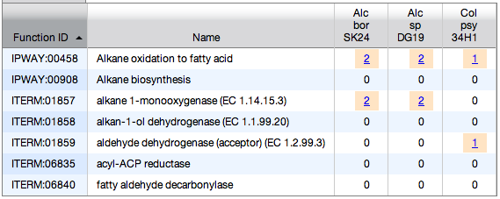
Pathways responsible for alkane degradation in Alcanovorax&Colwellia genomes

Slide 19
Summary
DWH is not very similar to OMZ or oligotrophic open ocean
DWH shares common features with whale fall
Abundance of proteobacteria, especially those with potential for degrading hydrocarbons
IMG tools provided sufficient evidence to formulate hypotheses that could be tested in subsequent lab experiments
Praise: Easy to toggle between metagenomes and individual genomes of abundant organisms
Wish: More descriptive metadata on DWH study

Slide 20

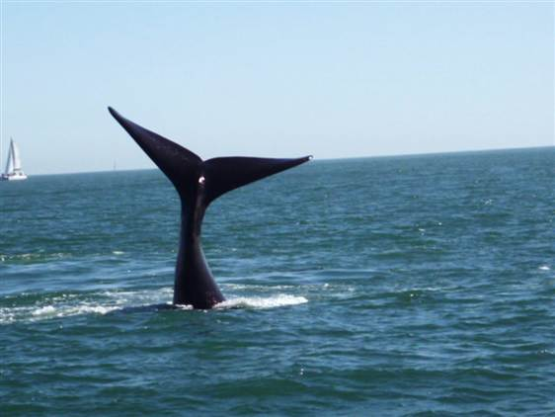
Acknowledgements
British Petroleum
The Whale

