Slide 1

OpenCPI - Open Component Portability Infrastructure
An Open Source Infrastructure for
Heterogeneous/Embedded Component-Based Systems and Applications
Advanced OpenCPI Platform Development

Slide 2
Summary of OpenCPI Development Roles
Three types of development with common XML-driven workflow
 | Application Development | Component Development | Platform Development
Objective | Create applications using components | Create building blocks for applications | Create infrastructure for running applications
Examples | Tb_bias FSK app | Bias FIR filter | Zedboard Matchstiq Transceivers
Key functions | Declare components and their connections and properties | Process data and interface between other components Vendor agnostic (ideally) | Provide interface to software and FPGA peripheral (devices workers)
Skills Required | Familiarity with component library | S/W: C, C++ H/W: VHDL | H/W: VHDL Strong knowledge of platform architecture and interfaces
 | Knowledge of OpenCPI build flow

Slide 3
Types of OpenCPI Platform Development
Enabling new platforms and devices for OpenCPI apps
Enable Development Host
Software Platform Development
Enable Embedded/
Target Host
Platform
Development
FPGA Platform Development
Enable New Platform
Enable New Device Type

Slide 4
Types of OpenCPI Workers
C Workers
RCC Workers
C++ Workers
Workers
HDL Application Workers
HDL Workers
(all VHDL for now)
HDL Device Workers
HDL Platform Workers

Slide 5
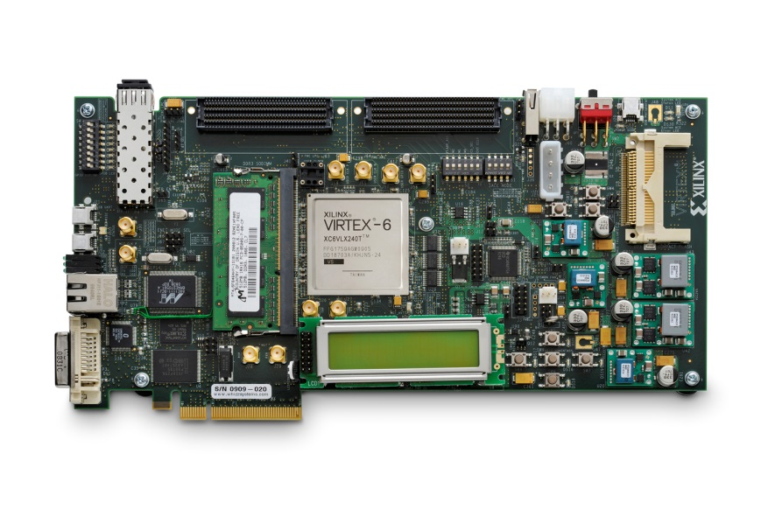
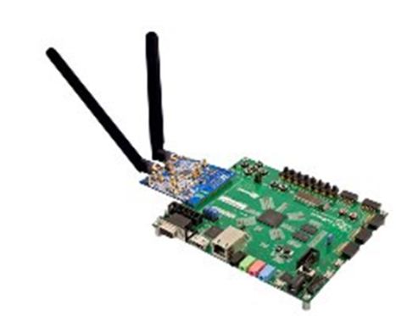
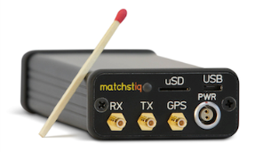
What is an OpenCPI FPGA Platform?
An OpenCPI FPGA Platform is the FPGA, its surrounding infrastructure and attached devices.
Enabling the platform allows it to be used for an OpenCPI application.
Put another way…
What do I need to run an OpenCPI app?
File Writer
256-Tap FIR Filter
FM
Demod
Fixed CIC
Resample
Software Worker | FPGA Workers
on my hardware?

Slide 6
What Does an OpenCPI FPGA Platform Consist of?
The FPGA: a place where HDL application workers may execute
Interconnects: off-chip connections to processor(s) or other FPGA platforms
Devices: peripherals attached to the FPGA, useful to applications
Slots: hardware physical interfaces where cards (with devices) are plugged in
Example Processor Interconnects | Example FPGA Peripheral Devices
Zynq
ARM
AXI
SPI
FPGA
Lime Micro XCVR
Data
Intel
x86
PCIe
I2C
SI Labs
Clock Gen
Other
FPGA
FMC Slot

Slide 7
What is Needed to Enable an OpenCPI FPGA Platform?
The OCPI on-chip clocks, control and data planes must be adapted to the external (off-FPGA) resources available in the platform: create the HDL platform worker.
  Control Plane: mechanisms to allow the processor to control and configure FPGA workers
  Data Plane: mechanisms to allow messages to flow between on-chip workers and workers elsewhere
  Clocks: the mechanisms to provide clocking and time-of-day to FPGA workers
The attached devices must be supported by specialized workers acting as device drivers:
create or reuse HDL device workers.
Example Processor Interconnects | Example FPGA Peripheral Devices
Zynq
ARM
AXI
SPI
FPGA
Lime Micro XCVR
Data
Intel
x86
PCIe
I2C
SI Labs
Clock Gen
Other
FPGA
FMC Slot

Slide 8
Generic, Platform-agnostic FPGA Infrastructure
Generic Infrastructure Modules
  For controlling FPGA worker registers/properties from software (control plane)
  For data transfer from FPGA workers to/from other platforms and software (data plane)
    These modules are instanced automatically as needed
Some existing HDL device workers/drivers for controlling certain devices (on any platform).
Adapter logic for different processor/FPGA interconnects
GPP | FPGA
Zynq
ARM
AXI
OpenCPI
AXI Adapter
Data
FPGA
Component
OpenCPI
Generic Infrastructure
Control
Infrastructure is the same for both implementations
OpenCPI
Generic Infrastructure
Control
Intel
x86
OpenCPI
PCIe Adapter
FPGA
Component
PCIe
Data

Slide 9
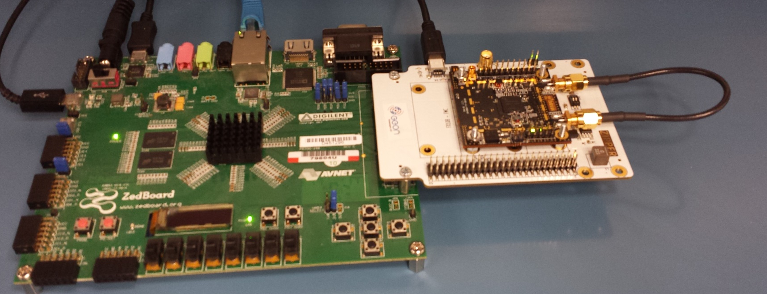
Case Study: Zedboard with MyriadRF
Treated as one board, ignoring the card/slot aspect for now
Processor
FPGA
Devices
Zynq 7020
ARM
Zynq 7020 Programmable Logic
Lime Micro XCVR
AXI
SI Labs
Si5351 Clock Gen
Zedboard with MyriadRF Daughtercard

Slide 10
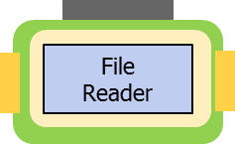
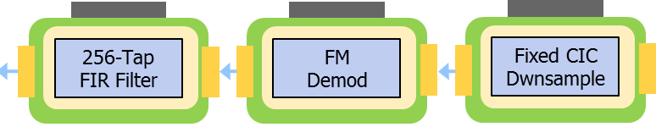
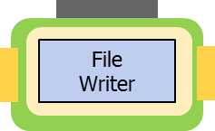
Case Study: What We Started With
Virtex6 PCIe development kit: ML605
OpenCPI adapter logic for Virtex6 PCIe
Existing application using file based input and output
No devices used
App
Implementation
File Writer
256-Tap FIR Filter
FM
Demod
CIC
Resample
File Reader
Intel x86
Virtex6 LX240
ML605 Platform
Worker
OCPI
Workers
OCPI
Generic
Infra
Structure
OCPI Workers
OCPI
PCIe
Adapter

Slide 11
Case Study: What Could Be Re-used?
What could be reused?
  Generic infrastructure
  HDL and software workers
    Workers must be recompiled for Zynq/ARM. No code changes needed
App
Implementation
File Writer
256-Tap FIR Filter
FM
Demod
Fixed CIC
Resample
Zynq 7020
ARM
Zynq 7020 Programmable Logic
Lime Micro XCVR
OCPI Generic
Infrastructure
OCPI
Workers
SI Labs
Si5351 Clock Gen
OCPI Workers

Slide 12
Case Study: What was Needed?
What was needed?
  Zed platform worker with OCPI adapter
  Device workers to ingest data and control devices
App
Implementation
File Writer
256-Tap FIR Filter
FM
Demod
Fixed CIC
Resample
Zynq 7020
ARM
Zynq 7020 Programmable Logic
Lime Micro XCVR
Zed Platform
Worker
Device
Workers
OCPI
AXI
Adapter
Lime
Worker
AXI
SI Labs
Si5351 Clock Gen
Si5351
Worker

Slide 13
Case Study: Final Implementation
App
Implementation
File Writer
256-Tap FIR Filter
FM
Demod
Fixed CIC
Resample
Zynq 7020 Programmable Logic
Lime Micro XCVR
Zynq 7020
ARM
Zed Platform
Worker
Device
Workers
OCPI Generic
Infrastructure
OCPI
Workers
OCPI
AXI
Adapter
Lime
Worker
SI Labs
Si5351 Clock Gen
Si5351
Worker
OCPI Workers

Slide 14
FPGA (HDL) Device Worker
Acts as the controlling logic for an attached device: the device driver
A superset of an application worker, with normal properties and ports
Connects directly to the I/O pins for signals between FPGA and device
HDL Device Worker OWD/XML has element: <Signal>
  Declares signals to/from the device, with their direction, width, I/O attributes
  These signals are made directly available in the VHDL architecture worker code
HDL Worker Control/Properties
Device Worker VHDL
Application Data Port
(optional)
Application Data Port
(optional)
Device Signals
e.g., ADC. etc.

Slide 15
FPGA Device Worker OWD XML Example
<!-- Example ADC worker -->
<HdlDevice language="vhdl" firstrawproperty='dc_regval' spec='qadc-spec'>
<ControlInterface Timeout="1024"/> <!-- timeout long enough for the SPI access -->
<Property name='USE_CTL_CLK_p' type='bool' default='1'/>
<Property name='source' type='enum' enums='adc,count,loopback' initial='1'/>
<!-- Properties in registers -->
<property name='dc_regval' type='uchar' volatile='true'/>
<property name='rccal_lpfcal' type='uchar' volatile='true'/>
<property name='dc_cntval' type='uchar' writable='true' volatile='true'/>
<!-- Ports -->
<StreamInterface Name="OUT" producer='true' DataWidth="32"/>
<!-- Signals to/from the device -->
<Signal Output="RX_CLK"/>
<Signal Input="RX_IQ_SEL"/>
<Signal Input="RXD" width="12"/>
<Signal Input="RX_CLK_IN"/>
<Signal Output="SEN"/>
<Signal Input="SDO"/>
<Signal Output="SDIO"/>
<Signal Output="SCLK"/>
<Signal Output="RESET"/>
</HdlDevice>

Slide 16
FPGA (HDL) Platform Worker
A special type of HDL device worker
Based on the "platform-spec" OCS, has properties
As a device worker, has external hardware/pin signals via <signal>
Has "infrastructure" ports to connect to generic infrastructure
HDL Worker Control/Properties
Platform Worker VHDL
Infrastructure Ports
External Signals
e.g., Clocks, Interconnects

Slide 17
FPGA Platform Worker Must Provide:
A suitable clock for the control plane
  Currently this is widely used as the "default clock" for many purposes
A suitable clock for timekeeping
  Typically the highest quality/stability
A path for an external processor to perform control access ops
  Typically allow processor to perform memory mapped load/store access
  Adapt this path to the OpenCPI "control plane master" interface.
A bus-mastering/DMA path for the system interconnect(s)
  Typically allow OCPI generic infrastructure to be bus master.
  Adapt this path to the OCPI generic "data plane" interface

Slide 18
FPGA (HDL) Platform Worker OPHD
Top level element is <HdlPlatform>
Spec is "platform-spec"
Declare infrastructure ports using these elements:
  <Timebase> for timekeeping clock
  <Metadata> for access to in-bit-stream compressed artifact metadata
  <CpMaster> for access to generic control plane infrastructure
  <unoc> or <sdp> for access to generic data plane infrastructure
Declare attached devices using <device> elements
  including any build parameters and settings required for this platform
Declare available slots using <slot> elements.
  including any non-standard slot pin signal names

Slide 19
Complications for Device Workers
Multiple devices may share some external signals
  SPI and I2C configuration busses
  Clocks, resets
Complex multifunction devices should act as separate simple devices
  Don't want to waste logic for unused functions
  Want functional modularity of device workers to be consistent
Solution is "subdevices", which are special device workers for:
  Encapsulating signal sharing among device workers
  Instantiated automatically when any of its supported devices are used.
  May or may not have their own properties

Slide 20
Subdevice Worker Example
ADC and DAC have separate data paths and clocks
They share an SPI and master reset
HDL Worker Control/Properties
HDL Worker Control/Properties
App
Data
Port
DAC Device Worker
ADC Device Worker
App
Data
Port
Raw Property Ports
TX Data x12
TX Clk
RX Clk
RX Data x12
Subdevice Worker
(present when either is used)
Reset
SPI Clk/En
SPI Data
Multifunction Device with ADC, DAC, Common Reset and SPI

Slide 21
Detailed Platform Diagrams
Platform modules can be found in the hdl/platforms directory
They have implementation XML and source code
  Just like other workers
Responsible for instancing OpenCPI adapter logic and some generic infrastructure

Slide 22
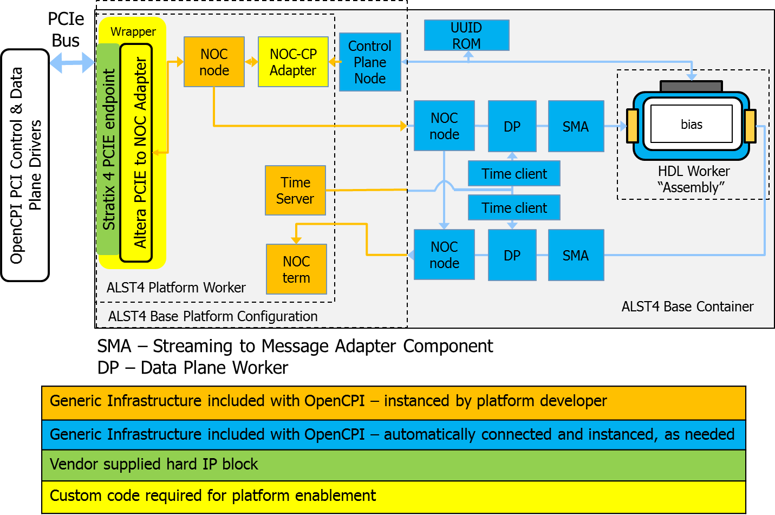
ALST4 Build Example: Single Worker App with File/Read File/Write Outputs

Slide 23
Zed Build Example: Single Worker App with File/Read File/Write Outputs
Zynq 7020 Programmable Logic
Container
Platform Configuration
Platform Worker
UUID & ROM
Wrapper
AXI-GP0
Control Plane
AXI2CP
HDL Assembly
AXI-HP0
Container Data Engine
SDP2AXI
App Worker
PS7 Primitive
AXI-HP1
Container Data Engine
SDP2AXI
AXI-HPx
AXI HPx Term
Time
Server
Time
Client
Generic Infrastructure included with OpenCPI – instanced by platform developer
Generic Infrastructure included with OpenCPI – automatically instanced and connected, as needed, by the code-generation tool
Vendor supplied hard IP block
Custom code required for platform enablement

Slide 24
Where Can I Find More Information?
OpenCPI Platform Development Guide
  https://opencpi.gitlab.io/releases/develop/docs/OpenCPI_Platform_Development_Guide.pdf
Matchstiq BSP Case Study
  https://opencpi.gitlab.io/releases/develop/docs/assets/Matchstiq_BSP_Case_Study.pdf
Matchstiq Platform Worker Data Sheet
  https://opencpi.gitlab.io/releases/develop/docs/assets/Matchstiq_Z1_Platform_Worker.pdf

