Slide 1

OpenCPI - Open Component Portability Infrastructure
An Open Source Infrastructure for
Heterogeneous/Embedded Component-Based Systems and Applications
Introduction to OpenCPI Development

Slide 2
Introduction to OpenCPI Development
What is OpenCPI?
Comparison to other SDR frameworks

Slide 3

OpenCPI is a framework for developing and deploying portable component-based applications:
Component-based development targeting heterogeneous systems
Built-in transport between technologies, automated test bench code generation
Vendor and technology neutral, no required data format standards

Slide 4

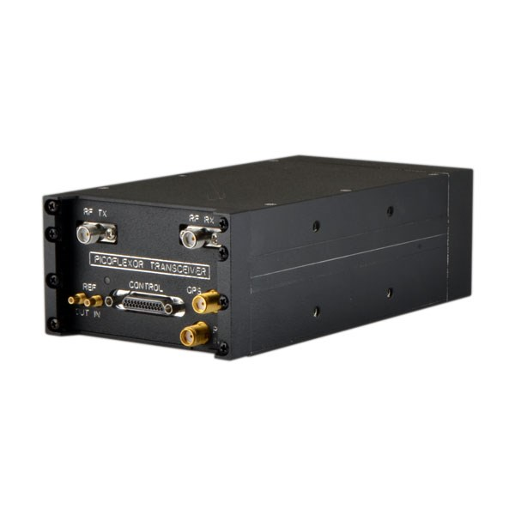
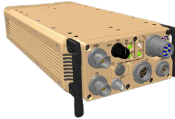
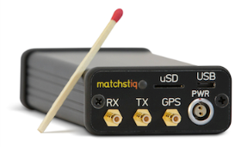
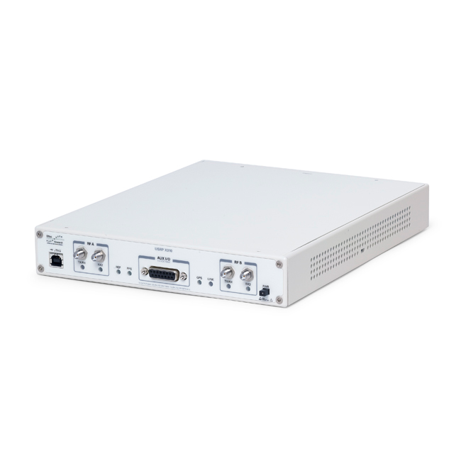
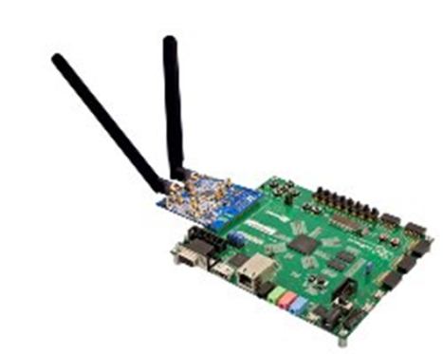
OpenCPI Target Platforms: Heterogeneous Systems
TX
RX
External
Interface
Ethernet
USB
WiFi
BlueTooth
GPP
CTRL
RF Chain
Processor
- Intel x86
- ARM
- Power PC
- OMAP
OS
Elinux
Integrity
RTOS
Vendor
Specific
Reconfigurable
Tactical Radios
D/A
A/D
CTRL
XPORT1
FPGA
Transports / Buses
PCI/PCIe
AXI
Avalon
Ad-Hoc
Altera
- Stratix
- Arria
- Cyclone
Xilinx
- Virtex
- Spartan
- Zynq
Clock, Crypto,
Timing, …
Development
Platforms

Slide 5
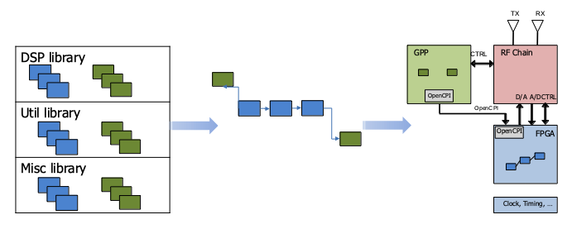
OpenCPI: Concept of Operation
Portable, reusable components are developed in VHDL/C++ independent of intended application or target platform
Using IDE, applications are constructed from existing libraries and built
Application deploys to target platform with components executing on disparate parts of platform

Slide 6









OpenCPI: Open Source
OpenCPI (FOSS)
  Component shell and structural code generation (VHDL, C/C++) to simplify component and application design
  Supplies the IP and infrastructure for component interconnection, setup, control and data transfer
  A robust, vendor-neutral build environment that links to FPGA vendor tool chains to generate FPGA bit
OpenCPI framework history dates back 15+ years
Standards Based Code Generation
Portable Infrastructure for Control, DMA
Build Engine Integrated with Vendor Tools

Slide 7
Introduction to OpenCPI Development
What is OpenCPI?
Comparison to other frameworks

Slide 8

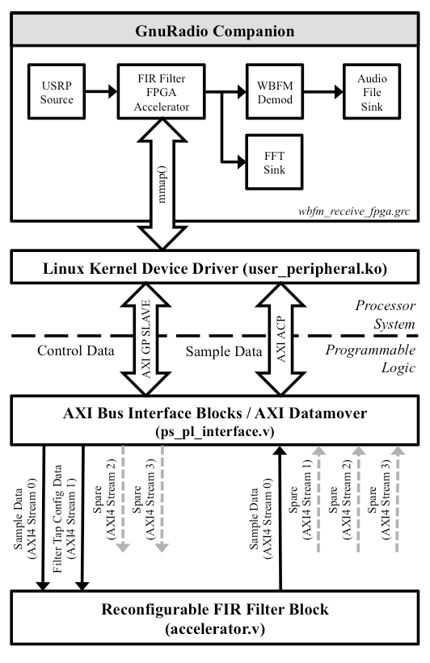
OpenCPI – GNURadio Comparison
Highly popular FOSS Software Radio Framework
    Large number of users and existing components
    Mature IDE for developing applications and components
Hardware is strictly not part of GNU Radio
    Quote directly from their wiki
No unified method for supporting FPGA and data exchange with host processors
    Custom solutions requiring vendor IP and custom drivers
Buffer management for compute engines requires memory copying
    More inefficient than the shared memory approach of OpenCPI
https://wiki.gnuradio.org/index.php/Zynq

Slide 9
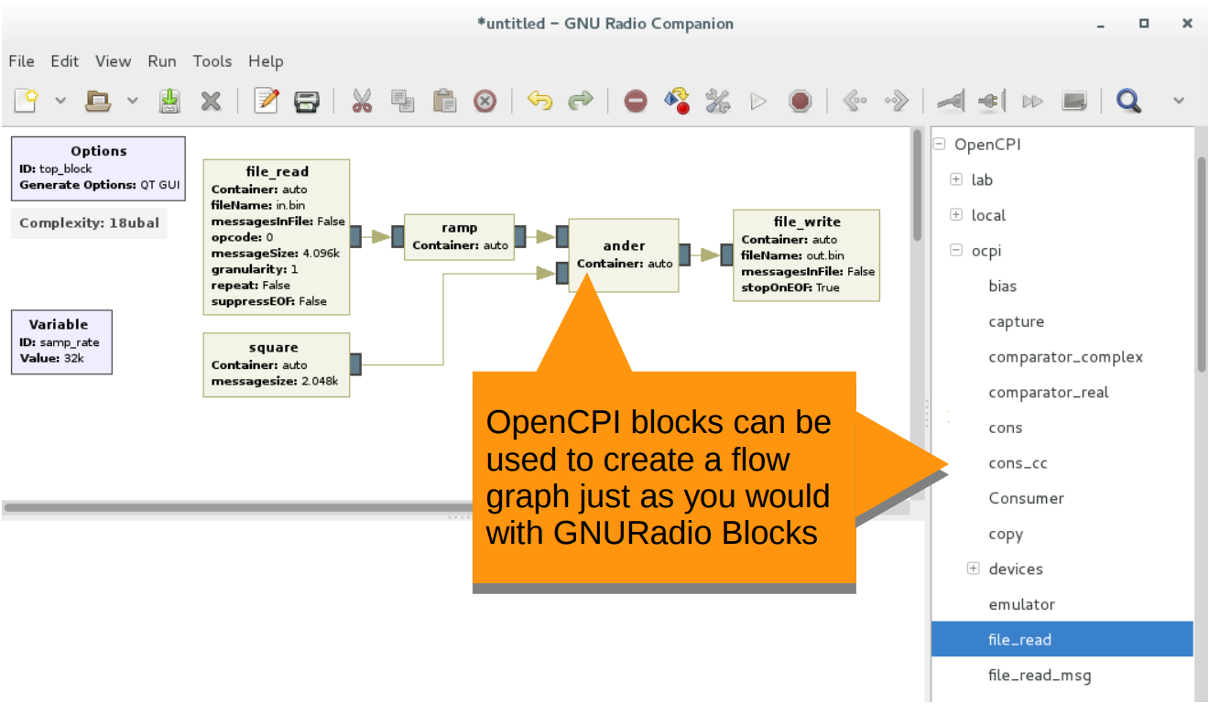
OpenCPI – GNURadio Comparison
OpenCPI's 2017 GNURadio Conference Presentation
^{https://youtu.be/CriLitW5vtM}
Preliminary integration with OpenCPI and GNURadio Companion
Tool developed to translate OpenCPI XML into GRC block XML
GRC Flowgraph can be generated and run using the standard GRC buttons

Slide 10
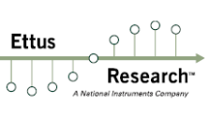
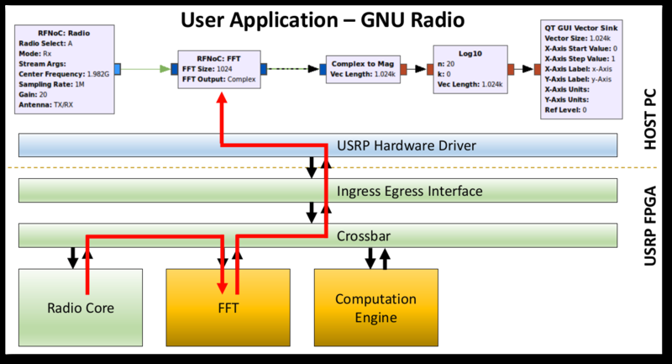
OpenCPI – RFNoC Comparison
Tool for enabling GPP-based and FPGA-based processing in an application
Targets Ettus lines of radios
  X and E series
Re-configurable connections between components are made through a crossbar switch
  Relies on Xilinx IP cores (limits portability)
Integrated with GNURadio
https://kb.ettus.com/RFNoC

Slide 11

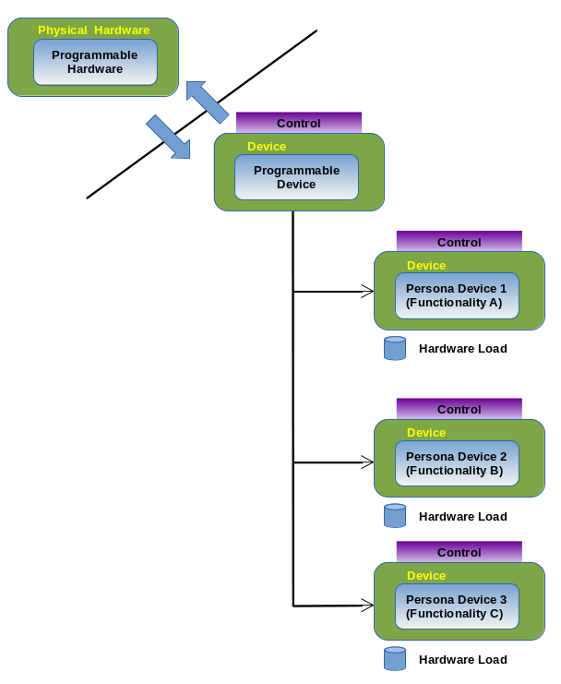
OpenCPI – REDHAWK Comparison
Homogenous processing system for SDR
Very SIGINT-focused with limited transmission support
Hardware acceleration/offload were added as a secondary capability
Does not dictate what is designed inside the black box
  Only describes how the interface should interact with the framework
What are the mechanics of the REDHAWK solution?
Two part solution - Programmable Role and Persona
Programmable role is the gatekeeper
  Controls what Persona is loaded
  Blocks subsequent requests until unloaded
  Contains generic functionality common to all Persona
Persona
  Defines the load and any interfaces pertaining to the specific load
  Bit file for FPGAs
  Kernels for GPUs

Slide 12

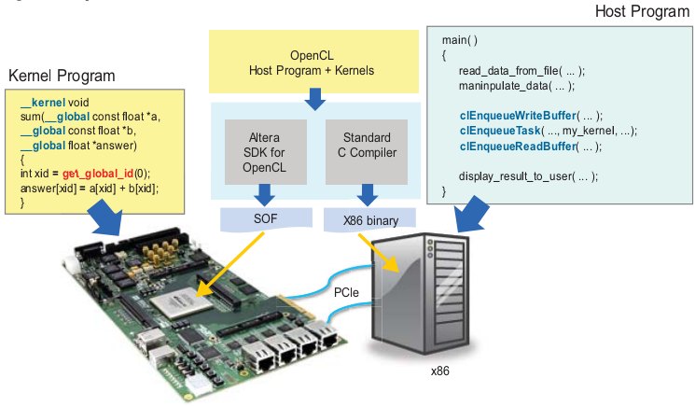
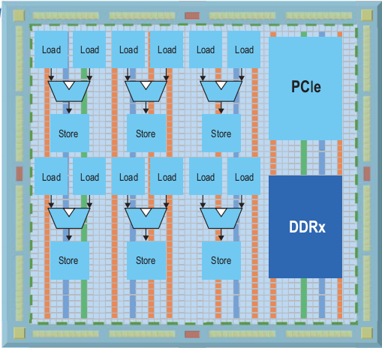
OpenCPI – OpenCL Comparison
A framework for writing programs that execute across heterogeneous platforms
  GPPs
  GPUs
  FPGAs
Xilinx and Altera supported
  Each require vendor-specific extensions to OpenCL
Limited FPGA platform support
  Mainly targeting hardware acceleration
  No ADC/DAC design examples
Can have OpenCL workers within OpenCPI

Slide 13
Comparison Summary
Advantages
  Extremely light weight
    Minimal dependencies
  Hardware/software interaction standard
    No need for specialized drivers
  Easy integration with other existing solutions
    REDHAWK programmable device concept
    GNURadio component model
    OpenCL component model
  Low overhead execution model
    Containers = process
    Direct memory
    No CORBA
  FPGA vendor neutral
  Existing ADC/DAC examples
Disadvantages
  Limited platform support
  Smaller user base

