Slide 1

OpenCPI - Open Component Portability Infrastructure
An Open Source Infrastructure for
Heterogeneous/Embedded Component-Based Systems and Applications
HDL Assemblies

Slide 2
Concepts and Terminology Review
Concepts and Terminology Review
HDL Assemblies

Slide 3
Review: App Worker Development Flow
Protocol (OPS): Use pre-existing or create new
Component (OCS): Use pre-existing or create new
Create new application worker (Modify OWD and source HDL/RCC code)
Build the application worker for the target device(s)
Create unit test (<component>-test.xml, generate, verify and view scripts)
Build unit test – Assembly/Container is generated/built here
Run unit test

Slide 4
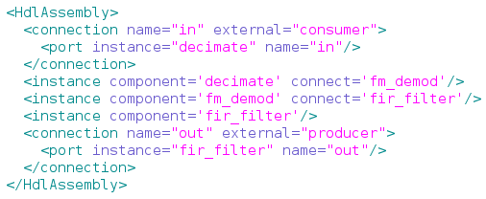
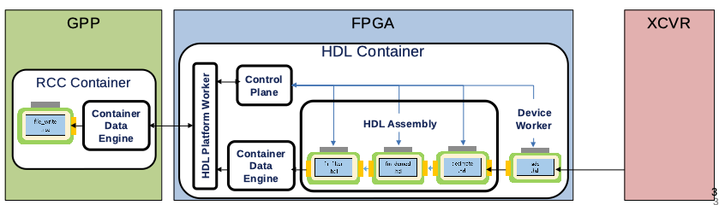
Review: Building Blocks Terminology
Term: HDL Assembly
Definition: A fixed composition of HDL workers that can act as subset of a heterogeneous OpenCPI application.
Described by: HDL Assembly Description XML (OHAD), NO VHDL
file_write.hdl
fir_filter.hdl
fm_demod.hdl
decimate.hdl
adc.hdl

Slide 5
Concepts and Terminology Review
Concepts and Terminology Review
HDL Assemblies

Slide 6
HDL Assemblies
The OpenCPI HDL Assembly Description (OHAD) provides metadata to the framework describing port interconnections and worker configurations (parameters) which, when built:
  Generates structural HDL source code
  Performs incremental compilation using FPGA vendor tools to produce a netlist for the target device
Directory for the HDL assembly created at “hdl/assemblies/<my_assy>/”
Assembly builds result in a single standalone artifact file per platform
  Executable is the term used for a simulator platform
  Bitstream is the term used for an actual physical FPGA
The HDL assembly is combined with a platform worker to create an HDL container that is transformed into a bitstream/executable - “<filename>.bitz”

Slide 7
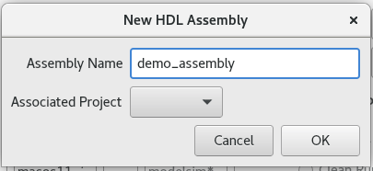
Creating HDL Assemblies
With ocpidev:
ocpidev create hdl assembly demo_assembly
With OpenCPI GUI:
Files created:
Files created:
hdl/assemblies/
|-- assemblies.xml
|-- demo_assembly
|-- demo_assembly.xml
Files of interest:
assemblies.xml: XML for all assemblies
demo_assembly.xml: OHAD that defines the assembly’s:
- HDL worker instances
- Property/parameter settings
- Connections
- External ports

Slide 8
HDL Assembly OHAD Structure
Worker instances reference HDL workers in a component library (worker's OWD name)
  Instance names are optional; when not specified, they are either the same as the worker name, without any package prefix (when there is only one instance of that worker in the assembly), or the worker name followed directly by a zero-based decimal ordinal (when there is more than one instance of the same worker)
connect elements define connections among worker data ports
The connect attribute of an instance indicates the instance's only output is connected to the only input of another instance
External ports, where the data is flowing into or out of the assembly itself, can be specified with:
  The external element, when the external port name is different from the worker port it's connected to
  The external attribute of the instance, when the worker port name and external port name are the same
  The externals boolean, to specify that all unconnected worker ports are external ports

Slide 9
HDL Assembly XML Attributes for Building
Optional top-level XML attributes used when an HDL assembly is built
  ComponentLibraries
    A list of component libraries in which to find the workers to make the HDL assembly
    Can also be set in the hdl/assemblies directory XML file “assemblies.xml” to apply to all the assemblies in that directory or in the project's “Project.xml” file.
  OnlyPlatforms
    An exclusive list of platforms for which this assembly (and default containers) should be built
  ExcludePlatforms
    A list of platforms for this assembly that should not be built
  Containers/DefaultContainers
    A list of containers for building the assembly
See the OpenCPI HDL Development Guide for details

Slide 10
HDL Container
Written in XML
Top-level module that implements the assembly on the platform
Metadata for the framework to compile an Application Assembly (netlist) + Platform Configuration (netlist) + additional optional Device Workers (netlist) into a bitstream for execution on an FPGA
Separating the assembly from the container keeps the assembly portable
Assembly's external input/output connections are unspecified until implemented in a container on the platform
file_write.hdl
fir_filter.hdl
fm_demod.hdl
decimate.hdl
adc.hdl

Slide 11

HDL Container (cont.)
Written in XML
Describes connections external to assembly
file_write.hdl
fir_filter.hdl
fm_demod.hdl
decimate.hdl
adc.hdl

Slide 12
HDL Assemblies Build Process
Steps taken to go from the HDL assembly OHAD to a bitstream/executable
  Describe the assembly in XML, specifying workers and connections
  Select the platform configuration that the assembly will be implemented on
  Specify how the assembly's external ports connect to the platform (e.g. to an interconnect like PCIe for off-platform connections, or to local devices). This is "defining the container"
  Generate the bitstream/executable
In many cases, steps 2 & 3 may use defaults
Under the hood, the scripts and tools take the following steps
  Generate the Verilog/VHDL code that structurally implements the assembly
  Build/synthesize the assembly module, that has some "external ports"
  Generate the Verilog/VHDL container code that structurally combines the assembly and the platform configuration, as well as any necessary adapters and device workers
  Build/synthesize the container code, incorporating the assembly and platform configuration. This is the top level module
  Run the final tool steps to build the bitstream (map, place, route, etc.)

Slide 13
HDL Default Container
DefaultContainers (optional top-level assembly XML attribute)
  Connects all assembly external ports to the platform's interconnect
  Lists platform configurations for which default containers should be automatically generated for this assembly
  Items in the list are <platform> or <platform>/<configuration>
  If defined as empty (DefaultContainers=) there are no default containers for this assembly
  If not defined (the default) will generate default containers for whatever platform the assembly is built for
    This is the base platform configuration with no device workers

Slide 14
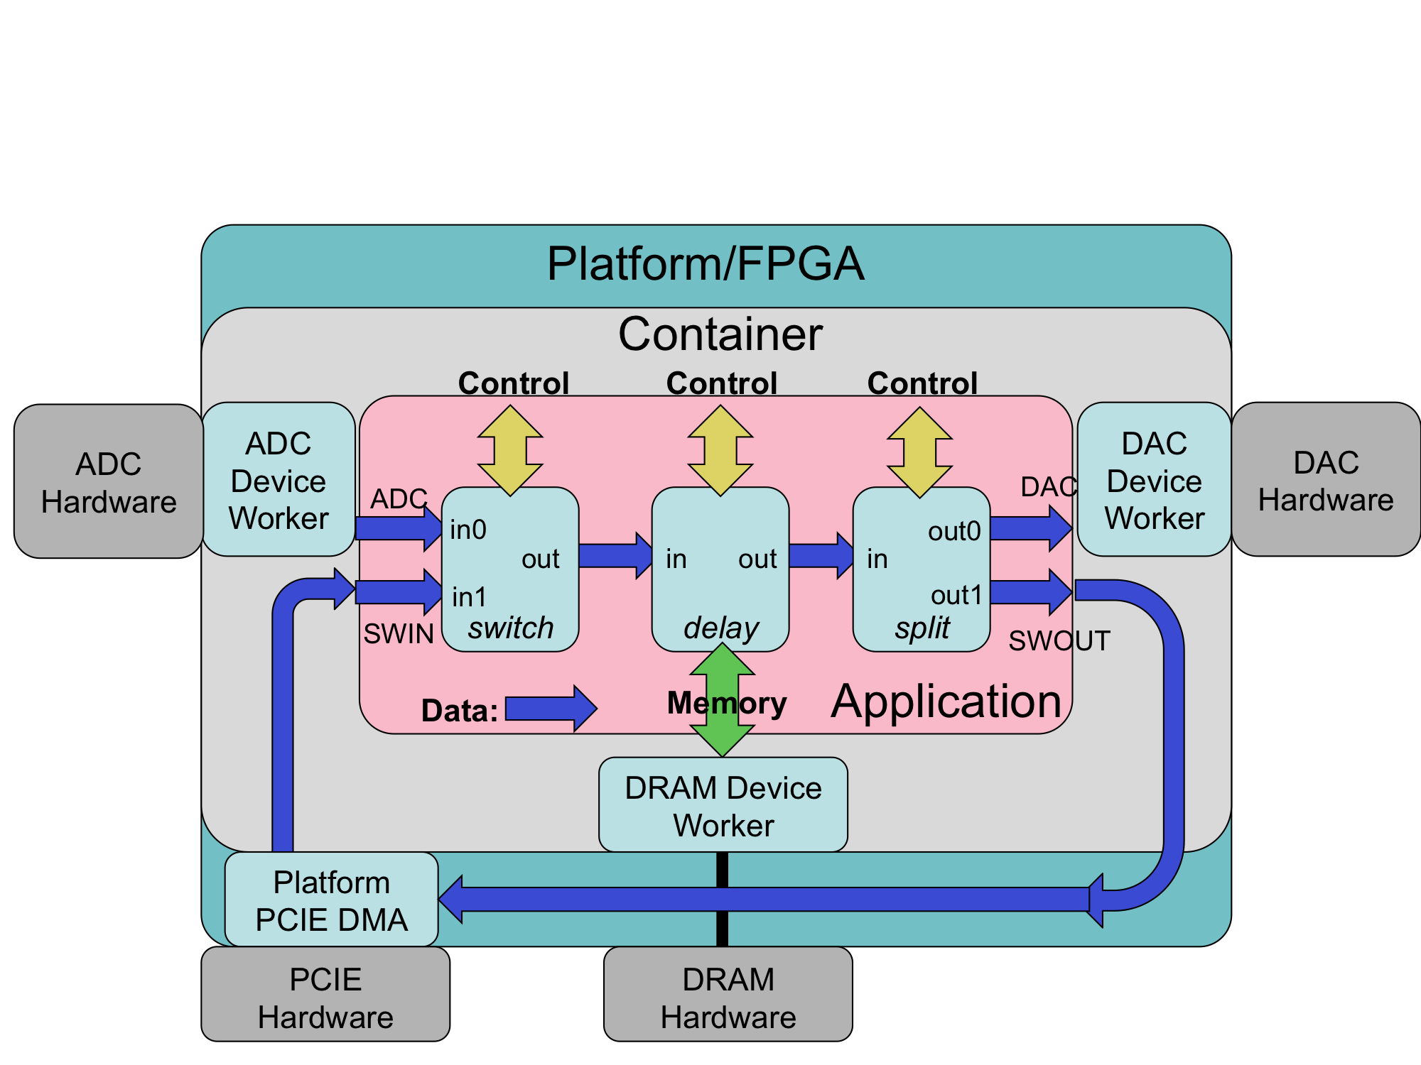
HDL Containers
Containers (optional top-level assembly XML attribute)
  Specifies a list of containers that should be built in addition to those indicated by DefaultContainers
  Does not suppress building default containers (must set DefaultContainers=)
  Used to add device workers to the container that are not part of the platform configuration

Slide 15
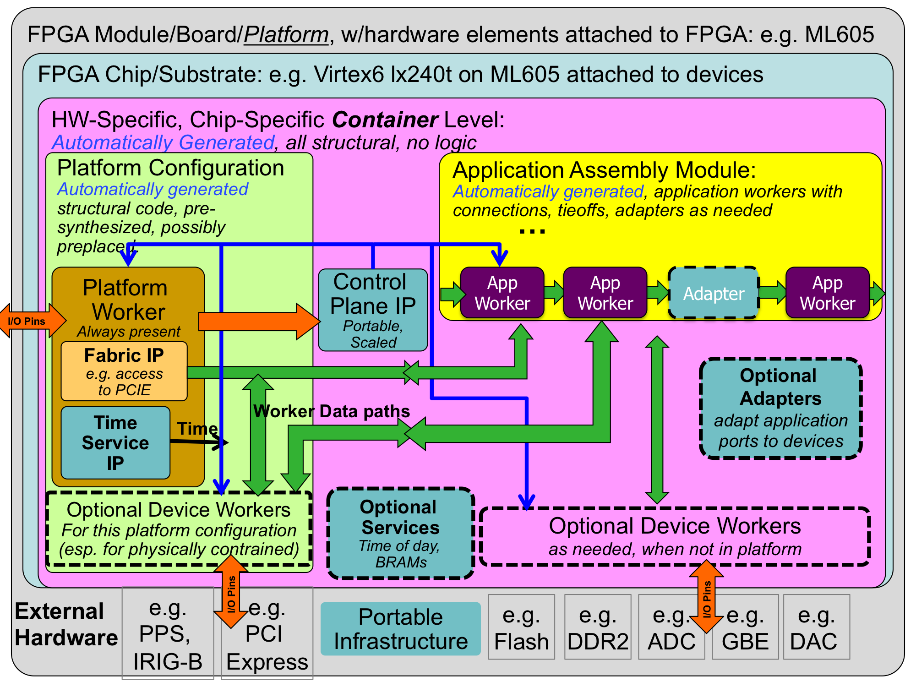
HDL Containers (cont.)

