Slide 1

OpenCPI - Open Component Portability Infrastructure
An Open Source Infrastructure for
Heterogeneous/Embedded Component-Based Systems and Applications
HDL Primitives

Slide 2
HDL Primitives
HDL primitives and primitive libraries are the preferred way in OpenCPI to store/present reusable HDL for use in multiple workers
Using HDL primitives in a worker or in another primitive requires mentioning them in the using primitive's XML or worker's OWD file with the Libraries or Cores attributes
May also be referenced in project and component library XML files with the HdlLibraries attribute to make them available to all HDL workers in the project/component library
Using HDL primitives is not required, but is recommended practice
  Alternatively, if used in a single worker, source could be added to the worker's directory and to the SourceFiles attribute in the worker's OWD
Must not have the same name as an HDL application worker

Slide 3
HDL Primitives (cont.)
HDL Primitive Library
  Collection of modules
  Built from HDL source code (ex: FIR, CIC, etc.)
HDL Primitive Core
  Single modules built from HDL source code or generated by vendor tools
    Vendor dependent (ex. Xilinx/Coregen or Vivado, Altera/MegaWizard)
  Prebuilt Cores from third party (.qxp/.edf/.ngc)
Primitives may depend on each other
  But circular dependencies are not supported
  Primitive libraries depend on primitive libraries
    When primitive libraries depend on each other, use the Libraries attribute in the “primitives.xml” file in the hdl/primitives directory
    When one primitive depends on another, use the top-level Libraries attribute in the primitive's XML file (e.g. “<myprimitive>.xml”)
  The ocpi.core project depends on primitive libraries

Slide 4
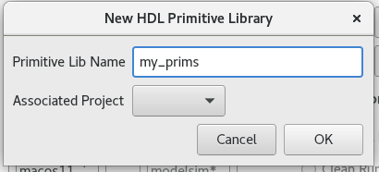
Creating HDL Primitive Libraries
With ocpidev:
ocpidev create hdl primitive library my_prims
With OpenCPI GUI:
Directory for the primitive library created at hdl/primitives/<my_prims>/
Libraries build in per-target directories named “target-<hdl-target>”
Library must include the VHDL file <libname>_pkg.vhd used for component declarations and unique type declarations
Can have multiple *_pkg.vhd files and separate package body *-body.vhd files

Slide 5
Creating HDL Primitive Libraries (cont.)
VHDL package name doesn't have to be the same as the library's name
Ex: Single package for a primitive library mylib
  library mylib; use mylib.mylib.all;
Ex: Multiple packages in the primitive library mylib; different package names
  library mylib; use mylib.mypkg.all;
SourceFiles attribute
  used to define build dependency order within a primitive library
  required when a multi-level directory structure is used within the primitive library
Log output of tools found in target-<hdl-target>/<libname>-<tool>.out
Exportable results for all primitive libraries & cores found in hdl/primitives/lib

Slide 6
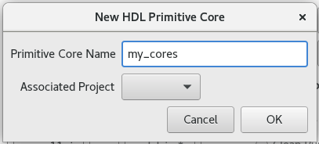
Creating HDL Primitive Cores
With ocpidev:
ocpidev create hdl primitive core my_cores
With OpenCPI GUI:
Directory for the primitive core created at hdl/primitives/<my_cores>/
Can be a mix of source and prebuilt files
  Pre-synthesized core files (Xilinx Vivado *.edf, Xilinx ISE *.ngc or Altera *.qxp)
VHDL instantiation must have a package file <corename>_pkg.vhd
Verilog instantiation must have a "black box" empty module definition file <corename>_bb.v
Optional XML attributes
  Top (ocpidev -M) - Specifies the top module name of core when different than ocpidev name <my_core>
  PreBuiltCore (ocpidev -B) - Specifies a file that is not source code

