Slide 1

OpenCPI - Open Component Portability Infrastructure
An Open Source Infrastructure for
Heterogeneous/Embedded Component-Based Systems and Applications
Component and Worker Development Overview

Slide 2
Component and Worker Development Overview: Topics
Acronyms
Component vs. Worker vs. Authoring Model
Example: Creating an OCS and OWD for a Boom Box
Control Plane & Worker LifeCycle
Properties (Configuration)
  Accessibility Rules, Common Attributes, Parameter Attribute, Types
Ports
Protocol
Application Worker Development Workflow

Slide 3
OpenCPI Acronyms
CDG – OpenCPI Component Development Guide
RDG – OpenCPI RCC Development Guide
HDG – OpenCPI HDL Development Guide
RCC – Resource-Constrained C/C++ Language (Authoring Model)
HDL – Hardware Description Language (Authoring Model)
OPS – OpenCPI Protocol Specification
OCS – OpenCPI Component Specification
OWD – OpenCPI Worker Description

Slide 4
Component vs. Worker vs. Authoring Model
Component
  Is a "Contract" or minimum set of requirements all Workers must respect
  Represents an abstract interface used to encompass functionality
  Specifies the ports and properties of a function (ex. FIR filter, CIC interpolator/decimator)
  Described in the OpenCPI Component Spec (OCS) XML or "Spec" file
Worker
  Specific implementation of a component, which must respect the "Contract"
  with source code written according to an authoring model
    MAY ADD capability to component (attributes of ports and properties) but MAY NOT REMOVE
  May ADD properties (i.e., unique to worker)
  Multiple workers may implement a single component
    Typically when targeting different technologies: GPP and FPGA
    Example: Component-a is implemented by workera1.rcc, workera2.rcc, workera1.hdl, workera2.hdl
  Described in the OpenCPI Worker Description (OWD) XML, Makefile and source code, and -build.xml
Authoring Model - "a way to write a Worker"
  Language used to implement a worker, directly related to target technology
  GPP ⇨ C or C++ ⇨ RCC workers (worker.rcc) and FPGA ⇨ VHDL ⇨ HDL workers (worker.hdl)

Slide 5
Example: Component
What is the function? Boom Box
What are the input and output ports? ant, speaker(s)
What are the properties? display, dial
OCS or "Spec" file ⇨ "boombox-spec.xml"
<ComponentSpec>
<Port Name="ant" Producer="false" Protocol="rx-prot"/>
<Port Name="speaker" Producer="true" Protocol="audio-prot"/>
<Property Name="display" Type="float" Volatile="true"/>
<Property Name="dial" Type="float" Writable="true"/>
</ComponentSpec>
ant
display
speaker
dial
speaker

Slide 6
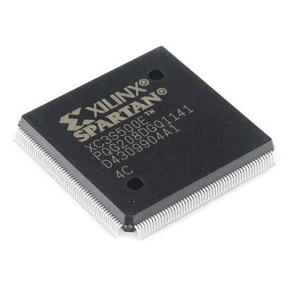
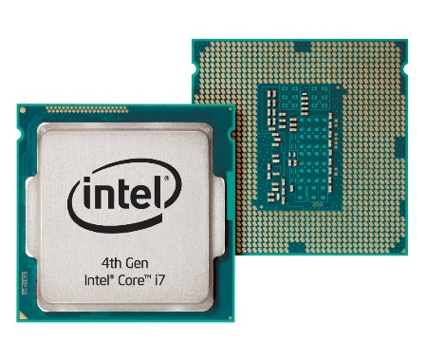
Example: Authoring Models
Suppose there are two different technologies for which the Boom Box will be implemented, one on a GPP and the other on an FPGA
Worker is created for a specific technology or Authoring Model
  .hdl, .rcc
RCC
HDL

Slide 7
Example Boombox: Worker 1
Worker 1 targets a technology that supports a "next" channel scan feature. This capability will require a new property to be added to this worker, in addition to OCS's properties.
ant
RCC
display
speaker
dial
speaker
next

Slide 8
Example Boombox: Worker 2
Worker 2's target technology is different from Worker 1. Its technology requires defining physical data widths on the ports. It supports unique properties: channel indicator, "chan_ind", an LED indicating to the user that the "dial" is on a clear channel.
ant
HDL
display
speaker
dial
speaker
chan_ind

Slide 9

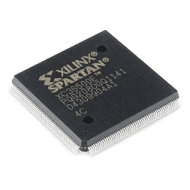
Example: Workers
Described by their OpenCPI Worker Description (OWD) XML and source code
For GPP, RCC Worker
  …/worker.rcc/worker.xml:
  <RccWorker language="c++" spec=boombox-spec>
    <Property Name="next" Type="Boolean"
    Writable="true"/>
  </RccWorker>
For FPGA, HDL Worker
  …/worker.hdl/worker.xml:
  <HdlWorker language="vhdl" spec=boombox-spec>
    <StreamInterface Name="ant" DataWidth=32 />
    <StreamInterface Name="speaker" DataWidth=16 />
    <Property Name="chan_ind" Type="Boolean" Volatile="true"/>
  </HdlWorker>
specs/boombox-spec.xml:
<ComponentSpec>
<Port Name="ant" Producer="false" Protocol="rx-prot"/>
<Port Name="speaker" Producer="true" Protocol="audio-prot"/>
<Property Name="display" Type="float" Volatile="true"/>
<Property Name="dial" Type="float" Writable="true"/>
</ComponentSpec>

Slide 10
More on Authoring Models
Since there's no one language, or API, to target all processing technologies:
  Define a set of authoring models that achieve native efficiency with sufficient commonality to allow:
    Efficient use of target processors development language: C++ for GPP, VHDL for FPGA
    Replace component's authoring model within an application without negative impact
    Combine workers into application using multiplicity of authoring models/processing technologies
Specifies how a worker is written, built and packaged for execution in an application
  RCC: Execute on GPPs (General Purpose Processors), written in C or C++ (focus)
  HDL: Execute on FPGAs (Field-Programmable Gate Array), written in VHDL (focus)
    Currently, VHDL is the only supported HDL worker authoring language (limited support for Verilog)
    Primitives may be written in either VHDL or Verilog

Slide 11
Control Plane: Introduction
Control software launches and controls the workers at run-time in an application. It can be the trivial "ocpirun" utility, or a full-fledged Python or C++ application using the Application Control Interface (ACI)
Control software sees a uniform view of how to control workers; each authoring model defines how this is accomplished from the point of view of the worker itself by defining two key aspects of control:
  LifeCycle Control
    Fixed set of control operations available to every worker
  Configuration Property Access
    Logically, the knobs and meters of the worker's "control panel"
Control Plane encompasses how the control software can access lifecycle control and configuration property access of workers at run-time in an application

Slide 12
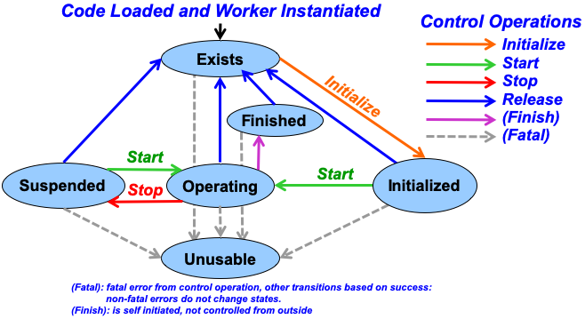
Control Plane: LifeCycle Control
LifeCycle Control
  Standardized for all authoring models and mostly managed by the framework
  Defined by the LifeCycle State Machine
    Control States (circles)
    Control Operations (arrows)
    Operations have default implementations,
    but Worker can customize behavior
…/worker1.rcc/worker1.xml:
<RccWorker language="c++" spec=boombox-spec
controlOperations="initialize,release">
<Property Name="next" Type="Boolean"/>
</RccWorker>

Slide 13
Control Plane: Configuration Properties
Enable controlling and monitoring of workers
  Memory Map registers
Specified in OCS and OWD <Property Name="next" Type="Boolean"/>
  OCS properties available to all of its implementations (workers)
  OCS properties may be augmented in OWD (<SpecProperty>)
Defined by Data Type and Read/Write Accessibility

Slide 14
Configuration Property: Accessibility Rules
Accessibility is from the perspective of the control software
Parameter
  Designates property to be specific to build/compile-time (constant)
  Value is set in the OCS or OWD
Initial or Writable, but NOT both
  Initial property values set upon initialization of the application, not run-time
  Writable property values settable at run-time
Volatile
  Value(s) of property is updated by "user code" within worker, after the application starts
  Implies the framework CANNOT cache values
    By default, all values are cached unless explicitly volatile
  May not be set with parameter
OWD may ADD accessibility to OCS property
  Cannot "unset" an OCS flag to make inherited properties less accessible
  Use <SpecProperty> in the OWD to "add-to" an OCS property's configuration

Slide 15
Configuration Properties: Common Attributes
Commonly used attributes across many XMLs:
  Name – case insensitive name of element
  Type – data type of element
  Default
    specify default value according to Type attribute
    assignment is ONLY allowed with Initial or Writable
  Value
    Using this attribute states that the value is fixed and may not be change at all
    For Parameters ONLY, this attribute may be used instead of default
  Accessibility (Only OCS or OWD)
    (None) – (special edge case; do not use)
    Parameter - two use cases: convenience variable within XML, build/compile-time constant value
    Initial – set an initial value prior to worker entering operating state, and never again
    Writable – can be written from the control software
    Volatile – changeable by worker
    Readable – (special HDL-only edge case; do not use)
  All properties can be read by the application. Note: Even if Readable is set to false

Slide 16
Configuration Properties: Parameter Attribute
TWO use cases:
  "Convenience variable" for defining build-time constants in other property attributes like StringLength, SequenceLength, ArrayDimensions or default
    Supported in both OCS and OWD
    <Property Name="myProp1" Default="16" Parameter="true"/>
    <Property Name="myProp2" Type="short" SequenceLength="myProp1*2-1"/>
  Build-time constants to create different configurations of same worker with trade-off performance and resource use
    C++ ⇨ static const and VHDL ⇨ generic
    At run-time, control software matches OAS with pre-built artifacts
Parameter attribute is not allowed for properties declared as Writable

Slide 17
Configuration Properties: Types (Scalar)
Default type is uLong
Unsigned types: uChar, uShort, uLong, uLongLong
Signed type: short, long, longLong
char
  Unit of a string
  Signed decimal value [-128, 127]
  unsigned decimal value [0, 255]
float, double, bool
String
  Use StringLength to specify max length of string excluding null termination
Enum
  Use Enums to specify a comma-separated list of strings

Slide 18
Configuration Properties: Types (Structure)
Struct
  Use Member elements to specify Name and Type
Sequences and Arrays
  Use SequenceLength or ArrayDimensions to define a type that is a Sequence or Array (Standard or Multidimensional)

Slide 19
Configuration Properties: Types
Scalars
  Unit length of 1
Sequences
  Variable length
  <SequenceLength> defines the maximum length of a Sequence (ex: user input)
Arrays
  Fixed length
  <ArrayDimensions> defines the fixed-length of an Array (ex: filter taps in a FIR filter)
CAN: have a Sequence of Arrays
CANNOT: have an Array of Sequences or Sequence of Sequences
For an Array of Arrays, use <ArrayDimensions> to infer multidimensionals

Slide 20
Configuration Properties: Examples
Scalar Example
  <Property Name="myScalar" Type="short"/>
  myScalar is a scalar of 1 signed 16-bit value
Sequence Example
  <Property Name="mySequence" Type="uLong" SequenceLength="64"/>
  mySequence is a sequence from 0 to 64 unsigned 32-bit values
Array Example
  <Property Name="myArray" Type="longLong" ArrayDimensions="32"/>
  myArray is an array of 32 signed 64-bit values; never more nor less
Array of Array Example
  <Property Name="myArrayOArrays" ArrayDimensions="16, 32, 64" Type="short"/>
  myArrayOArrays is three arrays, containing arrays of lengths 16, 32, and 64, containing signed 16-bit values, for a total of 16+32+64=112 16-bit values

Slide 21
Configuration Properties: Use Cases
Attribute Flag Combinations | Behavior
Volatile | Application can read value which the worker is allowed to update at any time
Parameter | Application can read constant value which the worker sets at build time
Writable | Application can write value any time and the last value written can be read back
Initial | Application can write value only during initialization and the value written can be read back
Initial + Volatile | Application can write value only during initialization Application can read value which the worker is allowed to update at any time
Writable + Volatile | Application can write value any time Application can read value which the worker is allowed to update at any time
Readable | Application can read value which the worker is only allowed to update during initialization Read-back value will be constant after initialization

Slide 22
Port
Input or output data interfaces of a component
  Uniquely named
  Unidirectional (Consumer or Producer)
  With or without a protocol (DISCUSSED ON NEXT SLIDE)
Port is an element of the OCS that has several attributes:
  Name
    Must be unique, case insensitive and valid across different languages
  Producer
    Unidirectional (Consumer or Producer)
    Consumer: (default) Producer attribute is "false" or not defined
    Producer: Producer attribute is "true"
  Protocol (Permissive or declares protocol)
    Permissive when protocol is not assigned, i.e. accepts any protocol! (e.g., file_write.rcc/.hdl)
      256 operations (opcodes) or message types
      Messages are of unbounded size, up to 64KB
      Messages may be of zero-Length
      Granularity of messages is a single byte
    Value of the attribute is the name of the protocol XML (.xml suffix is assumed if not present)
  Optional
    Indicates that Port may be left unconnected in an application
specs/boombox-spec.xml:
<ComponentSpec>
<Port Name="ant" Producer="false" Protocol="rx-prot"/>
<Port Name="speaker" Producer="true" Protocol="audio-prot"/>
<Property Name="display" Type="float" Volatile="true"/>
<Property Name="dial" Type="float" Writable="true"/>
</ComponentSpec>

Slide 23
Protocol
Set of messages that may flow between ports of components
  "shared" data path (multiplexing of messages)
Messages are specified by:
  Operation Code: message type encapsulating zero or more Operation Arguments
  Operation Argument: payload data of the Operation Code
Ports connected between components MUST:
  have matching protocols OR
  be Permissive (worker must "know" structure of data within message)
Described by one or more OpenCPI Protocol Specification (OPS) XML files
  With *-prot.xml suffix. (Deprecated: *_prot.xml, *-protocol.xml, and *_protocol.xml)

Slide 24
Protocol: OPS XML
Protocol – define top-level attributes
  Used to override value inferred by the operations,
  or in the absence of operations
  NumberofOpcodes, DataValueWidth, DataValueGranularity, ZeroLengthMessages, MaxMessageValues,etc.
Operation – message type or "Opcode"
Argument – data field in a message payload for the given operation
  Same attributes as configuration property: Name, Type, ulong, SequenceLength, etc.
  If not defined for an operation, its messages have no data fields, i.e., zero-length message
Member
  ONLY used when Argument is of type Struct
  Define the Name and Type of each Member
../specs/audio-prot.xml:
<Protocol>
<Operation Name="freq">
<Argument Name="high_low" type="struct" SequenceLength="2048"/>
<Member Name="high" type="short"/>
<Member Name="low" type="short"/>
</Argument>
</Operation>
</Protocol>

Slide 25
Protocol: Example
Example of a protocol available within OpenCPI:
<ocpi-install-path>/projects/core/specs/TimeStamped_IQ-prot.xml
<Protocol>
<Operation name="samples" >
<Argument name="iq" type="Struct" SequenceLength="4092">
<Member name="I" type="Short"/>
<Member name="Q" type="Short"/>
</Argument>
</Operation>
<Operation name="time">
<Argument name="sec" type="ulong"/>
<Argument name="fract_sec" type="ulong"/>
</Operation>
<Operation name="interval">
<Argument name="delta_time" type="ulonglong"/>
</Operation>
<Operation name="flush"/>
<Operation name="sync"/>
<Operation name="done" />
</Protocol>

Slide 26
App Worker Development Flow
OPS: Use pre-existing or create new
OCS: Use pre-existing or create new
Create new application worker (Modify OWD and source HDL/RCC code)
Build the application worker for the target device(s)
Create unit test (<component>-test.xml, generate, verify and view scripts)
Build unit test
Run unit test

