Slide 1

OpenCPI - Open Component Portability Infrastructure
An Open Source Framework for
Heterogeneous/Embedded Component-Based Systems and Applications
Introduction to OpenCPI

Slide 2
Introduction to OpenCPI
Definition, Positioning, Priorities, Background
Component Concepts and Terminology
Application Concepts and Terminology

Slide 3

Open-Source Component Portability Infrastructure
is a development and runtime framework embracing:
Open Source Software and Gateware
Component-Based Development (CBD)
Heterogeneous Embedded Computing

Slide 4
Component-Based Embedded Systems & Applications
Distributed and/or Embedded System: w/Diverse Technologies
Processor/Node W
Processor/Node X
GPS
App #1
I/O
Component1
Component2
GBE
Component6
Component3
I/O
GPP/x86
Component5
Interconnect/Bus/Network
e.g. PCI
Express
GPP/ARM
e.g. ARM/AXI
I/B/N
App #2
Processor/Node Z
Processor/Node Y
Component7
ADC
DVI
I/O
Component4
Component8
I/O
FPGA
GPU

Slide 5
What is OpenCPI?
A framework and methodology for:
  Component-based Development
  Mixing processor types (GPP, FPGA, GPU, DSP, Many-Core, etc.)
  Diverse interconnect technologies (PCIe, AXI, Ethernet, Aurora)
  Targeting embedded systems and applications
Treating FPGA and GPU (etc.) development as a peer of Software
  At the component level, not wrapped in software
Close to hardware, with drivers (in the FPGA) that touch hardware
  Analogous to Linux, with its hardware drivers and vendor/hardware independence
  Providing the OS-like infrastructure on FPGAs, some drivers for Linux (SW)
  Uses FPGA vendor tools and simulators
OpenCPI sits below modeling tools and IDEs, it requires neither
Cooperating/layered with a variety of other middlewares
  ZMQ, CORBA, DDS

Slide 6
What does OpenCPI consist of?
The kit is in a public open source repository on gitlab.com
For runtime: i.e. executing components and moving data among them
  Runtime libraries (software and FPGA IP) and command line utilities
  "Drivers" (FPGA and SW) for diverse platforms, devices, interconnects
  Portable, vendor-independent infrastructure (DMA, IO, Control, Timing)
For development time: i.e. developing components and applications
  Tools and Scripts (command line)
    A common development workflow for FPGA and SW and GPU components
  Specifications and Documentation
  Examples and Tests
  Optional GUI "proto-IDE"

Slide 7

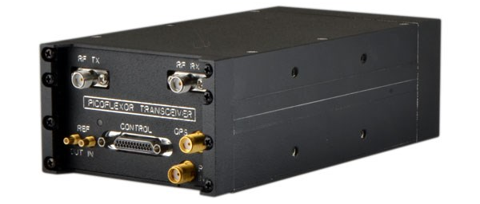
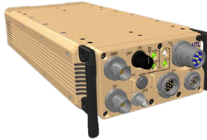
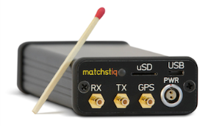
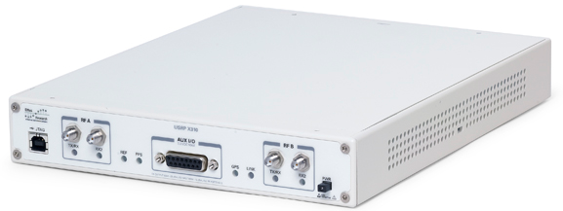
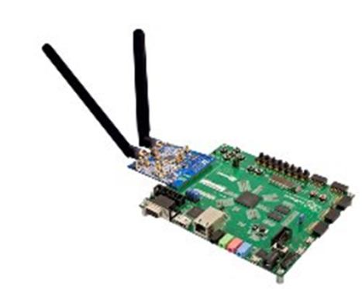
OpenCPI Targets Embedded Systems
Heterogeneous processing, mixing SW, FPGA, GPU etc.
Commonly used for software radios, but not always
External
Interface
Ethernet
USB
WiFi
BlueTooth
GPP
CTRL
RF Chain
Reconfigurable
Tactical Radios
Processor
- Intel x86
- ARM
- Power PC
- OMAP
OS
eLinux
Integrity
RTOS
Radio
Transceiver
D/A
A/D
CTRL
XPORT1
FPGA
Transports / Buses
PCI/PCIe
AXI
Aurora
Ad-Hoc
Altera
- Stratix
- Arria
- Cyclone
Xilinx
- Virtex
- Spartan
- Zynq
Commercial
SDRs
Clock, Crypto,
Timing, …
Development
Platforms

Slide 8
OpenCPI Concept of Development
Components developed in different languages (C++, VHDL)
Easily deployed to different processors in the system
TX
RX
DSP library
Comms library
Util library
GPP
RF Chain
CTRL
OpenCPI
D/A
A/D
CTRL
OpenCPI
OpenCPI
FPGA
Portable, reusable components are developed in VHDL/C++ independent of intended application or target platform | Using IDE, applications are constructed from existing libraries and built | Application deploys to target platform with components executing on disparate parts of platform
Clock, Timing, …
Portable, reusable components are developed in VHDL/C++ independent of intended application or target system
Applications are constructed from existing libraries and built
(Using GUI or XML)
Application deploys to target platform with components executing on disparate parts of the system

Slide 9
Why is OpenCPI needed?
Especially in embedded systems, diversity is everywhere.
  Meeting SWAP constraints requires diversity in the system solution.
  Changes in technology or mission require diversity over time.
To Support Diversity/Heterogeneity of:
  Processing: GPP/Multicore, GPU, FPGA, DSP, many-core
    Separate chips or SoCs (OMAP, Zynq, Arria), different vendors/architectures
  Interconnects: 1/10GE, PCIe, SRIO, point-to-point, Infiniband, AXI…
    And on-chip between collocated components
    And external connections to required middleware: DDS, CORBA, ZMQ
  Scale: Multicore SoC up to distributed or in-the-box clusters.
    Allow embedded/tactical configurations that also work scaled up.
  Devices: RF Transceivers, GPS, Memory, etc.
    Many systems share the same underlying components, using same drivers
Vendors promote their uniqueness, aspire to lock-in:
  They make things different that don’t have to be

Slide 10
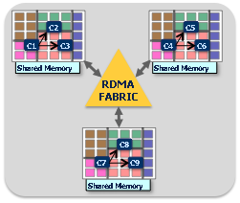
Interconnect Diversity
Many technologies available and needed
  usually with different programming abstractions and APIs
Intra-Chip/On-Chip
Multi-core/FPGA/GPU/DSP
Inter-Chip/Board/In-Box
Fabric/Bus/Backplane
Inter-Box/Clusters
Network (IP/TCP/UDP)
C2
C2
C5
C1
C3
C4
C6
C1
C3
Shared Memory
Shared Memory
Net/
Cloud
(R)DMA
BUS/FABRIC
Shared Memory
C8
C7
C9
Shared Memory
Grid/Cluster/Distributed
Processing
Multicore Processing
Multi-node Processing
OpenCPI Focus is Mostly Here, but Distributed Networking is Supported

Slide 11
OpenCPI alleviates and attacks diversity
Commonality at a reasonable price
  Careful, vendor and technology-neutral choices
  Don’t reinvent how algorithmic code is written (i.e. no new languages)
  Suppress diversity without significant performance or resource tax
  Common workflow, methodology, interfaces, reduces learning
Open source is key:
  Industry, products, tools are in silos, even when open-source
  Community and openness is necessary to cross all the boundaries
OpenCPI addresses this diversity as its primary focus:
  Paying attention to embedded efficiency requirements
  Crossing boundaries not addressed by other approaches
  Common component-based design & runtime across the boundaries
  Reduce unnecessary differences for design, development, training

Slide 12
Where did OpenCPI come from?
It evolved via a succession of IR&D and DoD funded projects
Core motivation was: apply CBD to real embedded applications
Various application areas were assessed and needs addressed
Many lessons learned, many boundaries crossed
2000-2002 Mercury Computer IR&D for Broadcast Video/Medical
2002-2007 DARPA Polymorphous Computing Architecture program
2004-2005 JTRS Program Office: SDR/SCA for DSP & FPGA
2007-2009 AF HDR-RF SATCOM Modem (w/Raytheon)
2008-2010 JEIDDO/I2WD JCREW S&T (Counter-IED)
2009-2010 AFRL/DDR&E Transition To Open Course
2010-2015 AFRL/DDR&E Software Producibility Initiative
2012- DoD Embedded Platform Framework (various)

Slide 13
Where OpenCPI comes from
Heterogeneous
Computing
Challenges
Component-based
Application
Model
Open-Source/
Acquisition
Issues
Wideband
Datalink
Requirements
OpenCPI
DoD Open Systems,
SDR mandates
DARPA
PCA Program
JTRS JPO-funded
Study/specification

Slide 14
Where OpenCPI can be applied:
Application areas using embedded technologies to meet performance and SWAP requirements
Characterized by rapid change and/or component-level re-use
Tech refresh demands tech changes
Wideband
Comms
EW/CIED
OpenCPI
SIGINT
Net-centric
ISR
Software
Radio

Slide 15
Positioning and Priorities
OpenCPI is a development framework that cuts across technologies and vendors, providing "insulation" from diversity
  GPP, FPGA, GPU etc.
  Xilinx, Intel/Altera, Mentor, etc.
  Nvidia, AMD/ATI, Intel, etc.
  ADI, Lime, other ADC/DAC/ GPS devices
High priorities:
  reduce vendor-specific training, tools, methods
  extreme openness – access to all source code
    rarely get stuck unable to fix a problem or hire your own expert
    move the "openness" frontier closer to hardware
    don't preclude proprietary modules when they are indeed modular
  facilitate change: reduce time and effort to move embedded apps
    changing processing technologies, and devices
    changing vendors
    changing algorithms
    changing configurations
    changing systems and platforms

Slide 16
Introduction to OpenCPI
Definition, Positioning, Priorities, Background
Component Concepts and Terminology
Application Concepts and Terminology

Slide 17
Component Model: What's a component?
Name/function: What does it do? e.g. “encrypt”
Properties: How is it controlled/configured?
  What are the switches, knobs, meters, parameters?
Ports: How does it communicate its input and output data?
  With protocols that say what messages come in or go out
Execution Model:
  Autonomous, simplified "actor" model, inherently concurrent, interacting with others via messages at connected ports
Configuration Properties
Set prior to, and maybe during, execution. Maybe examined during execution.
Data-consuming ports:
Receives messages
of a protocol
Component
Data-producing ports:
Transmits messages
of a protocol

Slide 18
Communication Model: What's a protocol?
A component port usually has an associated protocol.
An OpenCPI protocol is simply a set of defined messages.
  Many "protocols" are a single type of message
  Many messages are simply a fixed or variable length array of scalars
  Messages can be zero length (an event with no associated data)
  Messages are defined with data fields of various types
Each port specifies what protocol (what messages) it supports.
  Connections between component ports are valid if the protocols match
Configuration Properties
Set prior to, and maybe during, execution. Maybe examined during execution.
Data-consuming ports:
Receives messages
of a protocol
Component
A data-producing port:
Transmits messages
of a protocol

Slide 19
Control Model: Lifecycle and Properties
Components are managed through a standard “lifecycle”
  Initialize, start, stop, shutdown, etc.
Properties are the "knobs and meters" of a component
  Some are for "initial configuration"
  Some are for "dynamic control"
  Some are for feedback (e.g. a peak meter)
Configuration Properties
Set prior to, and maybe during, execution. Maybe examined during execution.
Data-consuming ports:
Receives messages
of a protocol
Component
A data-producing port:
Transmits messages
of a protocol

Slide 20
Component Specifications vs. Implementations
Components are defined functionality
  E.g. data compression, signal processing, etc.
  With properties and ports (with protocols)
  Specified in a small XML document – a component spec
    that may refer to protocol specs common to different components' ports
A component can have many implementations: workers
  Written in different languages to OpenCPI-defined APIs
  Compiled/synthesized for different targets (CPUs, FPGAs etc.)
  All meet the same component spec, perform the same function
  Perhaps using different algorithms to do the same job differently
Data-consuming ports:
Receives messages
of a protocol
Component
A data-producing port:
Transmits messages
of a protocol

Slide 21
Authoring Models: How to Write Workers
A component can be implemented by different workers
Worker source code is written for an authoring model
An Authoring Model:
  Defines one of several alternative ways to write a worker
    Usually for languages well suited for some processing technology
  It defines the interfaces (APIs) for control and communication (data)
  It must fit well with:
    How practitioners actually write code for some technology
    Tools/compilers that enable effective use of the technology
    Simple enough for technology-appropriate implementations
  Must coexist and interoperate with workers from other models
  Must efficiently interact with collocated similar workers
OpenCPI has authoring models for GPP, FPGA, GPU, DSP

Slide 22
Authoring Models: The Pattern for Each One
Define interfaces (APIs) and behavior for three aspects:
Control and Configuration Property Interface
e.g. start/stop/configure
Control
Plane
Input Ports:
Messages/data from other components
Output Ports:
Messages/data from this component
Worker
Data
Plane
…
…
Requests from component for local services
(e.g. Time-Of-Day, storage, etc.)
(services are somewhat different for each model)
Local
Services

Slide 23
Implementing Components
Workers (component implementations) are written:
  Implementing a component specification
  Using an authoring model
  In a language defined for that authoring model
  Compiled for some target processors and environments
Source Code
Target
e.g. virtex6
Worker
Authoring
Model
e.g. big+fast
Target
e.g. stratix4
Language
e.g. "HDL"
e.g. VHDL
Worker
Target
e.g. zynq FPGA
Component
e.g. small+slow
…
e.g. encrypt
Target
e.g. Softcore
Language
Worker
Target
e.g. Zynq linux
Authoring
Model
e.g. C
e.g. microctlrs
Language
Worker
Target
e.g. MacOSX
e.g. "RCC"
e.g. C++

Slide 24
OpenCPI Terms for Components
Component: building blocks for applications
  Defined in XML as a “spec” for (alternative) implementations
Property: component configuration and control
  Defined as part of component “spec”, usable at runtime
Port: component interfaces to talk to others
  Defined as part of component “spec” to send/receive messages
Protocol: the set of supported messages at a port
  Defined in XML and associated with component ports
Authoring Model: one of several ways to write worker code
  For different technologies, in different languages, different APIs
Worker: one of several implementations of a component
  Defined in XML and associated with a component, plus source code

Slide 25
Introduction to OpenCPI
Definition, Positioning, Priorities, Background
Component Concepts and Terminology
Application Concepts and Terminology

Slide 26
What's an OpenCPI Application?
An interconnected set of components, called an assembly
Each component in the assembly indicates that, at runtime,
  Some implementation (worker binary) must be found for this component
  A executing runtime-instance must be created from that binary
Each component can be assigned initial property values
Some ports are identified as external ports of the assembly
  Suggestive of, but not a true hierarchy
  Can be bound to files or other I/O devices when the application is run
Image Processing Assembly
inX
Sobel X
Component
Canny Component
contrast=5
out
inY
Sobel Y
Component

Slide 27
OpenCPI Terms for Defining Applications
How We Define Applications
Assembly: a set of components with interconnected ports
  Defined in XML (possibly program-generated) and used to launch applications
Property Values: the initial set of values set at startup
  Associated with the components in the assembly
External Ports: the component ports for external I/O
  Indicated in the assembly for specific component ports
  Allows these to be bound externally to other sources/sinks of data

Slide 28
How do we run an application?
For each component in the assembly, the system:
  Finds a binary artifact containing an implementation (compiled worker)
  Finds a runtime environment (container) where the worker can run
Artifacts (compiled binaries) are found in (heterogeneous) libraries.
  Artifacts are loaded on demand into the containers to run the assembly
Execution requires: assembly + artifact libraries + containers
Image Processing Assembly
Application Running on a System
Sobel X
Component
Processor/Node X
Container A
Canny Component
Sobel X
Worker
Processor/Node Z
Sobel Y
Component
GPU#1
Container C
+
Canny
Worker
PCI Express:
A Component Library
Processor/Node Y
Container B
GPP/x86
Sobel for
Nvidia GPU
Canny for
64-bit x86
Linux
Sobel Y
Worker
Sobel for
Virtex6 FPGA
FPGA#1

Slide 29
OpenCPI Terms for Executing Applications
Artifact: compiled binary package of one or more workers
  Result of building/compiling some workers (source code)
  Includes embedded metadata needed for runtime discovery
  Physical unit that can be patched, updated, emailed, like a DLL/so.
Artifact Library: collections of artifacts for runtime
  Typical "library" concept
  Runtime has a typical "library path" to find artifacts from libraries
Container: the execution environment for workers
  Managing the execution of workers on a processor
  Arranging control and data communications with other containers
  Typically on a "target processing node"

Slide 30
Component-Based Embedded Systems & Applications
Distributed/Embedded System: w/Diverse Technologies
Processor/Node W
Processor/Node X
Container C
GPS
Container A
App #1
I/O
Component1
Component2
GBE
Component6
Component3
I/O
GPP/x86
Container B
Component5
Interconnect/Bus/Network
PCI
Express
GPP/ARM
ARM/ACP
I/B/N
App #2
Processor/Node Z
Container C
Processor/Node Y
Component7
ADC
Container C
DVI
I/O
Component4
Component8
I/O
FPGA
GPU

Slide 31
FPGA Developers: How Can FPGAs Work This Way?
FPGA "processors" are not so dynamic
OpenCPI is not inventing on-the-fly constructed FPGA bit files
  Although this does work for simulators
OpenCPI is not relying on "partial reconfiguration"
  Although it is a natural fit for this model, and on the roadmap
OpenCPI artifacts for FPGAs are:
  Pre-constructed subassemblies
    A set of connected workers with external ports
    Some DSPs have similar statically linked configurations
So, if an FPGA artifact can implement a subset of the application, then that artifact can be used on an FPGA
  Artifacts contain embedded metadata describing what is there
OpenCPI does exploit dynamic/rapid (re)loading of FPGAs

Slide 32
Component-Based Embedded Systems & Applications
Distributed/Embedded System: w/Diverse Technologies
Processor/Node W
Processor/Node X
Container C
GPS
Container A
I/O
GBE
Component6
I/O
App #2
GPP/x86
Container B
Component5
Interconnect/Bus/Network
PCI
Express
GPP/ARN
ARM/ACP
I/B/N
Processor/Node Z
Container C
preconstructed
and available in
an artifact library
Container C
Processor/Node Y
Component7
ADC
Container C
DVI
I/O
Component4
Component8
I/O
FPGA
FPGA

Slide 33
Open-Source Component Portability Infrastructure
is a development and runtime framework embracing:
Open Source Software and Gateware
Component-Based Development (CBD)
Heterogeneous Embedded Computing

