Slide 1

OpenCPI - Open Component Portability Infrastructure
An Open Source Infrastructure for
Heterogeneous/Embedded Component-Based Systems and Applications
[Briefing Title]

Slide 2
OpenCPI Concepts: Overview
Building Blocks Terminology
Organizational Terminology
Who Can Develop with OpenCPI?

Slide 3
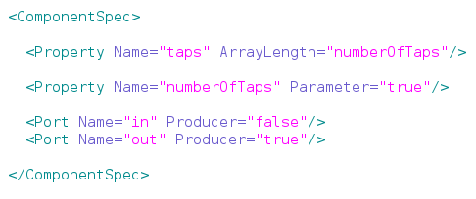
Building Blocks Terminology: Component
Term: Component
Definition: A specific function with which to compose applications and a "contract" for workers
Described by: OpenCPI Component Specification XML (OCS)
Example: FIR Filter
Features of Components Property – run time attribute used to control the component's operation Variable in C/C++, Register in VHDL Parameter – build time property used to control the way the component is built static const in C/C++, generic in VHDL Port – an interface used to communicate with other components | Example

Slide 4
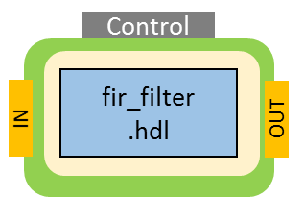
Building Blocks Terminology: Worker
Term: Worker
Definition: A concrete implementation of a component
Described by: OpenCPI Worker Description XML (OWD), Makefile, build file, source code
Example: fir_filter.rcc, fir_filter.hdl
Features of Workers Stored in directory indicating authoring model of worker <worker>.rcc for C/C++, <worker>.hdl for VHDL Worker files Makefile – Includes information for building worker Worker description XML – May contain additional properties & port information to expand or refine OCS -build.xml file – Declares worker build configurations (optional / future) Source code | Example One OCS ⇨ Two Workers fir_filter.hdl fir_filter.rcc

Slide 5
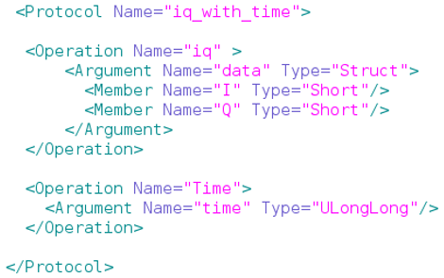
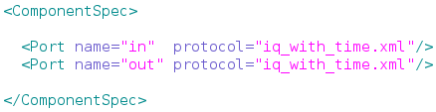
Building Blocks Terminology: Protocol
Term: Protocol
Definition: Description of the set of messages that may flow between the ports of components
Described by: Protocol Specification XML
Example: iq_with_time-prot.xml
Features of Protocols The protocol is specified in the Port element of an OCS Example Port Description | Example Protocol Specification XML
iq_with_time

Slide 6
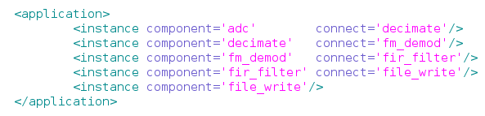
Building Blocks Terminology: Application
Term: Application
Definition: Heterogeneous group of connected OpenCPI components
Described by: Application Specification XML ("App XML")
Example: FSK Demodulator
Features of Applications: There can be multiple applications per OpenCPI Project XML-only applications do not need to be built
Application
Application Specification XML
file_write
fir_filter
fm_demod
decimate
adc

Slide 7
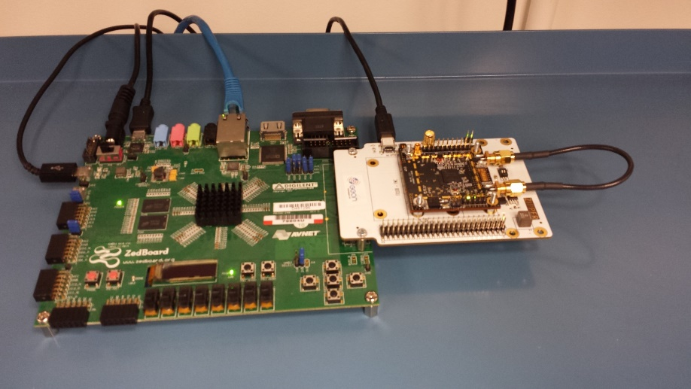
Building Blocks Terminology: Platform
Term: Platform
Definition: Physical "motherboard" housing one or more interconnected processors and associated I/O devices
Example: ZedBoard with Myriad-RF 1/Zipper daughtercards
GPP
Zynq 7020
ARM
FPGA
Zynq 7020 Programmable Logic
XCVR
Lime Micro LMS6002

Slide 8
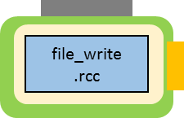
Building Blocks Terminology: Container
Term: Container
Definition: the OpenCPI execution environment on some platform that will execute workers (i.e., where they execute)
Description:
In HDL, the container is the complete design for an entire FPGA, including workers and infrastructure. Described by XML. Typically built inside of HDL assembly directories.
In RCC, the container loads, executes, controls, and moves data to/from RCC workers.
GPP
FPGA
XCVR
HDL Container
RCC Container

Slide 9
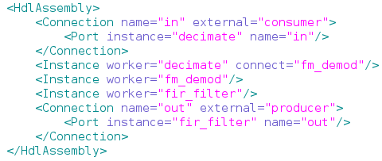
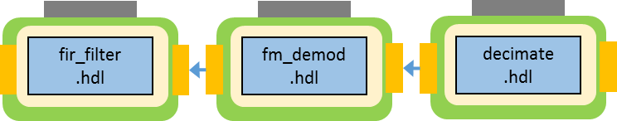
Building Blocks Terminology: HDL Assembly
Term: HDL Assembly
Definition: A fixed composition of HDL workers that can act as subset of a heterogeneous OpenCPI application
Described by:
HDL Assembly Description XML (OHAD)
NO VHDL
GPP
FPGA
XCVR
RCC Container
HDL Container
HDL Assembly

Slide 10
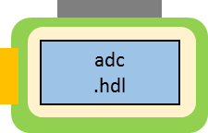
Building Blocks Terminology: Device Worker
Term: Device Worker
Definition: Specific type of HDL worker connected to I/O devices external to the FPGA
GPP
FPGA
XCVR
HDL Container
RCC Container
Device
Worker
HDL Assembly

Slide 11
Building Blocks Terminology: HDL Platform
Term: HDL Platform Worker
Definition: Platform-specific type of HDL device worker providing infrastructure for implementing control/data interfaces to interconnects external to the FPGA. Somewhat analogous to Board Support Package.
Described by: Platform XML and HDL source code.
Example: matchstiq_z1, zed, ml605, alst4 (located in hdl/platforms directories)
GPP
FPGA
XCVR
HDL Container
RCC Container
Device
Worker
HDL Platform Worker
HDL Assembly

Slide 12
Building Blocks Terminology: HDL Platform Worker
Term: HDL Platform Worker
Definition: Platform-specific type of HDL device worker providing infrastructure for implementing control/data interfaces to interconnects external to the FPGA. Somewhat analogous to Board Support Package.
Described by: Platform XML and HDL source code.
Example: matchstiq_z1, zed, ml605, alst4 (located in hdl/platforms directories)
GPP
FPGA
XCVR
HDL Container
RCC Container
Device
Worker
HDL Platform Worker
HDL Assembly

Slide 13
Building Blocks Terminology: Control Plane
Term: Control Plane
Definition: Platform-independent HDL module for reading and writing properties of HDL workers
Described by: HDL source code
GPP
FPGA
XCVR
HDL Container
RCC Container
Control
Plane
Device
Worker
HDL Platform Worker
HDL Assembly

Slide 14
Building Blocks Terminology: Container Data Engine
Term: Container Data Engine
Definition: Portable framework module for moving data to/from containers
Described by: C++ and HDL source code
GPP
FPGA
XCVR
HDL Container
RCC Container
Control
Plane
Container
Data Engine
Device
Worker
HDL Platform Worker
HDL Assembly
Container
Data Engine

Slide 15
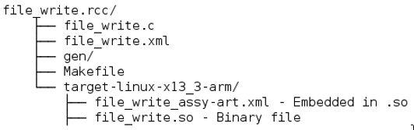
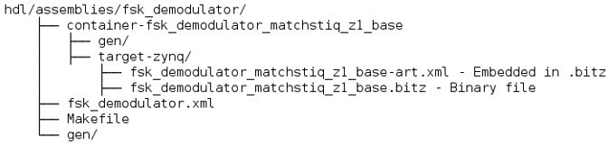
Building Blocks Terminology: Artifact
Term: Artifact
Definition: A file containing executable code for one or more workers for a specific platform
Described by: XML embedded in the binary
Example: file_write.so, fsk_demodulator.bitz
Features of Artifacts Output of build process For RCC workers: .so For HDL containers: .bitz XML appended to artifact describes everything OpenCPI needs to launch executable For RCC workers: describes worker properties, ports, platform For HDL containers: describes multiple workers and their connections & properties | Examples RCC worker HDL container – multiple workers

Slide 16
Building Blocks Terminology: Artifact
Application
Application Specification XML
Deployment of Application – Two Artifacts (file_write.so and fsk_demodulator.bitz)
file_write
.rcc
fir_filter
.hdl
fm_demod
.hdl
decimate
.hdl
adc
.hdl
GPP
FPGA
XCVR
RCC Container
HDL Container
Control
Plane
Container
Data Engine
Device
Worker
HDL Platform Worker
HDL Assembly
Container
Data Engine

Slide 17
Comparison of FPGA Build Flows: Build Time
Typical Design Flow
OpenCPI Design Flow
Write and simulate modules to implement algorithm using VHDL and vendor tools
Write structural code and glue logic to connect modules using VHDL
Write structural code to connect modules to platform interfaces using VHDL
Run FPGA vendor tools to create executable code
Write module as OCPI worker using VHDL and OCPI framework (which uses vendor tools)
Use IDE (or write XML) to describe workers' connections
Use automated build engine to generate structural code and run FPGA vendor tools to create executable code

Slide 18
Comparison of FPGA Build Flows: Switching between Xilinx and Altera
Typical Design Flow
OpenCPI Design Flow
(using OpenCPI-supported platform)
Run OpenCPI utilities (command-line or IDE) using different arguments
Create separate project for Vivado/Quartus
  Import source files
  Generate and rebuild any required IP cores
  Translate project settings and build options
  Translate constraint files

Slide 19
OpenCPI Concepts: Overview
Building Blocks Terminology
Organizational Terminology
Who Can Develop with OpenCPI?

Slide 20
Organizational Terminology: Project
Term: Project
Definition: A functionally-related set of components, assemblies, applications, platforms, etc. in a single location
Described by: Directory structure and Makefiles
Features of Projects Single directory tree containing all related source and artifacts to solve a specific problem Often top-level is stored in revision control SCM Provide an organizational hierarchy Can refer to other projects, e.g. the Core Project Single "exports" directory at top-level to be imported into other projects Can contain multiple applications | Example
Project Directory
specs
components
hdl
applications
specs
W1
W2
W3
A1
A2
A3
Platform
Development
primitives
assemblies
devices
platforms
Lib1
Lib2
Core3
Test
Bias
Test
DDC
specs
D1
D2
P1
P2
Libraries and
Cores
Subassemblies
built for
platforms
devices
specs
D1
D2

Slide 21
Organizational Terminology: Namespace
Term: Namespace
Definition: A sequence of words that are used to organize objects of various kinds so that they may be uniquely referred to
Describes: Various "things" within OpenCPI
Features of Namespaces Should start with a unique organizational designator designating the author, e.g., the OpenCPI team uses the prefix "ocpi" Second term is the Project name Used at various levels (not yet all) No official registration at this time, but internet domains are fairly unique Don't use ocpi for your own assets | Examples ocpi.core is the "Core Project" provided by "The OpenCPI Team" ocpi.assets is the "Assets Project" provided by "The OpenCPI Team" ocpi.assets.dsp_comps.complex_mixer is the "Complex Mixer" found in the "DSP_Comms" Library within the "Assets Project" provided by "The OpenCPI Team" (Italics indicate upcoming terms)

Slide 22

Organizational Terminology: Project Registry
Term: Project Registry
Definition: A directory that contains references to projects in a development environment
Described by: Symbolic links
Features of Project Registry By registering a project, a user is publishing his project so that it can be referenced/searched by any user or project using that same project registry A project registry can be created, deleted, and updated using ocpidev Default registry location is OCPI_CDK_DIR/../project-registry | Example To add add/remove project to a registry: ocpidev [register|unregister] project [project] To view registered projects: ocpidev show registry

Slide 23
Organizational Terminology: Project Library
Term: Library
Definition: A conceptually-related set of components within a single location
Described by: Directory structure and Makefile
Example: Utility Components
Features of Libraries Provide an organizational hierarchy Reduces clutter Encourages reusability | Example
A Component Library's Directory
A Component Library's Directory
Makefile
Component Unit Test subdirectories: <name>.test
One unit test per component "spec"
Makefile
Component Implementation (worker)
subdirectories: <name>.<model>
Multiple workers per component "spec"
specs
Which components
and targets to build
fft.hdl
…
fft.rcc
fft.test
sample-proto
.xml
Cvt-spec
.xml
fft-spec
.xml
sample-proto
.xml
fft-spec
.xml
Make-
file
Make-
file
Make-
file
Specifications for components
(xxx-spec.xml), and
inter-component message
protocols (xxx-proto.xml)
(all in XML)
fft
.xml
fft
.vhd
fft
.vhd
fft
.xml
fft.c
fft-test.xml
generate.py
verify.py
view
.sh
xyz.
vhd
Description
of Worker
Main
Worker
VHDL
Source
Code
File
Other
VHDL
Source
Code
Files
Description
of Unit Test
User-chosen scripts to generate, verify, and view test data

Slide 24
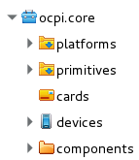
Organizational Terminology: Core Project
Term: Core Project
Definition: The minimal set of Components, Assemblies, etc., required for the OpenCPI framework to operate
Described by: Directory structure and Makefiles
Features of Core Project Provides utility components file read/write capabilities for testing Other unit test capabilities Provides all required board support infrastructure HDL for each target platform (e.g., AXI interface on Zed) Contains HDL simulation platforms Modelsim xsim isim Always needs to be compiled for each platform the user wishes to support | IDE View of Core Project
HDL Infrastructure
Simulator Platforms
Utility components

Slide 25
OpenCPI Concepts: Overview
Building Blocks Terminology
Organizational Terminology
Who Can Develop with OpenCPI?

Slide 26
Who Can Develop with OpenCPI?
Three types of developers:
  Application
  Component: Primary focus of this briefing
  Platform

Slide 27
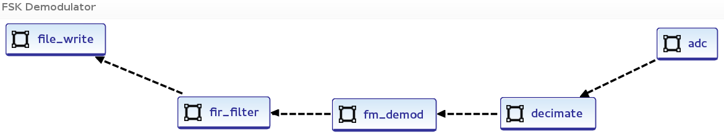
Application Developer
XML or IDE driven
Relies on existing libraries
Requires no C/C++ or VHDL knowledge

Slide 28
Component Developer
Requires C/C++ or VHDL knowledge
Knowledge of hardware details of target platform is not required
Auto-generated Component
Wrapper Code
Control
In
Port
Property access & control
Out
Port
Input
FIFO-like
Interface
Your code
here
Output
FIFO-like
Interface
down_sample.vhd
down_sample-impl.vhd
Interfaces to other services provided by platform (e.g., timing, memory, clocks, etc.)

Slide 29
Component Development Kit (CDK)
What's included?
Pre-built artifacts (ready to use) for commonly used software components | File I/O Test infrastructure
Makefiles required to build software and hardware workers | Makefiles are used to: Interpret XML and drive code generators Compile software workers Run FPGA synthesis software
Utility programs for running and debugging applications | ocpirun – run applications using application XML ocpidev – create projects, libraries, shell code ocpihdl –peek/poke HDL container for debug ocpixml – examine XML associated with artifacts
Headers for all C/C++ code to interface to OCPI framework | Standalone programs Provides interface for other frameworks like REDHAWK

Slide 30
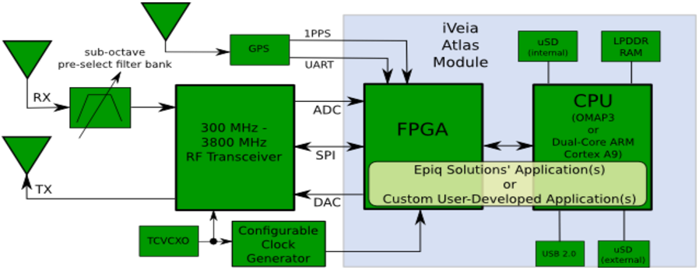
Platform Developer
Advanced
Requires in-depth knowledge of platform
  FPGA pinouts, interface control documents, schematics

Slide 31
Summary of OpenCPI Development Roles
Three types of development with common Makefile, XML-driven workflow
 | Application Development | Component Development | Platform Development
Objective | Create applications using components | Create building blocks for applications | Create infrastructure for running applications
Examples | tb_bias FSK app | bias FIR filter | ZedBoard Matchstiq-Z1
Key functions | Declare components and their connections and properties | Process data and interface between other components Vendor agnostic (ideally) | Provide interface to software and FPGA peripheral (devices workers)
Skills Required | Familiarity with component library | S/W: C, C++ H/W: VHDL | H/W: VHDL Strong knowledge of platform architecture and interfaces
Knowledge of OpenCPI build flow

