Slide 1

OpenCPI - Open Component Portability Infrastructure
An Open Source Infrastructure for
Heterogeneous/Embedded Component-Based Systems and Applications
OpenCPI Debugging Tools

Slide 2
Debugging Techniques
Use ocpihdl and ocpixml to collect HDL application worker and HDL device worker information
Review the worker lifecycle
Use ocpihdl to control the worker state
Change and view worker properties
Use the ocpi_debug built-in worker build configuration property

Slide 3
Using ocpihdl
You can use ocpihdl to:
  Probe the XML of the currently loaded bitstream
  Display currently loaded workers
  View/change worker status
  Set/change worker properties
  Reset workers
  Step through an application
When invoked without options, ocpihdl lists all of its uses
See the ocpihdl(1) man page for command usage details
You cannot currently use ocpihdl on simulators (this function may be enabled in a future release)

Slide 4
Finding Available HDL Devices on an FPGA Platform
ocpihdl search – provides information on available HDL devices, such as:
Device name
Date of bitstream creation
HDL platform
Part identifier
Unique identifier (UUID) of the bitstream
ocpihdl search
OpenCPI HDL device found: 'PL:0': bitstream date Fri Jan 7 09:35:37 2022, platform "matchstiq_z1", part "xc7z020", UUID 10226754-2e6e-11e7-88f7-573bc8e8124c
ocpihdl probe – similar to search, but you can specify an HDL device

Slide 5
Loading/Probing the Bitstream
Examine the XML packaged into any artifact (including bitstreams) with ocpixml get:
ocpixml get <artifact-file>.bitz | <artifact-file>.so
(See the ocpixml(1) man page for tool usage details)
Load a bitstream with ocpihdl load:
ocpihdl load <path-to-bitstream>
Examine the XML packaged into a currently loaded bitstream with ocpihdl getxml:
ocpihdl getxml <output-file>

Slide 6
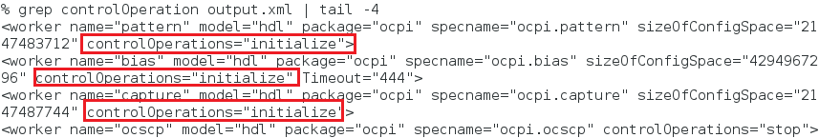
Loading/Probing the Bitstream (cont.)
ocpihdl getxml <output-file>
grep controlOperation <output-file>
What controlOperations are implemented by each worker?

Slide 7
Loading/Probing the Bitstream (cont.)
If you want to remove the bitstream from the FPGA, use ocpihdl unload
Most commonly used when the system's processor functions independently from the programmable logic
CAUTION: Unloading an FPGA that implements a PCIe interface may result in the card becoming unusable and may require a system reboot

Slide 8
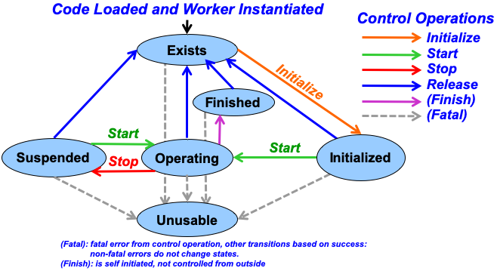
Worker Lifecycle

Slide 9
Controlling HDL Workers with ocpihdl
Find the worker index and other information:
ocpihdl get
You can also specify <worker-instance-index>, <worker-instance-name>, and even <worker-property> as arguments
Reset or unreset the control reset signal into workers:
ocpihdl [wreset|wunreset] <worker-instance-index>
Perform other control operations on workers:
ocpihdl wop <worker-instance-index> [start|initialize|stop]
Set worker properties:
ocpihdl set [<worker-instance-index>|<worker-instance-name>] \ <property> <value>
Observe worker state:
ocpihdl status [<worker-instance-index>|<worker-instance-name>]
Add the -v option to see worker properties

Slide 10
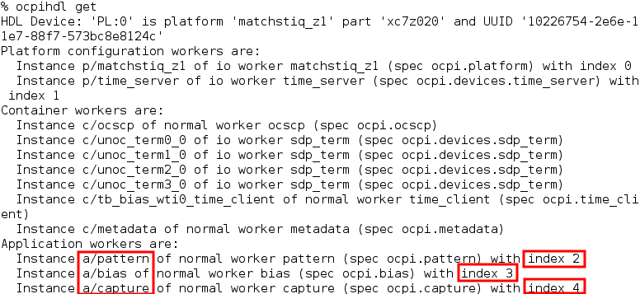
View Worker Information from Bitstream
ocpihdl get
We can identify the worker instances by their indices

Slide 11
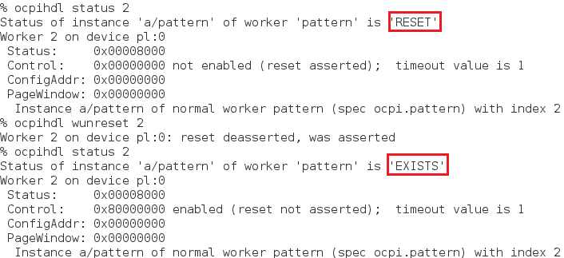
Controlling HDL Workers
If the worker instance status is “RESET”:
ocpihdl unreset <worker-instance-index>

Slide 12
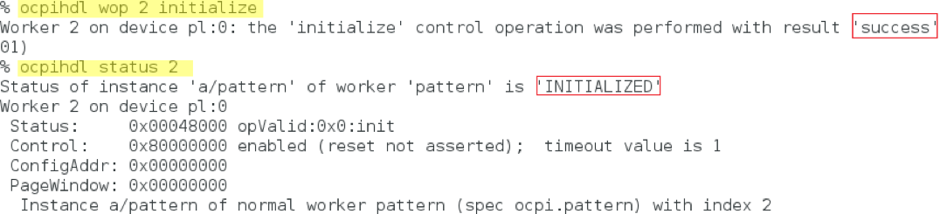
Controlling HDL Workers (cont.)
If the worker instance implements the initialize control option:
ocpihdl wop <worker-instance-index> initialize
Ultimately, to bring the worker instance status to “OPERATING” :
ocpihdl wop <worker-instance-index> start

Slide 13
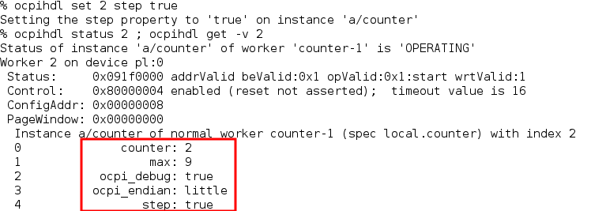
Controlling HDL Workers (cont.)
Writeable worker properties can be changed:
ocpihdl set [<worker-instance-index>|<worker-instance-name>] \ <property> <value>
Volatile properties can be read:
ocpihdl status -v [<worker-instance-index>|<worker-instance-name>]

Slide 14
Using the ocpi_debug “Parameter” Property
ocpi_debug is a framework-generated (built-in) worker build configuration “parameter” property for specifying a “debug” build vs. a “production” build
ocpi_debug is set to true in the OpenCPI Worker Description (OWD) before building a worker for debugging
You add the debugging functionality that depends on ocpi_debug to the worker
In VHDL: ocpi_debug
In C++: <WORKER-NAME>_OCPI_DEBUG

Slide 15
Execution and Debug Utilities
Log level:
export OCPI_LOG_LEVEL=8
ocpirun [–loglevel=8|-l 8] (l is a lowercase “L”)
ocpirun [--list|-C] - to find containers, including simulators
ocpiview - to view simulation waveform results
printf/cout - to display diagnostic output
ocpi_debug - for debug builds
gdb - GNU Project Debugger

