Slide 1

OpenCPI - Open Component Portability Infrastructure
An Open Source Infrastructure for
Heterogeneous/Embedded Component-Based Systems and Applications
OpenCPI RCC Development

Slide 2
RCC Development Overview
RCC Development Overview
Advanced RCC Features and Functionality

Slide 3
RCC Development Overview
RCC – Resource-constrained C/C++
C and C++ language workers
Focus on C++ moving forward
“Supported Systems and Platforms” in the OpenCPI Installation Guide and OpenCPI User Guide lists development hosts, embedded systems platforms

Slide 4
Application Worker Build Steps
OPS: Use a pre-existing OPS or create a new one.
OCS: Use a pre-existing OCS or create a new one.
Create a new worker (modify OWD and source code).
Build the worker for the target device(s).
Create the unit test (<component>-test.xml, generate, verify and view scripts).
Build the unit test.
Run the unit test.
OpenCPI Tutorial 3 demonstrates this process.

Slide 5
Execution Model
Software containers provide the execution environment for workers
  Load, execute, control, and configure workers
  Move data between workers
Provide interfaces for local services
  Including software watchdog timer
Evaluate data availability
  Consumer's buffer has data
  Producer's buffer has space
Each RCC container is a single thread

Slide 6
Execution Model (cont.)
Shared buffers between workers that are in the same container

Slide 7
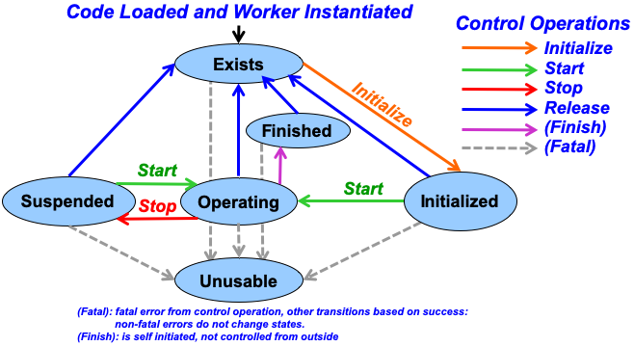
Worker Life Cycle

Slide 8
Run Method
Called by container when all ports are ready (input ports have data and output ports have a free buffer)
Other advanced use cases; for example, timeouts if run condition changed from default
Return values to container
  RCC_ADVANCE (good state + advance all ports)
  RCC_OK (good state)
  RCC_FINISHED (finished state)
  RCC_ADVANCE_FINISHED (finished + advance all ports)
  RCC_ERROR (bad state: recoverable; still operating)
  RCC_FATAL (bad state: unrecoverable)

Slide 9
Start/Initialize/Stop/Release
OWD XML: <RCCWorker language="c++" spec="myname_spec.xml" ControlOperations="start, stop, initialize, release"/> | C++: RCCResult start() // others are // initialize(), // stop(), and // release() { //your code goes here return RCC_OK; }

Slide 10
Property Access
OCS XML: <property name="myprop" type="bool" writeable="true" volatile="true"/> | C++: if (properties().myprop == true) { //do something } properties().myprop = false;

Slide 11
Port Access: Scalar Length
OCS XML: <Port Name="myin" Producer="false" Protocol="my_protocol"/> <Port Name="myout" Producer="true" Protocol="my_protocol"/> OPS XML: <Protocol> <Operation name="myOp"> <Argument name="myArg1" type="bool"/> <Operation/> <Protocol/> | Input ports can be assumed based on the protocol, because there is no variable length data. Output port lengths do not need to be set as long as all arguments are scalar: C++: //Nothing to do

Slide 12
Port Access: Scalar Data
OCS XML: <Port Name="myin" Producer="false" Protocol="my_protocol"/> <Port Name="myout" Producer="true" Protocol="my_protocol"/> OPS XML: <Protocol> <Operation name="myOp"> <Argument name="myArg1" type="bool"/> <Argument name="myArg2" type="bool"/> <Operation/> <Protocol/> | C++: const bool inArg1 = myin.myOp().myArg1(); const bool inArg2 = myin.myOp().myArg2(); myout.myOp().myArg1() = false; myout.myOp().myArg2() = true;

Slide 13
Port Access: Sequence Length
OCS XML: <Port Name="myin" Producer="false" Protocol="my_protocol"/> <Port Name="myout" Producer="true" Protocol="my_protocol"/> OPS XML: <Protocol> <Operation name="myOp"> <Argument name="myArg1" type="bool" SequenceLength="2048"/> <Operation/> <Protocol/> | C++: //length in elements const size_t length = myin.myOp().myArg1().size(); myout.myOp().myArg1().resize(length); //length in bytes myout.setDefaultLength(2*sizeof(bool));

Slide 14
Port Access: Sequence Data
OCS XML: <Port Name="myin" Producer="false" Protocol="my_protocol"/> <Port Name="myout" Producer="true" Protocol="my_protocol"/> OPS XML: <Protocol> <Operation name="myOp"> <Argument name="myArg1" type="bool" SequenceLength="2048"/> <Operation/> <Protocol/> | C++: const bool* inData = myin.myOp().myArg1().data(); bool* outData = myout.myOp().myArg1().data(); for (int i = 0; length > i; i++) { //do something with the data inData++; outData++; }

Slide 15
Port Access: OpCode
OCS XML: <Port Name="myin" Producer="false" Protocol="my_protocol"/> <Port Name="myout" Producer="true" Protocol="my_protocol"/> OPS XML: <Protocol> <Operation name="MyOp1"> <Argument name="myArg1" type="bool"/> <Argument name="myArg2" type="bool"/> <Operation/> <Operation name="MyOp2"> <Argument name="otherArg1" type="bool" SequenceLength="2048"/> <Operation/> <Protocol/> | C++: //for all outputs on this port myout.setDefaultOpCode(My_protocolMyOp1_OPERATION); //for the current output on this port myout.setOpCode(My_protocolMyOp1_OPERATION); switch(myin.opCode()) { case My_protocolMyOp1_OPERATION: { //do something break; } case My_protocolMyOp2_OPERATION: { //do something different break; } default: { cout << "bad Opcode" << endl; break; } }

Slide 16
Port Access: Manually Advancing
OCS XML: <Port Name="myin" Producer="false" Protocol="my_protocol"/> <Port Name="myout" Producer="true" Protocol="my_protocol"/> | C++ advance all: return RCC_ADVANCE; C++ advance manually: myin.advance(); myout.advance(); return RCC_OK;

Slide 17
Local Worker Variables
Define any local variables that you need as class variables. OWD XML: <RccWorker spec="myworker-spec.xml" language="C++"> </RccWorker> | C++: class My_workerWorker : public My_workerWorker base { bool myLocalVar1; bool myLocalVar2; … RCCResult run() { //use local variables }

Slide 18
Version 2 for RCC Workers
OWD XML: <RCCWorker language="c++" spec="myname_spec.xml" version="2"/> | We recommend that all newly created workers use the latest interface version. version 1: interprets a zero length message(ZLM) with opcode 0 as end of file(eof) on both input and output ports version 2: eof is received on an input port: myin.eof() eof is set on an ouput port: myout.setEOF()

Slide 19
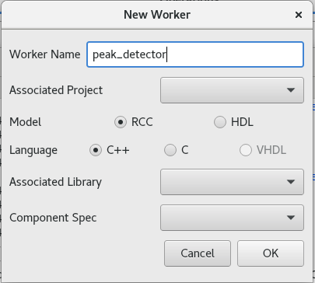
Creating RCC Workers
With ocpidev:
ocpidev create worker peak_detector.rcc
With OpenCPI GUI:
Files created:
peak_detector.rcc/
|-- gen
| |-- peak_detector_map.h
| |-- peak_detector-build.xml
| |-- peak_detector-skel.cc
| |-- peak_detector-skel.cc.deps
| |-- peak_detector-worker.hh
| |-- peak_detector-worker.hh.deps
|-- peak_detector.cc
|-- peak_detector.xml

Slide 20
Cross Building
An example of a cross-building target is Zynq-arm, the CPU inside the Zynq system-on-chip (SoC).
To enable cross build:
ocpidev build --rcc --rcc-platform xilinx19_2_aarch32
To enable build for x86:
ocpidev build --rcc
Or use the OpenCPI GUI

Slide 21
RCC Build Artifacts
A built RCC worker is a Linux shared object file
  Dynamically loadable on the platform that it is built for
Info about the worker (XML) embedded in .so
ocpixml get myworker.so

Slide 22
Advanced RCC Features and Functionality
RCC Development Overview
Advanced RCC Features and Functionality

Slide 23
Parameter Access
OWD XML: <RccWorker spec="myworker-spec.xml" language="C++"> <property name="myparam" type="bool" parameter="true"> </RccWorker> | C++: if (MYWORKER_MYPARAM == true) { //do something }

Slide 24
Property Write Notification
OWD XML: <SpecProperty name="myprop" type="bool" writeSync="true"/> | C++: RCCResult myprop_written() { //your code return RCC_OK; }

Slide 25
Property Read Notification
OWD XML: <SpecProperty name="myprop" type="bool" readSync="true"/> | C++: RCCResult myprop_read() { //your code return RCC_OK; }

Slide 26
Optional Ports
OCS XML: <Port Name="myout" Producer="true" optional="true" Protocol="rstream_protocol"/> | C++: if (myout.isConnected()) { //output the data to the port }

Slide 27
RCC Worker as a Control Proxy
A C++ worker that can manipulate other workers' properties
  Slave worker can be HDL or another RCC
  Can be 1:1 or 1:many (workers and/or properties)
Main use case is for platform development to simplify the user interface when developing a Board Support Package (BSP)

Slide 28
Running a Worker in a Debugger
Described in the RCC Development Guide:
  Gives directions on how to break gdb in your worker when trying to debug
  Can be used in a standalone graphical debugger such as DDD
  gdb is available native on remote systems (e310); remote debugging with gdbserver is not required

