Slide 1

OpenCPI - Open Component Portability Infrastructure
An Open Source Infrastructure for
Heterogeneous/Embedded Component-Based Systems and Applications
Introduction to OpenCPI Platform Development

Slide 2
Summary of OpenCPI Development Roles
Three types of development with common XML-driven workflow
 | Application Development | Component Development | Platform Development
Objective | Create applications using components | Create building blocks for applications | Create infrastructure for running applications
Examples | Tb_bias FSK app | Bias FIR filter | Zedboard Matchstiq Transceivers
Key functions | Declare components and their connections and properties | Process data and interface between other components Vendor agnostic (ideally) | Provide interface to software and FPGA peripheral (devices workers)
Skills Required | Familiarity with component library | S/W: C, C++ H/W: VHDL | H/W: VHDL Strong knowledge of platform architecture and interfaces
 | Knowledge of OpenCPI build flow

Slide 3
Overview
Review of Terminology
Systems vs Platforms ⇨ Platform Development
Enabling a new System (What's the process?)
Enabling Development Hosts (new Operating System)
Enabling GPP (General Purpose Processor) Platforms
Enabling FPGA (Field Programmable Gate Array) Platforms
  Case Study: Epiq Matchstiq-Z1
  Case Study: Device/Proxy Workers to support Lime MicroSystems Transceiver

Slide 4
Types of Platform Development
Enabling new platforms and devices for OpenCPI apps
Enable Development Host
Software Platform Development
Enable Embedded/
Target Host
Platform
Development
FPGA Platform Development
Enable New Platform
Enable New Device Type

Slide 5
Terminology Review
Component – a "promise" of a function where properties and ports are defined
Application – a set of connected components
Platform – a processor and its directly-connected hardware
System – Platforms connected by interconnects, used for running component-based applications
Interconnects – signaling (control/data) paths that connect platforms
Processor – an integrated circuit capable of executing a component-based application
Application Worker – a component implementation that requires only abstracted data interfaces
Container – execution environment on a processor that will execute workers
Platform Configuration – a unique configuration of devices on a platform
Control Plane – Worker "LifeCycle" and "Property" access
Data Plane – Container Data (DMA) Engine, "Ports" and "Protocols"
Device Worker – an HDL component implementation that interfaces with I/O devices that are FPGA-external
Platform Worker – Special type of device worker
HDL Assembly (sub-assembly) – a set of connected HDL application workers
See the OpenCPI Glossary for detailed definitions of OpenCPI and related industry terminology

Slide 6
Overview
Terminology Review
Systems vs Platforms ⇨ Platform Development
Enabling a new System (What's the process?)
Enabling Development Hosts (new Operating System)
Enabling GPP (General Purpose Processor) Platforms
Enabling FPGA (Field Programmable Gate Array) Platforms
  Case Study: Epiq Matchstiq-Z1
  Case Study: Device/Proxy Workers to support Lime MicroSystems Transceiver

Slide 7
Systems vs. Platforms: Platform Development
System – a collection of processing elements (Processor) that can be used together as resources for running component-based applications.
Platform – a Processor and its surrounding directly-connected hardware (memory and I/O devices).
Interconnect – data paths that allow platforms to communicate with each other.
Instead of enabling a "system", OpenCPI focuses on enabling each "platform" and "interconnects" within a system.
Hence Platform Development is enabling a platform, and enabling a system is enabling whatever platforms and interconnects are in the system.

Slide 8
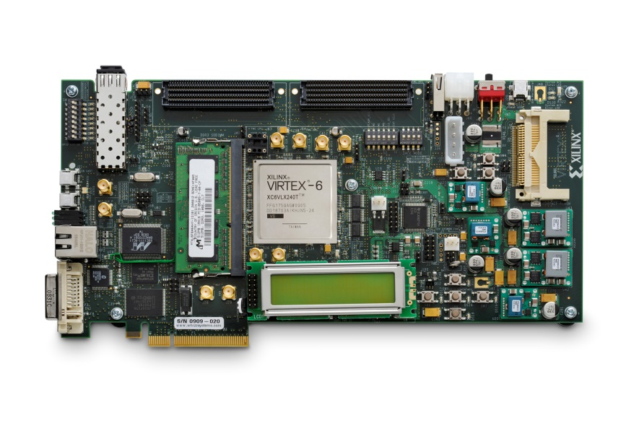
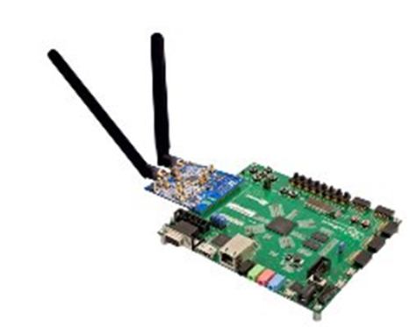
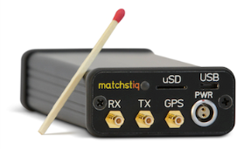
What is an OpenCPI FPGA Platform?
An OpenCPI FPGA Platform is the FPGA, its surrounding infrastructure and attached devices.
Enabling the platform allows it to be used for an OpenCPI application.
Put another way…
What do I need to run an OpenCPI app?
File Writer
256-Tap FIR Filter
FM
Demod
Fixed CIC
Resample
Software Worker | FPGA Workers
on my hardware?

Slide 9
Review: Pieces of OpenCPI Platforms
The FPGA: a place where HDL application workers may execute
Interconnects: off-chip connections to processor(s) or other FPGA platforms
Devices: peripherals attached to the FPGA, useful to applications
Slots: hardware physical interfaces where cards (with devices) are plugged in
Example Processor Interconnects | Example FPGA Peripheral Devices
Zynq
ARM
AXI
SPI
FPGA
Lime Micro XCVR
Data
Intel
x86
PCIe
I2C
SI Labs
Clock Gen
Other
FPGA
FMC Slot

Slide 10
Inside an OpenCPI Platform
An OpenCPI platform consists of a Processor with Interconnects allowing it to communicate with other platforms and two additional elements:
Devices
  Hardware elements locally attached to the processor
  Allow source or sink of data flowing between components to enter or exit a system
Slots (& Cards)
  A means to support add-on cards
  Cards – When plugged into a platform's slot, a card declares the use of additional devices

Slide 11
Examples of Supported Platforms
Common CPU, Intel or AMD x86 on a motherboard
  If cards are plugged into slots on the PC's motherboard, and those cards have processors (e.g. GPP, FPGA), then those cards can act as additional platforms in that system (e.g. Xilinx Virtex6 and Altera Stratix4 PCIe-based development boards)
  Multi-core GPPs are single "processors" since they generally run a single operating system and act as a single resource that can run multiple threads concurrently
ZedBoard from Digilent, based on Xilinx Zynq device
  "System-On Chip" (SoC)
  Two processing (aka platforms) elements: Dual-core ARM and FPGA
  Interconnects: AXI-4 interfaces (Master: GP 0/1, Slave: HP 0-3)
  Devices: memory, pushbuttons, etc
  Slots: FMC-LPC

Slide 12
Development and Execution
Every platform must be enabled for:
Development - the process of producing "executable binaries"
  Requires integrating compiler tool chains into OpenCPI's build framework
  Typically requires scripts or wrappers to enable tool operation within OpenCPI
  Does not preclude or require GUI-based IDEs in the development process
  Cross-compilers are leveraged for supporting embedded systems
Execution – the process of running those binaries on the available platforms in a system

Slide 13
Overview
Terminology Review
Systems vs Platforms ⇨ Platform Development
Enabling a new System (What's the process?)
Enabling Development Hosts (new Operating System)
Enabling GPP (General Purpose Processor) Platforms
Enabling FPGA (Field Programmable Gate Array) Platforms
  Case Study: Epiq Matchstiq-Z1
  Case Study: Device/Proxy Workers to support Lime MicroSystems Transceiver

Slide 14
Enabling New Systems
Enabling systems implies enabling platforms and interconnects in the system, as well as enabling processors and devices on the platforms and devices on any cards used in the system.
What are the steps?
  System Inventory – Which elements are relevant?
  Assessment – What's the current level of support?
  Additional System-Level information
  Experiments to fill in the knowledge gaps

Slide 15
System Inventory
Identify hardware elements relevant to component-based applications:
Processors, aka "Containers"
  Elements capable of executing a worker
  CPU - Intel AMD x86_64, Zynq-7000(ARM)
  FPGA - Zynq-7000(PL), Virtex6, Stratix4
Interconnects
  Physical paths which connect Processors (PCIe, Ethernet)
Devices
  Devices connected to Processors
  Examples: SPI, I2C, ADC, DAC, custom, memory, temperature, GPS

Slide 16
Assessment: Current Level of Support
For each:
Processor
  What is the current level of support by the framework? Is it already present, a variant, a new processor, or a new class of processor?
  What is the current level of support by the tool chain?: Is it already present, does it require an update/variant, or is it missing?
Interconnect – for each processor type that is attached to it
  What is the current level of support by the framework? Is it already present, does it require enhancements, or is it missing for the processor type?
Device
  What is the current level of support by the framework? Is it already present, does it require enhancements, is it missing but similar to supported devices, or missing?

Slide 17
Gather/Create Technical Data Package
Data sheets, ICDs, schematics, Connectivity (pinouts), signal timing, and memory maps
Description of functions for each element
Description of power sequences, boot sequences, initialization, reconfiguration, calibration, operation
Event driven actions
  E.g., temperature thresholds cause a throttling of the processors
Timing
  Oscillators drive synchronization (SW/HW) circuits, control and data clocks, etc.
  Synchronization with GPS or reference clocks (1PPS, 10MHz distro)
  Special calibration sequences
Non-volatile media, removable media
How are reprogrammable device programmed? (CPU, boot flash, JTAG)
Debug ports
Are there any "white wires" or other hardware errata?

Slide 18
Experiments to Fill in Knowledge Gaps
Reasons for performing experiments:
  Uncertainties and gaps in technical documentation
  Information is unavailable due to proprietary restrictions
  Verify functional or performance capabilities of the system that are missing or questionable from the gathered information
  Reverse engineer missing ICD aspects (assuming no legal impediments)
These efforts establish the final information to plan and budget for enabling a new system.

Slide 19
Now What?
Planning and Specification – Define requirements and tasking
Technical Development – Execute tasks
Verification – Testing
"Contribute" – Back to OpenCPI repository to benefit others

Slide 20
Overview
Terminology Review
Systems vs Platforms ⇨ Platform Development
Enabling a new System (What's the process?)
Enabling Development Hosts (new Operating System)
Enabling GPP (General Purpose Processor) Platforms
Enabling FPGA (Field Programmable Gate Array) Platforms
  Case Study: Epiq Matchstiq-Z1
  Case Study: Device/Proxy Workers to support Lime MicroSystems Transceiver

Slide 21
Enabling Development Hosts
All steps shall be recorded for reproducibility!
Install OS with suitable options and packages
Install native development tools to drive OpenCPI's build system using RPMs (or install scripts)
Retrieve current source code for OpenCPI
THE NEXT STEPS ARE THE SAME AS THOSE FOR SUPPORTING ANY RUNTIME PLATFORM AND ARE EXPLAINED IN THE NEXT SECTION "Enable GPP Platforms".
Establish a build environment with appropriate options
Build the core OpenCPI software targeting the development host
Build/Test OpenCPI component libraries and example applications

Slide 22
Overview
Terminology Review
Systems vs Platforms ⇨ Platform Development
Enabling a new System (What's the process?)
Enabling Development Hosts (new Operating System)
Enabling GPP (General Purpose Processor) Platforms
Enabling FPGA (Field Programmable Gate Array) Platforms
  Case Study: Epiq Matchstiq-Z1
  Case Study: Device/Proxy Workers to support Lime MicroSystems Transceiver

Slide 23
Enabling GPP Platforms
Two aspects:
Development/Cross development
  Building component and application binaries for the target platform
Execution
  Building the core OpenCPI runtime libraries and runtime command line utilities for the target platform

Slide 24
Development/Cross Development
Whether the GPP is native to the development host, or on an embedded system, the tool chain must be integrated into the OpenCPI build process
  Cross-compilers are used for embedded systems
Where is my compiler coming from?
  Development host's globally installed default tools, e.g. CentOS7, Ubuntu18.04, MacOS
  A unique prerequisite installation in OpenCPI's own installation tree (e.g. specific compiler dependency)
  A "side-effect" of another tool installation, ex. Xilinx Zynq SOC (FPGA + dual core ARM)

Slide 25
Execution for GPP Platforms
Requires building the framework using the appropriate [cross-]compiler for the target GPP platform
  Command line tools
  Libraries
  Device drivers
Several runtime libraries have conditional compilation depending on the system or CPU being targeted
  Significant Linux dependencies

Slide 26
Overview
Terminology Review
Systems vs Platforms ⇨ Platform Development
Enabling a new System (What's the process?)
Enabling Development Hosts (new Operating System)
Enabling GPP (General Purpose Processor) Platforms
Enabling FPGA (Field Programmable Gate Array) Platforms
  Case Study: Epiq Matchstiq-Z1 SDR
  Case Study: Device/Proxy Workers to support Lime MicroSystems Transceiver

Slide 27
Enabling FPGA Platforms: Overview
Two aspects enable an FPGA platform:
Need to understand "What is an OpenCPI..."
  ...FPGA Platform?
  ...FPGA Platform Infrastructure?
  ...Platform Worker?
  ...Device Worker?
  ...Slot?
  ...Platform Configuration?
  ...Container/Bitstream?
Case Study:
  Epiq Matchstiq-Z1 SDR
  Device/Proxy Workers to support Lime MicroSystems Transceiver

Slide 28
Types of OpenCPI Platform Development
Enabling new platforms and devices for OpenCPI apps
Enable Development Host
Software Platform Development
Enable Embedded/
Target Host
Platform
Development
FPGA Platform Development
Enable New Platform
Enable New Device Type

Slide 29
Enabling FPGA Platforms
Similar to enabling a GPP, there are two aspects to enable an FPGA:
Development environment - What do I need to build?
  Installation and integration of tool chain to target (build) the FPGA on the platform and core OpenCPI HDL code
Execution - What do I need to run?
  Writing specific new HDL code that supports the particulars of the hardware attached to the FPGA (except for simulator)
  Verifying reference test applications on the platform

Slide 30
Block Diagram of a Zynq 7000-based FPGA Design in OpenCPI
Zynq 7020 Programmable Logic
Container
Platform Configuration
Device Worker
Platform Worker
UUID & ROM
Device Worker
Wrapper
AXI-GP0
Control Plane
AXI2CP
HDL Assembly
AXI-HP0
Container Data Engine
Tx Path
Device Worker
SDP2AXI
PS7 Primitive
AXI-HP1
Container Data Engine
Rx Path
Device Worker
SDP2AXI
AXI-HPx
AXI HPx Term
Time
Server
Time
Client
Generic Infrastructure included with OpenCPI – instanced by platform developer
Generic Infrastructure included with OpenCPI – automatically instanced and connected, as needed, by the code-generation tool
Vendor supplied hard IP block
Custom code required for platform enablement

Slide 31
Types of OpenCPI Workers
C Workers
RCC Workers
C++ Workers
Workers
HDL Application Workers
HDL Workers
(all VHDL for now)
HDL Device Workers
HDL Platform Workers

Slide 32
Project Directory Layout
Project Directory
specs
components
hdl
applications
specs
W1
W2
W3
A1
A2
A3
Platform
Development
primitives
assemblies
devices
platforms
cards
Lib1
Lib2
Core3
TestBias
TestDDC
specs
D1
D2
specs
D1
D2
specs
D1
D2
Libraries and Cores
Subassemblies
built for platforms
devices
specs
D1
D2

Slide 33
What is an “OpenCPI FPGA” Platform?
A single FPGA on some board that has the infrastructure to serve as an OpenCPI Container to a component-based application
  May have Devices and Slots
  Ex. E310 (Zynq 7020), ZedBoard(Zynq 7020), Matchstiq-Z1 (Zynq 7020), Xilinx ML605 (Virtex6), Altera Stratix4
If a board has multiple FPGAs, then each one is an OpenCPI FPGA platform
  Provided that enough resources remain after the OpenCPI infrastructure is in-place and the proper interconnects are present
  Note: At this time, there are no working examples of platforms with multiple FPGAs
An FPGA simulator is an FPGA platform
  Where HDL components may execute, with all the same infrastructure as physical FPGA platforms ("co-simulation") or a "bare-bones" infrastructure environment

Slide 34
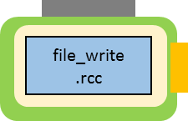
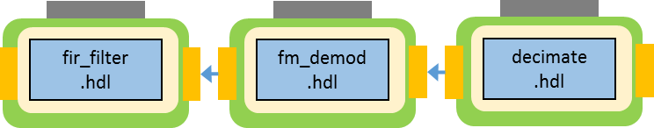
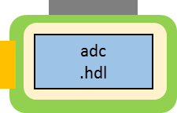
What is “OpenCPI FPGA Platform Infrastructure”?
Typically comprised of the following OSS IP HDL modules
  Platform Worker – Adapter for interfacing with Interconnects and internals
  Control Plane – Local bus to interface with a workers control port
  Data Plane – Pathways for workers to exchange data, and where the Container Data Engine(s) are used to pass data on/off the FPGA
ARM
FPGA
Transceiver
HDL Container
RCC Container
Control
Plane
Container
Data Engine
HDL Platform Worker
Device
Worker
HDL Assembly
Container
Data Engine

Slide 35
HDL Platform Worker
A specific type of HDL Device Worker that describes additional information regarding hardware aspects of the platform
  System-time, control, data
Provides infrastructure to adapt external interconnects to the internal control/data interfaces of the FPGA
Implements Platform Spec (OCS)
  <ocpi-install-path>/projects/core/specs/platform-spec.xml
Defined by XML and VHDL
Platform Worker
Wrapper
AXI-GP0
AXI2CP
AXI-HP0
HDL Platform Worker
SDP2AXI
PS7 Primitive
AXI-HP1
SDP2AXI
AXI-HPx

Slide 36
HDL Platform Worker: OHPD
Like all workers, the HDL Platform Worker has an OWD that defines requirements for the code-generation tool <HdlPlatform>.
  Configure platform <SpecProperty>, e.g. platform name
  Define properties <Property>
  Declares signals (similar to Device Worker!) <Signal>
  Declares capabilities that are unique to HDL Platform Workers
    Master of <metadata>, <timebase>, control plane <cpmaster>, data plane <sdp>
    Declare and parameterize frequency with which to operate time service module
    Declares all possible <Device> workers that are available in support of the platform
      Does not mean that they will be built into bitstream, but required for the build engine
    Defines Slots(s) <Slot>
    Signal re-mapping: platform signals to slot signals (and possibly device signals)
    Defines Dev-Signals which are signals connected between device workers <DevSignals>
The OWD is part of the HDL Platform Worker's OpenCPI HDL Platform Description (OHPD) XML file, which also describes the devices (controlled by HDL device workers) that are attached to the HDL platform and available for use.
Unlike App/Device Workers, HDL Platform Workers do not support DataInterfaces

Slide 37
HDL Platform Worker: VHDL
Instances modules to adapt external Interconnects to internal control/data mechanisms
System-level: reset and clocking (control plane and time server)
PCIe-based platforms instance a vendor PCIe IP block (ex. Xilinx Block Plus Endpoint) module and an OpenCPI IP uNOC (micro-Network On A Chip) and adapters are used to convert the PCIe to the Control Plane and Container Data Engines
Zynq-based platforms instance a processor module and OpenCPI IP adapters to convert AXI to the Control Plane and Container Data Engines infrastructure
modules
Platform Worker
AXI-GP0
Control Plane
Wrapper
AXI2CP
AXI-HP0
SDP2AXI
Container Data Engine
PS7 Primitive
AXI-HP1
SDP2AXI
Container Data Engine
AXI-HPx
AXI HPx Term

Slide 38
Control Plane
Platform-independent HDL module for reading and writing properties for all three types of HDL workers: App, Device, Platform
Instanced in the auto-generated Container VHDL
Scales according to the number of workers in the Container
System-level provider of reset and clock for all workers (adapters)
  HDL Platform Worker sources reset and clock to Control Plane, then Control Plane sources to workers' control interfaces
<ocpi-install-path>/projects/core/hdl/primitives/platform/ocscp_rv.vhd

Slide 39
Data Plane
Portable framework modules for moving data between workers and to/from containers
  Container Data (DMA) Engine per stream
  uNOC/SDP for multiplexing streams (maybe control plane) into an interconnect channel
  HDL Platform Worker's adaptation of these "interconnect access channels" to the system interconnect

Slide 40
Slots (and Cards)
Defined by XML (no HDL code)
Characterized by
  Physical connectors
  Electrical signaling and direction
  Pin and signal name assignments
Example of common types (hdl/cards/spec/)
  FMC (FPGA Mezzanine Cards, as defined by VITA 57 standard)
    fmc_lpc.xml, fmc_hpc.xml
  HSMC (High Speed Mezzanine Cards, as defined by Altera)
    hsmc.xml

Slide 41
Cards (and Slots)
Defined by XML (no HDL code)
Instances additional HDL Device Worker(s) that may be plugged into a Slot on various platforms
Therefore, devices may be directly attached to the pins of the platform FPGA, or they may exist on a plug-in card, that, when plugged into a slot, become attached to the platform FPGA
Example of common types (hdl/cards/spec/)
  Lime MicroSystems/Zipper
    lime_zipper_hsmc.xml lime_zipper_fmc_hpc.xml, lime_zipper_fmc_lpc.xml
  Analog Devices FMCOMMS3_EBZ
    fmcomms_2_3_hpc.xml, fmcomms_2_3_lpc.xml

Slide 42
HDL Platform Configuration
XML that defines an HDL platform with a particular set of devices
  Top-level element <HdlConfig> and child <device> elements
For devices mentioned in the HDL Platform OHPD, the device element simply has a "name" attribute indicating which of the platform's devices that will be instanced in the platform configuration
Can also specify devices that are on cards plugged into one of the platform's slots using the "card" attribute or "slot" attribute when there are multiple cards plugged in
<HdlConfig>
<device name='lime_dac' />
<device name='lime_adc' card='lime-zipper-fmc'/>
</HdlConfig>

Slide 43
Container
Execution environment on some platform that will execute workers
In HDL, the container is the complete design for an entire FPGA, including workers and infrastructure. Described by XML. Typically built inside of an HDL Assembly directory.
  Container (BitStream) = Platform Configuration + Assembly + Device Worker(s)
In RCC, the container loads, executes, controls, and moves data to/from RCC workers
<HdlContainer Config='matchstiq_z1_rx_tx' Platform='matchstiq_z1'>
<!-- external-to-FPGA device (worker) to FPGA assembly connections -->
<Connection External="in_to_asm_rx_path_from_adc" Port="out" Device="lime_adc"/>
<Connection External="out_from_asm_tx_path_to_dac" Port="in" Device="lime_dac" />
<!-- FPGA assembly to CPU interconnect connections -->
<Connection External="out_from_asm_rx_path" Interconnect="zynq"/>
<Connection External="in_to_asm_tx_path" Interconnect="zynq"/>
</HdlContainer>

Slide 44
UUID and ROM
Auto-generated VHDL which contains information used at execution and early in the process of platform enablement
UUID
  Unique identifier of the bitstream used by the framework during execution to confirm that the desired bitstream is loaded
ROM
  Compressed XML that describes the bitstream
  Used for debug or as apart of an platform inspection process

Slide 45
HDL Platform as it Relates to a Project
A directory that contains files that implement an HDL platform
  HDL Platform OHPD <HdlPlatform> and VHDL (arch)
  HDL Platform Configuration XML files <HdlConfig>
  HDL Device Workers that are unique to the platform (platform/devices/)
  File specifying vendor-tool build-time options (.ut)
  Vendor FPGA constraints files are managed at this level
    Xilinx *.xdc, Altera *.qsf

Slide 46
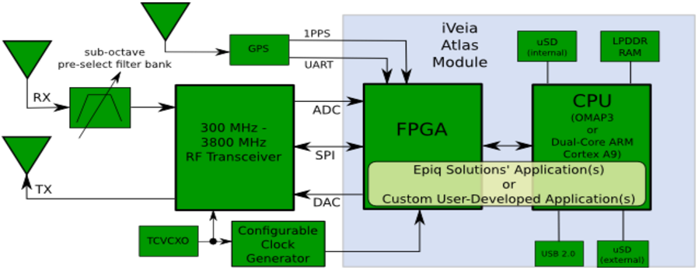
Case Study: Epiq Matchstiq-Z1
  Operating System : PetaLinux
Processors
  Xilinx Zynq 7020 (Dual-core ARM processor and FPGA)
Interconnects
  AXI (PS ⬄ PL)
Devices
  Lime Microsystems Transceiver: Tx, Rx, ADC, DAC, SPI
  I2C Bus: Temperature sensor, RF switch, RF step attenuator, clock synthesizer
  UART: GPS receiver

Slide 47
Use Case: Device/Proxy Workers
  To support Lime MicroSystems Transceiver
Zynq 7020 ARM
Zynq 7020 Programmable Logic
RCC Container
HDL Container
UUID & ROM
Lime Tx
OCS: rf_tx-spec
OWD: lime-properties.xml
Lime Tx Proxy
OCS:
rf_tx_proxy-spec
Lime Rx Proxy
OCS:
rf_rx_proxy-spec
Control Plane
Lime
SPI
OCS: 'internal'
OWD: lime_iq_properties.xml
File
Write
Container
Data Engine
Lime Rx
OCS: rf_rx-spec
OWD: lime-properties.xml
Platform Configuration
HDL Assembly
Container Data Engine
Tx Chain
Lime
DAC
OCS: qdac-spec.xml
OWD: lime_iq_properties.xml
Container Data Engine
Rx Chain
Lime
ADC
OCS: qadc-spec.xml
OWD: lime_iq_properties.xml

Slide 48
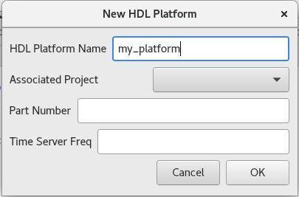
Creating HDL Platform
With ocpidev:
ocpidev create hdl platform my_platform
With OpenCPI GUI:
Create an HDL platform from the top level of a project
hdl/platforms/my_platform/my_platform.xml – HDL platform OHPD, which provides:
  HDL Platform Worker's OWD
  Additional information regarding hardware aspects of the platform
  XML attributes, e.g. exact FPGA device part number or OS target for embedded platforms

Slide 49
Overriding Project/Library XML Attributes in HDL Platform OHPD
Attribute Name In Project.xml or Library.xml | Override/Augment Platform Library XML | Override/Augment Platform Library OHPD | Description
SourceFiles | Y | Y | List of additional source files for this worker (VHDL or Verilog)
Libraries | Y | Y | List of primitive libraries built elsewhere. If a name has no slashes, it will follow the HDL Search Path rules
Configurations | Y | N | List of space-separated HDL Platform Configuration XML files
ExportFiles | Y | N | List of space-separated files to include as symbolic-links in the top-level exports/
XmlIncludeDirs | N | N | List of directories elsewhere for searching for XML files
IncludeDirs | Y | Y | List of directories elsewhere for searching for files indicated by “include” directives
ComponentLibraries | Y | Y | List of component libraries to search for workers
OnlyTargets OnlyPlatforms | Y | Y | List of targets/platforms for which worker may be built
ExcludeTargets ExcludePlatforms | Y | Y | List of targets/platforms for which worker may not be built

Slide 50
HDL Platform Directory
Other files to be added by developer
  <platform>.ut – Xilinx specific build-time global options
  <platform>.sdc – Altera specific build-time global options
  <platform>.{xdc|qsf} – Vendor-specific FPGA constraints file

Slide 51
Breakdown of Platform Worker Shell VHDL
  Auto-generated VHDL based on the HDL Platform Worker OHPD XML file
  hdl/platforms/<platform>/gen/<platform>-impl.vhd (auto-gen entity/arch)
    <platform> (entity/arch of the <platform>-impl.vhd. Wraps the <platform>_rv entity to expand the control interface records into signals which is required for subsequent code-generation processes when building for the Assembly)
      <platform>_wci (auto-gen entity/arch)
      <platform>_rv (auto-gen entity/arch "Record VHDL")
        <platform>_wci (auto-gen instance)
        <platform>_worker (auto-gen entity)
          <Your VHDL is written here!>.vhd (auto-gen arch shell for worker)
    <platform>_worker_defs (auto-gen package that defines records for props_in, props_out, ctl_in, ctl_out, and memory map property)
      DataInterfaces are not supported!

Slide 52
Breakdown of App/Dev Worker Shell VHDL
  <worker>/gen/<worker>-impl.vhd (auto-gen entity/arch)
    <worker> (entity/arch of the <worker>-impl.vhd. Wraps the <worker>_rv entity to expand the control, in and out interfaces records into signals which is required for subsequent code-generation processes when building for the Assembly)
      <worker>_wci (auto-gen entity/arch)
      <worker>_rv (auto-gen entity/arch "Record VHDL")
        <worker>_wci (auto-gen instance)
        <worker>_wsi.slave (auto-gen instance)
        <worker>_wsi.master (auto-gen instance)
        <worker>_worker (auto-gen entity)
          <Your VHDL is written here!>.vhd (auto-gen arch shell for worker)
    <worker>_worker_defs (auto-gen package that defines records for props_in, props_out, ctl_in, ctl_out, in_in, out_out, and memory map property)

Slide 53
Hierarchy of the FPGA
Container (Bitstream) = Platform Configuration + Assembly + Device Worker(s)
  Auto or User-defined XML and auto-generated VHDL
Platform Configuration(s) = Platform Worker + Time Server + Device Worker(s)
  User-defined XML and auto-generated VHDL
Platform Worker = IP Infrastructure HDL code + User-generated + Primitives + Slots
  User-defined XML and auto-generated and user-generated VHDL
Assembly = Application Worker(s)
  User-defined XML and auto-generated VERILOG!
Application and Device Workers = User-generated + Primitives
  Auto or User-defined XML and auto-generated and user-generated VHDL
Primitives
  User-generated (ideally generic) VHDL, vendor tool generated, 3rd party, IP cores

Slide 54
Breakdown of the FPGA HDL
Container (Bitstream) = Platform Configuration + Assembly + Device Worker(s)
  Auto-generated -impl.vhd (entity) and -assy.vhd (arch)
Platform Configuration(s) = Platform Worker + Time Server + Device Worker(s)
  Auto-generated -impl.vhd (entity) and -assy.vhd (arch)
Platform Worker = IP Infrastructure HDL code + User-generated + Primitives + Slots
  Auto-generated -impl.vhd (entity) and -assy.vhd (arch) shell, with User-generated arch content
Assembly = Application Worker(s)
  Auto-generated -impl.vhd (entity) and -assy.v (arch) VERILOG!
Application and Device Workers = User-generated + Primitives
  Auto-generated -impl.vhd (entity) and <worker_name>.vhd (arch) shell, with User-generated arch content
Primitives
  User-generated (ideally generic) VHDL, vendor tool generated, 3rd party, IP cores

