Slide 1

OpenCPI - Open Component Portability Infrastructure
An Open Source Infrastructure for
Heterogeneous/Embedded Component-Based Systems and Applications
HDL Application Workers

Slide 2
HDL Application Workers
HDL Worker Overview
HDL Application Workers

Slide 3
HDL Worker Types
Application Workers
  Ideally portable and hardware independent
Adapter Workers
  Connects workers with incompatible data ports (e.g., protocols), as defined in OCS/OWD
  No control plane access when OCS/NoControl="true" (i.e., Configuration Properties)
  Only wci_clk and wci_reset are provided by control interface
Device Workers (Subdevices, Emulators)
  Used to connect to the I/O pins of external hardware
Platform Workers
  Special type of device worker that performs platform-wide functions

Slide 4
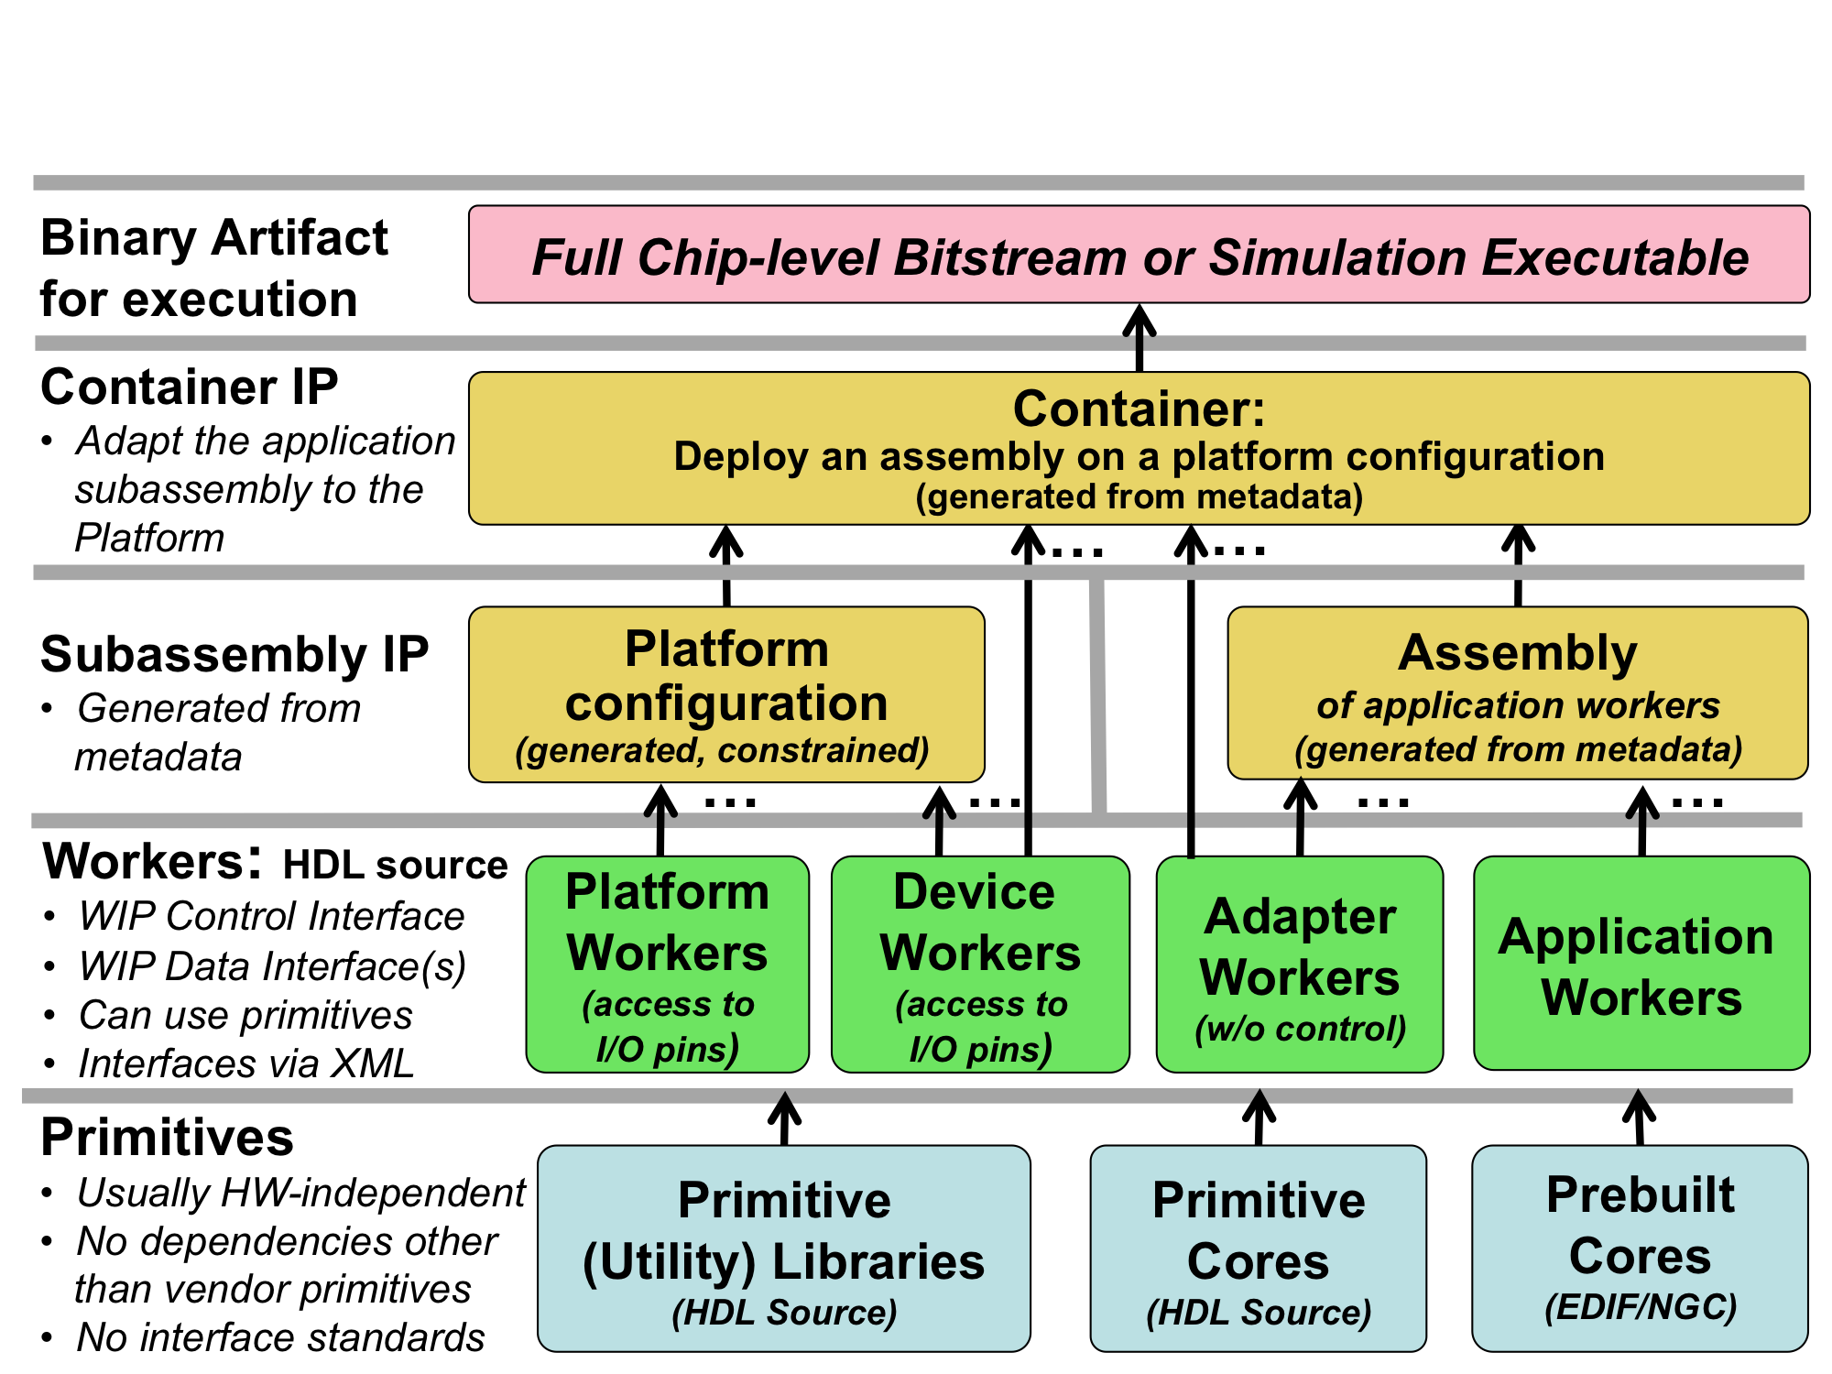
HDL Build Flow Hierarchy
Generated above this point
No user VHDL above this point

Slide 5
Project Directory Layout
Project Directory
specs
components
hdl
applications
specs
W1
W2
W3
A1
A2
A3
Platform
Development
primitives
assemblies
devices
platforms
Lib1
Lib2
Core3
TestBias
TestDDC
specs
D1
D2
specs
D1
D2
Libraries and Cores
Subassemblies
built for platforms
devices
specs
D1
D2

Slide 6
Component Directory Layout
A Component Library's Directory
Makefil
Component Unit Test subdirectories: <name>.test
One unit test per component "spec"
Makefile
Component Implementation (worker)
subdirectories: <name>.<model>
Multiple workers per component "spec"
specs
Which components
and targets to build
fft.hdl
fft.rcc
fft.test
…
sample-proto
.xml
Cvt-spec
.xml
fft-spec
.xml
fft-spec
.xml
Make-
file
Make-
file
Make-
file
Specifications for components
(xxx-spec.xml), and
inter-component message
protocols (xxx-proto.xml)
(all in XML)
fft
.xml
fft
.vhd
fft
.vhd
fft
.xml
fft.c
fft-test.xml
xyz.
vhd
gener-ate.py
verify.py
view.sh
Description
of Worker
Main
Worker
VHDL
Source
Code
File
Other
VHDL
Source
Code
Files
Description
of Unit Test
User-chosen scripts to generate, verify, and view test data

Slide 7
Vendor Tools and Environment Variables
Xilinx ISE 14.7, Isim
  OCPI_XILINX_DIR, OCPI_XILINX_VERSION, OCPI_XILINX_TOOLS_DIR
  OCPI_XILINX_LICENSE_FILE
Altera Quartus-II 15.1
  OCPI_ALTERA_DIR, OCPI_ALTERA_VERSION, OCPI_ALTERA_TOOLS_DIR
  OCPI_ALTERA_LICENSE_FILE
Mentor ModelSim 10.6a/10.4c (Mixed-language license REQUIRED)
  OCPI_MODELSIM_DIR
  OCPI_MODELSIM_LICENSE_FILE
Vivado 2017.1, Xsim (Vivado 2013.4 SDK is REQUIRED)
  Paths default to OCPI_XILINX_DIR and OCPI_XILINX_VERSION
  OCPI_XILINX_VIVADO_DIR, OCPI_XILINX_VIVADO_VERSION,
  OCPI_XILINX_VIVADO_TOOLS_DIR, OCPI_XILINX_VIVADO_LICENSE_FILE
Default tool installation locations work for most
MUST define license file location(s)
$ env | grep OCPI | sort

Slide 8
HDL Application Workers
HDL Worker Overview
HDL Application Workers

Slide 9
HDL Application Workers
Implement an OCS
  Declares properties (parameters) and ports
Described by an OWD, written in VHDL
  Ability to add-to accessibility of OCS Properties
  Declares unique worker properties
  Modify structure of ports
Ideally hardware/platform agnostic
  Wrap vendor-specific IP to achieve vendor-neutral code
  Build-time configurations (module feature support, vector size on input/output ports)
Can be built for multiple FPGA/simulation targets (i.e., Xilinx, Intel, FPGA family, toolset/version)
Typically, organized in a component library
Cannot instantiate other workers (no circular dependencies)
Connected together in an OHAD to form an HDL assembly

Slide 10
App Worker Development Flow
Protocol (OPS): Use pre-existing or create new
Component (OCS): Use pre-existing or create new
Create new application worker (Modify OWD, Makefile, and source HDL/RCC code)
Build the application worker for the target device(s)
Create unit test ({component}-test.xml, generate, verify and view scripts)
Build unit test – Assembly/Container is generated/built here
Run unit test

Slide 11
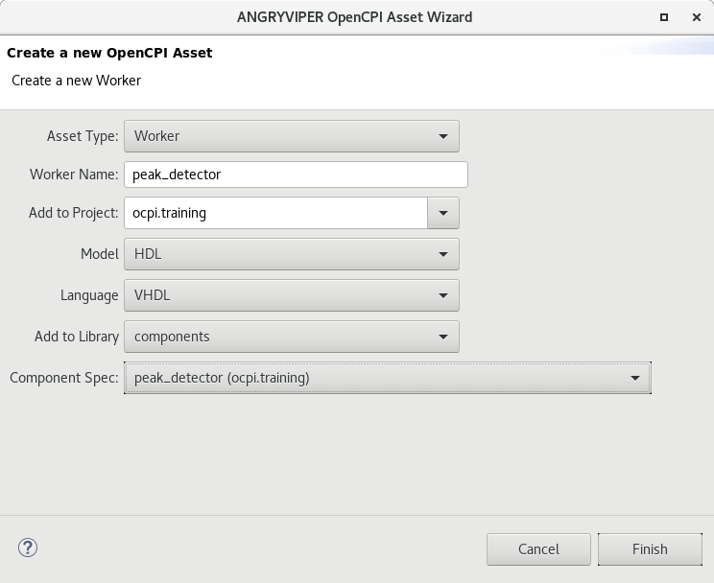
Creating an HDL Application Worker
Create via ocpidev utility (ran by IDE):
ocpidev create worker <name>.hdl -S <OCS>
Key files:
peak_detector.hdl/
|-- gen
| |-- peak_detector-build.xml # Initial build config
| |-- peak_detector-defs.vhd # VHDL package defs
| |-- peak_detector-impl.vhd # Generated Shell & Entity
| |-- peak_detector.mk # Parameter definitions
| `-- peak_detector-skel.vhd # Initial Source "skeleton"
|-- Makefile # a.k.a "Worker" Makefile
|-- peak_detector.vhd # Architecture (user code here)
`-- peak_detector.xml # OpenCPI Worker Description (OWD)

Slide 12
HDL Worker’s Generated VHDL
Shell, Entity, and Package of records: worker.hdl/gen/worker-impl.vhd
  Generated by framework based on OCS and OWD (Ports and Properties/Parameters)
  Outward-facing interfaces (subset of Open Core Protocol (OCP)) are "Normalized"
  to connect easily to other workers in an HDL assembly
  Inward-facing interfaces are available as VHDL records
    Control Ports: ctl_in.*, ctl_out.*
    Configuration Properties: props_in.*, props_out.*
    Data Ports (I/O): in_in.*, out_out.*
    Service Ports (time): time_in.*, time_out.*
    Port names above are the defaults, framework does supports ability to rename all ports
Architecture: worker.hdl/worker.vhd
  Upon initial creation of HDL workers, worker.hdl/gen/worker-skel.vhd is automatically
  copied and renamed worker.hdl/worker.vhd
  "Business Logic" goes here

Slide 13
HDL Application “Worker” Makefile
Variable in HDL Worker Makefile | Override / augment Component Library Makefile?
SourceFiles | N | A list of additional source files for this worker (VHDL or Verilog)
Libraries | Y | A list of primitive libraries built elsewhere. If a name has no slashes, it will follow the HDL Search Path rules
OnlyTargets | Y | A list of targets for which this worker should be built
ExcludeTargets | Y | A list of targets for which this worker should NOT be built
XmlIncludeDirs | Y | A list of directories elsewhere for searching for xml files included from the OWD (in addition to the ../specs directory in the component library containing this worker)
Worker | N | Name of worker; the default is from the directory name
Cores | N | A list of HDL primitive cores built elsewhere
VerilogIncludeDirs | Y | Searchable directories for Verilog include files, in addition to the worker directory
HdlExactPart | N | A variable to override the default part within a family specified by HdlTarget(s)
Generated by framework
Typically not manually edited
Minimally contains
include $(OCPI_CDK_DIR)/include/worker.mk
Build worker from <worker>.hdl/
  ocpidev build --hdl-target [target]
Build worker from parent library/
  ocpidev build library [libname] --worker [worker] --hdl-target [target]
Subdirectories created with build artifacts
  <worker>.hdl/target-[target]/

Slide 14
HDL Worker Description OWD XML
Primary reasons to modify the OWD (Properties and Ports):
  ADD implementation-specific configuration properties by using the "property" element
  Increase accessibility to existing OCS properties
    Use the "specproperty" element to ADD Readable(deprecated), Readback, Writable, Volatile, Initial
      MUST follow configuration property rules
      "Readable" is special / advanced case (NOT FOR NEW DESIGNS)
    CANNOT REMOVE accessibility defined in the OCS. CANNOT BREAK THE OCS “CONTRACT”!
  Designate SpecProperty/Property as limited to build-time, by applying the Parameter="true" attribute
    May set a default value for Parameter by:
      Property attribute “Default={value}”, or
      <worker>-build.xml (generics/constants for HDL; const for RCC)
    Specify an OCS property (“specproperty”) is a Parameter for a Worker
      Relevant only to OCS Initial properties (using specproperty) or OWD properties
  Specify interface style and implementation attributes for Ports
    stream interface, data path width, message abort support, etc.

Slide 15
HDL OWD Top-level Attributes
Specify which ControlOperations that worker will implement
  none are required for HDL workers
In addition to those attributes defined for all OWDs, an HDL worker's OWD may configure multiple additional attributes
HDL OWD Attribute | Data Type
DataWidth | unsigned | Default physical width of ALL data ports of worker. Otherwise, based on protocol of the port.
RawProperties | boolean | Indicates if worker will use raw property interface
FirstRawProperty | string | Indicates the name of the first property that requires the raw property interface.
Cores | list | List of HDL primtive cores required by this worker

Slide 16
HDL Worker Control Interfaces
Conveys life-cycle like initialize, start, or stop
  Required when top-level ControlOperations="initialize, start, stop" in OWD
Provides a control clock ctl_in.clk and associated synchronous reset ctl_in.reset
  Reset will be asserted synchronously for at least 16 clock cycles
  Available to all types of Workers (including Adapters: OCS/NoControl="true")
VHDL uses record ports ctl_in and ctl_out (default names)
  Input: clk, reset, control_op, state, is_operating, abort_control_op, is_big_endian
  Output: done, error, finished
Optionally use ctl_out.done and ctl_out.error when control operations or property accesses take more than one clock cycle, where done is an indication to change state
Optionally set ctl_out.finished if the worker has some semantic of being finished, i.e., transition the worker to the finished life-cycle state

Slide 17
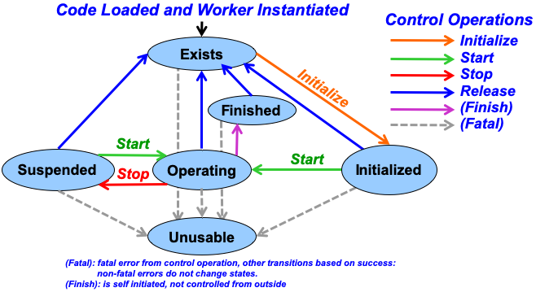
HDL Worker Control Interfaces
Typically, HDL workers have no need to implement any of the Control Operations
Enters Exists State upon deassert of Worker's ctl_in.reset
If Initialize Control Operation not implemented, then Worker is in Initialized State
MUST NOT perform any data transactions with data ports unless ctl_in.is_operating is asserted
  Indicates worker has been started and provides control software ability to suspend or resume all of parts of an application
  Operating State
Unusable state entered when Control Ops fail
Finished state declared by worker without any Control Op

Slide 18
HDL Worker Property Interfaces
VHDL records props_in and props_out
Types defined in package ocpi.types
  uchar_t, char_t, ushort_t, short_t, ulong_t, long_t, ulonglong_t, longlong_t
  float_t, double_t, string_t, bool_t, enum foo_t
Available signals depend on type of properties declared in OCS and OWD
  Scalar vs SequenceLength
Property Access Options | VHDL signal names | Accessible when
props_in. | foo | Initial or Writable
 | foo_length | Initial or Writable when SequenceLength is defined
 | foo_written | Writable
 | foo_any_written | Writable and SequenceLength is defined
 | foo_read | Volatile
props_out. | foo | Volatile
 | foo_length | Volatile when SequenceLength is defined

Slide 19
HDL Worker Property Behavior
Writable Properties
  Registered in the shell
  Available on "props_in" port record
  If not Initial, then Writable at run-time and given "props_in.<prop>_written" pulse
Writable Arrays/Sequences
  "props_in.<prop>_written" pulse only happens when value is completely updated
  "props_in.<prop>_any_written" is pulsed when any part is written
Readable Properties
  If not Volatile, shell handles read-back
  If Volatile, "props_out.<prop>" must be driven by "Business Logic" worker code

Slide 20
HDL Worker Raw Property Interfaces
Raw Property Interface
  Used when the worker manages storage and addressing of property values
  May avoid register duplication in both the outer shell and inner worker
  Enabled by setting rawProperties (all) or firstRawProperty (named and later) attributes in the OWD
  Often used when interfacing FPGA-external devices with memory mapped interfaces
Raw Property Access Options | VHDL signal names
Input | raw.address
 | raw.byte_enable
 | raw.is_read
 | raw.is_write
 | raw.data
Output | raw.data
 | raw.done
 | raw.error

Slide 21
HDL Worker Data Interfaces
Convey message with an associated opcode which indicates message types that are defined in the protocol
  Exception: When protocol contains ONE message type, NO opcode is used
Convey message boundaries between messages
  Opcode, Start-of-Message, End-of-Message, Length
Implement flow control
  Input data is explicitly accepted when offered from upstream
  Output data cannot be produced unless permission is granted from downstream
Special use case is when message is zero width
  ALL messages in protocol have no arguments, thus are ALL zero length
  Therefore, message opcodes are all that is conveyed. Essentially a "pulse" or "event" interface.

Slide 22
HDL Worker Data Interfaces
Streaming Data Interfaces
  FIFO-like interface with extra meta-bits for message boundaries and byte enables
    Metadata includes SOM, EOM, Valid, Abort (optional), Byte_Enable (optional)
  Buffers consist of 1 or 2 pipeline registers with flow control
  Output cannot be produced (give) unless permission is granted (output is ready; not full)
  Worker explicitly accepts (take) data at input interfaces only when input is ready (not empty)
StreamInterface Attribute | Data Type | Description
DataWidth | unsigned | The width of the data path for this interface. The default is the smallest element in the message protocol indicated in the OCS, unless overridden by a default datawidth attribute at the top level of this OWD (HdlWorker)
HDL workers must:
  Respect backpressure
  Convey message boundaries

Slide 23
Message Payload vs. Physical Data Width
Each Message Payload has a serialized format as a sequence of bytes that, when used in software, are laid out in byte-addressed memory
HDL Worker Data Interfaces have a Physical Width
  Indicates number of physical wires over which the message is conveyed
  Overridden by DataWidth attribute in the top-level of HDL OWD or per Port
  MUST be a multiple of the smallest data value in the protocol (DEFAULT is 1x)
If the Operation element in a protocol contains:
<Argument Name="a1" Type="uchar"/> <!-- SMALLEST DATA VALUE -->
<Argument Name="a2" Type="uShort" ArrayDimensions="2"/>
<Argument Name="a3" Type="ulongLong"/>
And the values of this payload are:
a1: 1, a2: {0x2345,0x6789}, a3: 0xfedcba9876543210

Slide 24
Message Payload vs. Physical Data Width
HDL Worker Data Interfaces:
Message Payload vs Physical Data Width
Then the byte sequence, with proper alignment and encoded little-endian, is shown below ("x" values are padding for alignment)
DataWidth=8 (DEFAULT because a1 is of type "uchar")
Sequence # ⇨ | 0 | 1 | 2 | 3 | 4 | 5 | 6 | 7 | 8 | 9 | 10 | 11 | 12 | 13 | 14 | 15
Contents (hex) | 01 | x | 45 | 23 | 89 | 67 | x | x | 10 | 32 | 54 | 76 | 98 | ba | dc | fe
Arguments | a1 |  | a2[0] |  | a2[1] |  |  |  | a3
Contents | 1 |  | 0x2345 |  | 0x6789 |  |  |  | 0xfedcba9876543210

Slide 25
Message Payload vs. Physical Data Width
HDL Worker Data Interfaces:
Message Payload vs Physical Data Width
Then the byte sequence, with proper alignment and encoded little-endian, is shown below ("x" values are padding for alignment)
DataWidth=16
Sequence # ⇨ | 0 | 1 | 2 | 3 | 4 | 5 | 6 | 7
15 downto 8 | x | 23 | 67 | x | 32 | 76 | ba | fe
7 downto 0 | 01 | 45 | 89 | x | 10 | 54 | 98 | dc

Slide 26
Message Payload vs. Physical Data Width
HDL Worker Data Interfaces:
Message Payload vs Physical Data Width
Then the byte sequence, with proper alignment and encoded little-endian, is shown below ("x" values are padding for alignment)
DataWidth=32
Sequence # ⇨ | 0 | 1 | 2 | 3
31 downto 24 | 23 | x | 76 | fe
23 downto 16 | 45 | x | 54 | dc
15 downto 8 | x | 67 | 32 | ba
7 downto 0 | 01 | 89 | 10 | 98

Slide 27
HDL Worker Data Interfaces: byte_enable
Byte enables on data interfaces are only present when needed
  Determined by combination of protocol (smallest data value) and DataWidth
Two values are inferred (can be overridden) from protocol
  DataValueWidth: smallest data value in protocol
  DataValueGranularity: least common multiple of data values among all messages in protocol; all message lengths are a multiple of this number of data values
Therefore, the physical data width of the interface (DataWidth) must be a multiple of DataValueWidth
  DataWidth > DataValueWidth * DataValueGranularity
    Byte enables are provided in the interface, because data words at the end of a message may be partially valid

Slide 28
HDL Worker Data Interfaces: byte_enable
Message is a sequence of short (16 bit) values, DataWidth is 16
  DataValueWidth = 16
  DataValueGranularity = 1
  No byte enables required
Message is a sequence of short (16 bit) values, DataWidth is 32
  DataValueWidth = 16
  DataValueGranularity = 1
  Byte enables (2) are required since sequences might be an odd number of shorts
Message is a sequence of pairs of short (16 bit) values, DataWidth is 32
  DataValueWidth = 16
  DataValueGranularity = 2
  Byte enables not required since sequences are always a multiple of two shorts

Slide 29
HDL Streaming Data Signals
som: Start of message: indicates first word in message, regardless of data present
eom: End of message: indicates last word in message, regardless of data present
valid: indicates the validity of data in a message
abort (optional): indicates this word is the end of an abort message
byte_enable (optional): combined with valid=true, indicates which bytes in a data word are valid
  All 1s except on the last valid word of a message

Slide 30
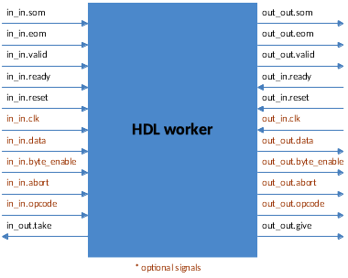
HDL Streaming Data Signals
SOM | Valid | EOM | Signal Description
1 | 0 | 0 | The start of a message, without any associated data
1 | 1 | 0 | The start of a message, coincident with data
1 | 0 | 1 | A zero-length message, with no data, in a single word
1 | 1 | 1 | A single word message
0 | 0 | 0 | Reserved
0 | 0 | 1 | A trailing end of message, with no data
0 | 1 | 0 | A data value in the middle of a message
0 | 1 | 1 | A data value, coincident with the end of the message
*When "abort" is not used, table is valid

Slide 31
HDL Streaming Data Signals
Rules for input interfaces:
  ready indicates that metadata and perhaps the data signals are valid
  If ready not asserted, none of the metadata signals are valid or meaningful
  Worker takes input data when ready is asserted by asserting take
  It is invalid to assert take if the ready input signal is not asserted
Rules for output interfaces:
  ready indicates that metadata and perhaps data can be produced
  If ready not asserted, none of the metadata or data output are considered valid
  Worker gives data when ready is asserted by asserting give
  It is invalid to assert give if the ready input signal is not asserted
Ready (I/O), take, give control the flow of data and metadata words through an interface

Slide 32
HDL Streaming Data Signals
Data flows according to FIFO semantics
Table of signal terminology comparison
  In AXI interfaces, either signal (valid or ready) may be asserted early. The handshake (ready) can in fact be asserted early even when valid is not yet asserted.
  With OpenCPI it is invalid to assert take or give without ready being asserted.
  In Xilinx FIFO, rd_en and wr_en are ignored if the fifo is empty (input) or full (output).
Meaning | OpenCPI | Classic FIFO | AXI | Xilinx FIFO
Data is available to consume | ready | not_empty | valid | !empty
Consume Data | take | dequeue | ready | rd_en
Data can be produced | ready | not_full | ready | !full
Produce Data | give | enqueue | valid | wr_en

Slide 33
HDL Application Worker Example
Example:
- No opcode or byte_enable is used since the protocol has a single operation
- ctl_in.is_operating reflects the reset condition
- Combinatorial logic: computation takes place in a single clock cycle: Simply adds a constant to every data value from input to output
library IEEE; use IEEE.std_logic_1164.all; use ieee.numeric_std.all;
library ocpi; use ocpi.types.all; -- remove this to avoid all ocpi name collisions
architecture rtl of my_vhdl_worker is
signal doit : bool_t;
begin
doit <= ctl_in.is_operating and in_in.ready and out_in.ready;
in_out.take <= doit;
out_out.give <= doit;
out_out.data <= std_logic_vector(unsigned(in_in.data) + 3);
out_out.som <= in_in.som;
out_out.eom <= in_in.eom;
out_out.valid <= in_in.valid;
-- loop-back property example
props_out.my_prop <= props_in.my_prop;
end rtl;

Slide 34
HDL Worker Service Interfaces
Time Service Interface
  "time of day" provided to the precision of the OWD attributes within the TimeInterface element, in GPS time
    SecondsWidth – 0 to 32 bits for reporting seconds field in time-of-day (Optional)
      = 32 bits, absolute time
      < 32bits, relative time truncated preserving the LSB, to that value and wraps.
    FractionWidth – 0 to 32 bits for reporting fractions field in time-of-day (Optional)
      = 32 bits, 2^-32 or ~233 ps.
      < 32bits, MSB are preserved, such that MSB is always ½ second
    AllowUnavailable – Indicates when time-of-day is valid (Optional)
  VHDL uses record port time_in.*
    Input: seconds, fraction, valid
    Ex: time_now <= std_logic_vector(time_in.seconds) & std_logic_vector(time_in.fraction);

Slide 35
HDL Build Targets: Targets vs. Platforms
Targets
Platforms
Chips or chip families, and simulators
Used to build HDL primitives, workers, and assemblies
OnlyTargets/ExcludeTargets
Smallest part in family chosen by default – to override, use the HdlExactPart Makefile variable
Ex: xsim, modelsim, isim, stratix4, virtex6, zynq, zynq_ise
Actual FPGAs on specific boards, and simulators
Used to build HDL containers (final bitstreams)
OnlyPlatforms/ExcludePlatforms
HdlTarget(s) implied (family and part) at all levels except final bitstream
Ex: xsim, modelsim, isim, alst4, ml605, zed, zed_ise, matchstiq_z1

