Slide 1
Branch Prediction
What is the optimal choice of branch prediction method?
Alison Davis
CIS655 – 3/3/2020

Slide 2



Motivation
Increasing ILP
Goal: minimizing stall cycles
Optimization problem
Accuracy
Complexity/Code Size
Energy

Slide 3
Existing Methods
Dynamic Prediction Methods
Local vs Global
BHT (Branch History Table)
Aliasing
Static Prediction Methods
Profiling & tracing
Heuristics & Bias
Additional Considerations
Combinational Methods

Slide 4
The best method of branch prediction…?
…it depends.
But, if I had to have an opinion..

Slide 5

SimpleScalar Demo

Slide 6
BP Method Accuracies in SimpleScalar

Slide 7
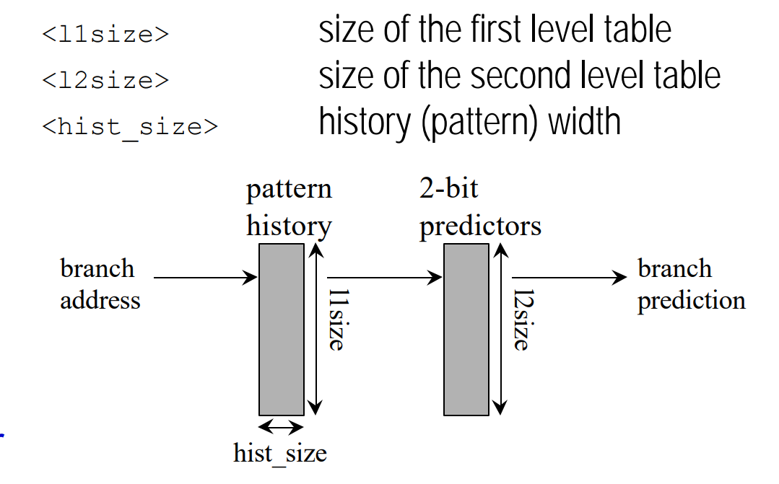
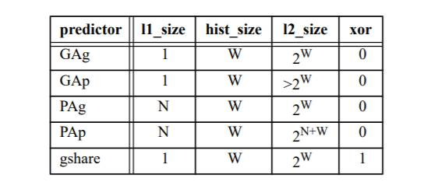
Increasing History Bits: Accuracy & Cache Miss Rate
Iterations of 2lev in SimpleScalar
M <l1size>
N <l2size>
W <hist_size>
X <Xor>
SimpleScalar Default: M, N, W, X = 1,1024, 8, 0
GAg = Global History Reg & Global Pattern History Table

Slide 8
Data for Varying History Width
Type of Predictor | M | N | W | X | Accuracy | Level 1 Cache Miss Rate
2lev | <1> | <2^W> | <W> | <0>
 | 1 | 2 | 1 | 0 | 0.6438 | 0.0607
 | 1 | 4 | 2 | 0 | 0.6507 | 0.0616
 | 1 | 16 | 4 | 0 | 0.6726 | 0.062
 | 1 | 256 | 8 | 0 | 0.7466 | 0.0625
 | 1 | 1024 | 10 | 0 | 0.7849 | 0.063
 | 1 | 32768 | 15 | 0 | 0.8049 | 0.0629
 | 1 | 1048576 | 20 | 0 | 0.8029 | 0.0624

Slide 9
Branch Prediction Accuracy for Increasing History Size in GAg Method
GAg = Global History Reg & Global Pattern History Table

Slide 10
L1 Instruction Cache Miss Rate for Increasing History Size in GAg Method
GAg = Global History Reg & Global Pattern History Table

