Slide 1
Thesis Summary
Brian Davis
Supervisor: Berenice Batut
Supervisor: Anika Erxleben

Slide 2
Overview
Introduction
Description of the State of the Art
Research Questions Answered by the Thesis
What Have I Done So Far?
Proposed Timeline

Slide 3
Introduction
Some aspects of evolution are not completely understood
E.g. the mechanisms behind reductive evolution
Prochlorococcus marinus – avg. of 2,000 bp.
Synechococcus – some strains have over 2.4 Mpb.
What controls the number of base pairs?
How can we identify a “successful” genome?
Fitness
Evolvability
Robustness

Slide 4
Definitions
Evolvability
“The ability of a population to develop […] adaptive diversity.”
Robustness
“The persistence of a certain characteristic or trait in a system under perturbations or conditions of uncertainty”

Slide 5
?

Slide 6
Introduction
Acquiring full records with in vivo evolutionary experiments would be too difficult, expensive, and slow
Use in silico evolution to simulate evolving organisms
Aevol is a set of software tools designed to study genome structure

Slide 7
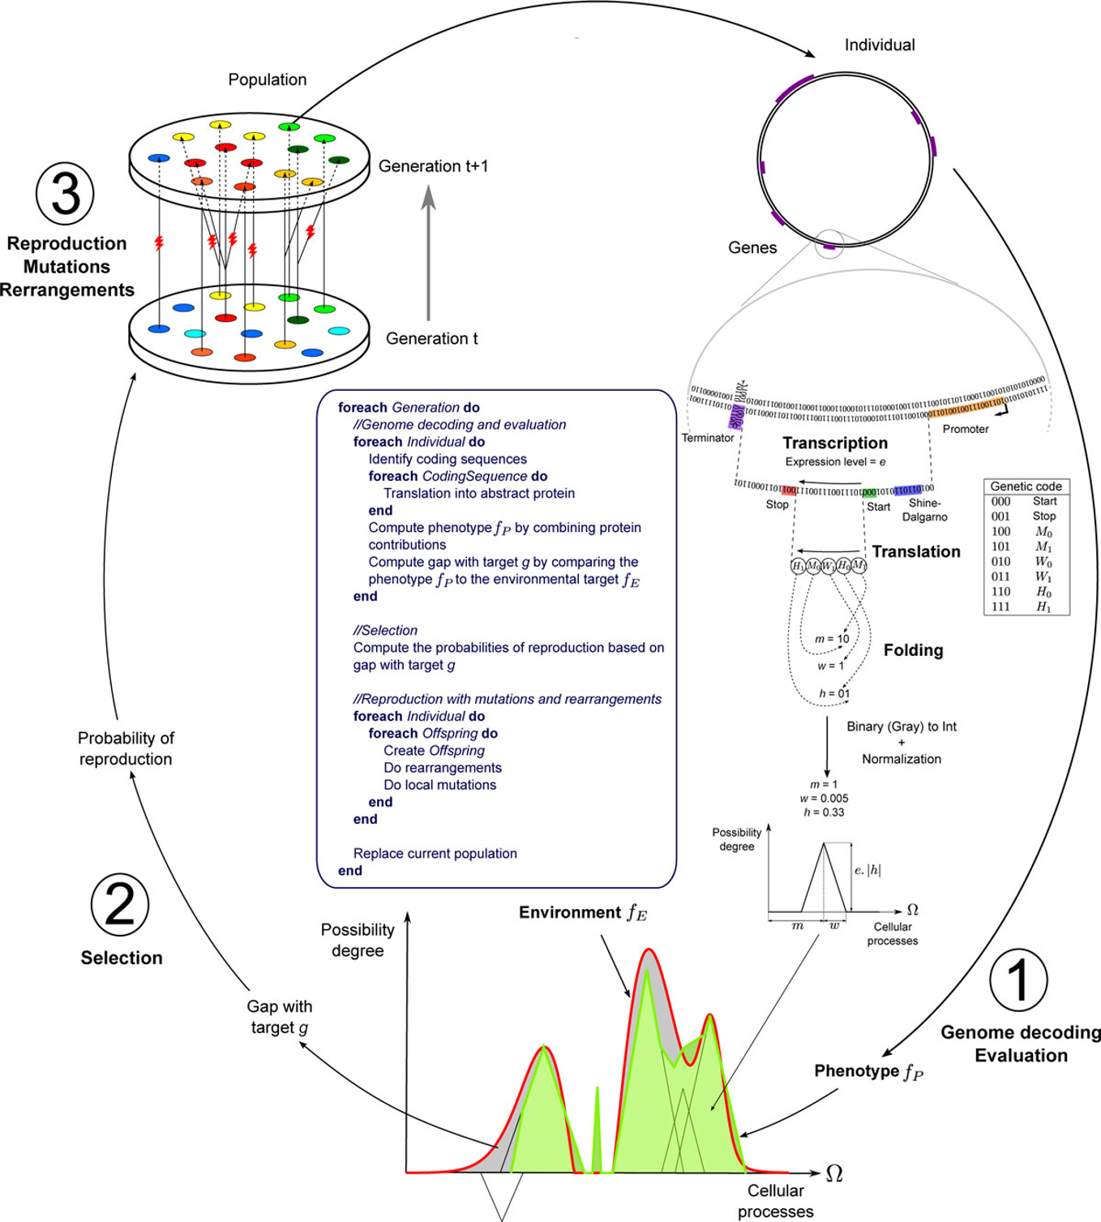
Aevol

Slide 8
Description of the State of the Art
Testing evolution predictability using the aevol software (Beslon, Liard, Elena, 2017)
Wild types are not equivalent wrt. evolvability
The Complexity Ratchet: Stronger Than Selection, Weaker Than Robustness (Liard, et al., 2018)
Molecular complexity is decoupled from environmental complexity.
New insights into bacterial adaptation through in vivo and in silico experimental evolution (Hindre, et al., 2012)
There is a trade-off between evolvability and the “mutational burden”
Adapting the engine to the fuel: mutator populations can reduce the mutational load by reorganizing their genome structure (Rutten, et al.)
The “mutational burden” is escapable

Slide 9
Purpose of the Thesis
Study the effects on the genome of varying conditions:
Changes in population size
Changes in mutation rates
Changes in selection rates
Identify some factor(s) leading to a reduced genome
Study the effects of these conditions on:
Structure (e.g. coding vs. non-coding RNA)
Evolvability
Robustness
Relate this to real-world bacteria like Prochlorococcus

Slide 10
Methods
Mutation+
Control
Num BP
Selection+
Population+
Generation

Slide 11
What Have I Done So Far?
Preliminary research
Familiarization with topic
Identifying research goals
Experiments using Aevol (currently running)
7 conditions
Control (1)
Population up/down (2)
Selection up/down (2)
Mutation up/down (2)
500,000 generations each
5 seeds
Thesis Report
Basic structure

Slide 12
Proposed Timeline – Overview
Register October 1
Work with Berenice until December 21, 2019
Focus on domain knowledge
Weekly meetings (generally Fridays)
Communicate via Github, E-mail, Skype
Submit work day before meeting
Work with Anika through March 31, 2020
Focus on writing process
Weekly meetings (suited to her schedule)
Communicate via whatever method is convenient
Suggested – Google Docs document to log work
Submit work day before meeting
Work with Guillaume Beslon
Focus on technical side of working with Aevol
Communicate via Skype, E-mail as needed

Slide 13
Proposed Timeline – Schedule
 | Week
 | 1 | 2 | 3 | 4 | 5 | 6 | 7 | 8 | 9 | 10 | 11 | 12 | 13 | 14 | 15 | 16 | 17 | 18 | 19 | 20 | 21 | 22 | 23 | 24 | 25 | 26
 | 1.10.19 | 8.10.19 | 15.10.19 | 22.10.19 | 29.10.19 | 5.11.19 | 12.11.19 | 19.11.19 | 26.11.19 | 3.12.19 | 10.12.19 | 17.12.19 | 24.12.19 | 31.12.19 | 7.1.20 | 14.1.20 | 21.1.20 | 28.1.20 | 4.2.20 | 11.2.20 | 18.2.20 | 25.2.20 | 3.3.20 | 10.3.20 | 17.3.20 | 24.3.20
Task
1. Analysis
Population Up Condition
Population Down Condition
Mutation Up Condition
Mutation Down Condition
Selection Up Condition
Selection Down Condition
2. Report
Introduction
Background
Methods
Results
Conclusion and Future Work
3. Final Presentation

