Slide 1







STACK OVERFLOW DEVELOPER SURVEY 2019
Quoc Hoang Xuan
March 10,2024

Slide 2



OUTLINE
Executive Summary
Introduction
Methodology
Results
Visualization – Charts
Dashboard
Discussion
Findings & Implications
Conclusion
Appendix

Slide 3

EXECUTIVE SUMMARY
Data contextualization and analysis goal.
Methodology description.
Data gathering.
Data analysis.
Data visualizations.
Results presentation supported with graphs and trends.
Discussion of overall findings and implications regarding
the results previously exposed.
Final conclusions of the carried out research.

Slide 4

INTRODUCTION
Stack Overflow’s annual Developer Survey is the largest
and most comprehensive survey of people who code
around the world.
Results don’t represent everyone in the developer
community evenly.
Nearly 90,000 developers.
Trends to predict where the developers are going.
Characterization of developers around the globe.

Slide 5

METHODOLOGY
Collect survey data & explore its content
Web Scraping.
APIs.
Request library.
Data Wrangling
Exploratory data analysis
Analyzing data distribution.
Handling outliers.
Correlations
Data Visualization
Highlight distribution of data, relationships, the composition and
comparison of data.
Dashboards

Slide 6

RESULTS

Slide 7
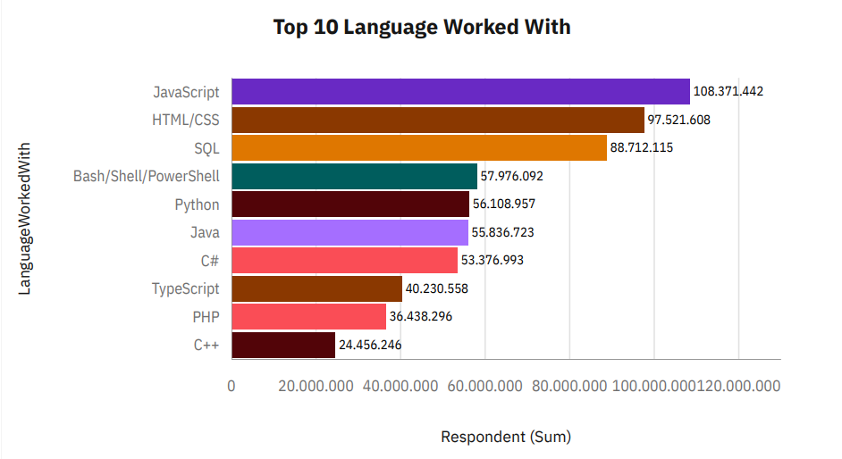
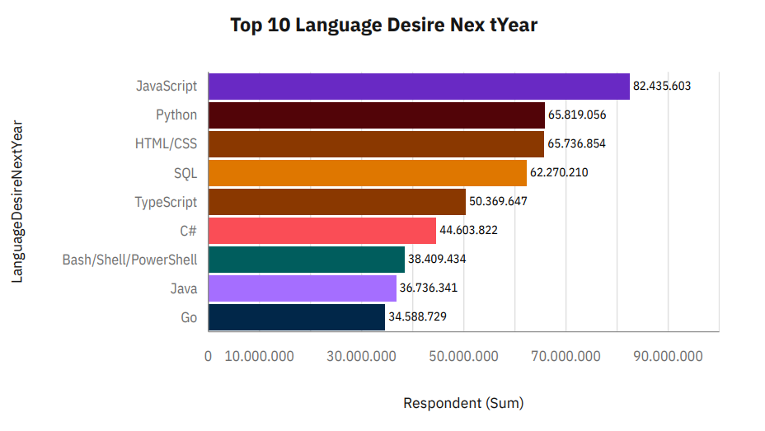
PROGRAMMING LANGUAGE TRENDS
Current Year
Next Year

Slide 8
PROGRAMMING LANGUAGE TRENDS - FINDINGS & IMPLICATIONS
Findings
JavaScript seems to keep as
leading language.
Python fastest-growing.
Great interest in TypeScript
Implications
Possible developers migration
from JavaScript to TypeScript.

Slide 9
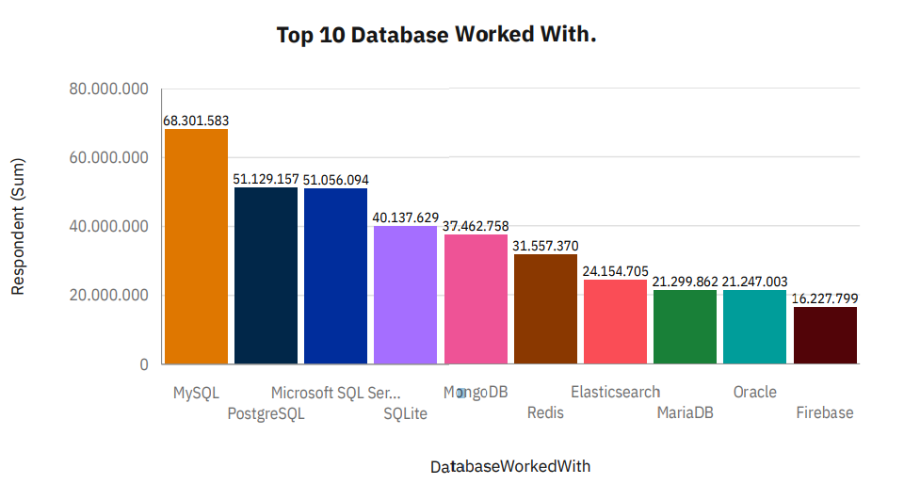
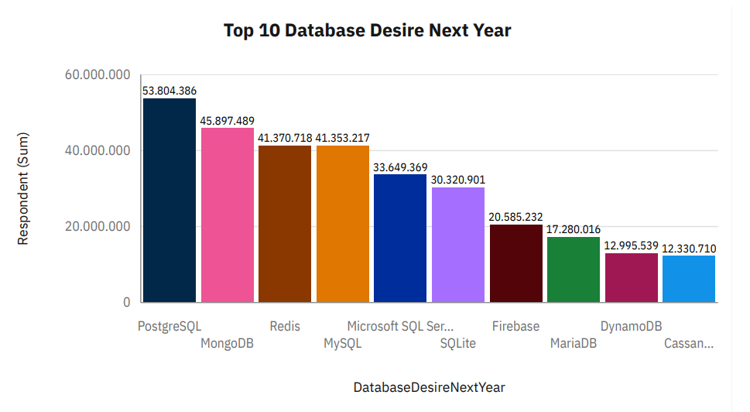
DATABASE TRENDS
Current Year
Next Year

Slide 10
DATABASE TRENDS - FINDINGS & IMPLICATIONS
Findings
MySQL as most used database.
Lack of interest in Microsoft SQL
Server and SQLite.
Increasing interest in PostgreSQL
and MongoDB.
Implications
Microsoft SQL Server and SQLite
losing ground in the market.
PostgreSQL and MongoDB
establishment in the market.

Slide 11

DASHBOARD
<The GitHub link of the Cognos dashboard goes here.>

Slide 12
DASHBOARD TAB 1
Screenshot of dashboard tab 1 goes here

Slide 13
DASHBOARD TAB 2
Screenshot of dashboard tab 2 goes here

Slide 14
DASHBOARD TAB 3
Screenshot of dashboard tab 3 goes here

Slide 15
DISCUSSION

Slide 16
OVERALL FINDINGS & IMPLICATIONS
Findings
Finding 1
Finding 2
Finding 3
Implications
Implication 1
Implication 2
Implication 3

Slide 17

CONCLUSION
Point 1
Point 2
Point 3
Point 4

Slide 18

APPENDIX
Include any relevant additional charts, or tables that you may have created during the analysis phase.

Slide 19
JOB POSTINGS
In Module 1 you have collected the job posting data using Job API in a file named “job-postings.xlsx”. Present that data using a bar chart here. Order the bar chart in the descending order of the number of job postings.

Slide 20
POPULAR LANGUAGES
In Module 1 you have collected the job postings data using web scraping in a file named “popular-languages.csv”. Present that data using a bar chart here. Order the bar chart in the descending order of salary.

