Slide 1







STACK OVERFLOW DEVELOPER SURVEY 2019
Quoc Hoang Xuan
March 10,2024

Slide 2



OUTLINE
Executive Summary
Introduction
Methodology
Results
Visualization – Charts
Dashboard
Discussion
Findings & Implications
Conclusion
Appendix

Slide 3

EXECUTIVE SUMMARY
Data contextualization and analysis goal.
Methodology description.
Data gathering.
Data analysis.
Data visualizations.
Results presentation supported with graphs and trends.
Discussion of overall findings and implications regarding
the results previously exposed.
Final conclusions of the carried out research.

Slide 4

INTRODUCTION
Stack Overflow’s annual Developer Survey is the largest
and most comprehensive survey of people who code
around the world.
Results don’t represent everyone in the developer
community evenly.
Nearly 90,000 developers.
Trends to predict where the developers are going.
Characterization of developers around the globe.

Slide 5

METHODOLOGY
Collect survey data & explore its content
Web Scraping.
APIs.
Request library.
Data Wrangling
Exploratory data analysis
Analyzing data distribution.
Handling outliers.
Correlations
Data Visualization
Highlight distribution of data, relationships, the composition and
comparison of data.
Dashboards

Slide 6

RESULTS

Slide 7
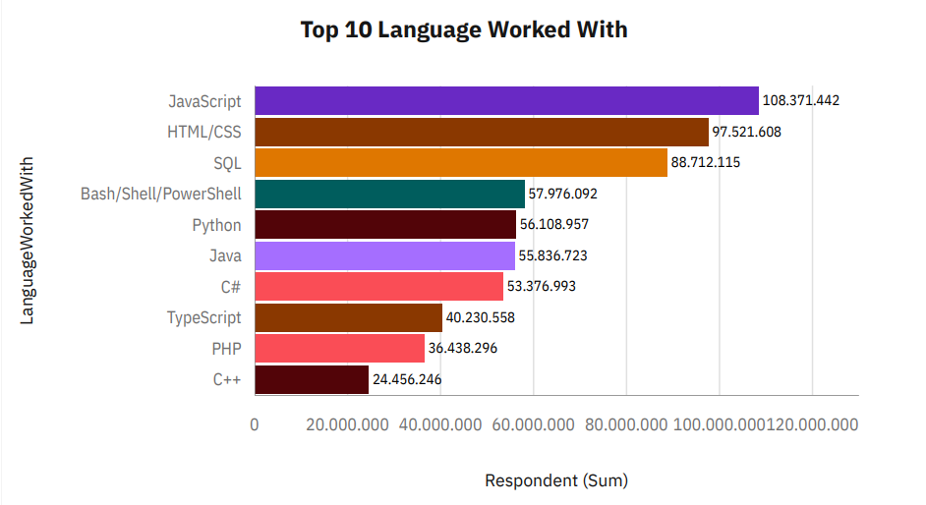
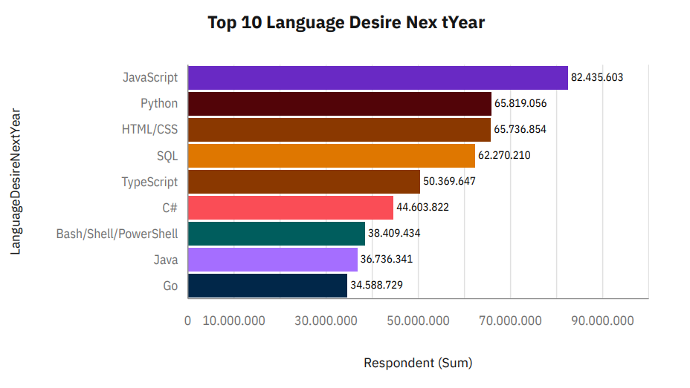
PROGRAMMING LANGUAGE TRENDS
Current Year
Next Year

Slide 8
PROGRAMMING LANGUAGE TRENDS - FINDINGS & IMPLICATIONS
Findings
JavaScript seems to keep as
leading language.
Python fastest-growing.
Great interest in TypeScript
Implications
Possible developers migration
from JavaScript to TypeScript.

Slide 9
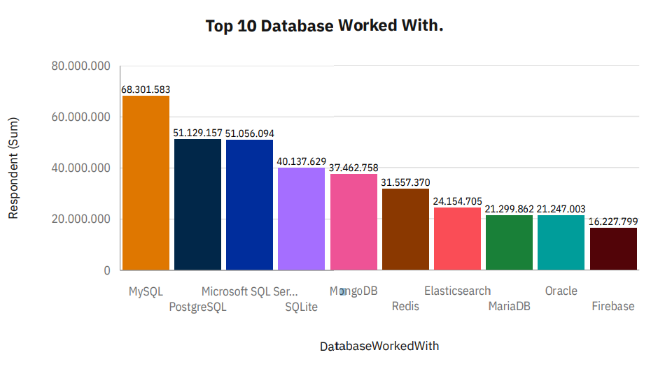
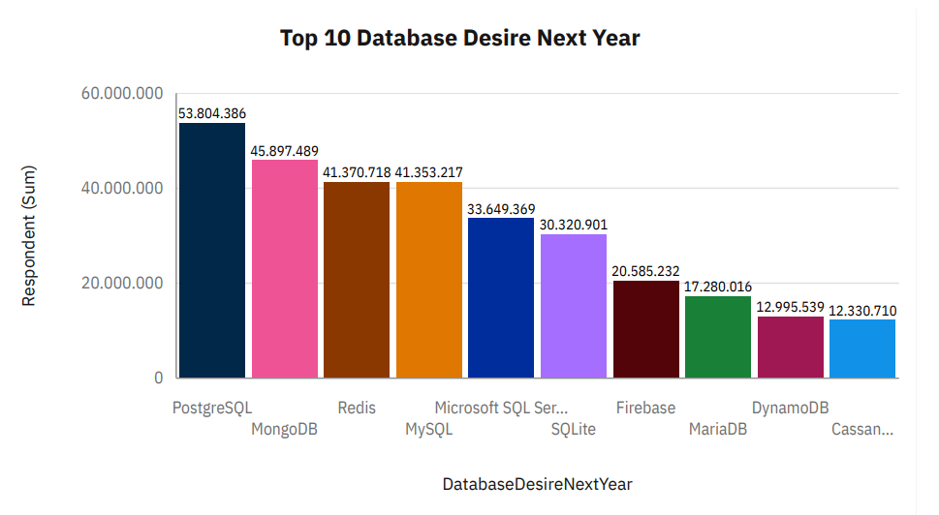
DATABASE TRENDS
Current Year
Next Year

Slide 10
DATABASE TRENDS - FINDINGS & IMPLICATIONS
Findings
MySQL as most used database.
Lack of interest in Microsoft SQL
Server and SQLite.
Increasing interest in PostgreSQL
and MongoDB.
Implications
Microsoft SQL Server and SQLite
losing ground in the market.
PostgreSQL and MongoDB
establishment in the market.

Slide 11

DASHBOARD
LINK TO GITHUB DASHBOARDS

Slide 12
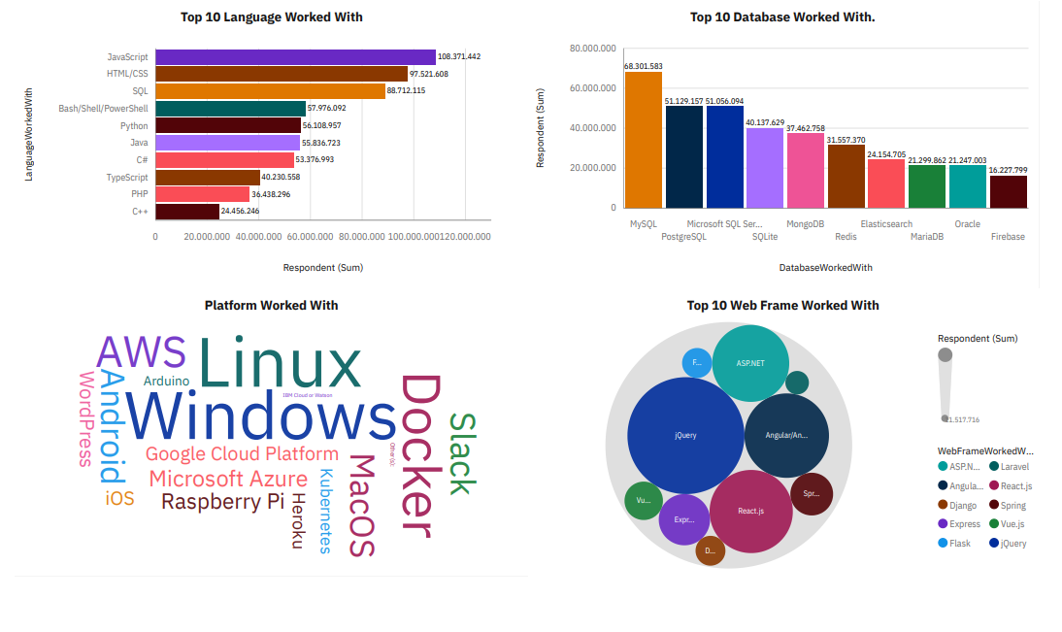
CURRENT TECHNOLOGY USAGE

Slide 13
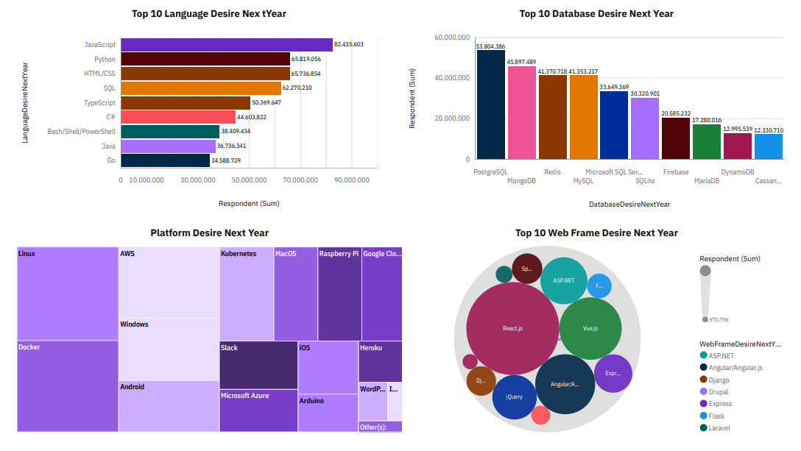
FUTURE TECHNOLOGY TREND

Slide 14
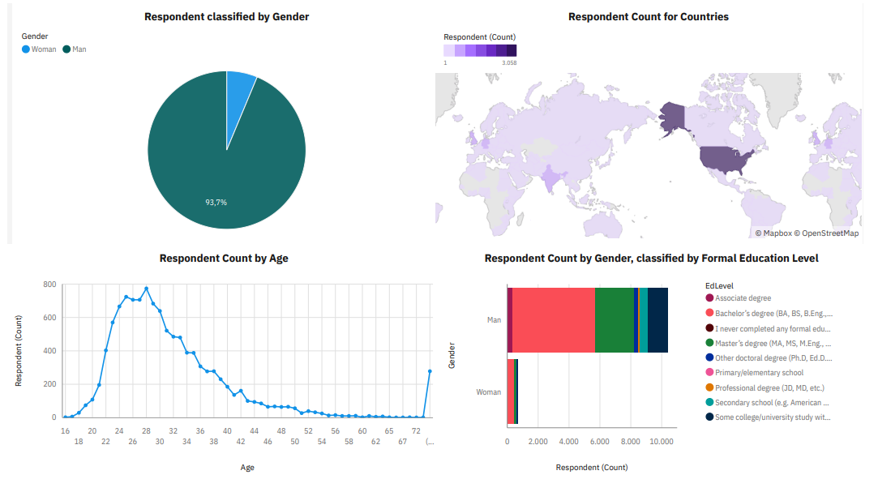
DEMOGRAPHICS

Slide 15
DISCUSSION

Slide 16
OVERALL FINDINGS & IMPLICATIONS
Findings
JavaScript widely used and
TypeScript getting popular.
Over 90% young male
developers.
Developers mostly located in
developed countries.
Implications
JavaScript and TypeScript web
frames gaining followers.
Global polarization of developers
location and gender.
Young developers without
postgrad studies on its majority

Slide 17

CONCLUSION
Developers are people with very marked
characteristics.
A good idea of popularity trends of different
tools, platforms and languages can be
obtained.
There is a job to be done to spread
accessibility of this labor market to
countries in development.

Slide 18

APPENDIX

Slide 19
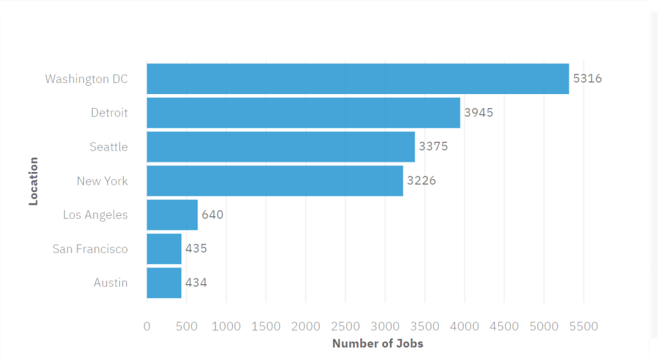
JOB POSTINGS

Slide 20
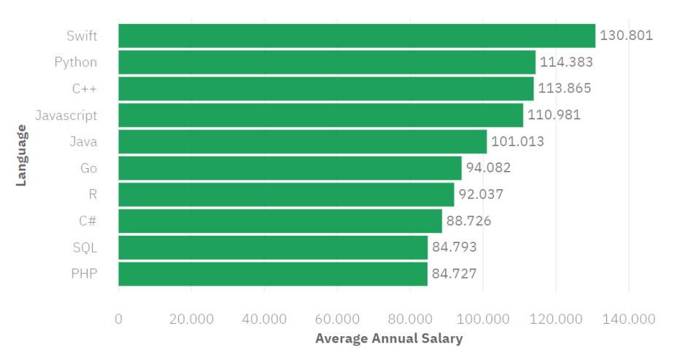
POPULAR LANGUAGES

