Slide 1
Classification Model
Dr. Wei Zhong

Slide 2
Classification Model
a classification model or classifier is constructed to predict class (categorical)
“safe” or “risky” for the loan application data;
“yes” or “no” for the marketing data
“treatment A,” “treatment B,” or “treatment C” for the medical data.

Slide 3
Classification Model
Classification is a form of supervised learning where we train a model with training examples that include known targets or outcomes of interest
The model is supervised with these example outcomes

Slide 4
Binary Classification
The simplest form of classification is when we have two classes; this is referred to as binary classification.
One of the classes is usually labeled as the positive class (assigned a label of 1)
while the other is labeled as the negative class (assigned a label of -1 or, sometimes, 0)

Slide 5
Binary Classification
A simple example with two classes is shown in the following figure. The input features in this case have two dimensions, and the feature values are represented on the x and y axes in the figure.
Our task is to train a model that can classify new data points in this two-dimensional space as either one class (red) or the other (blue).

Slide 6
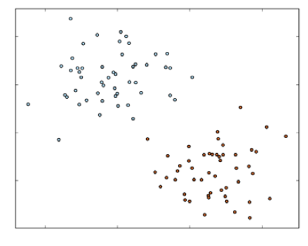
Simple Binary Classification Problem

Slide 7
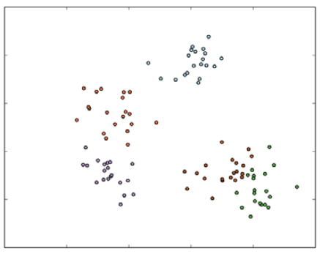
A simple multiclass classification problem

Slide 8
Model Training
Given a set of input data in the form of feature vectors and target variables, we would like to find the weight vector that is the best fit for the data
we minimize some error between what our model predicts and the actual outcomes
This process is called model fitting, training, or optimization.

Slide 9
Three Type of Classification Model
Linear models (Logistic regression and SVM)
decision trees (nonlinear)
naïve Bayes models (nonlinear)

Slide 10
Linear Models
Linear models, while less complex, are relatively easier to scale to very large datasets.
Decision tree is a powerful nonlinear technique that can be a little more computationally intensive to train, but delivers leading performance in many situations.
Naïve Bayes models are more simple but are easy to train efficiently and parallelize.

Slide 11

Linear Models
The core idea of linear models is that we model the target as a function of a simple linear predictor (or vector dot product) applied to the input variables.
Here, y is the target variable, w is the vector of parameters (known as the weight vector), and x is the vector of input features.
To this linear predictor, we applied a function f (called the link function).

Slide 12
Logistic regression
Logistic regression is widely used to predict a binary response.
Binary classification equates to the model's estimate of the probability of the data point belonging to the positive class.

Slide 13


Logistic regression
Given a new data point, denoted by x, the model makes predictions by applying the logistic function
By default, if f(z)>0.5, the outcome is positive, or negative otherwise
Unlike linear SVMs, the raw output of the logistic regression model, f(z), has a probabilistic interpretation (i.e., the probability that x is positive).

Slide 14

Loss (Error) Function for Logistics Regression
the loss function in the formulation given by the logistic loss:

Slide 15
Linear Support Vector Machines
Decision function for SVM
Given a new data point, denoted by x, the model makes predictions based on the value of z. By the default, if z≥0 then the outcome is positive, and negative otherwise.
this threshold is a model parameter of SVM and can be adjusted

Slide 16

Loss Function of Linear SVM
The loss function for SVM is known as the hinge loss and is defined as:
SVM is a maximum margin classifier—it tries to find a weight vector such that the classes are separated as much as possible.

Slide 17
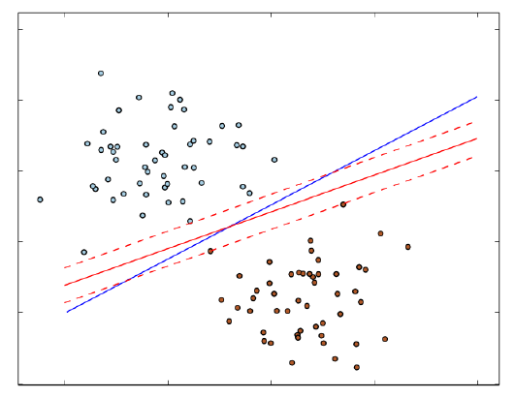
Decision functions for logistic regression and linear SVM for binary classification

Slide 18
The naïve Bayes model (nonLinear Model)
Naïve Bayes is a probabilistic model that makes predictions by computing the probability of a data point that belongs to a given class.
A naïve Bayes model assumes that each feature makes an independent contribution to the probability assigned to a class
Due to this assumption, the probability of each class becomes a function of the product of the probability of a feature occurring, given the class, as well as the probability of this class.

Slide 19
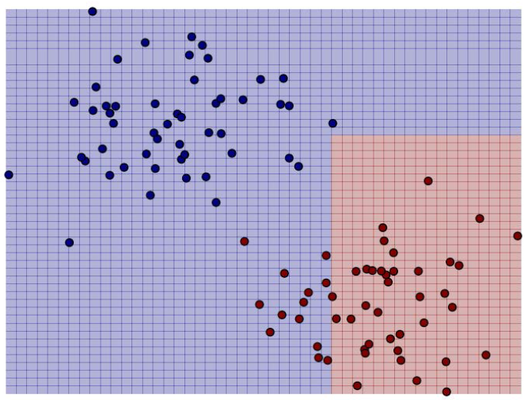
Decision function of naïve Bayes for binary classification (Non Linear)

Slide 20
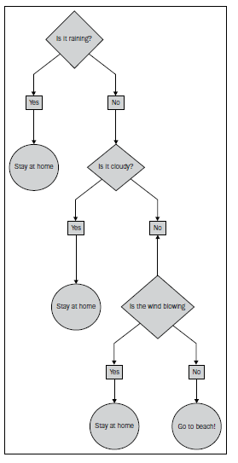
Decision Tree (Nonlinear Model)

Slide 21
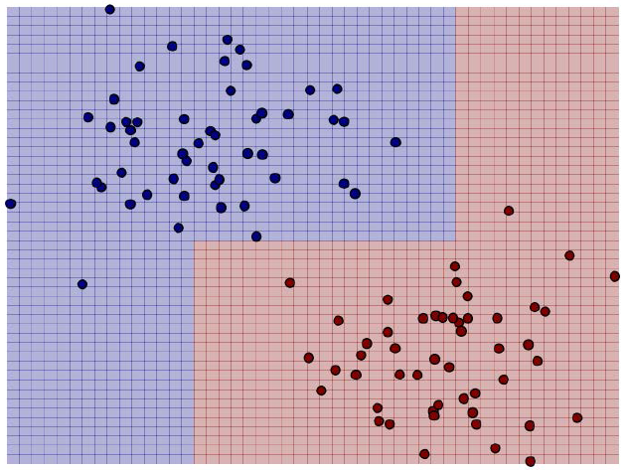
Decision function for a decision tree for binary classification

Slide 22
Model Evaluation and Prediction Value
Note that the predictions made by the model are not naturally exactly 1 or 0.
The output is usually a real number that must be turned into a class prediction.
This is done through use of a threshold in the classifier's decision or scoring function.
Note that the threshold itself is effectively a model parameter that can be tuned in some models.

Slide 23
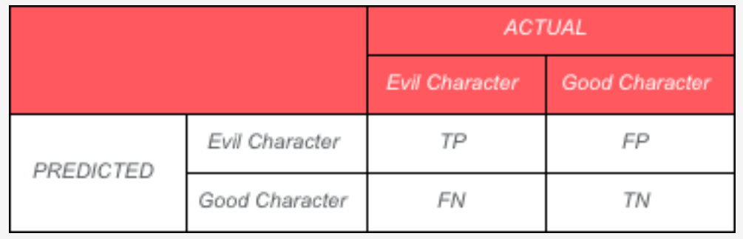
True Positive and False Negative
Evil Character is the positive class
Good Character is the negative class

Slide 24
Precision vs. Recall
Precision is measured by calculating: Out of the characters predicted to be evil, how many did the model identify correctly i.e. TP / (TP + FP)?
Recall is measured by calculating: Out of all evil characters, how many are predicted by the model i.e. TP / (TP + FN)?

Slide 25
Precision vs. Recall
There is always a trade-off between choosing high precision vs. high recall. Depending on the purpose of the model, one might choose higher precision over higher recall.
However, for fraud prediction models, higher recall is generally preferred even if some precision is sacrificed.

Slide 26
Precision vs. Recall
Precision and recall are not particularly useful as standalone metrics, but are typically used together to form an aggregate or averaged metric.
Precision and recall are also dependent on the threshold selected for the model.

Slide 27
The precision-recall (PR) curve
the following figure plots precision against recall outcomes for a given model, as the decision threshold of the classifier is changed.
The area under this PR curve is referred to as the average precision.
Intuitively, an area under the PR curve of 1.0 will equate to a perfect classifier that will achieve 100 percent in both precision and recall.

Slide 28
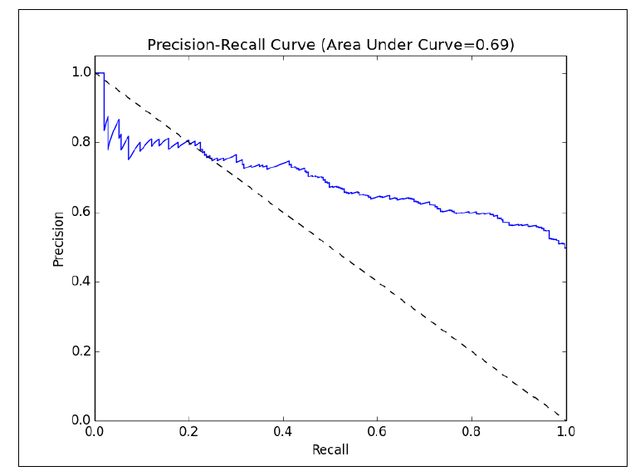
The precision-recall (PR) curve

Slide 29
ROC curve and AUC
It is a graphical illustration of the true positive rate against the false positive rate for a classifier.
The true positive rate (TPR) is the ratio of true positives to all positive examples like Recall (sensitivity)
The false positive rate (FPR) is the ratio of false positives to all negative examples.

Slide 30
ROC curve and AUC
In a manner similar to precision and recall, the ROC curve (plotted in the following figure) represents the classifier's performance tradeoff of TPR against FPR, for different decision thresholds.
Each point on the curve represents a different threshold in the decision function for the classifier.

Slide 31
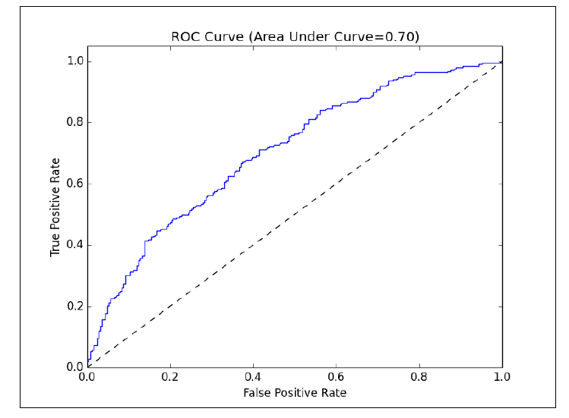
ROC Curve

Slide 32
ROC curve and AUC
The area under the ROC curve (commonly referred to as AUC) represents an average value.
Again, an AUC of 1.0 will represent a perfect classifier.
An area of 0.5 is referred to as the random score. Thus, a model that achieves an AUC of 0.5 is no better than randomly guessing.

Slide 33
Performance Comparison between Different Model
As both the area under the PR curve and the area under the ROC curve are effectively normalized (with a minimum of 0 and maximum of 1),
we can use these measures to compare models with differing parameter settings and even compare completely different models.
Thus, these metrics are popular for model evaluation and selection purposes.

Slide 34
Parameter Tuning
Mllib sets sensible defaults in most cases.
But in practice, the best parameter setting should be selected using evaluation techniques.

Slide 35
Parameter Tuning for Linear Model
Both logistic regression and SVM share the same parameters, because they use the same underlying optimization technique of stochastic gradient descent (SGD).
They differ only in the loss function applied.

Slide 36
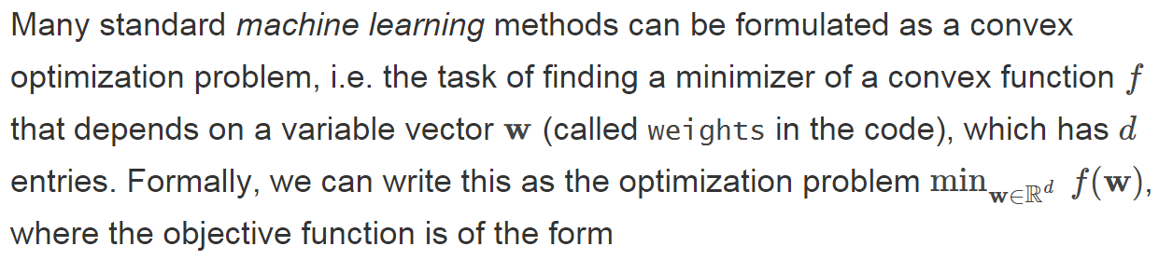
Mathematical Formulation

Slide 37
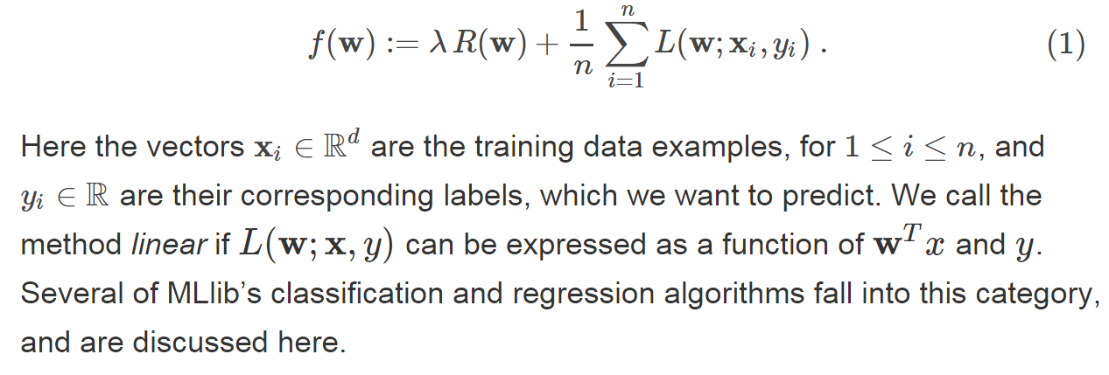
Objective Function for Optimization

Slide 38
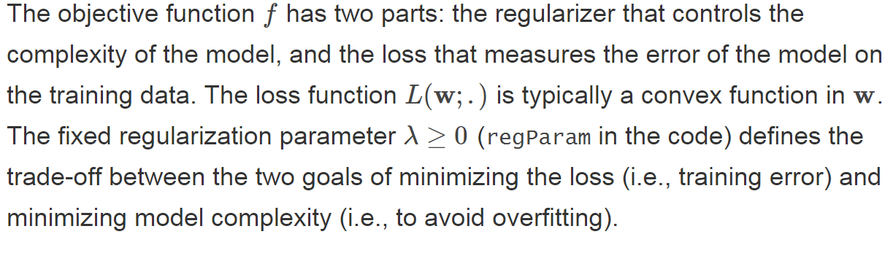
Regularize and Error (Loss function)

Slide 39
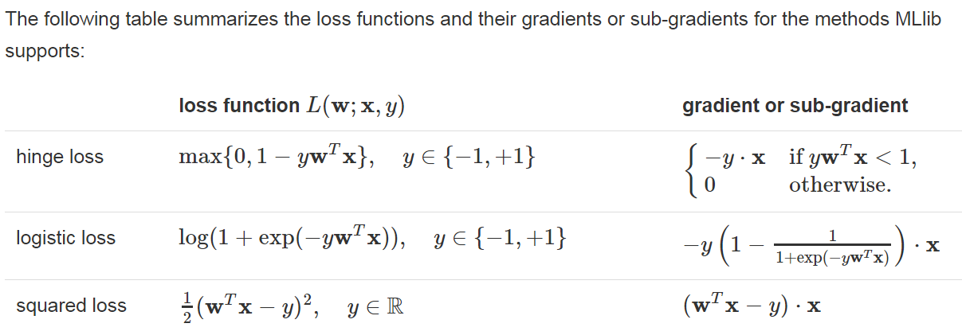
Loss function

Slide 40
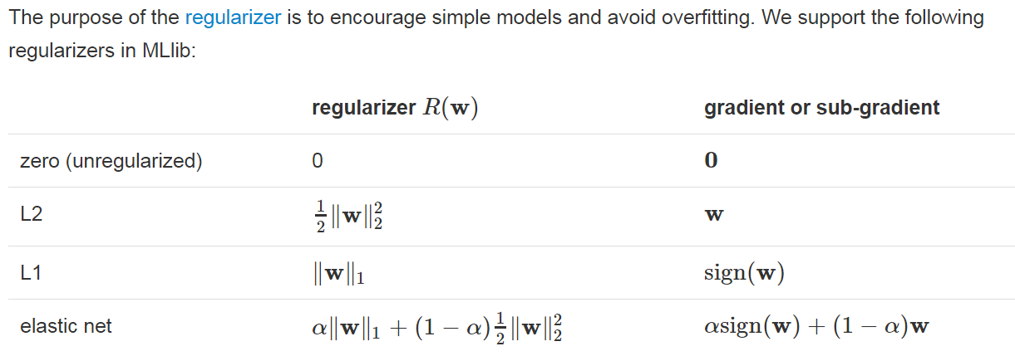
Regularizer

Slide 41
Regularization
Regularization can help avoid over-fitting of a model to training data by effectively penalizing model complexity.
This can be done by adding a term to the loss function that acts to increase the loss as a function of the model weight vector.

Slide 42
Regularization
When regularization is absent or low, models can tend to over-fit. Without regularization, most models will over-fit on a training dataset.
This is a key reason behind the use of cross-validation techniques for model fitting

Slide 43
Regularization
Conversely, since applying regularization encourages simpler models, model performance can suffer when regularization is high through under-fitting the data.

Slide 44
The forms of regularization available in MLlib
SimpleUpdater: This equates to no regularization and is the default for logistic regression
SquaredL2Updater: This implements a regularizer based on the squared L2-norm of the weight vector; this is the default for SVM models
L1Updater: This applies a regularizer based on the L1-norm of the weight vector; this can lead to sparse solutions in the weight vector (as less important weights are pulled towards zero)

Slide 45
The Impact of Regularization
As we can see, at low levels of regularization, there is not much impact in model performance.
However, as we increase regularization, we can see the impact of under-fitting on our model evaluation.

Slide 46
Number of Iterations
Many machine learning methods are iterative in nature, converging to a solution (the optimal weight vector that minimizes the chosen loss function) over a number of iteration steps.
SGD typically requires relatively few iterations to converge to a reasonable solution but can be run for more iterations to improve the solution.

Slide 47
Step Size (Learning Rate)
In SGD, the step size parameter controls how far in the direction of the steepest gradient the algorithm takes a step when updating the model weight vector after each training example.
A larger step size might speed up convergence, but a step size that is too large might cause problems with convergence as good solutions are overshot.

Slide 48
Tuning Tree Depth and Impurity for Decision Tree
The decision tree model we trained earlier was the best performer on the raw data that we first used.
We set a parameter called maxDepth, which controls the maximum depth of the tree and, thus, the complexity of the model.
Deeper trees result in more complex models that will be able to fit the data better.
For classification problems, we can also select between two measures of impurity: Gini and Entropy.

Slide 49
Tuning Tree Depth for Decision Tree
As you can see from the preceding results, increasing the tree depth parameter results in a more accurate model (as expected since the model is allowed to get more complex with greater tree depth).
It is very likely that at higher tree depths, the model will over-fit the dataset significantly.

Slide 50
Decision Tree
Note that decision tree models generally do not require features to be standardized or normalized, nor do they require categorical features to be binary-encoded.

Slide 51
Cross-validation
Cross-validation is a critical part of real-world machine learning and is central to many model selection and parameter tuning pipelines.
The general idea behind cross-validation is that we want to know how our model will perform on unseen data.
Cross-validation provides a mechanism where we use part of our available dataset to train our model and another part to evaluate the performance of this model.

Slide 52
Cross-validation
As the model is tested on data that it has not seen during the training phase, its performance, when evaluated on this part of the dataset, gives us an estimate as to how well our model generalizes for the new data points.

Slide 53
Cross-validation for Our App
Here, we will implement a simple cross-validation evaluation approach using a train-test split.
We will divide our dataset into two non-overlapping parts.
The first dataset is used to train our model and is called the training set.
The second dataset, called the test set or hold-out set, is used to evaluate the performance of our model using our chosen evaluation measure.
Common splits used in practice include 50/50, 60/40, and 80/20 splits, but you can use any split as long as the training set is not too small for the model to learn (generally, at least 50 percent is a practical minimum).

Slide 54
Cross-validation for Real World App
In many cases, three sets are created: a training set, an evaluation set (which is used like the above test set to tune the model parameters such as lambda and step size)
a test set (which is never used to train a model or tune any parameters, but is only used to generate an estimated true performance on completely unseen data).

Slide 55
Cross-validation for Real World App
when we train on one dataset and test on another, we see that generally a slightly higher level of regularization results in better test set performance.
In cross-validation, we would typically find the parameter settings (including regularization as well as the various other parameters such as step size and so on) that result in the best test set performance.
We would then use these parameter settings to retrain the model on all of our data in order to use it to make predictions on new data.

Slide 56
Evergreen classification dataset
the problem relates to classifying whether a given web page is ephemeral (that is, short lived and will cease being popular soon) or
evergreen (that is, persistently popular) on their web content recommendation pages.

Slide 57
Evergreen Dataset
The first two columns contain the URL and ID of the page.
The next column contains some raw textual content.
The next column contains the category assigned to the page.
The next 22 columns contain numeric or categorical
features of various kinds.
The final column contains the target—1 is evergreen, while 0 is non-evergreen.
https://www.kaggle.com/c/stumbleupon/data

Slide 58
Feature Normalization
Feature normalization can improve the performance of model significantly
it is not advisable to lose this sparsity, as the memory and processing requirements for the equivalent dense representation can quickly explode with many millions of features.
We can use StandardScaler and set withMean to false to avoid this.

Slide 59
Feature Normalization and Categorical Feature
Feature normalization can improve the performance of model significantly
Categorical feature can be added to the feature vector besides numerical feature (the performance can be enhanced).

