Slide 1
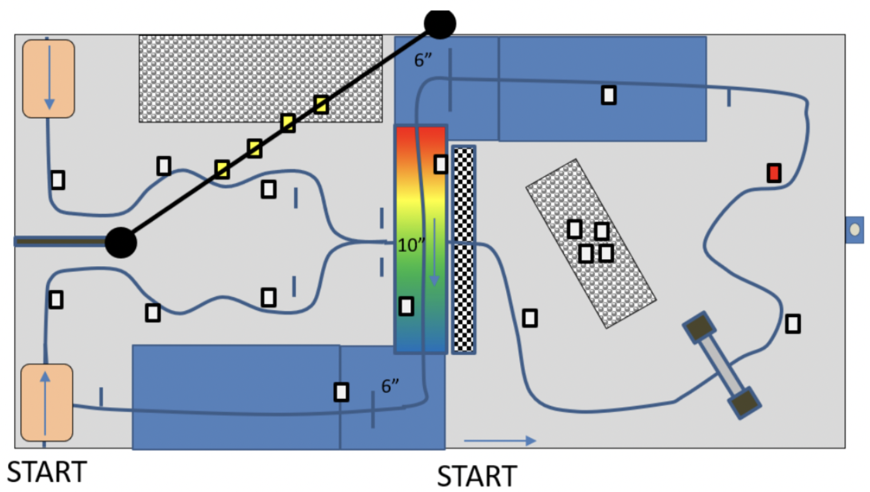




START
Item Box
Magnetic Bomb
Coin
Wall
Archway (12” x 12”)
Arch Bridge – Rainbow Road
IR Beacon
Finish Line
Rocks and Rubble
Zipline
START

