Slide 1
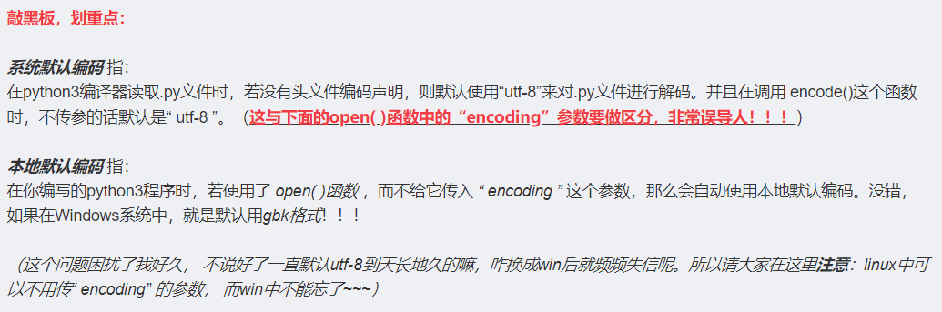

Slide 2
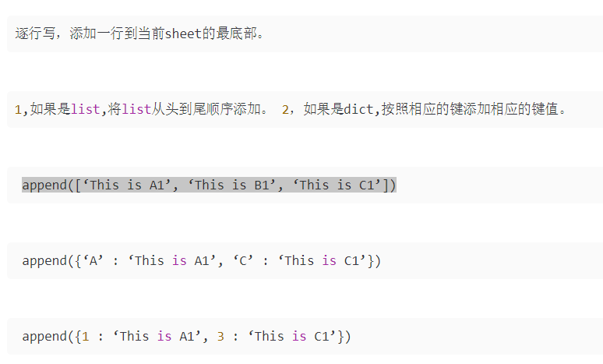
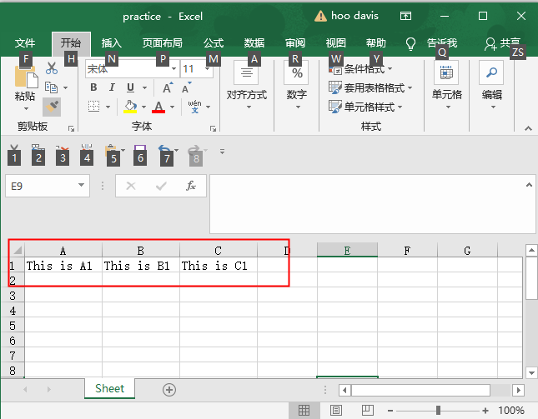
>>> import openpyxl
>>> wb = openpyxl.Workbook()
>>> wb.sheetnames
['Sheet']
>>> sheet = wb.active
>>> sheet.append(['This is A1', 'This is B1', 'This is C1’])
>>> wb.save('practice.xlsx')

Slide 3
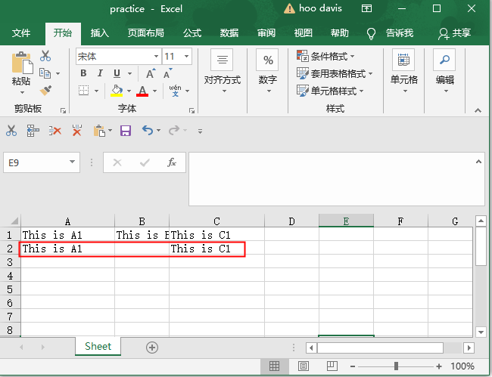
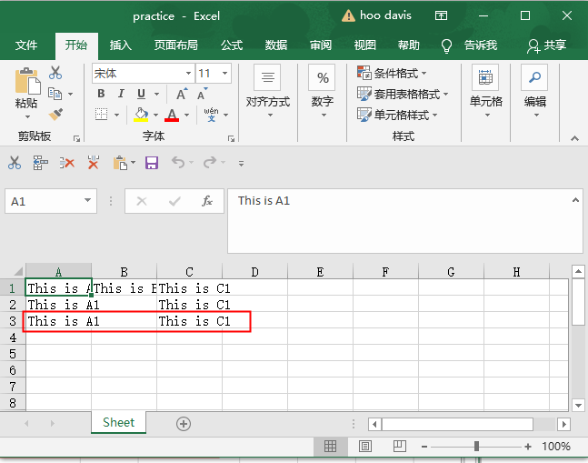
>>> sheet.append({'A' : 'This is A1', 'C' : 'This is C1'})
>>> wb.save('practice.xlsx')
>>> sheet.append({1 : 'This is A1', 3 : 'This is C1'})
>>> wb.save('practice.xlsx')

