Slide 1
An Exploratory Mixed-methods Study on General Data Protection Regulation (GDPR) Compliance in Open-Source Software
Franke🦃💻, Liang🦃💻, Farzanehpour🦃💻, Brantly🦃📜, Davis🚂💡, and Chris Brown🦃💻
Virginia Tech 🦃, Purdue 🚂
Computer Science 💻, Electrical and Computer Engineering💡, Political Science 📜
ESEM 2024

Slide 2


Motivation
Software is increasingly collecting data from users.
[W3 SpeedUp]
[Financial Times]

Slide 3
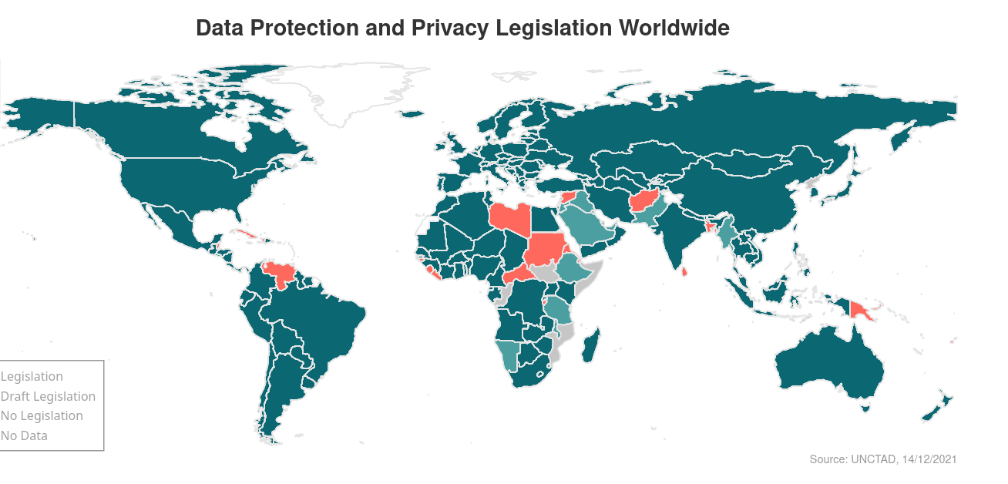
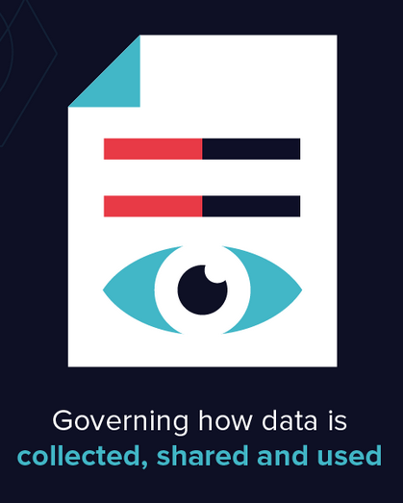
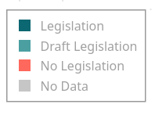
Data Privacy Regulations
[Varonis]

Slide 4

GDPR
The General Data Protection Regulation (GDPR) is a law which protects the personal data of European Union citizens.

Slide 5

Data Privacy Regulation Compliance
Software developers must understand and implement required features to ensure their organization’s products are compliant. However, data privacy regulations are a challenging source of software requirement for developers.
[randhome.io]

Slide 6
Research Questions
RQ1: How does GDPR compliance influence development activity on OSS projects?
RQ2: How do OSS developers perceive fulfilling GDPR requirements?
RQ3: What GDPR concepts do OSS developers find most challenging to implement?
RQ4: How do OSS developers assess GDPR compliance?

Slide 7
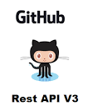
GDPR-Related Pull Requests
🔎
“GDPR”
Apr 2016 < created_at < Jan 2024
🧐
❌ bot
Manual inspection
[https://www.restapiexample.com]
15,731 GDPR-related pull requests

Slide 8


Methodology
Phase 1: Developer Survey
Phase 2: Mining GitHub Repositories

Slide 9


Developer Survey
Study Design
Pilot Study
Conducted semi-structured interviews with OSS developers
Participant Recruitment (n = 56)
Distributed survey to developers who authored GDPR-related PRs
Random drawing; n = 5
Broader calls for recruitment on social media
Random drawing; n = 42
Re-distributed survey to developers who authors GDPR-related PRs
$10 gift card; n = 9
Data Analysis
Thematic analysis

Slide 10
Mining GitHub Repositories
Study Design
Non-GDPR-related pull requests
Randomly sampled 15,731 (!GDPR) PRs from same repos
Development Activity Metrics
Comments: the total number of comments
Active time: time until PR merged or closed
Commits: the total number of commits
Additions: the number of lines of code added
Deletions: the number of lines of code removed
Changed files: the total number of modified files
Status: PR outcome (merged, closed, or open)
Developer Perception
Sentiment Analysis
Liu-Hu, VADER, and SentiArt
Data Analysis
Mann-Whitney U test
3-month bins
t-test
 | Titles | Bodies | Commit | Review | Discussion
GDPR | 15,731 | 14,515 | 15,217 | 4,922 | 4,862
non-GDPR | 15,731 | 13,718 | 15,652 | 3,427 | 3,165

Slide 11
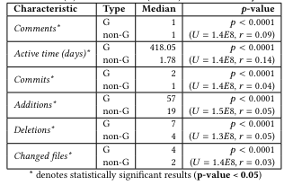
RQ1: Development Activity
GitHub Metrics
Survey
N = 41 (73%)
Data Management (n = 11)
Time/Costs (n = 5)

Slide 12
RQ2: GDPR Perceptions
Survey
Mostly negative perceptions (n = 22)
Cost
Organization
Enforcement
Positive
Raise awareness
Accountability
Sentiment Analysis
GDPR-related PRs had more positive sentiment than non-GDPR-related PRs
Limitations of tools
Wide range on non-GDPR
We observed no change in sentiment over time.

Slide 13
RQ3: Implementation Challenges
Data Management
“knowing what info can or cannot be accessed or saved” (P49)
Data Protection
“data may be relied on by many loosely connected applications and systems” (P55)
Vague Requirements
“[GDPR is] pretty vague” (P54) and “lack of clarity in the regulations leads to confusion” (P52)

Slide 14
RQ4: Compliance Assessment
Legal Counsel (n = 15)
“it slows things down” (P1), “it’s a bit of a headache” (P24), “mostly a box ticking exercise” (P51), “extremely expensive” (P52), and “a lot of back-and-forth. We have to change our design many times” (P54).
Compliance Resources (n = 3)
“special training” (P16), “accountability system” (P24), “articles on the Internet” (P15).
No or Self-Assessment
“get your consent in order” (P38)
“really no good way [to evaluate compliance]” (P18)

Slide 15



Implications and Future Work
Clear Requirements
Privacy by Design
Policy Resources
Automated Tools

Slide 16











Conclusion
Data privacy regulations protect users and their data from misuse. To adhere to regulations, developers must understand policies and modify source code accordingly. We examine the impact of GDPR compliance in OSS through surveys and repository mining, demonstrating negative developer perceptions and significant increases in coding activity. Our findings provide implications to enhance policies and their implementation, to ensure human safety in digital environments.
Acknowledgment 🙏🏾
Virginia Commonwealth Cyber Initiative (CCI)
Chris Brown
dcbrown@vt.edu
https://chbrown13.github.io
chbrown13
@d_chrisbrown2

