Slide 1


ZTDjava: Mitigating Software Supply Chain Vulnerabilities via Zero-Trust Dependencies
Paschal C. Amusuo, Kyle A. Robinson, Tanmay Singla, Huiyun Peng,
Aravind Machiry, Santiago Torres-Arias, Laurent Simon, James C. Davis

Slide 2
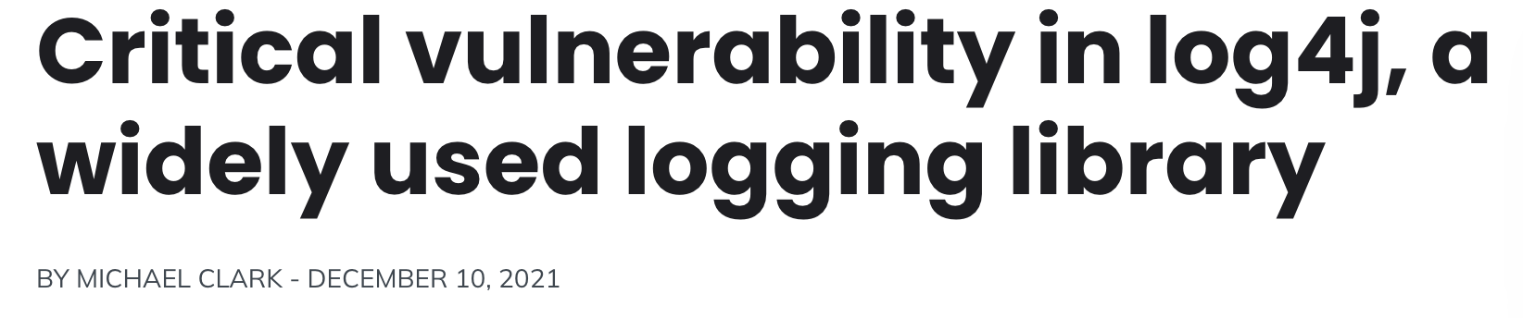
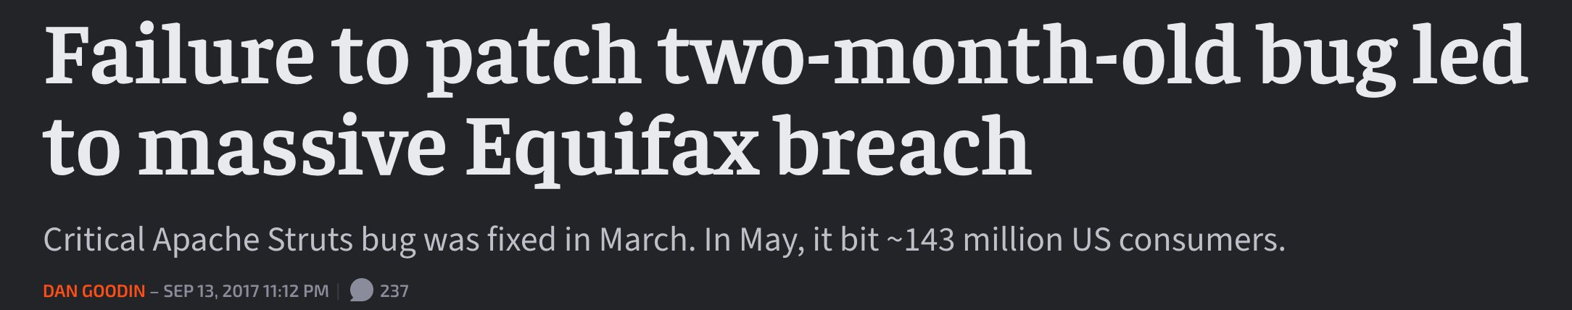
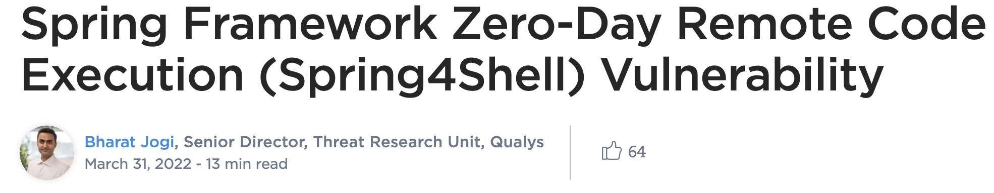
The Risk of Software Dependencies

Slide 3


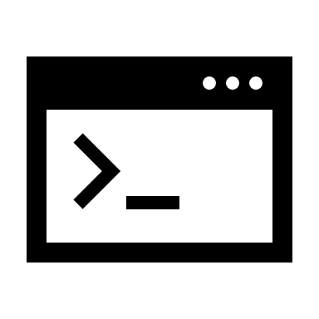
Software Supply Chain Vulnerabilities
Application
Application Logic
Third-party Code
Dependency
Maliciously Introduced
Operating System
Accidentally Introduced
Modern Software

Slide 4
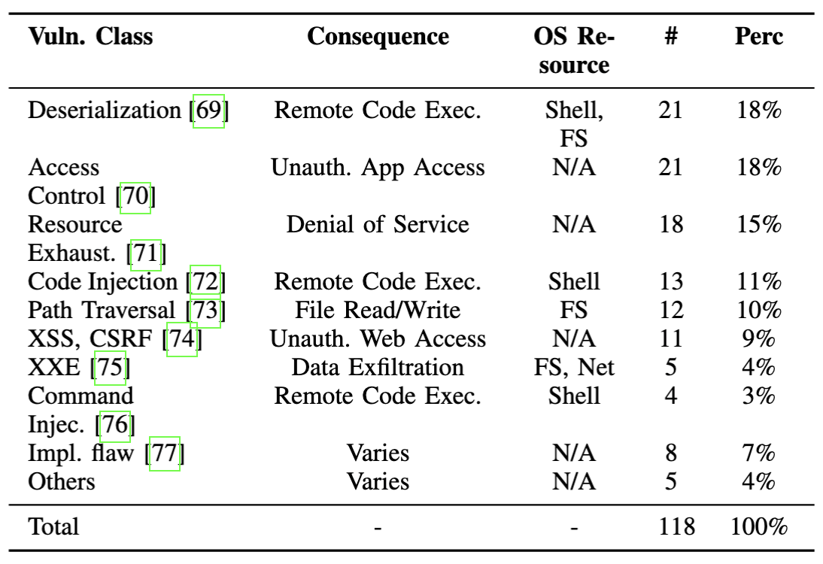
Characterizing Software Supply Chain Vulnerabilities
Is the Log4J vulnerability a one-off or are there others like it?
46%

Slide 5



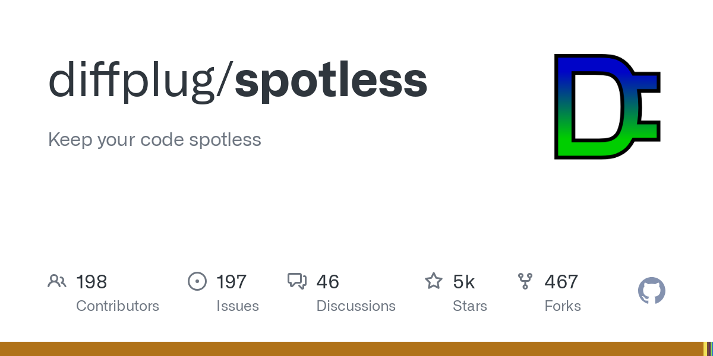

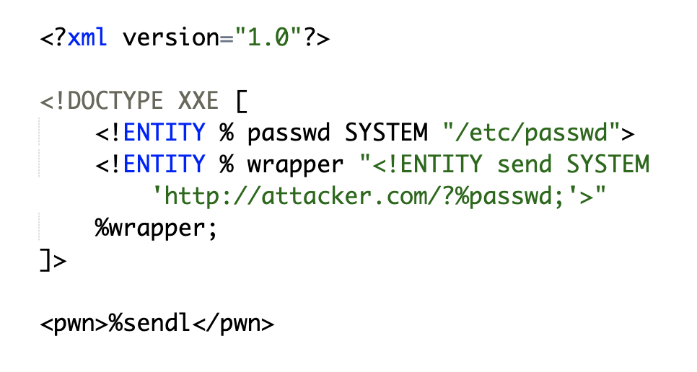

CVE-2019-9843: What if your code formatting library is also a thief?
Code
Formatted Code
What the developer expects
Malicious Server
Code
Formatted Code
Sensitive File
What actually happens

Slide 6
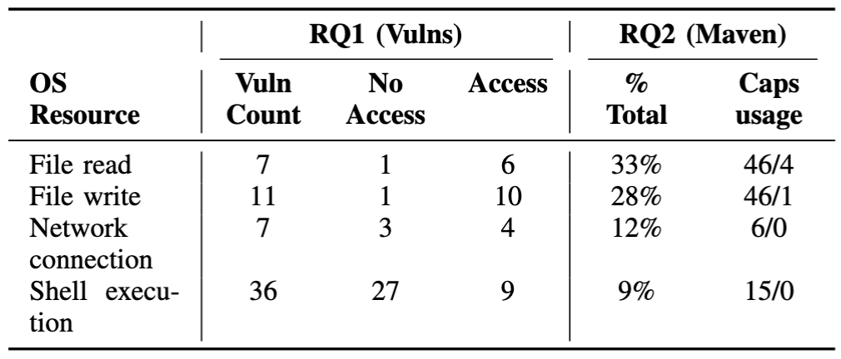
Do Dependencies need sensitive OS resources?
RQ1: Proportion of vulnerable libraries with access to the compromised OS resource?
RQ2a: Proportion of popular (20k) maven packages with access to sensitive OS resource?
RQ2b: Proportion of dependencies in applications that used OS resource at runtime?

Slide 7
Do Dependencies need sensitive OS resources?
Findings 1. At least, 9 – 33% of dependencies can access different sensitive resources.
2. However, only 4% access these resources when executing in applications.

Slide 8

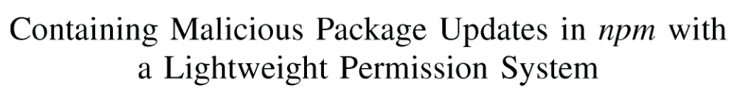
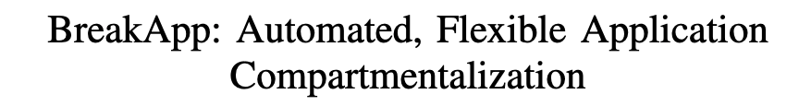


Existing Mitigations are Insufficient or Costly
CCS 2021
Application
Application Logic
Third-party Code
ICSE 2021
NDSS 2018
Operating System
Performance Cost
Human Cost
2 – 15% of overall latency
Specify policies for >100 dependencies
[1] Vasilakis, Nikos, et al. "Preventing dynamic library compromise on node. js via rwx-based privilege reduction." Proceedings of the 2021 ACM SIGSAC Conference on Computer and Communications Security. 2021. [2] Ferreira, Gabriel, et al. "Containing malicious package updates in npm with a lightweight permission system." 2021 IEEE/ACM 43rd International Conference on Software Engineering (ICSE). IEEE, 2021.
[3] Vasilakis, Nikos, et al. "BreakApp: Automated, Flexible Application Compartmentalization." NDSS. 2018.

Slide 9
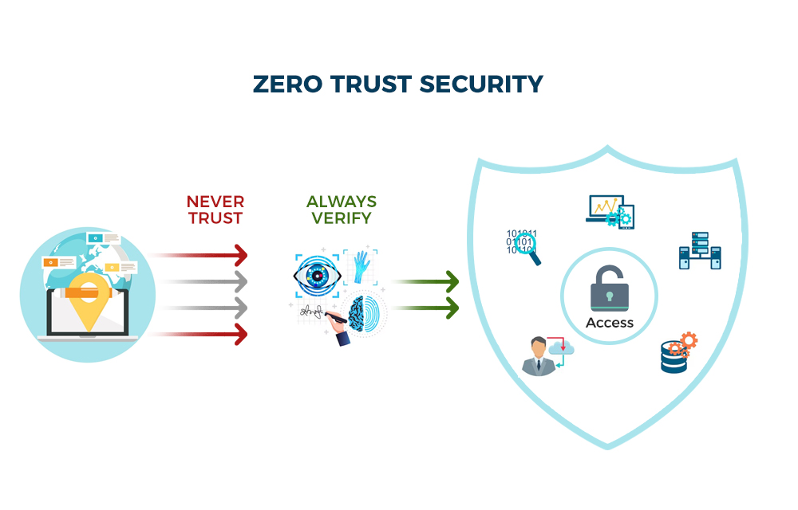
NIST Zero-Trust Architecture Model
Secure Access
Least Privilege
Continuous Monitoring
Can we apply Zero-Trust Architecture to applications?
Figure source: https://www.brickworkindia.com/blogs?name=zero-trust-architecture-and-how-to-build-one

Slide 10
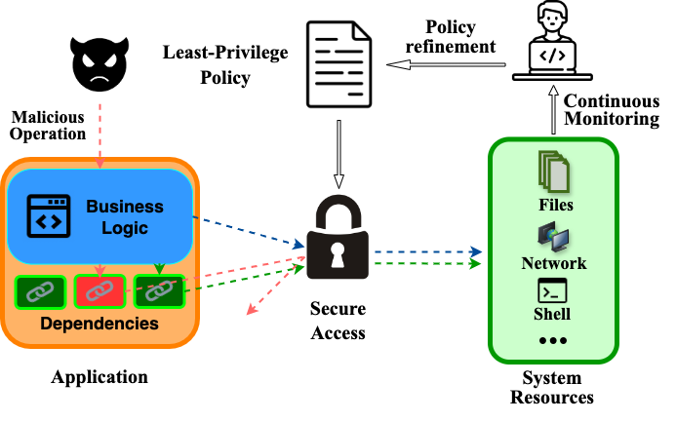
Zero-Trust Dependencies
No implicit trust in dependencies.
Secure Resource Access
Least Privilege Enforcement
Continuous Monitoring

Slide 11
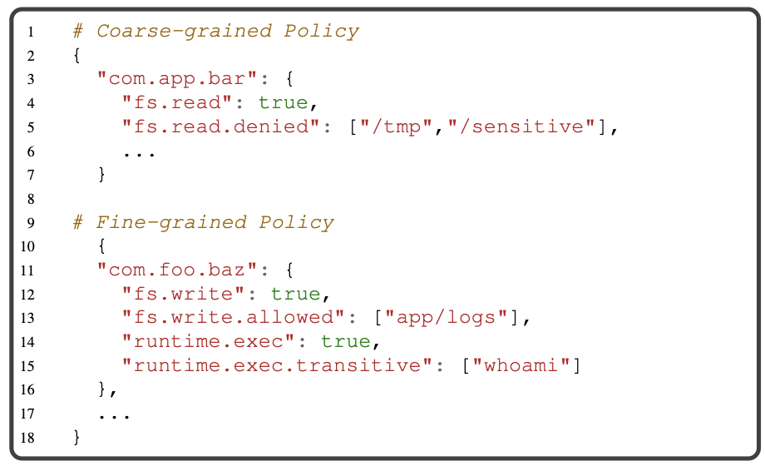
ZTD Policy Design
What resources to protect?
Shell system
Network
File System
What granularity to support?
Coarse vs fine?
e.g. Prevent all access files or prevent access to specific files?

Slide 12





How do we generate least-privilege policies?
When a resource is accessed:
Resource Operation
Resource Item
Access Logger
Access Logs
Call Stack
Dependencies
Intermittently or at shut down:
Policy Generator
Policy File
Access Logs

Slide 13




How do we enforce dependency policies?
Policy File
Operation (e. g. read)
Item
(e. g. /file-path)
Call Stack
Dependencies
Access is granted if ALL dependencies have permission to perform OPERATION on ITEM

Slide 14
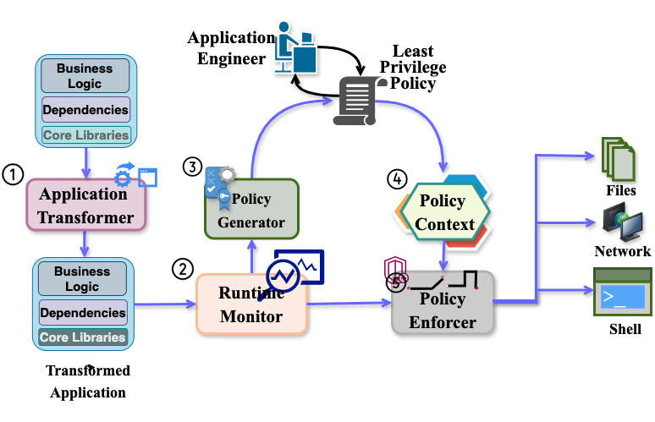
ZTDjava: A ZTD Prototype for Java Applications

Slide 15




Evaluating ZTDjava
EQ1: Does ZTDjava prevent real world SSC vulnerability exploits?
EQ2: What is the performance overhead of ZTDjava?
EQ3: How much effort is required to configure ZTDjava?
15 Vulnerabilities + exploits
15 Sample Applications
16 Real Applications

Slide 16
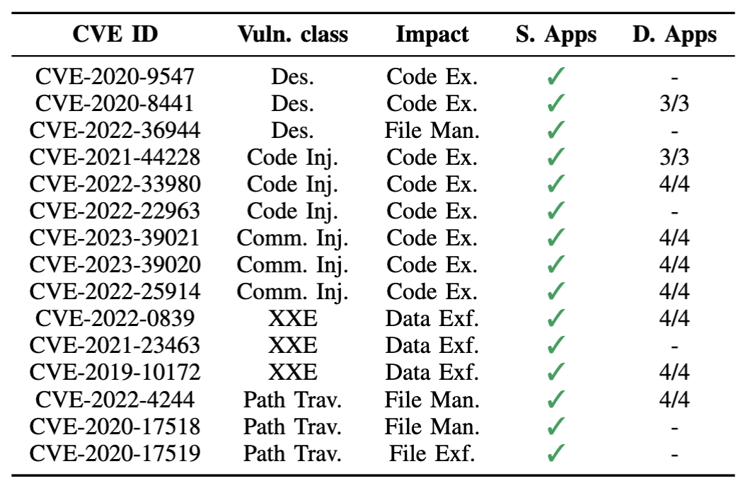
Does ZTDjava Prevent Real Exploits?

Slide 17
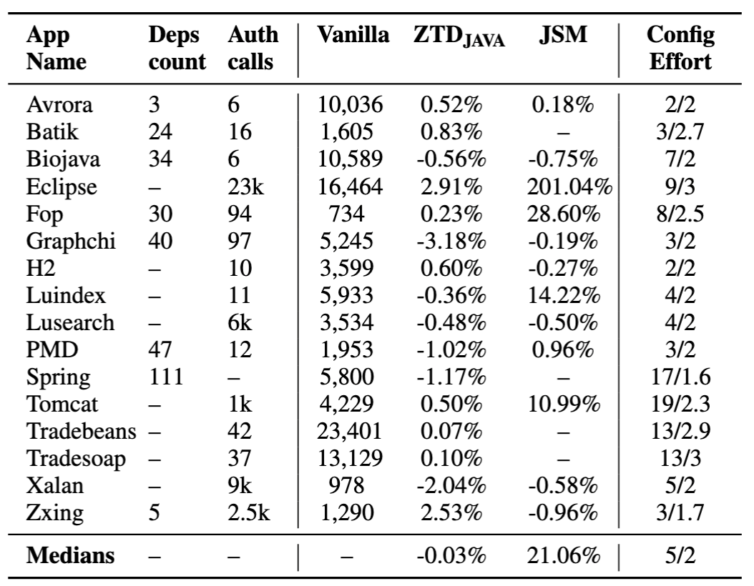
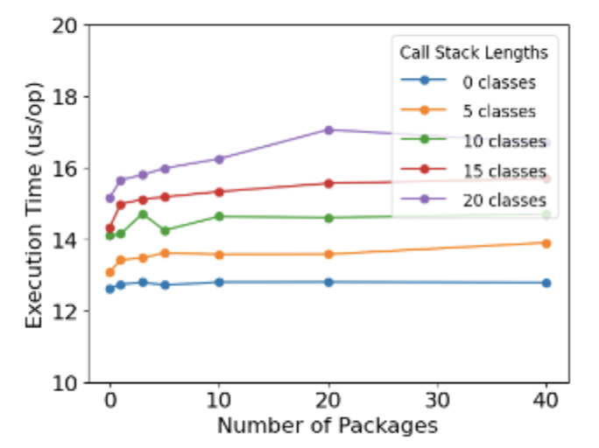
What is the performance overhead of ZTDjava?
ZTD’s performance does not depend on the number of dependencies in the application.
Number of Dependencies

Slide 18


Conclusion
Vulnerabilities in dependencies can compromise critical OS resources.
We can mitigate these vulnerabilities with negligible overhead using Zero-Trust Dependencies.
Preprint
Thank you
Paschal Amusuo
Pamusuo@purdue.edu

