Slide 1





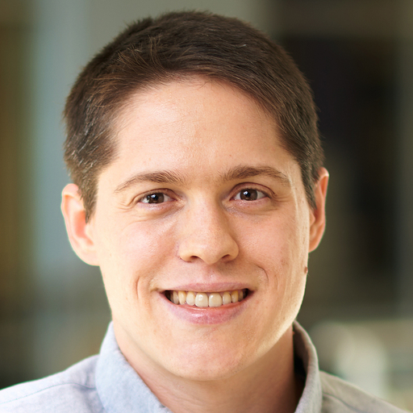
A Unit Proofing Framework for Code-level Verification: A Research Agenda
Paschal C. Amusuo
Parth V. Patil
Taylor Le Lievre
Owen Cochell
James C. Davis

Slide 2
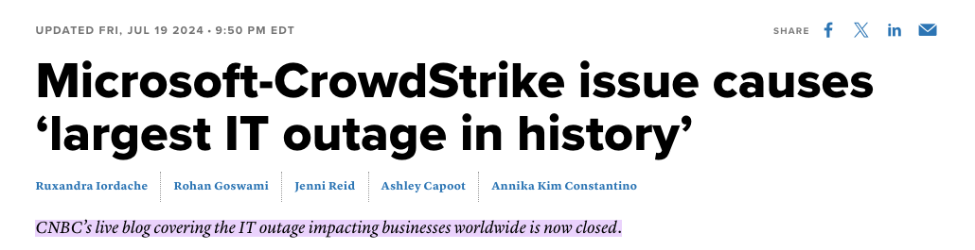
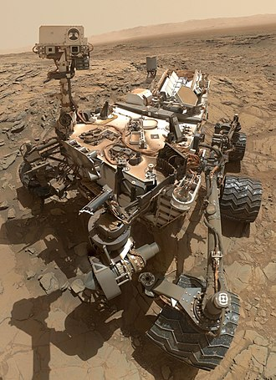
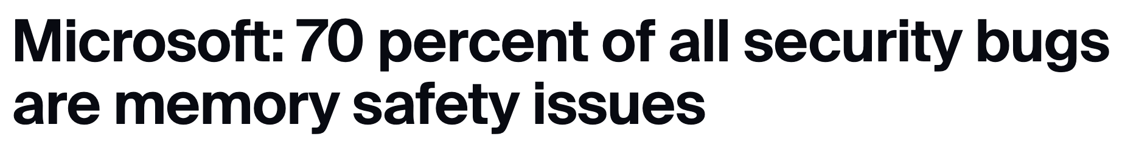

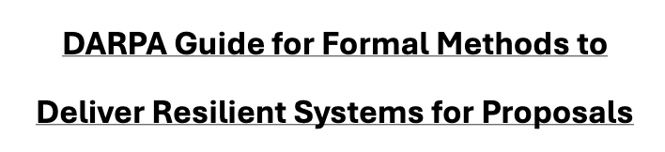
Increased Recognition for Formal Methods in SE
Mars Curiosity Rover
2025

Slide 3

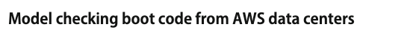
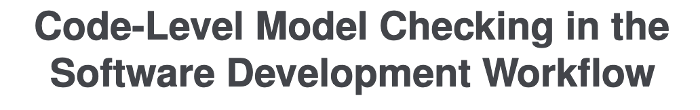
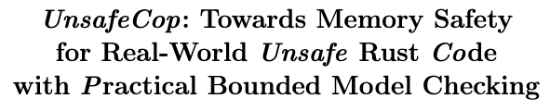


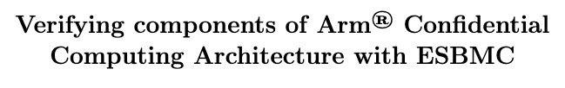
Major Organizations are Adopting Formal Methods
ICCAV '18
ICSE-SEIP '20
FM '24
SAS '24
Notes:
Specifically, AWS reported that after they started using unit proofs, they recorded increase in the number of bugs found and fixed during development.

Slide 4
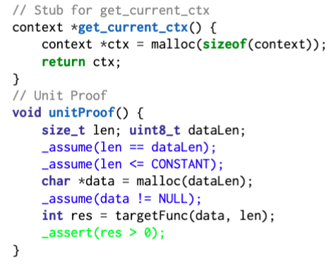
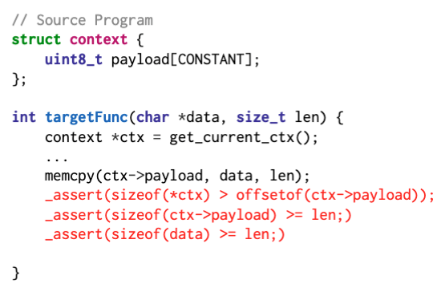
Code-level Verification using Specifications
A potentially vulnerable program.
A unit proof to verify the program.
Unit Proofing vs Unit Testing?

Slide 5
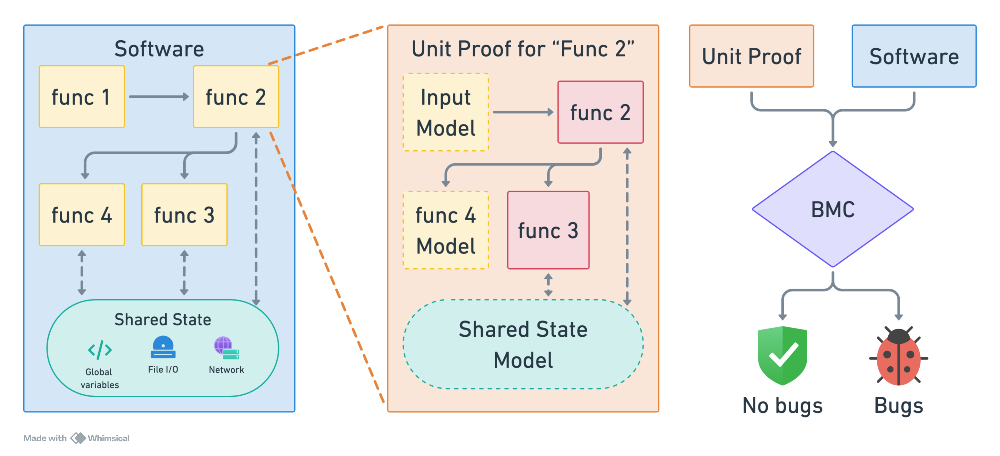
Unit Proofing: Engineering Activity for Scaling Bounded Model Checking
Notes:
First, the goal is to verify the whole software.
The software is too large, we need to verify it in bits. So we divide it.
Here, note that when dividing, we can group functions together.

Slide 6
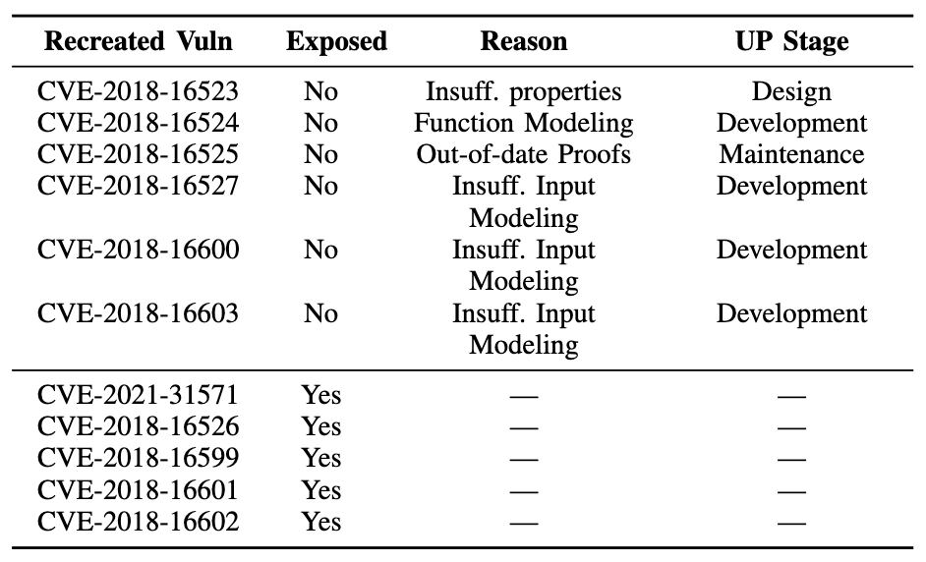
Does Unit Proofing Work? An audit of AWS
6 / 11 vulnerabilities were not exposed due to flaws in unit proof models and the unit proofing process.
Insufficient Properties
Insufficient Function Modelling
Outdated
Unit Proof
Insufficient Input Modelling
Notes:
If time permits, mention:
1. CVE-2024-38373, a buffer overread in DNS (CVSS score 9.6/10)
2. a patch by the CBMC core team to cause errors instead of warnings when function definitions are missing (CBMC PR #8292)
Not bad for auditing 11 unit proofs!

Slide 7
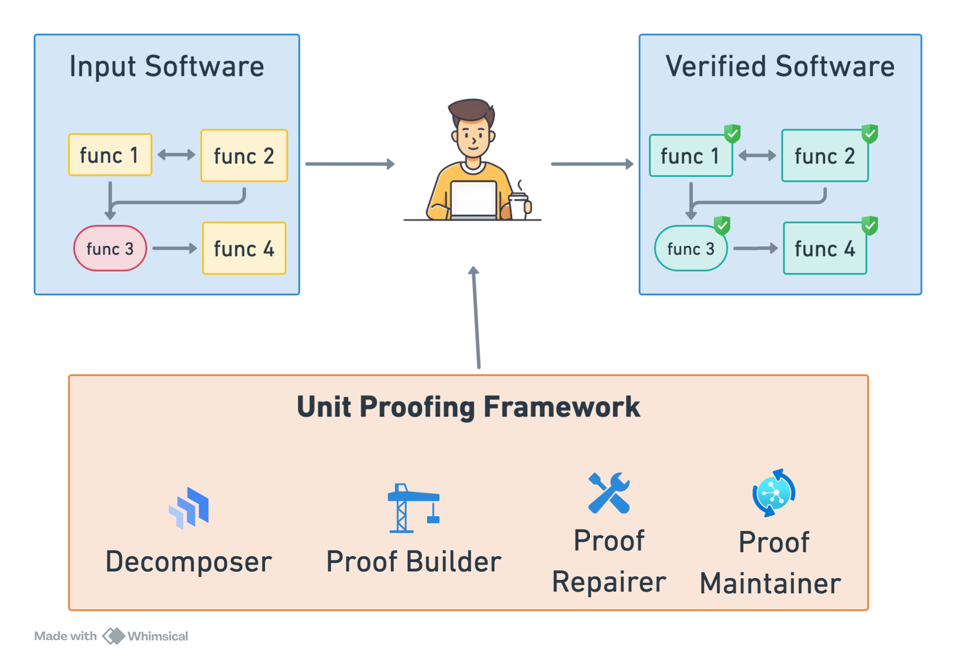
Our Research Agenda: A Unit Proofing Framework
How do we identify and repair faults in unit proofs?
How do we keep unit proofs in sync with the verified code?
How do we identify the optimal set of functions to unit proof?
How do we derive correct models for unit proofs?

Slide 8
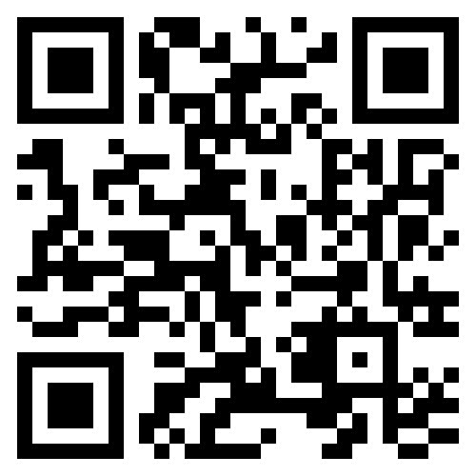

Conclusion
Unit Proofing democratizes code-level verification.
Let's automate it!
Preprint
Thank you
Paschal Amusuo
Pamusuo@purdue.edu

Slide 9
Bonus Slides

Slide 10
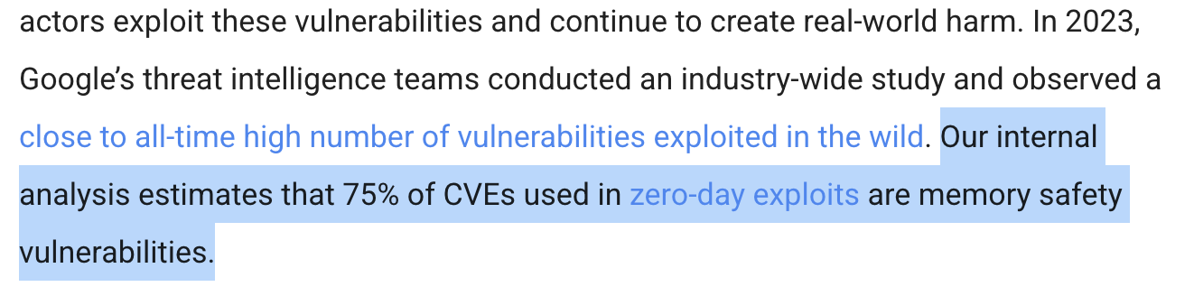
Code-level Defects – Security Attacks
https://www.zdnet.com/article/microsoft-70-percent-of-all-security-bugs-are-memory-safety-issues/ https://security.googleblog.com/2024/10/safer-with-google-advancing-memory.html

Slide 11



Bounded Model Checking (BMC)
Bounded Program
Program is Correct
Satisfiability Formularr
Satisfiability Solver
Expected Properties
Error trace

Slide 12
Does Unit Proofing Work?
RQ: Do engineers unit proof expose code-level defects?
Security Vulnerabilities
Existing Unit Proofs
Investigate Reason
FreeRTOS
BMC
Unit Proof Exposed Vulnerability

Slide 13

Evaluating Unit Proofs: Implications
Unit Proofs are effective but error-prone.
We need tools to aid correct unit proof development and maintenance.

Slide 14



Unit Proofing: Open Questions
Software decomposition
How do we identify the functions to unit proof?
Proof development and repair
How do we derive correct models for a target function?
How do we identify and fix errors in unit proofs?
Proof maintenance and evolution
How do we ensure unit proofs evolve with the software?

