Slide 1









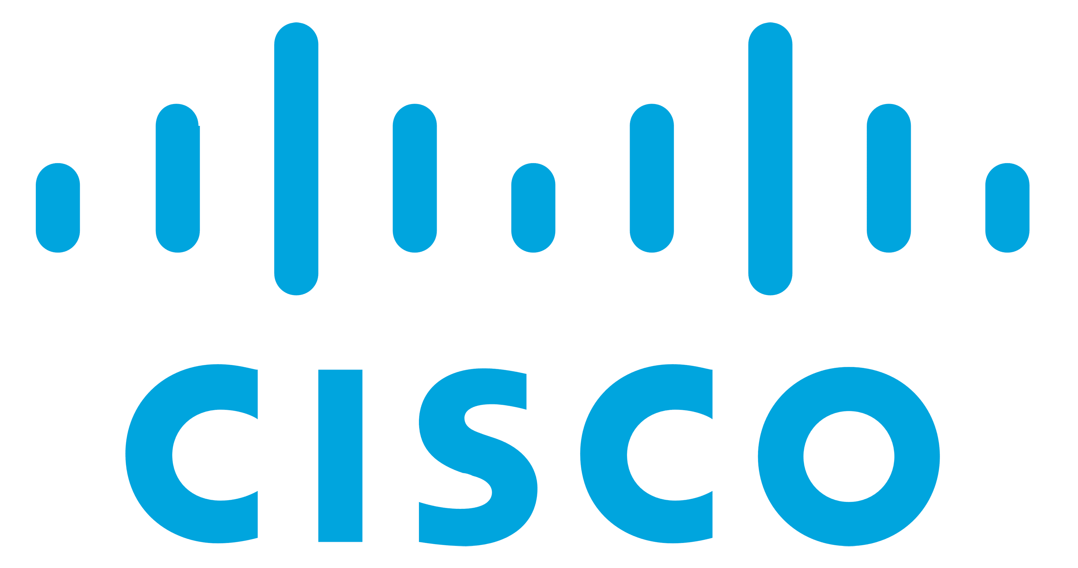

Why Johnny Adopts Identity-Based Software Signing: A Usability Case Study of Sigstore
Sofia Okorafor
James C. Davis
davisjam@purdue.edu
Sophie Chen
Kelechi G. Kalu
kalu@purdue.edu
Tanmay Singla
Santiago Torres-Arias
Notes:
Hello Everyone, I am Kelechi Kalu, I am a 4th year Phd student advised by Dr James Davis from Purdue University.

Slide 2

From Legacy Key-Managed to Identity-Based Signing
Traditional / Key-Managed Signing
Notes:
Traditional software signing, implemented by tools such as PGP and GPG, has long been difficult for developers to use.
Developers must generate, protect, distribute, and rotate long-lived cryptographic keys.
Decades of usable security research—including the classic Why Johnny Can't Encrypt studies—have shown that these requirements create significant usability barriers.
As a result, traditional signing has suffered from limited adoption despite its security benefits.
To address these challenges, the community introduced identity-based signing systems, such as Sigstore, that automate key management through short-lived, identity-bound certificates.
But this raises an important question: Did identity-based signing actually solve the usability problem?

Slide 3
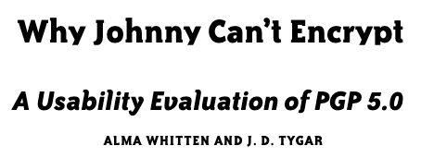
From Legacy Key-Managed to Identity-Based Signing
Traditional / Key-Managed Signing
Key-Managed Signing Usability Challenges
Manual key management
Difficult key distribution & rotation
Steep learning curve
Notes:
Traditional software signing, implemented by tools such as PGP and GPG, has long been difficult for developers to use.
Developers must generate, protect, distribute, and rotate long-lived cryptographic keys.
Decades of usable security research—including the classic Why Johnny Can't Encrypt studies—have shown that these requirements create significant usability barriers.
As a result, traditional signing has suffered from limited adoption despite its security benefits.
To address these challenges, the community introduced identity-based signing systems, such as Sigstore, that automate key management through short-lived, identity-bound certificates.
But this raises an important question: Did identity-based signing actually solve the usability problem?

Slide 4
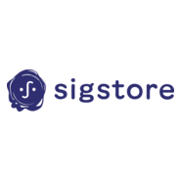
From Legacy Key-Managed to Identity-Based Signing
Traditional / Key-Managed Signing
Identity-Based Signing
Key-Managed Signing Usability Challenges
Manual Key Management
Difficult Key distribution & rotation
Steep learning curve
Notes:
Traditional software signing, implemented by tools such as PGP and GPG, has long been difficult for developers to use.
Developers must generate, protect, distribute, and rotate long-lived cryptographic keys.
Decades of usable security research—including the classic Why Johnny Can't Encrypt studies—have shown that these requirements create significant usability barriers.
As a result, traditional signing has suffered from limited adoption despite its security benefits.
To address these challenges, the community introduced identity-based signing systems, such as Sigstore, that automate key management through short-lived, identity-bound certificates.
But this raises an important question: Did identity-based signing actually solve the usability problem?

Slide 5
From Legacy Key-Managed to Identity-Based Signing
Traditional / Key-Managed Signing
Identity-Based Signing
Key-Managed Signing Usability Challenges
Manual Key Management
Difficult Key distribution & rotation
Steep learning curve
Did identity-based software signing actually solve these usability challenges?
Notes:
Traditional software signing, implemented by tools such as PGP and GPG, has long been difficult for developers to use.
Developers must generate, protect, distribute, and rotate long-lived cryptographic keys.
Decades of usable security research—including the classic Why Johnny Can't Encrypt studies—have shown that these requirements create significant usability barriers.
As a result, traditional signing has suffered from limited adoption despite its security benefits.
To address these challenges, the community introduced identity-based signing systems, such as Sigstore, that automate key management through short-lived, identity-bound certificates.
But this raises an important question: Did identity-based signing actually solve the usability problem?

Slide 6
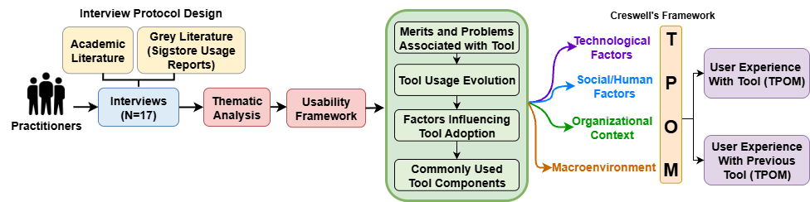
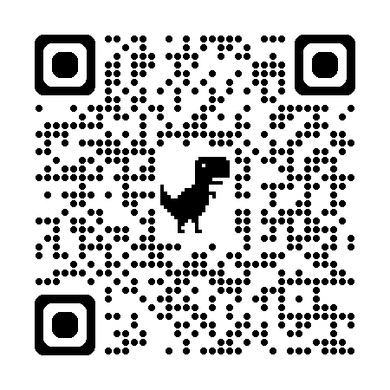
Methodology – Sigstore Case Study
17 experienced security practitioners across 13 organizations.
13 practitioners had implemented Sigstore.
Companion analysis appears in our USENIX Security ’25 paper:
Notes:
To answer this question, we conducted the first qualitative usability study of identity-based software signing using Sigstore as our case study, since it was the most widely adopted identity-based signing platform at the time of our study.
We interviewed 17 experienced security practitioners across 13 organizations, 13 of whom had implemented Sigstore in production. Interviews lasted a median of 50 minutes.
We then analyzed the interviews using thematic analysis and interpreted the findings through a formative usability framework to understand what helps—and what hinders—the adoption of identity-based signing.

Slide 7
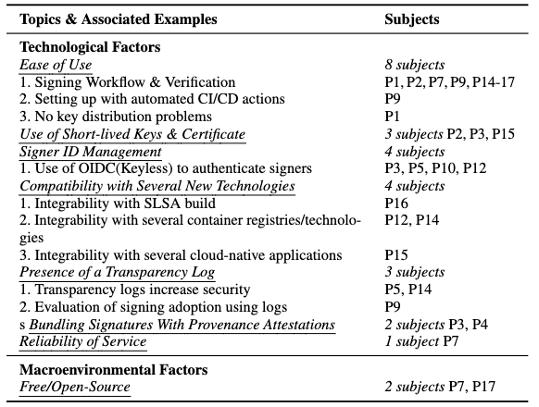
Sigstore Reduces Key Management Burden—But Friction Migrates
Usability Strengths
Notes:
The short answer to our research question is yes—but not completely.
Practitioners consistently told us that Sigstore succeeds at solving many of the traditional usability problems.
In particular, they highlighted easier signing workflows, automated key management through short-lived certificates, and better integration with modern CI/CD ecosystems.
(pause and gesture to the left table)
But the friction didn't disappear—it moved.
Instead of struggling with cryptographic keys, organizations now struggle with integrating transparency logs, deploying private instances, documentation, infrastructure costs, and performance constraints.
So identity-based signing reduces the burden of key management, but introduces a new class of operational and organizational usability challenges.

Slide 8
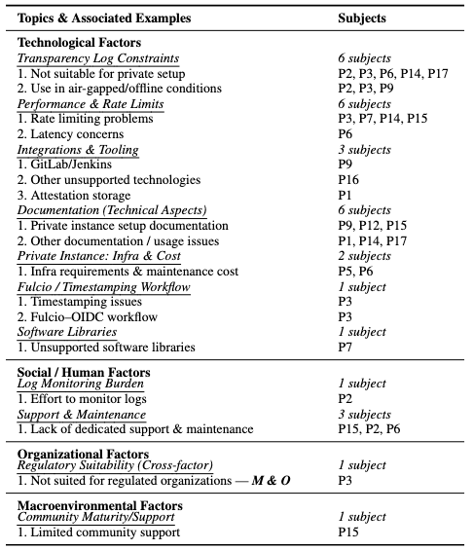
Sigstore Reduces Key Management Burden—But Friction Migrates
Usability Problems
Usability Strengths
Notes:
The short answer to our research question is yes—but not completely.
Practitioners consistently told us that Sigstore succeeds at solving many of the traditional usability problems.
In particular, they highlighted easier signing workflows, automated key management through short-lived certificates, and better integration with modern CI/CD ecosystems.
(pause and gesture to the left table)
But the friction didn't disappear—it moved.
Instead of struggling with cryptographic keys, organizations now struggle with integrating transparency logs, deploying private instances, documentation, infrastructure costs, and performance constraints.
So identity-based signing reduces the burden of key management, but introduces a new class of operational and organizational usability challenges.
This naturally led us to ask a second question: What actually determines whether organizations adopt these tools?

Slide 9
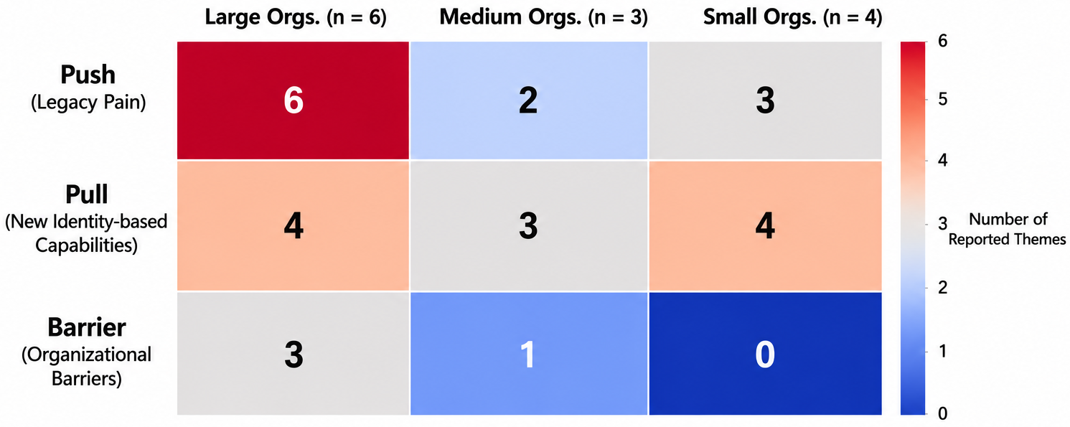
What Actually Determines Whether Organizations Adopt These Tools?
Adoption is:
pushed by legacy pain,
pulled by new identity-based capabilities
constrained by organizational barriers.
Notes:
To answer that question, we grouped participants' experiences into three categories.
Push factors are frustrations with legacy key-managed signing that motivate organizations to look for alternatives.
Pull factors are the benefits of identity-based signing, such as automated key management and easier integration.
Barrier factors are the remaining organizational and technical challenges that continue to slow adoption.
What surprised us is that organizations don't adopt identity-based signing simply because it offers better technology. They adopt because legacy workflows become too painful, while organizational policies, deployment constraints, and privacy concerns continue to shape whether adoption succeeds.
Ultimately, improving cryptography is only part of the solution—widespread adoption requires designing for organizational usability.

Slide 10




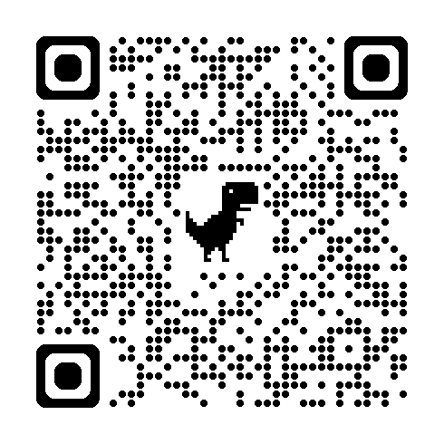
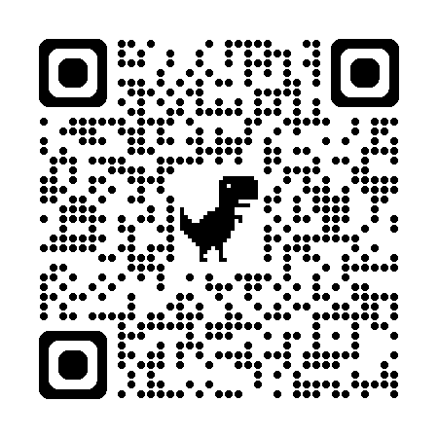
Lessons for Identity-Based Signing
Identity-based signing reduces legacy key-management burdens.
Its adoption depends on solving today's organizational usability challenges.
  Design Recommendations
Enterprise & private
deployments
2. Workflow-first
integrations
3. Usable transparency & privacy
Private instances, air-gapped environments, & scalability
Official CI/CD integrations,
plugins/APIs, & migration guidance
Configurable transparency-log privacy controls, & clearer documentation
Find our full paper here:
Thank you for your attention!
Kelechi G. Kalu
kalu@purdue.edu
Find our other works:
Notes:
Our main takeaway is that identity-based signing successfully addresses many of the cryptographic usability problems that limited traditional signing.
However, our interviews show that its widespread adoption now depends on addressing organizational usability challenges.
Based on these findings, we recommend three design priorities for future identity-based signing tools: better support for enterprise and private deployments, tighter integration into existing developer workflows, and more usable transparency through improved privacy controls and documentation.
Thank you.

