Slide 1


An Intercultural Engineering Module for Software Engineers
Nicole Hornbrook
James C. Davis
Notes:
Introductions

Slide 2
Educational context: Purdue’s ECE 461
Learning Outcomes
An understanding common models of the software engineering process
The ability to conduct key elements of the software engineering process
An understanding of the social aspects of software engineering, including issues and openness in communication, teamwork, culture, and ethics.
#3 was added Fall 2021 as part of relaunching the course
Notes:
The computing industry is culturally diverse as a result of outsourcing, offshoring, and immigration. Our graduates will be better engineers if they can understand the role of culture in engineering.
ECE has a packed curriculum, students learning circuits and electronics as well as software systems. Not much room for electives, and studying abroad is unusual. Looking for a way to incorporate intercultural competencies within the curriculum.
There has been a lot of conversation in the field about intercultural issues in software engineering teams, but I was not able to find educational material suitable for use in an undergraduate course.
I teach ECE 461. ~70 students each year.
Nicole and I worked together in Spring 2021 to develop a learning module for the course. We will be piloting it next week!

Slide 3
Assessment plan for Fall 2021
“An understanding of the social aspects of software engineering, including issues and openness in communication, teamwork, culture, and ethics.”
Quantitative: MGUDS-S
Qualitative: Student reflections after using 1 module in class and another module as a homework assignment
Notes:
MGUDS-S: Miville-Guzman Universality-Diversity Scale
Short, validated survey instrument. Measures openness and comfort with differences.

Slide 4


Thank you!
Notes:
Our ACIEE abstract has links to the modules – 2-4 pages each. They’re available on my website.

Slide 5
Slides

Slide 6
An Intercultural Engineering Module for Software Engineers
Nicole Hornbrook
Professor James Davis
Notes:
The world is continuing to intertwine more and more because of technology, and, as a result, it is becoming more important to develop software engineering products that are culturally inclusive and acceptable. It is important to educate future software engineers about intercultural engineering, both in terms of requirements and in terms of engineering collaboration.
I’m Nicole Hornbrook and …
And in this presentation we will be discussing three case studies we developed to help educate the next generation of software engineers to be more culturally aware and to stimulate their ideas in developing more culturally-inclusive products.

Slide 7
Research Methods and Outcomes
Strategies:
Systematic literature review
Hofstede and Nisbet
Targeted review on specific cultural factors
Religion
Combined findings from literature research into 3 case studies
Software Engineering in Multicultural Teams
Culturally Appropriate Interfaces
Smart Phones and Orthodox Judaism
Notes:
We organized our project into three strategies or steps. First, we performed a systematic literature review. Some of which was targeted on Hofstede, and others on more specific cultural factors like religion. After the literature review we combined our findings into 3 case studies that describe a way in which culture impacts software engineering with additional reading and discussion questions

Slide 8
Background
Hofstede’s [1] Cultural dimensions
Hofstede’s Six Cultural Dimensions and the USA and China’s Placement
Hofstede Dimension | Description | USA Score | China Score
Power Distance (PDI) | A high score indicates that unequal treatment of those of lower power is common/acceptable. | 40 (Low) | 80 (High)
Uncertainty Avoidance (UAI) | A high score indicates a society that highly prepares for the future/uncertain circumstances. | 46 (Low) | 30 (Low)
Individualism (IDV) | A high score indicates a society that acts and thinks as individuals rather than as a group/the people look out for themselves. | 91 (Very High) | 20 (Low)
Masculinity (MAS) | A high score indicates a society values masculine values such as competition and achievement. | 61 (High) | 66 (High)
Long-Term Orientation (LTO) | A high score indicates a society that makes decisions based on predicted long-term/future results, instead of short-term/present results. | 26 (Low) | 87 (Very High)
Indulgence (ING) | A high score indicates a society that makes decisions based on impulses. | 68 (High) | 24 (Low)
Notes:
Most of our literary search was based on Hofstede’s cultural dimensions. Hofstede provides a very convenient way of explaining why certain cultures behave the way they do, and also allows us to consistently document cultural preferences.
This table was provided in our case study: “Culturally Appropriate Interfaces” to provide students a brief summary and example of Hofstede’s dimensions. The USA and China are used as examples as they are fairly opposite in almost all the dimensions.

Slide 9
Related Work
GEC Project – Jesiek et al. [2]
Short scenarios
Touches a variety of Engineering fields
Possible real-life situations
Cultural conflicts
Notes:
The GEC project is a very similar project to ours in that Jesiek provides a number of scenarios posing cultural issues for students to analyze.
They can be implemented in various different ways. Some have multiple choice answers, some are short answer.
They can be used as a study abroad pre and post evaluation and as a in-class exercise.
Differences:
The GEC project has scenarios in all different engineering fields,
It also focusses on the team-interaction/culture conflicts between people of different cultures
Our project wants to dig deeper into the specific topic of software engineering, and look at more the technical issues raised by cultural differences

Slide 10
Literature Search
 | HOFSTEDE | NISBETT
CHI | 41 | 4
IEEE SECURITY & PRIVACY | 0-1 | 0
CCS | 0-2 | 0
SOUPS | 1 | 0
OSDI | 0 | 0
SOSP | 0 | 0
EUROSYS | 0 | 0
TSE | 0 | 0
TOSEM | 0-3 | 0
ICSE | 10
ASE | 0 | 0
ESEM | 3 | 0
EMSE | 0 | 0
Human-computer interaction
Security and privacy
Computing systems
Software engineering
Research conferences and their papers mentioning Hofstede and Nisbett
Notes:
As stated before, we started the project by doing a systematic literature search through prestigious publication venues in computing. Since Hofstede’s work is cited often, we decided to search specifically for papers citing Hofstede to see what kind of research relating to software engineering already exists
This table summarizes our findings. It is obvious from this table, that Hofstede’s dimensions have been used to research topics such as teamwork and user interfaces, but not hardly at all used in research relating to more back-end software and computer hardware topics
We also search each publication venue for Nisbet as his work on measuring psychological differences between eastern and western cultures is also cited a lot, but the number of papers in these venues that cited Nisbet was even smaller than Hofstede.

Slide 11
Case Study: Software Engineering in Multicultural Teams
Issues Explained with stereotypes
Matthiesen et al. [3] - biases towards other people cause unfair treatment
Wang and Zhang [4] - countries can be categorized as warm or competent
Mistreatment as a result of past experiences
Mistreatment as a result of categorization
Issues Explained with Hofstede’s dimensions
Alsenoosy [5] – compares Saudi Arabia to Australia
Borchers [6] – Looks at American, Indian, and Japanese teams
Solutions: in-class exercises and projects
International projects: Altin et al.[7]
Time-zone exercise: Li et al.[8]
Notes:
After the literature search, we summarized and analyzed our findings in three case-studies that could hopefully be used in a class-room setting.
The first case study touches the subject that appeared the most often in our literary search, and that is the subject of issues in multicultural teams. The purpose of this case study is to teach students about common problems that arise as a result of working in teams with teammates from other cultures.
First, the case study analyzes team conflict through common stereotypes and biases we can have of other cultures
Our case study summarizes a series of papers about intercultural software engineering. We selected work by Matthiesen, who talks about how even making conclusions with Hofstede’s dimensions can create biases and stereotypes.
And Wang and Zhang who explain that people often trust and don’t trust people from other cultures based on their past experiences with people from that culture.
Later we go into an analysis with Hofstede’s dimensions.
we talk of Alsenoosy who compares Saudi Arabias dimensions to Australia and how it coincides with how each culture behaves in a team.
and we talk about Borcher’s research and comparison on the differences between American, Indian, and Japaneese software developing teams
We also provide some solutions researchers have come up with to solve these issues.
These researchers focused more on in-class exercises and projects such as an in-class time-zone exercise
and a team project conducted by students in two different countries

Slide 12
Case Study: Software Engineering in Multicultural Teams
Discussion Questions
From a cultural perspective, different societies perceive time in different ways. Saudi Arabians, for example, do not value punctuality as highly as other cultures do. Alsanoosy et al. (2018) stated that Saudi Arabians often are late to meetings and can take a month or more to approve requirements. Cultures that value time and punctuality may experience much frustration when working with those who do not value time when deadlines are not met, and team meetings do not adhere to the set times.
What would you do if you worked in a team with members who perceive time differently than you (if they are more relaxed and not punctual, or if they are way more punctual than you)?
Notes:
In all of our case studies we provide a set of discussion questions that facilitate reflection.
Here is one discussion question provided in the case study which asks the student to reflect on how they would handle difference in how they and a teammate perceive time

Slide 13
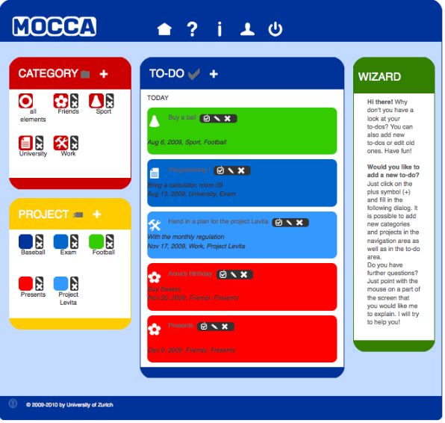
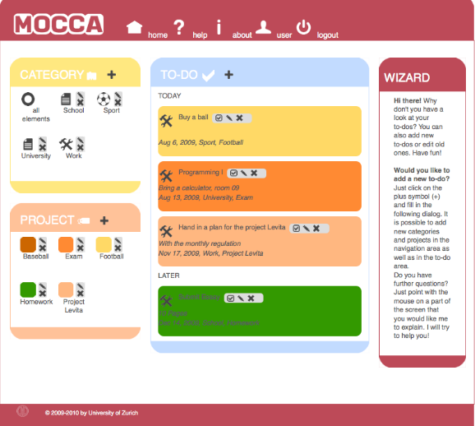
Case Study: Culturally Appropriate Interfaces
MOCCA [9]
Using Hofstede’s dimensions to adapt user interfaces
Bright colors for high MAS Pastel colors for low MAS
Notes:
The next case study explores how user interface preferences can differ between cultures, and how we can better adapt to these preferences when creating our interfaces. The goal of this case-study is to make the students aware of the need of culturally adaptable interfaces and to stimulate their creative ideas to solve the current interface issues.
The main focus of this case study is this program called MOCCA which stands for “Modeling Culture for Cultural Adaptivity” which was a result of a study conducted by , Reinecke, and Bernstein . The program provides the user with a survey where they can input all the countries they ever lived in and then will generates an interface based on that input. MOCCA can generate three different versions of eight different interface aspects such as color, and density. The versions are determined based on if the countries the user inputted score high medium or low on different Hofstede dimensions
Examples:

Slide 14
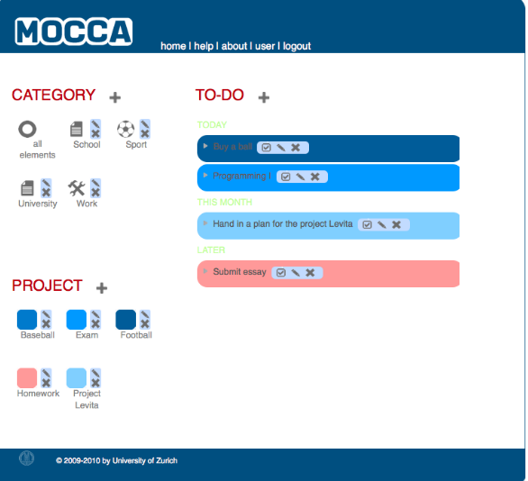
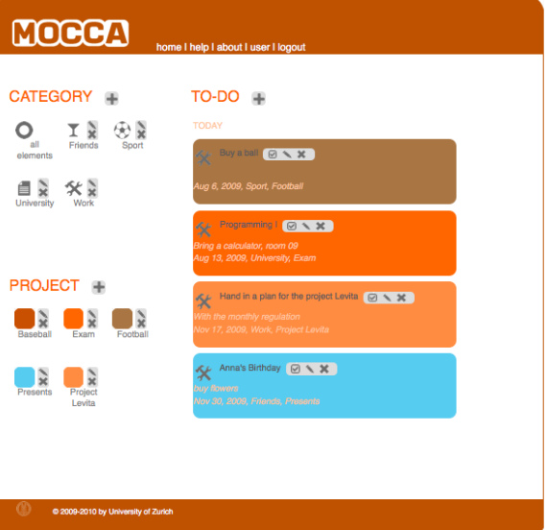
Case Study: Culturally Appropriate Interfaces
Minimal information density for low LTO
Minimum structure definition for medium INDV
Notes:
long term orientation

Slide 15
Case Study: Culturally Appropriate Interfaces
Discussion Questions
The MOCCA requires each user to fill out a form before entering the website to get an idea of user’s cultural background. This restriction affects its accessibility (users might not be willing to share the information) and usability (users want to access the website, not fill out a survey!). How might a computer system’s user interface infer and dynamically update to match a user’s preferences?
Just as with culture, people of different genders tend to prefer different interfaces as they think and problem solve differently. ¹ In your own culture, how do you think user interfaces be developed to include the preferences and requirements of other genders? Collect your thoughts and then discuss them with a classmate of a different gender.
Notes:
Here, the first question is challenging the students to apply their technical engineering training to improve the design of this culturally-aware system, and the second one is inviting students to broaden their thinking about what constitutes a good interface for the systems they build.

Slide 16
Case Study: Smart Phones and Orthodox Judaism
Woodruff et al. [10] – automated lights for Sabbath
Rosenburg et al. [11] – Jewish Rabbi debate whether cellphones should be allowed at all
General Engineering Requirements
Free of distractions and temptations
No social media
No browsers
No entertainment applications
Notes:
We took a different track for the last study and focused on a different aspect of culture: religion. Specifically, the goal of this case study is to educate the students about orthodox Judaism and their restrictions on smart phones, and to provide an example of a more technical solution of a cultural inclusive system with much back-end engineering.
We introduce the topic by looking at how technology is used in other aspects of orthodox Jews’ lives, like automated lights and timers to facilitate the practice of the Sabbath. And we mention some previous research regarding the debate of whether cellphones should be allowed at all for orthodox Jews.
In general, the engineering requirements for a smart phone would be:

Slide 17
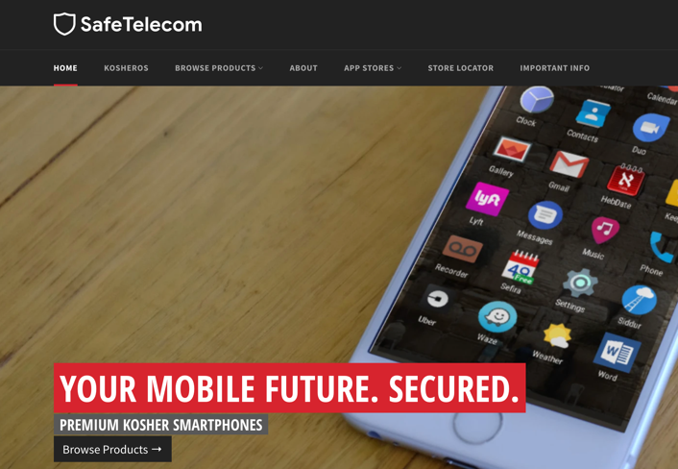
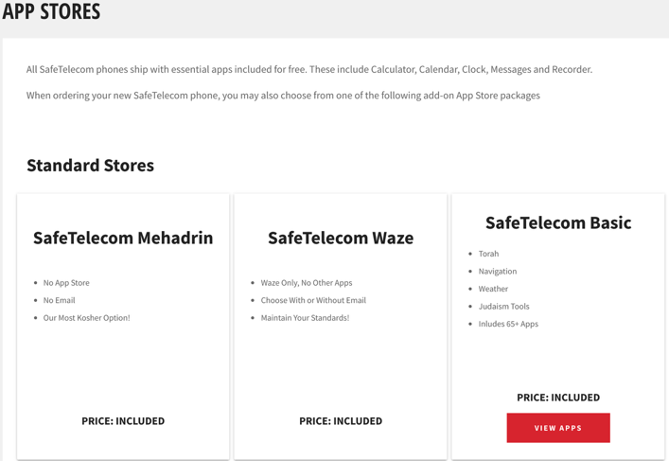
Case Study: Smart Phones and Orthodox Judaism
SafeTelecom
KosherOS
Completely stripped phone
Pure android implementation
Browsers engineered out of certain apps
Personalized apps stores
Notes:
A few solutions exist fulfilling these engineering requirements. The solution we focus on in our case study is the KosherOS developed by SafeTelecom. Unlike the other solutions, KosherOS is not a filtering system on a cellphone, its its own operating system. Only a couple select devices can implement this OS.
In short, the phone is completely stripped of its old operating system, allowing only the certain applications that are allowed in the personalized app store to be downloaded. The image shows some of the available app stores to buy. Some are made specifically for Jewish schools and organizations.
We actually got to interview the head developer of Kosher OS. From the interview we were able to include some in-depth technical details of Kosher OS into the case study as well as some of the history and background of the OS

Slide 18
Case Study: Smart Phones and Orthodox Judaism
Discussion Questions
The purpose of a Kosher Smartphone is to minimize the distracting potential of smartphone technology. Would you give up control of your smartphone to eliminate temptations and distractions? Would you be willing to trust someone else to decide what is “tempting” and “distracting” for you?
Suppose you are part of an Orthodox Jewish community that wants a bit more flexibility. How might you extend the technologies behind the “Kosher Phone” to be more content- and context-sensitive?
Notes:
Here, the first question asks the students to empathize with their users, while the second again challenges them to apply their technical engineering training

Slide 19
References
[1] G. Hofstede, “Dimensionalizing Cultures: The Hofstede Model in Context,” Online Read. Psychol. Cult., vol. 2, no. 1, 2011, doi: 10.9707/2307-0919.1014.
[2] B. K. Jesiek, N. T. Buswell, and Q. Zhu, “Global Engineering Competency: Assessment Tools and Training Strategies,” ASEE Annu. Conf. Expo. Conf. Proc., 2018, doi: 10.18260/1-2--30559.
[3] S. Matthiesen, P. Bjørn, and C. Trillingsgaard, “Attending to implicit bias as a way to move beyond negative stereotyping in GSE,” Attending to implicit bias as a way to move beyond negative stereotyping in GSE | Proceedings of the 15th International Conference on Global Software Engineering, 01-Jun-2020. [Online]. https://dl.acm.org/doi/10.1145/3372787.3390432. [Accessed: 08-Nov-2021].
[4] Y. Wang and M. Zhang, "Country Stereotypes, Initial Trust, and Cooperation in Global Software Development Teams," 2019 ACM/IEEE 14th International Conference on Global Software Engineering (ICGSE), 2019, pp. 152-161, doi: 10.1109/ICGSE.2019.00036.
[5] T. Alsanoosy, M. Spichkova and J. Harland, "Cultural Influences on the Requirements Engineering Process: Lessons Learned from Practice," 2018 23rd International Conference on Engineering of Complex Computer Systems (ICECCS), 2018, pp. 61-70, doi: 10.1109/ICECCS2018.2018.00015.
[6] G. Borchers, "The software engineering impacts of cultural factors on multi-cultural software development teams," 25th International Conference on Software Engineering, 2003. Proceedings., 2003, pp. 540-545, doi: 10.1109/ICSE.2003.1201234.

Slide 20
References Continued
[7] R. Altin et al., “Working across time zones in cross-cultural student teams,” Proc. Conf. Integrating Technol. Comput. Sci. Educ. ITiCSE, p. 360, 2009, doi:
[8] Y. Li, S. Krusche, C. Lescher, and B. Bruegge, “Teaching Global Software Engineering by Simulating a Global Project in the Classroom,” SIGCSE 2016 - Proc. 47th ACM Tech. Symp. Comput. Sci. Educ., pp. 187–192, 2016, doi: 10.1145/2839509.2844618.
[9] Harvard School of Engineering and Applied Sciences, K. Reinecke, A. Bernstein, and University of Zurich, “Knowing What a User Likes: A Design Science Approach to Interfaces that Automatically Adapt to Culture,” MIS Q., vol. 37, no. 2, pp. 427–453, Feb. 2013, doi: 10.25300/MISQ/2013/37.2.06.
[10] A. Woodruff, S. Augustin, and B. Foucault, “Sabbath day home automation: ‘it’s like mixing technology and religion,’” in Proceedings of the SIGCHI Conference on Human Factors in Computing Systems - CHI ’07, San Jose, California, USA, 2007, pp. 527–536. doi: 10.1145/1240624.1240710.
[11] S. Matthiesen, P. Bjørn, and C. Trillingsgaard, “Attending to implicit bias as a way to move beyond negative stereotyping in GSE,” Attending to implicit bias as a way to move beyond negative stereotyping in GSE | Proceedings of the 15th International Conference on Global Software Engineering, 01-Jun-2020. [Online]. Available: https://dl.acm.org/doi/10.1145/3372787.3390432. [Accessed: 08-Nov-2021].

