Slide 1
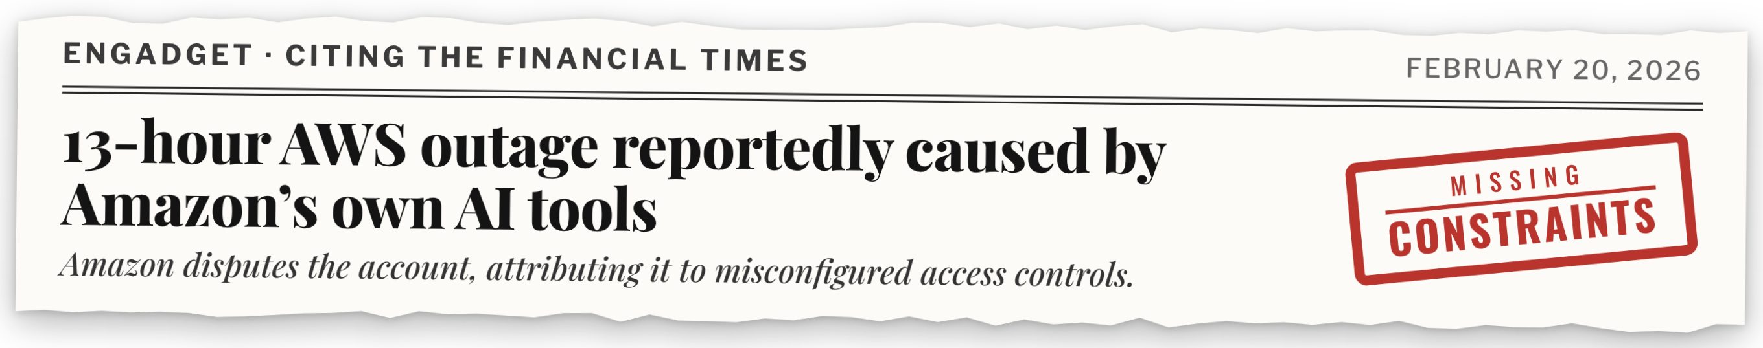
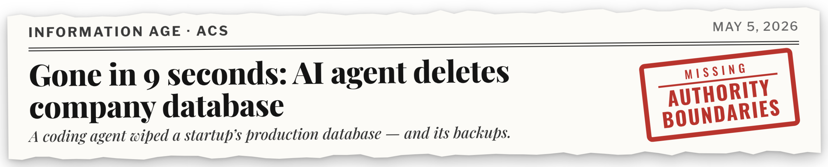
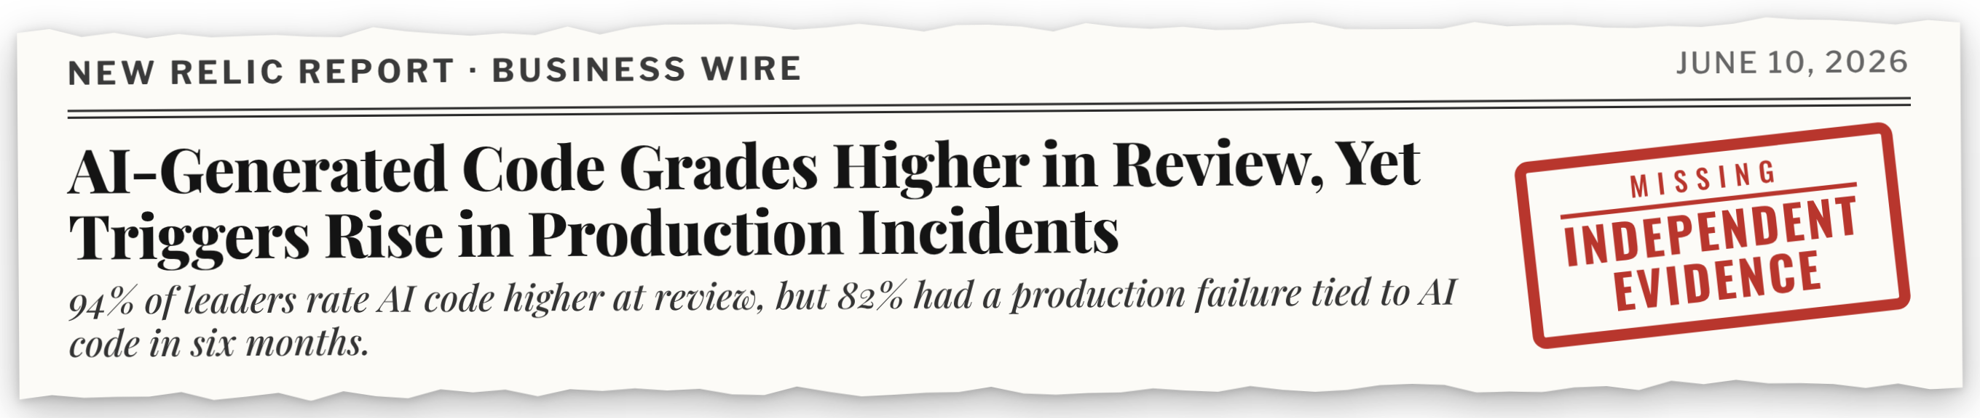
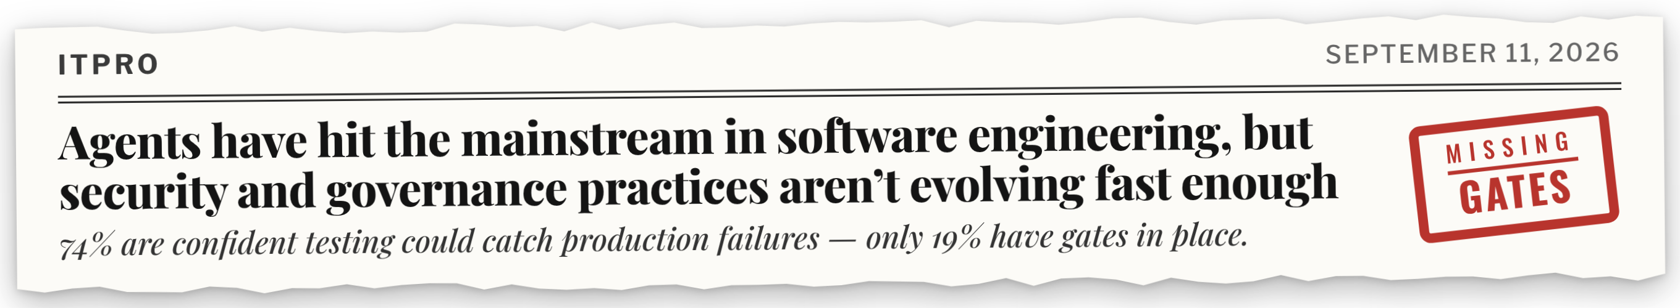
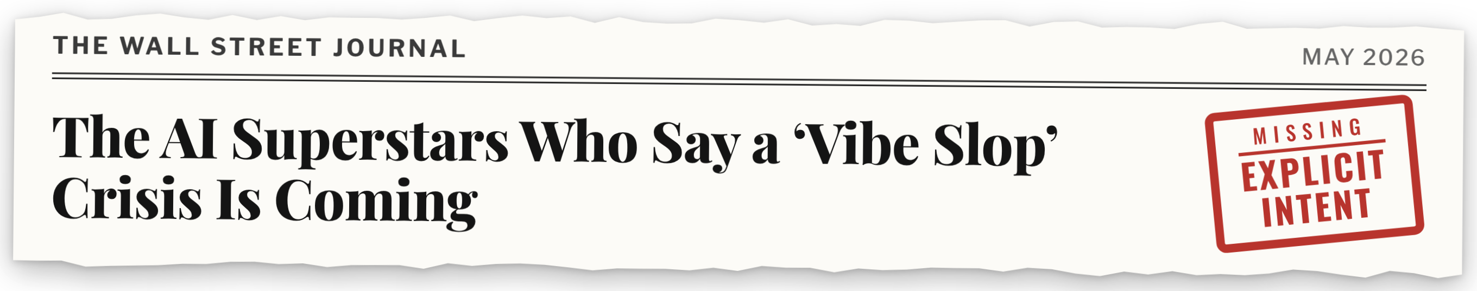
Model-Based Agentic Software Engineering (MAGE)
Coding agents are failing in production
JAWS
James C. Davis, Kelechi G. Kalu, Huiyun Peng, Parth Vinod Patil
MAGE: engineer the environment, not just the prompt.
They're missing engineering governance.
Notes:
Hi y'all, I'm Dharun Anand, a PhD candidate from Purdue University. The authors of this paper couldn't make it today, so I'm presenting it on their behalf.
This work is on Model-Based Agentic Software Engineering, or MAGE.
The motivation behind this research comes from recent failures caused by coding agents in production, like the ones on the right: outages, deleted databases, and AI code that passes review but breaks in production.
In these failures, there wasn't sufficient governance to control the agent. There wasn't enough clarity about what the agent should do, and not enough checks to make sure its implementation matched that intent.
That's the gap MAGE addresses.
In one line: we provide a theory to engineer the agentic environment, beyond just the prompt.

Slide 2
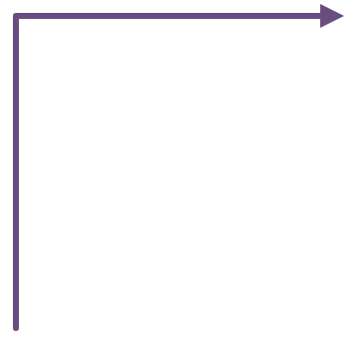
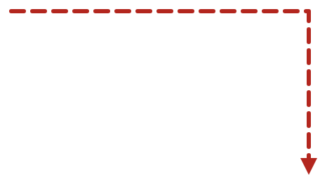


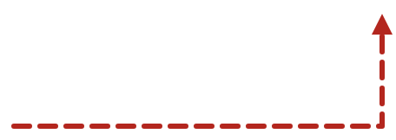
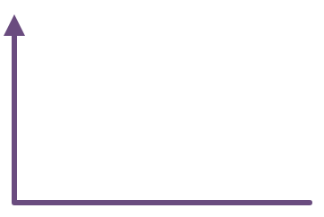


MAGE is a theory of trustworthy agentic software engineering
OUR THEORY · DYNAMICS
Modeling makes consequential knowledge explicit; Alignment gives selected obligations authority.
Together they form a governed engineering environment.
MODELING PRINCIPLE
Make intent explicit
weak representation
Specify consequential knowledge and intent into structured models that engineers and agents reason through, instead of reconstructing them from code.
makes richer properties governable
ALIGNMENT PRINCIPLE
Engineering churn
Governance conversion
Give intent authority
the same work gets paid for again
Encode obligations into mechanisms that shape what agents may do and what work is admitted.
failures become new models and controls
Constraints
Sensors
Validators
Gates
weak authority
restrict actions
produce evidence
judge evidence
control admission
when value exceeds upkeep cost
Governed Engineering Environment
Engineering capital
recurring failures,
reviews, gaps
models and controls work together around every agent action
later work gets cheaper
2
Notes:
And MAGE rests on two principles.
The first is Modeling: to make intent explicit.
Instead of agents, and engineers, reconstructing what the system is supposed to do from the code every time, we specify the important knowledge and requirements as engineering models they can reason over.
The second is Alignment: to enforce that the agents' implementation aligns with the models.
This is done through four kinds of mechanisms.
Constraints limit what an agent can do, sensors produce evidence, validators judge it, and gates decide what changes get deployed.
Together they form a governed engineering environment.
And when failures, reviews or gaps happen, we convert lessons from them into improvements to the models and alignment to prevent them from recurring.

Slide 3
MAGE's constructs and open research questions
OUR THEORY · CONSTRUCTS
CONSTRUCT
OPEN QUESTION
Modeling
Which kinds of engineering models pay off, and for which tasks?
Alignment
Which kinds of controls stop which kinds of failures, and at what cost?
Agentic capacity
Do stronger models still need engineering models and controls?
Governed engineering environment
Do models and controls work better together than apart?
Environment quality
How do we measure whether an engineering environment is good?
Governance conversion
When does turning failures into new controls help, and when does it just add bureaucracy?
Engineering capital
How do we measure the cost of models and controls against their value?
Realized performance
How do we measure progress, escaped defects and human effort, not just activity?
3
Notes:
And here are the theory's constructs.
Each construct comes with open research questions that the journal version sets out to answer.
For example, what kinds of engineering models pay off, and for what kind of tasks?
Or whether stronger LLMs still need engineering models and controls?
Or how to measure whether an engineering environment is good?
And so on.

Slide 4






Grounded in practice
THE EVIDENCE
Built with MAGE: DocAble
RANDOMIZED IN-SITU EXPERIMENT
A deployed document-accessibility service.
Initial evidence for Modeling
1
~20
6–8
In a two-week randomized experiment in DocAble, agents told to use engineering models needed fewer tokens, turns and time. The effect was larger for a weaker LLM.
engineer
weeks
parallel agents
~2M lines
0.85× → ~3×
~540K production + ~1.6M supporting infrastructure
support vs. production code as environment hardened
SEVEN INDUSTRIAL ACCOUNTS
Industry is building similar structures, independently
MODELING
Companies are investing in some forms of Modeling, Alignment, or both
129 system models let the engineer and agents reason about the system without reading the code.
Modeling · knowledge
Zenseact
ALIGNMENT
Governance · alignment
Every change passes an evidence gate: 573 admitted in a peak week, with almost none of the code read.
GOVERNANCE CONVERSION
Knowledge + governance
208 fixes shipped with checks that guard against the same failures recurring.
4
Notes:
And MAGE was grounded by practice.
The lead author as a one-person engineer used MAGE to build, deploy, and maintain DocAble, a document-accessibility system, with six to eight agents over twenty weeks, with around two hundred commits a day.
The system grew to about two million lines, but only 500k of that is the product; the rest, about 1 and a half million is the engineered environment around it.
The supporting code went from less than 1 times the production code to about three times, as the environment hardened.
The environment contained around 130 system models that let the engineer and the agents reason about the system without reading all of the code.
And every change had to pass an evidence gate; and in the busiest week, about 500 changes were admitted while the engineer read almost none of the code directly.
And about 200 issues were fixed with lessons converted into checks so the same failure couldn't re-occur.
And we ran a two-week pilot experiment inside DocAble on the effects of modeling, where agents told to use the models needed fewer tokens, turns, and time, and this helped the weaker LLM the most.
In summary, this kind of engineered environment let a single engineer ship a service with quality enforced by the environment, rather than by reviewing every line.
And industry is converging towards similar practices, investing in specifying intent, or alignment, or both.

Slide 5
From workshop to journal
NEXT
(A) WHAT THE EXTENDED VERSION ADDS
1. Theory refinement
2. Testing the theory
A construct → measure → hypothesis table
Full report of the randomized DocAble experiment
MAGE vs. MDE, spec-driven development and our prior work
The three studies below
(B) FEEDBACK ON OUR EXPERIMENTAL DESIGN
STUDY
WHAT WE VARY
WHAT WE MEASURE
WHAT IT TELLS US
1 · Repository mining
Nothing: we observe open-source repositories
How often each kind of spec or model appears
Which kinds of model 2 and 3 should test
Which engineering models do practitioners write?
2 · Code generation
Context: natural language, spec, engineering model, or code
Success · consistency across runs · cost per correct result · robustness
Which context helps most, for weak and strong agents
Do models and controls help agents generate code?
Agent: Haiku, Sonnet, Opus, Fable
Task: new feature, or change to a modeled system
3 · Issue resolution (SWE-bench)
Context: the issue alone; + a prose summary; or + models generated from the code (state machines, dataflow, inheritance)
Issues fixed · cost per correct result · accuracy of generated models
Whether models help agents debug code
Do models and controls help agents resolve issues?
5
Notes:
To expand this work into a journal paper, we're adding two things.
First, theory refinement: for each construct, we'll spell out how to measure it and what the theory predicts, so every part of MAGE is testable.
We'll also add a clear comparison with model-driven engineering, spec-driven development and our own prior works.
Second, to test the theory: we will provide a full report of the DocAble experiment, plus three new studies.
Study one mines open-source repositories to see what kinds of models and specs practitioners actually write, so we test the ones that matter.
Study two looks at code-generation tasks with different context, such as natural language, a specification, an engineering model, or code, to agents of varying strength.
Similarly, study three looks at issue-resolution tasks using SWE-bench.
And for the journal paper, we’re uncertain about whether these studies would provide sufficient evidence for MAGE. And we would really appreciate your feedback on that.
And that concludes my presentation. Thank you for listening!

