Slide 1


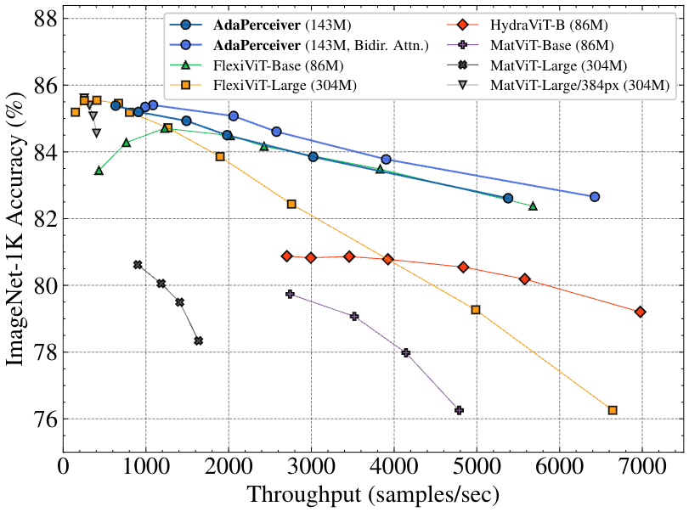
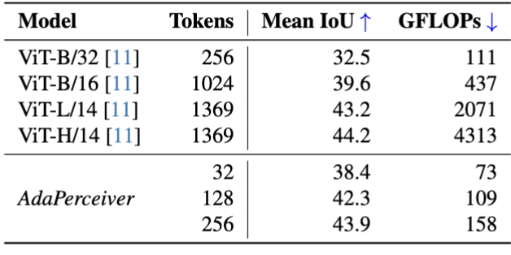
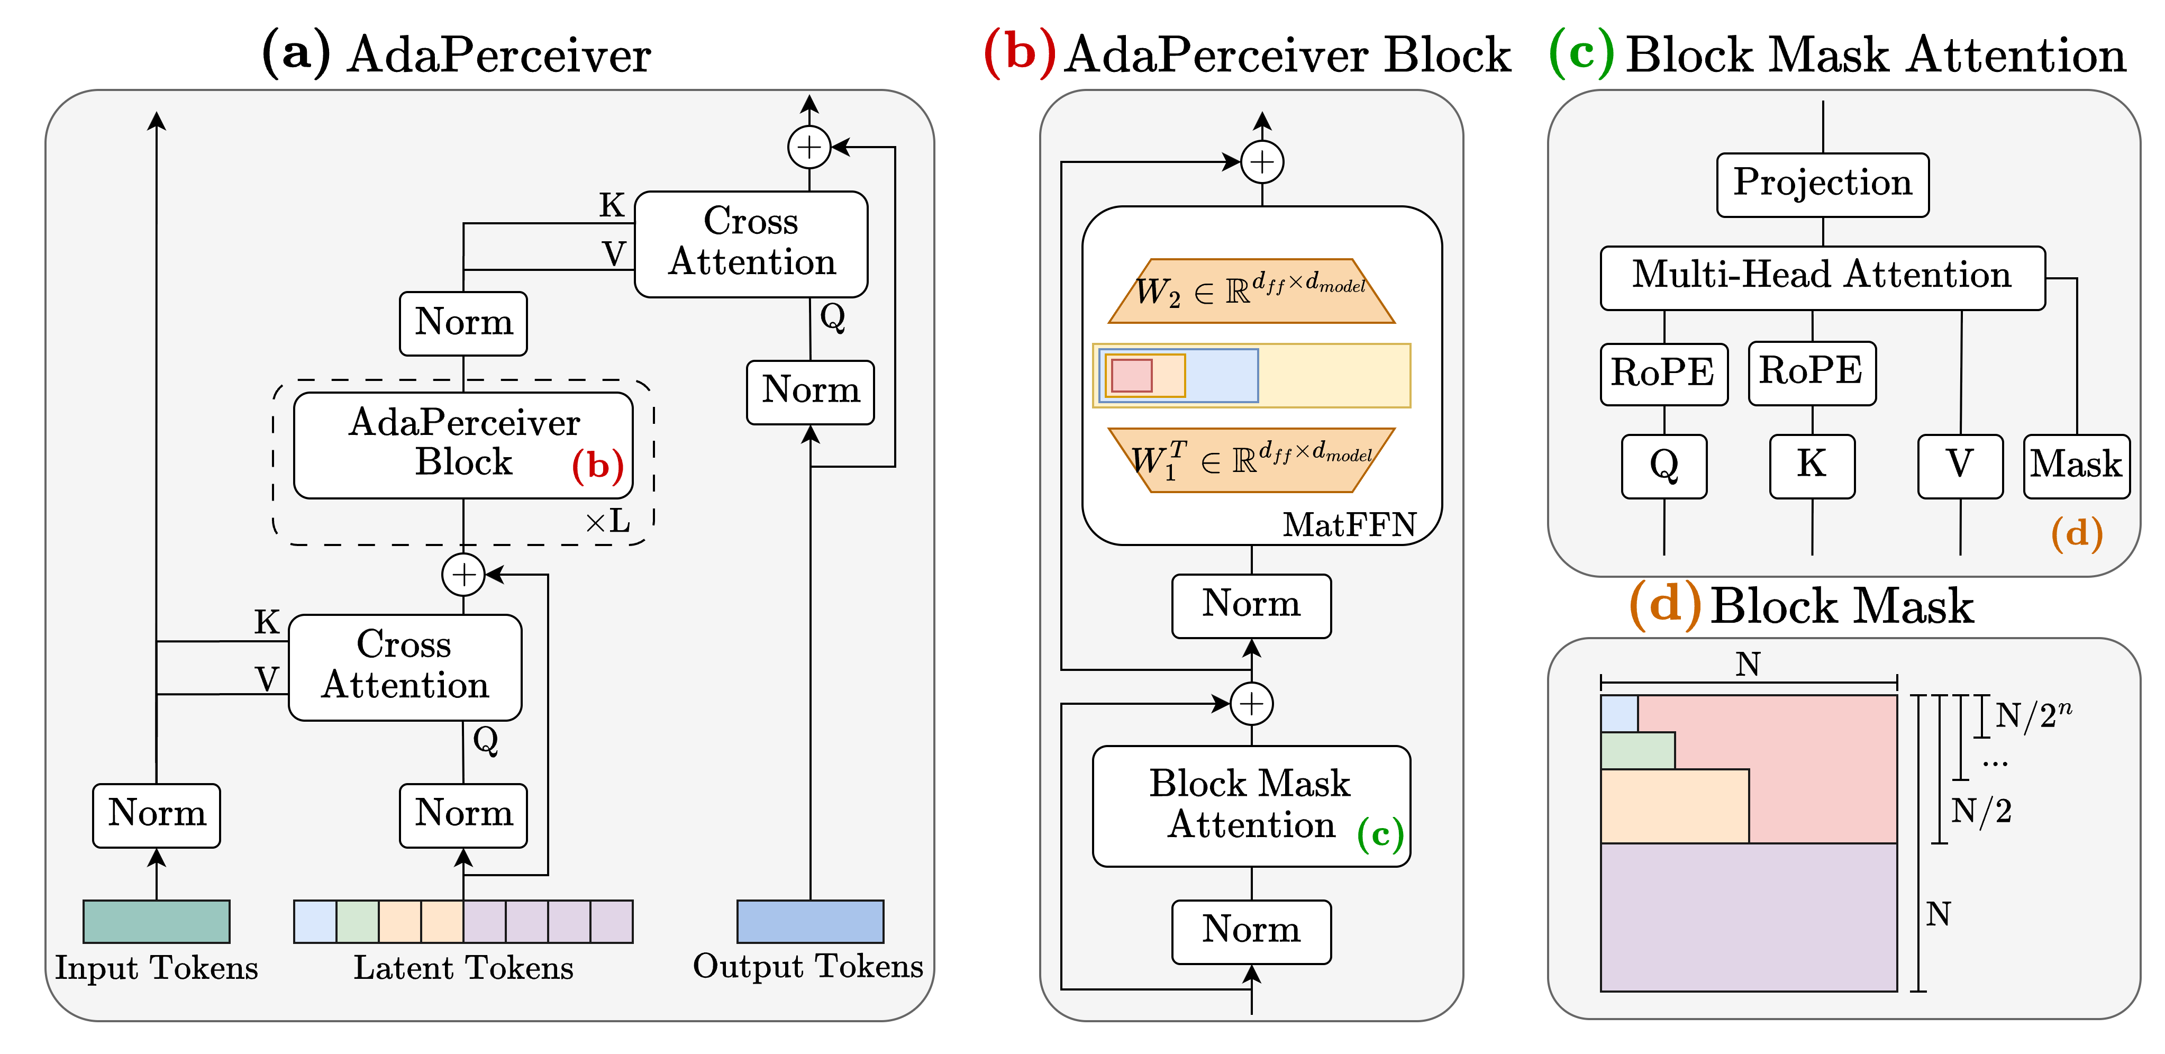
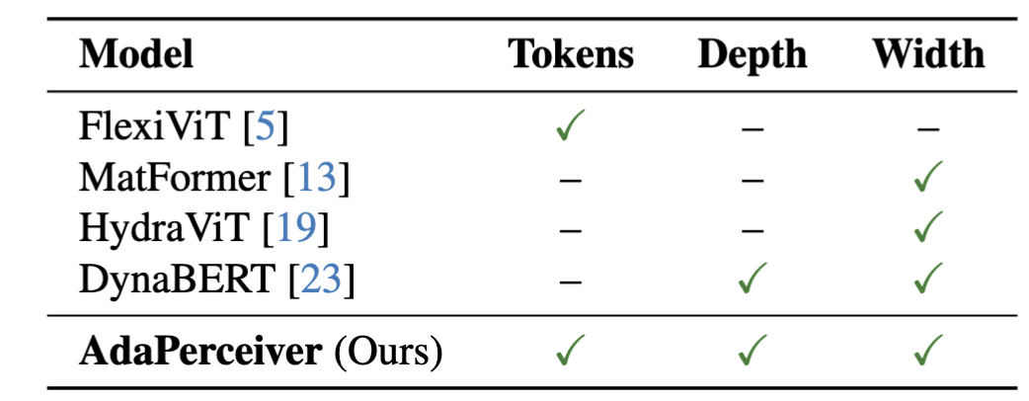
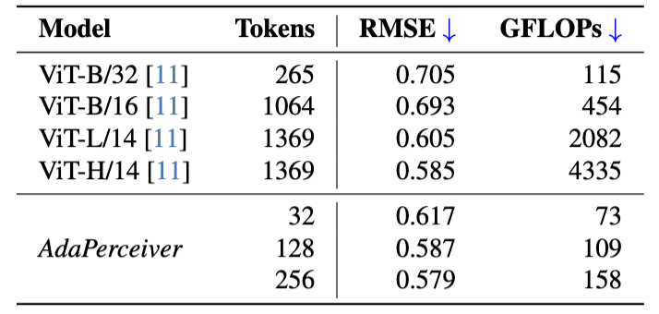
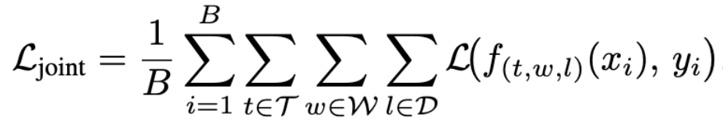
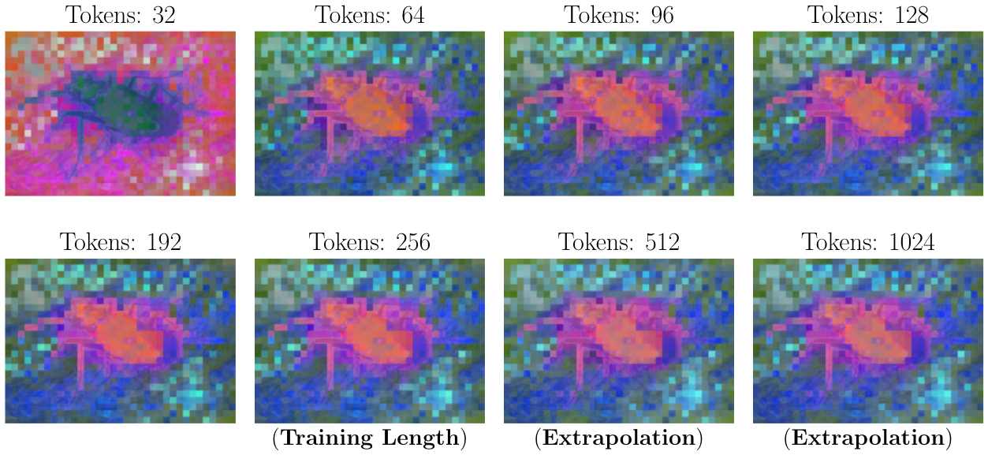
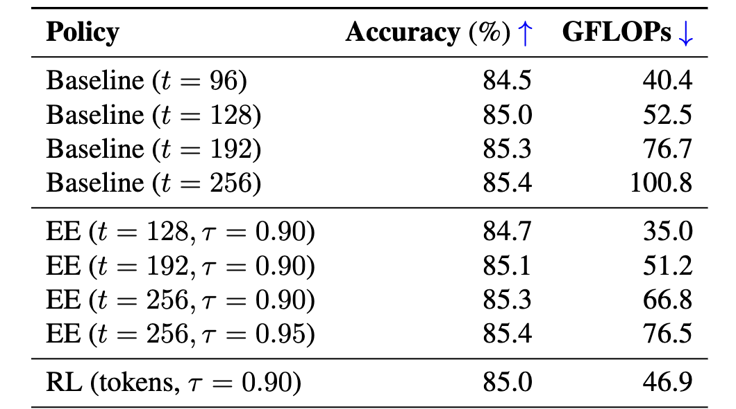
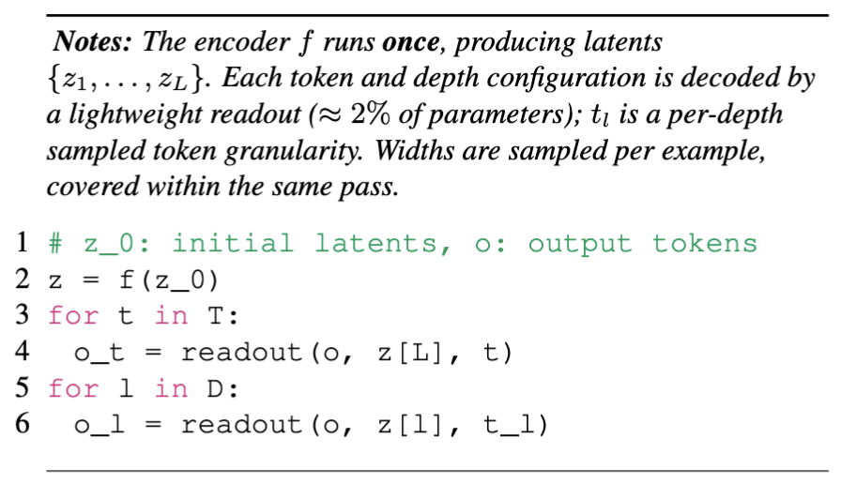
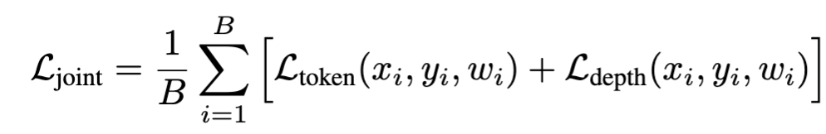
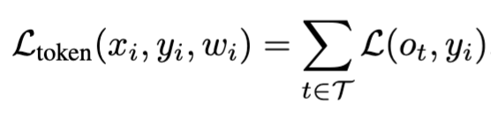
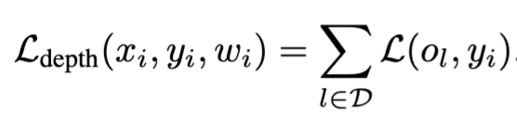
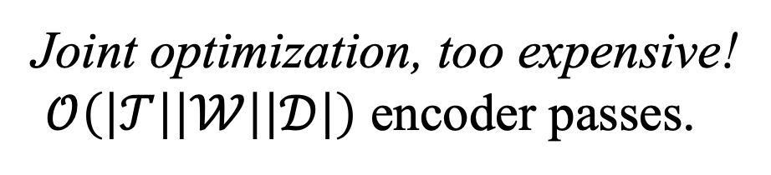
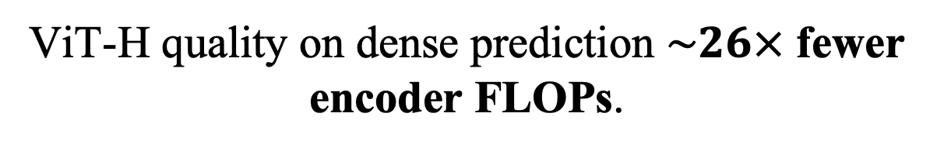
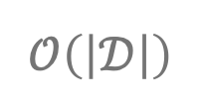
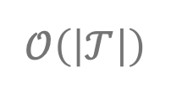
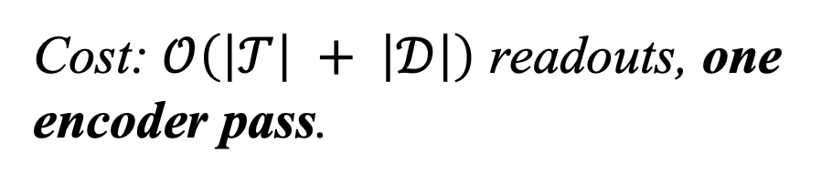
AdaPerceiver: Transformers with Adaptive Width, Depth, and Tokens
Purvish Jajal¹; Nick John Eliopoulos¹; Benjamin Shiue-Hal Chou¹; George K. Thiruvathukal²; Yung-Hsiang Lu¹; James C. Davis¹
¹Purdue University, ²Loyola University Chicago
Motivation
Methods
Results
Transformers are rigid at inference. Each input gets the same fixed budget of tokens, layers, and width.
Deployments need a range of compute-accuracy trade-offs.
Existing adaptive methods flex only 1-2 axes [1, 2]. None cover tokens, depth, and width together.
Goal: Can we make a single model that allows for flexibility along tokens, layers, and width?
Problem 1: How should we design the architecture?
We extend PerceiverIO with adaptivity in the latent stream:
Flexible Tokens → Block-mask attention.
Flexible Width → Matryoshka feed-forward networks.
Flexible Depth → Early Exiting.
One model, the whole Pareto frontier – large ViT accuracy to small ViT throughput.
ViT-H quality on dense prediction $\sim 26×$ fewer encoder FLOPs.
ADE20K
NYUv2
Contributions
A flexible transformer along three-axes. One model configurable at inference along tokens, depth, and width.
Once-for-all training. All sub-networks are trained from one encoder forward pass.
Strong accuracy-compute trade-offs across classification and dense prediction.
Inference-time policies that cut FLOPs 24-33% at near-equal accuracy.
Problem 2: How should we train the architecture?
*linear probing
Joint optimization, too expensive!
$𝒪\left(\left|𝒯\right|\left|𝒲\right|\left|𝒟\right|\right)$ encoder passes.
Features change from 32 → 64, then converge: suggests benefits from additional tokens diminish.
Early Exiting: a free lunch – 24-33% fewer FLOPs, same accuracy.
Tokens
Widths
Depths
We evaluate all token and depth configurations in one forward pass.
Paper
Code
Weights
Cost: $𝒪\left(\left|𝒯\right| + \left|𝒟\right|\right)$ readouts, one encoder pass.
$$𝒪\left(\left|𝒯\right|\right)$$
$$𝒪\left(\left|𝒟\right|\right)$$
Contact
References
Purvish Jajal
Purdue University
Email: pjajal@purdue.edu
Kudugunta, Sneha, Aditya Kusupati, Tim Dettmers, Kaifeng Chen, Inderjit Dhillon, Yulia Tsvetkov, Hannaneh Hajishirzi, Sham Kakade, Ali Farhadi, and Prateek Jain. "Matformer: Nested transformer for elastic inference." Advances in Neural Information Processing Systems 37 (2024): 140535-140564.
Hou, Lu, Zhiqi Huang, Lifeng Shang, Xin Jiang, Xiao Chen, and Qun Liu. "Dynabert: Dynamic bert with adaptive width and depth." Advances in Neural Information Processing Systems 33 (2020): 9782-9793.

Slide 2
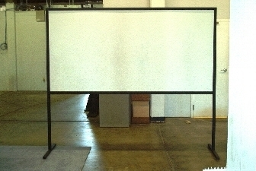
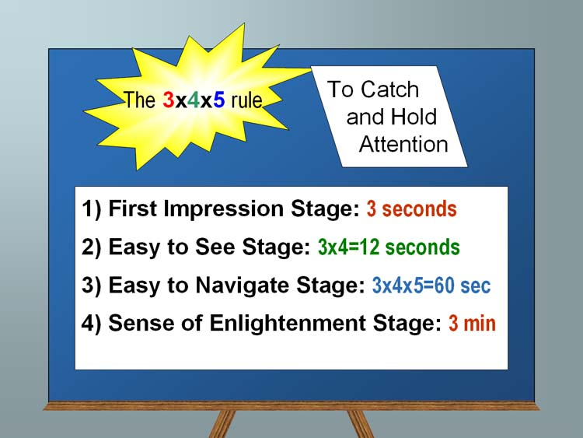
Template– Replace This Text With Your Title
School Logo here
John Smith, MD¹; Jane Doe, PhD²; Frederick Jones, MD, PhD^{1,2}
¹University of Affiliation, ²Medical Center of Affiliation
Abstract
Methods and Materials
Results
Discussion
Section 1 (sizes):
Section 1 (sizes):
  Posters boards are 48” tall and 96” wide, but we recommend you leave a little border since you may not be able to pin at the vertical edge. Since PowerPoint does not let one define such a large paper size, this template is designed to be printed at 200%, yielding a 46” x94” poster. You can scale it up or down a bit (e.g. 42” is a common paper size at FexEd). Note there is no direct international A0.. A1 equivalent. The poster size is approximately three A0 boards next to each other, i.e., each column in this example is about one A0 board.
  Ideally you want to keep it very readable: this is not your paper, it is a poster. 32pt here (64 final printing) is good for most text:
    Sub-bullets are 28 here (56 final)
      Don’t use smaller than 24pt in this template (which is 48pt in final printing at 200%)
      Insert plenty of graphics and any math you need
  When inserting graphics or equations, keep the resolution high (remember this will be printed at 200%). If you can see blocking artifacts at 400% magnification in PowerPoint, consider finding better graphics. This is an example of BAD/LOW RES GRAPHICS
  Leave enough margin for pushpin and remember many big plotters cannot get within .5” of the actual paper edge.
  You are free to use colored backgrounds and such but they generally reduce readability.
  You are free to use what ever fonts you like.
    San Serif fonts like Arial are more readable from a distance,
    Serif fonts like times may look more consistent with your mathematics
Section 2 (layout):
  Remember the poster session will be crowded so design the poster to be read in columns so people can read what is in front of them and move left to right to get the whole story.
  The poster should use photos, figures, and tables to tell the story of the study. For clarity, present the information in a sequence that is easy to follow.
  There is often way too much text in a poster - there definitely is in this template! Posters primarily are visual presentations; the text should support the graphics. Look critically at the layout. Some poster 'experts' suggest that if there is about 20-25% text, 40-45% graphics and 30-40% empty space, you are doing well
Section 3:
  Include more figures than are in the paper so you can talk to them. Include things that are not in the paper and then encourage them to read the paper. Don’t try to just put all the paper here.
  If it looks like a cut/paste of the paper, people skip that poster since they can read the papers after the conference. Many people find it better to spend time talking with poster presenters that have more to offer than just redoing the paper content paper in big fonts.
  People will likely have already seen your posted video, so the poster can serve as a talking point for you.
  Remember Poster boards look like this (you will be sharing this space with another poster.. This is your canvas. Paint us a picture of your work.
Conclusions
Table 1. Label in 20pt Calibri.
Summary/Conclusion
  Summarize your contributions
  Summarize your results (if applicable)
  You an add in links to additional videos, code, or project website (or QR code)
References
Click here to insert more Results text. Type it in or copy and paste from your Word document or other source.
To change the font style of this text box: Click on the border once to highlight the entire text box, then select a different font or font size that suits you. This text is Calibri 24pt and is easily read up to 4 feet away on a 24x48 poster, up to 6 feet away on a 36x72 poster, and up to 8 feet away on a 48x96 poster.
Zoom out to 100% (for 24x48), 150% (for 36x72), or 200% (for 48x96) to preview what this will look like on your printed poster.
Contact
References
<your name>
<your organization>
Email:
Website:
Phone:

