Slide 1
Software Engineering
ECE 30861 / CSCI 45000
Modeling: Purposeful Reduction
What must the model preserve?
Prof. James C. Davis
Prof. Steve France
OBLIGATION
MODEL
TERRITORY
Lecture 1 (today): One model, one question.
Lecture 2: Modeling larger systems
Notes:
Lecture 1 of 2 on Modeling: one model, one question. Lecture 2 turns to systems of many models. Today is learning how to make a model, not a catalogue of model types. [ASSUMPTION per plan section 8.1: deck filename 2-2-Modeling-1-Purposeful-Reduction.pptx pending author ratification.]
Today’s spine is the production equation from the theory chapter. Delegation introduced that picture qualitatively; today we bring it back quantified and point at the one term Modeling acts on; Alignment will return to the same drawing from the other side. Open on it deliberately: the next three slides are the map for the whole of Act II, not a warm-up.

Slide 2
The agent works inside an engineered environment
ENGINEERING ENVIRONMENT
MODELING
changes the reasoning surface
ALIGNMENT
governs what may pass
MODELS
TASK
REASONER
realization
ARTIFACT
consequence
Today: what does Modeling change about this production system?
Notes:
1.5 minutes — We ended Delegation with this picture. The agent does not work alone; it works inside an engineered environment.
- This is the master picture for the rest of Act II, and here it is still entirely qualitative. We are the ones bringing it back and putting numbers on it, starting today.
- The path first. A task enters, a reasoner works, an artifact comes out. Nothing on this row is new — read it back, do not re-teach it.
- Click one. MODELS is the one station drawn with a heavy rim, and its arrow enters the path BEFORE the reasoner runs. Leave the claim open: the arrow lands before the reasoner, and why that should matter is the question this lecture answers. Do NOT say what the models "set" — you have not earned it yet.
- Today we are going to open up the left-hand side. In particular, what does putting a model between engineering intent and the reasoner actually change?
- Click two. ALIGNMENT is the only annotation whose arrow crosses the boundary of the environment. We will return to the blue Alignment boundary later. For now, leave it in the picture but do not explain it — the on-slide gloss "governs what may pass" is all it gets, and declining to open a door you just revealed is a stronger deferral than never drawing it.
- Click three raises the question the rest of the lecture answers. Ask it, then leave it standing: what must a representation preserve for this task?
- The colour code belongs to this PICTURE, not to the deck: red is Modeling's lever, blue is Alignment's, and it returns whenever the picture returns. Nothing here rests on colour alone — the words carry it, and so does the drawing: Modeling's stroke is solid and lands on the path, Alignment's are dashed because passage is conditional, and only Alignment's crosses the boundary.
- Leave the space under the station row empty and do not fill it. Two slides from here, on "Open the box", that is exactly where the arithmetic arrives.
- FORWARD HOOK, and you must say it out loud when you get there: on "Open the box", beat two, name this red arrow — "there it is: R is in the first two factors; that is what the arrow was pointing at." The visual rhyme will not connect itself.
- Next we put a number on the production process.

Slide 3
The production equation
FOR A FIXED ENGINEERING ENVIRONMENT
p(T,M,R,H)
the probability that one attempt produces an acceptable candidate
T
an engineering task or task family
M
the reasoning model
R
the representation available to it
H
the harness and process through which production is organized
Change any one of the four and the probability changes.
Does the engineering system produce the thing?
Notes:
Whole system before the lever. Put the equation up and ask the class to name the four terms before you reveal the labels; give it about a minute, no more.
T is an engineering task or task family, M the reasoning model, R the representation available to it, H the harness and process through which production is organized. For a fixed engineering environment, p(T,M,R,H) is the probability that one attempt produces an acceptable candidate.
Keep the thing they care about on screen: does the engineering system produce the thing? Four levers sit inside that one number, and an engineering organization can reach for any of them.
Modeling is named on the picture behind you, but do not yet say which term it acts on. Naming the lever here spends the next slide’s move, which is to open the probability and point at the one term Modeling acts on. About 2.5 minutes including the naming exchange.

Slide 4
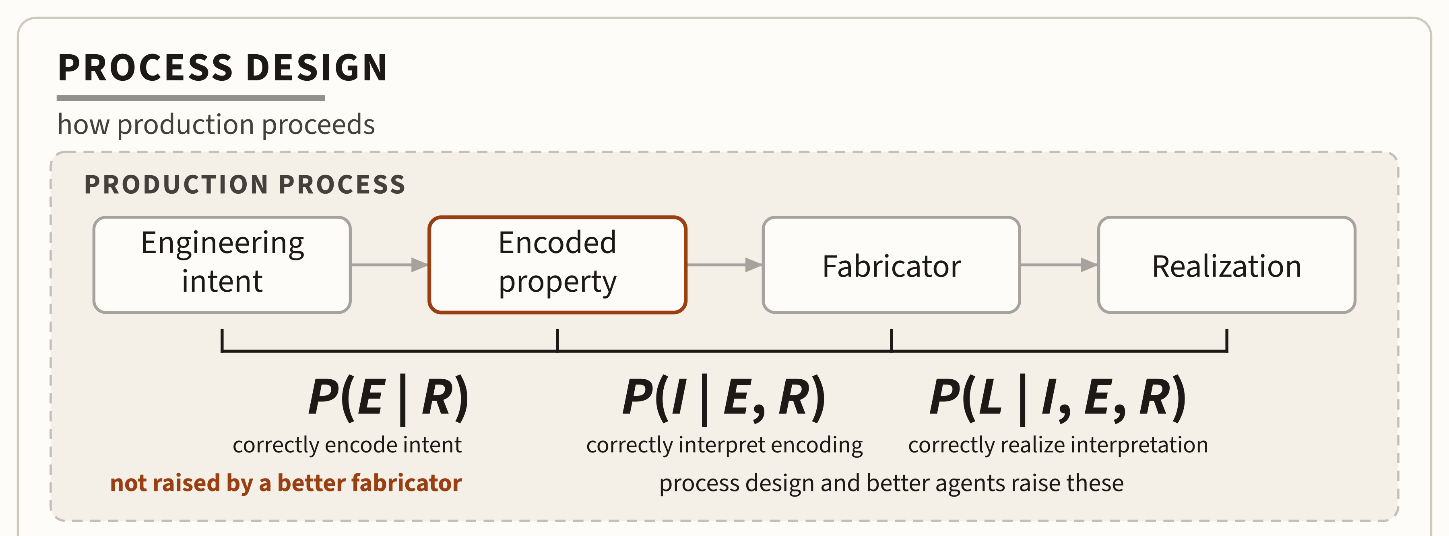
Open the box — where things can go wrong
p_{R} = P(E | R) · P(I | E, R) · P(L | I, E, R)
ENCODE
INTERPRET
REALIZE
a chain decomposition, not an independence assumption
MODELING CHANGES
THE REPRESENTATION
So what makes one representation better than another?
Notes:
That single probability hides several distinct opportunities for failure. Open it: E is correct encoding of consequential intent, I correct interpretation of that encoding, L correct realization of the interpreted intent.
Say the caveat out loud, and say it in these words: this is a chain decomposition, not an independence assumption. The stages will not in general be statistically independent. Students who have had a probability course will otherwise read the product as a claim of independence.
LEVER DISTINCTION — the figure’s own annotations and the red arrow are about different levers, and a careless delivery makes the slide look self-contradicting. A better fabricator cannot raise P(E | R); a better representation can. Say exactly that. “Not raised by a better fabricator” sits under the first term, and the red arrow points at the same term, because the arrow is the representation lever and the annotation is the fabricator lever.
R IN ALL THREE — long form puts an R in every factor, because one representation is held fixed across the whole chain. The overlay boxes only two. Name the asymmetry before a student asks: the lecture’s claim is about the two factors where representation does its work — did we manage to say the consequential thing, and did the agent manage to recover it. Realization is the agent doing work it already understood.
The claim is deliberately twofold. Modeling helps the engineer encode consequential intent (P(E | R): did we manage to say it?) and helps the reasoner recover it (P(I | E, R): did the agent understand it?). After this slide, “we failed to say it” and “the agent failed to understand it” are two different failures with two different names.
Do NOT show the limit equation here. It is held back to the capability slide later in the deck, where every symbol is already known.
Click 2 brings in the red arrow and the closing question: so what makes one representation better than another? That question is the rest of the lecture. About 3 minutes.

Slide 5
Delegation leaves a representation problem
FROM DELEGATION
Implementation is cheap to delegate: an agent can realize a design a hundred acceptable ways.
We cannot specify every realization choice, and we should not try.
So what must a representation preserve for this task?
DELEGATION
ENGINEER
AGENT
E encode
I interpret
what matters must survive this hop
The gap is a property of delegation, not a failure of the agent.
Modeling answers the question delegation leaves open.
Notes:
Bridge from the Agents unit (2-1): implementation is cheap to delegate, and we cannot and should not specify every realization choice. Delegation therefore creates a problem of representation: what matters must survive the hop from engineer to agent. Modeling is the discipline that answers it.
Retitle rationale: the previous two slides just named the problem as representational, not merely informational. The hop is not a bandwidth shortage; it is an encode-and-recover chain. The engineer encodes (E), the agent interprets (I), so this picture is the first two factors of the decomposition drawn as people rather than as arithmetic. That is why the gap now carries E and I tags.
The gap is a property of delegation, not a failure of the agent. Keep that line — students reach for “the agent was not smart enough” first, and the whole lecture depends on refusing it.
Leave the question standing and do not answer it here: what must a representation preserve for this task? The rest of the lecture is the answer. About 1.5 minutes.

Slide 6
SEE THE MODELS
SECTION 1
One territory. Five engineering questions.
ENGINEERING QUESTION
MODEL
PROPERTY
QUALITY
Notes:
Section 1 no longer argues that questions come first. It SHOWS it: five diagrams over one territory, then the thesis, then the definition.
State the tour's rule before starting it, so the pace does not read as rushing: the engineering question is the title, the diagram is the slide, and there is almost no prose. Forty-five to sixty seconds each. Five slides, about five minutes.
Do not teach notation syntax on any of them. If the room wants UML mechanics, that is what the reading is for.
The strip is the lecture's own discipline and it returns at every section break. This section is the ENGINEERING QUESTION beat — the highlighted box — because the tour's entire claim is that the question, not the notation, is what selects the model.

Slide 7
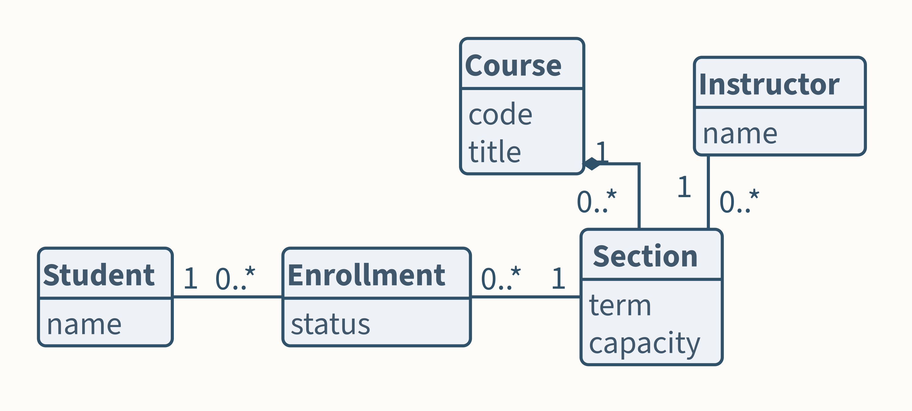
What exists?
What things exist, and how are they related?
Notes:
Twenty to sixty seconds. Name the form aloud once — this is a class diagram, the repertoire's answer to the what-exists question — and then move.
Name the territory once, here, and never set it up again: the course-registration system every person in this room has fought. That is why it was chosen. Zero setup cost per slide is what buys us five diagrams in ten minutes.
Do NOT teach notation. If someone asks what the 0..* means, answer in four words and move on. The tour is an existence proof, not a syntax lesson.
What this diagram preserves: which things exist and how they connect. What it throws away: order, timing, state, who wants what. Every one of those omissions is deliberate, and the next four slides each rescue exactly one of them.

Slide 8
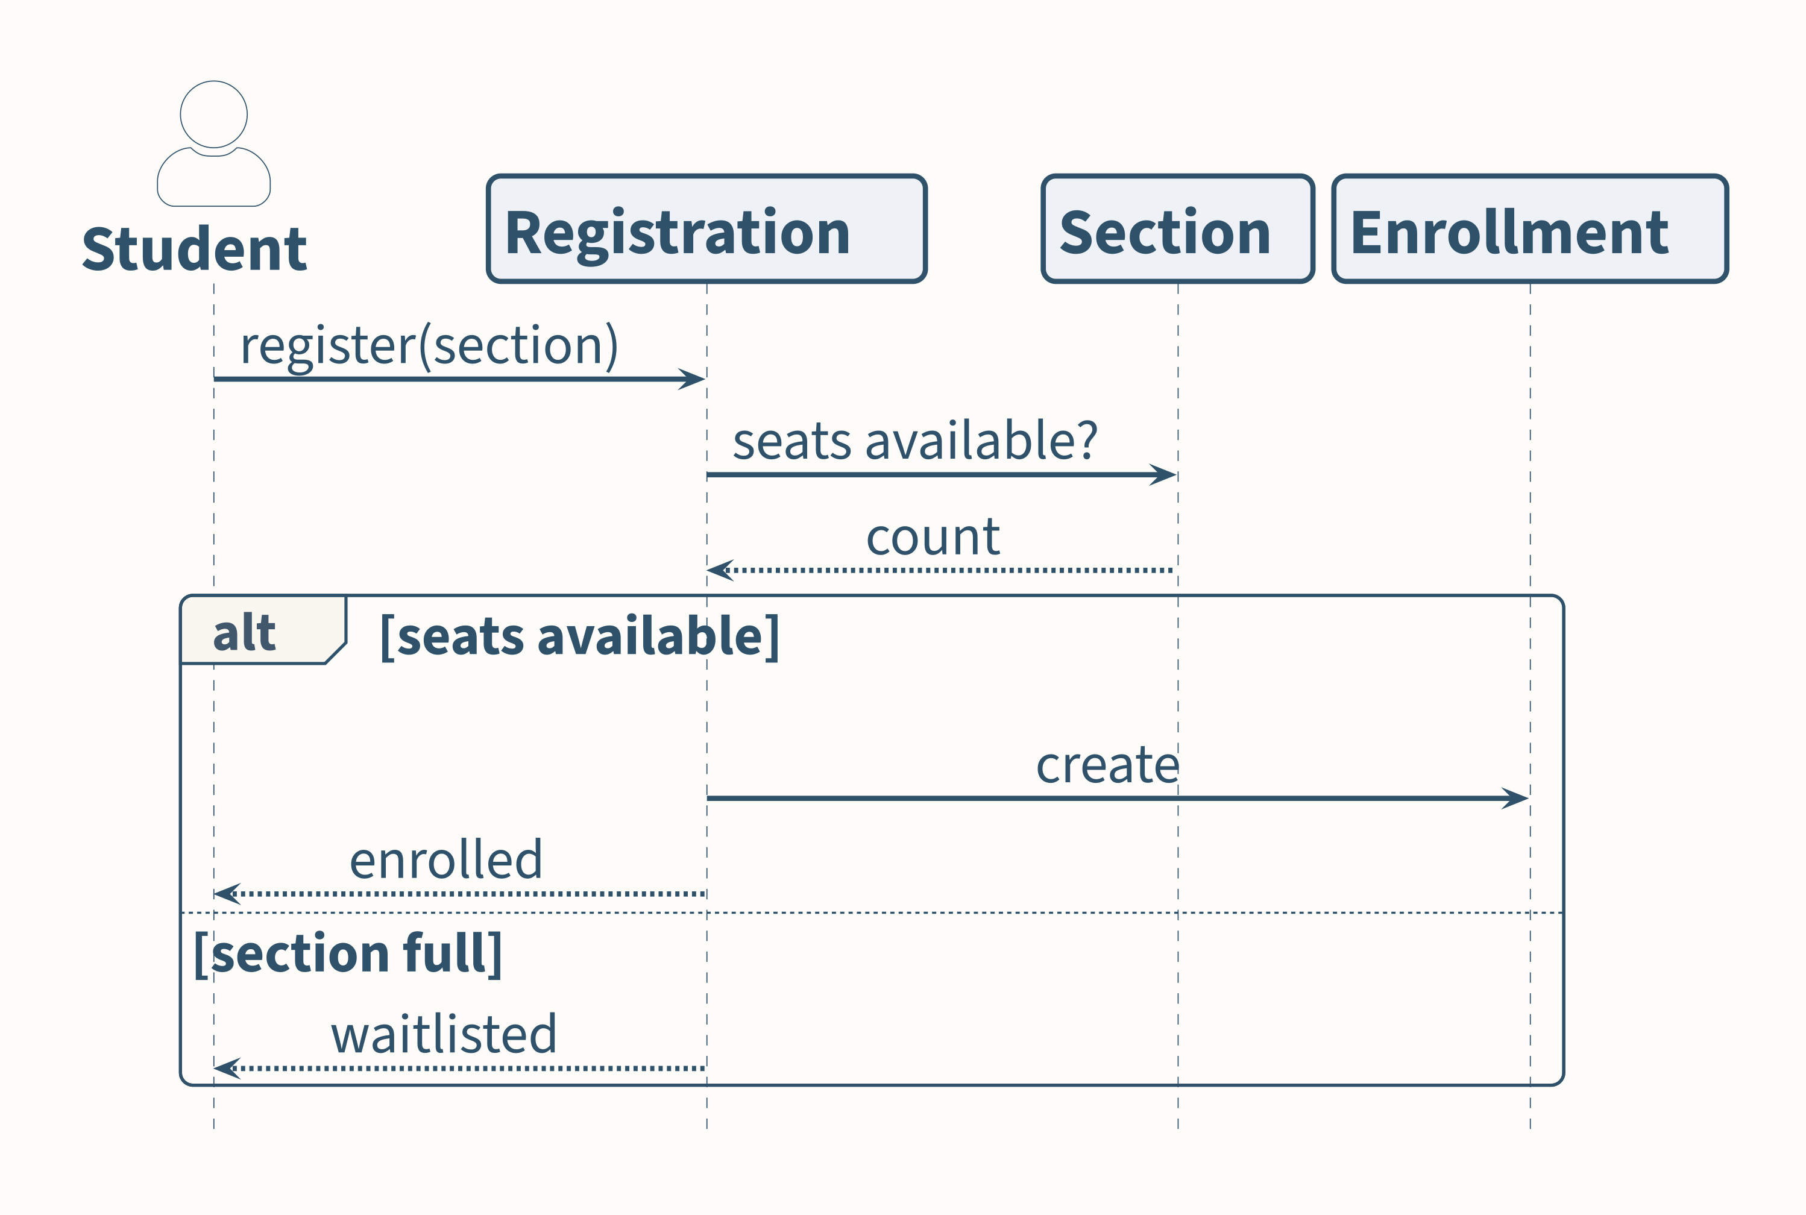
Who talks to whom?
In what order do the parts of one registration happen?
Notes:
Same territory. New question. Say that sentence, because it is the whole argument of the section and this is the first slide where students can verify it themselves.
Nothing about classes survives here. There is no inheritance, no attribute, no multiplicity. The entities appear only as lifelines — names with a timeline attached.
What this preserves that the class diagram could not: ORDER. The capacity check happens before the enrollment is created. That ordering is a fact about the system the previous diagram was structurally incapable of stating.
One breath, then move.

Slide 9
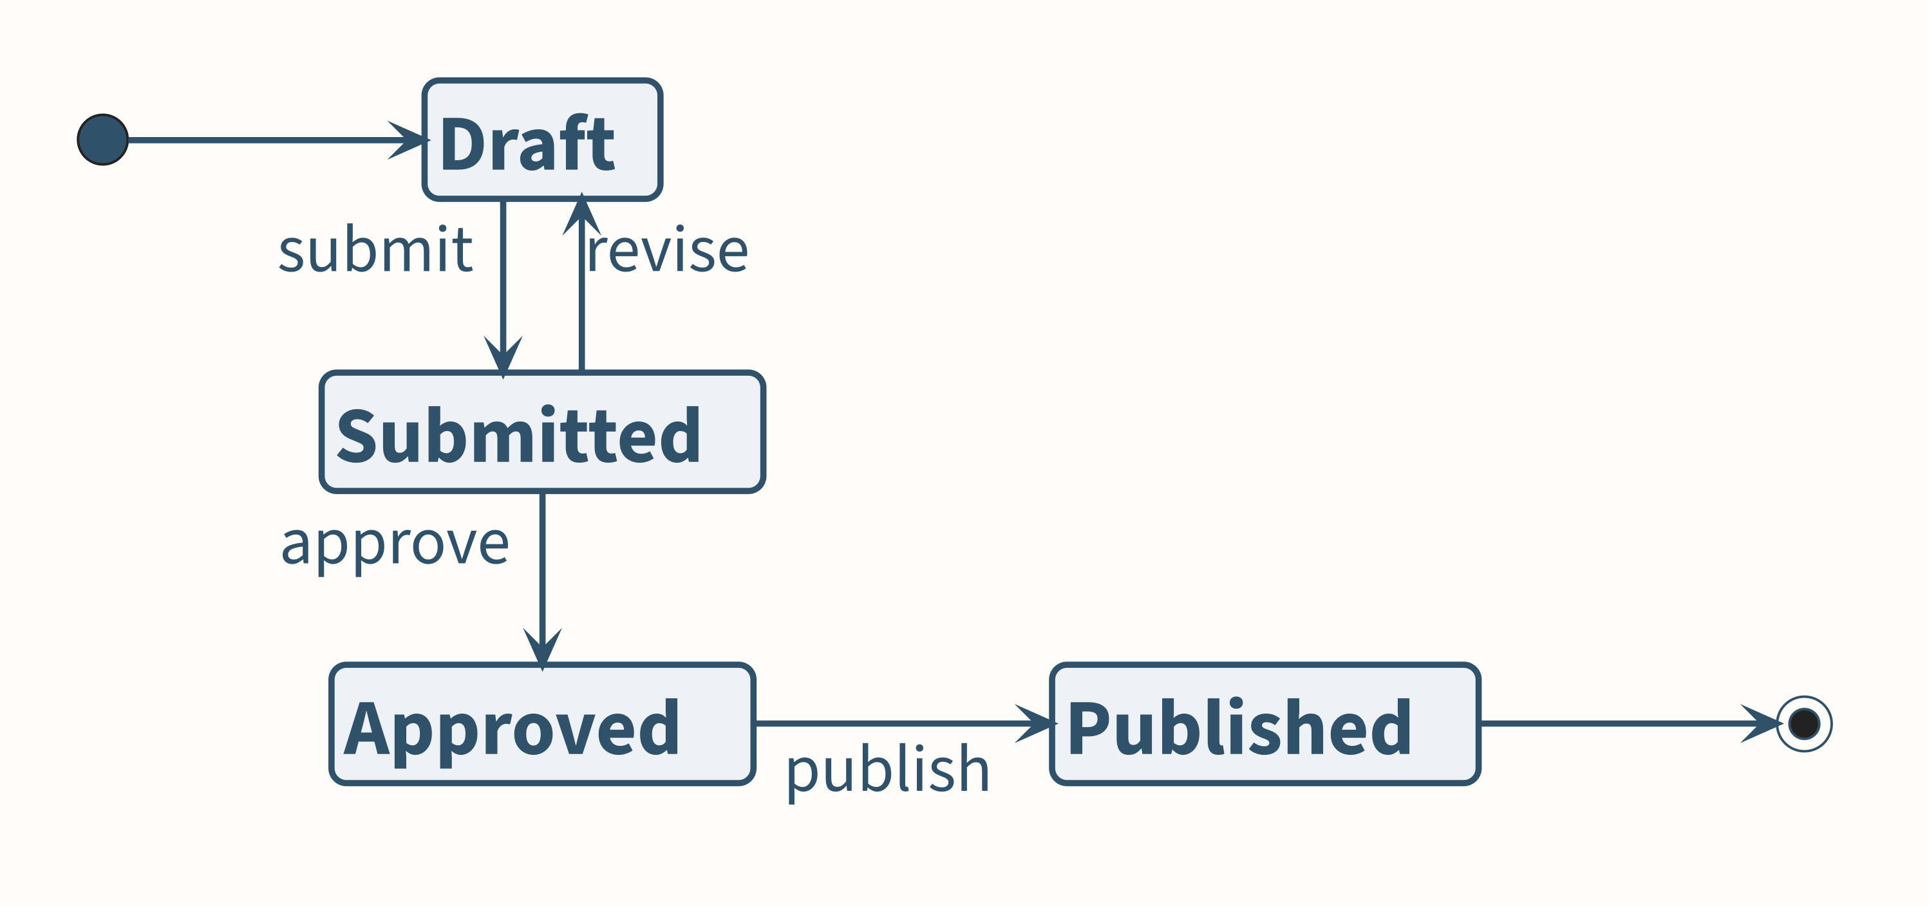
What states?
What states can this thing occupy, and which transitions are legal?
Notes:
The territory's catalog side, not its enrollment side: a course proposal moving through registrar approval into the published catalog.
The content is the ILLEGALITY, not the legality. There is no arrow from Draft to Published. A model of states is mostly a statement about what cannot happen, and that is the first hint of Section 2's obligation argument.
The revise edge back to Draft is what makes this a machine rather than a pipeline. Point at it for one second.
BUILD NOTE, not spoken: this exact artwork returns in Section 3 as the one-model-many-implementations anchor. Visual identity between the two placements is required — it is literally the same image file. Do not let a later edit re-draw either one.

Slide 10
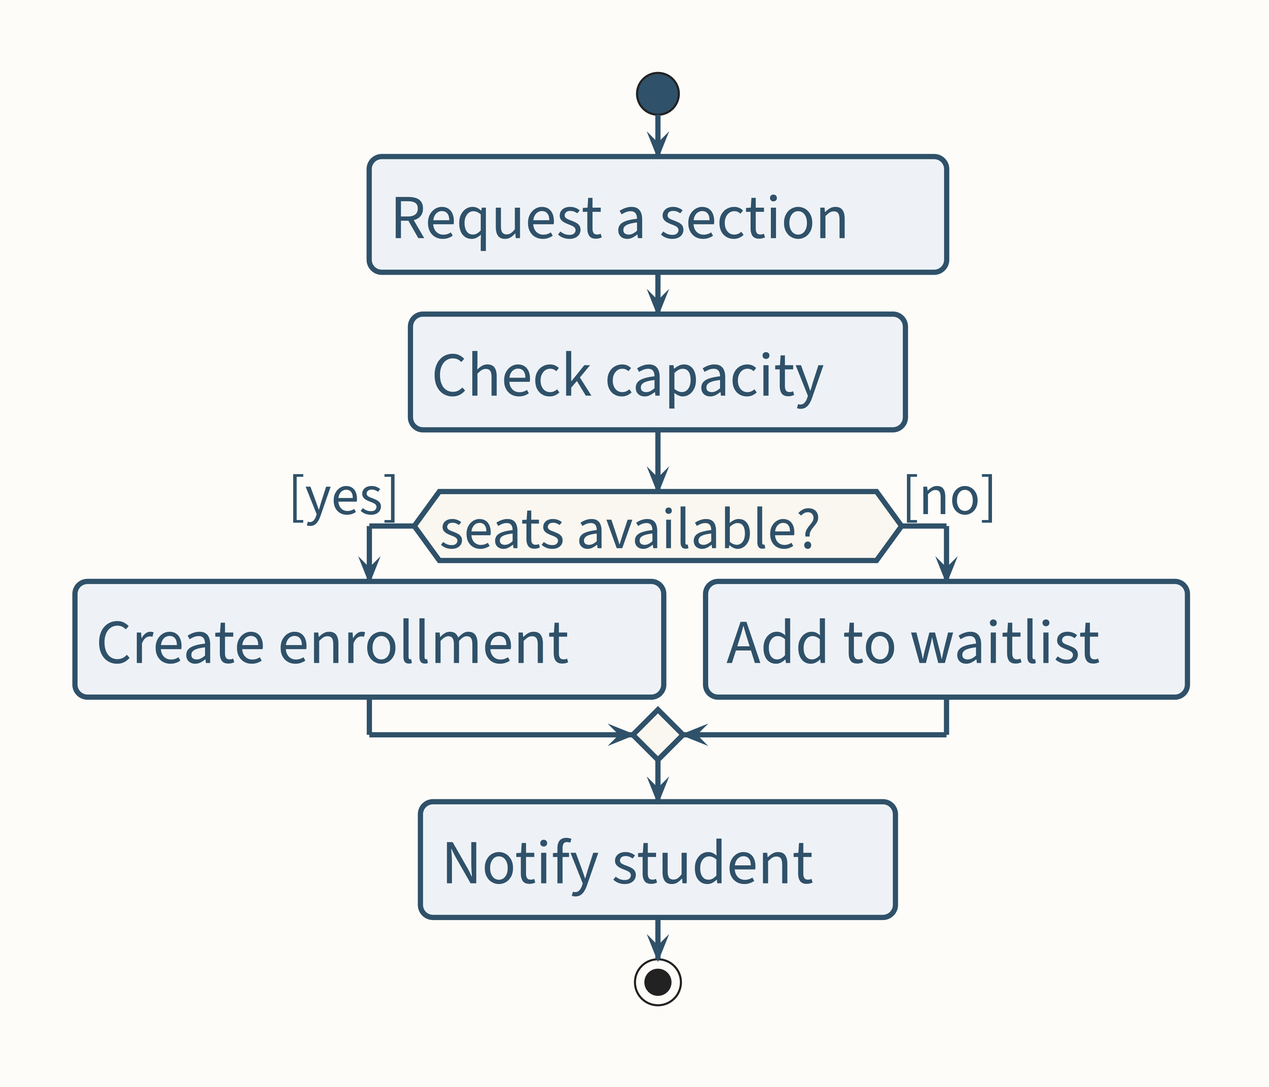
What paths?
What paths can execution take?
Notes:
The BRANCH is the content. Everything else on this slide is scaffolding for the diamond.
One breath on how this differs from the sequence view, because students reliably conflate them: the sequence diagram asked WHO participates and in what order; this asks which PATHS execution can take. Same capacity check, two different questions about it.
Both diagrams are correct. Neither is more true. They preserve different distinctions because they were built to answer different questions — which is the thesis two slides from now, arriving by demonstration rather than by assertion.

Slide 11
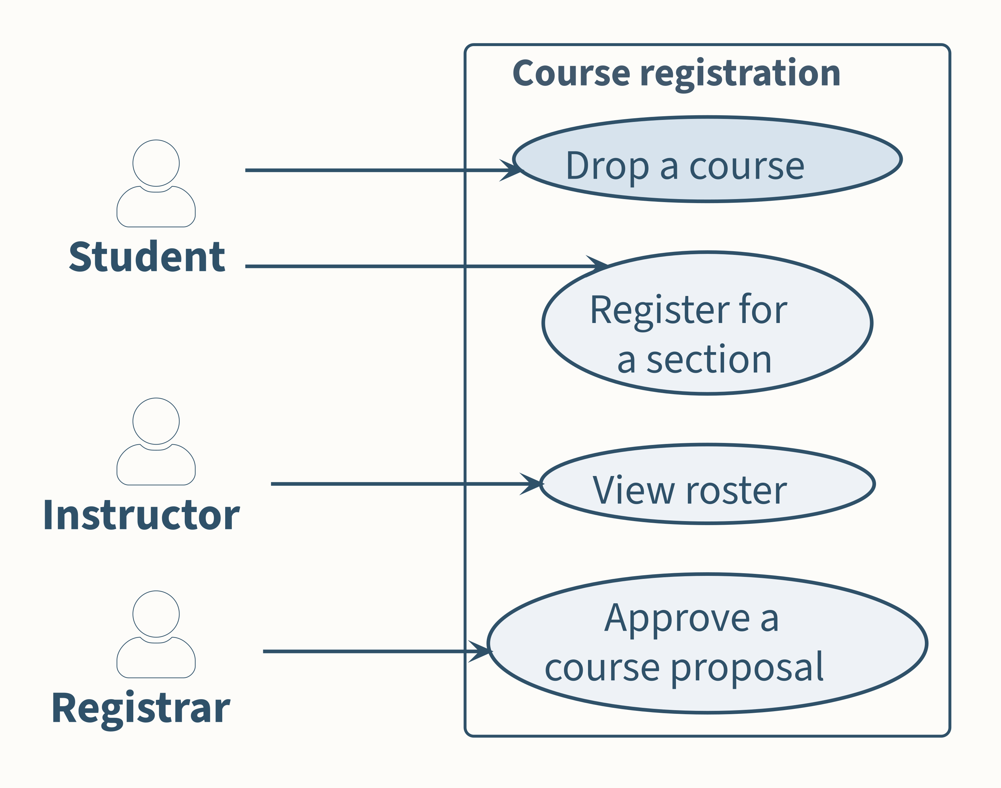
Who needs what?
What does each actor want from the system?
Notes:
Say this explicitly, because it is the beat students most often miss: this is a different ENGINEERING QUESTION, not merely a different notation. The previous four diagrams all described the system's insides. This one steps outside it and asks who wants something from it.
The actors are not classes. Registrar is not a table; it is a role that needs something.
Drop a course is drawn slightly accented on purpose — Section 3 starts its refinement chain from exactly that use case. Do not flag it now; it should feel like a callback later, not a forward reference now.
Last tour beat. The next slide is the punchline — do not deliver it here.

Slide 12
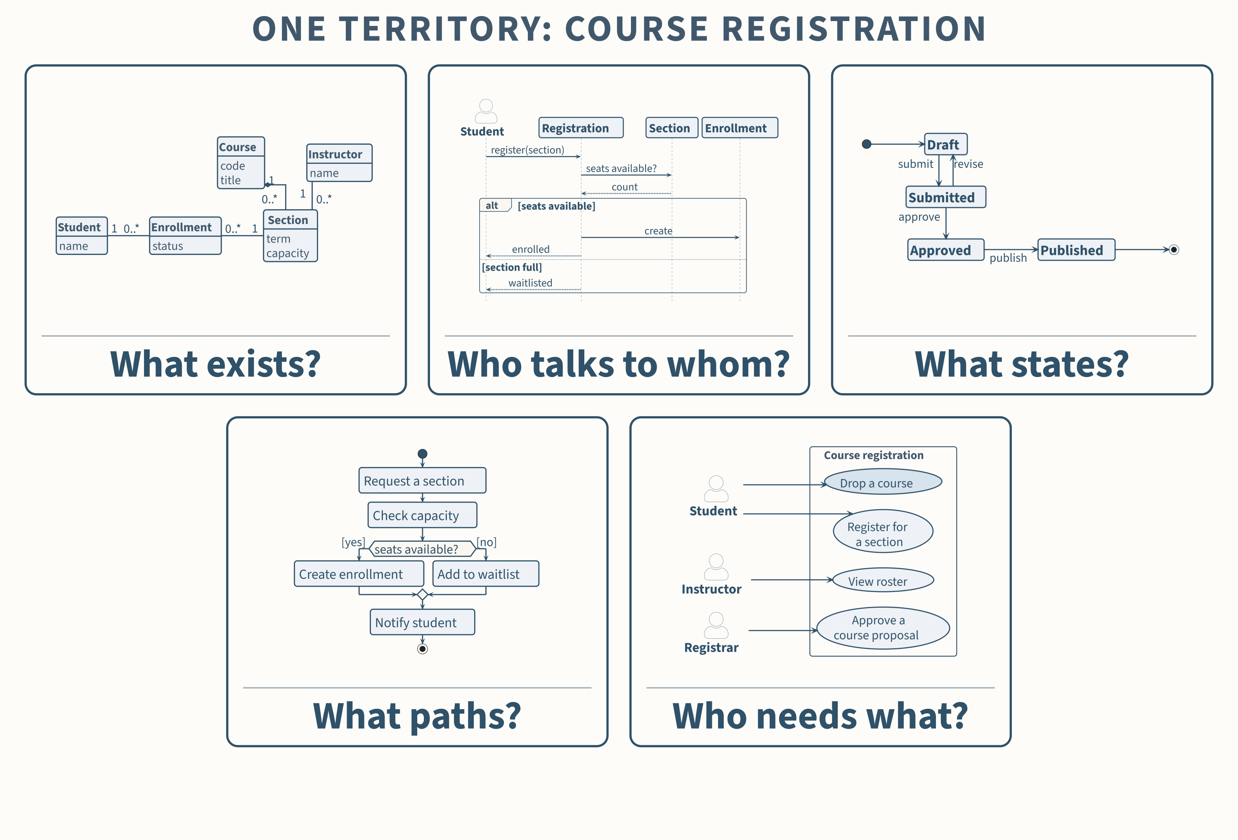
Same territory, different questions
Different questions preserve different distinctions.
Notes:
Five artifacts. One territory. Not one of them is the system, and not one of them is wrong.
The spoken line, and it is the section's thesis: hold the system constant, change the question, watch the model change. Different questions preserve different distinctions.
This is where COMPLETENESS stops being a measure of model quality. None of these five is trying to be complete, and a version of any of them that tried would be worse. That point was asserted on a slide in the old deck; here the students have just watched it happen five times, which is why the assertion has been deleted.
Do not walk all five again. Point, land the thesis, move. Forty-five seconds.
Callback anchor: this slide is what the embedded battery example later reprises. When the controller's energy model and thermal model arrive in Section 2, the line is — you have seen this already, in software, on the tour; here it is on territory you can feel.
NAME THE FIVE DISTINCTIONS ALOUD while pointing, one per card — this is the evidence for the second half of the thesis, and the thumbnails are too small to carry it on their own: structure, order, lifecycle, branching, intent. Five questions, five things worth keeping, one territory.

Slide 13
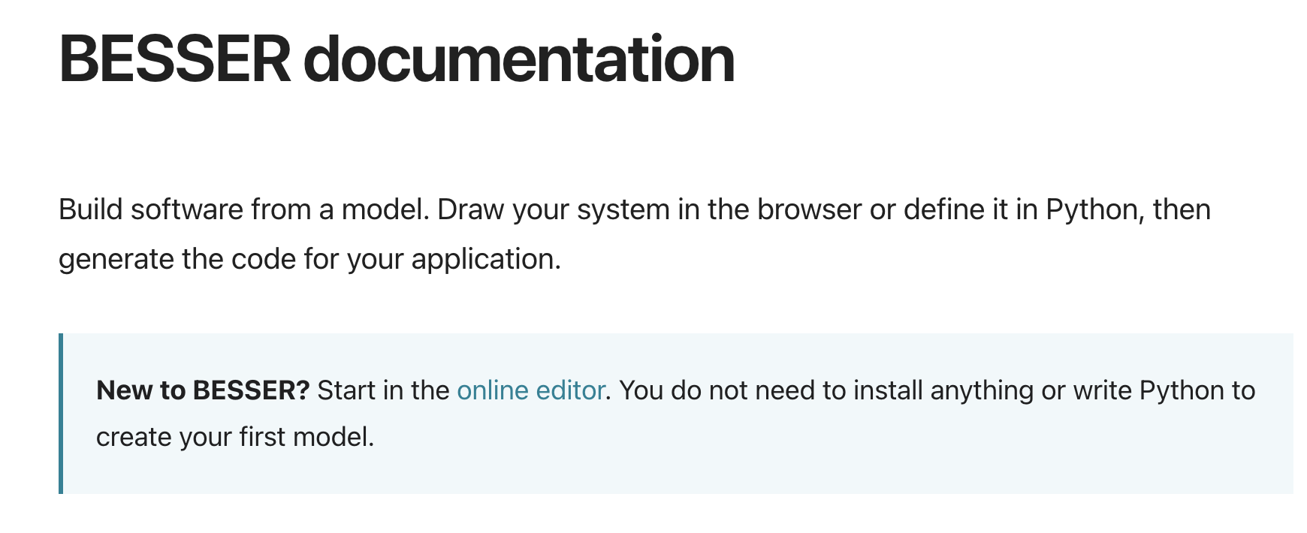
Modeling is a living practice
An engineering practice with living tools, decades older than the agents.
BESSER — BESSER-PEARL (Jordi Cabot's group), MIT licence · github.com/BESSER-PEARL/BESSER
The forms already exist. Select before you invent.
Notes:
One slide, ninety seconds, and a named flex point — this is the first thing to compress if the room is running long.
The job is one claim and one claim only: modeling is an extant engineering practice with living tools, not a conceptual vocabulary invented last year for agents. The UML tradition and the MBSE tradition are decades old and still under active development.
BESSER comes out of Jordi Cabot's group — the same tradition as the Model-Driven Software Engineering in Practice textbook. It is MIT-licensed and current.
Do NOT teach the tool, and do NOT catalogue Cabot's work. Read the tagline off the screen — build software from a model, draw it in the browser or define it in Python, then generate the code — and let that be the argument. The students can go find it themselves.
The takeaway line is the survivor of two deleted catalog slides: the forms already exist, so select before you invent. That is the practical instruction the old six-box gallery was trying to deliver, minus the gallery.
Screenshot provenance: besser.readthedocs.io, captured 2026-09-30, used for teaching and attributed on the slide.

Slide 14
Modeling is purposeful reduction
THE PREMISE
The objective is not another copy of the system.
A model is a representation in which some consequential question becomes cheap to answer.
It is useful because it leaves things out, and because it makes explicit what must remain.
ENGINEERING QUESTION
MODEL
PROPERTY
QUALITY
What do we need to know?
What reduction makes it tractable?
What claim becomes expressible?
Is the reduction adequate, and its interpretation likely?
Ask all four, every time — they return at every section break.
Notes:
NOW the definition, and notice what just changed about it. It is no longer an assertion the students have to accept on faith — it is an explanation of five things they just watched. Every one of those diagrams left out almost everything, and every one of them was useful.
Read the definition aloud, slowly, once: a model is a representation in which some consequential question becomes cheap to answer. Both halves carry weight. CONSEQUENTIAL — not any question. CHEAP — not merely possible.
The premise line underneath is the pair of claims that used to open the lecture: a model is useful because it leaves things out, AND because it makes explicit what must remain. The tour earned both.
Say the strip line aloud once, here, because this is where the four questions are introduced and they return at every section break from now on: engineering question, model, property, quality.
A line worth keeping in your pocket if the room needs it: a reduction you can hold in view beats a faithful copy too large to reason through.
About two minutes. This slide closes Section 1 and hands off to Section 2, which stops asking WHAT models look like and starts asking how an engineer DECIDES what belongs in one.

Slide 15
REDUCTION REQUIRES JUDGMENT
SECTION 2
What must remain? What may remain free?
ENGINEERING QUESTION
MODEL
PROPERTY
QUALITY
Notes:
The conceptual center of the lecture. Two directions of reasoning - top-down from the obligation, bottom-up from the proposed model - then both worked live on one embedded system.
Spine strip: MODEL stage highlighted (stage 2 of the recurring discipline from slide 9).
ASSUMPTION (plan section 8.3): spine strip motif ENGINEERING QUESTION - MODEL - PROPERTY - QUALITY per the plan recommendation; author ratification pending.

Slide 16
Top-down: the obligation decides what must remain
ENGINEERING OBLIGATION
what the system must guarantee
REQUIRED DISTINCTIONS
what the model must preserve
LEGITIMATE FREEDOM
everything else: the agent’s degrees of freedom
Degrees of freedom are known freedom, not ignorance.
Ask of every model: what must it preserve?
Notes:
Question to ask of every model: what must this model preserve? (R1.s15)
Degrees of freedom, called back from the Architecture/Design unit: the obligation bounds acceptable realizations without choosing one.
DOF is known freedom, not ignorance - we know these choices are open, and we leave them open on purpose.

Slide 17
Bottom-up: parsimony challenges what we kept
CANDIDATE MODEL
SMALLEST DOES NOT MEAN BEST
components
smallest adequate to purpose
depends-on edges
smallest possible
faithful copy
edge direction
deploy schedule
For every row: what engineering question requires this? If none, why carry it?
The target is the smallest model adequate to purpose,
not the smallest model.
Top-down: what must remain. Bottom-up: why is this still here?
Notes:
For every represented distinction: what engineering question requires this? If none, why carry it?
The correction matters (R1.s17): the target is the smallest model adequate to purpose, not the smallest model. Below adequate, the obligation is lost.
Top-down finds what must remain; bottom-up challenges what we chose to keep (the couplet returns on the closing slide). Now we work both, live.

Slide 18
Worked: protect the battery
THE METHOD, WORKED
TEMP SENSOR
PWM FAN
WI-FI TELEMETRY
CONTROLLER
one control loop
FLASH LOG
DISPLAY
LOW-POWER SLEEP
BATTERY
minimum safe voltage
Every component draws from the one battery.
One question: can the battery run out before the 8 hours end?
Notes:
Territory an ECE student grasps in thirty seconds - that is why it, and not a software system, carries the method (plan section 7).
Present territory before model; the model does not exist yet.
Exactly one engineering question (R4 verbatim): can the controller exhaust the battery before completing an 8-hour operating period?

Slide 19
Top-down: preserve what the obligation requires
OBLIGATION: 8 or more hours above minimum safe voltage
temperature sensor
ENERGY MODEL
PWM fan
operating mode
Wi-Fi telemetry
power(mode)
flash logging
duration(mode)
display
usable energy
low-power sleep
not: temperature value · PWM internals · packet format · flash layout · display contents · task names
PROPERTY: Σ P(mode) · t(mode) ≤ E(usable)
The whole system collapses into four quantities.
Notes:
Ask the room: what do we need to reason about that? BEFORE revealing the model card.
The obligation (8+ hours above minimum safe voltage) demands: battery usable energy, power by operating mode, time in each mode, the safety threshold. Nothing else.
The system has become a small quantitative model; keep the math no harder than the sum (R4). The PROPERTY beat of the spine happens here - point at it.

Slide 20
Bottom-up: make every distinction earn its place
CANDIDATE: MODE
CPU frequency
CPU utilization
fan PWM %
MODE
Wi-Fi state
power
flash writes per second
duration
display brightness
plus two model-level facts:
usable energy · safety threshold
sample rate
estimated power
duration
CPU frequency, fan PWM, Wi-Fi state: needed to derive the power estimate,
not to live in the model.
Nine distinctions walked in. Three survived.
Notes:
The genuinely useful discussion (R4): if estimated power already incorporates CPU frequency, fan PWM, and Wi-Fi state, those details may be needed to DERIVE the estimate without living in THIS model.
Not an obvious right answer; let the room argue briefly. That argument is the bottom-up test being practiced.

Slide 21
The territory did not change. The question did.
New question: can the fan keep the device below 70 °C under peak load?
SAME CONTROLLER
THE 8-HOUR BATTERY QUESTION
THE 70 °C THERMAL QUESTION
ENERGY MODEL
THERMAL MODEL
operating mode
heat generation
power(mode)
thermal mass
duration(mode)
ambient temperature
usable energy
airflow
battery capacity
How much of the answer must we tell the agent?
Notes:
Worded as a CALLBACK to the diagram tour that closed on “Same territory, different questions”: the software version made this point across five models of one registration system; the embedded version closes the loop on territory you can feel. Say the callback aloud, do not re-teach it.
Suddenly thermal mass, ambient temperature, heat generation and airflow matter — and battery capacity largely disappears.
Closing hinge, spoken over the slide: we have judged what must remain. The next question is not whether we judged right — correspondence answers that, later — but how much of the answer we must tell the agent. That is the boundaries slide.

Slide 22
Obligation and specification are different boundaries
HOW MUCH MUST WE SAY?
specification boundary
the edge of what we write down
OBLIGATION
what must be true
obligation boundary
fixed by what must be true
specification boundary
for a more capable agent, it moves in
SCAFFOLDING — what this agent needs
DEGREES OF FREEDOM — the rest is the agent’s
Specified region = obligation + scaffolding; outside it, degrees of freedom.
Two boundaries, not one. Only one of them moves.
Notes:
CLICK 1 — the two boundaries. The obligation boundary encloses what must be true. The specification boundary encloses what we actually write down. Between them sits the scaffolding: what this particular agent needs to interpret and realize the obligation reliably — examples, decomposition, intermediate structure. Outside the specification boundary, degrees of freedom, left to the realization.
CLICK 2 — parsimony restated for delegation: how little must we specify while still preserving the obligation and still enabling THIS agent to realize it? A more capable agent needs fewer examples, less decomposition, less intermediate structure, so the dashed boundary moves toward the obligation.
Watch what did NOT move: the core. That is the next slide.

Slide 23
Capability cannot reduce what must be true
The specification boundary moves with capability. The obligation boundary does not.
UPSTREAM
the reduction happens here
THE PIPELINE
stage after stage
DOWNSTREAM
an arbitrarily capable agent
✗ a distinction
nothing arrives to recover; the distinction no longer exists
dropped here, in the model
The limit is semantic, not a shortfall of intelligence.
p_{R} = P(E | R) · P(I | E, R) · P(L | I, E, R)
a perfect reasoner drives the last two factors to one
lim_{M → perfect reasoner} p_{R} = P(E | R)
Better reasoning cannot recover consequential intent the representation failed to encode.
What reduction removed, no capability restores.
Notes:
The reduction happened upstream. However capable the downstream agent, nothing arrives for it to recover — the distinction no longer exists in the model. The obligation boundary is capability-invariant; the specification boundary is not. The limit is semantic, not a capability shortfall.
THE REVEAL, in three beats. Beat 1: the chain from “Open the box”, unchanged, with the encoding factor set in bold. Beat 2: a perfect reasoner drives interpretation and realization to one. Beat 3: what is left is the limit — for a fixed representation R, p_R goes to P(E | R).
Every symbol is already known: T, M, R and H from the production equation, E, I and L from the chain decomposition, obligation and scaffolding and degrees of freedom from the argument just made. That is why the limit was held back until here. Read it off the chain rather than announcing it — the room should watch the last two factors go to one.
Say it in these words: a better M cannot recover a distinction that R failed to carry. An organization that has not determined and externalized the obligations governing its work cannot discharge them by purchasing a more capable reasoner.
The opening band figure is deliberately NOT reprised here. At the size this slide can spare, its internal type projects at four to seven pixels, and its red MODELING CHANGES THE REPRESENTATION overlay would in any case fight a slide that argues a perfect reasoner stays bounded by P(E | R). The chain line carries the same recall at a size the back row can read.
Forward tag: you will watch this limit reach production in the correspondence section, on the account-quota case — a distinction the model could not express, and production said so.

Slide 24
THE EVIDENCE
SECTION 3
How do you find out whether you left out the right things?
Two production reductions — one vindicated, one refuted.
✓ THE LEASE
✗ ACCOUNT QUOTA
ENGINEERING QUESTION
MODEL
PROPERTY
QUALITY
Notes:
ROLE CHANGE, stated aloud: Section 2's controller taught how to reason. These two cases show how you find out whether the reasoning was right — a different job, not a second pass of the same lesson.
Both production cases come from the instructor's production system. The lease's omission was vindicated; the account quota's was refuted. A hypothetical can teach judgment; only production can grade it. (Plan §7 — this section break exists to make the method/evidence split visible.)

Slide 25
Too much reduction loses the obligation
An account quota was reduced to a single credit count.
THE ACCOUNT
quota: unlimited
renewal: monthly
usage history …
REDUCE TO A SCALAR
credits_remaining: 0
the whole model of the quota
✗ unlimited
has nowhere to live in a scalar
The implementation distinguished unlimited from exhausted. The model represented both as 0.
The reduction erased a distinction the obligation required.
Notes:
The account carried a quota; the reduction kept one scalar, credits_remaining. Unlimited and exhausted are two different states of that account, and a single integer has room for only one of them — both arrive at the model as 0.
Keep this off the user: the failure is not that somebody was refused, it is that the representation could not express a distinction the obligation required. Bottom-up said removable; the obligation said no. This is refutation — the omitted distinction actually mattered, and production said so.
Once a distinction is discarded, no downstream reasoning can recover it. That is the limit you stated on “Capability cannot reduce what must be true” — here it is reaching production.

Slide 26
Good reduction leaves implementation free
THE LEASE MODEL
owner · generation · lifetime · reclamation
forbidden: releasing a lease under a stale generation
✓ unchanged — the model did not move
omitted from the model: the processing topology
BEFORE
the topology changed
AFTER
one service, one pass over the document
fan out across chunk workers
merge the results
The omission was tested by reality, and passed.
“We changed the pointers to the code, but not the model.”
Notes:
The lease model preserved owner, generation, lifetime, reclamation, and the forbidden transition: releasing a lease under a stale generation. It omitted the processing topology on purpose.
The topology then really changed — the work was re-chunked and services rearranged — and nothing in the model moved. Vindication: the omission was tested by reality and passed. The omitted detail really was a degree of freedom, not something forgotten.
The footer line is verbatim from the team.

Slide 27
The evidence, side by side
THE LEASE
ACCOUNT QUOTA
candidate omission
processing topology
unlimited vs. exhausted
top-down judgment
not required by the question
required by the obligation
bottom-up judgment
safe to remove
cannot remove
evidence
topology changed; model held ✓
production decision exposed the loss ✗
Represent no more than the question requires, but no less than the obligation requires.
Three rows of method. One row of evidence.
Notes:
The first three rows are Section 2's vocabulary — candidate omission, top-down judgment, bottom-up judgment. The room has already used each of them on the controller. Only the evidence row is new: the method produces judgments; production grades them. That is the method/evidence split on one screen.
One sentence on revision: a model is a provisional judgment, revised when evidence arrives. The richer account of how designs explored with agents harden into durable models stays in the book — mention it, do not slide it.

Slide 28
Activity: Reduce
TEAM ACTIVITY · 10 MINUTES
Same controller, new question: can the device respond to an over-temperature condition within 50 ms?
YOUR TASK — TOP-DOWN, THEN BOTTOM-UP
Activity QR
1. Top-down: what distinctions must your model preserve?
2. Bottom-up: justify every distinction you kept.
3. Name at least three facts about the real system your model deliberately omits.
DEBRIEF
Everything converges on one chain: sample → schedule → compute → actuate
T_{sample} + T_{schedule} + T_{compute} + T_{actuate} ≤ 50 ms
Team response
Google Form
Work the model as a team. Then submit one response per team.
Notes:
~10 minutes including debrief. Students re-enter the controller cold — that is the retention test.
Debrief challenge sequence (R4, verbatim): Do you need the RTOS scheduler algorithm? Maybe — not if a justified worst-case delay is already carried. The temperature? Only as the trigger. Wi-Fi? Only if it can interfere with timing. Battery voltage? Not for this question — unless voltage affects actuator response inside the envelope. That last chain is the judgment being practiced.
The DEBRIEF label, the convergence chain, and the bound are hidden until the click — reveal only after teams have committed. The bound is the PROPERTY beat of the spine.
[QR placeholder — form URL pending per plan §8.2; a finisher unit drops in the real QR PNG with alt text = URL.]

Slide 29
Stretch break
Notes:
~2-3 minutes. Post-Reduce placement; also the natural re-entry point if Reduce ran long.
[ASSUMPTION per plan §8.4: the content brief never mentions a stretch break; one per deck recommended, placed after the mid-lecture activity.]

Slide 30
A model is not its representation
MODEL ≠ REPRESENTATION
Model — a purposeful reduction of some territory that preserves selected properties for engineering questions.
Representation — a concrete form in which a model is inspected, manipulated, analyzed, or consumed.
ONE MODEL
STATE DIAGRAM
TRANSITION TABLE
from → to
staged → published
published → recorded
no other rows
STRUCTURED TEXT
transitions:
staged: published
published: recorded
nothing else declared
staged
published
recorded
The property — publication precedes the record — is statable in every one of them.
Three representations. One model.
Notes:
A diagram is a representation, not a synonym for a model. The same recovery relation renders as a state diagram, a transition table, or structured text; the property — publication precedes the record — is statable whatever the encoding.
Quiet setup for Deck 2: the same model can have several representations without making each representation an independent source of truth. Do not develop it further here.

Slide 31
Representation changes interpretation
P( agent correctly interprets claim c | representation r )
one intended claim c — representations differ in how reliably a reader recovers it
REPRESENTATION A — TYPED RELATION
staged → published → recorded
no other transitions
P(interpret c) higher
READER
human or agent
REPRESENTATION B — INFORMAL PROSE
“Files usually get staged before they show up in the database.”
P(interpret c) lower
Reduce freedom of interpretation where meaning is consequential.
Preserve freedom of realization where it is not.
The fourth question — Quality — just became concrete.
Notes:
Merged R1.s25+s26 — the probabilistic seed motivates the asymmetry in one move. Seed P(agent correctly interprets c | r) and STOP THERE: no expected loss, no utility, no economics. Two representations of the same intended model differ in how reliably the claim is recovered.
The fourth question — Quality — just became concrete: does the representation make the consequential interpretation sufficiently likely? Later units use this probabilistic view systematically; today the seed is enough.

Slide 32
Activity: Interpret
TEAM ACTIVITY · 9 MINUTES
For each item: what model does this representation appear to express, what claim does it make, and what remains ambiguous?
ONE DRAWING, TWO SEMANTICS
Activity QR
A → B
the arrow means: A may call B
(a design decision)
A → B
the arrow means: A was observed calling B
(a runtime observation)
TWO REPRESENTATIONS, ONE INTENDED MODEL
You also receive two different representations intended to express the same model.
Do they? What claim survives in both? What remains ambiguous in each?
Team response
Google Form
Discuss each item. Then submit one response per team.
Notes:
~9 minutes. Makes P(interpret) tangible without estimating a number — do not ask students for a number.
Both directions on purpose, because the lecture just taught that a model is not its representation: (a) one drawing under two stated semantics — different models from the same picture; (b) two different representations intended to express one model — the same model from different pictures.
Debrief flexes 2 minutes either way — the deck's main timing valve.
[QR placeholder — form URL pending per plan §8.2; a finisher unit drops in the real QR PNG with alt text = URL.]

Slide 33
A good model is not a small copy of the system
Top-down: what must I preserve to answer the engineering question?
Bottom-up: why am I carrying each distinction that remains?
Different questions produce different purposeful reductions of the same territory.
Feedback QR
Tomorrow: one model can be useful. How do many models remain trustworthy together?
Notes:
~2 minutes; compresses to 1 if needed. Reprise, not new content — the couplet was earned in Section 2 — top-down, bottom-up, then the worked controller — and adjudicated on “Capability cannot reduce what must be true”. Read the couplet, land the ital line, then the teaser names Deck 2's problem in one sentence and stops.
[QR placeholder — feedback form URL pending per plan §8.2; a finisher unit drops in the real QR PNG with alt text = URL.]

