Slide 1
Software Engineering ECE 30861 / CSCI 45000
Course Introduction aka “Syllabus slides”
Prof. James Davis
Prof. Steve France
Notes:
Happy syllabus day!
This is a Power Hour course so strap in.
This slide deck covers syllabus, then we’ll take a little break, and then we’ll talk about the course project.

Slide 2
Slides outline
Course staff
Course structure & policies

Slide 3
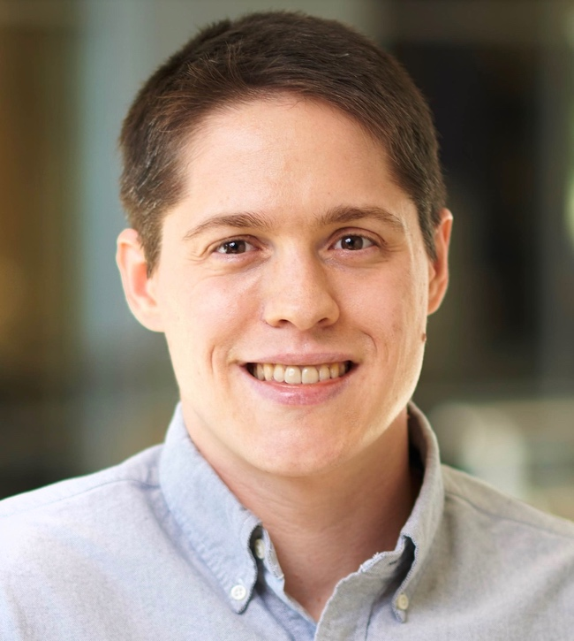

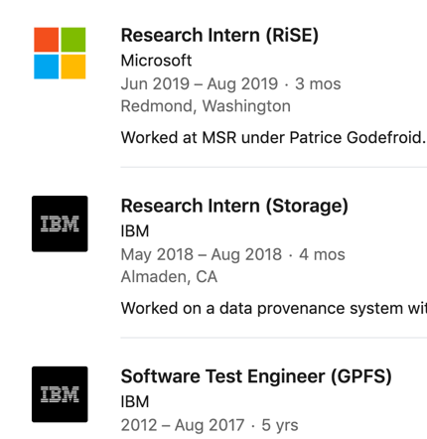
Course staff
PWL Instructor: Assistant Prof. James Davis
PhD 2020
Notes:
Experience in SE
Why I am running this course
What I do for fun

Slide 4
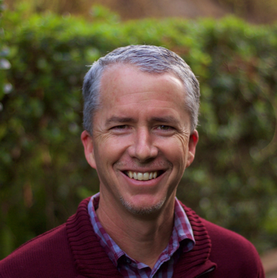

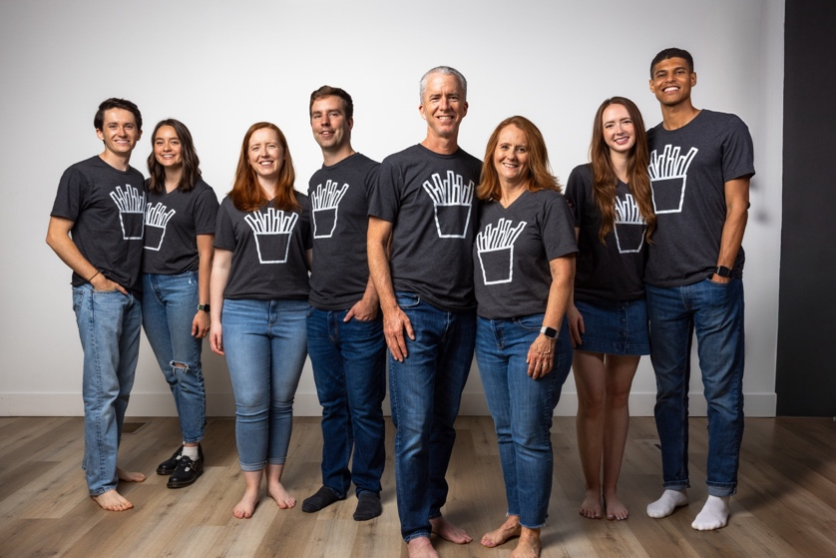


Course staff
PIN Instructor: Assistant Prof. Steve France
M.S. Computer Science, Cal Poly, 1995
25+ years Software Dev & Engr Leadership
Asst. Prof. SW Engr, ERAU, 2021-23
Joined Purdue ECE Fall 2023

Slide 5
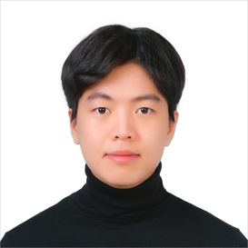
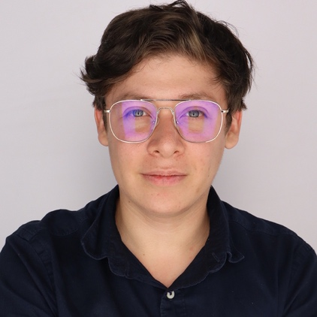
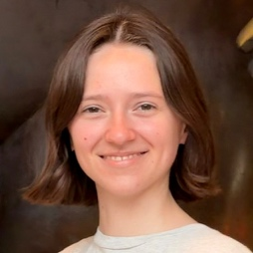
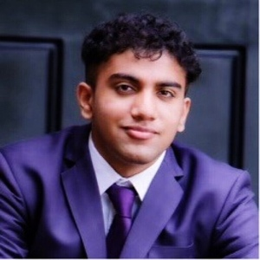
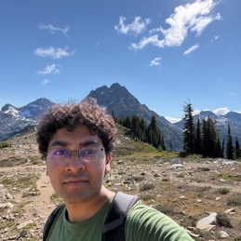
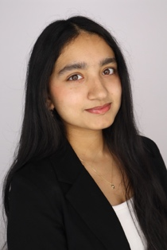

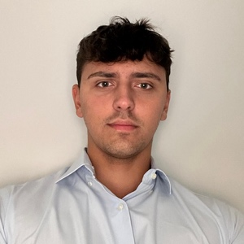
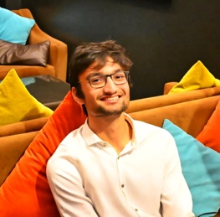
Course staff
UTAs:
Charlie Kim
Reva Pettigrew
Rohan Muppa
Sasmit Pandey
Umberto Puddu
GTA: Ricardo Mendez
PhD, 2nd yr, formal verification & code optimization
UTAs:
Aadi Rave
Divya Kumari
Jaanav Shah

Slide 6
Course structure & policies Important and yet so boring
Notes:
TL;DR: You should learn certain things from the course. I will need to measure that learning.
If you cheat and I find out, we will have uncomfortable conversations, and I will likely fail you and pursue further punishments.

Slide 7
Course Learning Outcomes
By the end of the course, you will be able to:
Conduct object-oriented design and use the unified modeling language.
Understand different models of software development processes.
Analyze requirements and write project specifications.
Develop a team software project on time and meet the specifications successfully.
Notes:
I will teach you as much as I can
Think.
Engage.

Slide 8

Assessments
The course grade is derived as follows:
75%: Course project
7.5%: Oral exam 1
7.5%: Oral exam 2
10%: Class engagement (in-class activities, reading quizzes)
Notes:
We will try hard to give you “3 hours outside of class for every hour in class”. If we go overboard, please let us know!
1 team project divided into 6 major phases
These will take up much of your time.
2 oral exams
Discussed on next slide
Reading quizzes + a variety of in-class activities (including some pre- and post- speaker documents)
These should take you 1-3 hours.

Slide 9
Oral Exams - 1
Two Oral Exams
Regulation, specification and system design
Realized system and validation
Specific topics published in advance.
Assessments:
depth and accuracy of content
clarity of articulation
Notes:
No Final this semester
The intent of this approach is to provide instructors a simple and effective means of assessing student learning.

Slide 10
Oral Exams
Logistics:
Administered by either Prof. Davis or Prof. France.
Held in person, during normal class time or office hours.
Exam audio will be recorded, both questions and answers.
Exam time per student ~5 minutes.
No class week 9 or week 16 for exams
Notes:
No Final this semester
The intent of this approach is to provide instructors a simple and effective means of assessing student learning.
ANIMATE
Describe details
Questions?

Slide 11
Extra credit
Contribute meaningfully to at least 10 answers on Piazza
→ +2 to final grade
Assessment: Send Ricardo Mendez screenshots of your posts

Slide 12

Cheating discussion
What behaviors do you think constitute cheating in this course?
From the Syllabus
This course mandates the use of Generative AI across the software engineering lifecycle. Students are responsible for oversight, judgment, and being able to explain the full stack of decisions.
Notes:
My cheating policy is “be reasonable”. This is a senior-level course. By now I hope you understand that if you cheat, it has consequences – you won’t get a job, or you’ll be fired from it for incompetence. So, let’s talk through the course elements and what would constitute cheating.
ANIMATE
Kick off the think-pair-share
ANIMATE
ASK – how does this statement in the syllabus change your answer?
TRANSITION to next slide
Is there precedent for this kind of statement in our discipline?

Slide 13
Use of tools
Historical Perspective
Every generation of engineers has had a tool that felt like "cheating" — until it became the job.
Era | Tool | The worry at the time
Early 2000s | SourceForge / forums | "Copying open-source code isn't real programming"
Mid 2000s | Google | "If you can look it up, are you actually learning?"
2010s | GitHub + Stack Overflow | "Copy-pasting answers isn't problem-solving"
Early 2020s | LLMs (ChatGPT, Copilot) | "If the AI writes it, did you write it?"
Now | Autonomous agents | "If the agent plans, codes, and tests — what's left for the engineer?"
Hopefully, this course will help answer that question!
Notes:
Intro
ANIMATE
Briefly walk through table to show progression
ANIMATE
There is still plenty of engineering work to do!
TRANSITION
But each student must still do the requisite work, and contribute fairly to their team.

Slide 14
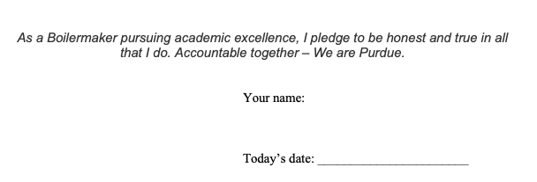
Academic honesty pledge
As a Boilermaker pursuing academic excellence, I pledge to be honest and true in all that I do. Accountable together – We are Purdue.
Notes:
This is the honesty pledge you will be required to sign for every team assignment.
If you sign it, that means you are stating that you contributed substantially to the submission.
If you do not sign it, you will receive a zero for the assignment.
Some team members might perform notably worse on oral examinations than their teammates do.
They might do so in a way that indicates a lack of involvement with the project.
In such a case, the active members of a team may have their project grade increased by up to two letter grades,
and the inactive members may have their project grade decreased by up to two letter grades, at the discretion of the instructor.

Slide 15
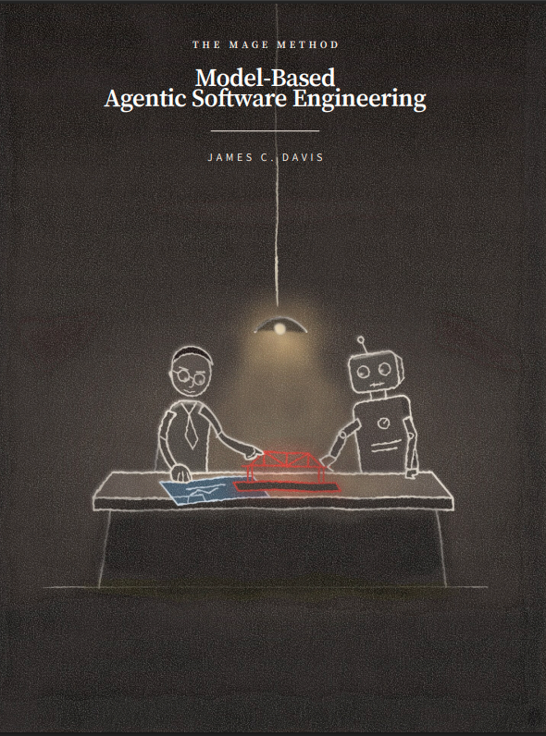

Required text
https://davisjam.github.io/model-based-agentic-software-engineering/book/mage-book.pdf
https://abseil.io/resources/swe-book/html/toc.html
Like all O’Reilly books, an e-edition is available through Purdue’s library
Notes:
Why did I choose these texts?
Other texts: Will post PDFs of readings.
Some readings will be provided as a resource to help you with homework.
Others may be posted for you to review before class, to facilitate discussion.
For any assignments, we will post the questions themselves, not the question numbers, in case you are working without a book.

Slide 16
Required equipment
You are expected to have at least a $20/mo. subscription to OpenAI or Anthropic or Google or etc., or access to comparable open-model capabilities.
This course will teach you how to do software engineering with those capabilities. Their effective use is a differentiator for anyone working in the field.

Slide 17
Miscellany
Attendance policy
Guest speakers
Brightspace → Slides, lecture recordings, gradebook
Piazza → Q&A, e.g., clarifying assignments and debugging
Gradescope → Assignments
GitHub → Software
AWS → Service
Office hours → Grading, debugging, project advice, etc. etc.
Email Prof. → TA disputes; personal matters (subject “ECE 30861”)
Notes:
Attendance:
The course does not have a formal attendance policy, except insofar as there will be several in-class activities that are graded. If you do not attend class and have not contacted the instructor in advance to explain your absence, you will receive a 0 on those activities.
The assignments in this course have deadlines. However, I am not so naïve as to believe you have no other demands on your time. This is a senior-level course, and I will treat you as professionals. If you need an extension or accommodation, contact me and request it. A professional can manage their time and does not procrastinate on assignments. However, surprises and emergencies of many kinds – including health, finances, and family matters – are all excellent reasons to retroactively request an accommodation
We may have a few guest speakers over the course of the semester on various aspects of SE
Prepare appropriately, by studying their LinkedIn, company, job role, etc.
Treat them with respect. Learn as much as you can from them.
After a speaker there will be a homework reflection on what you heard and learned.

Slide 18
A note about readings and reading quizzes
We will assign readings periodically.
‘Quizzes’ will be lightweight.
Along the lines of “I read X and here is what I learned”, with an honesty pledge.

Slide 19
Emergency preparedness
Medical emergency: Call 911.
Fire / fire alarm: Go outside.
Tornado: Go to basement or restrooms.
Active shooter: Based on situational awareness:
(1) Flee; or
(2) Lock the doors and arm yourselves.

Slide 20
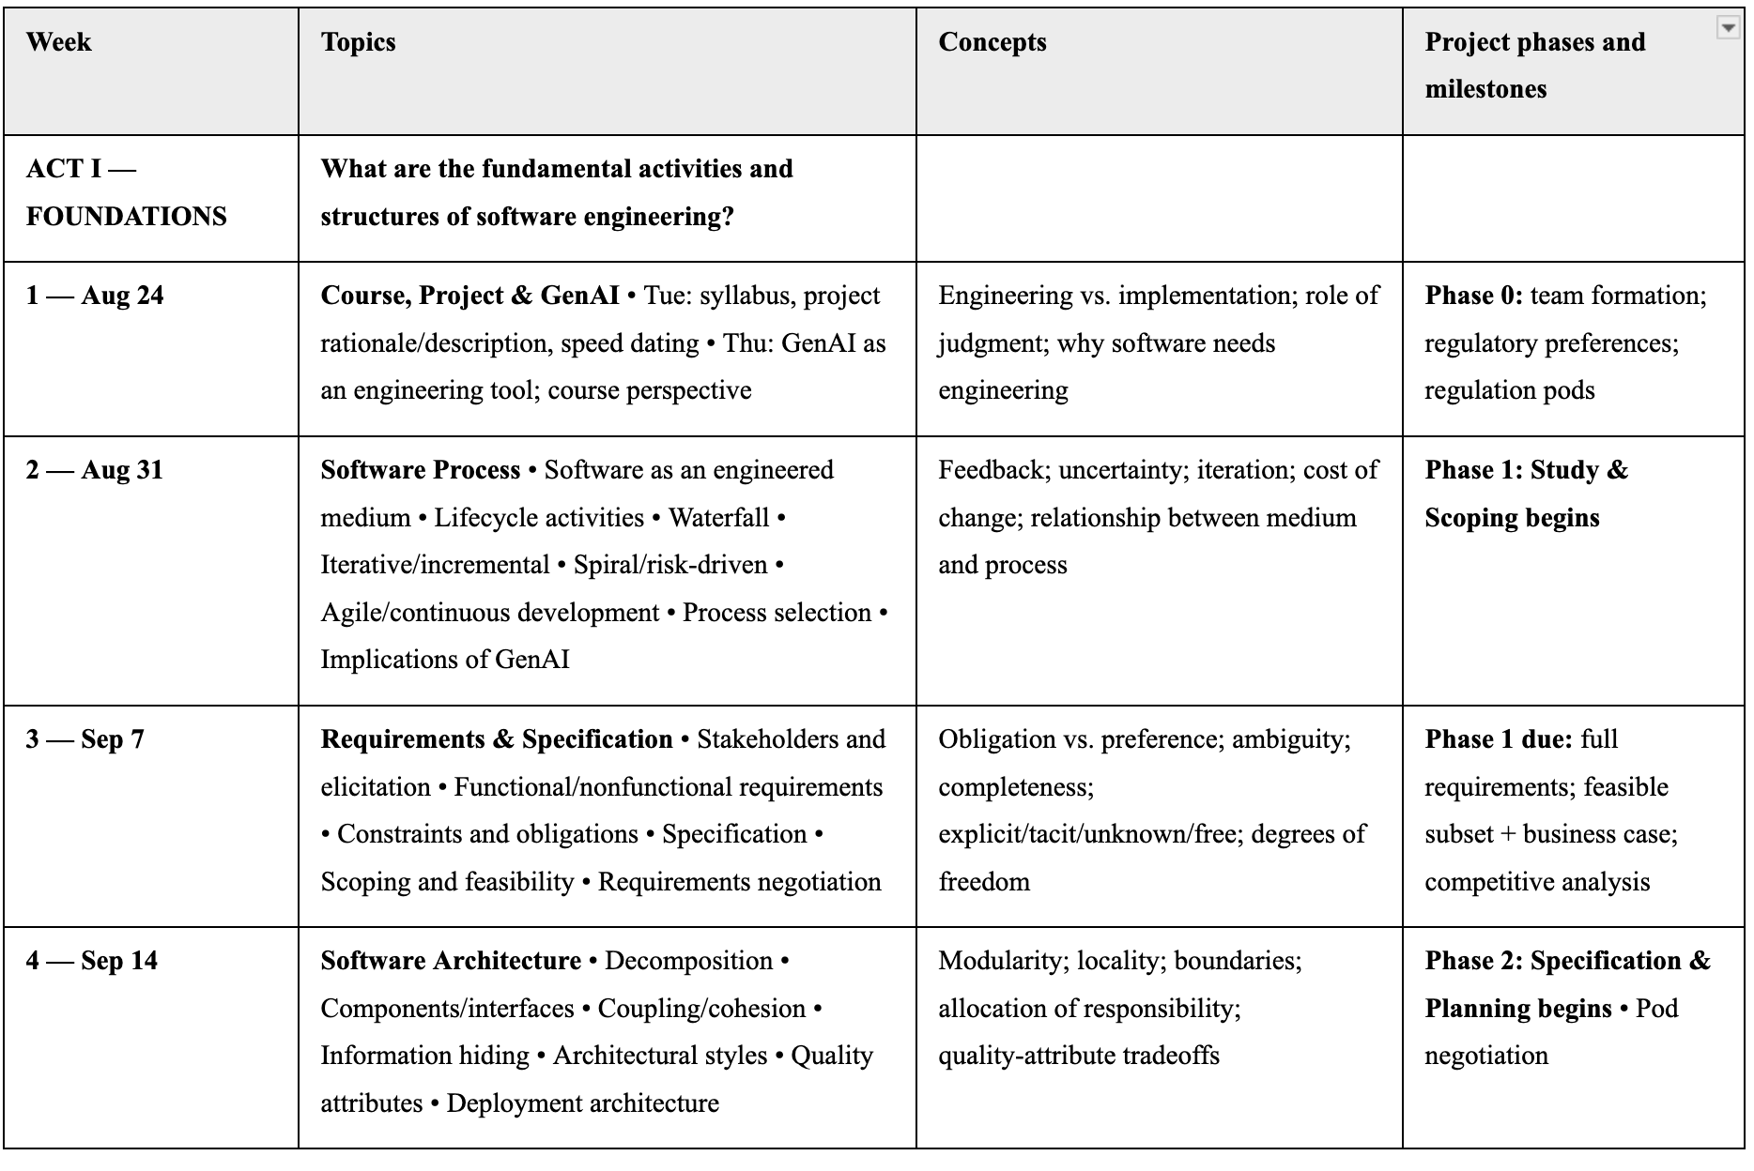
Course calendar (no plan survives)

Slide 21
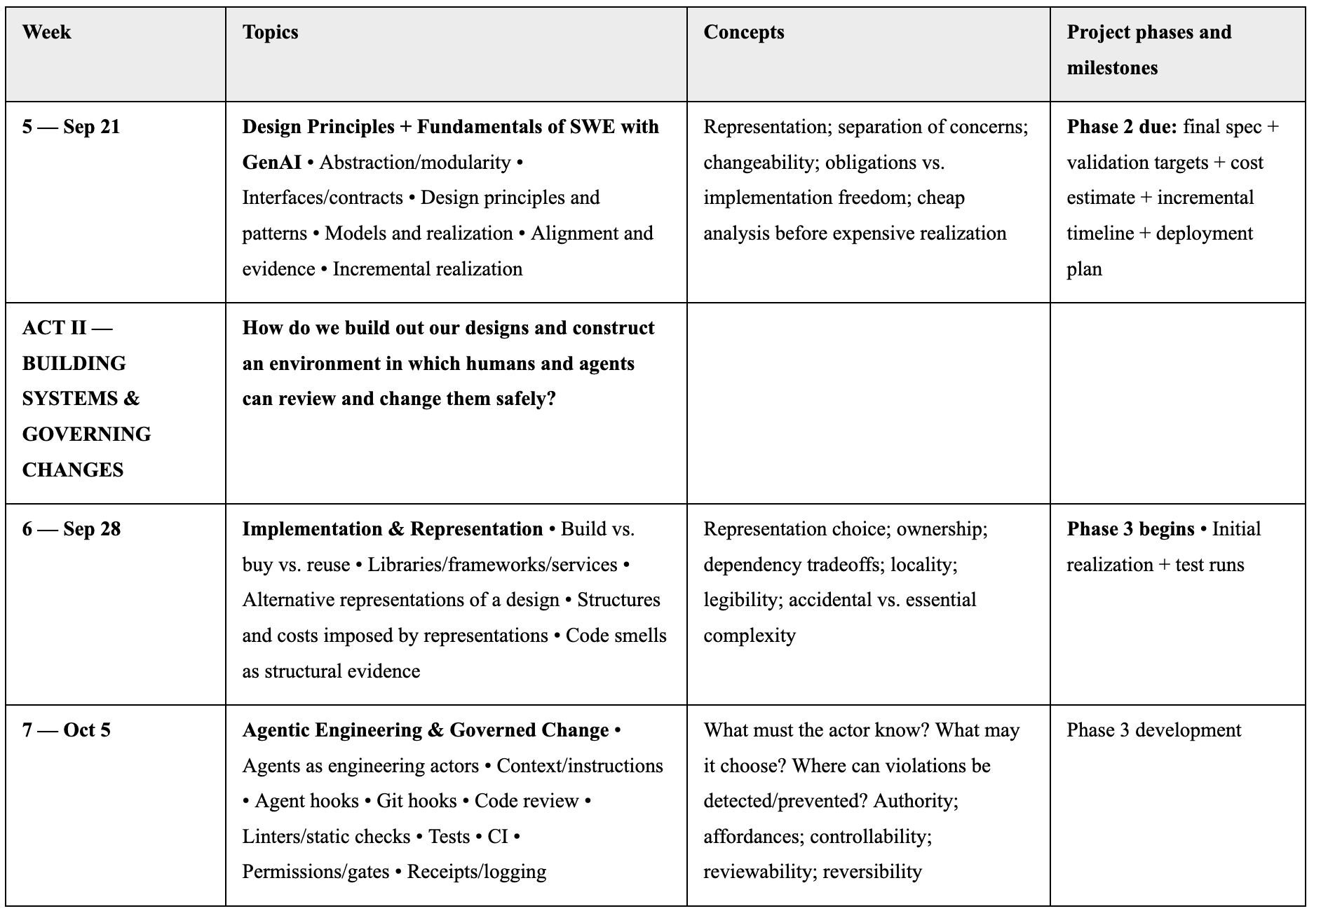
Course calendar (no plan survives)

Slide 22
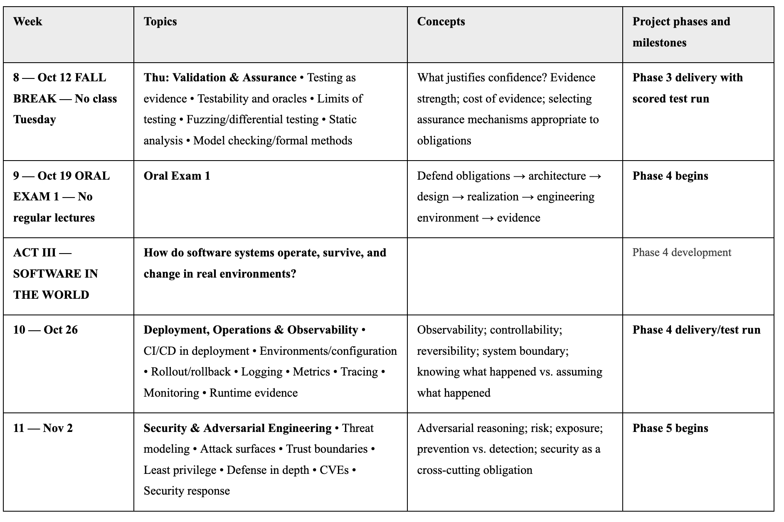
Course calendar (no plan survives)

Slide 23
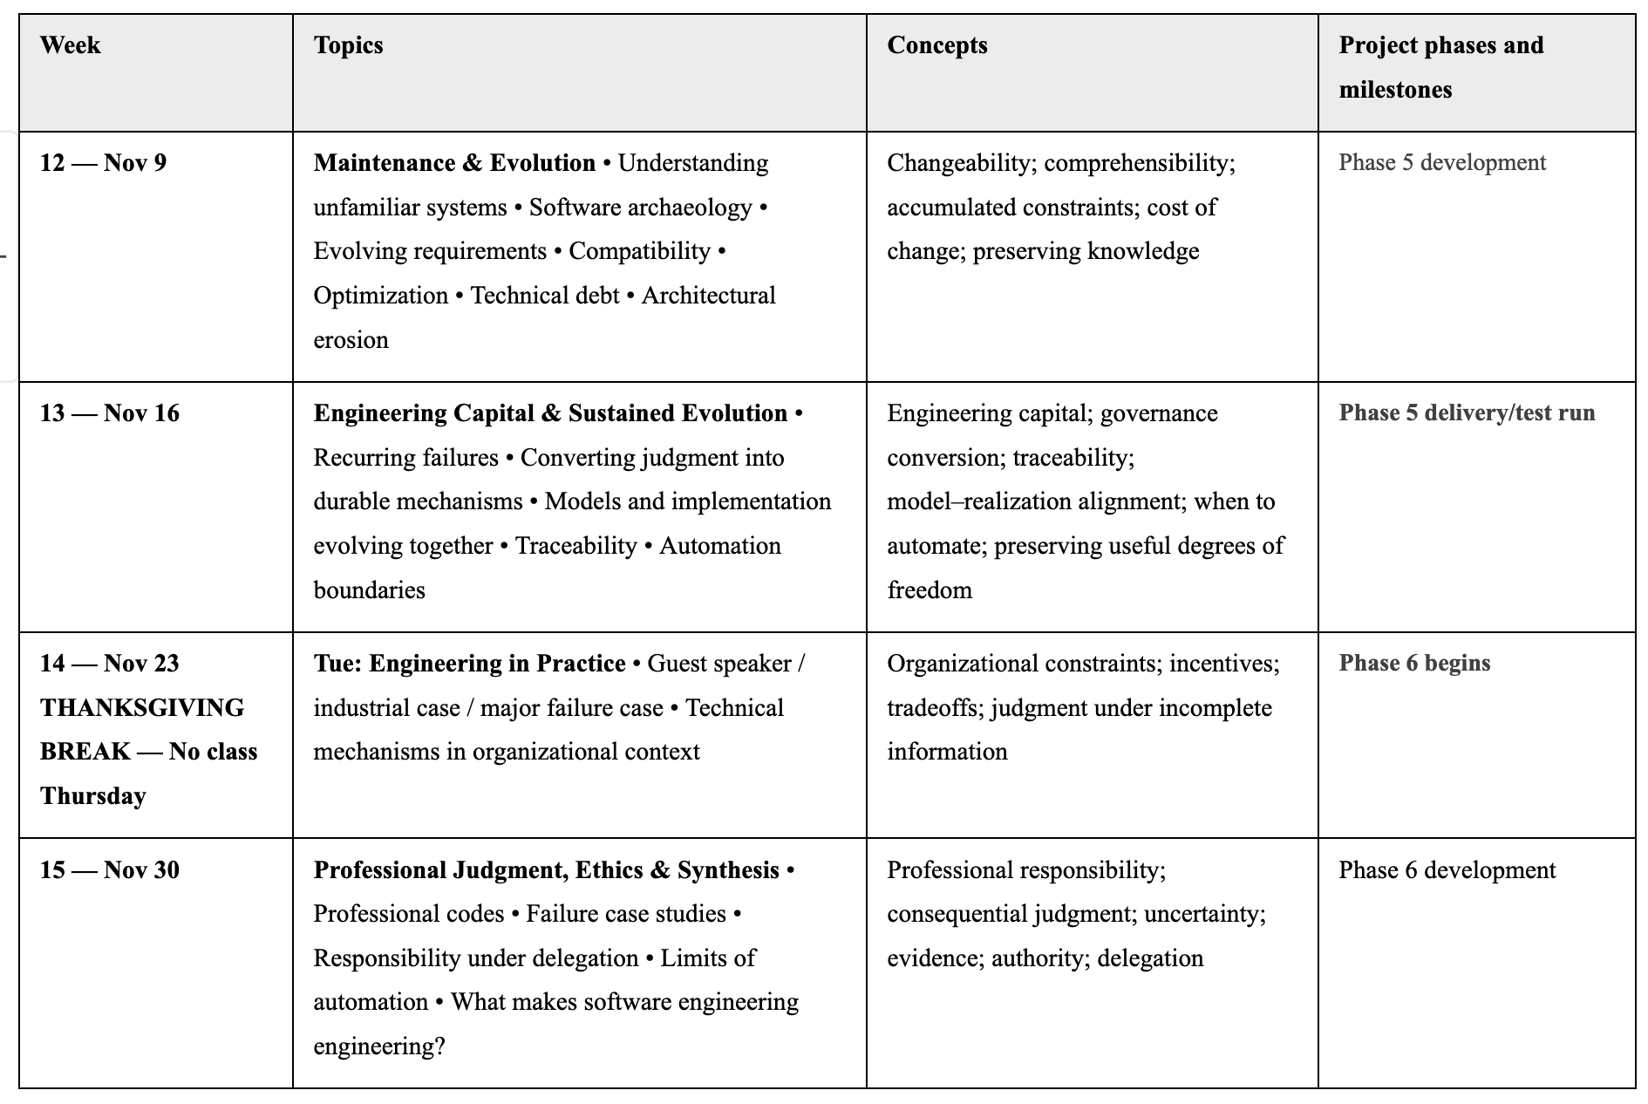
Course calendar (no plan survives)

Slide 24
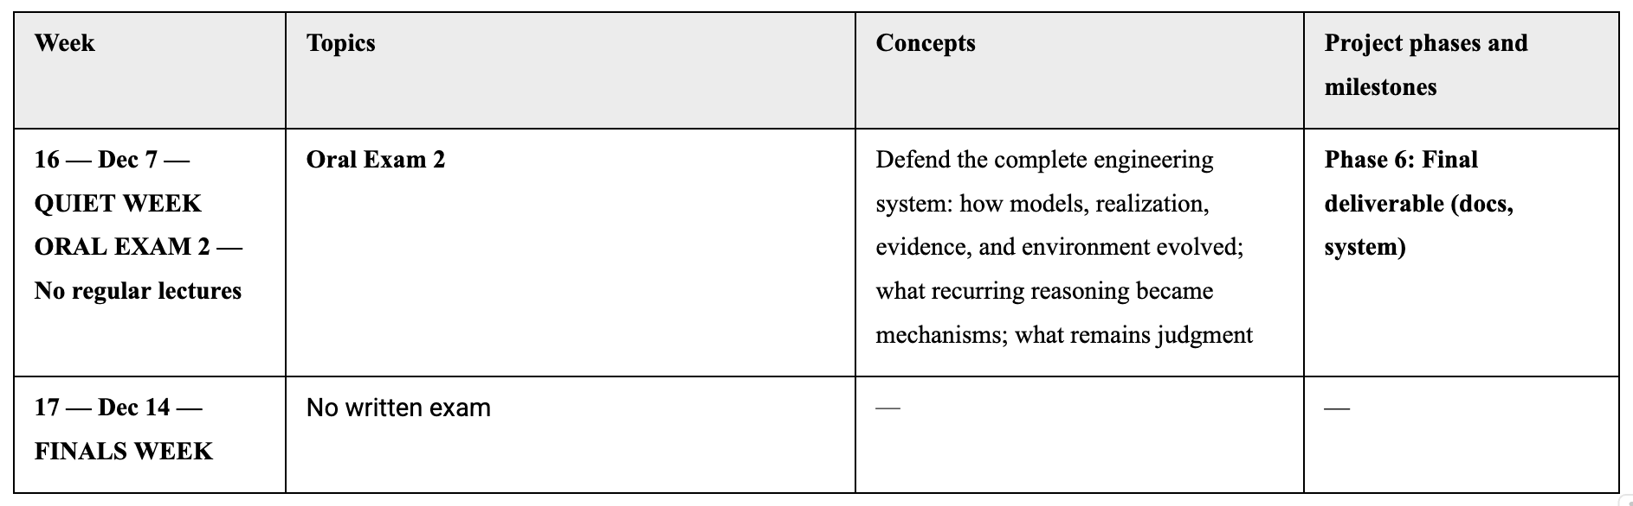
Course calendar (no plan survives)

Slide 25
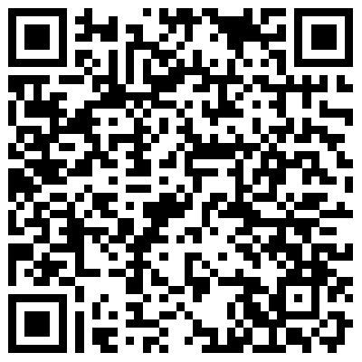
Team Sign-up
https://docs.google.com/spreadsheets/d/1xZ5HZNXP2QW7ndaoFL9PdE4Avq8sWbXxNu8AoyRWjtM/edit?gid=1339879320#gid=1339879320
Use Piazza, in-person, email, etc. to coordinate
You may put partial teams up (e.g., you and a friend) to facilitate matchmaking

Slide 26
Skill / Gap “Speed Dating”
Pair up with another person – introduce.
Each of you share:
1 main skill / 1 gap you bring to the course
1 way you would help your team succeed
You have 90 seconds.
Rotate & Repeat
Notes:
To help kick start the process and give you an opportunity to meet your fellow students…
Continue for 5 – 10 minutes, depending on vibe

