Slide 1
ECE 30861/46100: Software Engineering
Models of the
software engineering process

Slide 2
Class Notes
Team Formation
You should all be on a team. If not, talk to me after class.
Guest Speaker reminder / Zoom
This week’s assignments
Reading
Guest Speaker (prep & follow up)
Project – Phase 1 – Milestone 1
Indy weekly campus announcements

Slide 3
Project Phase 1 – Project Plan
Due next Sunday, Sept. 7
Tool selection & preparation – think justification / trustworthiness
Team contract – e.g., mtg times, comms, conflict resolution
Requirements – from the spec
Preliminary design – metric operationalization
Design planning – UML diagrams
Milestones

Slide 4

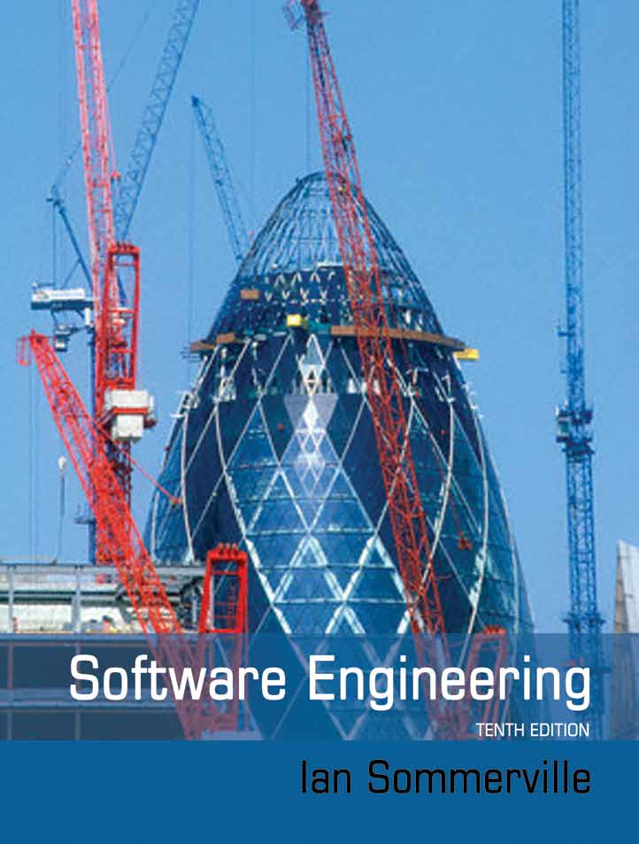
Some definitions of software engineering
“An engineering discipline concerned with all aspects of software production”
“Programming integrated over time”
Notes:
SE @ Google:
Programming integrated over time – what practices can we introduce into our programming in order to make it sustainable – able to react to necessary change – over its life cycle?
Time and change: Code will need to adapt over the length of its life
Scale and growth: As your ORGANIZATION grows, it will need to adapt as well
Trade-offs and costs: How do you make decisions about your code?
Now, definitions like this one from Google naturally lead to a more formal engineering discipline.
Sommerville:
Engineering discipline: Using appropriate theories and methods to solve problems bearing in mind organizational and financial constraints. You don’t work in a vacuum. Engineers are paid to produce a working system on time and on budget, or have a good reason why not.
All aspects: Not just technical process of development. Also project management and the development of tools, methods etc. to support software production.
My definition: “Obtaining high quality software conducting engineering activities through the use of people, processes, and tools”. (draw out the figure)
=====
====
Does software have any properties that make software engineering distinctive from other engineering disciplines?
No physical limitations
No traditional manufacturing costs
Next we’ll talk about the four key SE activities.

Slide 5
Some definitions of software engineering
People
Engineering activities
Engineered product (e.g. software)
Processes
Tools

Slide 6
What are the fundamental activities of an engineering discipline?
Notes:
What are the fundamental activities of an engineering discipline?
- Write answers from the crowd.
The question of engineering process is this: How shall we arrange these activities so that we can deliver the desired product on time and within budget?
Any suggestions of a core SE activity?
Specify / Requirements engineering: Developers and clients meet to discuss ideas for the new software product, and converge on a description of the expected behavior of an acceptable system.
For example…
Develop: Engineers design and implement the system so that it is expected to meet the requirements.
For example…
Validate: Engineers identify errors in each component, and incompatibilities when integrating components. The customer completes Acceptance Testing and agrees that the product meets their requirements.
For example…
Release & Maintain: The software undergoes various changes after delivery in order to fix bugs, add new functionality, port the software to new platforms, or adapt the software to new technologies. The development team ensures that the customer remains satisfied.
For example…
In what ways is this process similar to – or different from – the process followed by an engineer in another discipline?
A process model answers two questions:
(1) What shall we do next?
(2) How long shall we continue to do it?
In what order should we conduct these activities? It is very tempting to use a process flowchart like this one (DRAW – see hidden slide)
…but some subtleties here. If you try to do it sequentially like this, it’s called the Waterfall Model. Derived from the process used to develop large military projects. As it turns out, this approach does not work well for many software projects. The industry has converged towards an incremental development model instead. Let’s take a look.

Slide 7
Engineering activities
Prototype
Implement
Manufacture
Specify
Validate
Design
Repair
Release & Maintain

Slide 8

In what order shall we do them?
Notes:
This is a traditional engineering workflow, referred to as the “waterfall” method. It follows from the observation that “making changes in physical systems is expensive, so let’s create a thorough design up front to minimize the chances of a change later on.“
Let’s take a look at a physical engineered system like a bridge.
On whiteboard:
“Hopefully you find errors quickly” (back-edges to the preceding step)
“But sometimes (often) design errors are not detected until much later in the process.” (bigger edges, e.g. from Testing back to design back to requirements)
Let’s look at a formalization of this process, as recommended by an international standards body for software systems.

Slide 9
“Waterfall” model
Specify
Design
Develop
Validate
Release & Maintain
Repeat.
Notes:
Specify / Requirements engineering: Developers and clients meet to discuss ideas for the new software product, and converge on a description of the expected behavior of an acceptable system.
For example…
Develop: Engineers design and implement the system so that it is expected to meet the requirements.
For example…
Validate: Engineers identify errors in each component, and incompatibilities when integrating components. The customer completes Acceptance Testing and agrees that the product meets their requirements.
For example…
Release & Maintain: The software undergoes various changes after delivery in order to fix bugs, add new functionality, port the software to new platforms, or adapt the software to new technologies. The development team ensures that the customer remains satisfied.
For example…
In what ways is this process similar to – or different from – the process followed by an engineer in another discipline?
In what order should we conduct these activities? It is very tempting to use a process flowchart like this one.
…but some subtleties here. If you try to do it sequentially like this, it’s called the Waterfall Model. Derived from the process used to develop large military projects. As it turns out, this approach does not work well for many software projects. The industry has converged towards an incremental development model instead. Let’s take a look.

Slide 10
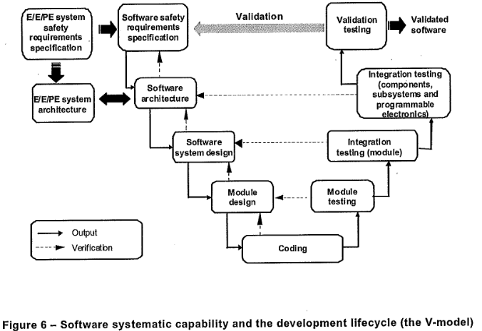
“V-model”: Plan-based, but shaped into a V
Taken from: IEC 61508-3: “Functional safety of electrical/electronic programmable electronic safety-related systems – Part 3: Software requirements
Example IEC 61508-compliant software system: AdaCore toolchain – see https://www.adacore.com/press/iso-26262
Notes:
(Show this after drawing it out on the board)

Slide 11
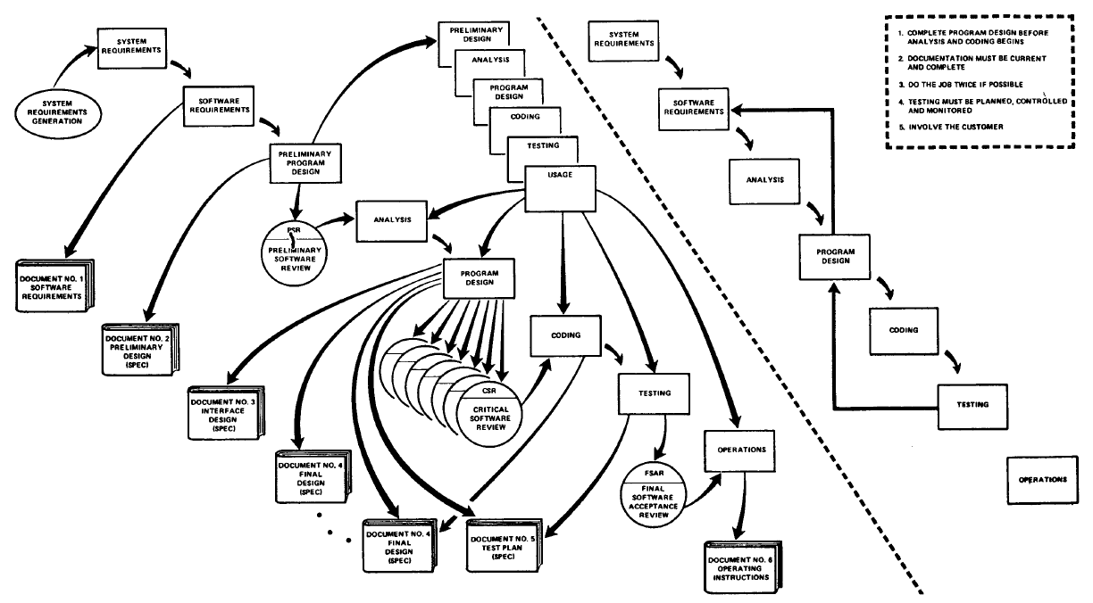
Royce and Brooks: Prototype-driven waterfall
Notes:
Let’s compare and contrast.
On the RIGHT we have the “waterfall” model, which is characterized by:
Early commitment to system design
Early scheduling and timeline
Costly changes
On the LEFT we have :
- Prototype-driven implementation. “Build one to throw away, learn from the mistakes”, and incorporate those lessons to refine the design, coding, testing, and maintenance. The benefit of a prototype is that we may be able to model/simulate the “real” system’s performance properties, and make informed decisions about resource constraints and performance goals.
Note the heavy dependence on documentation: “The first rule of managing software development is ruthless enforcement of documentation requirements”.
Documentation “forces a design”, “allows defects to be identified unequivocally”, “makes it cheaper to operate the software (e.g. because the documentation allows a lowe—skilled person to use the system), and enables retrofits and repairs in the field (because you can understand how it CURRENTLY works in order to make an informed change decision)
- Boehm 1988: A primary source of difficulty with the waterfall model has been its emphasis on fully elaborated documents as completion criteria for early requirements and design phases. For some classes of software, such as compilers or secure operating systems, this is the most effective way to proceed. However, it does not work well for many classes of software, particularly interactive end-user applications. Document-driven standards have pushed many projects to write elaborate specifications of poorly understood user interfaces and decision- support functions, followed by the design and development of large quantities of unusable code.
However: Notice that there is no opportunity for feedback on the requirements! The prototype lets us revisit the design, but it does not let us interact with the requirements.
Sometimes the requirements will not change. Any suggestions?
Software drivers for a new hardware device have a pretty clear-cut set of requirements based on properties set in silicon. But the further removed the software becomes from physical constraints, the more it is subject to change that results from “human whims”.
Other times the requirements will change. Why might this happen? Any examples of things that can result in changing requirements?
New regulations like GDPR, CCPA, or HIPAA
Changing business needs (competitor releases a new feature)
Original design does not work well (fails user testing or runs too slowly)
Users discover new features they want through interacting with the prototype
There are some contexts where this kind of approach makes sense. If the system is one-of-a-kind (e.g. space probes) or safety-sensitive (e.g. nuclear reactors and other industrial control systems), or lends itself to formalism (compilers, operating systems), there is little room for error and a lot of effort spent on planning and documentation is helpful.
But there are MANY other contexts where this kind of approach is not sensible. The crux of the matter is that we may know “generally” what to build, but not “specifically”. We cannot really find out until we’ve built it. Most software that has an “end-user” interface, e.g. web browsers, word processors, phone applications, payroll systems, etc. etc. is of this nature.
======
If we follow the Royce approach, every time there is a change in requirement, much of what we’ve built may becomes rubbish. That includes the voluminous non-software documentation (e.g. binders and printouts).
What the software engineering community learned between 1970 and ~2000 is that requirements always change. Software is simply more mutable than physical components. Given that we KNOW this, we need to tweak the engineering process to work well for us.
======
It is also difficult to estimate the cost (implementation time) of a given software engineering project.
In particular, the “coding” and “testing” phases can take a really long time, while looking like they are almost done the whole time. Business rules like 80/20: 80 percent of the work goes into the last 20 percent of the job, i.e. finishing is hard.
Using Royce’s approach we can get stuck here. No delivery = no value for customer.

Slide 12
Why do these problems happen?
“The programmer, like the poet, works only slightly removed from pure thought-stuff. He builds his castles in the air, from air, creating by exertion of the imagination. Few media of creation are so flexible, so easy to polish and rework, so readily capable of realizing grand conceptual structures.”
- Brooks 1995, “The Mythical Man Month”
“You can’t touch software.”
- Me
Notes:
Contrast to a bridge. How many bridges have people built, roughly? How long have we been building bridges? How well do we understand what it takes to put together a bridge – time, personnel, and money? How well do we understand the requirements of a bridge? How well can we predict whether a bridge will meet our needs?
To sum up, it seems that:
People have trouble understanding what they really want. People want to interact with a product in order to understand whether it meets their needs.
Software allows computing systems to be really flexible, but this can also make it hard to understand whether a given system is possible to build, and how long it will take to build a given system.
What kind of engineering process will help software engineering teams account for these issues in a cost-effective manner?

Slide 13
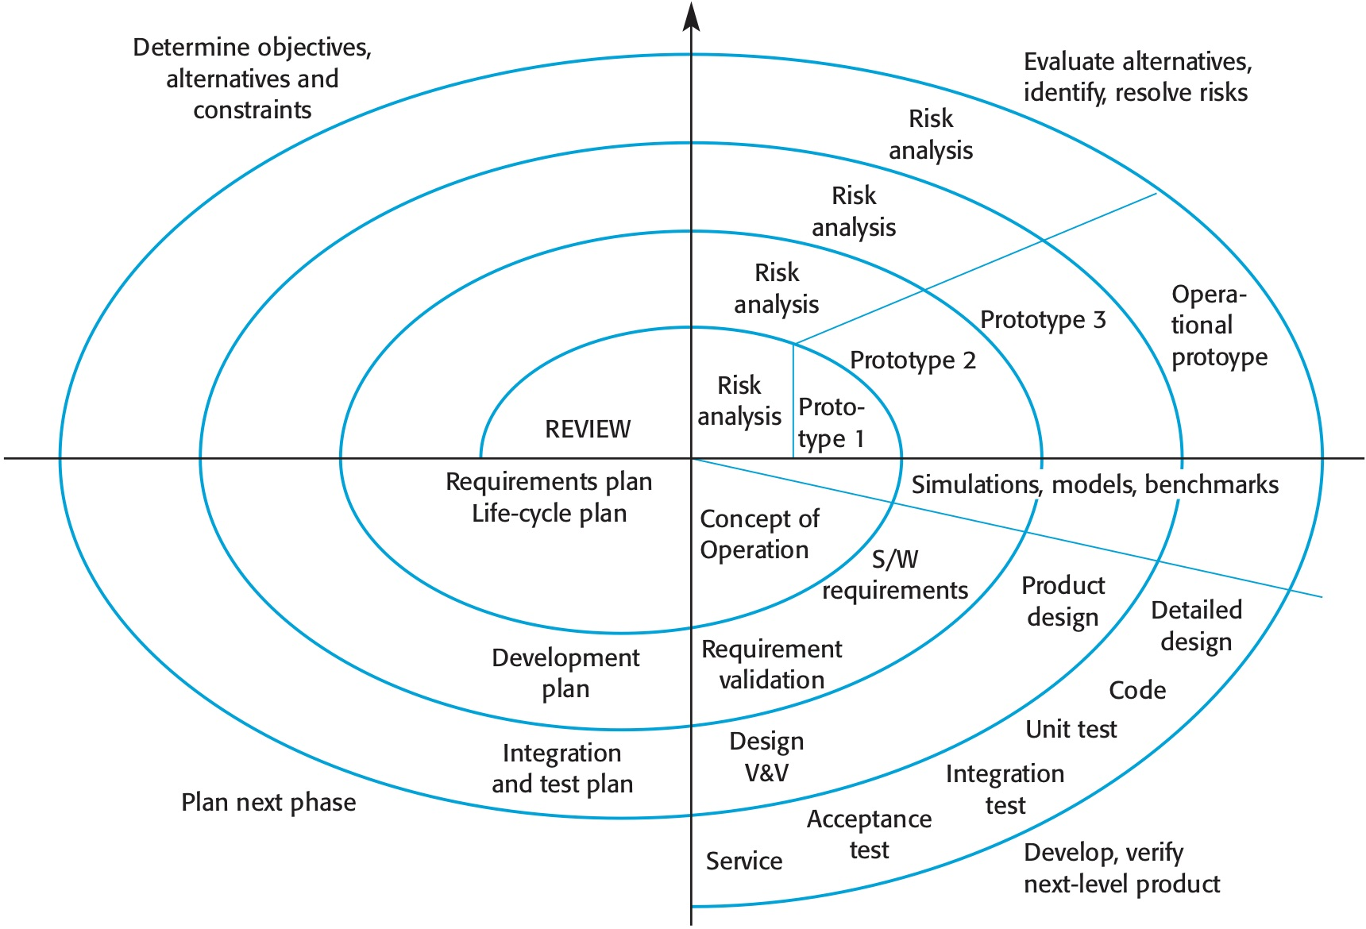
Boehm’s spiral model (1988): Flexible plan
Cumulative cost
Boehm 1988. IEEE Computer. “A Spiral Model of Software Development and Enhancement”
Notes:
By the 1980s, it was clear that this plan-driven approach was not appropriate for all kinds of systems, and that there were recurring problems resulting from changing requirements.
Boehm proposed to incorporate specific “risk-themed” aspects into the same waterfall approach, in his “spiral” model of software engineering.
In each phase, we should:
Determine objectives, the range of approaches, and constraints.
Preliminary evaluation of the range of approaches (prototyping), identify and resolve risks
Develop and verify
Review what you’ve done and plan the next phase.
We still end up running through the steps of requirements-design-implement-validate-release. But we’ve divided the bigger project into a series of increasingly complex builds. Within each of those steps we are very aware of risks and alternatives. The plan becomes flexible (but it is still a bit linear, just bent around into a spiral)

Slide 14
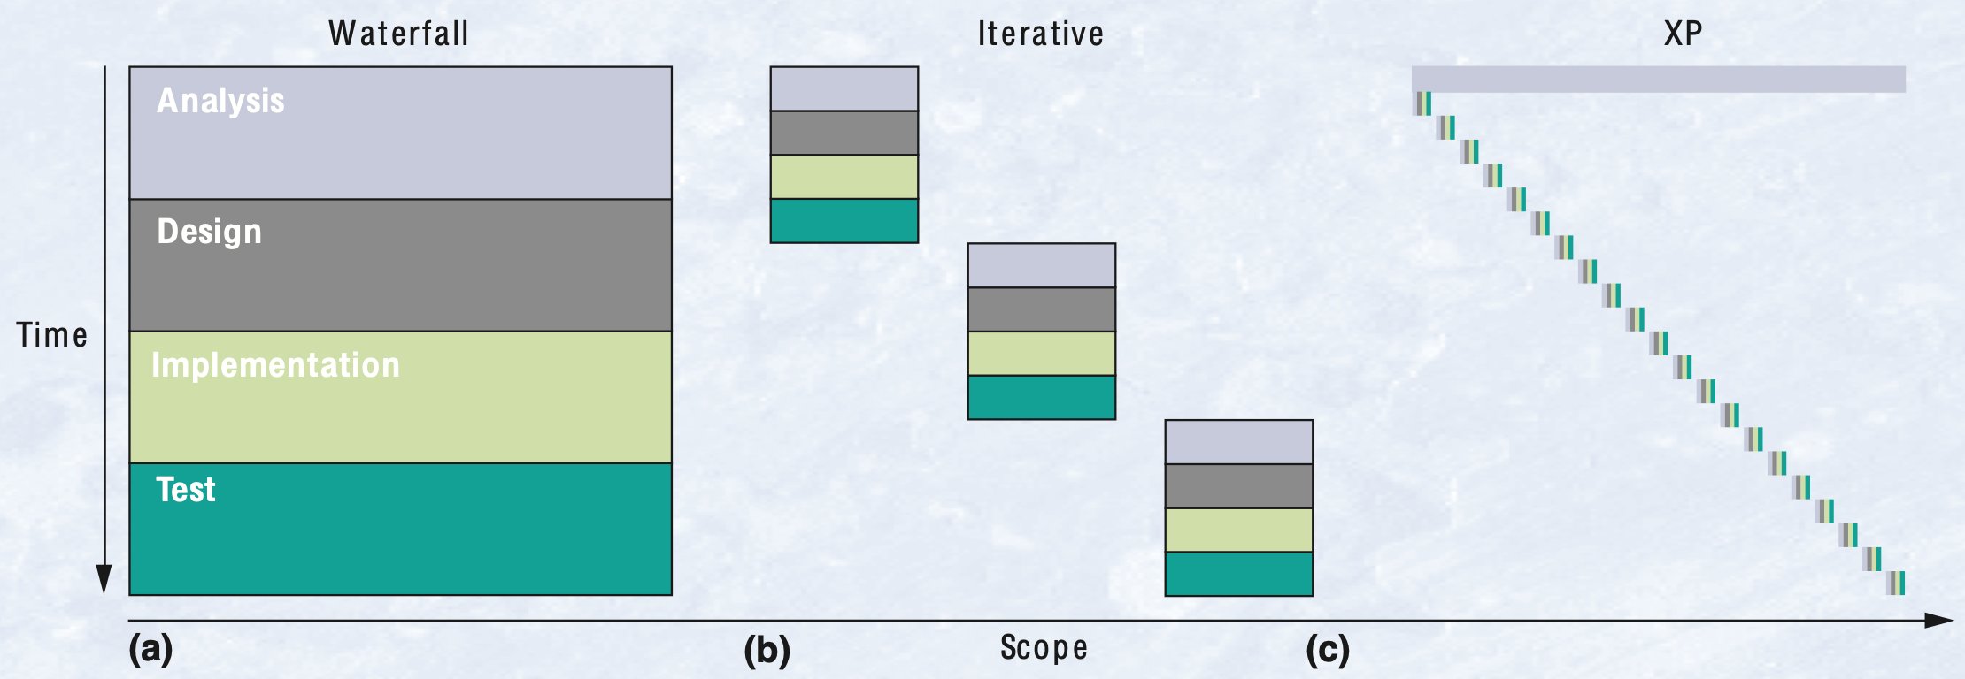
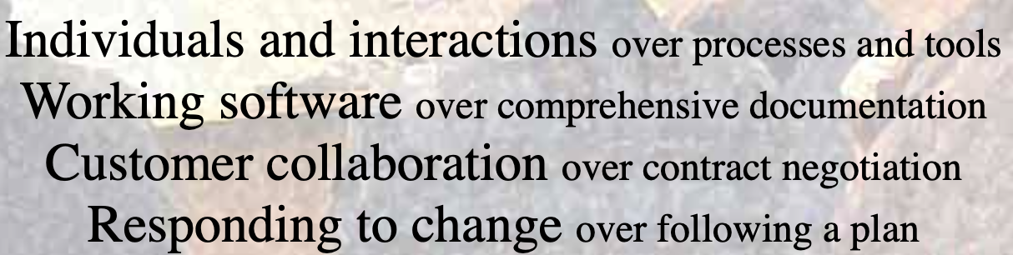
Incremental development and XP (Beck 1999; Agile Manifesto)
Notes:
This is the same figure, but made highly iterative. More smaller cycles = good?
How small can we make these cycles? How small should we make them?
Characterized by:
Cheaper to make changes
Easy to get customer feedback
Can deliver partial solution early on – reduce time-to-value
TDD
Instead of minimizing change via a plan, the goal is to embrace change.
However:
Documentation can get left behind – invisible progress. It’s not cost effective to draw up plans if you’re about to throw them away, so you end up not bothering.
If you keep tacking on new code, you can end up with a mess. Structural Degradation occurs, and refactoring is needed to address it. Organic growth leads to ill-structured code.

Slide 15
Scrum: A popular Agile approach (Schwaber & Sutherland)
Notes:
(Draw figure on next slide)
Scrum team
Sprint (Planning -> Execution -> Retrospective)
Backlog
Increment
The fundamental unit of Scrum is a small team of people, a Scrum Team. The Scrum Team consists of one Scrum Master, one Product Owner, and Developers. Within a Scrum Team, there are no sub-teams or hierarchies. It is a cohesive unit of professionals focused on one objective at a time, the Product Goal.
Scrum master
Product owner
Software engineers (“Developers”)
Product owner:
Developing and explicitly communicating the Product Goal;
● Creating and clearly communicating Product Backlog items;
● Ordering Product Backlog items; and,
● Ensuring that the Product Backlog is transparent, visible and understood.
Developers are always accountable for:
● Creating a plan for the Sprint, the Sprint Backlog;
● Instilling quality by adhering to a Definition of Done;
● Adapting their plan each day toward the Sprint Goal; and,
● Holding each other accountable as professionals.
Scrum master:
● Coaching the team members in self-management and cross-functionality;
● Helping the Scrum Team focus on creating high-value Increments that meet the Definition of
Done;
● Causing the removal of impediments to the Scrum Team’s progress; and,
● Ensuring that all Scrum events take place and are positive, productive, and kept within the
timebox.
The Product Backlog is an emergent, ordered list of what is needed to improve the product. It is the single source of work undertaken by the Scrum Team.
The Sprint Backlog is composed of the Sprint Goal (why), the set of Product Backlog items selected for the Sprint (what), as well as an actionable plan for delivering the Increment (how).
Sprints: Fixed-length events of <= 1 month
Each sprint starts immediately after the previous one.
All the work necessary to achieve the Product Goal, including Sprint Planning, Daily Scrums, Sprint Review, and Sprint Retrospective, happen within Sprints
During the Sprint:
● No changes are made that would endanger the Sprint Goal;
● Quality does not decrease;
● The Product Backlog is refined as needed; and,
● Scope may be clarified and renegotiated with the Product Owner as more is learned.
- Sprint Planning : Topic One: Why is this Sprint valuable? Topic Two: What can be Done this Sprint? Topic Three: How will the chosen work get done?
Daily Scrum: 15-minute status updates through the whole team
Sprint retrospective: The Sprint Retrospective concludes the Sprint. It is timeboxed to a maximum of three hours for a one- month Sprint. For shorter Sprints, the event is usually shorter
An Increment is a concrete stepping stone toward the Product Goal. Each Increment is additive to all prior Increments and thoroughly verified, ensuring that all Increments work together. In order to provide value, the Increment must be usable.
Sprint delivers 1 or more increments
- Each increment must have a “Definition of Done”: a description of the state of the Increment upon which it meets the quality goals for the product

Slide 16
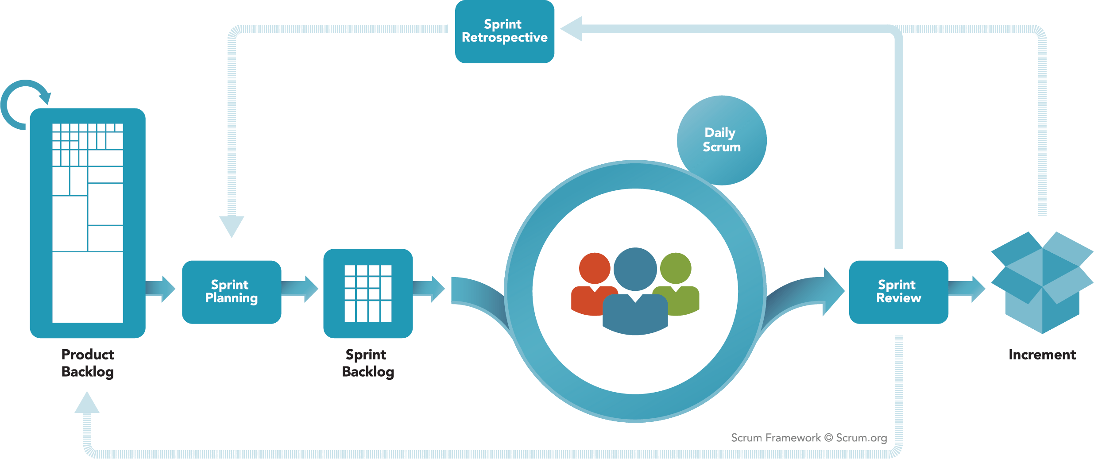
https://scrumguides.org

Slide 17
When to use which?
Waterfall / Plan-based
Incremental / “Agile”
Notes:
On what kinds of computing systems might a Waterfall approach be preferable?
- Embedded systems – if you’ve got to develop hardware, you may not be able to defer decisions about the hardware-software interface. More up-front planning may be required.
Critical systems where extensive safety and security analysis is needed. The specification and design docs are used by analysts, so they need relatively complete ones in advance.
“System-of-systems” -- partnerships between companies. If timelines are not carefully synchronized, it can be difficult to integrate systems in an incremental fashion. Up-front planning enables independent development of subsystems.
On what kinds of computing systems might an incremental approach be preferable?
User interface
Systems built by a co-located team (easy to communicate)
Systems where a customer representative is on call to assess versions and discuss requirements (easy to get feedback)
Web-based systems (delivery and updates are controlled by YOU, not by the customer)
Situations in which users say, “I can’t tell you what I want, but I’ll know it when I see it.”
In practice, most practical processes include elements of both plan-driven and agile approaches.
There are no right or wrong software processes.

Slide 18
Activity: A bank wants to join the 21st century
Analysis
Specification: What are some requirements the bank might have?
Preliminary design: Can we think through how those requirements could be realized through a layered system architecture? What might the layers be?
Planning: What might the project timeline be if we use plan-based or incremental approaches? Why might we do it one way or another?
Layer 1
Layer …
Layer N
Notes:
Exercise: Bank system
Analysis. What might each layer do?
What would our project timeline look like if we build according to a plan-based approach?
How about an incremental approach? In what order should we do things?
The big question: ”Vertical slices” or “Horizontal slices”?

Slide 19
Plan-based vs. incremental: Redux

Slide 20
In what sense could the principles of the Agile movement be applied to bridge-building?
Notes:
Let’s distinguish agile *management* vs. agile *implementation*.

Slide 21
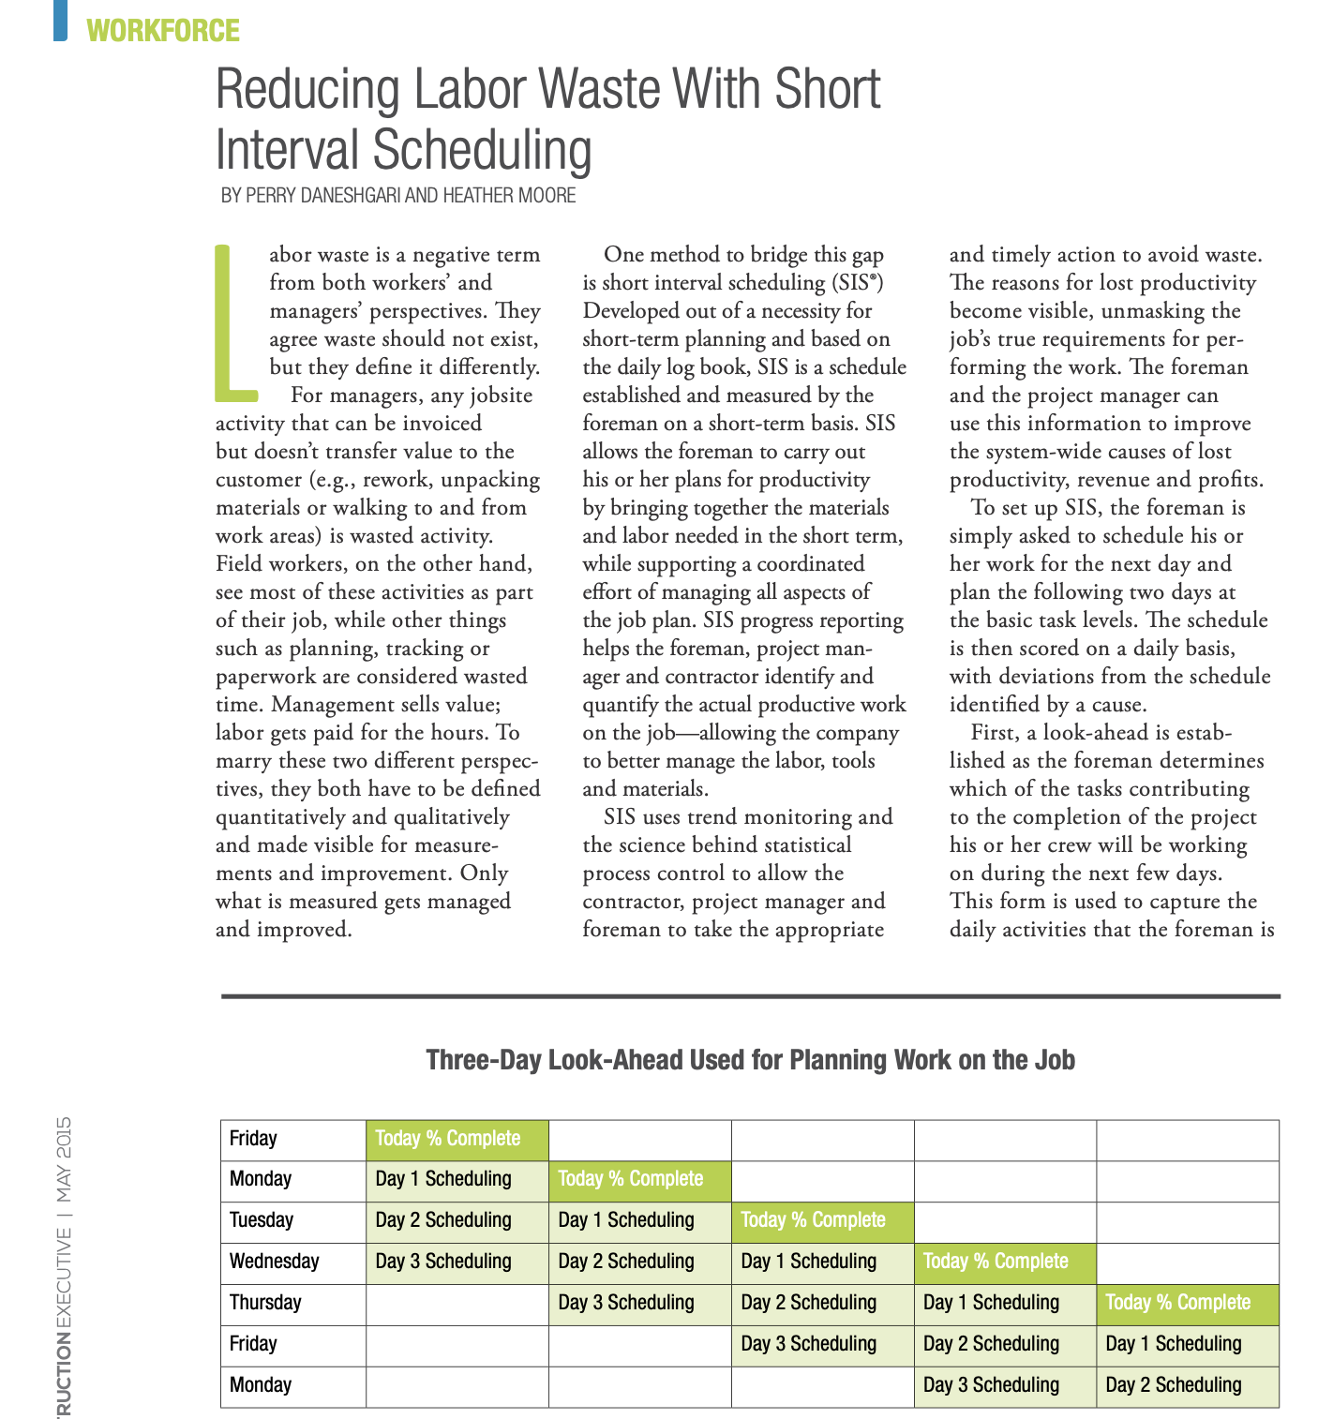
Agile Construction
Reducing Labor Waste With Short
Interval Scheduling BY PERRY DANESHGARI AND HEATHER MOORE
Notes:
The eight agile construction principles^{[5]} are:
Agile construction project management
Agile construction labor productivity measurement^{[6]} and labor productivity improvement
Agile construction job scheduling and planning^{[7]}
Agile construction procurement and material management^{[8]}
Agile construction externalizing work, through prefabrication^{[9]} (components or parts pre-assembled off-site by suppliers or in a prefab shop, to reduce time, risk, and complexity)
Agile construction labor management and labor composite rate reduction (the average cost of a job crew member to the company per unit of time)
Agile construction estimation accuracy and improvement ^{[10]}
Agile construction project financial management^{[11]}

Slide 22
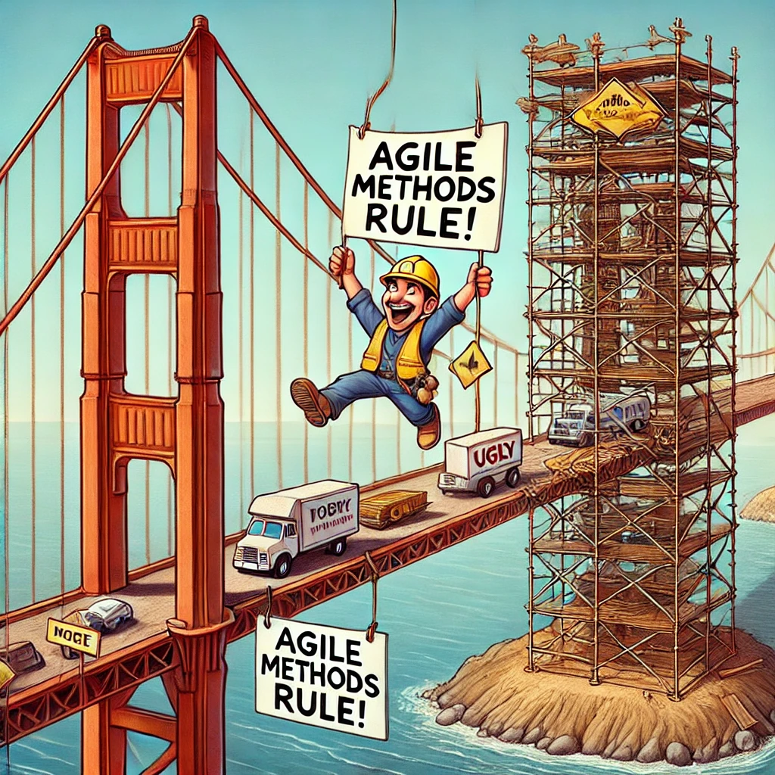

This one time at
we were told to “go agile”
How could you incorporate Agile methods into your existing project?
Agile project management vs. agile (incremental) feature delivery?
What pushback might you receive from your team?
Notes:
Experience trying to make GPFS more Agile

Slide 23

SWEBOK
https://www.computer.org/education/bodies-of-knowledge/software-engineering
In practice, software processes and activities are often interleaved, overlapped, and applied concurrently. Software life cycle models that specify discrete software processes, with rigorously specified entry and exit criteria and prescribed boundaries and interfaces, should be recognized as idealizations that must be adapted to reflect the realities of software development and maintenance within the organizational context and business environment.
(SWEBOK pg. 8-6)
Notes:
What is SWEBOK ?

Slide 24

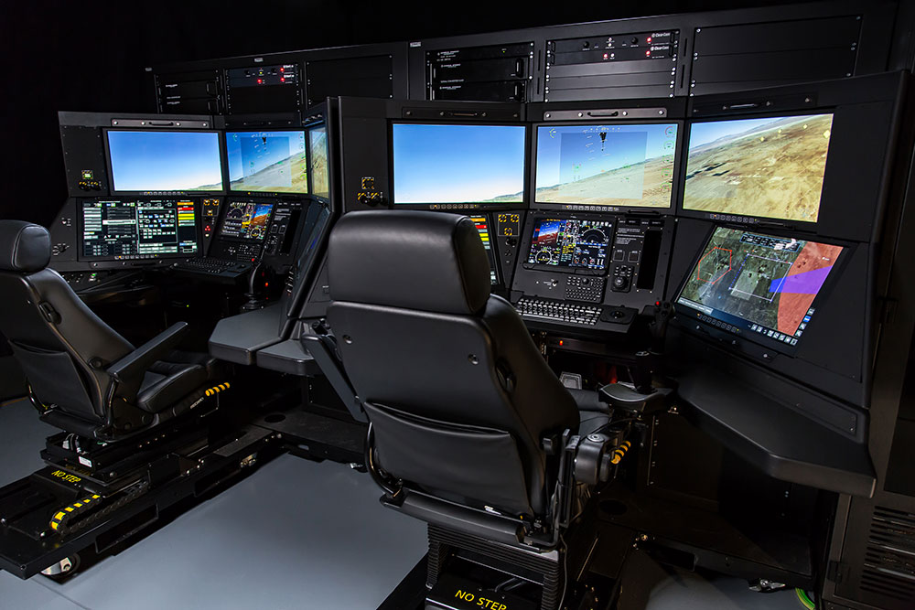
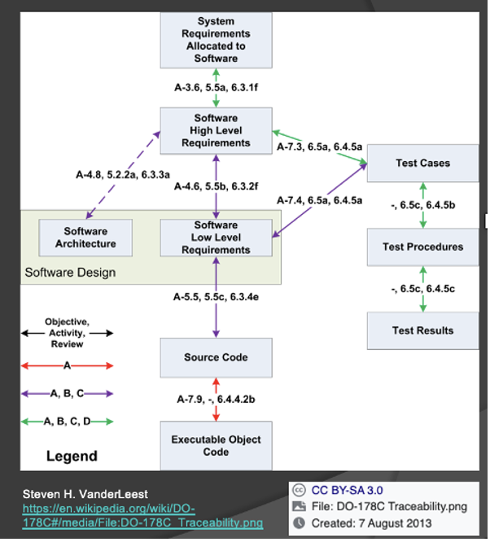
MQ-9 Overview
RPAs – MQ-9A / B
Remote Split Ops (LOS, SATCOM)
Ground Support Equipment
Ground Control Stations
Mission Control
Launch & Recovery
DO-178C - Software Considerations in Airborne Systems and Equipment Certification
Design Assurance Levels
Notes:
Complex system with many HW and SW components
Getting approval to fly anything in FAA controlled airspace requires an enormous number of SW dev processes.
The higher the DAL (Design Assurance Level) of your SW component, the more work you must do

Slide 25
MQ-9 – Think-Pair-Share
Given the MQ-9 / SkyGuardian system overview, which SDLC do you think the SW team used?
Waterfall, V-Model, Incremental or Evolutionary
Why did you choose that one?
And the answer is… ALL of them.
There is no single model that always works.
The approach is often hybrid.
Notes:
Waterfall
DoD acquisition
program constraints
SW is only part of the system
DO-178C !!
V-Model
highly relevant
System Integration Lab (SIL)
System Test & Qualification (ST&Q)
Incremental
plan from the beginning
partition capabilities (requirements)
3-month SW release cycles
Evolutionary
user feedback ➔ planning (re-planning! 😐)
risk assessment (ex. asset availability)
system test progress often drives decisions
Companies must do what makes sense in their context to:
make money (stay in business)
keep the customer happy
balance innumerable competing demands for resources
and much more...
These realities have a direct impact on Software Engineering.

Slide 26
Imagine you’re leading a software project for the following client need. Would you use a more plan-based or a more Agile approach? Why? How would you respond to a team member arguing the other way?
Mars rover guidance system with launch in 18 months
BoilerMater, a new mobile dating app
A compliance-driven system for financial transactions at a multinational bank
A course project with 3-4 undergrads working on unfamiliar technology in a 15-week timeline
Notes:
Sample follo—up questions
“What if the mobile app now has HIPAA constraints?”
“How would your answer change with a smaller/larger team?”
“Can you imagine blending elements of both approaches?”

