Slide 1
ECE 461: Software Engineering
Software Engineering Teamwork
Prof. James C. Davis

Slide 2
Module outline
Main learning outcome: An understanding of the social aspects of software engineering, including issues and openness in communication, teamwork, culture, and ethics.
Topics:
Software engineering as a team endeavor
Social: Teamwork and intercultural challenges
Technical: Tools and patterns for collaboration
Readings: Focused on problems arising from teamwork
Greg Wilson: ”How to run a meeting” (Project!)
Brooks: “The Mythical Man Month”
SE@Google: Two chapters – Definitely read chapter 2, optionally chapter 7
Homework: Reading quiz + Project work
Notes:
Why are we talking about this today? (Project part 1 spec released tonight)
Team endeavor
Job roles
What makes a great software engineer?
Social
Some personal and organizational factors that can lead to challenges
Technical
- HW on this

Slide 3
1 Software engineering: A team endeavor

Slide 4




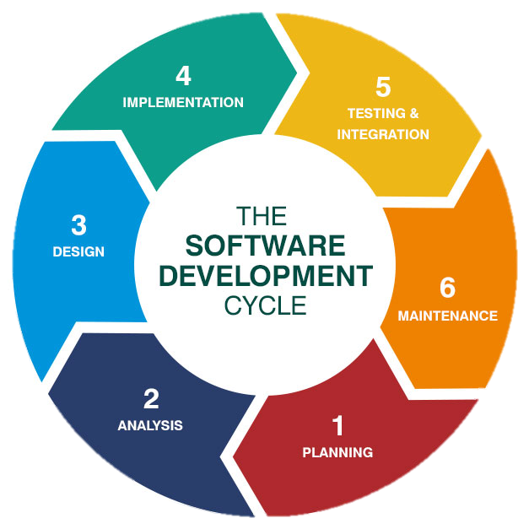
Team structure and job roles
Leadership
Product Managers
Architects
Development
Test / QA
Function tester
System tester
SRE
Sys Admin
GUI tester
Test Automation Engineer
Security analyst
"Full stack"/X-end engineer
Operations
Chief / principal engineers
Research
Researcher
DB Admin
University liaison
Engineer
VPs and Directors
Security: SOCs, TH, IR
Pentester
Data scientist
Performance engineer
Mobile/Cloud/etc. engineer
DevOps? DevSecOps?
Support tech
Notes:
Most of these jobs:
Bachelor’s in CompE, EE, CS
Plenty of other STEM degrees, e.g. physics degrees are a common sight
Some self-taught folks, some bootcamps
Some of these jobs:
MBA (some leadership roles)
PhD (some research roles)
There is always a counter-example
Master’s: Start at a higher grade (e.g. senior vs. junior), may have greater scope for leadership roles. However, hands-on experience is highly valued.
Why the “full-stack” roles? There’s a trend towards holistic approaches and overlapping roles. Software engineers are being asked to have a wider breadth of expertise, e.g. having some cybersecurity skills, knowing multiple programming languages, knowing multiple technology stacks, etc.
Communication is hard, so having fewer personnel can reduce errors (to a point)
What are typical interaction patterns among these folks?
Feed-forward
Product is designed, developed, and shipped
Feed-back
Predictable: Retrospectives
Unpredictable: Emergency outages/disasters
Research talking points
- IBM: As a general rule, research prototyped the product and advanced features, engineering (development+testing/QA) made it work, and Operations gave feedback to engineering. However, many PhDs in the development and testing/QA because things were complicated.
- Cisco: Product prototyping
At Microsoft
- Research I did here was focused on validation, though Microsoft was also trying to productize this as a “testing-as-a-service” for customers deploying in Azure
At Rolls Royce
- Research I do for them is about validation

Slide 5
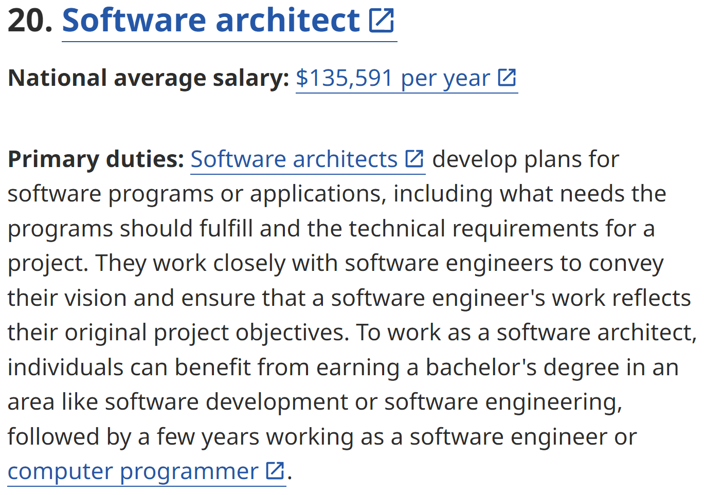
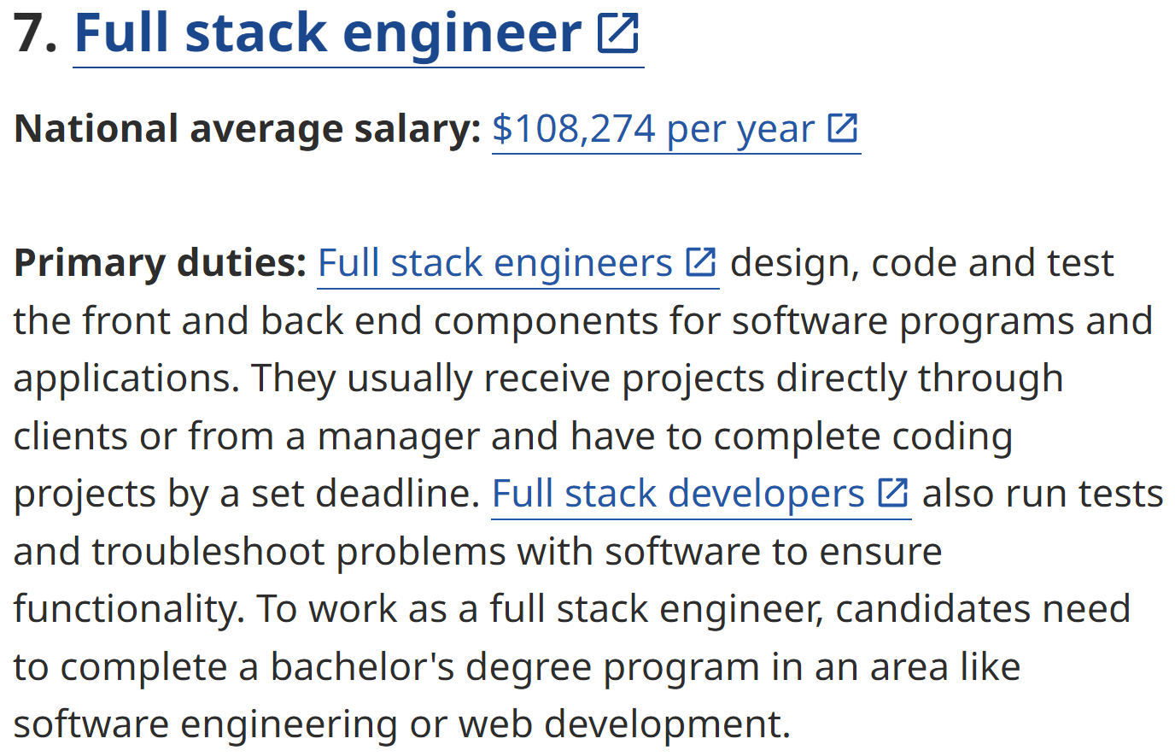
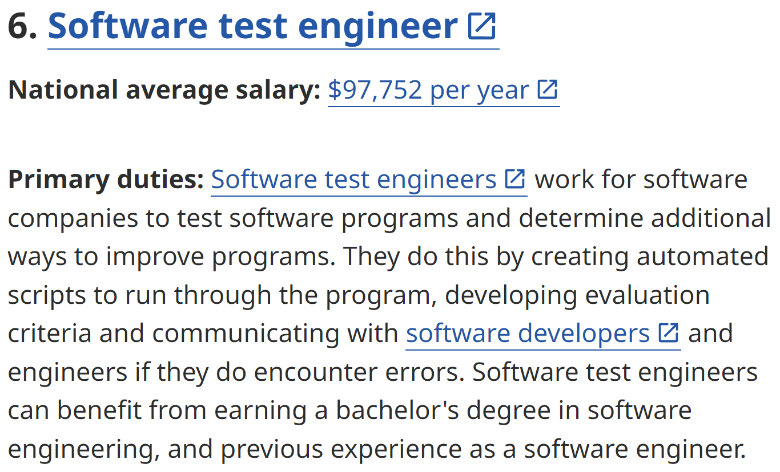
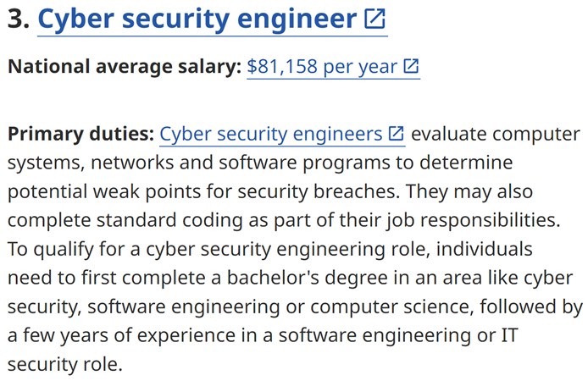
Example positions
https://www.indeed.com/career-advice/finding-a-job/best-jobs-for-software-engineers -- Data as of 2023

Slide 6
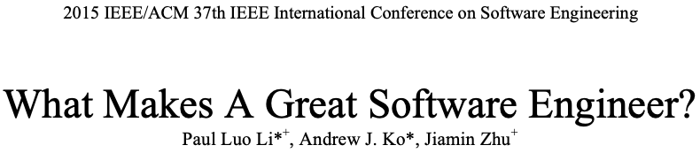
What makes a great software engineer?
Notes:
Q: What do you think?
- Hopefully we get attributes of both individuals and teams
Q: How would you find out?

Slide 7
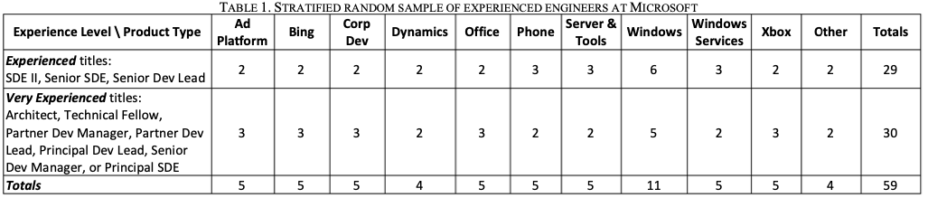
Notes:
Random sample of engineers across two important dimensions: product type (10 major divisions at Microsoft plus one for all others including Skype, Data Center Ops, and Distribution) and experience level (‘experienced’—titles at or above SDEII—and ‘very experienced’—titles at or above Senior Dev Manager— typically with 15+ years of experience)

Slide 8
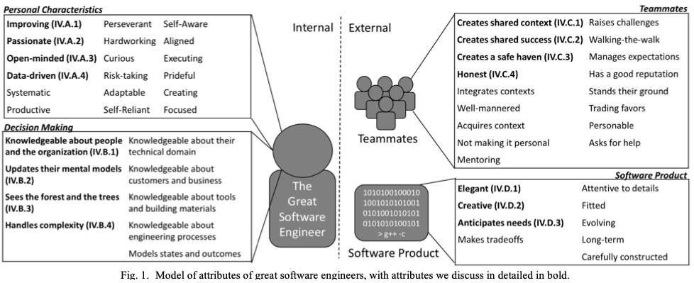
0: Write, implement, debug software
3: Play nicely with others
1: The ability to learn
4: Think “product”, not “pile of code”
2: Making good decisions
Notes:
Baseline: Write, implement, and debug software
Personal characteristics
Improving—not satisfied with the status quo: constantly looking to improve themselves, their product, and/or their surroundings
Adaptable—adapting to changes in their environment, including changes in what they do (e.g. the software product) and how they do it (e.g. people, processes, and tools).
Self-reliant—getting things done independently (i.e. not always going to their manager for help); removing roadblocks by leveraging their abilities and resources (e.g. asking experts for help)
Focused—allocating and prioritizing their time for the most impactful work.
Open-minded—willing to judiciously let new information change how they think
Example: “Not invented here” – story from IBM (inter-team competition)
Data-driven Taking and evaluating measurements of their actions and of the product, creating behavioral feedback loops for optimizing software and processes.
=======
Decision-making
Informants felt strongly that having book knowledge was not sufficient; great engineers understood how decisions play-out in complicated real-world conditions. Great engineers not only knew what should happen, but also what can and likely will happen
Knowledgeable about people and the organization—informed about the people around them: their responsibilities (i.e. organizational structure), their knowledge, and their tendencies . For example, knowing ownership enabled great engineers to determine key stakeholders for decisions and to communicate with the right people to align their work. This alignment commonly meant their management chain, but informants also discussed aligning with key partner teams (e.g. other parts of a product offering):
Sees the forest and the trees—considering situations at multiple levels, including technical details, industry trends, company vision, and customer/business needs
Update Their Mental Models
Informants described great engineers as continuously updating their mental models at all levels of abstraction— ranging from technical details to industry trends—by explicitly evaluating changes in their context. “You can always follow patterns too much... It's worked in the past, but conditions have changed.”. For example, “Sometimes what used to be a second or third order effect comes to dominate. So way back in the day, if you wanted to performance optimize something you counted instructions. Processors got faster and faster, but memory references didn't. There became a day when it made more sense to count memory references than it did to count instructions"
Knowledgeable about customers and business—conversant about the role their software product plays in the lives of their customer and the business proposition that entails
Knowledgeable about tools and building materials—versed in strengths and limitations of the tools and building materials used to construct their software product
======
Teammates
Create shared context
Adapting to another person’s understanding of a situation, was the most important aspect of “communicating effectively”. This involved tailoring the message to another person’s perspective:
One person can only accomplish so much so you've always got to be working as part of the bigger group. People who can't communicate are only going to be sort of so-so effective...”
great engineers, especially ones at higher-levels, often had to communicate with people that do not have a complete (or the same) understanding of the situation but are critical to success (e.g. partner teams, customers, or management). Therefore, crafting the message such that others can comprehend the situation was important:
Creates A Safe Haven
Many informants described great engineers as creating a safe haven where other engineers can learn and improve from mistakes and situations without negative consequences. Usually associated with leaders, informants felt that if engineers are afraid of mistakes, then their growth would slow:
The lack of this attribute as a major contributing factor for talent loss.
Safe haven != “no criticism”. People need to understand the impact of a mistake in order to learn from it – we learn from pain. But great engineers create a space where that kind of learning is possible and doesn’t compromise a career.
Honest
Informants felt that being honest was the most important attribute related to ‘trust’. This was about great engineers providing credible information. Engineers that presented a version of the situation that suited their own benefits were viewed negatively. Informants felt that they needed to be able to take action based on information that an engineer provided:
“Influence comes to someone else trusting you”
======
Software product
Elegant and Creative (when needed)
Possessing simple and intuitive designs that another person (or themselves later) could easily understand.
Great engineers knew of and knew when to apply existing solutions (and not be creative). This was important because informants felt that known solutions were generally preferable since they were less costly and less error-prone:
“You are now using all of your creativity to reinvent things that are already invented and that is just basically wasteful.
Understanding patterns and understanding how to apply something is very important so you don’t recreate wheels all the time
======
Be humble and open to improvement. You do not know everything! Your design is not perfect. Your implementation is not perfect. Your tests are not perfect. Part of the value of a team is to help everyone on it do their best for the customer.
Respect others. Care about the other people you work with. Don’t focus on their weaknesses, but recognize their strengths and how you can learn from them.
Take a default stance of trusting that everyone on your team wants what is best for the team, the customer, and the company. Never attribute to malice what can instead be attributed to a simple mistake. (There do exist dysfunctional teams where internal politics have come to dominate. If that happens to you, find a new team.)

Slide 9
2 Social: Teamwork and intercultural challenges
Meetings
Email, Slack, etc.

Slide 10
How to run a meeting
Credit: Greg Wilson, http://third-bit.com

Slide 11
Does there actually need to be a meeting?
To inform? Only if you are expecting questions
To consult? Only if people get a vote
Otherwise it’s just informing with pretense
To discuss? Yes
But only in small groups
Or with well-defined procedural rules
To collaborate? That’s not a meeting…

Slide 12
Create an agenda
If you don’t care enough to make a list, you don’t need a meeting
Include timings
Prioritize
Plan to end early
“The most fundamental unit of time is the bladder”

Slide 13
Seek truth, not victory
No social dominance displays
“Well actually…”
Ask yourself, does the group really need to hear what I will say?
The devil doesn’t need more advocates
But there are no stupid questions – just stupid repeated questions

Slide 14
Record minutes
So people who weren’t there know what happened
So people who were there agree what happened
So people can be held accountable at later meetings
Minutes → Backlog?

Slide 15
Communicating outside of meetings

Slide 16
What methods should we use to communicate ?
Common types of communication
Company-wide memos
Department/ “internal org”-wide memos
Team communication
Individual communication
Notes:
Ask for input – what types of communication are there?

Slide 17
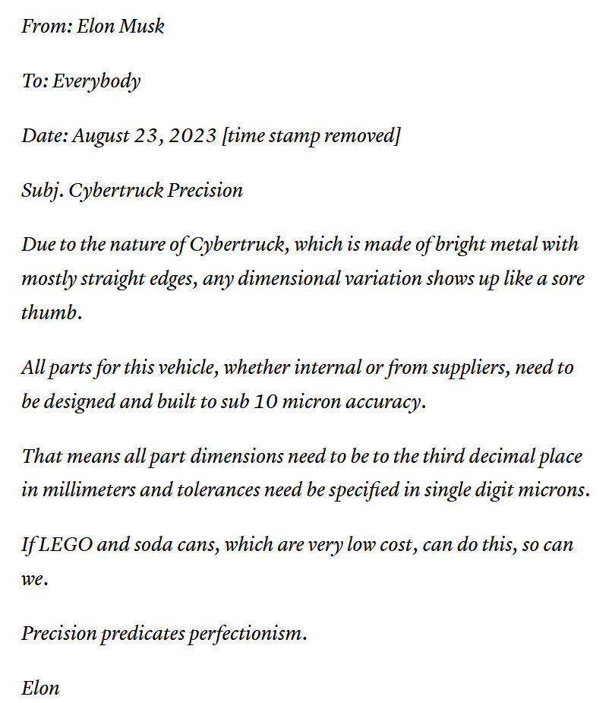
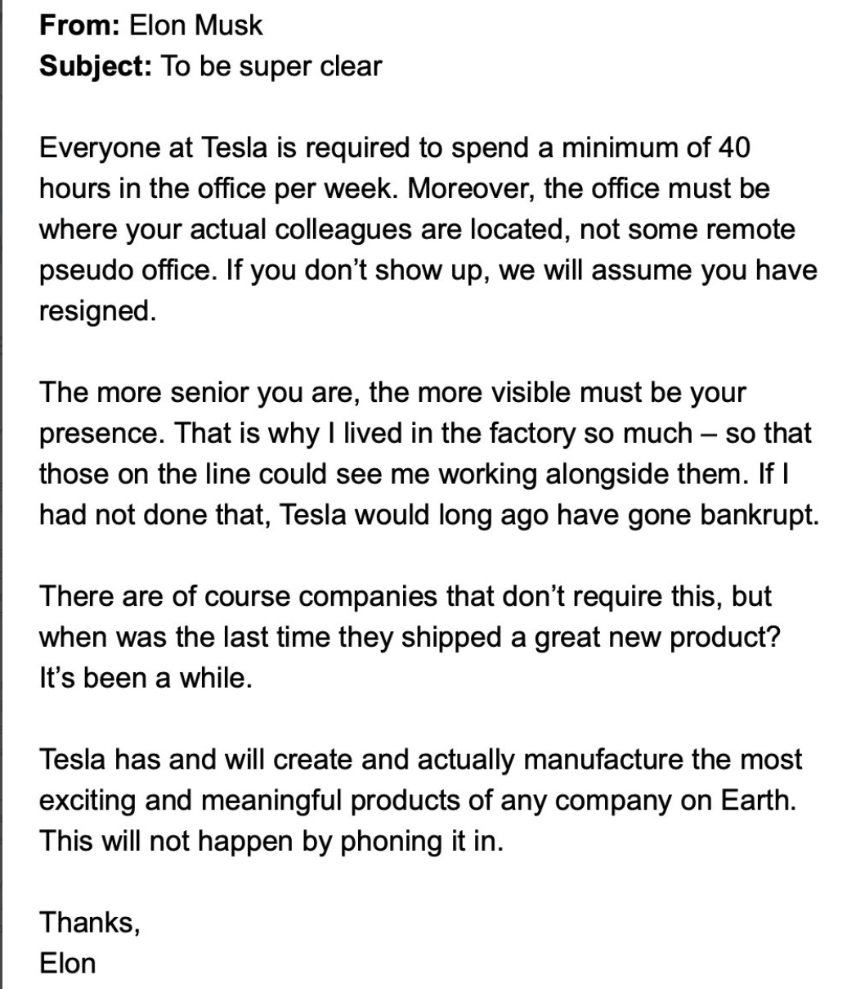
Company-Wide Communications
Notes:
https://techcrunch.com/2022/06/03/elon-musk-orders-hiring-freeze-warns-of-job-cuts-in-latest-leaked-email/

Slide 18
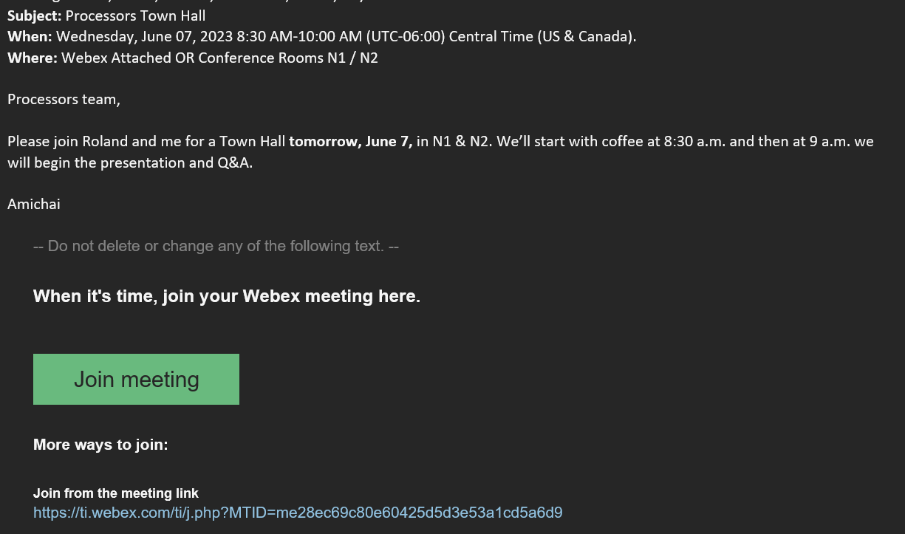
Department-Wide Communication
Notes:
See any combination?
Send out a Webex meeting invite via email

Slide 19
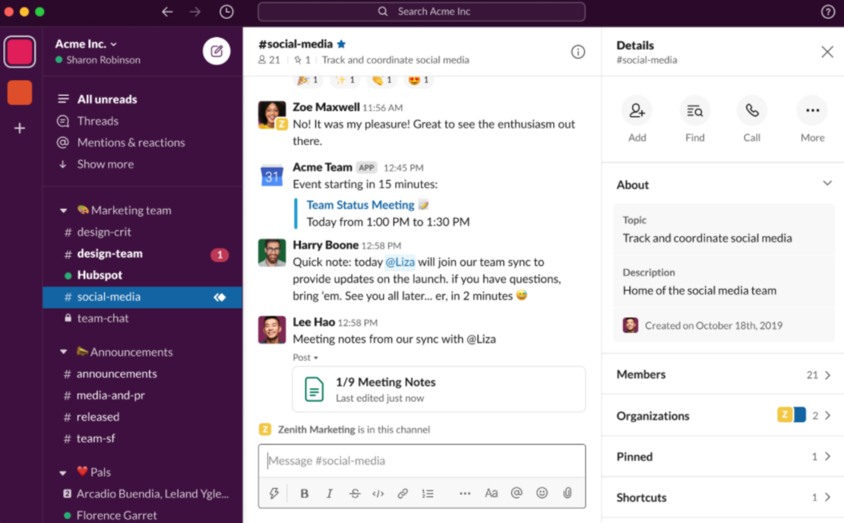
Team Communication
Notes:
https://sproutsocial.com/insights/how-to-use-slack/

Slide 20
Written (subpoena-able) communications
AITA → TNAA
Ask yourself: Would you be embarrassed if this appeared in the New York Times?
I just jedi mind tricked this [FAA regulator] fools. I should be given $1,000 every time I take one of these calls. I save this company a sick amount of $$$$.”
– (Former) 737 Max Chief Technical Pilot
https://fortune.com/2020/01/10/designed-clowns-supervised-monkeys-internal-boeing-messages-slam-737-max/
Notes:
AITA: IBM Felipe
- The converse of this story is, of course, that you should assume the other person is not the asshole either
===
“This airplane is designed by clowns, who in turn are supervised by monkeys,” said one company pilot in messages to a colleague in 2016
“These newly-released emails are incredibly damning,” said U.S. Representative Peter DeFazio, an Oregon Democrat who chairs a committee that is investigating Boeing and the Max.
“We regret the content of these communications, and apologize to the FAA, Congress, our airline customers, and to the flying public for them,” the Chicago-based company said in a statement.

Slide 21
What’s the best method of communicating?
Notes:
There isn’t a best method, it all depends on the circumstances and the subject of the communication
If you want to tell your manager you’ll take PTO , no need to let the entire company know
Like wise, if you want to introduce a new C level executive to the company , one should expect the executive to send out individual emails to everyone in the team

Slide 22
What is the best software to use?
Notes:
There isn’t a correct answer.
Pick a couple you like and that you know they integrate well and use them throughout the org.
Ex) don’t pick Webex , email and Microsoft teams – why picking both Teams and Webex ? They don’t integrate well
Ex) Use only Microsoft software: outlook , teams
Both discussions should focus on the fact that there is no correct answer to both questions. Everything is flexible but organizations need to make informed decisions on what to use and stick to their choices.

Slide 23
Teamwork
1. Regular
2. Global engineering and Intercultural challenges
Notes:
Regular:
Be humble and open to improvement. You do not know everything! Your design is not perfect. Your implementation is not perfect. Your tests are not perfect. Part of the value of a team is to help everyone on it do their best for the customer.
Respect others. Care about the other people you work with. Don’t focus on their weaknesses, but recognize their strengths and how you can learn from them.
Take a default stance of trusting that everyone on your team wants what is best for the team, the customer, and the company. Never attribute to malice what can instead be attributed to a simple mistake. (There do exist dysfunctional teams where internal politics have come to dominate. If that happens to you, find a new team.)
Read Chapter 2 from SE@Google.
====
Some unique aspects of software engineering: You can’t touch software – it’s easy to move around the globe.
A little history of “offshoring”.

Slide 24
3 What are some potential challenges of global teams?
Notes:
Generally, you can’t
Communication strategy (esp. for synchronous communication)?
What language to meet in?
Different educational background and experiences
Tell story about choking in India. The message here is: Don’t assume anything is “universal”. Mathematics (and e.g. program semantics) are universal. Everything else is not.

Slide 25
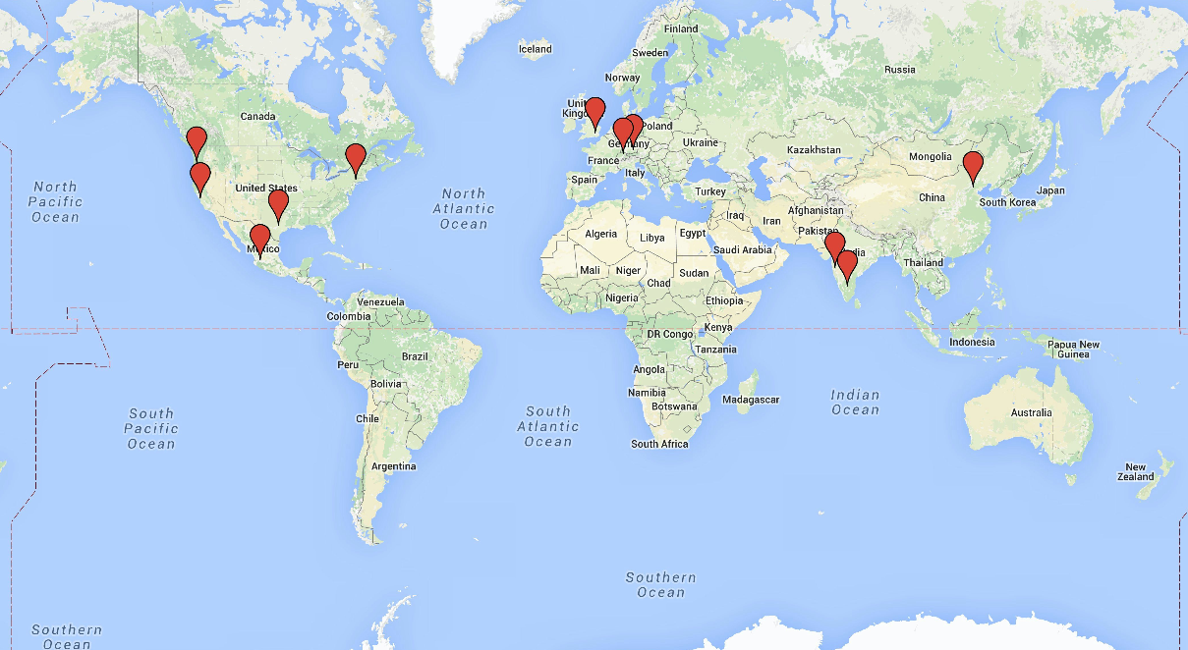
Global teams
GMT
GMT + 1
GMT - 8
GMT - 5
GMT + 8
GMT - 6
GMT + 5h30
Why might a company have a global software engineering team?
How might these teams collaborate?
Carmel, “Global Software Teams”, 1999.
Notes:
These are the sites involved in the project while I was there.
US employees in Poughkeepsie/NY, Austin/TX, Beaverton/OR, and Silicon Valley, CA.
2012-2014 Beijing/CN, two sites in India (Pune and Bangalore), as well as Zurich/Switzerland
2015 + Mexico, UK, Germany
And just look at all of those time zones! California, UK, and Beijing are “evenly spaced”, each 8 hours apart from the next.
Why global teams?
Access to skills, e.g: Specialized technologies (experience with a particular HW component), specialized skills (experience adapting a product to meet a particular regulatory requirement – or, e.g., Israel has a huge cybersecurity scene because of the mandatory military service and active threats to that country)
Acquisitions – expanding a product family by buying a company with an appropriate product. Later the products might neeed to collaborate.
Proximity to customer – face-to-face feedback, on-site support
It can be cheaper. If a company is funded in USD and pays in Rupees, the exchange rate is favorable
(These are almost all BUSINESS reasons. Ours is not to question why…)
Unavoidable
US colleagues: American, Brazil, India, China, Egypt
Team meetings: microcosm of the world
Collaboration strategies:
Module (works well)
Phase-Based (requirements -> Design ->) – Handoffs are hard.
Huge team / Follow-the-sun
Hand-offs are hard! Can work well for customer support, not so good for design/impl.

Slide 26
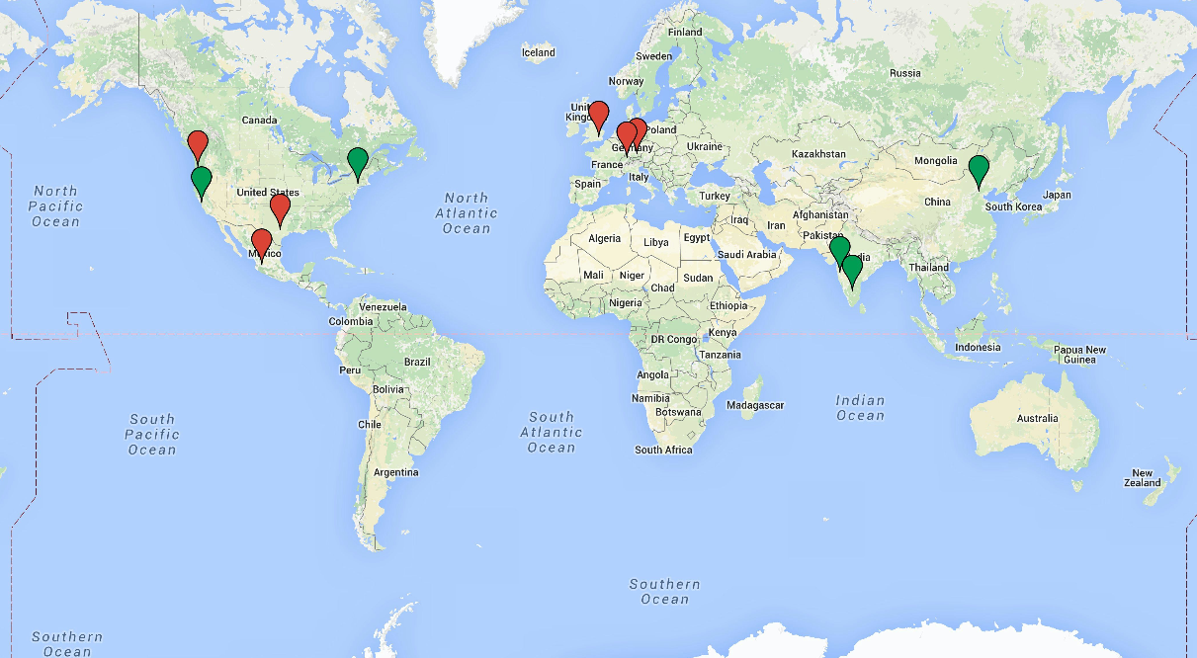
Why business trips?
Notes:
Highlighted in green you can see the places I worked (NY)
or visited on business (IBM Research in the Silicon Valley, Pune and Bangalore in India, and Beijing)
QUESTION: Why business trips?
I saw two main reasons:
TECHNICAL
- share technical skills, learning, education, etc. - efficient
BUSINESS/PERSONAL
- build relationships across geographies, strengthen interaction, etc.
- “we care about you” – morale boost, reassure a worried customer, etc.
> for the same reason, not uncommon to have a head engineer have a conversation with a big customer even though more junior personnel could do it
For example, goal of my trip to India in 2015:
- Indian team was experiencing issues with turnover and quality
> several resignations and new hires within one year
> lots of “test escapes”
- By sending the team lead (me) over there, management was trying to
1. TECHNICAL: address quality issues: sharing best practices
2. BUSINESS/PERSONAL: boost morale: “we care about you”

Slide 27
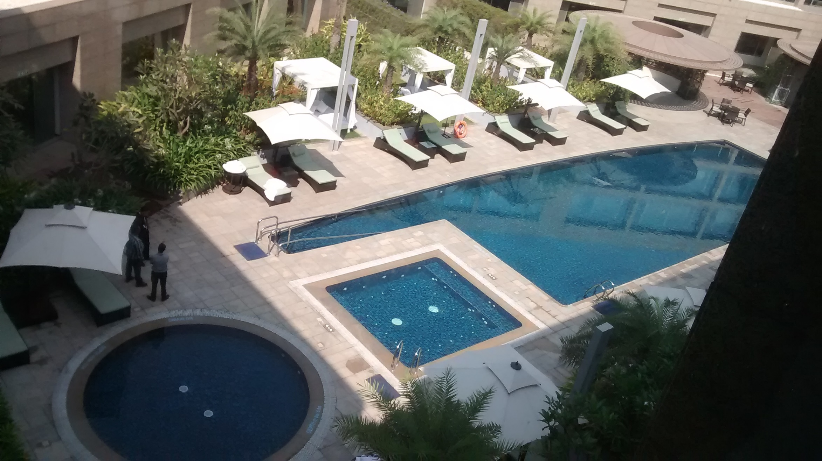
Luxury hotel
Cool, but what if something goes wrong?
Notes:
One morning I started choking over breakfast.
Food was unfamiliar, didn’t quite have a sense of how much to chew it.
Swallowed potato, could feel it catch in my throat
I could still breathe, and it was slowly, but painfully and burningly, moving down
Being brilliant, I decided to speed things up by drinking water
BIG MISTAKE
OK, so now I’m choking/drowning in the breakfast room at the hotel.
My thinking became crystal-clear, which was actually a bit of a surprise.
I remember thinking, “What am I supposed to do now?”
Rapidly evaluated my options…
What do you guys think? What would you do?
QUESTION: What do you do next?

Slide 28
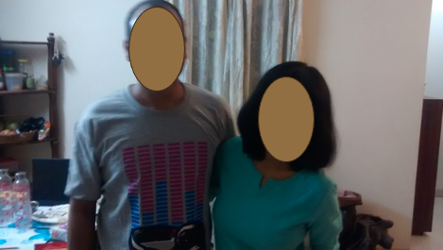

Hashing it out: a survey of programmers' cannabis usage, perception, and motivation. Endres et al., ICSE 2022.
From Organizations to Individuals: Psychoactive Substance Use By Professional Programmers. Newman et al, ICSE 2023.
Notes:
My colleague Ajay invited me to his home for dinner and to meet his fiancée Nitasha.
- Ajay and I had interacted a lot over email and text in the years prior to my visit.
He had told me he was a “lone wolf” who didn’t plan to marry,
then about meeting his old high school crush on a motorcycle trip,
then about getting engaged to her,
so it was awesome to meet them.
On a final note, Ajay offered me marijuana while I was at his home.
QUESTION: What would you do, and why?
QUESTION: Can anyone suggest one of my four reasons to say no?
Personal desire: I didn’t want to
Safety: Would it affect my ability to get safely back to my hotel (via taxi)?
Legality: Had no idea what the legality is in India
Corporate policy: Probably against IBM’s corporate policies even if it was legal in another country
It turns out that (according to Wikipedia) possession of marijuana is actually illegal in India.
Consequently, smoking it could have gotten me arrested, and getting arrested for this would have gotten me fired.
I believe I signed a form somewhere saying that I would also have had to pay IBM back for the plane tickets.
Clearly this would have been, shall we say, less than ideal for my career.
The lesson here is not “Don’t do drugs, kids”.
Instead, it’s “If you’re even remotely in doubt about the local laws, don’t do whatever it was you were thinking”.
You’re always representing someone when you travel abroad.
On vacation you’re representing, at least, yourself, your family, your culture, and your country.
On this trip I was representing, among other things, my employer, and I accordingly acted conservatively.
Keep that in mind when you’re faced with questionable possibilities.
Meanwhile, what about drugs? THIS IS A TANGENT.
Small amount of research and no (AFAICT) experimental data. There are two recent papers from Wes Weimer and friends up at UMichigan that are studying the use of non-coffee substances.
The first paper here, “Hashing it out”, surveyed 803 software developers about their cannabis usage prevalence, perceptions, and motivations. Their sample included 440 responses from developers on github, a response rate of about 7%. They also surveyed students, Reddit, Twitter, etc. They found that some programmers do regularly use cannabis while programming: 35% of our sample has tried programming while using cannabis, and 18% currently do so at least once a month. There was a higher proportion of cannabis use from engineers on github than from engineers recruited from other contexts. This cannabis usage is primarily motivated by a perceived enhancement to certain software development skills (such as brainstorming or getting into a programming zone) rather than medicinal reasons (such as pain relief). Let’s look at a chart on the next page.

Slide 29
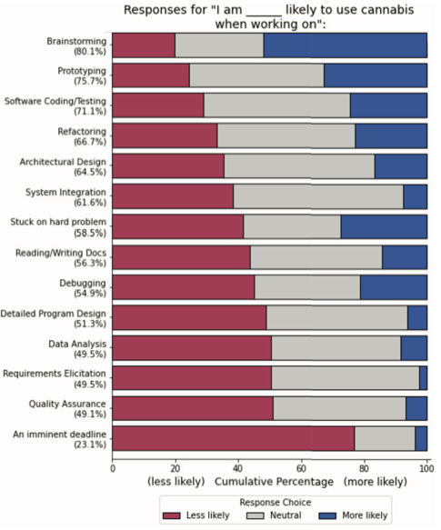

Slide 30
Let us consider the effect of (human) culture on (software) engineering work
Hofstede’s model of culture
Power distance
Short/Long-term orientation
Individualism/Collectivism
General trend: “The West and the Rest”
Notes:
Now, back to our regularly scheduled programming…
(Write definitions on the board)
Power distance: This dimension deals with the fact that all individuals in societies are not equal, and it expresses the attitude of the culture toward these power inequalities amongst us. Power distance is defined as the extent to which the less powerful members of institutions and organisations within a country expect and accept that power is distributed unequally. A high score means that you accept power hierarchies; a lower score means that you are more willing to cross the perceived power hierarchies.
Long-term orientation is when you are focused on the future. You are willing to delay short-term material or social success or even short-term emotional gratification in order to prepare for the future. If you have this cultural perspective, you value persistence, perseverance, and adaptability.
Short-term orientation is when you are focused on the present or past and consider them more important than the future. You care more about immediate gratification than long-term fulfillment.
Individualism: The fundamental issue addressed by this dimension is the degree of interdependence a society maintains among its members. It has to do with whether people´s self-image is defined in terms of “I” or “We”. A high score means that the individuals are relatively independent from one another. In contrast, a low score reflects a more collective society, where people view themselves in terms of their relationship to others and more as part of a team.
REMEMBER: This is a model, and scores are averaged across nationalities. Models are useful for interpreting and predicting, and for working with trends, but they may not describe any one individual. But if you’re working with an international team, those ‘averages’ will probably show up.
=== Other attributes of the model that are hard to connect directly to engineering work ===
“Masculinity stands for a society in which social gender roles are clearly distinct: Men are supposed to be assertive, tough, and focused on material success; women are supposed to be more modest, tender, and concerned with the quality of life.”“Femininity stands for a society in which social gender roles overlap: Both men and women are supposed to be modest, tender, and concerned with the quality of life.”
Uncertainty is a state wherein outcomes and conditions are unknown or unpredictable. Some people are more comfortable with uncertainty than others, and the degree to which individuals participate in certain behaviors to stay in comfortable situations is called uncertainty avoidance. Uncertainty avoidance is one of the five cultural dimensions presented by Geert Hofstede in his 1980 book on the subject, Culture's Consequences.

Slide 31
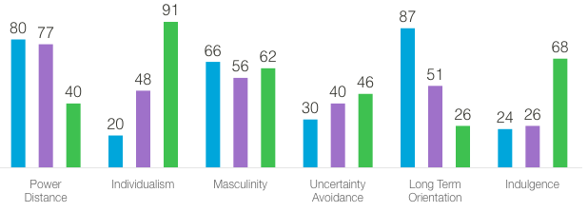

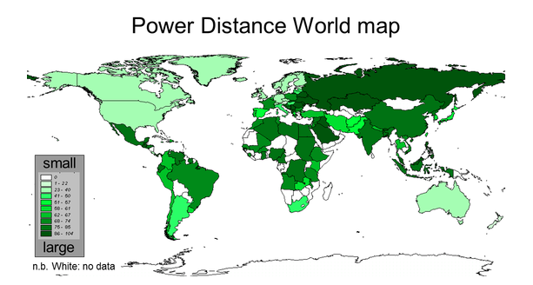
Power
Distance
What is the potential impact for a team with members from the US and China or India?
Notes:
Power distance: This dimension deals with the fact that all individuals in societies are not equal, and it expresses the attitude of the culture toward these power inequalities amongst us. Power distance is defined as the extent to which the less powerful members of institutions and organisations within a country expect and accept that power is distributed unequally. A high score means that you accept power hierarchies; a lower score means that you are more willing to cross the perceived power hierarchies.

Slide 32
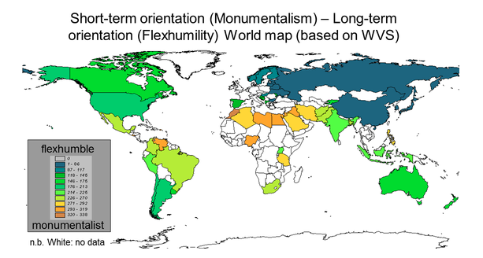
Long-term
Orientation
What is the potential impact for a team with members from the US and China or India?
Notes:
Long-term orientation is when you are focused on the future. You are willing to delay short-term material or social success or even short-term emotional gratification in order to prepare for the future. If you have this cultural perspective, you value persistence, perseverance, and adaptability.
Short-term orientation is when you are focused on the present or past and consider them more important than the future. You care more about immediate gratification than long-term fulfillment.

Slide 33
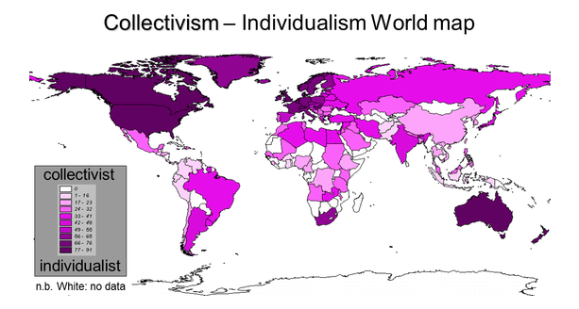
Individualism
What is the potential impact for a team with members from the US and China or India?
Notes:
Individualism: The fundamental issue addressed by this dimension is the degree of interdependence a society maintains among its members. It has to do with whether people´s self-image is defined in terms of “I” or “We”. A high score means that the individuals are relatively independent from one another. In contrast, a low score reflects a more collective society, where people view themselves in terms of their relationship to others and more as part of a team.

Slide 34
Interpreting teamwork through Hofstede
Power
Distance
Individualism
Masculinity
Uncertainty
Avoidance
Long-term
Orientation
Indulgence
Notes:
Ask them to recap these definitions.
Power distance: This dimension deals with the fact that all individuals in societies are not equal, and it expresses the attitude of the culture toward these power inequalities amongst us. Power distance is defined as the extent to which the less powerful members of institutions and organisations within a country expect and accept that power is distributed unequally. A high score means that you accept power hierarchies; a lower score means that you are
Individualism: The fundamental issue addressed by this dimension is the degree of interdependence a society maintains among its members. It has to do with whether people´s self-image is defined in terms of “I” or “We”. A high score means that the individuals are relatively independent from one another. In contrast, a low score reflects a more collective society, where people view themselves in terms of their relationship to others and more as part of a team.
Long-term orientation is when you are focused on the future. You are willing to delay short-term material or social success or even short-term emotional gratification in order to prepare for the future. If you have this cultural perspective, you value persistence, perseverance, saving and being able to adapt.
Short-term orientation is when you are focused on the present or past and consider them more important than the future. If you have a short-term orientation, you value tradition, the current social hierarchy and fulfilling your social obligations. You care more about immediate gratification than long-term fulfillment.

Slide 35
4 Technical: Tools and patterns for collaboration
Version control
Project management
Bug tracking

Slide 36

Version control: Two general approaches
SVN
GIT
Centralized
Distributed
Many copies
Negotiated content
One copy
Mediated access
Notes:
Version control (VC) systems identify, store and control access to the different versions of components. There are two types of modern version control system
Centralized systems, where there is a single master repository that maintains all versions of the software components that are being developed. Subversion is a widely used example of a centralized VC system.
Distributed systems, where multiple versions of the component repository exist at the same time. Git is a widely-used example of a distributed VC system.
All VCS offer:
Version and release identification
Change history recording
Support for independent development
Project support
Storage management
Centralized: check out substructures of the repository, e.g. file or directory or tree
- Depending on the implementation, you might be the only person allowed to modify that substructure until you’re done – “lock”
Advantages of distributed approaches:
It provides a backup mechanism for the repository.
If the repository is corrupted, work can continue and the project repository can be restored from local copies.
It allows for off-line working so that developers can commit changes if they do not have a network connection.
Project support is the default way of working.
Developers can compile and test the entire system on their local machines and test the changes that they have made.

Slide 37
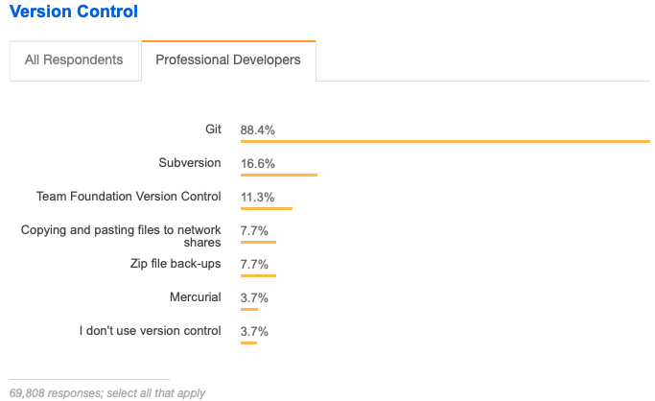
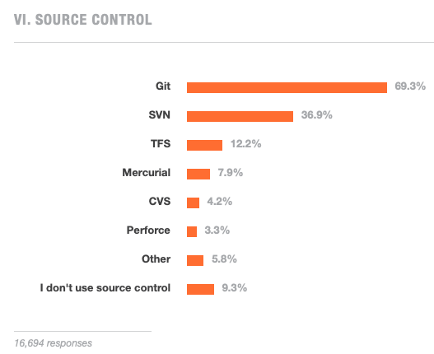
Git won
https://insights.stackoverflow.com/survey/2015
https://insights.stackoverflow.com/survey/2018 – they stopped asking.
2018
2015

Slide 38
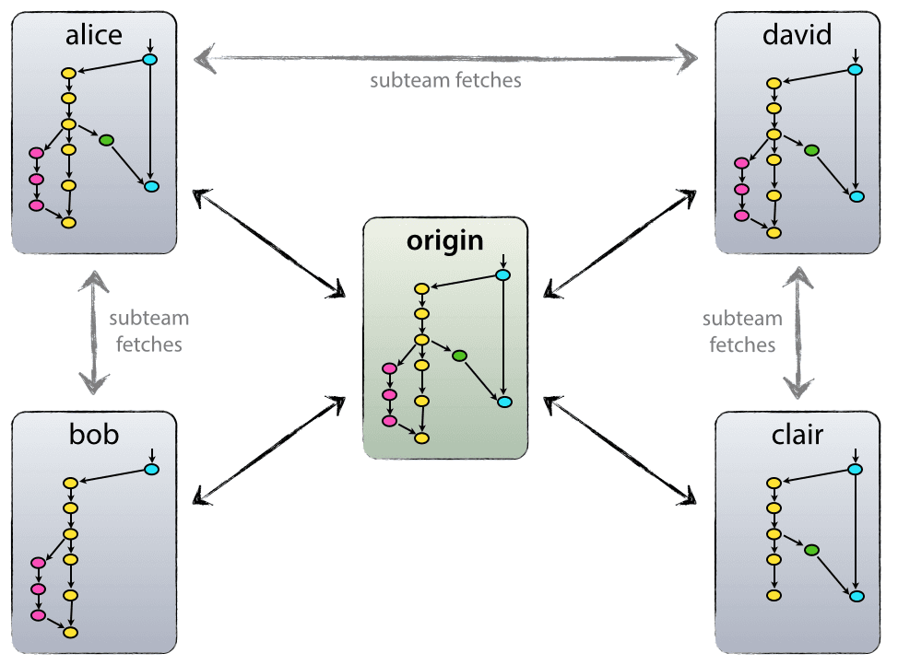

Did git actually win from a design view? Typical use is hybrid: One “true” origin and many forks
https://nvie.com/posts/a-successful-git-branching-model/
Notes:
Q: OK, so “git won”, but do teams typically operate in that truly distributed manner?
A: No. Typically teams operate in a “Decentralized but mostly centralized” manner.
There are some cases where branches are shared among teammates without merging them to the main branch.
For example, might be unstable code shared with a tester or shared for review by other teams or …

Slide 39
Bug tracking
Depending on your software stack, integrated with version control systems there also exist bug tracking software and planners
Atlassian – Bitbucket
Project management: Kanban
Defects: Jira Issues
Microsoft – Github
Project management: GitHub Projects
Defects: GitHub Issues

Slide 40
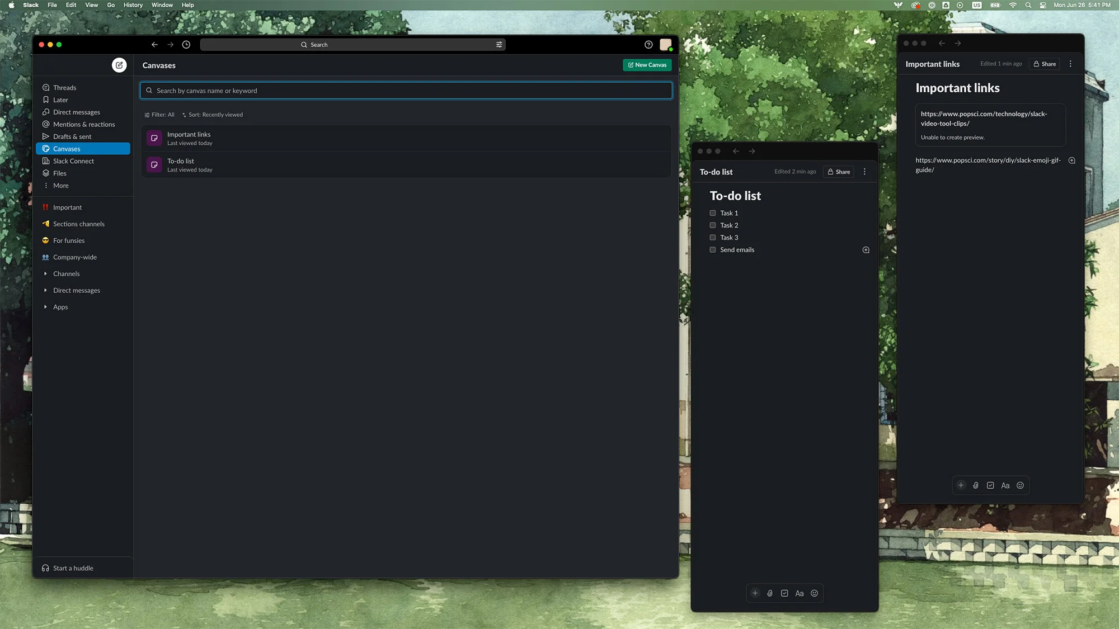
Slack - Canvas
Notes:
https://www.popsci.com/diy/slack-canvas-how-to/

Slide 41
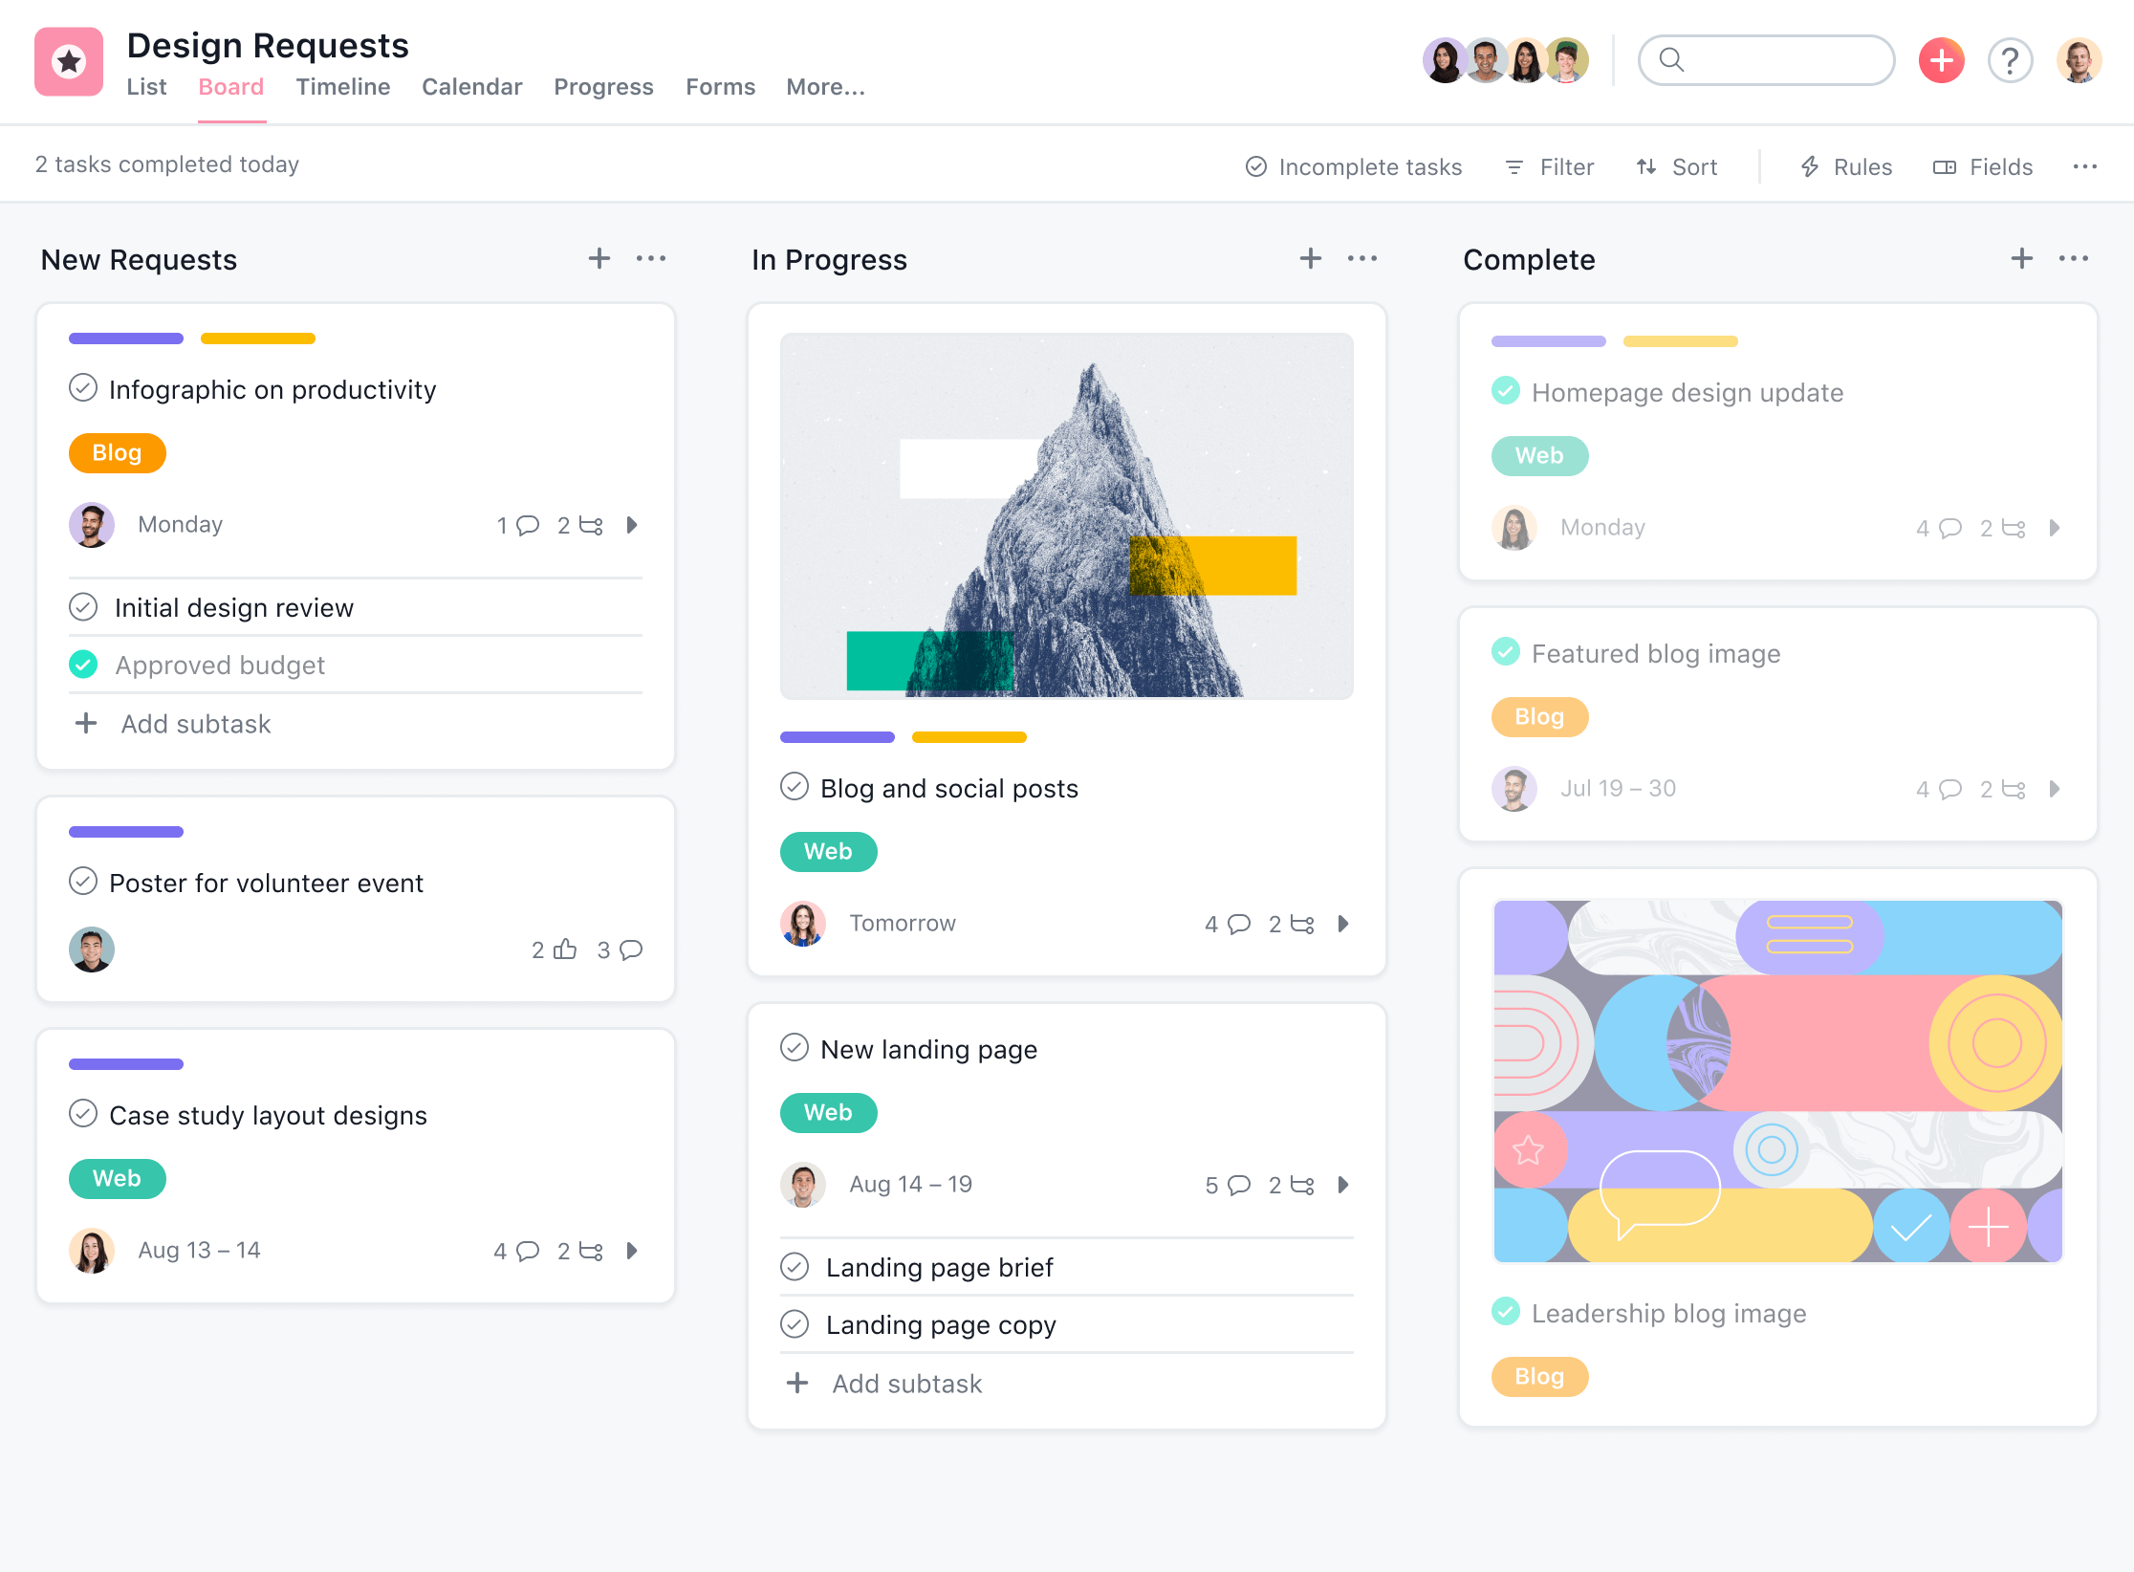
Kanban (Bitbucket)
Notes:
https://asana.com/uses/kanban-boards

Slide 42
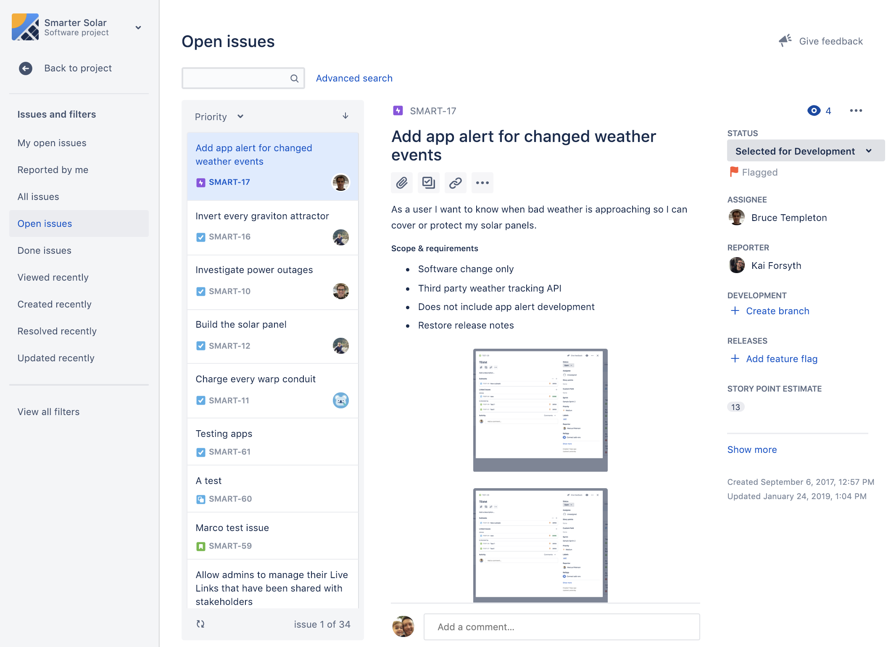
Jira Issues (Bitbucket)
Notes:
https://support.atlassian.com/jira-work-management/docs/view-a-projects-issues/

Slide 43
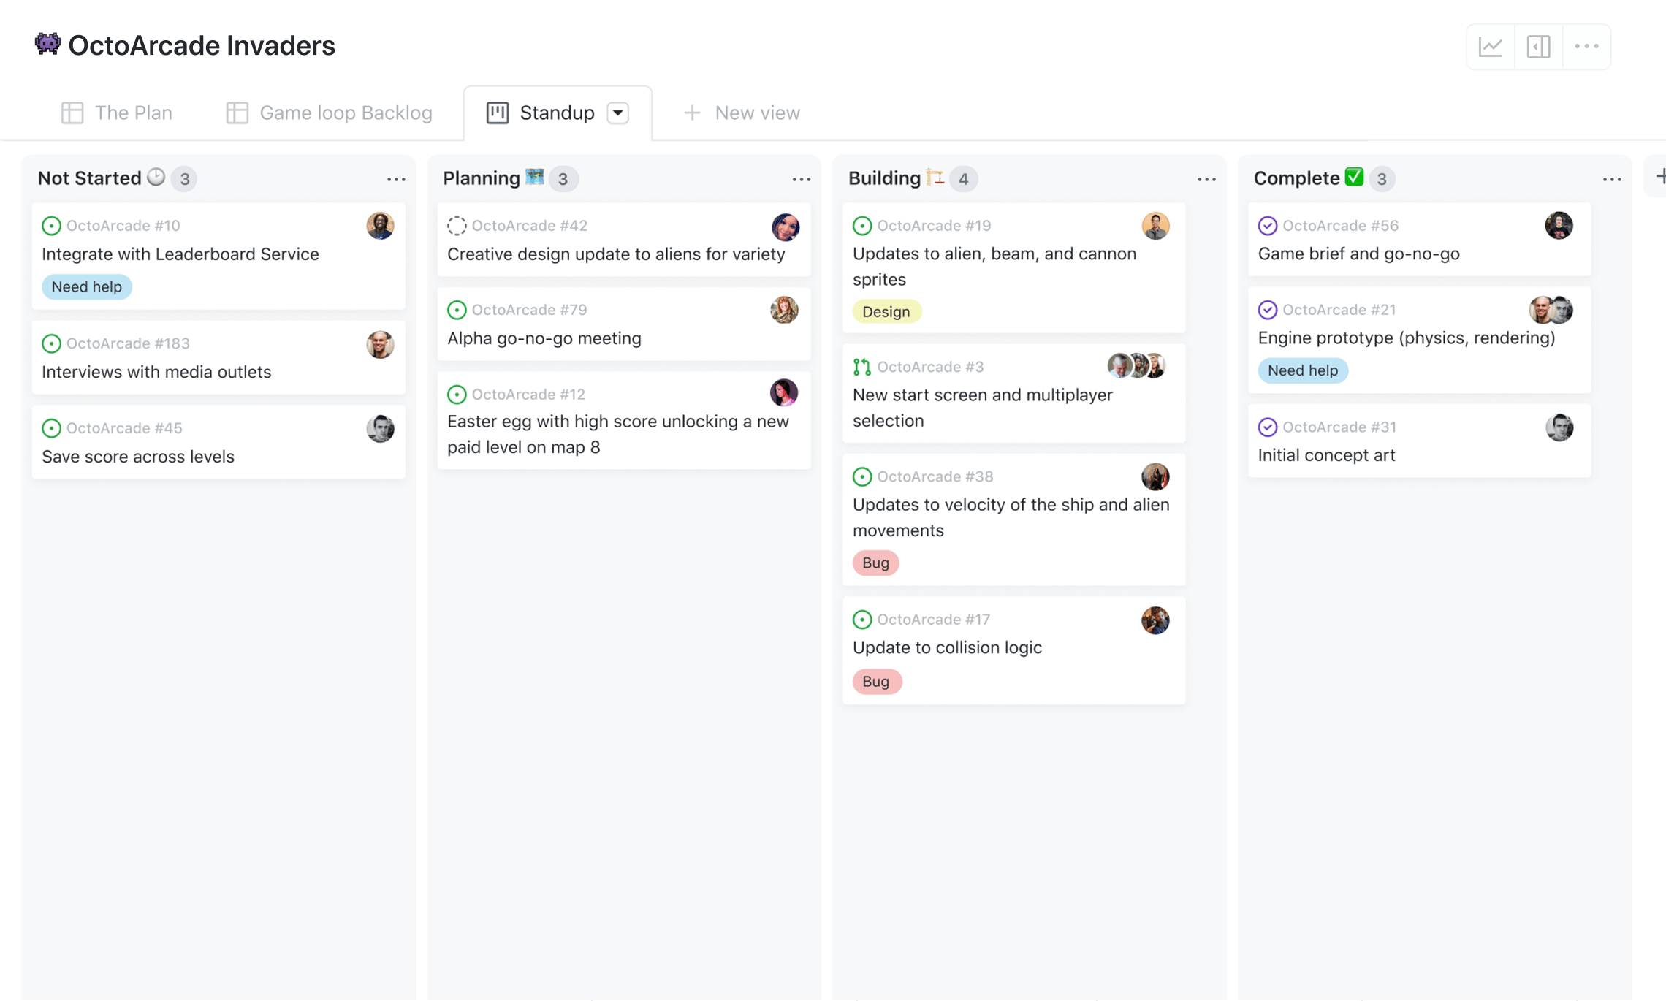
Github Project (Github)

Slide 44
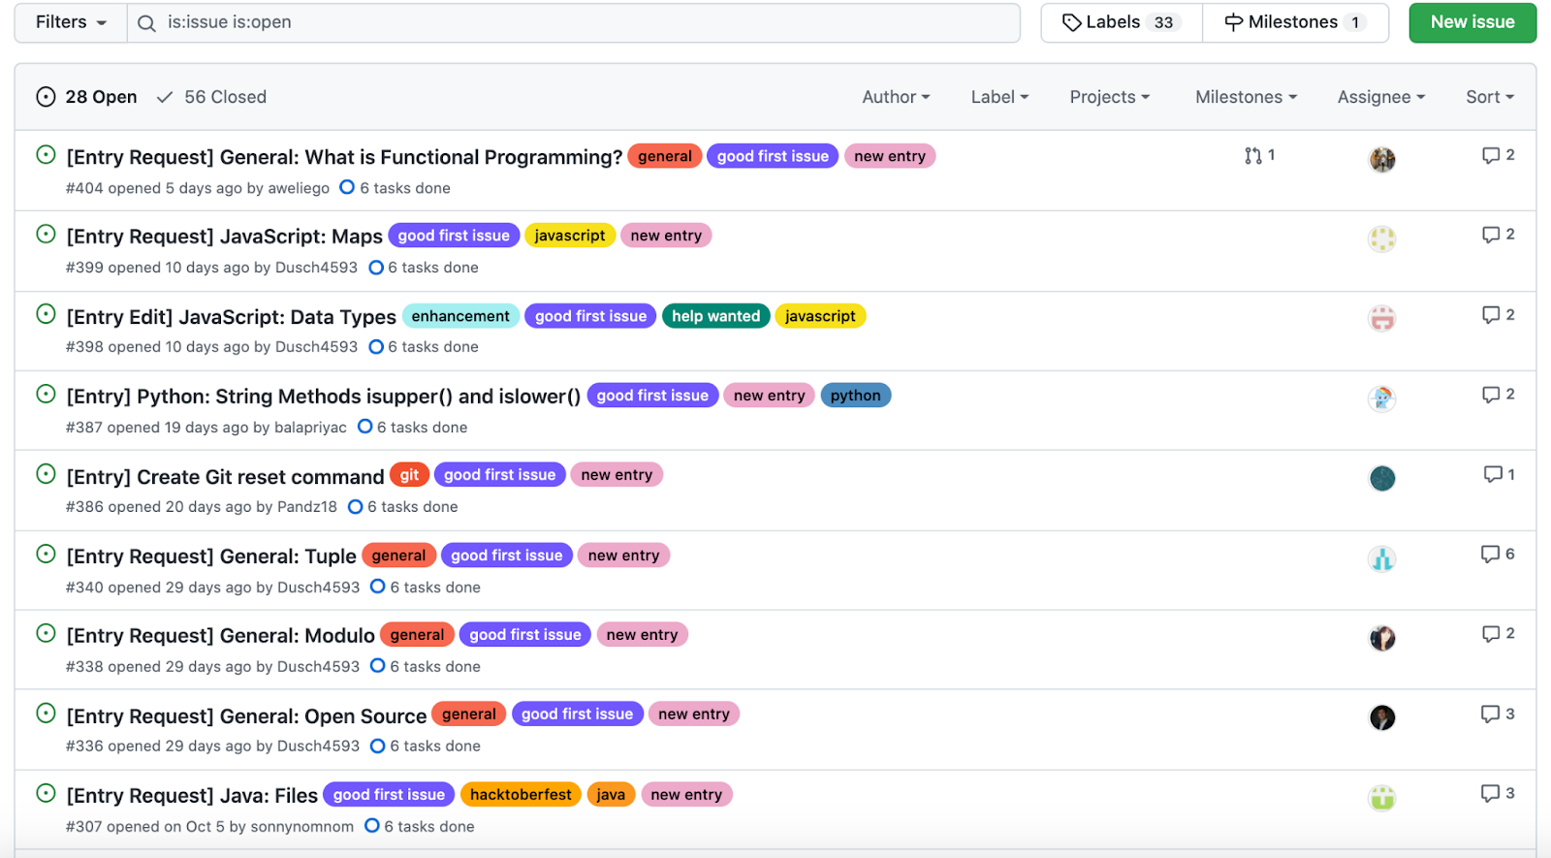
Github Issues (Github)

Slide 45
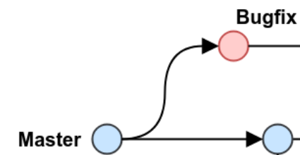
Simple lifecycle of issues – Part 1
A bug was found and reported by a user
Look into the ticket and see where the bug is located
What component?
Within which branch?
Branch out and perform the bugfix

Slide 46
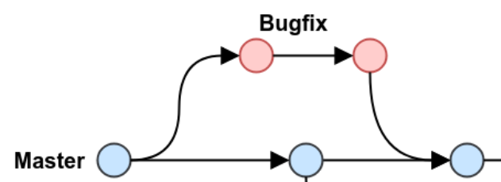
Simple lifecycle of issues – Part 2
Once you have completed your bug fix
Test the code! Don’t introduce a new bug to solve an already existing bug
Then you are ready to merge
Pull Request
Begin merging
Often multiple people in charge of the repo have to look into the request:
Approve the request and then go ahead and merge the diffs
Reject it and provide feedback
Pull Request
Merge Complete
Notes:
Created the code
Tested the code ! Don’t introduce a new bug to solver an already existing bug
Then you are ready to merge

Slide 47
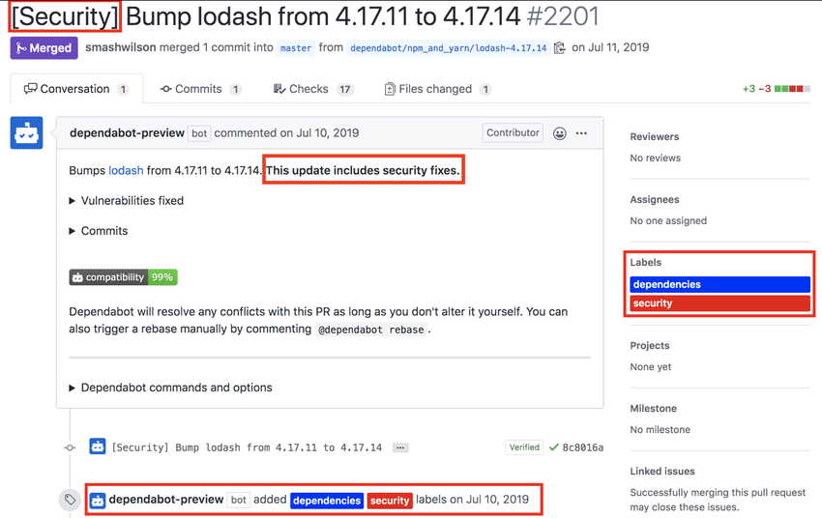
Automated Feedback – Dependabot

Slide 48
Which version control to use in ECE 461?
Github

