Slide 1
S o f t w a r e E n g i n e e r i n g
ECE 30861 / CSCI 45000
The Nuts and Bolts of Coding Agents
Hands-on Workshop
Prof. James C. Davis
Prof. Steve France
Ricardo Calvo
Yongjae Chung
Tuesday, October 27, 2026
Notes:
Course faculty: Prof. James C. Davis and Prof. Steve France. Workshop contributors Ricardo Calvo and Yongjae Chung receive the same typographic treatment. Keep the cover faithful to the source course deck, with a readable session date.

Slide 2
Case study: Campus study-room availability
A campus wants a simple way to check which study rooms are free.
Each room has a capacity. Reservations occupy time intervals. A user supplies a start, end, and minimum capacity; the API returns rooms that meet the request.
ROOM INVENTORY · data/rooms.json
RESERVATIONS · data/reservations.json
LIB-101 — 2 seats
LIB-202 — 4 seats
ENG-303 — 6 seats
LIB-202: booked 10:00–11:00
ENG-303: booked 11:30–12:30
Times are stored with UTC offsets
THE QUESTION
“Which rooms can fit four people from 11:00 to 11:30?”
The same study-room API will anchor each topic and exercise.
Notes:
Explain the use case in ordinary terms: a campus needs to know which rooms have sufficient seats and are free during a requested interval. Rooms and reservations are stored in local JSON. Use the example request with four people from 11:00 to 11:30, without revealing the implementation defect yet.

Slide 3
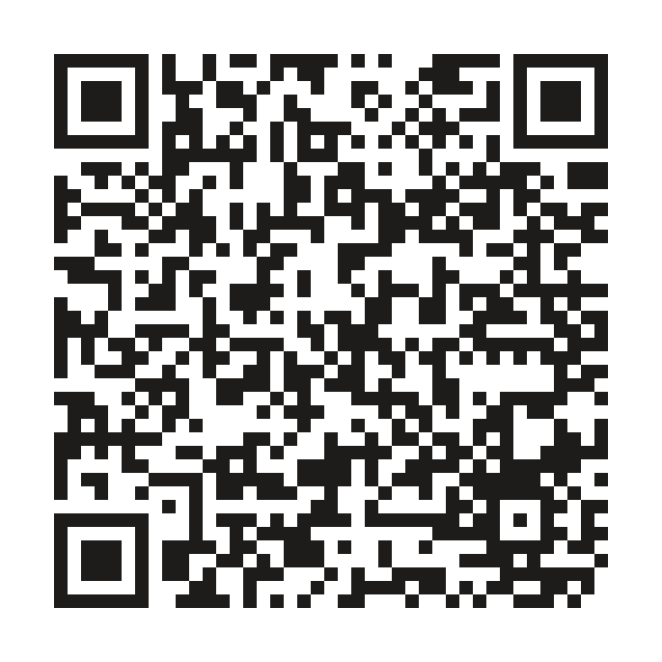
Start here: let an agent set up the repository
GETTING STARTED
SUGGESTED PROMPT
Inspect this project and prepare a local Python environment.
Check the required Python version.
Create or reuse a .venv and install dependencies inside it.
Run the smoke tests, check /docs, and summarize what happened.
Do not change source files or commit anything.
Scan to open the repository
github.com/rcalvom/
agentic-coding-workshop
Notes:
Follow the dry-run checklist: clone the repository, use the coding agent to inspect requirements, create/reuse a project-local Python environment, install dependencies, and run python -m pytest -q tests/test_rooms.py (expected two passes). Start the API with python -m uvicorn app.main:app --reload and check http://127.0.0.1:8000/docs. Avoid changing application code or tests during setup.

Slide 4
TOPIC 1
CONTEXT ENGINEERING
What should the agent know before it acts?
Notes:
Introduce context engineering as choosing and verifying what the agent receives: current task, persistent instructions, code and specifications, tool descriptions and feedback. The next slides compare these categories before introducing AGENTS.md as its own topic.

Slide 5
Context engineering: what the agent receives
REPOSITORY RULES
AGENTS.md: conventions and test commands
YOUR REQUEST
The task and constraints you give the agent
PROJECT FILES
Code and specifications the agent reads
TOOL FEEDBACK
Observed test output, errors and code diffs
Choose relevant information; avoid filling context with noise.
Notes:
Clarify context engineering with concrete items: persistent project instructions, the current user request, files the agent reads and observed tool/test output. More text is not automatically better context; the engineer and harness should supply relevant information.

Slide 6
Follow an availability request
Which files handle a request to GET /rooms/available?
1. REQUEST
2. LOAD DATA
3. FILTER ROOMS
app/main.py
Validates times and
minimum capacity
app/store.py
Reads rooms.json and
reservations.json
app/availability.py
Filters capacity and
reservation conflicts
CONTRACT docs/api-spec.md TESTS tests/test_availability.py
Notes:
Instructor explanation only—NOT an additional student activity. Walk through GET /rooms/available: app/main.py validates input, app/store.py loads the JSON files, and app/availability.py filters rooms. Mention that Exercise 1 will ask the coding agent to explore these files. Do not pause for a separate exercise here.

Slide 7
TOPIC 2
AGENTS.md
How should a coding agent work in this repository?
Notes:
Introduce AGENTS.md as a separate tool for persistent repository-level guidance rather than conflating it with task prompts, skills or MCP. The goal is to make the agent's working conventions and test commands available across sessions. Different coding agents may use different filenames.

Slide 8
AGENTS.md: instructions that persist across sessions
WHAT TO INCLUDE
WHAT TO LEAVE OUT
Concise project guidance
One-off task details
Build and test commands
Coding conventions
Review and safety rules
Bug-specific fixes
Unverified assumptions
Pasted source files
Use the correct instructions file for your agent.
Restart your agent to verify that the instructions are loaded.
Notes:
Explain what makes a useful AGENTS.md: verified setup and test commands, a short architecture map, conventions, specification locations, and guardrails. Avoid task-specific fixes, source-file dumps and invented claims. Restart the client or inspect its instructions to verify loading.

Slide 9
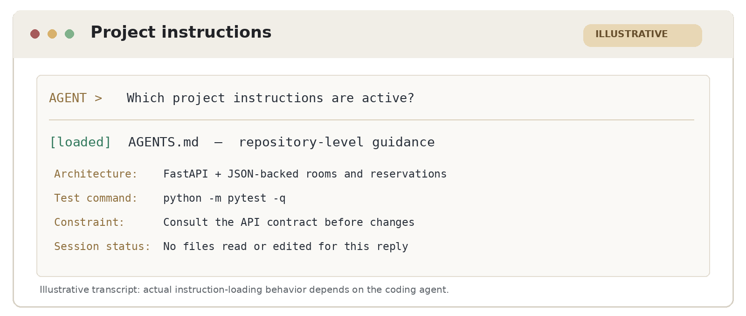
Example prompt: create repository instructions
EXAMPLE PROMPT · ADAPT TO YOUR AGENT
Explore this repository, then write a concise AGENTS.md from verified
architecture, setup/test commands, and development constraints.
Do not change application code. Start a new session and report
which project instructions were loaded.
Notes:
Project-instructions example: the terminal graphic is a purpose-built illustration, not an actual Codex screenshot. It demonstrates how a coding agent could identify repository-level instructions in a fresh session. In class, students should confirm what their own client actually loads; filename and discovery behavior differ across agents.

Slide 10
Try it: write project instructions
10 MINUTES · TRY IT
1
Draft (3 min)
Ask your agent to inspect the repo and create AGENTS.md.
2
Review + compare (4 min)
Check commands and constraints; compare with a neighbor.
3
Restart + verify (3 min)
Open a new session and confirm the instructions are loaded.
Notes:
Exercise 1, 10 minutes total. 3 min: students ask their agent to inspect the repository and draft AGENTS.md. 4 min: inspect the file, verify setup/testing commands and constraints against actual sources, then compare with a neighbor and correct mistakes. 3 min: restart the agent and test whether instructions persist. No graded submission. Hide the DISCUSS footer until the following slide.

Slide 11
Try it: write project instructions
10 MINUTES · TRY IT
1
Draft (3 min)
Ask your agent to inspect the repo and create AGENTS.md.
2
Review + compare (4 min)
Check commands and constraints; compare with a neighbor.
3
Restart + verify (3 min)
Open a new session and confirm the instructions are loaded.
DISCUSS What did the agent remember in a new session?
Notes:
This is the end-of-exercise reveal for Exercise 1. Same 10-minute exercise, with a discussion prompt visible only at the end. Ask students what the agent remembered and what changed after checking the file with a neighbor.

Slide 12
TOPIC 3
MODEL CONTEXT PROTOCOL (MCP)
How does the agent retrieve external engineering data?
Notes:
A short explanation of MCP as tool interface, then one observed real tool call. The GitHub integration may require pre-connection; teacher demonstration or partner fallback is legitimate but not the same as MCP by that learner.

Slide 13
MCP connects an agent to external tools
CODING AGENT
MCP SERVER
GITHUB TOOLS
Codex / Claude / Gemini
Scoped tools
Read Issue #1
GitHub tools return issue data to the agent.
Issue data is external input, not a new instruction.
MCP adds tools; the coding agent still controls permissions.
Notes:
GitHub is the external service accessed through MCP tools. The coding agent chooses a GitHub tool exposed by the MCP server; the tool reads Issue #1 and returns issue data. Treat issue data as untrusted input and check against project specifications. The agent/harness maintains the permissions boundary.

Slide 14
How to verify an MCP tool call
1. TOOL CALL
2. RESULT
3. PERMISSIONS
What ran?
What returned?
What could it do?
Server and tool name
Arguments and status
Time or request ID
Issue number and title
Acceptance criteria
Link to the source
Read-only or write?
Which account/scope?
Treat data as untrusted
Check the tool log—not just the agent's final answer.
Notes:
For a real MCP demonstration, inspect three things: server/tool and arguments, actual returned issue data, and the permissions granted to that tool. A textual issue summary by itself does not prove MCP executed. Treat issue text as untrusted data rather than higher-priority instructions.

Slide 15
GitHub MCP: create a read-only token
1. CREATE
2. LIMIT
3. PROTECT
GitHub Settings
Least privilege
Keep it private
Developer settings
Personal access tokens
Fine-grained: New token
Short expiration
Public repositories
Issues: read-only
Copy token once
Store outside repo
Never paste into chat
Create a token: github.com/settings/personal-access-tokens/new
GitHub PATs are credentials; never commit them to source control.
Notes:
GitHub PAT optional advanced setup, especially for stronger students. Fine-grained personal access token, minimal permissions, short expiration, Issues read-only. Keep tokens out of source control and prompts. Connected GitHub MCP needs no PAT. A public shell fallback is provided so students can continue with Skills and Loop exercises if MCP authentication is too slow. Instructor can use these steps as an independent demo.

Slide 16
GitHub MCP: connect and verify
TOKEN SETUP · OPTIONAL CHALLENGE
Already connected? Use your existing GitHub MCP tools.
In bash/zsh, enter the PAT (input is hidden):
read -s GITHUB_PERSONAL_ACCESS_TOKEN
export GITHUB_PERSONAL_ACCESS_TOKEN
Suggested agent prompt: Connect read-only GitHub MCP using the GITHUB_PERSONAL_ACCESS_TOKEN variable, retrieve Issue #1, and show the tool call.
VERIFY THE CONNECTION
SERVER
GitHub MCP registered (read-only)
TOOL
Issue-reading tool invoked
RESULT
Issue #1 loaded and summarized
If authentication fails: read the public issue via shell (not MCP).
Notes:
GitHub MCP advanced setup and verification. After PAT creation, export GITHUB_PERSONAL_ACCESS_TOKEN in the same shell that starts the coding agent; use a client-specific read-only MCP connection. For Codex: codex mcp add github --url https://api.githubcopilot.com/mcp/x/all/readonly --bearer-token-env-var GITHUB_PERSONAL_ACCESS_TOKEN . Restart agent and inspect connected MCP tools. Note: only a real MCP invocation counts as an MCP demonstration; curl/gh issue view is a valid workflow fallback, not an MCP tool call.

Slide 17
Try it: retrieve GitHub Issue #1 via MCP
10 MINUTES · TRY IT
1
Connect (3 min)
Use an existing GitHub MCP connection or try read-only PAT setup.
2
Retrieve (4 min)
Ask the agent to read Issue #1 and summarize its requirements.
3
Inspect (3 min)
Inspect the tool name, arguments and result; label any shell fallback.
DISCUSS Did an actual MCP tool read the issue?
Notes:
Exercise 2, 10 minutes. Connect to GitHub MCP if possible; students with a connected account can skip PAT creation. Advanced learners may follow the read-only PAT instructions. Fetch public GitHub Issue #1 from rcalvom/agentic-coding-workshop and inspect the MCP tool-activity trace (server, tool, arguments, response). If auth/setup blocks them, have the agent read the public issue via shell and label it as NOT an MCP tool call; they should still extract acceptance criteria for the later Skills and Loop exercises. Do not fix code here.

Slide 18
TOPIC 4
SKILLS
How can we reuse a reliable development procedure?
Notes:
Contrast a skill with AGENTS.md. Discuss just enough of open Agent Skills format: frontmatter, description triggers, procedure, resources, client-specific discovery. Instruct no implementation during this block.

Slide 19
AGENTS.md versus an Agent Skill
PROJECT INSTRUCTIONS
REUSABLE PROCEDURE
AGENTS.md file
SKILL.md
Project structure
Coding conventions
Test commands
Read requirements
Run focused tests
Fix and verify
Both are Markdown files, but they have different jobs.
AGENTS.md: general rules. Skills: repeatable tasks.
Notes:
Use the visible file names to avoid vague jargon: AGENTS.md is a Markdown file of project-wide instructions; SKILL.md packages a reusable procedure for a specific category of task. Both use Markdown, but they serve different purposes. Read left first, then right, as does the takeaway.

Slide 20
SKILL.md: name, description, and procedure
HEADER
name: resolve-api-issue
TRIGGER
description: Use for API bugs with tests
PROCEDURE
1 Read specification + issue
BASELINE
2 Run focused tests before edits
FEEDBACK
3 Change → retest → inspect result
CLOSE
4 Run full suite + review diff
Discovery: does the agent recognize this skill?
Invocation: did the agent follow its procedure?
Notes:
Check name, description and procedure in SKILL.md. The description says when the skill is applicable. Distinguish discovery (listed/recognized by the agent) from invocation (actually used during the task). If the client cannot discover skills natively, explicitly paste the skill procedure as a labeled fallback; that is not proof of native discovery.

Slide 21
Try it: create an API repair skill
10 MINUTES · TRY IT
1
Create
Create resolve-api-issue as a reusable SKILL.md.
2
Review
Check the description, test-first steps, and stop conditions.
3
Discover
Confirm the agent discovers the skill; do not fix code yet.
SUGGESTED PROMPT
Create a reusable API-bug skill. Read issues through MCP or a shell, run tests before edits, use failures to guide repairs, and verify the final diff. Do not fix this issue yet.
A skill must be discovered—and actually used—to help.
Notes:
Exercise 3, REQUIRED, 10 minutes. Each participant uses their coding agent to create a reusable resolve-api-issue SKILL.md in its supported skills directory. Check the YAML name and description (appropriate trigger), test-before-edit workflow, bounded retries, full suite, diff review. Verify the client discovers the skill in a new session. Do not implement Issue #1 yet. If a client lacks native discovery, explicitly load SKILL.md as a labeled fallback. No graded submission.

Slide 22
TOPIC 5
LOOP ENGINEERING
What makes a change trustworthy?
Notes:
The final exercise uses actual pytest output. Ensure context and skill exercise files do not itself solve the defect. The loop is red -> repair -> green (not guaranteed more than one failed patch).

Slide 23
A coding agent needs test feedback
ONE SHOT
Ask → generate code → claim “done”
ENGINEERING LOOP
PLAN
EDIT
TEST
OBSERVE
If tests fail, inspect the output and revise the next attempt.
Stop with verified evidence or explain why the task remains blocked.
Notes:
Explain the difference between one-shot code generation and an evidence-guided development loop. An engineer expects the agent to plan, edit, test, inspect the results and either adjust the code or stop with a clearly documented blocker.

Slide 24
The bug: adjacent bookings appear to conflict
REQUEST: 11:00–11:30 UTC MINIMUM CAPACITY: 4
10:00
10:30
11:00
11:30
12:00
12:30
LIB-202
Booked
REQUEST
Requested
ENG-303
Booked
Expected: both LIB-202 and ENG-303 are available.
Observed: {"available_rooms": []}
The bookings touch the requested interval without overlapping it.
Notes:
The target API issue: LIB-202 is booked until 11:00, ENG-303 begins a booking at 11:30, and the user's request is 11:00–11:30 for capacity at least four. Both rooms should be available because intervals only touch at the boundaries. The existing implementation erroneously excludes them.

Slide 25
Tests reveal the bug and verify the repair
BEFORE THE FIX
AFTER THE FIX
7 PASS · 3 FAIL
10 PASS · 0 FAIL
API returns an empty list
Expected: two free rooms
Three boundary tests fail
API returns both rooms
Targeted and full tests pass
Review the implementation diff
Fix the overlap logic—not the tests or specification.
An observed failing test motivates the fix; rerunning tests checks it.
Notes:
Only show the failing and passing test totals here, not again on the practice prompt. The full starter suite initially has seven passes and three failures. After a minimal implementation-only fix, all ten pass. The independent contract, tests and code diff are the evidence for correctness.

Slide 26
Try it: from GitHub issue to verified fix
10 MINUTES · TRY IT
1
BASELINE
Review Issue #1; run focused tests before editing.
2
REPAIR
Invoke resolve-api-issue; change implementation only.
3
VERIFY
Rerun focused and full tests; inspect git diff.
SUGGESTED PROMPT
Use the Issue #1 requirements you already retrieved. Invoke resolve-api-issue; run tests before edits, fix only implementation, rerun the full suite, and show git diff. Do not change tests or push.
Which tests and code changes support your conclusion?
Notes:
Exercise 4, 10 minutes. Use acceptance criteria for Issue #1 retrieved during the MCP activity or shell fallback. Invoke the resolve-api-issue skill, run focused tests before editing, change implementation code only, rerun targeted and full tests, and inspect git diff. No test or specification changes. If a fix fails, use test output to guide the next attempt and report blockers. Correct result is ten passing tests, but do not require a particular number of failed iterations.

Slide 27
Putting the workflow together
01
02
03
04
AGENTS.md
GITHUB MCP
SKILL.md
TESTS
Project rules
Issue data
Repair steps
Evidence
AGENTS.md sets rules; GITHUB MCP fetches the issue; skills guide the work; tests check the fix.
What will you try in your project this week?
Notes:
Final substantive slide. Short recap in plain terms: AGENTS.md tells the agent project rules; GitHub MCP brings in task information; a skill specifies a reusable procedure; tests and diff show whether the change worked. Leave them with a concrete question about what they will try this week.

Slide 28
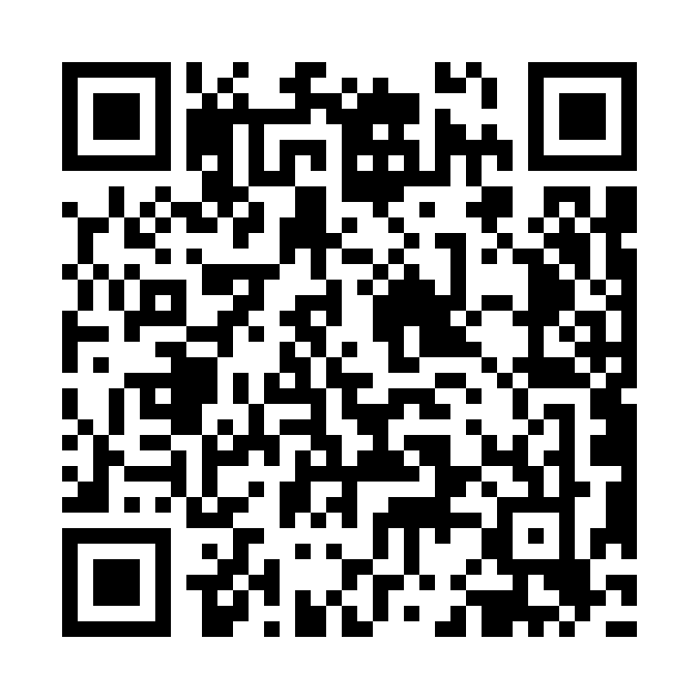
Reflection: what will you try this week?
Scan the QR code
Complete the reflection form before leaving.
https://forms.gle/J4FenBkBM5r23jgB6
Notes:
Live reflection form: https://forms.gle/J4FenBkBM5r23jgB6 . The QR on this slide was regenerated to encode exactly this URL and independently decoded for verification. Do not display the form questions on the slide; students open them by scanning the QR. No form-close deadline is stated on the slide.

