Slide 1
Software Engineering ECE 30861 / CSCI 45000
Requirements Engineering
What should we build?
Prof. James C. Davis
Prof. Steve France
Notes:
1 minute — Open on the governing question instead of on definitions.
- Two lectures out of one topic: today is Requirements, Thursday is Specification.
- The whole lecture hangs on one question: what should we build, and what do we need to know before promising to build it?
- Three movements today: what a requirement is, how we discover candidates, and which candidates we commit to.
=====
We have talked about process: how engineering work is arranged in time. Today we go after the thing the process is arranging work around. Somebody has to decide what the system is supposed to do.
That sounds like a listening exercise. It is not. Requirements engineering discovers what might matter and turns enough of that understanding into commitments we can responsibly make.

Slide 2
The lecture in three movements
Requirements Engineering
1
Requirements
Uncertainty about
what matters
What counts as a requirement?
2
Discovery
How do we learn what to build?
Engineering commitments
3
Commitment
What are we willing to promise?
Notes:
2 minutes — Give students the intellectual shape of the lecture: define the object, learn candidates, decide commitments.
- These three names are the deck’s sections; each returns as a numbered break slide.
- Say the progression out loud: define the object, then learn candidate requirements, then decide which candidates become commitments.
- Warn them that section 3 is the part most requirements lectures leave out.
- The flowchart on the right is the definition of the discipline: uncertainty in, commitments out. Point at it when you say so.
=====
Section one is vocabulary and definitions: what kind of thing a requirement is, and where obligations come from. You need that before the rest is intelligible.
Section two is discovery: how engineers actually learn what people need, from asking through to building something cheap and watching the reaction.
Section three is the one to flag. Discovering that something would be valuable does not mean we should promise it. Engineering capacity is finite, so accepting a requirement spends something we cannot spend twice.
Thursday’s lecture is Specification, which is about stating promises precisely. Today is about deciding which promises to make at all.

Slide 3
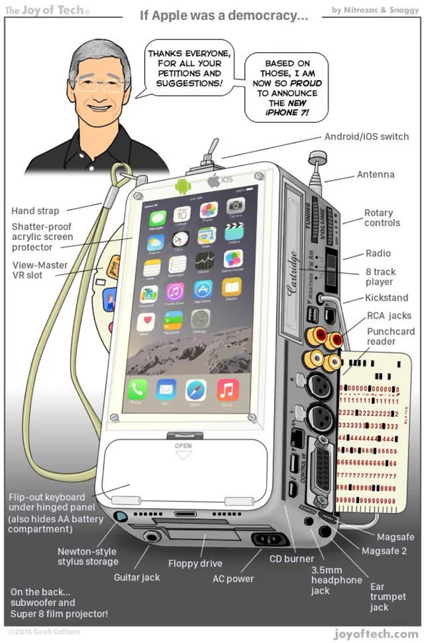
Is the customer always right?
Take user feedback seriously—but not necessarily literally.
Notes:
2 minutes — Establish the first problem: what people ask for and what would satisfy them are not the same object.
- Transition in: the cover said interpretation happens between what they say and what we build. Here is why interpretation is unavoidable.
- The requirements engineer is not a stenographer. Recording a stated wish is not the same as understanding a need.
- Ask the room for a case where a user asked for a feature and the underlying need turned out to be different. Take one or two, 30 seconds.
=====
This is an HCI and product-thinking point before it is a software engineering point. A user reports the solution they can imagine, in the vocabulary they have, about the system they already use. What they are actually telling you is that something is wrong, or that some goal is hard to reach.
Two failure modes, and both are real. Ignore the feedback and you build for yourself. Implement it literally and you ship a faster horse: you satisfy the request and miss the need. Neither is acceptable, so the engineer has to do interpretive work and then be accountable for the interpretation.
Transition forward: if we cannot simply transcribe what people say, then requirements engineering has real intellectual content. It has two parts.

Slide 4
Requirements engineering has two problems
NEED AND VALUE
ECONOMICS AND COMMITMENT
What would
create value?
What can we
responsibly promise?
What are people trying to accomplish?
What problem actually matters?
What assumptions are we making?
Is it feasible?
What will it consume?
What should we prioritize?
Requirements Engineering:
Needs, constraints, uncertainty → engineering commitments.
Notes:
4 minutes — Install the lecture's central claim: need and economics are one coupled problem, not two topics.
- Left column is the HCI/problem-understanding half. Right column is the economics half.
- The columns are coupled: you cannot prioritize what you do not understand, and you cannot promise what you have not costed.
- Tell them explicitly: we will come back to this slide's two columns several times today.
- Key line to say out loud: requirements are not discovered facts, they are choices about which obligations are worth scarce resources.
=====
Requirements treatments often emphasize the left column: eliciting, analyzing, and recording what stakeholders need. That half is genuinely hard, and it is mostly a problem of understanding people and their work.
But no engineering organization can promise everything it understands to be valuable. Engineering capacity is finite. So the moment you write a requirement down and someone agrees to it, you have spent something. That is why negotiation, prioritization, scope, and estimation are not project-management afterthoughts bolted onto requirements engineering; they are inside it.
These two problems exist regardless of the process we choose. What changes across processes is when, how often, and at what level of detail we answer them.

Slide 5
Every process does requirements work
“Waterfall”
Reqts/Specify
When and how often is a process choice.
Incremental
Notes:
60–90 seconds — Connect today’s problem to the previous Process lecture.
- This is a callback, not a reprise of Waterfall versus incremental development.
- Every process has to decide what to build.
- What varies is when requirements are established, how much is established at once, and how often those decisions are revisited.
- Do not imply that incremental development eliminates up-front requirements work, or that sequential development literally performs requirements only once.
=====
You saw this picture in the Process lecture. Today’s topic appears inside every version of it. Every process has to decide what to build.
What differs is the timing and granularity. A more sequential process may establish a substantial body of requirements before development begins. An incremental process may establish some commitments early and revisit others as the system develops.
So requirements engineering is not synonymous with a box called “requirements” at the beginning of a project. When and how often we make these decisions is itself a process choice.
Now set process aside. What kind of thing are we actually deciding?

Slide 6
1 Requirements
What counts as a requirement?
Notes:
20 seconds — Mark the move from framing the lecture to defining the object.
- Section 1 of 3. This section is vocabulary: what a requirement is and where obligations come from.
- Say the question out loud and move on; do not take answers here.
=====
Before we can talk about discovering requirements or choosing among them, we need to agree on what kind of thing we are looking for. That is this section: definitions, categories, and sources.

Slide 7
Requirements depend on what the system is for
Purpose
Requirements
System
What it’s for
What we promise
What we deliver
No purpose → No way to tell success from failure.
Nuseibeh & Easterbrook, “Requirements engineering: a roadmap”, ICSE 2000 Zave, 1997
Notes:
3 minutes — Make purpose an engineering necessity rather than a nicety.
- Correctness is relative to intent. A system with no stated purpose cannot be correct or incorrect, only surprising.
- Requirements sit between purpose and system: they state obligations intended to serve that purpose.
- Ask: why might it be hard to learn the purpose of a system? Prompt for numerous, distributed, conflicting, implicit, and changing stakeholders.
=====
Nuseibeh and Easterbrook make the point that software is built to serve some purpose in the world, and that requirements engineering is the activity that relates the two. Pamela Zave’s formulation is similar: requirements engineering concerns the real-world goals for, functions of, and constraints on software systems.
Why is this hard? The people who hold the purpose are numerous and distributed. They disagree. Much of what they know is implicit and only surfaces when violated. And the purpose moves while you are building. Every technique in the rest of the lecture exists because of that list.
Transition forward: if requirements are what connect purpose to system, we had better be precise about what kind of thing a requirement is.

Slide 8
Requirements describe services and constraints
Services
Constraints
What must the system do?
What else must be true?
Functional
Quality (NFR)
Domain
What behaviour?
How well? Within what limits?
What does the world outside require?
Email an admin when a project has no moderator.
95% of searches return within one second.
Withdrawing consent is as easy as giving it.
The categories overlap.
Notes:
4 minutes — Give the conventional vocabulary without presenting the categories as metaphysical truth.
- Top split is the classical definition: services plus constraints.
- Teach the three kinds with the words quality and constraint; give them the term non-functional requirement so they recognise it in industry.
- Expect boundary arguments. Welcome them, then use the caveat line: the categories overlap. They are a checklist for coverage, not a classification test.
- Precision of statement is Thursday’s lecture, not today’s.
=====
A conventional useful cut: some requirements say what the system does, and some say what must be true of it or around it. Functional requirements describe behavior the system must provide. Quality requirements and constraints bound the engineering: latency, availability, security posture, the platform you must run on, the budget you must fit.
Domain and external obligations are the ones students forget. Nobody in your company asked for them. The law asked, or the standard asked, or the physics of the domain asked.
Somebody will point out that a security requirement can be written functionally. They are right, and that is fine. The categories earn their place by helping you notice what you have not thought about, not by settling arguments about what a requirement really is.
Transition forward: the third column raises an obvious question. Where do requirements come from?

Slide 9

Requirements can leave engineering decisions open
GDPR
Organizational duty
Software behavior
“… the risk of varying likelihood and severity for the rights and freedoms of natural persons, the controller and the processor shall implement appropriate technical and organisational measures to ensure a level of security appropriate to the risk …”
What must you decide before building against this requirement?
Think. Underline the undecided words.
Pair. Agree on two or three decisions.
Share. Report one to the room.
GDPR (EU) 2016/679, Article 32(1)
Notes:
8 minutes — Show that an external source can impose a genuine requirement even though considerable engineering interpretation remains.
- Think-pair-share number one. This means we actually stop: two minutes individual, three minutes in pairs, three minutes collecting.
- This is the concrete payoff to domain and external requirements from the definitions slide, and to laws and standards on the sources slide. The two gold phrases are the target. Appropriate to whom, judged how, and against what threat model?
- Expect: what data is in scope, what counts as a breach, encryption at rest or in transit, key management, retention, logging, who reviews, how often, what evidence satisfies an auditor.
- Do not resolve it. Making obligations measurable and testable is Thursday’s lecture. Leave the thread hanging on purpose.
- Pedagogical point to say out loud: authoritative requirement is not the same as implementable instruction.
=====
The chain at the top is the point of the first half of the slide. GDPR is a regulation aimed at organisations, not at software. The organisation acquires a duty. Some of that duty can only be discharged by software behaviour: consent capture, deletion, export, access control, logging. So an external document ends up specifying your system.
The slide shows Article 32(1) verbatim, elided at both ends; the full sentence also weighs the state of the art, the costs of implementation, and the nature, scope, context and purposes of processing. Then read the clause. You are the engineering team, and someone has told you to implement appropriate measures with security appropriate to the risk. These words create a real obligation without resolving the engineering decisions needed to satisfy it.
Run the activity. When collecting, sort answers into two piles as you go: decisions about what the world requires, and decisions about what we will build. That distinction is the bridge to Thursday.
Context if asked: surveys of practitioners report lack of clear requirements as the biggest challenge in achieving compliance, which is exactly this problem at industrial scale.
Transition forward: an authoritative requirement can still leave substantial engineering interpretation open. We will return to that problem in Specification. For now, we have defined the object. Before we leave it, one look at everything a single requirement is attached to.

Slide 10
A requirement is one node in a network of elements
plays a role in
Stakeholder
Priority
is owned by
Scenario
Goal
has importance
Interface
occurs in
connects to
satisfies
Measurement
verifies
Requirement
is justified by
Rationale
defines a term in
Definition
Example sub-types
(broadly: Functional and Non-functional)
Function
Quality
Constraint
Alexander & Beus-Dukic, Discovering Requirements, Wiley, 2009
Notes:
3 minutes — Show that a requirement is never a lone sentence: it sits in a web of other elements, and every link is work someone has to do.
- Do not walk all twelve boxes. Name three groups and move: what a requirement points at (goal, stakeholder, scenario, priority, interface), what supports it (rationale, measurement, definition), and what it can be (function, quality, constraint).
- The gold box is usually the only thing anyone writes down. Everything attached to it is what makes the requirement reviewable by someone other than its author.
- Rationale and measurement are Thursday: why the requirement exists, and how we would know it is met.
- Subtypes connect back to the previous slides: function, quality and constraint are the services-and-constraints split, now shown as kinds of one thing.
=====
A requirement in a real specification is not a sentence in a list. It is a node. Pick any one on the diagram and follow its edges: it satisfies some goal, that goal is owned by a stakeholder, it occurs in a scenario somebody can act out, it carries a priority relative to everything else, it touches an interface, and it is justified by a rationale that outlives whoever wrote it. A definition fixes the terms it uses, and a measurement is what makes it checkable.
That is why the interpretation problem from the last slide matters. The GDPR clause gave us the obligation. It did not give us the measurement, the rationale, the priority, or the interface, and every one of those is a decision someone has to make and record.
Transition forward: everything on this diagram has to come from somewhere. Section 2 is where we go and get it.

Slide 11
2 Discovery
How do we learn what to build?
Notes:
20 seconds — Turn from what a requirement is to how engineers find out.
- Section 2 of 3.
- Order in this section: the toolkit, two illustrations, the loop, then the industrial case.
=====
We now know what kind of thing we are looking for, and that each one arrives with attachments: a goal, a stakeholder, a scenario, a rationale, a measurement. None of that is on the whiteboard yet. So how do we actually find them? Everything in this section is a way of buying information about the problem.

Slide 12
Requirements come from more than users
Users
Laws and standards
Candidate requirements
Customers
Contracts
Existing systems
Competitors
Technology
Operations
Asking users is necessary. It is not sufficient.
In your project, regulation is a deliberate source of obligations.
Notes:
3 minutes — Widen the source model so students stop equating requirements with user wishes.
- The visual is the argument: eight inflows, only one of which is users.
- Start Discovery by widening the source model. Requirements do not simply come from asking users. Users, customers, existing systems, technology, laws and standards, contracts, competitors, and operations can all generate candidate requirements. The word candidate matters: discovery identifies possibilities; Commitment decides which become obligations.
- Sets up GDPR on the next slide.
=====
Ask an incident on-call engineer what the system needs and you get an answer no user would give: better logging, a kill switch, a rate limiter. Read the contract and you find obligations nobody in the building remembers agreeing to. Look at the existing system and you inherit data formats, integration points, and behaviour that users now depend on.
Everything arriving at that box can generate candidate requirements. Some of it will become a commitment; some of it will not. Deciding which is the economics half of the lecture.
Transition forward: take the source that students least expect to generate software behaviour, and follow it all the way down.

Slide 13
Choose whom to ask, then how to learn
Stakeholders
Producers
Consumers
External
Who gains or loses if this system succeeds, or fails?
Ask
Observe
Interviews · surveys · workshops
Work practice · existing systems · data
Compare
Build
Competitors · substitutes · prior work
Mockups · prototypes · experiments
Choose techniques for what you do not yet know.
Notes:
7 minutes — Give a usable toolkit organised by what it teaches you, not a catalogue of named techniques.
- Stakeholder definition: anyone with a legitimate interest. Producers build, operate and maintain; consumers use it or live with its output; external includes regulators, partners, affected third parties, and the public. Competitors belong under Compare, not here.
- Room question, 30 to 60 seconds. Call back to GDPR.
- Five standing difficulties to weave in: vision, language, expression, politics, change.
- Two worked examples follow, one for Compare and one for Build. Do not give away SafeRTOS here.
=====
Start with the stakeholder map, then the question. Who gains or loses if this system succeeds or fails? Losing matters as much as gaining: the group whose workaround you are about to automate away is a stakeholder, and so is the auditor who will inspect you in two years.
The four quadrants are the whole toolkit. Ask when people can tell you. Observe when they cannot, because expertise becomes invisible to the expert and the workaround never appears in the official process. Compare when somebody has already solved a version of the problem. Build when nobody can judge the idea in the abstract.
Why not just ask? Five reasons, and they are worth naming. Stakeholders may not have a clear vision of what they want. They may speak in domain language you do not share. They may be unable to express what they do know. Political interests distort what they say in public. And what they need changes while you build.
Note that these four are not equally expensive, and their costs have not stayed fixed. Compare is cheap when somebody has already solved a version of the problem. Build used to be the costly one. The next two slides work one example of each.
Transition forward: let us work one of these far enough to see what it actually buys us. Start with Compare.

Slide 14
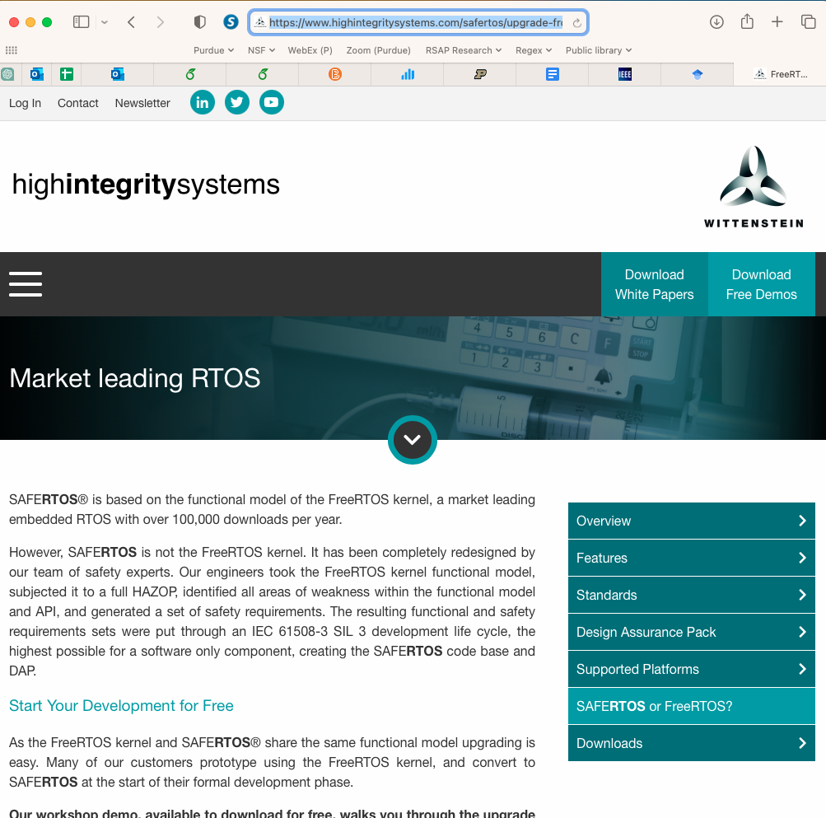
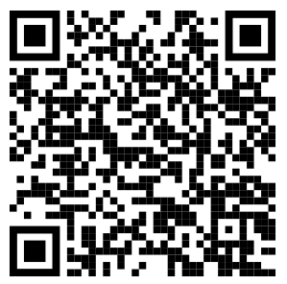
Where did SafeRTOS get its requirements?
Take a minute to open this page and read it. Then:
Where did SafeRTOS get its requirements?
Does SafeRTOS differentiate itself on functional requirements?
If SafeRTOS exists, what value does FreeRTOS add?
Source: WITTENSTEIN high integrity systems, SafeRTOS
Notes:
6 minutes — The worked example for the Compare quadrant. Students read a real vendor page and work out what comparison handed the team and what it did not.
- Do not narrate the page. Put it up, give them a genuine minute to read, then take the three questions in order.
- Students have just learned functional versus quality in section 1. This applies that vocabulary rather than introducing it.
- Question 1, expect: FreeRTOS. SafeRTOS is a safety-certified derivative of an existing open-source kernel, and the API was kept compatible on purpose, so most of the functional baseline is inherited.
- Question 2, expect: no. The differentiation is quality and assurance, not features: a defensible design and coding standard, failure analysis, documented and bounded timing, test evidence and traceability an assessor will accept, certification against the standard. Comparison told them what was already settled; the obligations that make their version different were the entire product.
- Question 3, expect: the uncertified one buys freedom. No certification burden means experimentation, cutting-edge features, drivers for untrusted or unproven components, fast iteration, and a large user base that shakes out the functional model for free. The ecosystem needs both: one to explore the design space, one to certify a frozen version of it.
- Take three or four answers per question. Room discussion, not think-pair-share.
=====
Give them the minute. Then ask question one and wait; somebody will find FreeRTOS on the page.
On question two, push past the first answer. Ask what SafeRTOS actually had to produce that FreeRTOS did not. Everything they name is a quality or assurance obligation, and none of it is visible in the API.
On question three, resist the assumption that the certified product is simply the better one. The uncertified kernel is where new hardware support and new ideas land first, because nobody has to re-certify them. Certification freezes a version so it can be trusted; the free version keeps moving so there is something worth freezing.
Connect back: comparison narrows what we know about the problem. Deciding whether certification is worth the engineering effort is a commitment question, and that is section 3.
Transition forward: Compare can give an enormous head start. What about Build? Building used to be one of the expensive ways to learn. That has changed.

Slide 15
Cheap prototypes are an elicitation tool
🧙 MAGE Moment
Building can be a way of asking questions
Tell me what you want, or tell me what is wrong with this?
When prototypes are expensive
Idea
Describe in detail
Build
First real reaction
When prototypes are cheap
Idea
Build enough to react to
Reaction
Revise
and again
A prototype can teach us the requirements. It is not the specification, and it is not the product.
Notes:
3 minutes — The optimistic MAGE moment: cheap partial realisations make learning-by-building economically attractive.
- MAGE Moment one of four. GenAI changes the economics of learning what to build.
- Ask the hook and let them answer it out loud; people are far better at criticising an artefact than at specifying one.
- Tie back to the Process lecture: incremental processes are attractive exactly when a partial system can be meaningfully evaluated.
- End on the caution. Then transition: that was one user reacting to one prototype. Next we place it in the general loop, and then make the case much harder.
=====
Look at the fourth quadrant again. Building a working prototype could be an expensive way to learn about requirements, so we only did it when the stakes justified it. If a working sketch costs an afternoon, the calculation changes.
The two rows are the argument, and the thing that moves is where the first real reaction happens. When prototypes are expensive you have to get the description right first, which is precisely what stakeholders are bad at, and you do not hear a genuine reaction until late. When they are cheap, you put something in front of them early and their reactions become the elicitation data.
Two cautions. A prototype that cannot be meaningfully evaluated teaches nothing, so make sure the thing you build exercises the question you have. And a prototype that looks finished invites people to treat it as finished.
Key line to say out loud: when realization becomes cheap, building can become a way of asking questions. Then the caution, said carefully: a prototype can teach us what the requirements are. It is not necessarily the specification, and it is definitely not necessarily the product.

Slide 16
Requirements engineering is a loop, not a stage
Discover
Organise
Negotiate
Record
Learn
and repeat
Each process runs this loop at its own tempo.
Notes:
2 minutes — Give a working model of requirements activity without implying a fixed phase.
- Five verbs, one cycle. The return arrow is the important part of the picture.
- Negotiate is where section 3’s economics will live. Flag it and move on.
- Say that the prototype we just discussed is one way to buy information inside this loop, as are feasibility studies. Do not detour into the process diagram.
=====
Discover what people need. Organise it into something you can reason about. Negotiate and prioritise, because you cannot have all of it. Record what was decided so nobody has to rediscover it. Then learn something that invalidates part of what you just recorded, and go round again.
A feasibility study or a prototype is a way of buying information inside this loop. What matters here is the return arrow. Recording a decision does not end discovery: what we learn can reopen earlier decisions.
Transition forward, and make it explicit: that was the easy case. One user looks at a prototype and tells us what is wrong. Now make it hard. What if the customer is a multinational with thousands of employees, dozens of offices, conflicting objectives and two previous failed implementations, and you have to quote a price?

Slide 17
“We already have the requirements”
AFI, the customer
Nexell needs to know
1 What does AFI actually need?
“We collected everyone’s requirements in a spreadsheet.”
2 Can we deliver it?
3 What should we promise, and at what price?
A list of requirements is not the ability to commit.
Kostova et al., RE 2019
Notes:
3 minutes — Show that possessing requirements is not the same as being able to make a responsible commitment.
- The hard case, deliberately placed after students already have the toolkit, stakeholders, candidate requirements and the loop. AFI is a multinational finance company; Nexell is the integrator bidding on a Salesforce CRM (customer relationship management) integration.
- Thousands of employees, roughly 40 locations, and two prior failed CRM attempts.
- Question 3 is the one this lecture is about: the vendor has to name a scope and a price.
- Connect back to the thesis slide: question 1 is the left column, questions 2 and 3 are the right column, which is section 3.
=====
A prototype will not save you here, and neither will one interview. AFI arrives with a spreadsheet. Every department has submitted what it wants. In one sense they do have requirements: requirements have been collected and recorded in a spreadsheet and RFP.
Now put yourself on the vendor side. You are being asked to sign a contract. What is in that spreadsheet is a pile of stated wishes at wildly different levels of detail, from people with different authority, some of whom contradict each other. You cannot cost it, you cannot sequence it, and you cannot tell which items are actually load-bearing.
Two prior CRM attempts had already failed here, which is exactly the kind of history that should make a vendor cautious about promising anything.
Transition forward: so who do you talk to?

Slide 18
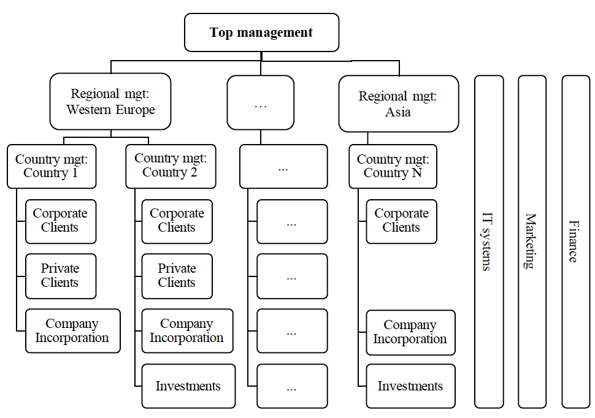
Who actually knows what AFI needs?
Who would you talk to?
Notes:
3 minutes — Turn “ask the customer” into a stakeholder problem the students feel.
- Room engagement, not a think-pair-share. Take four or five answers and write them where everyone can see.
- Push back gently on “the CEO” and on “the users”: ask what each one would and would not know.
- Land the point that no single person on this chart holds the requirements, and call back explicitly to the stakeholder model from the toolkit slide: there is no one customer.
=====
This is AFI. Pick someone on this chart and tell me what you would learn from them, and what you would still be missing.
Expect: executives know strategy and budget but not daily work; regional managers know local exceptions; the sales team knows the workarounds; IT knows the existing systems and the integration constraints. Nobody has the whole picture, and several of them will describe incompatible systems.
Transition forward: Nexell’s answer to this was not one giant meeting. They split the room deliberately.

Slide 19
Different stakeholders see different systems
Management
Operations
Strategy
Competitors
Regulation
Organisational goals
Daily workflow
How the CRM is actually used
Friction and workarounds
Practical constraints
Kostova et al., RE 2019
Notes:
3 minutes — Explain why Nexell deliberately separated the management and operational conversations.
- Two kinds of workshop, using the same basic elicitation approach but engaging different perspectives. Kostova reports fourteen workshops in total, organised around management and operational views.
- One giant meeting is not automatically better: authority silences detail.
- Do not teach the canvas tool itself; the structure of the conversation is the lesson.
=====
Nexell ran separate workshops for the two perspectives. Management talked about strategy, competitive position, regulatory obligations and what the company was trying to become. Operations talked about what happens on a Tuesday afternoon: which screens they avoid, which spreadsheet they keep on the side, which step they skip when the queue is long.
Why not put everyone in one room? Because in a room containing your director you do not volunteer that you have been working around the official process for two years. And because the two groups disagree about what the system is for, and that disagreement is information you want on the table rather than smoothed over.
Build the left view alone and you get a system that serves the strategy and nobody’s work. Build the right view alone and you automate today’s workarounds.
Transition forward: what did this buy them?

Slide 20
Better requirements, better promises
BEFORE
BETTER REQUIREMENTS
BETTER PROMISES
“We need Salesforce.”
Components and dependencies
Stakeholder alignment
Training and change needs
Roadmap and sequencing
More credible scope and estimate
A proposal Nexell could stand behind
requirements work
Notes:
2 minutes — End Discovery by linking requirements knowledge to what the vendor could responsibly commit to.
- The lesson is not “have a requirements phase”. That is process-specific and weaker.
- The lesson is that problem knowledge is what makes a commitment defensible.
- AFI also changed how it thought about its own operation: from buying a product to buying a service.
=====
Before the workshops, AFI had chosen the product family and collected stated requirements, but Nexell did not yet have a coherent basis for implementation and commitment. Afterwards they could name components, say which depended on which, sequence the work, plan for training and the organisational change, show each stakeholder group where its concerns landed, and make a more credible implementation proposal.
Notice what kind of gain that is. It is partly a better product. But it is mostly a better decision: they now knew what they were agreeing to and what it would cost. That is the bridge into the second half of the lecture.
Transition forward, and say it explicitly: Nexell did not merely learn more about AFI. Better knowledge let them decide what they could credibly promise, and at what price. That is the turn into our last section.

Slide 21
Stretch break
Five minutes
Notes:
5 minutes — Mark the real conceptual break: we stop asking what would be valuable and start asking what we will promise.
Timing checkpoint. If you have not reached this slide by about halfway through the class, keep the break to three minutes and trim inside Commitment: the MAGE moment on build-versus-buy is the one slide you can cut whole, and the estimating slide can be told rather than discussed. Protect the wrap-up.
- Discovery is now complete: the Nexell case closed the whole question of how we learn enough about what should be built.
- The section divider that follows is the restart. Do not start teaching before it.
=====
Five minutes. When we come back, the question changes.
Reopen with this: so far we have been trying to learn what would be valuable. Now comes a different question. Which of those things are we actually willing to promise?

Slide 22
3 Commitment
What are we willing to promise?
Notes:
40 seconds — Make the conceptual turn explicit: valuable is not the same as required.
- Section 3 of 3, and the part most requirements lectures omit.
- Say it plainly: discovering that something would be valuable does not mean we should make it a requirement. Now we have to choose.
- Call back to the right-hand column of the two-problems slide.
=====
Everything so far has helped identify candidate obligations and the information needed to choose among them.
A requirement is a different thing from a candidate. It is an obligation we have accepted, which means we have agreed to spend scarce engineering capacity on it rather than on something else. This section is about making that choice defensibly.

Slide 23
Opportunity Cost: Requirements consume resources
ONE TEAM, ONE SEMESTER
You can afford two:
A
B
A Accessibility remediation
B New collaboration feature
C and D do not fit.
C Two-times performance
Opportunity cost: the value of what we do not build.
D Enterprise SSO and audit
Choosing A and B means giving up C and D.
Which two do you require?
What information would change your answer?
Notes:
5 minutes — Make the economics experiential: students allocate scarce capacity and discover what they need to know to do it.
Give students a moment to inspect the four choices, then ask: “Which two do you require?” Take several answers and ask briefly why.
Do not spend much time trying to reach consensus. There is intentionally not enough information to identify a correct pair.
Then ask the more important question: “What information would change your answer?”
Draw out the kinds of information they now realize they need: customer value, deadlines, regulatory obligations, cost, risk, dependencies, technical feasibility, and consequences of failure.
Connect this back to requirements engineering: requirements are not simply a list of desirable features. Choosing what to require commits scarce engineering resources and creates opportunity costs.
Do not resolve the exercise to a “correct” pair. The missing context is the point.
Transition: We have been asking what stakeholders want and what the organization can afford to promise. But feasibility and customer demand are not the only limits on what we should build. That leads directly to the professional-judgment and ethics exercise on the next slide.

Slide 24
Should we build it?
The customer wants it. We can build it. They can pay. Is that enough?
MORAL OBJECTION
HUMAN COST
SOCIETAL RISK
Maven / JEDI
Cyberpunk 2077
Frontier AI
Google and Microsoft staff refused military work.
CD Projekt Red mandated six-day weeks.
Altman, Amodei and Hassabis warn of extinction risk.
Should engineers build systems they oppose?
Should we accept deadlines that burn out the team?
What if building it successfully is the risk?
Think. Which would you refuse to work on? Why?
Pair. Where do you draw the line differently?
Share. What principle decides when to say no?
Maven / JEDI: medium.com/@employees_of_microsoft/an-open-letter-to-microsoft-dont-bid-on-the-us-military-s-project-jedi-7279338b7132
Cyberpunk 2077: bloomberg.com/news/articles/2020-09-29/cyberpunk-2077-publisher-orders-6-day-weeks-ahead-of-game-debut
Frontier AI: safe.ai/work/statement-on-ai-extinction-risk
Notes:
8–9 minutes — Add ethics to the commitment decision: accepting a requirement is itself a professional judgment.
- Think-pair-share number three of three, and a full one. Roughly two minutes individual, three paired, three to four discussing.
- Arrive directly from the scarce-resources exercise. Students have just reasoned about value, feasibility, cost and opportunity cost.
- Do not lecture about the three cases beforehand. Give only enough factual context that each case is intelligible, then run the activity.
- Push for the principle behind the answer, especially where students disagree with each other.
- Do not imply the lecture has supplied a formula. Reasonable engineers disagree about all three.
=====
We just treated requirements as choices under scarcity. We asked what creates value, what is feasible, what it costs, and what we give up by choosing it.
Suppose all of those questions come out favorably. The customer wants it. We know how to build it. They can afford it. Is that enough?
Here are three cases where real engineers might still say no.
Maven and JEDI. Google contracted with the Defense Department to apply AI to drone footage. Thousands of employees signed a petition, around a dozen resigned, and Google did not renew. When JEDI came up, Microsoft employees published an open letter objecting to bidding, arguing that they had not signed up to build technology for increased military lethality. The point here is not whether military software is good or bad. The point is that real software engineers have refused or protested work because they objected to its intended use.
Cyberpunk 2077. As the game approached release, CD Projekt Red imposed mandatory six-day weeks, having publicly promised earlier that it would not force crunch. Notice this case is different. The engineer need not object to the product at all. The objection is to a commitment whose fulfilment imposes unreasonable costs on the people doing the work.
Frontier AI. Sam Altman, Dario Amodei and Demis Hassabis have all signed a public statement that mitigating extinction risk from AI should be a global priority alongside pandemics and nuclear war, while their organisations continue building more capable systems. Do not editorialise about whether that risk is real. The point is that engineers sometimes face uncertain but potentially enormous external risks created by succeeding.
Run the activity. During the share, and only after students have reasoned, name the three kinds of objection. In Maven and JEDI the objection is to the purpose or intended use of the system. In Cyberpunk the product may be unobjectionable and the concern is the human cost of the commitment. In frontier AI the purpose may be beneficial and the objection concerns external risk created by successful development.
Spoken synthesis, not on the slide: engineering responsibility does not end when a requirement is valuable, feasible and affordable. Accepting the requirement is itself a professional judgment.
Transition forward: those questions do not replace value, feasibility and cost. They are additional reasons we may accept, modify or refuse a commitment. For the rest of today, back to the economic side: when we do consider accepting a requirement, what does it actually cost us?
Further source for the Maven protests and resignations: nbcnews.com/news/military/google-halt-controversial-project-aiding-pentagon-drones-n879471

Slide 25
Cheap implementation does not make features free
“It’s only one more feature.”
“Codex writes it in five minutes. Why does it cost us?”
Cheaper ↓
Still costs
Implementation
Requirements · design · integration · validation
Security · operations · maintenance · change
Coding is only part of the cost of a feature.
Notes:
3 minutes — Correct the marginal-cost misconception: implementation is one term in the cost, not the whole of it.
- Reads as a direct continuation of the scarce-resources exercise: coding cost is only one input into the cost of accepting a requirement.
- Deliver the hook in the product manager’s voice; it is the argument they will actually face.
- Say the takeaway out loud: coding is only part of the cost of a feature. The marginal cost fell; it did not fall to zero.
- Note that the surrounding costs are not immutable either: architecture, automation and reusable validation can bring them down.
=====
You just told me you needed to know what A through D cost. Here is the argument you will hear when you try to say something costs anything: it is only one more feature, and the model can write it in five minutes.
The claim is half right. Implementation genuinely got cheaper. But look at the right panel: someone still has to decide what the feature means, how it interacts with what exists, how we know it works, what it exposes, who operates it at three in the morning, and what it costs us the next time we want to change the system. None of that was the typing.
Some of these surrounding costs can also be reduced through better architecture, automation, reusable validation, and explicit engineering knowledge.
Transition forward: if the cost structure is moving, our estimates are built on assumptions that are also moving.

Slide 26
Estimating before we know what we are building
We need an estimate to choose scope, and scope to estimate.
Cost ≈ Size × cost per unit of size × cost drivers
Size
× Productivity
× Cost drivers
Function points · features · components · estimated LOC
Historical projects · calibrated model · expert judgment
Complexity · team · platform · assurance · integration
COCOMO: PM = A × Size^{E} × ∏ EM
Size plus calibrated multipliers
Effort, schedule, cost
Requirements set size and drivers. Estimates decide what survives.
Estimate ≠ budget ≠ target ≠ commitment
Notes:
5 minutes — Give students one durable mental model of where an early software estimate comes from, and tie it back to requirements.
- The boxed relation is a conceptual cost model, not COCOMO. Do not present it as COCOMO.
- Teach the three terms, then show COCOMO as the canonical concrete instance. Do not teach coefficients or model variants.
- Function points are the useful one to dwell on: you can characterise requested functionality before any code exists.
- Key line: learning more may increase the estimate while improving the estimate.
- Keep the four-way distinction. Confusing an estimate with a commitment is how projects acquire impossible deadlines.
=====
You asked me what the options cost. Here is the shape of an answer. Notice first that we are stuck: we need an estimate to choose scope, and scope to estimate. So we do not start from scope. We start from whatever we can characterise about the requested functionality.
Cost is approximately some measure of size, multiplied by what a unit of size costs us, multiplied by the factors that make this project harder or easier than the average. That is the whole idea, and it is worth remembering because it is not “how long will the coding take?”
Size first. Function points are the interesting case for us: they characterise the functionality being requested, so you can compute them from requirements, before there is any code. Others are cruder: a count of features, of components or work items, or an estimated line count by analogy with a previous system.
Then what a unit of size costs. That number comes from history: your own completed projects, an empirically calibrated model, or the judgment of people who have built something similar. Then the drivers: complexity, the team’s experience, the platform, the assurance you owe, how much you must integrate with what already exists.
COCOMO is the canonical concrete version. Person-months equal a constant times size raised to an exponent, times a product of effort multipliers. Two things to notice, and then move on. The exponent is not one, so doubling the size more than doubles the effort. And the multipliers are exactly the cost drivers we just listed. We are not doing the coefficients today. Modern organisations often use looser analogues of the same idea: historical velocity, comparable projects, decomposition, expert judgment.
Now the requirements payoff, which is why this slide is in this lecture. Every input on this slide is set by requirements. What we ask for determines size; what we ask of the system, such as assurance or integration, sets the drivers. And then the estimate comes back and decides which requirements we can afford. So we iterate: candidate requirements, estimate, prioritise and scope, learn more, revised estimate.
Keep the four words apart. An estimate is a prediction, a budget is money allocated, a target is what we would like, and a commitment is what we have promised. As we learn about obligations we had not accounted for, such as accessibility, migration and security, the estimate may rise even as its uncertainty falls. More expensive can still be a better estimate.
Transition forward: notice which term generative AI touches. It may change what a unit of size costs us. It does not remove the drivers, and it does not tell us the size. If the cost of building is moving, then so is the calculation about what to build at all rather than buy.

Slide 27
AI changes the build-versus-buy calculation
🧙 MAGE Moment
If AI can rebuild the features, what exactly are we paying for?
Buy software
AI prototype in days
Build it
Reproduce Salesforce’s visible features in a weekend, and have you reproduced Salesforce?
Cheap replication challenges the value of implementation.
It does not reproduce data, integration, operations, or support.
Bain & Company, Asia-Pacific Private Equity Report 2026
Notes:
TIME CUT — Skip this slide if running behind.
4 minutes — Show that cheap replication changes the build-versus-buy calculation, though not necessarily the decision.
- MAGE Moment four of four, and the last slide of section 3. GenAI changes the economics of commitment and acquisition.
- Ask the room question and collect three or four answers: data, integrations, reliability, security, operations, support, institutional knowledge.
- Punchline: everything they just named is also a source of requirements and of cost. They met all of those in sections 1 and 2, and priced them in section 3.
- Room discussion only, 30 to 60 seconds. This is not a think-pair-share.
=====
State the provenance carefully. Bain’s Asia-Pacific Private Equity Report 2026 says that in technical diligence buyers may build prototypes that replicate key product features, in order to assess AI risk and refine an investment thesis before committing to a deal. Bain described a concrete version of this in 2024: during diligence on a proprietary AI software target, a team built competing prototypes with GPT-4 and open-source models in days and compared them against the target.
Do not claim that Bain is replacing its own enterprise SaaS with do-it-yourself AI software. The narrower claim is the interesting one: a weekend prototype is now cheap enough to be used as evidence about what a software company’s features are actually worth.
Sources: Bain & Company, Asia-Pacific Private Equity Report 2026 (bain.com/insights/topics/asia-pacific-private-equity-report). Background: Bain & Company, Tech Due Diligence.
Do not spend long here; it is a vivid example, not a case study. Transition forward: that is the last of the four MAGE Moments. Step back and name what we have been doing all lecture.

Slide 28
Wrapping it all up
What should we build?
Notes:
20 seconds — Tell students plainly that the substantive lecture has ended and synthesis has begun.
- Deliberately unnumbered. The lecture promised three movements and those remain the content; this is the conclusion, not a fourth movement.
- Two slides follow: the conceptual synthesis, then the structural recap and the handoff to Specification.
=====
That is the material. We have defined what a requirement is, seen how engineers discover candidates, and worked through what it takes to commit to one. The question we opened with is the question we close with, so let us put the whole thing together.

Slide 29
Requirements are choices under uncertainty
What might matter
discovery
what we learn sends us back
What appears valuable
feasibility, negotiation, economics
What we will promise
Requirements engineering reduces uncertainty enough to make defensible commitments, not enough to eliminate it.
Next: Specification
What exactly are we promising?
Notes:
90 seconds — Name what the whole lecture has been doing, then summarise it.
- The first synthesis slide, immediately after the closing divider. The substantive lecture is over.
- The two downward arrows are the two halves of the lecture: discovery narrows what might matter; economics decides what we promise. The arrow up the left side is iteration.
- Stress that uncertainty is reduced, never removed. That is why estimates carry ranges and why the loop keeps running.
=====
Step back and look at the shape of what we did today. We started with an enormous space of things that might matter to somebody. Discovery narrowed that to a set of candidates that appear valuable. Then feasibility, negotiation and economics narrowed it again to the things we are prepared to promise.
Notice that at no point did the uncertainty go to zero. We did not learn everything about AFI. Nexell did not know exactly what the integration would cost. What changed is that the remaining uncertainty became small enough, and understood well enough, that a commitment was defensible. That is the standard to hold yourself to, not certainty.
Close on the handoff: on Thursday we ask what exactly these promises mean and how precisely we need to represent them. And the boundary is not clean: trying to specify a requirement often exposes assumptions and tacit requirements we did not discover today.

