Slide 1
ECE 461: Software Engineering
Software Engineering Teamwork
Prof. James C. Davis

Slide 2
A team coordinates engineering capability
Structures and mechanisms
shape interactions
Interactions
Individual capability
Combined capability
Coordination costs
emerge from interactions
Today: Individual capability · Team capability · Amplifying capability · Engineering coordination · Applying the model
Notes:
Why are we talking about this today? (Project part 1 spec released tonight)
Team endeavor
Job roles
What makes a great software engineer?
Social
Some personal and organizational factors that can lead to challenges
Technical
- HW on this

Slide 3
Why do we need teams?
If interactions impose costs, why not use one engineer?

Slide 4
1 Individual capability
What makes an engineer effective on a large engineering effort?

Slide 5
Effective engineers extend beyond implementation
Learn & adapt
Exercise judgment
Learns unfamiliar domains quickly and updates their model when evidence changes
Makes defensible decisions under incomplete information and knows which decisions are reversible
Understand the system
Enable others
Reasons about the product and its consequences, not only the code in front of them
Raises what the people around them are able to do
Clusters adapted from Li, Ko & Zhu, “What makes a great software engineer?”, ICSE 2015
Notes:
Baseline: Write, implement, and debug software
Personal characteristics
Improving—not satisfied with the status quo: constantly looking to improve themselves, their product, and/or their surroundings
Adaptable—adapting to changes in their environment, including changes in what they do (e.g. the software product) and how they do it (e.g. people, processes, and tools).
Self-reliant—getting things done independently (i.e. not always going to their manager for help); removing roadblocks by leveraging their abilities and resources (e.g. asking experts for help)
Focused—allocating and prioritizing their time for the most impactful work.
Open-minded—willing to judiciously let new information change how they think
Example: “Not invented here” – story from IBM (inter-team competition)
Data-driven Taking and evaluating measurements of their actions and of the product, creating behavioral feedback loops for optimizing software and processes.
=======
Decision-making
Informants felt strongly that having book knowledge was not sufficient; great engineers understood how decisions play-out in complicated real-world conditions. Great engineers not only knew what should happen, but also what can and likely will happen
Knowledgeable about people and the organization—informed about the people around them: their responsibilities (i.e. organizational structure), their knowledge, and their tendencies . For example, knowing ownership enabled great engineers to determine key stakeholders for decisions and to communicate with the right people to align their work. This alignment commonly meant their management chain, but informants also discussed aligning with key partner teams (e.g. other parts of a product offering):
Sees the forest and the trees—considering situations at multiple levels, including technical details, industry trends, company vision, and customer/business needs
Update Their Mental Models
Informants described great engineers as continuously updating their mental models at all levels of abstraction— ranging from technical details to industry trends—by explicitly evaluating changes in their context. “You can always follow patterns too much... It's worked in the past, but conditions have changed.”. For example, “Sometimes what used to be a second or third order effect comes to dominate. So way back in the day, if you wanted to performance optimize something you counted instructions. Processors got faster and faster, but memory references didn't. There became a day when it made more sense to count memory references than it did to count instructions"
Knowledgeable about customers and business—conversant about the role their software product plays in the lives of their customer and the business proposition that entails
Knowledgeable about tools and building materials—versed in strengths and limitations of the tools and building materials used to construct their software product
======
Teammates
Create shared context
Adapting to another person’s understanding of a situation, was the most important aspect of “communicating effectively”. This involved tailoring the message to another person’s perspective:
One person can only accomplish so much so you've always got to be working as part of the bigger group. People who can't communicate are only going to be sort of so-so effective...”
great engineers, especially ones at higher-levels, often had to communicate with people that do not have a complete (or the same) understanding of the situation but are critical to success (e.g. partner teams, customers, or management). Therefore, crafting the message such that others can comprehend the situation was important:
Creates A Safe Haven
Many informants described great engineers as creating a safe haven where other engineers can learn and improve from mistakes and situations without negative consequences. Usually associated with leaders, informants felt that if engineers are afraid of mistakes, then their growth would slow:
The lack of this attribute as a major contributing factor for talent loss.
Safe haven != “no criticism”. People need to understand the impact of a mistake in order to learn from it – we learn from pain. But great engineers create a space where that kind of learning is possible and doesn’t compromise a career.
Honest
Informants felt that being honest was the most important attribute related to ‘trust’. This was about great engineers providing credible information. Engineers that presented a version of the situation that suited their own benefits were viewed negatively. Informants felt that they needed to be able to take action based on information that an engineer provided:
“Influence comes to someone else trusting you”
======
Software product
Elegant and Creative (when needed)
Possessing simple and intuitive designs that another person (or themselves later) could easily understand.
Great engineers knew of and knew when to apply existing solutions (and not be creative). This was important because informants felt that known solutions were generally preferable since they were less costly and less error-prone:
“You are now using all of your creativity to reinvent things that are already invented and that is just basically wasteful.
Understanding patterns and understanding how to apply something is very important so you don’t recreate wheels all the time
======
Be humble and open to improvement. You do not know everything! Your design is not perfect. Your implementation is not perfect. Your tests are not perfect. Part of the value of a team is to help everyone on it do their best for the customer.
Respect others. Care about the other people you work with. Don’t focus on their weaknesses, but recognize their strengths and how you can learn from them.
Take a default stance of trusting that everyone on your team wants what is best for the team, the customer, and the company. Never attribute to malice what can instead be attributed to a simple mistake. (There do exist dysfunctional teams where internal politics have come to dominate. If that happens to you, find a new team.)

Slide 6
Individual effectiveness becomes team effectiveness
Creates shared context · Enables others to succeed · Creates a safe haven · Honest and credible · Knows the organization and its stakeholders
One engineer
The team around them shared context · trust · coordination
A strong engineer increases the effectiveness of the system around them.

Slide 7
2 Team capability
How does individual capability become collective capability?

Slide 8
What makes a team effective?
Not “what makes its members effective?”—what properties belong to the team itself?

Slide 9
Effective teams create shared context
Shared context
Trust
Coordination
Goals and priorities
State of the system
Who owns what
What was decided, and why
What is changing right now
Every member
Understandings must be compatible enough—not identical.
Winters, Manshreck & Wright, Software Engineering at Google, Ch. 2–3.

Slide 10
Effective teams create trust
Shared context
Trust
Coordination
Honesty about status, risk, and mistakes
Uncertainty can be voiced safely
Information from teammates is credible
A failure exposes a problem, not a person
Without trust, a status report is a work of fiction.
Winters, Manshreck & Wright, Software Engineering at Google, Ch. 2.

Slide 11
Effective teams coordinate action
Shared context
Trust
Coordination
Ownership—who decides, who answers for it
Dependencies—what depends on what
Division of work—who does what, in parallel
Integration—how the pieces come back together
A team must produce all three. Every mechanism today serves one of them.

Slide 12
Why don’t teams scale linearly?
If 5 engineers are productive, why aren’t 50 engineers 10× as productive?

Slide 13
Adding capability also adds coordination
Communication paths · Dependencies · Onboarding · Integration · Maintaining shared context
5 engineers → 10 pairs
15 engineers → 105 pairs
N*(N−1)/2 possible pairs – Communication can become quadratic in the team size.
Brooks, The Mythical Man-Month, 1975.

Slide 14
Goal: Make coordination costs grow sublinearly
Capacity should grow with people.
Software Engineering at Google, Ch. 1.

Slide 15
Engineer coordination for sublinear scaling
Strategy | Mechanisms
Reduce dependencies | Clear ownership · stable interfaces · modularity
Make knowledge reusable | Documentation · shared conventions · discoverable expertise
Automate coordination | Version control · automated tests · CI · tooling
Scale decision structures | Code review · ownership and reviewer rules · team boundaries
One decision should serve many future interactions.
The scalability criterion is from Software Engineering at Google, Ch. 1; the mechanisms are general software engineering practice.

Slide 16
Architecture changes the coordination topology
Everyone ↔ everyone
Teams behind interfaces
Module A
Module B
Module C
28 possible paths
2 inter-team interfaces
Interfaces let teams work with bounded knowledge and bounded coordination.
Conway, “How do committees invent?”, 1968.

Slide 17
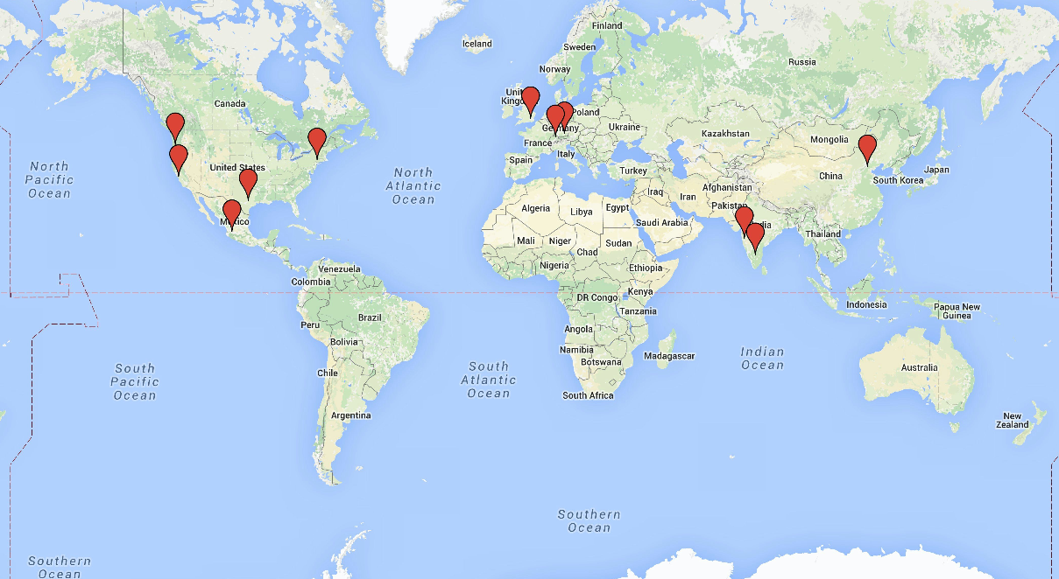
Global engineering exposes coordination costs
GMT
GMT + 1
GMT - 8
GMT - 5
GMT + 8
GMT - 6
GMT + 5h30
What becomes harder when coordination spans these sites?
Carmel, Global Software Teams, 1999.
Notes:
These are the sites involved in the project while I was there.
US employees in Poughkeepsie/NY, Austin/TX, Beaverton/OR, and Silicon Valley, CA.
2012-2014 Beijing/CN, two sites in India (Pune and Bangalore), as well as Zurich/Switzerland
2015 + Mexico, UK, Germany
And just look at all of those time zones! California, UK, and Beijing are “evenly spaced”, each 8 hours apart from the next.
Why global teams?
Access to skills, e.g: Specialized technologies (experience with a particular HW component), specialized skills (experience adapting a product to meet a particular regulatory requirement – or, e.g., Israel has a huge cybersecurity scene because of the mandatory military service and active threats to that country)
Acquisitions – expanding a product family by buying a company with an appropriate product. Later the products might neeed to collaborate.
Proximity to customer – face-to-face feedback, on-site support
It can be cheaper. If a company is funded in USD and pays in Rupees, the exchange rate is favorable
(These are almost all BUSINESS reasons. Ours is not to question why…)
Unavoidable
US colleagues: American, Brazil, India, China, Egypt
Team meetings: microcosm of the world
Collaboration strategies:
Module (works well)
Phase-Based (requirements -> Design ->) – Handoffs are hard.
Huge team / Follow-the-sun
Hand-offs are hard! Can work well for customer support, not so good for design/impl.

Slide 18
Follow-the-sun: parallelism versus handoff cost
Three sites, eight hours each—the promise of 24-hour progress
Site A
00:00 – 08:00
Site B
08:00 – 16:00
Site C
16:00 – 24:00
handoff
handoff
Every handoff must transfer enough context for another engineer to continue correctly.
Handoff cost is the price of parallelism.

Slide 19
People don’t share all of your assumptions
Language and working-language fluency
Hierarchy—who may be contradicted
You
A teammate
Willingness to challenge in public
Communication norms—directness, silence, written versus spoken
Educational and professional background
Cultural models such as Hofstede’s are population-level lenses. They are not predictions about the person in front of you.
Notes:
Now, back to our regularly scheduled programming…
(Write definitions on the board)
Power distance: This dimension deals with the fact that all individuals in societies are not equal, and it expresses the attitude of the culture toward these power inequalities amongst us. Power distance is defined as the extent to which the less powerful members of institutions and organisations within a country expect and accept that power is distributed unequally. A high score means that you accept power hierarchies; a lower score means that you are more willing to cross the perceived power hierarchies.
Long-term orientation is when you are focused on the future. You are willing to delay short-term material or social success or even short-term emotional gratification in order to prepare for the future. If you have this cultural perspective, you value persistence, perseverance, and adaptability.
Short-term orientation is when you are focused on the present or past and consider them more important than the future. You care more about immediate gratification than long-term fulfillment.
Individualism: The fundamental issue addressed by this dimension is the degree of interdependence a society maintains among its members. It has to do with whether people´s self-image is defined in terms of “I” or “We”. A high score means that the individuals are relatively independent from one another. In contrast, a low score reflects a more collective society, where people view themselves in terms of their relationship to others and more as part of a team.
REMEMBER: This is a model, and scores are averaged across nationalities. Models are useful for interpreting and predicting, and for working with trends, but they may not describe any one individual. But if you’re working with an international team, those ‘averages’ will probably show up.
=== Other attributes of the model that are hard to connect directly to engineering work ===
“Masculinity stands for a society in which social gender roles are clearly distinct: Men are supposed to be assertive, tough, and focused on material success; women are supposed to be more modest, tender, and concerned with the quality of life.”“Femininity stands for a society in which social gender roles overlap: Both men and women are supposed to be modest, tender, and concerned with the quality of life.”
Uncertainty is a state wherein outcomes and conditions are unknown or unpredictable. Some people are more comfortable with uncertainty than others, and the degree to which individuals participate in certain behaviors to stay in comfortable situations is called uncertainty avoidance. Uncertainty avoidance is one of the five cultural dimensions presented by Geert Hofstede in his 1980 book on the subject, Culture's Consequences.

Slide 20
3 Amplifying capability
What happens to coordination when individuals can produce much more?

Slide 21

Suppose every engineer is 10× more productive
🧙MAGE Moment
What breaks in teamwork first?
Shared context
Trust
Coordination

Slide 22
GenAI can amplify individual capability
One engineer
Coding agents
A larger owned surface
+
Understand unfamiliar code faster · Produce and test more · Explore more alternatives before committing
Fewer people can mean genuinely less coordination.
Some coordination costs disappear rather than being managed.

Slide 23
Individual throughput ≠ team throughput
More changes produced
More to review, decide, record, integrate
Higher coordination load
An amplifier amplifies a well-designed coordination system—or overwhelms a bad one.

Slide 24
Four dimensions of coordination
Topology
who must coordinate with whom
Frequency
how often coordination occurs
Cost
how expensive each one is
Reliability
whether it happens correctly
We cannot eliminate coordination. We can engineer it.
For any mechanism, ask: which dimension does it change?

Slide 25
4 Engineering coordination
How can we deliberately change the cost and structure of interaction?

Slide 26
Communication is an engineering mechanism
What information
must move?
Between whom?
How quickly?
How long
must it last?
Synchronous
or asynchronous
Ephemeral
or durable
The medium follows from these answers; it is not the starting point.
A meeting, a message, a document, a ticket — each answers these four questions differently.

Slide 27
Meetings are expensive synchronization points
A meeting trades simultaneous attention from several people for rapid shared context and decisions.
Purpose
inform, consult, or decide—name which
Agenda
no list, no meeting
Timing
fixed length; plan to end early
Record
decisions and actions, written down
Is this meeting worth the attention it costs?
Credit: Greg Wilson, third-bit.com

Slide 28
Durable decisions reduce repeated coordination
A decision
Written down
Others can use it later
minutes · decision records · tickets · documentation
A decision
Left in memory
Reconstructed later, or lost
A decision that exists only in memory has to be reconstructed.
A durable decision turns one act of coordination into many future uses.

Slide 29
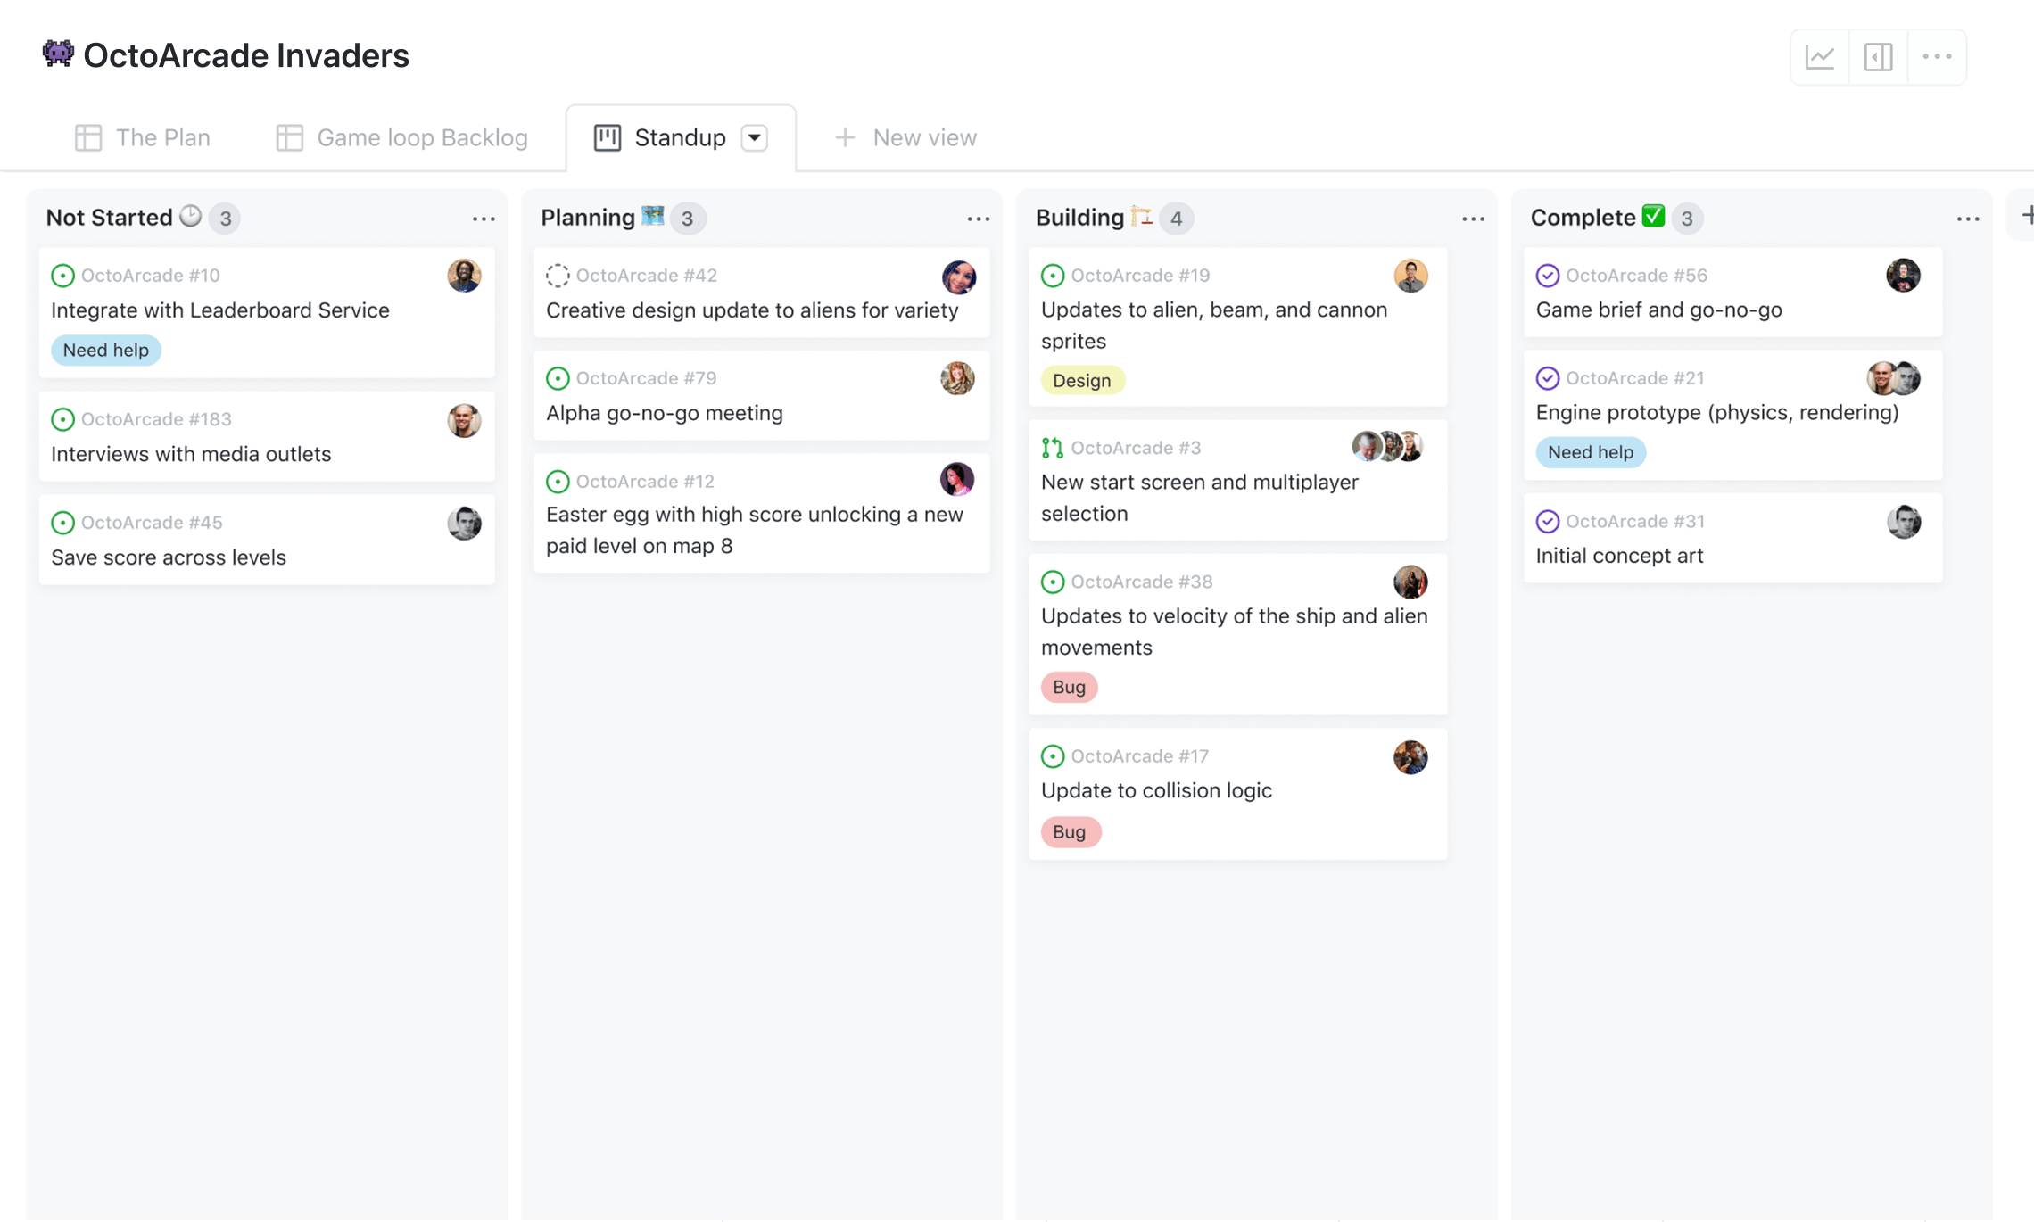
Project management makes work state visible
What exists?
Who owns it?
What state is it in?
What blocks it?
What happens next?

Slide 30
Git is a protocol for concurrent change
Mechanism | Coordination job
Branch | Isolates work in progress from the shared integration state
Commit | Records a discrete change and its history
Pull request | Exposes a proposed integration for inspection
Review, then merge | Supplies a decision point, then establishes shared state
Version control turns important coordination conventions into explicit, inspectable mechanisms.

Slide 31
A change moves through coordination boundaries
Issue
Owner
Branch
Code
Pull request
Checks
Review
Merge
Human decision
Automated check
Every boundary is a place where coordination happens.
Automated checks move some coordination from human judgment into enforced machinery.

Slide 32
5 Applying the model
How should you design coordination within your team and across your pod?

Slide 33
Your project has coordination at two scales
Pod
Team A
Team B
Team C
Team D
Inside your team—ownership, branches, review, meetings
Across the pod—interfaces, dependencies, integration, schedule
Which coordination problems from today can actually occur here?

Slide 34
Design the interface between teams
Everyone ↔ everyone
Through points of contact
POC
POC
9 possible cross-team relationships
1 designated interface per team
Choice | Gains | Costs
Stable POC | Accumulated context, fewer handoffs | Bottleneck, key-person risk
Rotating POC | Distributed knowledge, no bottleneck | Context must be transferred at each rotation
Should your team designate a pod point of contact? Should it rotate?

Slide 35
Your Team Contract is a coordination design
Make each of these a deliberate choice, not a default:
Communication
Meetings
Ownership
Work tracking
Git & review
Blockers
Pod coordination
Teams don’t scale simply by adding capability.
They scale by engineering coordination.

