Slide 1
Model-Based Agentic (Software) Engineering
Implementation is now cheap. What does it mean for engineering?
https://davisjam.github.io/model-based-agentic-software-engineering/
James C. Davis
https://davisjam.github.io
Notes:
Q: Who’s used ChatGPT or Claude as a chat interface? Q: Who’s used them “agentically”?
Here is what you need to know.
AI is not a better stapler.
It is open-ended productive capacity.
The skill you need to develop is learning to engineer the task and environment around it—then letting it operate with supervised autonomy.

Slide 2
Talk outline
1
Metaphors and constructs
Useful ways of thinking about what AI is
2
How much work can we give the AI?
Degrees of agency — and what can go wrong at each one
3
How do we keep control?
Model what matters, check what matters, turn repeat failures into structure
4
Worked example
DocAble: accessibility remediation for ordinary documents
5
What happens when our students have agents?
How should our approach to education change?
Notes:
1 minute — Orient the room to the intellectual route, not an agenda.
- Name the four movements out loud; they are the PowerPoint Sections and the divider slides use the same words.
- Movements 1 and 2 are the argument; 3 is the worked example; 4 is why this room should care.
- Do not re-display this slide between sections.
=====
Four questions, in order. First, how much of the work can we actually hand over — and what starts going wrong as we hand over more. Second, given that, how do we keep control. Third, I will show you a real system built exactly that way. And fourth, what this means for us, because everything I am about to show you is already available to our students.

Slide 3


3D Printer, not Stapler: AI is open-ended productive capacity
Does one job
Obvious how to use
With instructions (CAD), does many jobs
Bad instructions, bad results
The “instructions” for GenAI are the new engineering problem.
Notes:
If the instructions matter, then the instructions become the engineering problem.

Slide 4
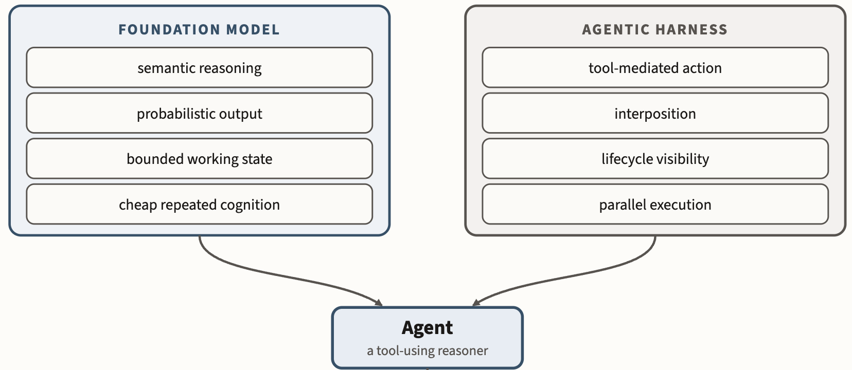
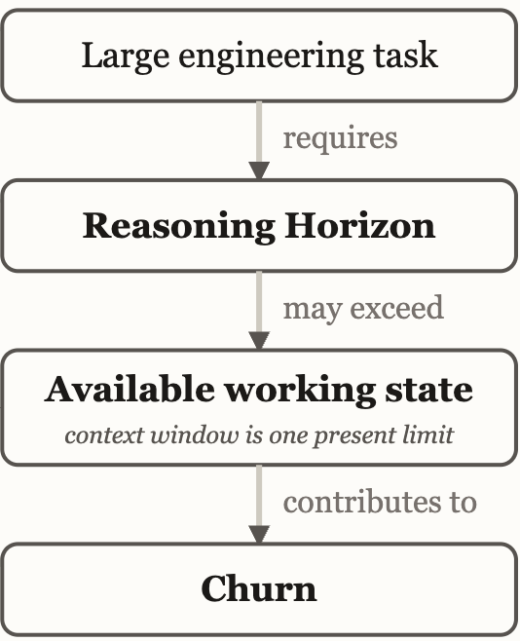
The new technology: “Agents” ~~ “Commodity Intelligence”
Notes:
The foundation model supplies inexpensive semantic reasoning under finite, probabilistic working conditions; the harness turns that reasoning into observable, interceptable action.
This talk is about my understanding of how CODING AGENTS will re-organize engineering work, and what the nature of the relatively scarce resource becomes.

Slide 5
How much work can we give the AI?
SECTION 1
From asking questions to delegating tasks
Notes:
Purpose: Mark the turn: we stop talking about what AI is and start asking how much of the work we hand over.
Talk track: Everything so far has been me using AI on my own work. Now I want a vocabulary for the thing that is actually changing, which is not model quality but how much of a task we hand over, and what we hand over with it.
Transition: Next slide lays out three degrees of that handover and what can go wrong at each.
Timing: ~15 seconds. Do not linger.

Slide 6
More agency creates more opportunity and more risk
ASK
You do the work; the AI advises
“Explain why this code is failing.”
DELEGATE
You specify the task; the AI does the work
“Sort these submissions into five coarse bins.”
“Write this grant for me.”
Risk: Wrong output
Mitigation: Your brain
Risk: Wrong output
+ wrong decisions along the way (problems later?)
+ wrong actions in your environment
Mitigation: ???
All the major AI vendors have offerings of both kinds.
More autonomy → Larger error surface → More need for controls
Try an agent
https://code.claude.com/docs/en/vs-code If you want to use commercial LLMs, $20/mo or $100/mo is plenty
https://openclaw.ai If you have a strong-enough computer, eg recent MacBook Pro
Yes, you have to pay. Yes, your time is worth the money. Yes, Purdue is working on access.
Notes:
2 minutes — Establish one axis, degree of delegation, and show that the error surface grows along it.
- Two columns, not three. Environment access is a capability the AI can be given, not a separate kind of interaction.
- Read the failure column aloud as a sum. Each line is added to the ones above it, not swapped for them.
- Do not map products to columns. The same product sits in both places depending on what you hand it.
- This is an ordinary engineering consequence of autonomy, not a safety warning.
=====
There is really one axis here, and it is how much of the work you hand over.
ANIMATE
At one end you ask. You keep the work. The AI advises you, and the only thing that can go wrong is that the answer is wrong. You will notice, because you are the one doing the work.
ANIMATE
At the other end you delegate. You specify the task and the AI does it. Sort these submissions into five coarse bins.
ANIMATE
Now look at what can go wrong, and notice that it accumulates. The output can still be wrong. But the AI is also making decisions between my instruction and the result, and those decisions can be wrong. And as we give it more capabilities, including the ability to act on our files and our tools, the set of things it can get wrong grows again.
That is the whole point of the slide. More autonomy, larger error surface, more need for controls.
And delegation now reaches farther than many people realize.

Slide 7
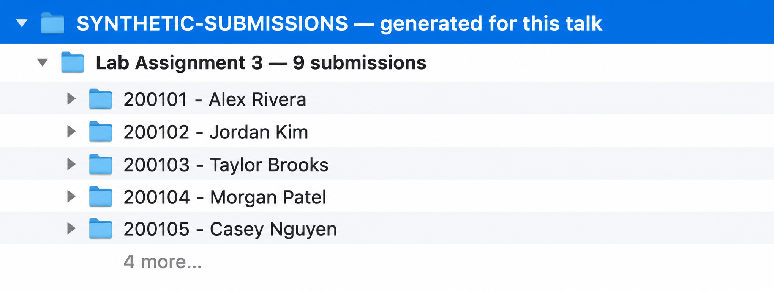
Example application of Agentic AI: Grading assistant
WARNING: FERPA COMPLIANCE – Anonymize before using commercial models
ILLUSTRATIVE SCENARIO · SYNTHETIC SUBMISSIONS, NOT STUDENT WORK
The prompt
In ~/Desktop/synthetic-submissions/ there are nine submissions, the full rubric, and one graded sample.
Use a coarse-grained version of the rubric – bad/middle/good, on each dimension.
Make a folder for each of three performance bins, bin each submission into one, and write a short note for each with the justification.
WHAT CAME BACK
— Three folders created
— Every submission placed into one folder
— A note in each submission explaining why
— No grades assigned
I agreed with almost all of the choices.
I write the rubric. I make the judgment calls.
Coarse judgments are delegate-able and reduce cognitive load on grading.
Notes:
I’d rewrite the notes around the selective delegation point and use them to absorb old Slide 7:
2 minutes — Show what useful delegation actually looks like.
The point is not the vendor or a taxonomy of agents. The point is that I can now hand over a meaningful chunk of work rather than ask for advice about how to do it.
Say plainly that the submissions are synthetic and generated for this talk.
Emphasize what I supplied: the rubric, a graded example, and the coarse categories. Those are representations of my judgment.
Emphasize what I delegated: reading the submissions, making coarse judgments against the rubric, organizing them, and recording the rationale.
Emphasize what I retained: the actual grading decision. I reviewed the result and agreed with almost all of its choices.
Do not let this become a grading-policy conversation. FERPA is a real constraint, but it is not today’s argument.
=====
I did not ask it how I should grade these submissions. I gave it the full rubric, one graded example, and nine synthetic submissions, and asked it to make a coarse first pass.
It found the files, read the rubric and example, made coarse judgments against the rubric, organized the submissions into three bins, and recorded why it put each one there. I agreed with almost all of its choices.
Notice what I delegated and what I did not. I wrote the rubric. I supplied an example of what I meant. I still make the actual judgment calls. What I delegated was the expensive intermediate work that makes those judgments easier.
This is increasingly how I think about using AI: not “Can it do my job?” but which parts of the work can I delegate, and what do I need to represent so that delegation works?
And once I start delegating substantial work, the engineering question follows: How do I represent what matters, and how do I keep control?
Then straight into the Section 2 divider. That last sentence replaces Slide 7 cleanly.

Slide 8
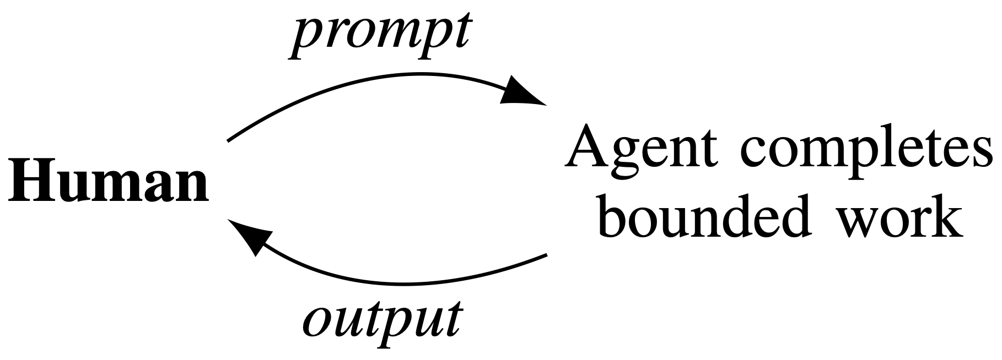
How do we keep control?
SECTION 2
How do we “prompt” GenAI?
How do we check its work?
Notes:
Purpose: Frame MAGE as the answer to the error surface just described, not as a separate research pitch.
Talk track: If more autonomy means more places to be wrong, the response is the ordinary engineering one: represent what matters, check what matters, and turn recurring failures into structure instead of conversation.
Transition: Three ideas follow, each with a concrete instance: modeling, alignment, conversion.
Timing: ~15 seconds.

Slide 9
Specifications constrain acceptable realizations
REQUIREMENTS
SPECIFICATION
consequential obligations, made explicit
OBLIGATIONS
what we constrain
DEGREES OF FREEDOM
what we leave open
ACCEPTABLE REALIZATIONS
A ✓
B ✓
C ✓
D ✗
not acceptable
Notes:
Purpose: Establish what a specification does: it makes consequential obligations explicit while deliberately leaving other choices open.
Talk track: Engineering rarely means specifying one unique realization. We identify the obligations that matter, while leaving other decisions to whoever—or whatever—does the realization. A, B, and C can therefore be different and all correct. D crosses a boundary we said mattered.
This becomes especially important with probabilistic implementors. Every consequential fact we fail to put inside this boundary becomes something the implementor may have to infer.
Transition: And once agents increasingly perform the realization, this changes where we put our engineering effort.
Timing: ~1 minute.

Slide 10
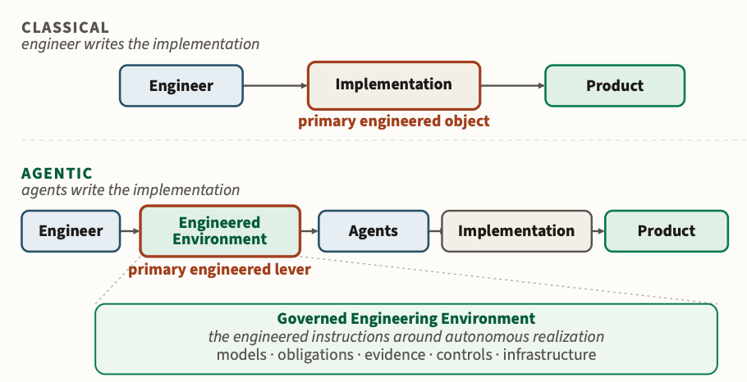
Turn your attention from the object to the agentic environment
“Implementation” here is not only software: documents, analyses, grant proposals, lectures, and slides can all be engineered within the same framework.
Notes:
Purpose: Explain the central MAGE shift: when realization can increasingly be delegated, the engineer’s primary leverage moves from directly producing the realization toward engineering the environment in which it is produced. Make “implementation” intelligible across engineering disciplines, not synonymous with source code.
Talk track:
Now take the picture from the previous slide and ask: where does the engineer put their effort?
I use the word implementation here very broadly. I’m a software engineer, so my natural example is code. But don’t get hung up on that word. Depending on your field, the realization might be a circuit, a structural design, a manufacturing plan, a control system, an analysis, a document, or something else entirely.
And, of course, many engineers don’t personally produce the implementation today. You may specify it, design it, review it, or govern its production while technicians, contractors, manufacturing systems, or other engineers actually realize it.
ANIMATE: classical row.
So this is the familiar picture. The engineer acts on the implementation—or at least the implementation is the primary engineered object—and that eventually produces the product.
ANIMATE: agentic row.
What changes with agents is that another implementor can increasingly sit between me and that realization. I can hand over substantial amounts of the production work.
So my engineering leverage moves upstream. I increasingly work on the engineered environment in which the agent operates: the models it can reason through, the obligations it has to satisfy, the evidence we collect, the controls around its actions, and the infrastructure it works within.
The claim is not that every physical implementation in every engineering discipline suddenly became cheap. The claim is conditional: where realization gets cheaper to delegate, engineering effort shifts toward deciding what should happen and constructing the environment that makes acceptable realization more likely.
And that judgment did not suddenly become cheap.
Key emphasis: Do not define “implementation” narrowly. The important distinction is engineering intent versus its realization, regardless of who or what performs that realization.
Animation:
Classical row.
Agentic row.
Engineered-environment box and its contents.
If animated separately, highlight the shift from “primary engineered object” to “primary engineered lever.”
Transition:
So what belongs in that engineered environment? MAGE starts with two principles. The first is about what the implementor gets to know.
Timing: ~1.5 minutes.

Slide 11
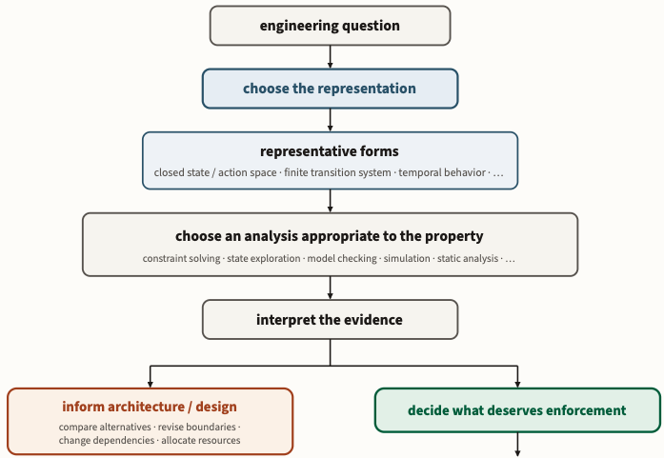
The Modeling Principle
Modeling Principle: Externalize engineering knowledge and intent into explicit, structured models that both humans and agents can reason through.
Notes:
Purpose: State the first MAGE principle and make clear that “model” means an explicit, structured representation of engineering knowledge and intent—not necessarily UML, formal methods, or a particular notation. Connect directly back to the grading example.
Talk track:
The first is the Modeling Principle:
Externalize engineering knowledge and intent into explicit, structured models that both humans and agents can reason through.
The important word here is externalize.
If something consequential exists only in my head, then an agent doesn’t know it. It has to infer it. And a probabilistic implementor may infer it differently from me, or differently from one run to the next.
We actually already saw a simple example of this in the grading demonstration.
I didn’t say, “Here are nine submissions; figure out what good means.” I gave the agent the rubric. I gave it a graded example. Those artifacts externalized some of my judgment so that the agent had something concrete to reason against.
Models do not have to mean UML diagrams. A specification is a model. A rubric can be a model. A schema can be a model. An architecture can be a model. What matters is that consequential knowledge has been represented explicitly enough that the implementor can work against it.
This is one reason agentic engineering pushes us toward modeling. As implementation gets easier, repeatedly making the implementor rediscover knowledge we already possess becomes increasingly wasteful—and increasingly dangerous.
Don’t make the implementor infer what you already know.
Key emphasis: Do not turn this into “everything written down is a model.” The relevant representations encode consequential engineering knowledge or intent in a form that supports reasoning about the realization.
Animation: If the slide contains only the principle/figure, reveal the figure first and the formal principle second, or vice versa according to the existing build. Do not over-animate individual words.
Transition:
But there is an important limitation here. Writing down a requirement gives the implementor information. It does not guarantee that the requirement will remain true. That is the second principle.
Timing: ~1.25–1.5 minutes.

Slide 12
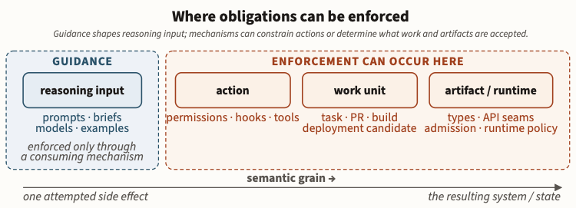
The Alignment Principle
Alignment Principle: Make engineering obligations enforceable by encoding them into deterministic and probabilistic mechanisms that constrain agentic action.
Notes:
Purpose: Explain the difference between merely informing an agent of an obligation and engineering mechanisms that constrain or evaluate realization against that obligation. Establish deterministic and probabilistic controls as complementary.
Talk track:
The second is the Alignment Principle:
Make engineering obligations enforceable by encoding them into deterministic and probabilistic mechanisms that constrain agentic action.
This is the difference between telling and engineering.
I can put a sentence in a prompt saying, “Never violate this requirement.” That is useful information. But the only thing making it true is the implementor following the instruction.
If the requirement is consequential, I would rather arrange the environment so that we can constrain or evaluate the realization against it.
Sometimes that mechanism can be deterministic. A type system can make some states impossible. A schema can reject malformed structure. A test can establish a property. A linter or policy rule can reject a known class of violation.
But not every engineering obligation can be reduced to a deterministic predicate. Some questions genuinely require judgment: Does this alternative text convey what matters in the figure? Does this analysis actually answer the question? Does this design satisfy the intent behind the requirement?
Those checks may themselves be probabilistic.
So the goal is not to make everything deterministic. The goal is to be deliberate about where probabilistic judgment belongs—and to use stronger controls where the property permits them.
A requirement in a prompt is information. A requirement backed by a mechanism that can constrain or evaluate the realization is a control.
Key emphasis: Avoid implying that “alignment” means making an AI share human values in the generic AI-safety sense. Here it is an engineering concept: consequential obligations are encoded into mechanisms that can constrain/evaluate agentic realization.
Also avoid saying that every requirement can literally be prevented from failing. Probabilistic checks remain probabilistic.
Animation:
Principle / central assertion.
Deterministic mechanisms.
Probabilistic mechanisms.
If present, final contrast between information and control.
Transition:
And this raises the practical question: where do all of these models, obligations, and controls come from? We don’t know all of them in advance. A lot of them come from failure.
Timing: ~1.5 minutes.

Slide 13
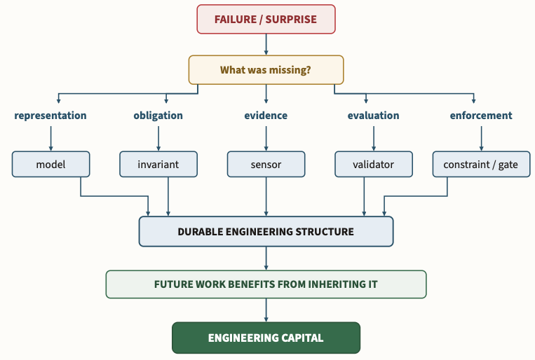
Governance conversion: When a failure repeats, make your expectations explicit and (more) deterministically checkable
Notes:
Purpose: Explain how an engineered environment accumulates engineering knowledge over time. Recurring failures are evidence of missing knowledge, constraints, or controls; MAGE converts that experience into durable structure rather than repeatedly repairing individual outputs or expanding prompts.
Talk track:
This is the feedback mechanism that makes the first two principles practical.
We are not going to anticipate every obligation, every failure mode, or every useful representation before the system does any work.
The agent works. Something goes wrong.
The first time, perhaps I just fix it.
But if the same class of failure keeps coming back, that is engineering information. It is telling me that something I care about is still missing from the environment.
Maybe the agent repeatedly flattens the heading structure in a document. I can respond by adding another sentence to the prompt: “Please preserve the heading levels.”
But if I actually know the heading contract, the stronger response is to represent it explicitly and check it on every run.
Now that lesson no longer depends on me remembering it, or on the next agent paying attention to paragraph seventeen of a prompt. It has become part of the engineering environment.
That is what I mean by governance conversion: recurring experience gets converted into more explicit models, obligations, evidence, or controls.
And notice the direction of travel. The system doesn’t improve because I progressively decide to trust the agent more. It improves because the environment accumulates engineering knowledge and removes some of the accidental freedom that produced failures.
This is also why I think a lot of what gets called “prompt engineering” is temporary scaffolding. If a sentence in a prompt captures a durable engineering lesson, the question should eventually become: Can this become structure? Can I represent it more clearly? Can I check it more reliably?
Key emphasis: Do not claim that every failure should become a deterministic rule. Conversion can produce:
a better model;
an explicit obligation;
additional evidence;
a deterministic control;
a probabilistic check;
or a deliberate decision that some freedom should remain.
The principle is durable engineering learning, not “turn every mistake into a unit test.”
Animation: Build the conversion loop progressively:
Work / realization.
Failure becomes visible.
Diagnose what was missing.
Convert that lesson into structure.
Return to future work.
If the figure visually distinguishes increasing determinism, reveal that last.
Transition:
So those are the pieces: externalize what we know, make consequential obligations effective through controls, and convert recurring failures into more structure.
Now let me show you a system that was actually built this way.
Advance immediately to “A system built this way — DocAble.”
Timing: ~1.5 minutes.

Slide 14
A system built this way
SECTION 3 · WORKED EXAMPLE
DocAble: automated accessibility remediation for educational documents.
Document
Obligations
Checks
Remediated
Notes:
Purpose: Move from principle to a real system, and preview its shape so the demo and the architecture land as one thing.
Talk track: Everything in the last section was abstract. This is a system I actually run, built the way I just described, and the reason its architecture looks the way it does is the argument, not an implementation detail.
Transition: Start with why the obvious instruction is not a specification.
Timing: ~15 seconds.

Slide 15
“Make this accessible” is not a specification
PPTX · DOCX · XLSX · PDF
“Make it accessible.”
?
WHAT THAT INSTRUCTION LEAVES OPEN
document structure
alternative text
reading order
table semantics
colour contrast
document metadata
which standard we must meet
the original file must appear the same
NEEDS JUDGMENT
What does this figure convey to someone who cannot see it?
CAN BE DETERMINED
Does the file have a title? Are the heading levels well formed?
“Looks accessible” is not a check.
(For $2-$5 per deck, frontier models like Claude Fable can handle PPTX. Can we trust it? Can we make it cheaper?)
Notes:
Purpose: Establish the DocAble problem: the instruction everyone would give is not a specification, and the gap is inspectable.
Talk track: If I hand a document and that sentence to any capable system, the result depends entirely on what it assumes. Each of these items is a separate obligation, and they do not have the same character: some need semantic judgment about content, and many are properties of the file that a library can answer directly.
Do not: Do not read the list as an accessibility checklist. It is there to show that one instruction hides many obligations.
Animation: Flow first, then the obligations, then the judgment/determinable split, then the closing line.
Transition: That split is the architecture of the system.
Timing: ~1.5 minutes.

Slide 16
MAGE Application: Use AI for judgment; use checks for what is checkable
Document
PROBABILISTIC · WHERE JUDGMENT IS NEEDED
interpret what a figure conveys
draft candidate alternative text
infer semantic intent the file does not record
Remediation graph
Accessibility obligations
Transformations
DETERMINISTIC · WHERE IT IS NOT
does the document have a title
are the heading levels well formed
does the output satisfy the schema
conformance checks against the standard
Checks and evidence
Remediated document
The remediation graph provides the model for execution.
Everything that can be deterministic is deterministic.
For the remainder, deterministic data helps the GenAI reason.
GenAI models propose changes; the pipeline applies, checks, and records.
Notes:
Purpose: Show AI as one component inside an engineered pipeline, and show the division of labour that makes the system trustworthy.
Talk track: Read the pipeline top to bottom: a document comes in, we build a representation of it, we attach the obligations that apply, we transform, we check, and we emit both a document and evidence. I do not ask a model whether a PDF has a title when a library can answer that. I ask a model only the questions that genuinely require interpretation, and everything it proposes still has to pass a check.
If asked about implementation: The remediation graph is the authoritative object for execution; transformations are applied against it rather than against free-form model output.
Animation: Pipeline first, then the probabilistic column, then the deterministic column, then the closing note.
Transition: Enough architecture. Let me show you it running.
Timing: ~2 minutes.

Slide 17
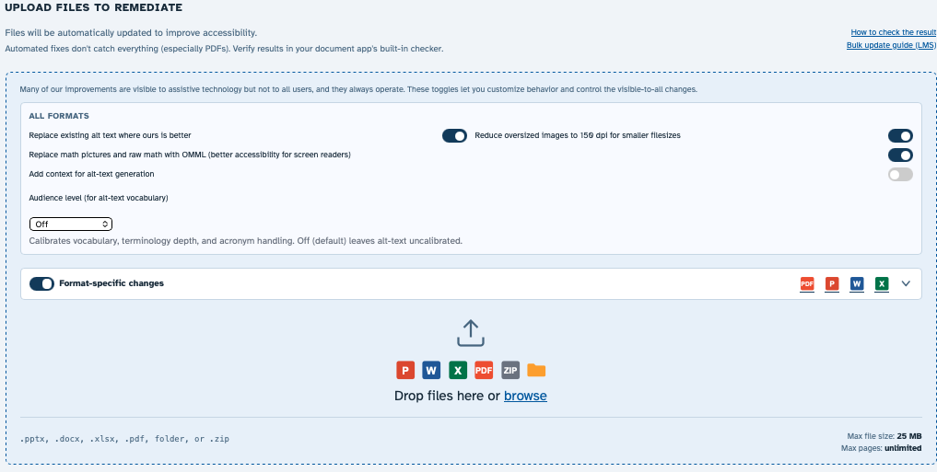
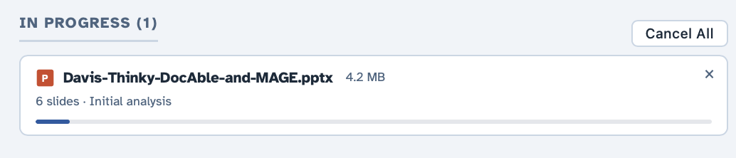
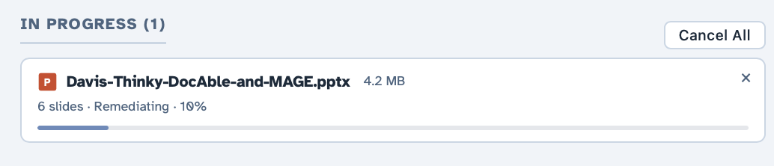
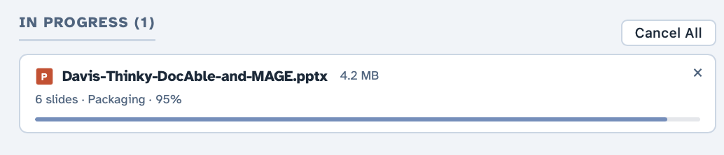
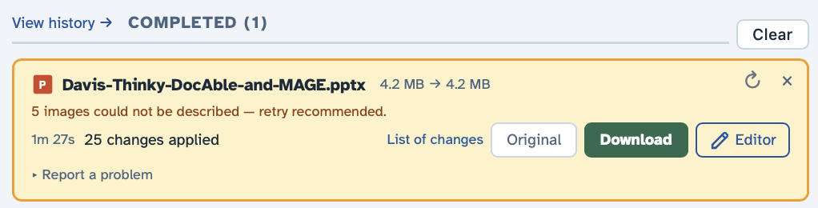

With GenAI, one engineer can build a remediation system
$0.11
Notes:
Purpose: Establish that the system is real, usable, and that the output is inspectable. The demo is the content; the slide stays out of the way.
Demo discipline: Three to four minutes, hard stop. One document chosen because its changes are visible and explainable. Answer four questions only: what do I give it, what does it do, what do I get back, how hard is it to use.
Talk track: While it runs, say what it is doing in the terms of the previous slide: building the representation, attaching obligations, transforming, checking. Then open the result and show one change with the check that verified it.
Risk: This is the largest timing risk in the talk. If anything stalls, cut to the recorded fallback and move on; the argument does not depend on the demo succeeding live.
Transition: Then the question people actually ask me: how did one person build this?
Timing: 3–4 minutes.

Slide 18
The agent did not “build DocAble”
The agent does the work
Failures become visible
and around again
The agent works inside a narrower environment
Structure is added: types, tests, rules, the graph
~2M
lines of code
heavy
agent assistance throughout
extensive
automated testing and checking
I did not get there by trusting agents more.
I used my knowledge of software engineering to construct an environment in which they tended to be more right, and were prevented from being wrong.
Notes:
Purpose: Kill the misleading story that someone prompted an AI and a large system appeared. Show the loop that actually produced it, and connect it to conversion.
Talk track: Every turn of this loop looks the same. The agent does work, something goes wrong in a way I can see, and I respond by narrowing what is possible: a type, a test, a rule, an entry in the execution graph. The next turn happens inside a smaller space of wrong answers. That accumulated structure is why the system is bigger than what I could personally implement.
Do not: Do not linger on statistics. The numbers are there to establish scale, not to impress.
Animation: Reveal the loop one step at a time, then the scale facts, then the closing line.
Transition: One more DocAble slide, then what all of this does to teaching.
Timing: ~2 minutes. This is one of the most important slides in the talk.

Slide 19
You can use DocAble today
WHAT IT DOES
Automated accessibility remediation for PPTX, DOCX, XLSX, LibreOffice, LaTeX, Typst, and PDF files.
WHERE
scholaccess.com
WHO CAN USE IT
Log in with your Purdue email using the Microsoft button.
STATUS
Under active development. Expect rough edges. We have until April.
If it does not work on your document, report the failure.
Use the issues button at the bottom left of the website, or email davisjam@purdue.edu
Include files and details!
A colleague did his entire course’s PPTX decks, spent 5 minutes reviewing each deck, and then promised me a beer.
Notes:
Purpose: Operational slide. Tell them what it does, where it is, and what to do when it breaks.
Talk track: Keep this short and factual, not promotional. The one thing to emphasise is the failure path: silently abandoning it costs me the information I need most.
Why failures matter: Connect back to conversion: a recurring failure is what gets turned into structure. Every report is a candidate for a new check rather than a one-off fix.
Animation: Reveal the reporting band after the facts so it lands as the ask.
Transition: Everything I have shown you is available to our students too. That is the next question.
Timing: ~45 seconds.

Slide 20
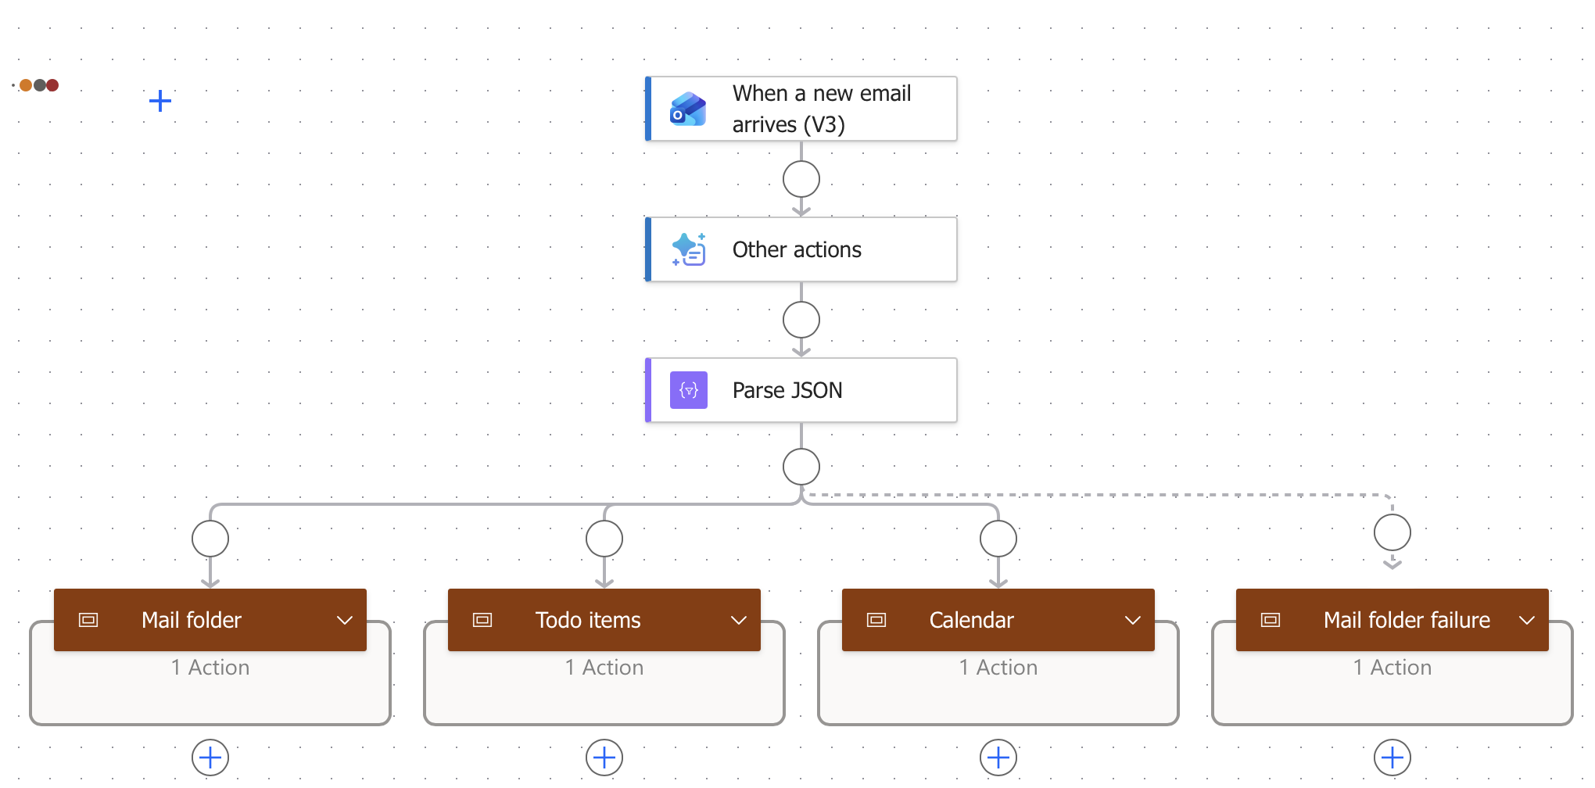
Another way to use AI in your daily work?
Should be able to do more with less
Identify bottlenecks, identify the right models, apply GenAI
GPT: Analyze this email
Parse the result
Bin my mail into High/Medium/Low
Extract action items
Make calendar entries

Slide 21
What happens when our students have agents?
SECTION 4
Everything I have just shown you is already available to them.
There are tutorials online.
Notes:
Purpose: Make the turn to teaching follow from the argument rather than switching topics.
Talk track: Do not say 'now let me tell you about my course.' Say that the capability I have been demonstrating is in our students' hands already, and then ask what an engineering course should measure under those conditions.
Transition: Start with what our assignments were built to assume.
Timing: ~15 seconds.

Slide 22
Many assignments assume the artifact is the hard part
WHAT WE ASK STUDENTS TO PRODUCE
working code
a set of calculations
a written report
a design diagram
a presentation
a data analysis
The cost of producing each of these is collapsing.
Cheaper to produce is not the same as correct, and not the same as understood.
So what was the assignment measuring?
If the artifact was our evidence of reasoning, that evidence is now weaker.
Notes:
Purpose: Reframe the student-AI question as an assessment design question rather than an academic integrity question.
Talk track: The framing of cheating is too narrow to be useful. The engineering question is what the assignment was intended to measure. Most of ours used the artifact as evidence of reasoning, because producing the artifact was expensive enough that you could not fake the reasoning behind it. That inference is what got weaker.
Careful: Do not claim agents make these artifacts correct. They make them cheap. Those are different claims and the room will notice if you conflate them.
Animation: Artifacts first, then the collapsing-cost line, then the caveat, then the question.
Transition: So what is still hard?
Timing: ~1 minute.

Slide 23
What remains difficult when production gets cheap?
GETTING CHEAP
draft the code
draft the prose
make the diagrams
generate candidate solutions
summarise the sources
STILL CONSEQUENTIAL
decide what should be built
represent the requirements explicitly
compare alternatives on real criteria
find the failures before someone else does
validate against evidence, and explain the decision
The right-hand column is what our assessments now have to reach.
Notes:
Purpose: Name what stays scarce, in terms this audience recognises from their own work.
Talk track: Tie it back to the opening example. A student who can generate an implementation in a minute still has to know whether it is the right implementation, and what evidence would establish that. That is the same problem I had with the binning task, and the same problem I had building DocAble.
Animation: Left column first, then the right, then the closing line.
Transition: Here is what I did with that in ECE 30861.
Timing: ~1 minute.

Slide 24
In ECE 30861, GenAI is not a separate week
THE SEMESTER ARC
Requirements › Architecture › Design › Implementation › Validation › Operations › Maintenance
Agents appear in every one of these, not in a unit of their own.
WHAT THAT CHANGED IN THE COURSE
Team project
one system, full lifecycle, open-ended specification, “build a real product”
Agents mandated
and their use declared
Collaborating teams
Cross-tested against each other
Oral examinations
Explain the decision, not the artifact
It is still Software Engineering.
It is more Software Engineering than ever.
Implementation abundance forces the engineering discipline to become explicit.
Open course materials: davisjam.github.io/model-based-agentic-software-engineering/teach
Notes:
Purpose: Show one demonstrated realisation of teaching under implementation abundance, and make the design choices legible.
Talk track: The temptation was to add a GenAI week. That would have been wrong, because the change is not a topic; it runs through every phase. What actually changed is assessment: independent implementations that have to survive each other's tests, and oral examinations where a student explains a decision rather than hands over an artifact.
Useful line: GenAI is forcing me to teach judgment that I could previously leave implicit.
Do not: Do not claim this is now an AI course. It is Software Engineering with the discipline made explicit.
Animation: Lifecycle first, then the overlay line, then the course choices, then the closing statement.
Transition: The material is open; borrow whichever piece is useful. Then three things to try.
Timing: ~2 minutes.

Slide 25
Closing Remarks
Notes:
Purpose: Make the turn to teaching follow from the argument rather than switching topics.
Talk track: Do not say 'now let me tell you about my course.' Say that the capability I have been demonstrating is in our students' hands already, and then ask what an engineering course should measure under those conditions.
Transition: Start with what our assignments were built to assume.
Timing: ~15 seconds.

Slide 26
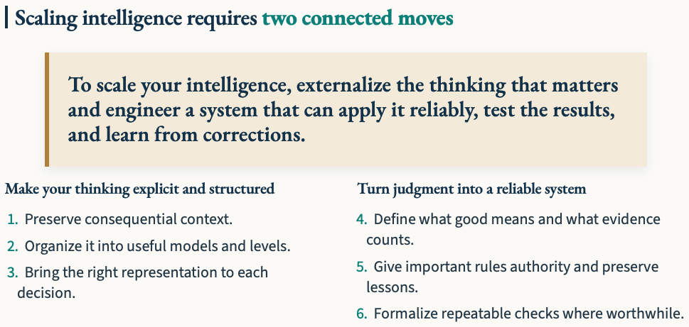
Closing thoughts

Slide 27


Homework for you!
1
Delegate something
Use an agentic interface.
Give an agent a bounded, real task.
2
Reconsider one assignment
Ask what to teach now that producing the artifact is cheap.
3
Try DocAble
Run your course materials through it and help me make it better for everyone ☺
ECE 30861 course materials
DocAble — scholaccess.com
Implementation is becoming abundant. Engineering is more important than ever.
MAGE: davisjam.github.io/model-based-agentic-software-engineering
Notes:
Purpose: Leave the room with three concrete actions and one sentence they will remember.
Talk track: Keep it brief and specific. The first action matters most: delegating a bounded real task, then inspecting what happened, teaches more in twenty minutes than any talk about agents.
Close: Return to the thesis: the opportunity is not that AI produces more work, it is that we can delegate substantial work. As we delegate more, we also delegate more intermediate decisions and permit more consequential actions, which makes engineering structure more important rather than less. Then land the last line and stop.
Q&A: Leave this slide up during questions; the three links stay visible.
Timing: ~1 minute, then questions.

