Slide 1
ECE 30861/46100: Software Engineering
Software Engineering ECE 30861 / CSCI 45000
Software engineering processes
Prof. James Davis
Prof. Steve France

Slide 2
Lecture outline
Activities and ordering
The engineered medium
Feedback and uncertainty
Choosing a process

Slide 3
Definition What do we mean by “software engineering”?

Slide 4
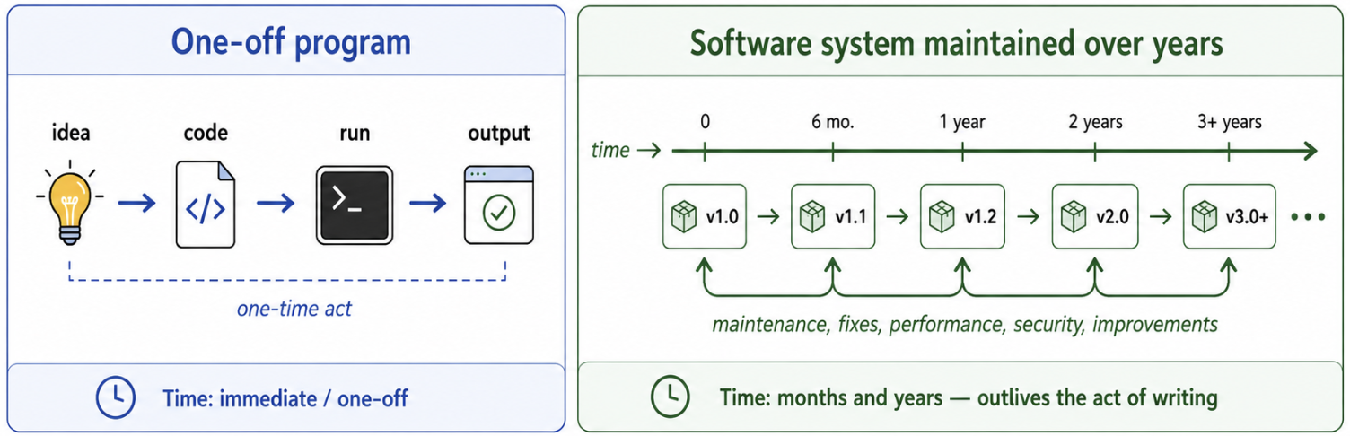
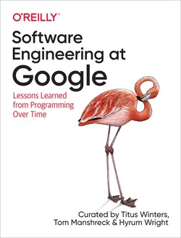
Software engineering ≅ programming over time
“Programming integrated over time”
Notes:
2 minutes — Establish that software engineering begins when programming must survive over time.
Google (Winters et al.): software engineering is “programming integrated over time.”
Start from the definition, then establish the one-off programming case.
Contrast the act of programming with a system that must persist and evolve.
Time brings change: requirements, people, platforms, and dependencies move.
This distinction establishes the frame for the course.
Builds: Google quote/book up on entry; click 1 reveals the one-off program; click 2 reveals the maintained-system timeline.
=====
Google’s Software Engineering at Google gives us a wonderfully compact definition: software engineering is “programming integrated over time.”
The word integrated is the key there. Think about what we normally mean by programming.
ANIMATE
You have an idea. You write some code. You run it. You get the output you wanted. That is a programming act. Much of the software you have written so far in your degree looks like this: there is a task to accomplish, you produce a program that accomplishes it, and the task ends.
But now take that programming act and integrate it over time.
ANIMATE
The picture changes. Version 1.0 ships, but that is no longer the end of the story. There is a 1.1, a 1.2, a 2.0, a 3.0. Between those versions are maintenance, fixes, performance work, security work, and improvements. The artifact outlives the act of writing it.
And time creates a deeper problem: the world underneath the software moves. Requirements change. People join and leave. Platforms evolve. Dependencies change. Users find new uses for the system. The assumptions under which version 1.0 was written do not remain fixed.
So the distinction here is not that software engineering means writing a bigger program. It means engineering something that must remain useful as both the system and its environment change over time.
That is our first frame for the course. Programming gives us the artifact. Software engineering has to contend with what happens to that artifact over time.
Time and change: Code will need to adapt over the length of its life
Scale and growth: As your ORGANIZATION grows, it will need to adapt as well
Trade-offs and costs: How do you make decisions about your code?
Definitions like this one from Google naturally lead to a more formal engineering discipline.

Slide 5
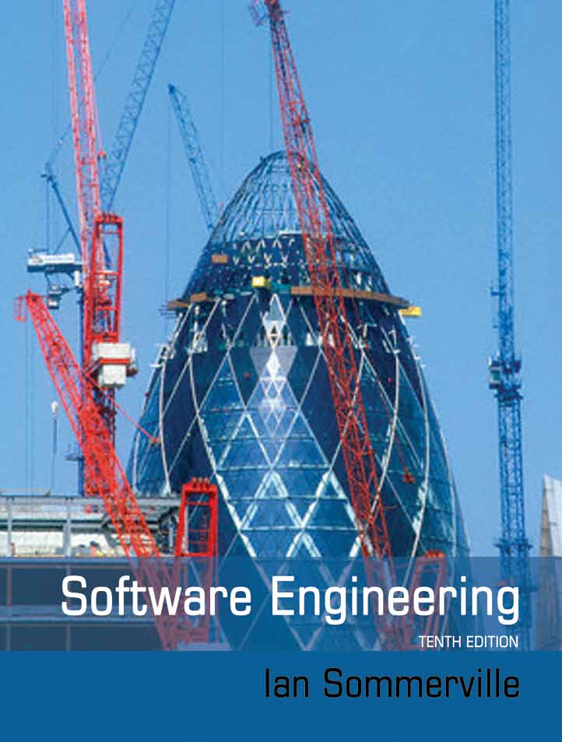
Software engineering considers all aspects of production
People
Engineered product (e.g., software)
Engineering process
Tools
“An engineering discipline concerned with all aspects of software production”
Notes:
2 minutes — Broaden software engineering from programming over time to the whole system of production.
Slide 2 established the temporal distinction: the artifact persists and its environment changes.
Sommerville broadens the scope: software engineering concerns all aspects of software production.
People use tools to carry out engineering processes that produce and sustain software.
A process organizes engineering activities: requirements, design, implementation, validation, evolution, and coordination.
Transition: what activities belong in a software process, and how should we organize them?
=====
The previous slide gave us one way to distinguish software engineering from programming: time. We are responsible for an artifact that persists and must be adapted to emerging needs.
Sommerville gives us a complementary definition. Software engineering is “an engineering discipline concerned with all aspects of software production.”
In Google’s definition “integrated over time” was the key phrase.
In Sommerville’s definition, “all aspects” is the key phrase.
Producing and sustaining software takes more than somebody sitting down and writing code.
Look at the picture.
We have people: engineers, users, customers, managers, domain experts.
And those people have tools: editors and compilers, version control, issue trackers, testing and CI infrastructure, and increasingly AI agents.
But people using tools does not by itself give us an engineered product. Their work has to be organized. They have to decide what should be built, design it, implement it, evaluate whether it works, deploy it, maintain it, and change it.
That organization of engineering activities is what we mean by a software process.
If you take nothing else away from this lecture, take this: There is not one right way to organize those activities in order to produce a given product.
Instead, the arrangement of people and tools into processes raises many questions and we must select contextually appropriate answers.
Do we determine all of our requirements before we design? Can design and implementation overlap? When do we test? When do users see the system? When do we revisit earlier decisions?
So that gives us the two questions for the next part of the lecture:
What activities have to happen to engineer software?
And how should we organize them?

Slide 6
Process What work do we do, and how do we arrange it?
People
Engineered product (e.g., software)
Engineering process
Tools

Slide 7
What are the fundamental engineering activities?
Let’s hear your ideas
Notes:
~2 min. class engagement activity
ROOM QUESTION — students call them out; build the inventory live
Also: elicit requirements, prototype, manufacture / realize, repair, “decide when to burn it down and start again”
(see next slide)

Slide 8
Engineering activities
Prototype
Implement
Manufacture/Build
Specify
Validate
Design
Elicit requirements
Repair
Release & Maintain
Burn it with fire
Notes:
Compare ROOM list to this one.

Slide 9
Arrangement #1: “Waterfall” / “Plan-based”
Not strictly linear – back-edges for rework
Notes:
2 minutes — Introduce plan-based development as one plausible arrangement of engineering activities, without yet arguing when it is appropriate.
Arrange specification, design, implementation, validation, and release largely in stages.
Progress is gated: establish that one stage is sufficiently complete before committing heavily to the next.
“Waterfall” does not mean errors can never send us backward; show the back-edges.
Each stage therefore needs some criterion for being done.
Hold the question of why we might prefer this arrangement until after comparing alternatives.
=====
Here is one answer to our question: arrange the activities largely in sequence.
We begin by figuring out what the system should do. Then we design a solution. Then we implement it. Then we validate what we built. Eventually, we release and maintain it.
This family of approaches is usually called plan-based development, and its simplest graphical representation is the waterfall.
But don’t take the picture too literally. It does not mean that engineers blindly march forward and are forbidden to go backward. Suppose I’m implementing something and discover that the design cannot work. I go back and revise the design. If testing exposes a misunderstanding of the requirements, I may have to go back even farther.
The important feature is that the activities are relatively large stages, and there is an expectation that we reach some meaningful degree of completion before proceeding.
That immediately creates another engineering question: how do I know when a stage is done?
If I’m going to say “requirements are done; now we design,” I need some evidence that the requirements are good enough to proceed. Likewise for design, implementation, and validation. So a plan-based process usually has artifacts, reviews, or other completion criteria at these boundaries.
For now, don’t decide whether this is good or bad. It is simply one reasonable way to arrange the work.

Slide 10
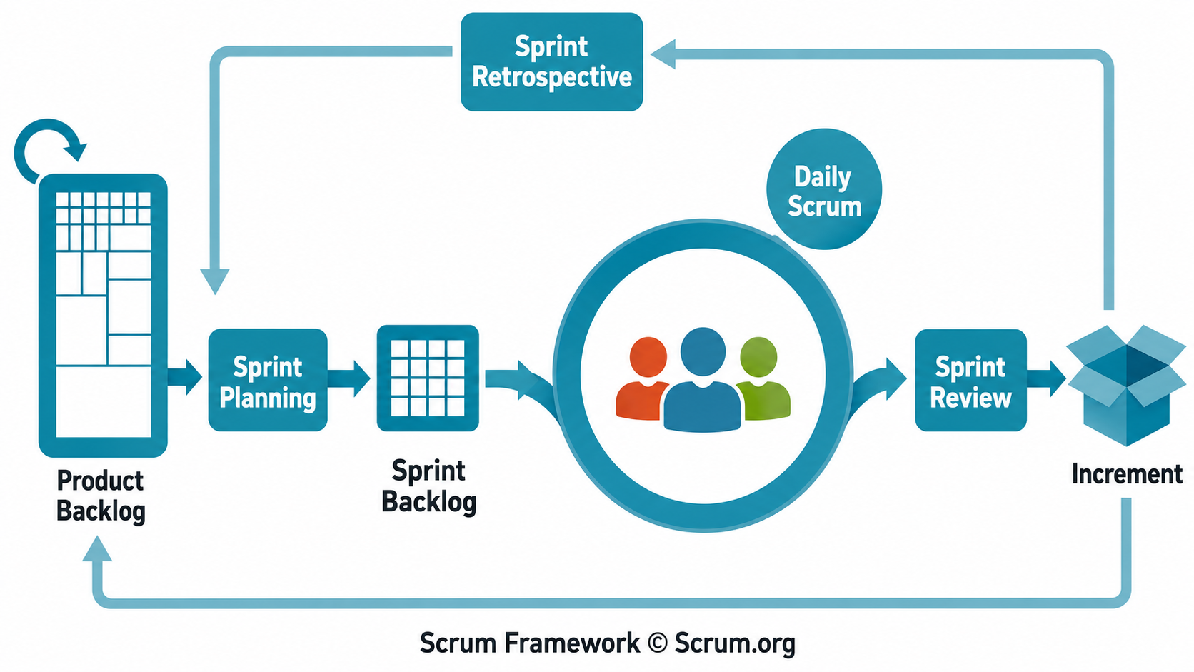
Arrangement #2: Incremental, Iterative, “Scrum”
Notes:
2 minutes — Contrast one large progression through the activities with repeated, smaller progressions that produce increments.
Perform many of the same engineering activities, but over a much smaller slice of the product.
Backlog → select work → specify/design/implement/validate → usable increment → repeat.
The increment is the conceptual point; don’t teach Scrum roles and ceremonies here.
Completion still matters: each increment needs a Definition of Done.
Establish the contrast: large commitments versus repeated smaller commitments.
=====
Here is a very different answer.
Instead of trying to move the whole product through those activities, take a smaller piece of the work and move that piece through them.
In Scrum, we maintain a backlog of things the product might need. We select some manageable subset for a sprint. During that sprint, we still have to understand what we’re building. We still design, implement, and validate it.
At the end of EVERY sprint, the goal is a usable increment of the product.
Then we do it again.
So, notice what has—and has not—changed. The fundamental engineering activities haven’t disappeared. We have changed how much work passes through them at once and how frequently we repeat the cycle.
And just like the plan-based process, Scrum needs an answer to “when are we done?” Scrum makes that explicit with a “Definition of Done” for the work items The team needs evidence that an increment actually meets its quality expectations before treating it as complete.
So, these aren’t “organized engineering” versus “just start coding.” Both organize the work. Both require decisions about completion.
They make very different choices about the size and frequency of the commitments we make.
Why would we want one arrangement rather than the other? Hold that thought.

Slide 11
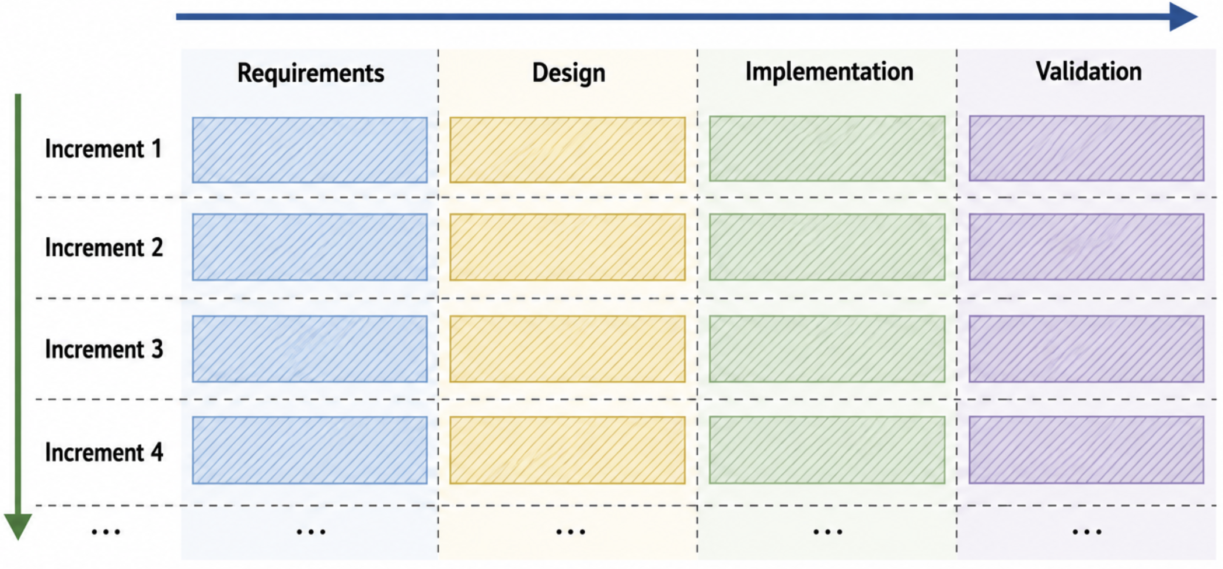
Plan vs. Increment: Organizing by activity vs. by feature
Plan-based organizes by activity – All requirements, then design, then…
Incremental organizes by feature
each feature handled separately
Notes:
Slide 11 — Plan vs. Increment: Organizing by activity vs. by feature
**2 minutes — Show that plan-based and incremental development differ fundamentally in how they partition the engineering work. ** The same engineering activities appear in both approaches: requirements, design, implementation, validation.
Plan-based: organize primarily by activity—requirements across the product, then design across the product, etc.
Incremental: organize primarily by product slice—take Increment 1 through the activities, then Increment 2, and so on.
Each increment should be a coherent slice that can be handled separately.
This is a spectrum rather than a binary: real processes can mix both forms of decomposition.
Transition: what properties of the project determine which decomposition makes sense?
=====
The last two slides showed us two very different-looking processes. But I want to pull out the more fundamental difference between them.
They don’t disagree about whether we need requirements, design, implementation, and validation. We need those engineering activities either way.
What changes is how we partition the project.
ANIMATE
Look first from left to right.
In a strongly plan-based process, we organize primarily by engineering activity. We work out the requirements for the product. Then we design the product. Then we implement it. Then we validate it.
So, we’re effectively taking a horizontal slice through the engineering work: do this kind of work across the system, then move on to the next kind.
ANIMATE
Now look from top to bottom.
Incremental development introduces another way to partition the work: by product increment or feature. Take Increment 1 and move that through requirements, design, implementation, and validation. Then take Increment 2 through those activities. Then Increment 3.
The important idea is that each increment can be handled separately. We don’t have to wait until we’ve specified or built the entire product before taking some coherent portion of it through the engineering process.
Also, note that these processes are not mutually exclusive.
A real project can do substantial up-front requirements or architecture work and still implement and validate features incrementally.
So, think of this as a question of how strongly we organize the work along each axis, not “Waterfall or Scrum?”
That gives us a much more interesting question.
When does it make sense to organize primarily by activity, and when does it make sense to organize primarily by increment?
What properties of the system, the project, or its environment should drive that choice?
That is what we’re going to explain next.

Slide 12
Factors that Shape Process What factors should influence our decisions?
People
Engineered product (e.g., software)
Engineering process
Tools
Notes:
The 1st process question was: “What work do we do, and how do we arrange it?”
Now we want to consider the factors that shape the processes we choose for software engineering efforts.

Slide 13


Why might you choose one of these models over another? What do the models cost and offer, and on what dimensions?
Plan-based
Iterative
And does your answer change if we’re trying to build a bridge?
Notes:
Slide 13 — Why might you choose one model over another?
**4 minutes — Have students generate hypotheses about process choice, then challenge those hypotheses by changing the engineered medium. ** Think–pair–share: Why choose plan-based versus iterative/incremental development?
Prompt for costs and benefits, not methodology preferences.
Accept and collect hypotheses: uncertainty, feedback, changing requirements, cost of rework, risk, ability to deliver pieces, coordination, etc.
Do not organize their answers into the course’s dimensions yet.
Reveal the bridge and ask the same question again.
Transition: process choice depends on properties of the engineering problem—not merely on a preferred methodology.
=====
We’ve now seen two substantially different ways to organize the same engineering activities.
So, I want you to make the engineering decision.
Why might you choose one of these models over the other? What does each one cost you? What does each one give you?
Take about thirty seconds on your own first. Come up with at least one reason why you might prefer a more plan-based process and one reason why you might prefer a more iterative one.
Then compare with the person next to you.
[THINK — ~30 seconds]
[PAIR — ~45 seconds]
Okay. What did you come up with?
[SHARE — take several answers. Put them on the board if convenient. Probe rather than classify.]
If someone says requirements change, ask: Why does that favor one process?
If someone says iteration is faster, ask: Faster in what sense? What are we avoiding or learning sooner?
If someone says Waterfall is safer, ask: What about it would make it safer? Under what conditions?
If someone says Agile gives feedback, ask: What can you learn from that feedback, and when is it available?
The point isn’t to find the magic correct answer yet. We are generating candidate reasons why rational engineers might organize the same work differently.
ANIMATE
Now I’m going to change one thing.
Suppose we’re not building software. Suppose we’re building this bridge.
Do your answers change?
Would you build one span, put some cars on it, see what users think, and then decide how to design the next span?
Probably not.
But why not? The fundamental engineering activities haven’t disappeared. We still have requirements. We still design. We still build. We still validate. Yet some ways of arranging those activities suddenly seem much more or less attractive.
That tells us something important: process choice depends on properties of what we’re engineering and the environment in which we’re engineering it.
So rather than asking “Which process is best?”, we need a better question:
What properties of the engineering problem should drive our choice of process?
And that’s where we’re going next.

Slide 14
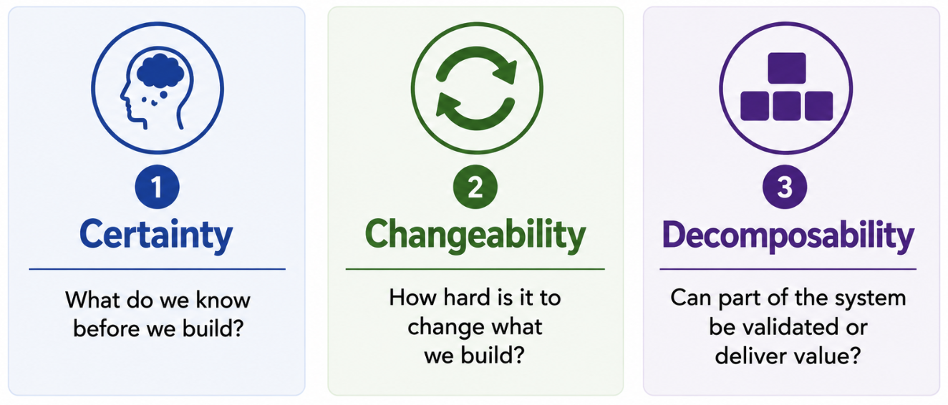
What should determine the process?
🧙MAGE Moment
Which of these is most impacted by GenAI?
Notes:
I think we can summarize the discussion as follows:
Three plain-English questions: 1. What do we know before we build? 2. How hard is it to change what we build? 3. Can part of the system be validated, or deliver value?

Slide 15
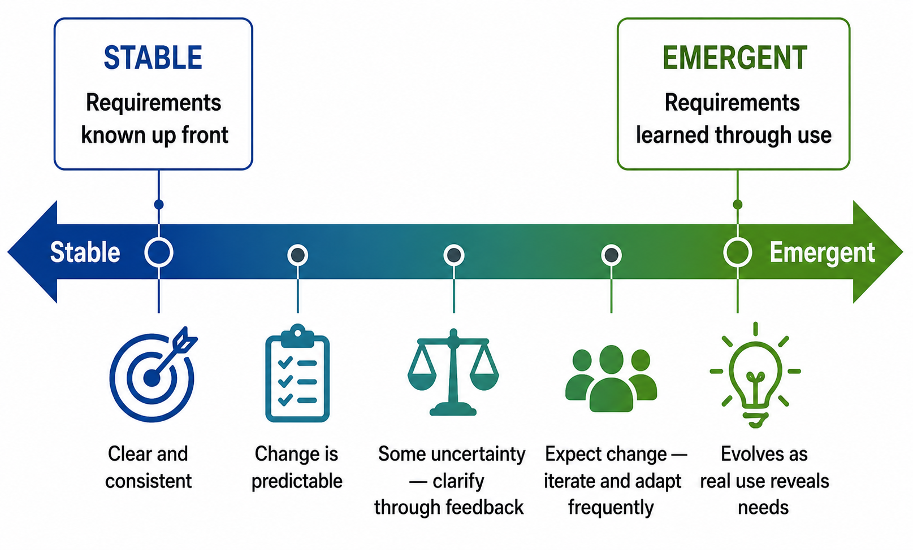
Factor 1: Certainty. What do we know before we build?
If you know what to build up front, just build it.
Notes:
**2 minutes — Establish that the value of planning depends on how much consequential knowledge is available before implementation. ** Certainty concerns what we can know before building: requirements, constraints, and important design implications.
At the stable end, requirements are sufficiently clear that substantial specification and planning can happen up front.
At the emergent end, some requirements can only be discovered through building, use, and feedback.
Most projects lie between the endpoints.
Uncertainty is not inherently bad; the process must provide a mechanism for resolving it.
Process implication: the more we can know up front, the more useful up-front planning can be; the more knowledge emerges through use, the more we need feedback.
=====
Our first factor is certainty: what do we know before we build?
At one extreme, the problem is stable and well understood. The requirements are clear and consistent. Change is relatively uncommon and predictable.
In that world, there is real value in doing substantial work up front. If I can determine what the system needs to do before I build it, then I can specify it, reason about it, and design around those requirements before making implementation decisions.
If you know what to build up front, just build it.
But now start moving to the right.
Maybe some things are uncertain, but we can resolve them through analysis. Maybe we need to talk to stakeholders, build a prototype, or get some feedback before committing.
Farther to the right, we expect requirements to change as people interact with the system.
And at the extreme, the requirement itself is emergent. We cannot completely specify the right system in advance because using the system is part of how we discover what the right system is.
Think about a new consumer product. You can interview users and make informed predictions, but sometimes the only way to discover whether a feature is actually useful is to put something in front of people and observe what happens.
That changes what we should want from the process.
If important knowledge is available before implementation, a process can exploit that knowledge through planning.
If important knowledge becomes available because of implementation and use, then the process needs to create opportunities to build something, observe what happens, learn, and revise.
So certainty gives us our first reason for choosing different processes:
How much do we already know—and how much can we only learn by building?

Slide 16
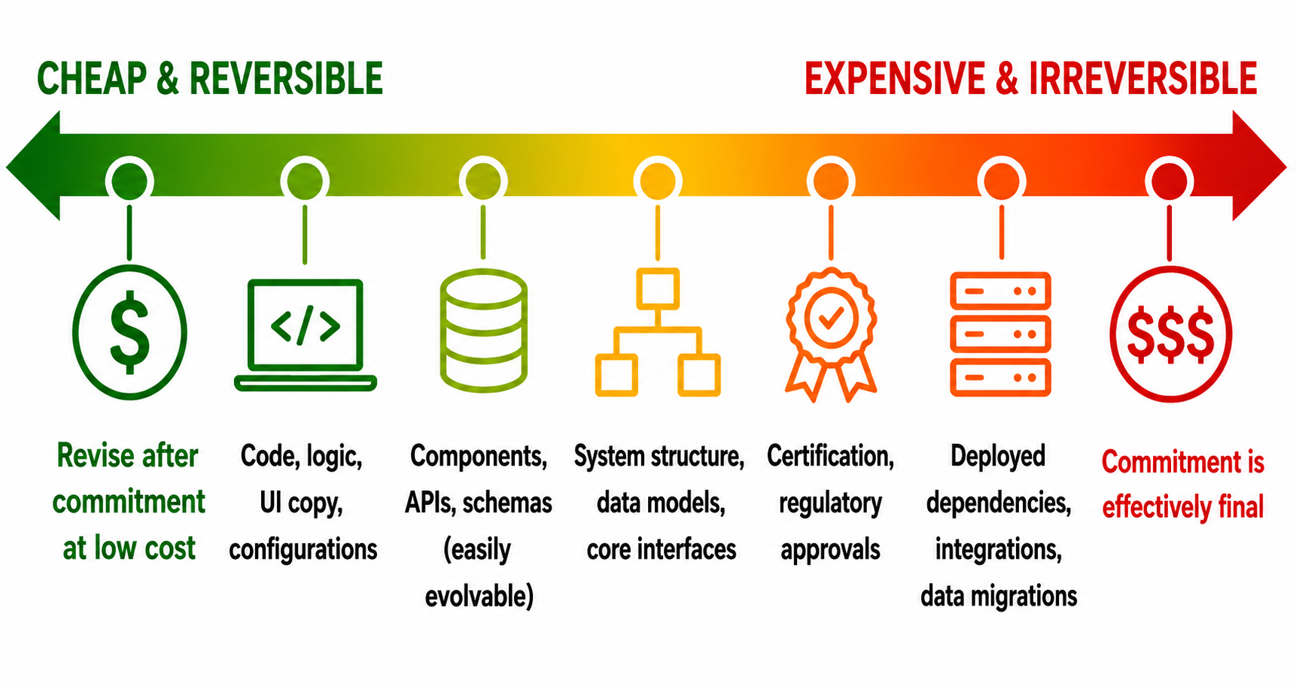
Factor 2: Changeability. How hard is it to re-work?
If it’s expensive to change, get it right the first time.
If it’s cheap to change, don’t sweat it.
Notes:
**2 minutes — Establish that planning becomes more valuable as decisions become expensive or irreversible to change. ** Changeability concerns the cost of changing a decision after commitment.
Many software decisions are cheap and reversible: code, UI copy, configuration, some APIs and components.
Others create substantial commitment: architecture, data models, certification, deployed dependencies, migrations.
The key question is not simply “is this software?” but which decisions are cheap to revisit, and which are not?
Process implication: expensive commitments justify more reasoning before commitment; cheap decisions permit experimentation and correction.
Punchline: If it’s expensive to change, get it right the first time. If it’s cheap to change, don’t sweat it.
=====
Our second factor is changeability: how hard is it to re-work something after we’ve committed to it?
This is where software is unusual as an engineered medium.
A lot of software decisions are extraordinarily cheap to change. I can change some logic, a configuration value, or a piece of UI text, run the tests, and deploy a new version. I haven’t poured concrete. I haven’t manufactured ten thousand parts.
That makes experimentation economically reasonable. If getting a decision slightly wrong costs me twenty minutes tomorrow, spending three days proving that it is right today probably doesn’t make sense.
But don’t make the mistake of concluding that all software decisions are cheap to change.
Move across this spectrum and commitments begin to accumulate. Components acquire users. APIs acquire clients. Data models accumulate data. Architecture constrains subsequent design. External systems become integrated. Certification may depend on specific decisions. A deployed data migration may be extremely difficult to reverse.
At the far end, a decision may be effectively final—or at least so expensive and risky to change that we should treat it that way.
So, process should respond to the cost of commitment.
If a decision is expensive to reverse, we have a reason to analyze, design, review, and validate it before making the commitment.
If it is cheap to reverse, we can often make the decision, observe the result, and correct it later.
That’s our second dimension:
If it’s expensive to change, get it right the first time. If it’s cheap to change, don’t sweat it.

Slide 17
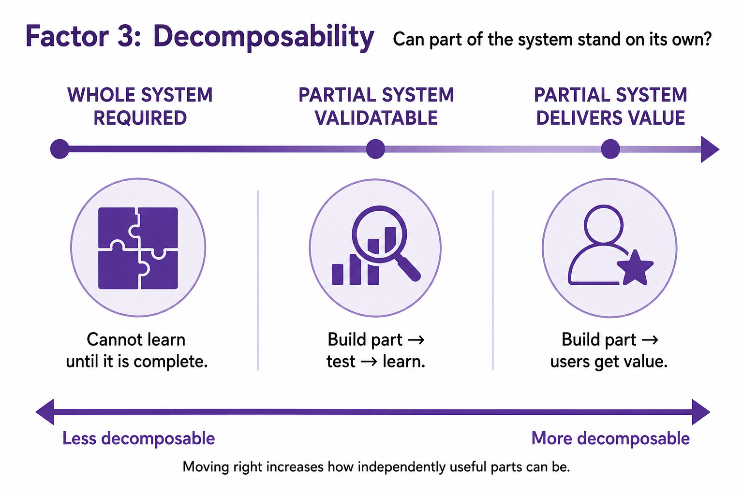
Factor 3: Decomposability. Does anyone want half a system?
I’d rather sell half a system now than a whole system in 3 years with 2 more competitors.
Notes:
**2 minutes — Distinguish whether partial systems permit learning from whether they can actually deliver value. ** Decomposability asks whether a meaningful part of the system can stand on its own.
Lowest decomposability: the whole system is required before meaningful validation is possible.
Intermediate: a partial system cannot yet deliver value but can be validated—so building it creates information.
Highest: a partial system can both be validated and deliver useful value.
Validation and delivery are different thresholds.
Process implication: incremental development becomes more attractive as useful learning or value can be obtained from smaller slices.
=====
Our third factor is decomposability: can part of the system stand on its own?
Or less formally: does anyone want half a system?
At the left is a system where the answer is basically no. We have to build nearly the whole thing before we can meaningfully judge whether it works.
Think back to the bridge. Half a bridge is not half as valuable as a bridge. Nobody gets halfway across the bay and says, “Great first increment.”
But there is an important middle case.
A partial system might not be useful to its eventual users, but it might still be validatable.
I can build part of something, test it, measure it, put it in a realistic environment, and learn whether my assumptions were right. That partial system has produced no customer value yet—but it has produced information.
Then we get to the highly decomposable case: a partial system can deliver value.
Maybe I am building an online store. Search can become useful before recommendations exist. Basic checkout can work before I add every payment method. Each increment can pass through requirements, design, implementation, and validation—and somebody can actually use the result.
That distinction matters because learning and delivery are not the same threshold.
A process can benefit from incremental construction even when the increments aren’t independently shippable, provided they let us validate important assumptions. If the increments also deliver value, the economic case for incremental development becomes stronger still.
So, our third question is:
How much of the system must we build before we can learn something meaningful—or deliver something useful?
And now we have our three dimensions: certainty, changeability, and decomposability. Together, they give us a much better basis for choosing a process than simply asking whether Waterfall or Agile is fashionable.

Slide 18
One more question, and then a stretch break
Why isn’t ”consequence of failure” in here? Where to put it?
Notes:
There’s one obvious thing missing from this picture.
Where is consequence of failure?
If we’re building an operating system vs. a hackathon entry, surely that matters. So why isn’t it one of these dimensions?
[Take answers.]
The reason is that I think it answers a different engineering question.
Suppose failure could kill somebody. Does that tell me whether I know the requirements before I build?
Not necessarily.
Does it tell me whether the system is cheap or expensive to change?
No.
Does it tell me whether I can meaningfully build and validate part of the system?
Again, no.
A highly consequential system could be anywhere on each of these three dimensions.
What consequence changes is how much evidence I require before I say the system is good enough.
If I’m making a game and a feature occasionally behaves strangely, perhaps I ship it and learn from what happens.
If I’m making flight-control software, “let’s ship it and see what happens” is not an acceptable validation strategy.
So, keep these two questions separate.
These three dimensions help us reason about how to organize the engineering work.
Consequence of failure helps determine how much assurance we demand before accepting that work.
We’ll have much more to say later in the course about how you obtain that evidence.
And with that distinction in place, stretch break.

Slide 19
Two worked examples

Slide 20

What process would you recommend for a mobile app?
Notes:
3 minutes — Apply the three dimensions to a consumer software product where user behavior creates substantial uncertainty.
Certainty: relatively low. We can specify functionality, but cannot reliably predict what users will enjoy, adopt, ignore, or abandon.
Consumer preferences are fickle; actual use generates information that requirements analysis cannot fully provide.
Changeability: much of the software is comparatively cheap to change and redeploy, although some architectural and platform commitments are less reversible.
Decomposability: high. Features and experiences can often be released, observed, measured, and revised independently.
Therefore, favor short feedback loops and incremental delivery—not because the software is unimportant, but because the product itself must be learned through use.
Active feedback matters: telemetry, experiments, user reports, retention/engagement measures, operational data.
Connect back to process: iteration is valuable when each cycle produces information that changes what you should do next.
=====
Let’s apply our three dimensions to something very different.
Suppose we’re building a mobile application—something like Pokémon Go.
Start with certainty. How much do we know before we build?
We can know quite a lot technically. We can specify that the application needs a map, accounts, location services, particular game mechanics, and so forth.
But there is something extremely consequential that we cannot specify with much confidence: what will people actually want to do?
People are fickle. A feature that sounds wonderful in a requirements meeting may be ignored. Something you thought was minor may become the reason people use the product. Users may interact with the system in ways you never anticipated. And their preferences can change as the product and the community around it evolve.
So, this is a case where use itself produces important requirements information.
What about changeability?
A lot of this system is relatively changeable. We can modify game mechanics, interfaces, parameters, content, and many other behaviors and distribute another software release. That doesn’t mean everything is cheap to change—architecture, data models, platform dependencies, and commitments to millions of existing users can become quite expensive—but many product decisions remain reversible.
And finally, decomposability.
Very high. We don’t need to invent every feature Pokémon Go will ever have before anybody can use version 1. We can deliver a coherent experience, observe what happens, add another capability, and observe again.
And notice how these three properties reinforce each other.
We don’t completely know what users will want. We can change much of the product relatively cheaply. And partial versions can be used.
That makes frequent iteration extremely valuable.
But iteration only helps if we close the feedback loop. We need telemetry. We need experiments. We need user reports. We need to watch what people use, where they struggle, what keeps them engaged, and what causes them to leave.
The point isn’t that mobile apps are somehow less important and therefore we can afford to be sloppy.
It is almost the opposite: when user behavior is part of what determines whether you’ve built the right system, careful and active feedback is part of the engineering process.
So, for this project, I would strongly favor an incremental process with short feedback loops—not because “Agile is for apps,” but because the properties of this engineering problem make iteration informative.

Slide 21


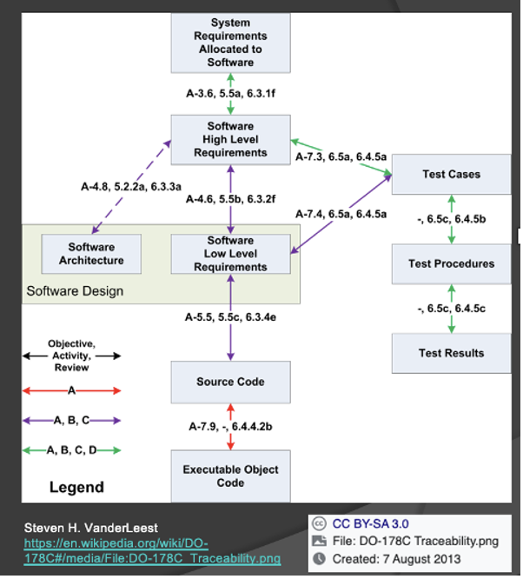
And for MQ-9 program?
RPAs – MQ-9A / B
Remote Split Ops (LOS, SATCOM)
Ground Support Equipment
Ground Control Stations
Mission Control
Launch & Recovery
DO-178C - Software Considerations in Airborne Systems and Equipment Certification
Design Assurance Levels
Notes:
3 minutes — Apply the same dimensions to a safety-critical cyber-physical system and show why they imply a different balance of planning, evidence, and iteration.
Certainty: substantial obligations can be known up front—mission requirements, interfaces, safety constraints, certification requirements—but a complex system still contains uncertainty.
Changeability: many commitments are expensive to reverse, especially hardware interfaces, deployed equipment, integration decisions, and certified software.
Decomposability: subsystems can certainly be developed and validated independently, but useful operational capability depends on integration across aircraft, communications, ground stations, and control systems.
DO-178C makes evidence consequential: higher assurance levels impose substantially greater development and verification obligations.
Therefore, expect more explicit requirements, controlled interfaces, traceability, verification, reviews, and carefully managed change.
Contrast with the app: iteration still occurs, but the cost of learning by changing the deployed system is much higher.
=====
Now let’s take the same three questions and apply them here.
This is the MQ-9 program. And notice immediately that we’re not talking about one piece of software. We have an aircraft, ground-control stations, launch and recovery systems, communications links, support equipment, and many hardware and software components that must operate together.
Start with certainty.
There are important things we can—and must—know before we build. What does the aircraft have to do? What are the interfaces between components? What safety properties must hold? What evidence will regulators require?
That doesn’t mean there is no uncertainty. This is a complex engineered system. But there is a substantial body of consequential knowledge that we can establish before committing to implementation.
Now changeability.
Suppose I discover that a button label in our mobile app is confusing. I can change it.
Suppose instead that I discover late in this program that I’ve chosen the wrong interface between two major subsystems.
That’s a very different problem.
Hardware has been built. Other components depend on that interface. Integration has occurred. Software may have been certified against specific requirements and designs. Changing one decision can trigger changes—and new evidence requirements—throughout the system.
So many of these commitments are much farther toward the expensive end of our changeability spectrum.
Finally, decomposability.
We absolutely can decompose this system. In fact, we must. Individual components and subsystems can be developed and tested independently.
But decomposability has limits. A ground-control station sitting by itself isn’t the mission capability. Neither is the aircraft, the communications system, or one software component. Eventually we need evidence that these pieces work correctly together.
ANIMATE
And now add the regulatory environment.
Software used in airborne systems may be subject to DO-178C. The required rigor depends on its Design Assurance Level. As the consequences of software failure become more serious, the development and verification obligations become correspondingly demanding.
So, compare this with Pokémon Go.
Both projects iterate. Both learn. Both change software.
But here, many important commitments are expensive to reverse, substantial obligations are knowable in advance, and final behavior depends on integration across a complex physical system.
That pushes us toward more deliberate up-front reasoning, explicit requirements and interfaces, controlled changes, traceability, and substantial verification evidence.
And that’s the point of these two examples.
We didn’t say: “apps use Agile and aircraft use Waterfall.”
We asked the same three engineering questions—and the answers pushed us toward different ways of organizing the work.

Slide 22
How might you influence an engineering project’s certainty, changeability, and decomposability?
Notes:
Ask the ROOM: are these factors we’ve been discussing static?
No.
The last topic we’ll consider today is how we might influence these factors, and the implications thereof.

Slide 23
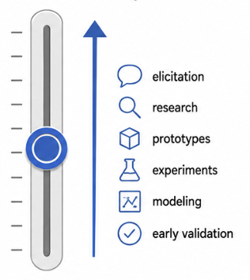
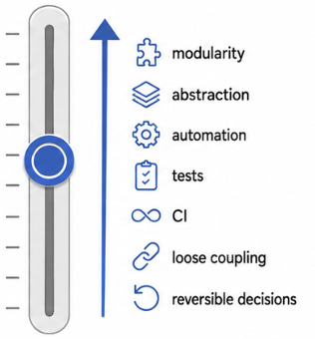
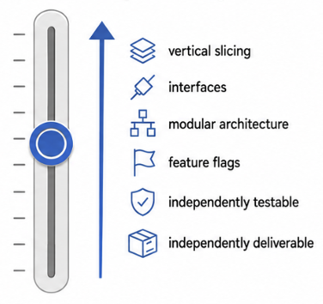
How can you increase your:
Certainty
Changeability
Decomposability
Engineering can move the knobs.
But moving them isn’t free.
Notes:
**4 minutes — Shift from treating the three dimensions as properties we observe to properties engineers can deliberately influence. ** The dimensions constrain process choice, but they are not necessarily fixed.
Ask the room for ways engineers can move a project along each dimension.
Certainty: elicitation, research, prototypes, experiments, modeling, early validation.
Changeability: modularity, abstraction, automation, tests, CI, loose coupling, reversible decisions.
Decomposability: vertical slicing, interfaces, modular architecture, feature flags, independently testable/deliverable capabilities.
Important qualification: moving a dimension has a cost. We do it when the resulting process flexibility is worth that investment.
Transition: apply both questions to the course project—where are we on each dimension, and can/should we move?
=====
So far, I’ve presented these three dimensions as though they are facts about the project.
How certain are we? How expensive is change? How decomposable is the system?
But engineers don’t merely observe those properties. Sometimes we can change them.
Let’s take them one at a time.
How could you increase certainty?
[Take answers.]
You can talk to stakeholders. Study the domain. Build a prototype. Run an experiment. Model the system. Validate assumptions before committing to a design.
All those activities cost something—but they can turn something we don’t know into something we do know.
What about changeability? How can we make a system cheaper to change?
[Take answers.]
This is a huge part of software design. Modularity. Good interfaces. Loose coupling. Automated tests. CI. Keeping decisions reversible until they actually need to be made. All of these can reduce the cost of changing our minds later.
And finally, decomposability. How can we make it possible to build or validate smaller pieces independently?
[Take answers.]
We can design around independently meaningful capabilities. Establish interfaces between components. Find vertical slices through the system. Separate things that need to evolve independently. Sometimes feature flags or deployment architecture let us put part of a capability into use before everything around it is finished.
So, these aren’t merely three knobs that nature sets for us.
Engineering can move the knobs.
But—and this is important—moving them isn’t free. More research costs time. More modularity can add complexity. Making something independently deployable can require infrastructure and architectural work.
Process selection is not just:
“What kind of project do I have?”
It is also:
“What kind of project is it worth engineering this into?”
And that brings us back to your project.
You should be able to look at it and ask two sets of questions:
Where are we on certainty, changeability, and decomposability? And what could we deliberately do to move those dimensions?

Slide 24
What does it mean for your project?
Notes:
Ask the ROOM: are these factors we’ve been discussing static?
No.
The last topic we’ll consider today is how we might influence these factors, and the implications thereof.

Slide 25
Final activity: Discuss the process for your project
Organize
Move physically to sit with your team.
Introduce yourselves briefly.
Discuss
Discuss what type of software engineering process you will use for your project.
Assess your project on the dimensions of certainty, changeability, and decomposability.
Submit
Submit a summary of your analysis for the 3 dimensions and a (non-binding) recommendation for your process.
Teams are posted on Piazza.
You have 10 minutes.
https://tinyurl.com/4wz35rwj

