Slide 1

Software Engineering
ECE 30861 / CSCI 45000
Modeling: Degrees of Semantic Commitment
Models carry different amounts of their own meaning.
Prof. James C. Davis
Prof. Steve France
quick sketch
UML
structured schemas
SysML v2 + KerML
the same marks can carry more — or less — of their own meaning
Lecture 1: Purposeful reduction — what must the model preserve?
Lecture 2 (today): Semantic commitment — and a modeling laboratory.
1
Notes:
Lecture 2 of the Modeling unit. Last time: one model, one question — purposeful reduction. Today: a second, independent axis — how much of its meaning a representation carries explicitly — and then we work with a semantically defined model in the MAGE Workbench.

Slide 2

Last time: purposeful reduction
An engineering model preserves the distinctions required by a question
and deliberately leaves other choices free.
ENGINEERING
QUESTION
MODEL
PROPERTY
QUALITY
the discipline from Lecture 1 — every model starts from a question
WHAT THE MODEL PRESERVES
WHAT STAYS FREE
The distinctions the question requires:
states and forbidden transitions, typed
relations, quantities and bounds.
Degrees of freedom — realization choices
the model deliberately does not settle:
algorithms, data structures, naming,
decomposition.
Purposeful reduction governs what the model says.
2
Notes:
Thirty-second callback. Bring back degrees of freedom explicitly — slide 7 needs them. The banner is deliberately half a sentence: slide 4 completes it (semantic commitment governs how much the model itself says about what it means).

Slide 3
Who uses semantic models?
AEROSPACE & DEFENSE
AUTOMOTIVE & INDUSTRIAL
Boeing · Airbus · Lockheed Martin
Siemens · peer industrial firms
ENGINEERING-TOOL VENDORS
GOVERNMENT & RESEARCH
Dassault Systèmes · Ansys · PTC
Space and defense agencies
· research laboratories
These organizations helped develop SysML v2 — the OMG contributor and signatory ecosystem.
That is the claim — not that every one of them runs SysML v2 in production today.
The commonality: they engineer consequential systems where software meets physical
resources, timing, safety, power, hardware, organizations, requirements, and other systems.
They need models that support consequential engineering reasoning — not merely pictures.
3
Notes:
Motivation, not technical argument — which is why this slide lives in the opening. Wording discipline: 'helped develop the standard', not 'use it in production'.

Slide 4
Today: from meaning to engineering
Two independent questions about any model:
What distinctions does
the model preserve?
How explicitly does the representation
define what those distinctions mean?
purposeful reduction — Lecture 1
semantic commitment — today
§1
Degrees of Semantic Commitment
What does the representation mean?
§2
Engineering with Semantic Models
What can we do because it means that?
§3
Working with Semantic Models
What is it like to work with one?
→ the lab
§4
Optional: Reasoning with
SysML and KerML
reference — a worked example,
after the core lecture
Two models can preserve the same distinctions and carry their meaning very differently.
4
Notes:
The conceptual thesis of the lecture, plus the map. The arc: what does the representation mean → what can we do because it means that → what is it like to work with one. §4 is optional/reference.

Slide 5
What does this arrow mean?
A
B
calls?
may call?
depends on?
sends data to?
was observed calling?
Same marks. Different engineering claims.
A diagram that permits five readings licenses none.
Whoever interprets the sketch — teammate or agent — supplies the meaning
the marks do not carry.
The marks are the same; the meaning is supplied by the interpreter.
5
Notes:
Reused from the strongest material of the previous deck. Run the readings quickly; the point lands in one beat. This is the itch §1 scratches: where does the meaning live?

Slide 6
Models carry different amounts of meaning
SEMANTIC COMMITMENT
How much of a representation's meaning is carried explicitly by the representation itself,
rather than supplied by whoever — or whatever — interprets it.
quick sketch
UML
structured schemas
SysML v2 + KerML
examples along one axis — not maturity levels
A quick sketch may be exactly right when several engineers need to communicate an
architectural idea to one another — or to an agent for a prototype.
STRONGER SEMANTICS BUY
AND THEY COST
reliable interpretation · query ·
composition · analysis · validation
authoring effort · expertise · tooling ·
maintenance · sometimes human accessibility
The engineering decision is not “maximize semantics.”
6
Notes:
Folds the draft's cost slide in. No disparagement of informal modeling — the sketch is often the right engineering choice. The question is what the representation must support.

Slide 7
Precision is not completeness
AMOUNT SPECIFIED
DEGREES OF FREEDOM SURVIVE
STRONGER SEMANTICS
an enormous prose
spec — still
ambiguous
A model may precisely define memory,
allocation, units, and a resource
constraint —
a tiny model —
semantically
precise
— while saying nothing about data
structures, algorithms, task
decomposition, naming, or logging.
PRECISION OF MEANING
Those are not gaps. They are
authorized freedom.
The two axes are independent.
Neither corner implies the other.
Precision about modeled decisions does not settle unmodeled decisions.
7
Notes:
The draft wanted this visually strong: the two-axis figure IS the slide. Folds degrees of freedom back in from Lecture 1. Sets up the table's non-monotonic realization-freedom column on slide 8.

Slide 8
Degrees of semantic commitment
Concrete example
Where the meaning lives
Interpretation burden
What it enables
Remaining realization freedom
Informal box-and-arrow sketch
Almost none in the marks — the team supplies what boxes and arrows mean
Low if you share the context; high if you do not
Fast communication
Very large
UML 2.5.1
Standardized model elements and relationships
Requires notation knowledge and project context
More precise shared interpretation
Large — describes selected aspects
OpenAPI 3.1 / JSON Schema
Explicit machine-readable types, fields, constraints, references
Structure explicit; domain intent remains contextual
Inspection, validation, transformation
Often still large
SysML v2 + KerML
Types, relationships, expressions, constraints defined as part of the language
Language and tool knowledge up front — less semantics to reconstruct
Query, composition, analysis, machine reasoning
Potentially very large
Interpretation burden is relocated, not removed. And realization freedom does not shrink as commitment grows — precise semantics do not imply complete specification.
These are examples, not maturity levels. Semantic precision and amount specified are different dimensions.
8
Notes:
The culmination of §1 — the Chapter 2 table (book §2.1.4, label semantic-commitment-spectrum), deck-condensed from six columns to five (row-label and Agentic-implication columns dropped; 'What it enables' added back per the author's deck sketch; cell wording from the landed chapter, including the renamed Interpretation-burden column). The burden column relocates interpretive work — it does not rank informal=human-friendly vs formal=machine-friendly. SysML/KerML appears only as the strongest-commitment row. The red cell is the point: the freedom column is NOT monotonically decreasing.

Slide 9
What semantics buys
query
“which buffers does the radio stack own?”
compose
join two models: “does an optional component feed an essential one?”
SEMANTIC
MODEL
analyze
“do the allocations fit the 256 KiB budget — with how much margin?”
validate
“is this comparison licensed by a declared ordered domain?”
generate
“emit the interface types from the one declared schema”
one concrete example each — the first four return as questions in §3's lab
Selected meanings become machine-operable.
9
Notes:
One concrete example per operation, not five bare nouns. The examples are drawn from the embedded-sensor-node model students meet in §3 — deliberate foreshadowing.

Slide 10
If machines understand the model, why not generate the code?
Sometimes we should.
GENERATE WHAT THE MODEL DETERMINES
Want the generator to decide less
configuration
interfaces and schemas
state-machine fragments
deployment artifacts
boilerplate
The model must decide more
More realization encoded in the model
At the limit: you have built another
programming language
Purposeful reduction says: that may not be what we want. The decisions worth modeling are not
always the decisions needed to determine the code.
Generation needs the decision to be made.
10
Notes:
Lead with the honest answer to the skeptical question: sometimes we should — deterministic transformation for what the model genuinely determines. Then the tension: fully-generative modeling collapses into programming. Ties §2 back to purposeful reduction.

Slide 11
Generate, delegate, or model
purposeful model
Kind of decision
Response
Mechanically determined
Generate it
obligations + freedom
agent
Open within modeled obligations
Delegate it
realization choices
Recurring and consequential
Consider modeling it
implementation
The third row is how recurring, consequential
knowledge gets promoted into durable structure —
a library, a domain extension.
Traditional generator: specify enough to
determine the transformation.
Agentic implementation: specify what
matters; delegate the remaining choices.
MODEL: what matters · obligations · properties IMPLEMENTATION: one realization · many further decisions
Some relationships are generation, some delegation, some validation back against the model.
The model is not another implementation.
11
Notes:
The §2 synthesis: machine-operable semantics → generation challenge → the agentic answer. Agents can cross the realization gap a purposeful model deliberately leaves. Don't teach 'agents should extend the language' — teach promotion of recurring consequential knowledge into durable structure.

Slide 12
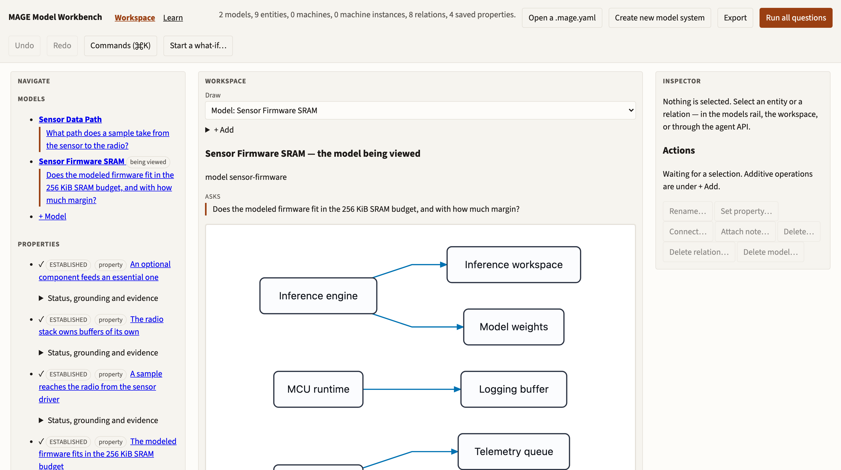
The MAGE Workbench
davisjam.github.io/model-based-agentic-software-engineering/workbench
Models · saved questions · evidence · an agent API — one-minute orientation, then we start from a question.
12
Notes:
Real screenshot: the Embedded Sensor Node example loaded, viewing the Sensor Firmware SRAM model. Orientation only: the models rail and saved properties (left), the drawn model and its declared purpose (center), inspector and actions (right). Don't tour controls — the next slide starts from an engineering question.

Slide 13
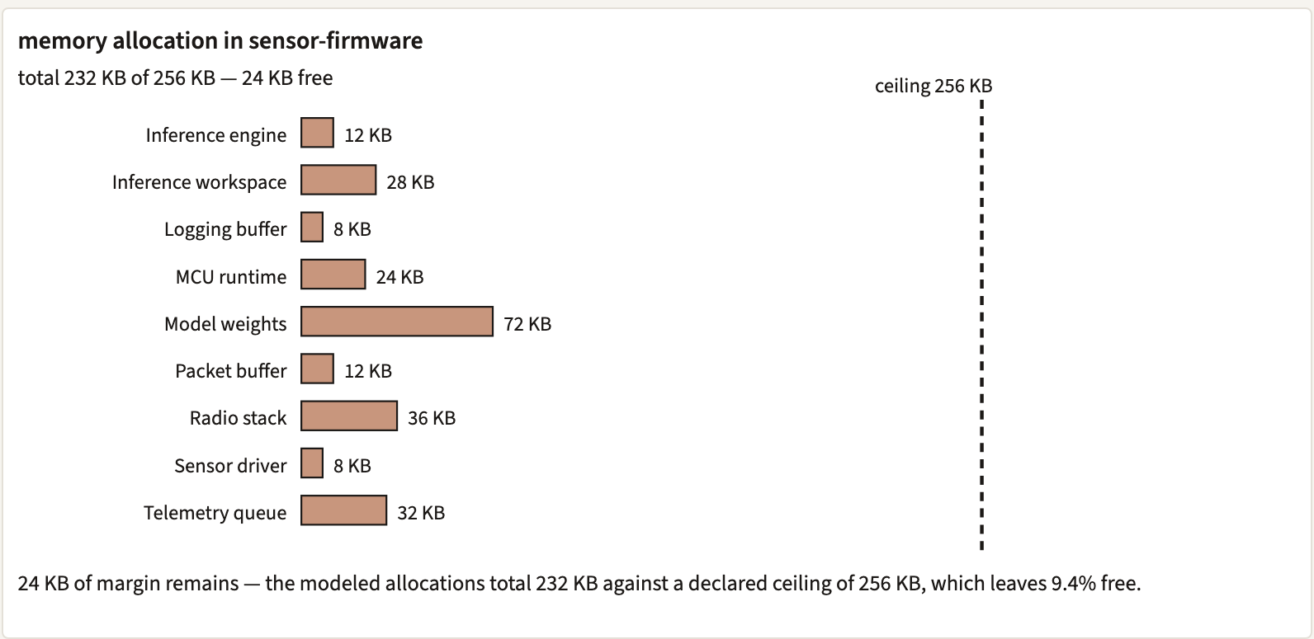
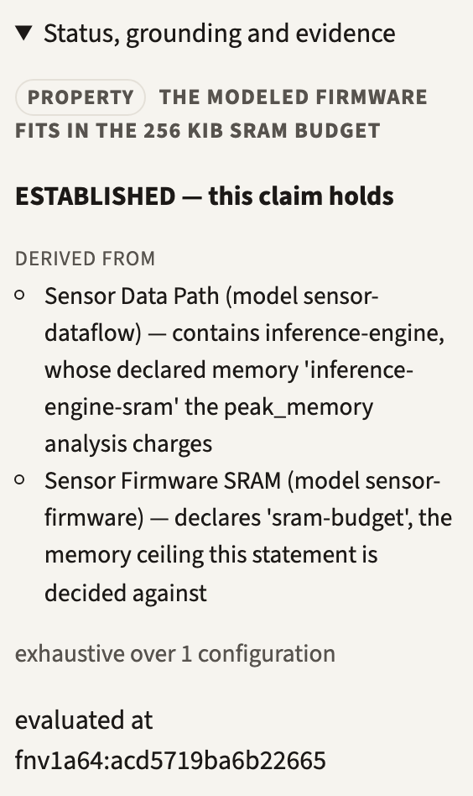
Ask the model
Does this configuration fit within its memory budget?
the saved question, run deterministically
model
semantic machinery
result
No LLM required. Elements, relations, and quantities have
declared semantics; the answer is computed, with provenance.
the verdict carries its evidence:
derived from which models,
exhaustive over what
232 KB of 256 KB — 24 KB of margin. The answer arrives with its evidence.
13
Notes:
Both panels are real Workbench output for the shipped example. Surface honesty: the quantity question runs as a SAVED question ('The modeled firmware fits in the 256 KiB SRAM budget') — the composable ask surface covers graph questions. Provenance is displayed: DERIVED FROM both models, 'exhaustive over 1 configuration', plus an evaluation fingerprint.

Slide 14
Ask through an agent
“What is consuming memory on the sensor node?”
Interacting with models can be tedious: navigate the model, find the right question form, formulate
the query. The Workbench's composable ask surface covers graph questions; the rest run as saved
questions.
Engineer
THE AGENT SURFACE
question
window.mage — the Workbench exposes
the model to agents: typed operations,
questions, evidence.
Agent
model operations
Model
semantic result
THE KEY DISTINCTION
Agent
The agent helps interpret the question
and operate on the model.
It need not invent the engineering facts.
explanation
Engineer
Natural questions in — the model's semantics still produce the facts.
14
Notes:
Introduce the agent from the friction, not as a feature checklist. The agent operates the model through window.mage; the semantic result comes from the model's machinery, and the agent explains it.

Slide 15
Lab: model → query → revise
LAB
1
Determine current memory consumption and margin.
WHAT THE MODEL DECLARES
2
Identify the largest consumers.
budget: 256 KiB of SRAM
total: 232 KB → 24 KB margin (9.4%)
pinned requirement:
“the modeled firmware fits in the
256 KiB SRAM budget”
doubling the telemetry queue
(32 → 64 KB) takes the total to
264 KB — the requirement fails
by 8 KB
a ≥20% margin needs the total
at or under 204.8 KB — several
changes achieve it, several
near-misses do not
the model's KB tokens are binary:
256 KB here is exactly 256 KiB
3
Double the telemetry queue.
4
Re-evaluate the budget requirement.
5
Restore a margin of at least 20%.
Tasks, not UI instructions.
Use whichever surface you prefer:
• run the saved questions and read the evidence
• edit through the workspace, or through the agent
• ask the agent — then check it against the model
The search is the design activity, not a lookup.
15
Notes:
Release students into the activity. The numbers come from the shipped model: 9 allocations totalling 232 KB against 256 KiB; doubling telemetry-queue breaks the pinned requirement by 8 KB; restoring a 20% margin needs ≤204.8 KB. Largest single allocation: model-weights at 72 KB (31% of budget).

Slide 16
What can’t the model answer?
What is peak SRAM consumption?
“It answers ‘what if everything is live at once’, and it cannot answer ‘is everything live at once’. The second question needs operating modes — Sleeping, Sampling, Inferring, Transmitting — and resource lifetimes tied to them … That is the earned transition to Behavior, and it is deliberately not in this file.”
— the shipped model's own header, embedded-sensor-node/system.mage.yaml
More prompting cannot create missing engineering knowledge.
The agent can navigate, infer, or propose — but if the answer needs distinctions the purposeful
model does not preserve, stronger prompting does not repair the model.
Lab closing question: what would we need to add to make this question answerable?
— exactly Lecture 1's judgment: which distinctions must the model preserve, and at what cost?
The model states its own boundary — an omission declared on its purpose.
16
Notes:
The lab payoff, and the lecture's punchline — quoted from the shipped artifact itself, not asserted. The model's purpose block lists 'operating modes' as its first declared omission. Students can try the agent first; the boundary holds.

Slide 17
END OF THE CORE LECTURE
Modeling makes knowledge explicit.
Alignment gives it consequence.
The model says the margin stays above 20%.
Next lecture: what happens when reality disagrees?
OPTIONAL · REFERENCE
§4 — Reasoning with SysML and KerML
The sensor node named what it was missing: operating modes.
These six slides take a sibling system where modes, flow, and quantities are modeled —
and show what the stronger semantics let us derive. Not “SysML 101.”
17
Notes:
The Alignment handoff closes the core lecture (kept from the previous deck). §4 is optional/reference. The frame: §3's model documented operating modes as its missing distinction; §4 works a sibling system where those distinctions are modeled — in SysML v2, the strongest-commitment row of slide 8's table.

Slide 18
A sensing system — behavior and resources
part def SensorNode {
attribute samplingPeriod = 5 [s];
attribute sampleSize = 512 [B];
attribute bufferCap = 4096 [B];
attribute radioRate = 4096 [B/s];
attribute txPeriod = 30 [s];
state def Modes {
state Sleep; // 0.1 mW
state Sample; // 5 mW, 50 ms
state Transmit; // 60 mW
}
requirement avgPowerBudget {
// average power <= 2 [mW]
}
}
ONE RICHER EMBEDDED SYSTEM
modes Sleep / Sample / Transmit
sampling period 5 s
sample size 512 B
buffer capacity 4 KiB = 8 samples
radio throughput 4 KiB/s
transmit timer every 30 s
mode power 0.1 / 5 / 60 mW
requirements average power ≤ 2 mW,
and the buffer must not overflow
SysML v2 textual notation — excerpt, abridged
Exactly the distinctions the sensor node declared as omissions: operating modes, and resource
lifetimes tied to them.
Enough SysML to establish the actual model — the constructs earn their keep on the next slides.
18
Notes:
Introduce the system once, with the actual numbers; slides 19-21 reason over them. The excerpt is abridged notation, not a complete model. Power figures: Sleep 0.1 mW; Sample 5 mW for 50 ms per sample; Transmit 60 mW while draining at 4 KiB/s.

Slide 19
Can the buffer overflow?
Given: avg production rate (512 B / 5 s ≈ 102 B/s) < radio throughput (4096 B/s)
Locally plausible: “then it cannot overflow.”
tx done
Sleep
sample timer
Sample
buffer full
Transmit
done
tx timer (30 s)
Sample produces data. Transmit consumes it. Modes draw different power.
Comparing the two rates cannot answer the question. The radio drains the buffer only while
Transmit is active — transmission availability depends on state behavior, batching, and timing.
The honest answer needs behavior, flow, and quantity composed. That is the next slide.
A locally plausible conclusion can be wrong — now the semantics do real work.
19
Notes:
The trap: average-rate reasoning. The machine: Sleep -sample timer-> Sample -done-> Sleep; Sleep -tx timer-> Transmit -tx done-> Sleep; Sample -buffer full-> Transmit. Data is drained only in Transmit, so the buffer's fate depends on when Transmit runs.

Slide 20
Behavior, flow, and quantity
state
occurrences
sample
production
buffer
capacity
transmission
behavior
quantities
+ units
+
+
+
+
the buffer property
THE BASELINE, DERIVED
samples per 30 s transmit cycle: 30 s ÷ 5 s = 6 ≤ capacity 8 → no overflow (6/8)
transmit time per cycle: 6 × 512 B ÷ 4096 B/s = 0.75 s
average power: (60·0.75 + 5·6·0.05 + 0.1·29.0) mW·s / 30 s ≈ 1.65 mW ≤ 2 mW ✓
every step is licensed by a declared quantity, unit, or state occurrence — nothing is folklore
Derived by hand from the model. The semantics make each step well-defined; no tool computed
this verdict for us — slide 22 says exactly what tools can and cannot decide today.
This is where SysML/KerML earns its keep: one property composed across three views.
20
Notes:
Walk the composition slowly. Honesty constraint: the derivation is hand-performed; the language's semantics license it (typed quantities, units, state occupancy), but no available tool executes it — foreshadow slide 22.

Slide 21
Change the sampling rate
Perturbation: sampling period 5 s → 2.5 s.
What changed?
THE BUFFER PROPERTY
THE POWER REQUIREMENT
12 samples per cycle > capacity 8
Overflow? No.
At the 8th sample the buffer-full
transition fires and Transmit
drains early.
STILL HOLDS — because of
behavior, not arithmetic.
transmit: 12 × 512 ÷ 4096 = 1.5 s
avg ≈ (90 + 3.0 + 2.79) mJ / 30 s
≈ 3.2 mW > 2 mW budget
NOW FAILS — the same change,
a different property, the opposite
verdict.
One model modification propagates into multiple engineering properties.
All numbers hand-derived from the model's declared quantities — and the slide says so.
One change, two properties, two different verdicts.
21
Notes:
The numbers are chosen so the answer is nontrivial and mechanically derivable BY HAND: the naive overflow prediction is wrong (behavior rescues it), and the passing power budget flips to failing. Arithmetic: 12 samples per 30 s; transmit 12x512/4096 = 1.5 s -> 60 mW x 1.5 s = 90 mJ; sample 5 mW x 12 x 0.05 s = 3.0 mJ; sleep 0.1 mW x (30 - 1.5 - 0.6) = 0.1 x 27.9 = 2.79 mJ; total 95.79 mJ / 30 s = 3.19 = ~3.2 mW against a 2 mW requirement.

Slide 22
Why can the model answer?
WHAT THE SEMANTICS LICENSE
MEASURED — OCTOBER 2026
typed features + units
512 [B] ÷ 4096 [B/s] is well-defined;
a magnitude is a number with exactly
one unit of its dimension
state occurrences
when Transmit is active determines
when the buffer drains
expressions + constraints
the requirement is a claim over model
values, not a comment
SysML supplies the systems concepts;
KerML, the semantic foundation beneath.
SysML v2 Pilot Implementation
(release 2026-08, kernel 0.62.0):
✓ parses + validates these models
✓ name resolution, typed structure
✗ cannot execute state machines
✗ cannot compute a verification
verdict
✗ quantity expressions stay
symbolic (d + e unevaluated)
✗ 2 [kg] assigned to a length
validates silently
“SysML v2 can express far more than its reference implementation can decide.”
“The semantics make it derivable” is a claim about the language — not about a tool run.
22
Notes:
The honesty slide. The derivations of slides 19-21 are licensed by the language's defined semantics and were carried out by hand. Measured ground truth (workbench differential-conformance design, Oct 2026): the Pilot parses/validates but cannot execute machines, produce verification verdicts, or normalize quantities; dimension conformance is unchecked at kernel 0.62.0. Express vs decide.

Slide 23
What still can’t be known?
What is peak SRAM consumption?
Asked of the richer model this time — modes, flow, power, and all.
Still missing: stack depth under interrupt nesting · allocator fragmentation · DMA buffers
· which allocations are simultaneously resident within a mode
Insufficient information — unless we model the distinctions that property requires.
§3's model named its missing distinction — operating modes. §4 modeled them — and still
has a boundary. Every purposeful model does.
The question is never “is the model complete?” It is “does it preserve the distinctions this
question requires — and is adding more worth the cost?”
The optional section closes where the lecture began: on purposeful reduction and degrees of
semantic commitment — not on SysML syntax.
Stronger semantics sharpen the boundary; they do not remove it.
23
Notes:
Symmetry close: the same question that ended §3 ends §4. Even the strongest-commitment language leaves purposeful omissions; commitment buys precision about what IS modeled, never completeness.

