Slide 1
Software Engineering ECE 30861 / CSCI 45000
Generative AI as an Engineering Tool
Prof. James Davis
Prof. Steve France
Notes:
All about the course project.

Slide 2
DON’T PANIC Today’s material is quite conceptual, and we will use the vocabulary for the whole course.

Slide 3
What changes when implementation is abundant?
The new engineering problem
What changes when implementation becomes abundant?
Engineering for abundance
What must the engineering environment provide?
What engineering becomes
Where does engineering work move?

Slide 4
Part 1: The new engineering problem

Slide 5
Suppose implementation became essentially free
Suppose any implementation you can specify appears instantly, at no cost.
Would we still need software engineering?
What work would remain?
What would become more valuable?
Notes:
3 minutes — Open the lecture with a counterfactual that makes the rest of the argument necessary.
Pose it, take three or four answers, and resolve none of them.
Write the answers where you can return to them — slide 42 comes back to this slide explicitly.
Do not name MAGE, Modeling, or Alignment yet. Students derive all three in Part 2.
Likely answers: knowing what to build; someone still has to check it; requirements; maintenance.
=====
Suppose the cost of writing code went to zero. Not cheaper — zero. Anything you can specify, you can have, instantly.
Would we still need software engineering?
Take a moment with that. What work would remain? And of the work that remains, what becomes more valuable than it is today?
I am not going to answer this now. Hold your answer — we will come back to this exact slide at the end and see whether you would change it.

Slide 6
Technology moves engineering bottlenecks
Goldratt’s Theory of Constraints / Amdahl’s Law:
Removing one constraint exposes the next
Technology | Makes abundant | Relatively scarce resource
Steam engine | Mechanical power | Control & Coordination
Factory | Physical production | Control & Coordination
Integrated circuit | Computation | Control & coordination
Coding agents | Knowledge-work implementation | Control & coordination
Notes:
2 minutes — Technology shifts the bottleneck rather than eliminating engineering work.
• The pattern is not “new technology makes engineering unnecessary.”
• A technology makes one resource much cheaper or more abundant; another constraint then dominates.
• Reveal the examples one row at a time so the class sees the pattern before the coding-agent case.
• Goldratt’s Theory of Constraints / Amdahl’s Law: removing one constraint exposes the next.
=====
Start with the header only. The claim is that technology moves engineering bottlenecks.
ANIMATE
Steam engine: mechanical power becomes abundant. Control and coordination become relatively more important.
ANIMATE
Factory: physical production scales. Again, control and coordination become a larger part of the engineering problem.
ANIMATE
Integrated circuits make computation extraordinarily cheap. The constraint moves again.
ANIMATE
Now coding agents: knowledge-work implementation becomes dramatically more abundant. If that is true, what becomes relatively scarce next?
Pause here. I want them thinking in terms of constraints before we name judgment, specification, validation, and trust later.
The Goldratt / Amdahl line is the general systems intuition: improve one constrained part of a system and the next constraint becomes visible.

Slide 7

Where in SE can we apply GenAI?
You have watched it write code. Where else in software engineering could it do the work?
Think · 1 min · jot down three places and notes
Pair · 2 min · compare lists. Keep the overlap, argue about the rest.
Share · 3 min · one place, and what “help” would actually mean there.
Notes:
8 minutes — Let students discover that GenAI touches the whole lifecycle, so the change reads as engineering-wide rather than as an IDE feature.
Do not show the lifecycle. They will assemble it; you only name it at the end.
Board technique: write answers in five loose columns without labelling them. Label them after Share.
Expected coverage, roughly in the order it usually arrives:
Requirements and specification · Architecture and design · Implementation and transformation · Testing, analysis, and review · Maintenance, migration, and operations
Most rooms produce implementation and testing immediately, then stall. That stall is the teaching moment.
Close by naming what they built: that is the lifecycle. The change is not to one phase.
Prompts to unstick a quiet room — use two or three, not all:
“What did you do last sprint that was not typing code?”
“Who on a team never touches an editor? What could it do for them?”
“What happens before anyone writes a line? What happens six months after?”
“Your service is paging at 3am. Could an agent help? Doing what, exactly?”
“Somebody has to decide whether the thing is correct. Is that a place or not?”
Prompts to push past a shallow answer:
“You said testing. Writing tests, choosing what to test, or judging whether coverage is adequate?”
“Would you let it do that unsupervised? What would have to be true first?” — plant this; it is the whole second half of the lecture.
=====
So far, every example has been the same shape: you describe something, and it produces code. I want to widen that.
Think first, on your own, one minute. Where else in software engineering could a system like this do the work? Write down three places. Not three tools — three places.
Now pair up. Two minutes. Compare your lists. Where you both wrote the same thing, that is probably real. Where you disagree, that is more interesting — argue about it.
Let us hear them. Give me one place and tell me what “help” would actually mean there — because “it helps with testing” could mean writing tests, choosing what to test, or deciding whether the coverage you have is good enough. Those are three different jobs.
Look at the board. Requirements. Design. Implementation. Testing and review. Maintenance and operations. Nobody in this room said “the software development lifecycle,” and yet you just rebuilt it.
That is the point I want to leave you with before we move on. This is not a better autocomplete sitting inside one phase. It reaches every phase — which makes it an engineering-wide change, and that is why this is a software engineering course and not a tools tutorial.

Slide 8

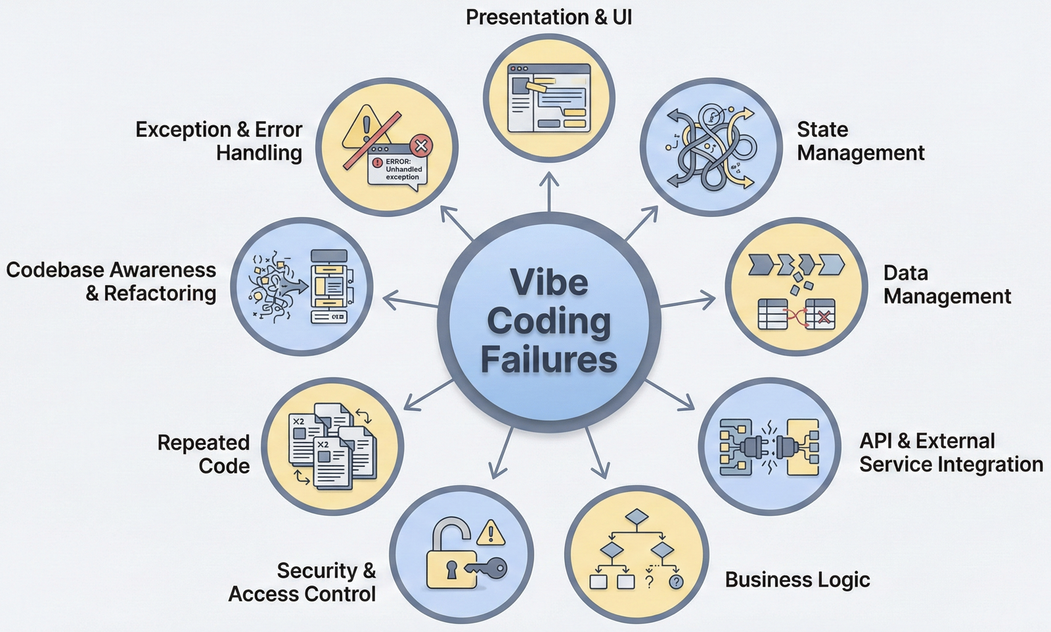
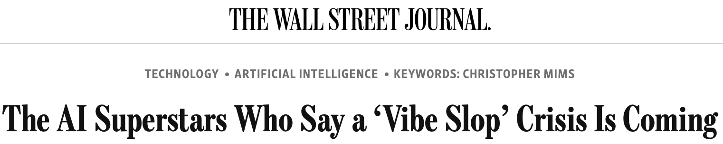
Shall we “vibe” our systems?
Feb. 2025
Jan. 2026
May 2026
https://daplab.cs.columbia.edu/general/2026/01/07/why-vibe-coding-fails-and-how-to-fix-it.html
https://daplab.cs.columbia.edu/general/2026/01/08/9-critical-failure-patterns-of-coding-agents.html
https://www.wsj.com/tech/ai/vibe-coding-slop-ai-tools-e6a99394

Slide 9

Vibe coding is cheap fabrication
Describe
Fabricate
Discard
Regenerate
Explore
Part of engineering.
Not all of engineering.
Notes:
3 minutes — Give students a physical analogy for cheap fabrication, then mark its boundary before they over-extend it.
Six words on screen; all the content is spoken. Do not read the bullets aloud as a list.
The prose that used to be on this slide, one beat per bullet:
Describe / Fabricate — describe an outcome and rapidly produce a working artifact.
Discard / Regenerate — throw away and regenerate implementations at low cost.
Explore — try alternatives with little upfront investment.
Not engineering — a useful capability, but fabrication is not engineering judgment.
State the analogy's boundary explicitly: a 3D printer does not tell you the part will hold.
Do not disparage vibe coding. It is genuinely useful; the claim is about what it does not supply.
Sets up slide 8: cheap artifact does not mean cheap system.
=====
Think about a desktop 3D printer. You describe an outcome, and a few hours later there is a physical object in your hand. If it is wrong, you shrug and print another one. The cost of trying is almost nothing, so you explore — you print six variants and pick the one you like.
That is what vibe coding gives you, and I want to be clear that it is genuinely valuable. Describe. Fabricate. Discard. Regenerate. Explore. Cheap fabrication changes how you work.
Now the boundary of the analogy, because this is the part that matters.
The printer does not tell you whether the bracket will hold under load. It does not know what load it needs to hold. It will happily produce a beautiful part that fails in service, and it will produce it just as fast as a good one.
Fabrication capacity is not engineering judgment. Those are different things, and getting a great deal more of the first does not give you any of the second. Hold that thought — the next slide is what happens when people assume it does.

Slide 10
What changes when you care whether the result is correct?
Inspect the output?
Test it?
Have another agent review it?
Assign roles and stages?
Impose a process?
What does each of these actually buy us?

Slide 11
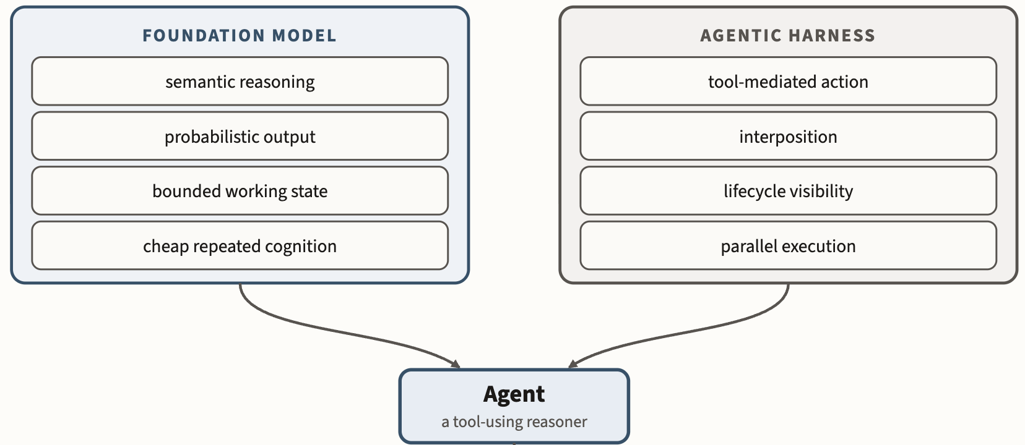
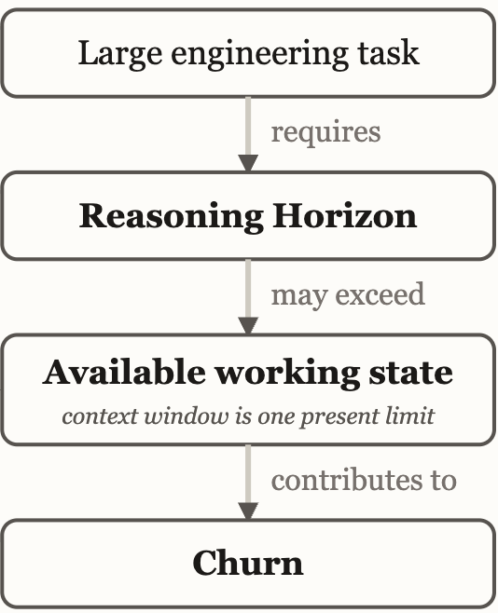
Vibe coding fails because engineering has a large reasoning horizon
Notes:
The foundation model supplies inexpensive semantic reasoning under finite, probabilistic working conditions; the harness turns that reasoning into observable, interceptable action.
4 minutes — Establish the enduring problem — scale, not tooling — and close the “wait for bigger models” objection in the same breath.
Full definition to say aloud: the amount of intermediate reasoning state that must remain available at once to carry a task to a correct result.
Human or agent — it is a property of the task, not of who reasons. Hammer this or they hear “the model is not smart enough yet”. Large systems exceed what any one reasoner can keep active; whatever will not fit is compressed and rebuilt later, which the harnesses call compaction.
More context ≠ better representation — bigger windows, retrieval and compaction all help, but none of them decide which relationships matter.
Missing abstractions → repeated reconstruction — state not represented at the right level gets rebuilt on every task, by every agent, at full cost.
Closer — fifty years of answering scale with abstraction. Commodity intelligence raises the stakes because many reasoners now rebuild the same understanding in parallel.
Anchor concretely: ask how much of their own codebase they could hold in working memory at once.
Bridge: if state must be rebuilt, somebody pays. That cost becomes churn in Part 2.
=====
Here is the problem that does not go away, and it is older than any of this technology.
A reasoning horizon is the amount of intermediate state a task needs held at once to get to a correct result. Read that definition carefully, because the important words are the ones it does not contain. It is a property of the task. Not of the person. Not of the model. Not of next year's model.
Human or agent — same constraint. Large systems exceed what any one reasoner can keep active. That was true of you on your last group project, and it is equally true of a coding agent. Whatever will not fit gets compressed and rebuilt later; the harnesses call that compaction.
Now, someone always asks: does a bigger context window not just solve this? It helps. Retrieval helps. Compaction helps. But notice what none of them do — none of them decide which relationships matter. More context is not better representation. A larger window lets you carry more raw material; it does not tell you that this module owns that invariant.
And where the abstraction is missing, you get reconstruction. Every task. Every agent. Full price each time.
Software engineering has answered scale the same way for fifty years: abstraction. Commodity intelligence does not retire that answer — it raises the stakes, because now you have many reasoners rebuilding the same understanding in parallel.
Reasoning horizon: amount of state needed for a task
Human or agent
More context ≠ better representation
Missing abstractions → repeated reconstruction
Engineering has always answered scale with abstraction.

Slide 12
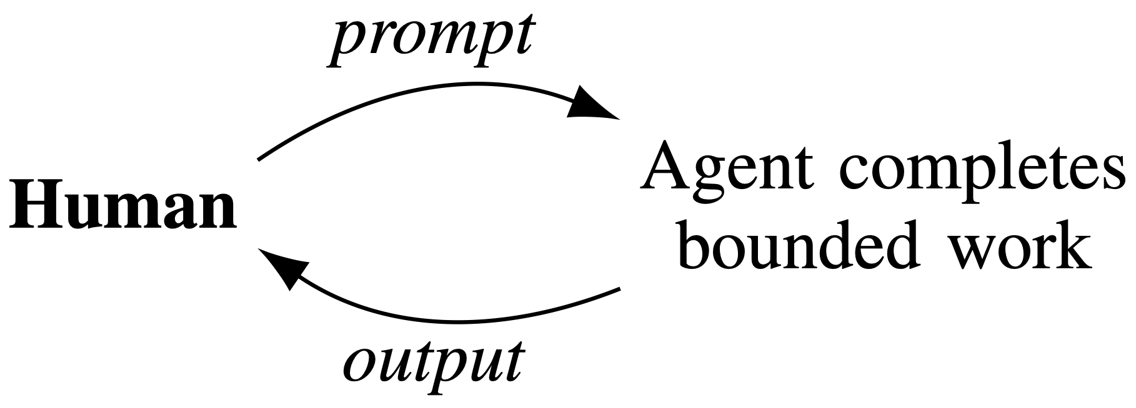
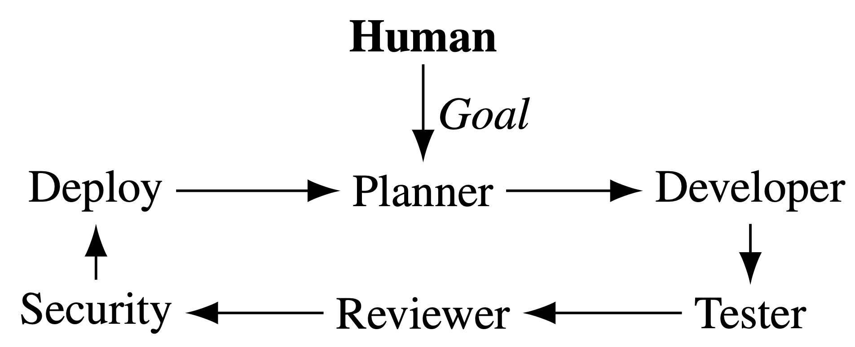
More oversight does not solve scaling
Oversight
Process imitation
“My job is now code review”
Personas, e.g., Yegge’s Gastown
Does not scale / DevExp
Process is not judgment
Q: How do we retain agentic velocity while preserving engineering judgment & oversight?
A: We will derive that ourselves, after the break.
Notes:
4 minutes — Give process its due, then show that scaling the review of agent work is not a scaling answer.
FOLDED IN from the former “Process can arrange for judgment” slide — deliver these four beats first, over the left panel:
Review steps create opportunities to inspect work.
Roles can separate production from evaluation.
Iteration can expose failures and trigger repair.
But process is not itself judgment.
The compressed form: process arranges for judgment to occur; it does not supply it.
Right panel — persona and process imitation, e.g. Yegge’s Gastown. Agents playing roles imitate a process; imitation is not independent assurance.
The scaling argument: agent output grows far faster than human inspection capacity. Adding a second probabilistic reviewer does not make it an independent one.
“My job is now code review” is the symptom, not the remedy. Ask who in the room already feels this.
Leave the question on screen. Do not answer it — the closing line defers it to after the break, on purpose.
=====
Before I attack this, let me give process its due, because I am not about to tell you that process is worthless.
Review steps create opportunities to inspect work. Roles can separate the person producing something from the person evaluating it. Iteration exposes failures and triggers repair. These are real mechanisms and they earned their place over decades.
But notice precisely what they do. Process arranges for judgment to occur. It does not supply the judgment. A review step is an appointment; somebody still has to show up and think.
So the obvious answers are the ones on this slide. More oversight. More process — and lately, process imitation: give the agents personas, have one play architect and another play reviewer.
Here is why that does not close the gap. Agent output grows much faster than human inspection capacity, so the human reviewer becomes the bottleneck, and you have simply moved the constraint rather than removed it. And a second probabilistic reviewer is not an independent one — two systems with correlated blind spots agreeing with each other is not assurance.
Some of you will end up in a job where the honest description is “my job is now code review.” That is the symptom.
So: how do we keep the velocity and still preserve engineering judgment? I am not going to answer that. We are going to derive the answer ourselves, after the break.

Slide 13
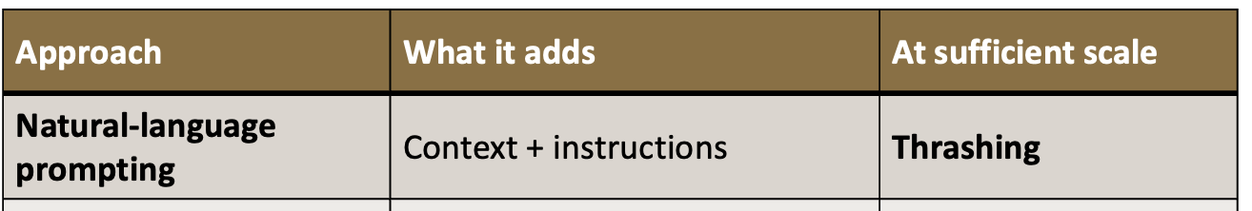
However, each improvement moves the failure boundary
Approach | What it adds | At sufficient scale
Natural-language prompting | Context + instructions | Thrashing
Spec-driven development | Explicit intent + checking | Drift
Elaborate harnessing | Prompts · hooks · tests · CI · runtime checks | Drift
At >400 KLOC, you’ll still hit the failure boundary.
What is missing?
Notes:
3 minutes — Show that progressively stronger engineering approaches kept moving the failure boundary without eliminating the scaling problem.
This is experience from building the ~2 MLOC system, not a controlled comparison or a claim about universal scale thresholds.
Each approach genuinely helped. Do not caricature the earlier approaches.
SDD is important: it both externalizes intent and checks realization against it.
Harnessing adds more opportunities to constrain and validate agent work.
The empirical pattern is works → system grows → drift/thrashing.
Do not explain the eventual solution. Part 2 exists to derive it.
=====
I went through roughly this progression while building the system.
At first, natural-language prompting works remarkably well. Give the agent the relevant code and context, tell it what you want, and it can make impressive progress.
ANIMATE
Then the system gets bigger. More relationships matter. More prior decisions matter. The agents begin reconstructing context, contradicting earlier decisions, and undoing work. Eventually: thrashing.
So I moved toward spec-driven development. Make the intent explicit, and check the implementation against it.
That is a real improvement. It moved the failure boundary substantially outward.
ANIMATE
But as the system kept growing, I eventually encountered the problem again: drift.
So add more harnessing. Better prompts. Hooks. Tests. CI. Runtime checks. More opportunities to constrain actions and catch incorrect work.
Again, this works. The failure boundary moves outward again.
ANIMATE
And eventually I hit it again.
That is the observation I want you to retain. These are not three failed ideas. Each one bought more scale. But increasing the sophistication of the surrounding machinery kept moving the point where the system fell apart rather than eliminating the underlying problem.
ANIMATE
By roughly two million lines, I had progressively strengthened the obvious answers we just discussed — and I still hit the failure boundary.
ANIMATE
What was still missing?
Do not answer it yet. That is what I want us to build after the break.

Slide 14
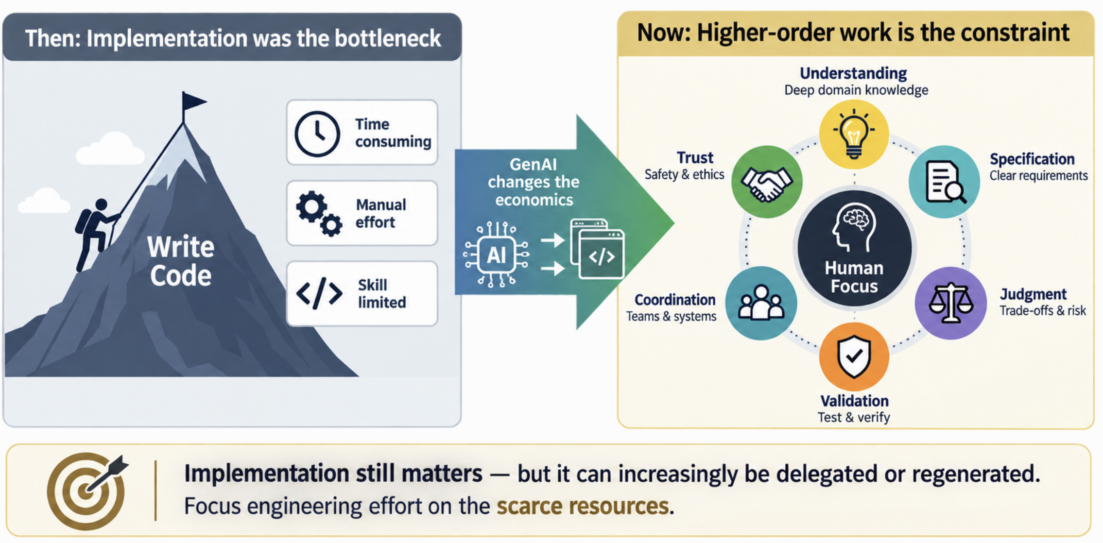
Implementation speed is no longer the constraint
Notes:
Implementation still matters.
But implementation can increasingly be delegated or regenerated.
Attention, understanding, specification, judgment, validation, coordination, and trust become relatively scarce.
Engineering effort should follow the scarce resources.

Slide 15
What is scarce now?
First — what is scarce now?
Which of these can software or agents amplify?
Which require human judgment?
Which can be captured once and reused?
Which can be turned into durable engineering structure?
Second — which of these are we paying for repeatedly?
Reconstruction · Review · Repeated judgment · Repair · Coordination

Slide 16
Stretch break

Slide 17
Part 2: Engineering for abundance

Slide 18
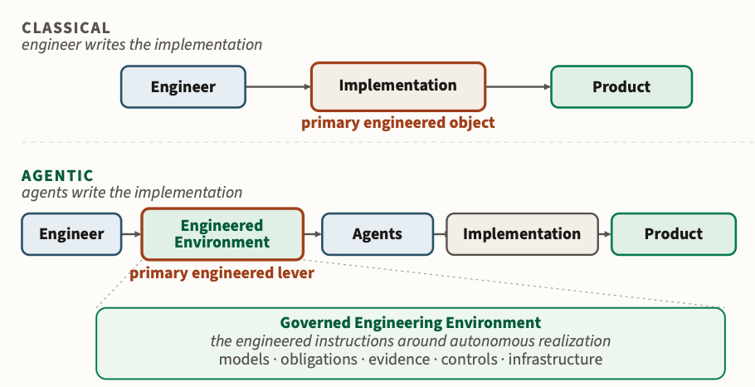
Your task: design the engineering environment
Notes:
Assume coding agents can produce implementation faster than you can inspect it.
You want to give them substantially more autonomy.
What must the environment provide before you would be comfortable doing that?
Work from the engineering problem — not from MAGE terminology.

Slide 19
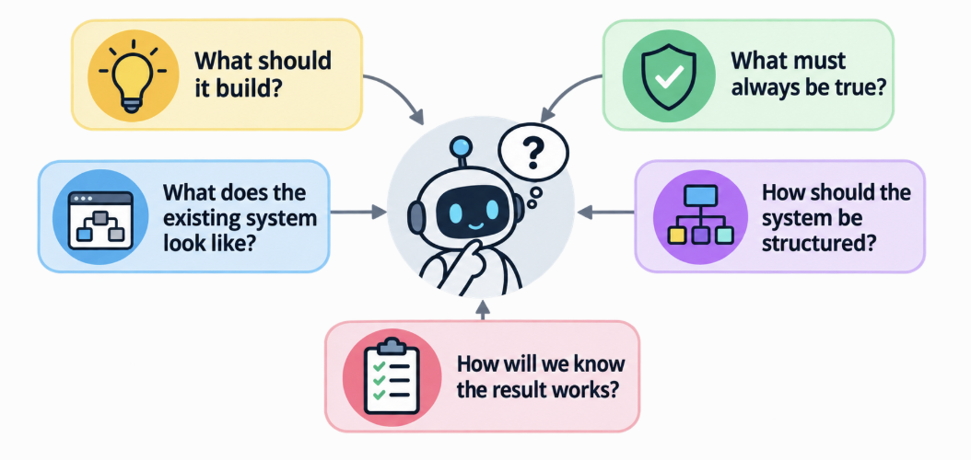
Stage 1 · What does the agent need to know?
Notes:
1 minute – get students thinking about questions
When starting an engineering effort, the questions we ask are similar, whether the build is human or agent.

Slide 20
What would you make explicit?
Write down concrete representations your team would create.
Prefer artifacts that can be reused across many agent actions.
Which are authoritative? Which are descriptive?
Which can machines inspect directly?

Slide 21
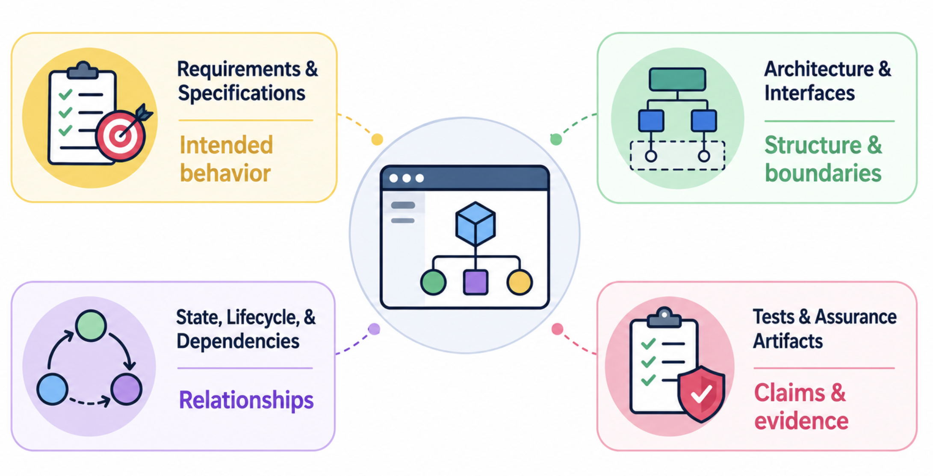
You are building models
Notes:
2 minutes - Review modeling approaches.
Requirements and specifications represent intended behavior.
Architecture and interface models represent structure and boundaries.
State, lifecycle, and dependency models expose relationships that code can hide.
Tests and assurance artifacts represent claims and evidence.
TRANSITION
Different questions expose different needs for representation.

Slide 22
Different questions need different models
Model class | What question does it answer? | Something you already use
Structural | What exists? How are parts related? | Module and dependency diagrams
Behavioral | What may happen? In what order? | State machines, sequence diagrams
Implementation | How is it realized in code? | Class hierarchies, inheritance, interfaces
Notes:
3 minutes — Show that modeling is already familiar work, so the principle lands as a rename rather than a new burden.
Lead with recognition: they have drawn all three of these in prior courses.
Read the middle column, not the left. The question is what selects the model.
Inheritance is the useful hook — a class hierarchy is a model, and nobody calls it documentation.
Say plainly that six classes exist; three are enough today. Do not enumerate the other three.
Map their activity output onto these three before moving on.
=====
You just invented a pile of artifacts. Let me organize them, and I want to start by pointing out that none of this is new to you.
Structural models: what exists and how the parts relate. You have drawn module diagrams and dependency graphs since your second programming course.
Behavioral models: what may happen, and in what order. State machines. Sequence diagrams.
And implementation models: how the thing is realized in code. A class hierarchy is a model. Inheritance is a modeling decision — you are asserting that these types share structure and substitute for one another. Interfaces are models of what a caller may rely on.
Notice what the middle column is doing. The model class is chosen by the question, not by taste. If your question is “can this call cross that boundary,” a state machine will not help you.
There are six classes in the book. Three are enough for today; the others show up when we get to ownership, policy, and evidence later in the semester.

Slide 23
An agent adds a new API endpoint
Browser
API
User data
The agent has just added:
GET /api/profile
Only the authenticated user may access their profile.
What would you give the agent so it gets this right?
Notes:
7 minutes — Make the abstract problem concrete, and let students propose a deliberately mixed pile of representations and mechanisms.
Pose it at the board. Walk the diagram left to right, then read the obligation aloud.
Ask the question as written. Do NOT ask “what does the agent need to know?” — that biases toward representation and kills the productive confusion.
Collect everything without sorting. The mixing is the point; slide 25 sorts it.
Likely answers — information kind:
the requirement written down · an OpenAPI spec · an existing authenticated endpoint as an example · the auth architecture · who owns this route · a better prompt or context file
Likely answers — mechanism kind:
human or agent review · a test that calls the endpoint as another user · static analysis · a security scan · a CI check · refuse the merge
If someone says “just tell it in the prompt”, write it down without comment. Slide 24 tests exactly that answer.
If the room only produces information, prompt: “suppose you gave it all of that and it still shipped the bug — then what?”
If the room only produces mechanisms, prompt: “your test has to know what correct means. Where does that come from?”
Keep the board visible. You will point back at it during the reveal.
=====
Let us stop being abstract. Here is a system, and it is about as simple as a system gets. A browser talks to an API, and the API reaches user data.
An agent has just added an endpoint: GET slash api slash profile. It works. It returns a profile. Tests pass.
And here is something that must be true of it: only the authenticated user may access their profile. That is not a preference. If that is wrong, it is on the front page.
So my question to you — and I want concrete answers, not categories — what would you give the agent so it gets this right?
Shout them out. I am going to write down everything, and I am not going to sort them.
[Collect for three or four minutes. Resist the urge to organize the board — the disorder is doing work.]
Good. Look at that list. Hold onto it, because in two slides I am going to point out something about it that you have not noticed yet.

Slide 24
How much authority should this have?
Only the authenticated user may access /api/profile.
Increasing authority →
Tell
Inspect
Check
Gate
prompt · context
agent or human review
static analysis · automated test
prevent merge or deploy
Where would you enforce this? Why?
Notes:
6 minutes — Have students discover that authority is a spectrum, and that this particular obligation needs checked evidence at a consequential boundary.
Same scenario, same obligation — do not make them load a new example.
Reveal one intervention at a time; ask where they would stop before showing the next.
The lesson is NOT “always maximum enforcement”. It is that the mechanism should match what the obligation is worth.
For this obligation students should land on: telling is weak, and independently checked evidence at a gate is strong.
Useful counterweight: ask for an obligation where Tell is the right answer (naming style, comment tone). Preserves the tolerance idea for slide 28.
Watch for “the agent promised it did it” — self-report is not evidence. Name that explicitly.
Do not name Alignment yet.
=====
Same endpoint, same obligation. Now a different question: how much authority should that requirement actually have?
Start at the weak end.
ANIMATE
Tell. You put it in the prompt, or a context file: every endpoint requires authentication. Several of you suggested exactly this. How much protection does it buy? Some — it genuinely raises the hit rate. But nothing checks it. The obligation exists only as a sentence the agent may or may not have weighted.
ANIMATE
Inspect. A human reviews the diff, or another agent does. Better — now something looks. But we spent the first half of this lecture on why inspection does not scale, and a second probabilistic reviewer is not an independent one.
ANIMATE
Check. Static analysis, or a test that calls the endpoint as a different user and asserts it gets rejected. This is a real change in kind. The check does not care how persuasive the agent was. It produces evidence, and the evidence is independent of the thing being judged.
ANIMATE
Gate. The check runs, and if it fails the change does not merge. Now the obligation has consequences. Violating work cannot cross the boundary.
So: where would you enforce this one, and why?
[Take answers. Push on “why”, not “where”.]
I want one caution. The lesson is not that everything belongs at a gate. Gates are expensive and they slow you down. The lesson is that the mechanism should match what the obligation is worth — and for an authentication boundary on user data, a sentence in a prompt is not proportionate.

Slide 25
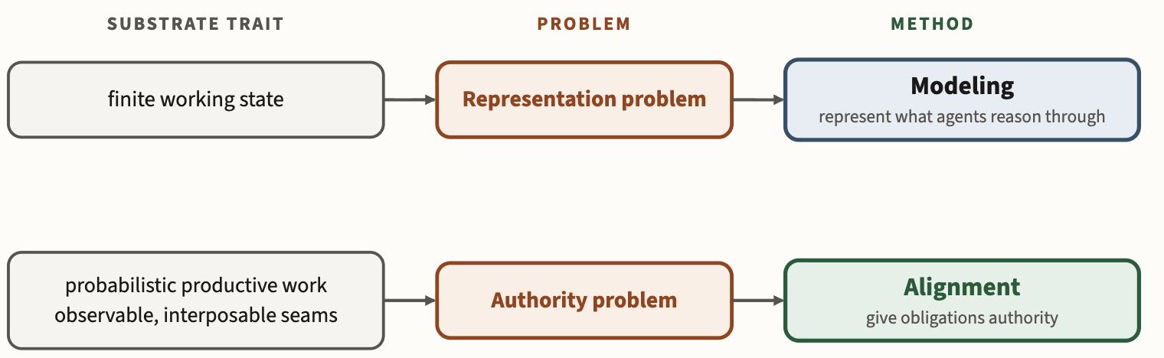
Representation and authority differ
Representation — what does authenticated access mean for this system?
Authority — what stops violating work crossing a consequential boundary?
A representation without authority may be ignored. Authority without sufficient representation may be unable to decide the property.
Notes:
4 minutes — Sort the pile students produced into two kinds of thing, and only then hand them the names.
Point at the board from slide 23 and sort their own answers live. Do not sort a hypothetical list.
Information kind — spec, examples, architecture, ownership: these say what authenticated access means here.
Mechanism kind — tests, static analysis, review, CI gate: these stop violating work crossing a boundary.
Only after they see the split in their own answers, walk the figure left to right, one row at a time.
Figure rows: finite working state → representation problem → Modeling. Probabilistic work with observable seams → authority problem → Alignment.
Both halves of the qualification matter. A model nobody enforces is a wish; a gate that cannot decide the property is theatre.
Do not present Modeling as a prerequisite for Alignment — the next slide makes that explicit.
=====
Go back to the list you gave me two slides ago. I said I would point out something you had not noticed.
Some of what you named tells the agent what the obligation means for this system. The specification. An existing authenticated endpoint as an example. The auth architecture. Who owns the route. Those answer a question about meaning: what does authenticated access mean here?
The rest does something different. The test. The static check. The review. The CI gate. None of those explains anything to anybody. They answer a question about consequence: what stops violating work crossing a boundary?
You mixed them together, and that was the right instinct — you need both. But they are not the same kind of thing.
And they come from different properties of the substrate. Because a reasoner has finite working state, you get a representation problem, and the answer is Modeling: represent what agents reason through. Because the work is probabilistic but has observable, interposable seams, you get an authority problem, and the answer is Alignment: give obligations authority.
Hold both halves of the caveat. A representation with no authority may simply be ignored — that is every architecture diagram rotting in a wiki. But authority without sufficient representation is just as broken: a gate can only refuse what it can decide, and if the property depends on meaning the environment does not have, a person has to supply it by hand.

Slide 26
Not every obligation needs the same mechanism
Same endpoint, same obligation. Four kinds of mechanism.
Authentication middleware, permissions → Constraint
Request and access logging → Sensor
Security test → Validator
CI and release policy → Gate
Constraint restricts actions · Sensor produces evidence · Validator checks it · Gate admits work
Roles, not products. One mechanism may play several.
Alignment does not require Modeling. Local rules can be governed directly; models matter when the obligation needs meaning the environment cannot observe.
Notes:
4 minutes — Make the four mechanism roles concrete on the endpoint they already know, and block the misreading that Modeling must precede Alignment.
Same scenario throughout — no new example to load.
Full role definitions: constraints restrict permissible actions; sensors produce evidence; validators check evidence against an obligation; gates decide whether work may cross a workflow boundary.
Roles, not product categories. A CI pipeline is often sensor, validator and gate at once; ask the room which of the four a linter is.
The key point: a sandbox, a test, or a permission boundary already holds a local rule with no model at all. That is Alignment with no Modeling in sight.
Models change the boundary of what is governable — architecture, ownership, end-to-end behavior. Without them a person supplies the missing meaning, and that person is the bottleneck from Part 1.
Name the semantic gap if the room is with you: some obligations cannot be decided until enough of the system exists.
=====
Stay on the same endpoint. Everything you proposed for it falls into four roles, and the roles tell you what each thing is for.
Authentication middleware, or a permissions layer, is a constraint — it restricts what actions are permissible, so the bad thing cannot happen.
Request and access logging is a sensor — it does not stop anything, it produces evidence about what happened.
A security test is a validator — it checks evidence against the obligation and returns a verdict.
And your CI or release policy is a gate — it decides whether the change may cross a boundary: merge, deploy, release.
These are roles, not products. Your CI pipeline is very likely playing three of them at once. Do not try to buy one of each.
Now the part people get wrong about this method. You do not need a model of your system to govern it. That middleware forbids the action using a local rule. The test blocks the regression by encoding expected behavior. No model anywhere.
What models buy you is reach. When the obligation depends on architecture, on ownership, on end-to-end behavior — the environment has nothing to check against unless somebody made that explicit. Otherwise a human supplies the missing meaning, and that human is exactly the bottleneck we spent the first half of this lecture on.

Slide 27
Stage 2 · Not every decision deserves the same authority
“Use a blue navigation bar.”
“API conforms to the pod OpenAPI specification.”
“No SQL injection.”
“The UI should feel intuitive.”
For each of these:
how settled is the intent?
how should it be represented?
how strongly should it be enforced?

Slide 28
Govern what is settled; preserve what is free
Settled + machine-checkable → explicit model + strong automated authority.
Settled + semantically difficult → explicit model + evidence and review.
Unsettled → guidance, exploration, and preserved freedom.
A tolerance bounds the variation an obligation permits. A degree of freedom is what may still vary within those bounds.
An unmodeled choice is not automatically a free one. It may conceal an obligation whose tolerance nobody has written down.
What is a tacit obligation vs. a degree of freedom?
Notes:
Go back to our example: only the authenticated user may access /api/profile.
That obligation is settled, and it is machine-checkable. So we should model it explicitly and give it strong automated authority—ideally a check or gate that prevents code from shipping if unauthenticated access is possible.
But the requirement does not settle everything. It does not tell us how authentication should be implemented, how the endpoint should be structured internally, or what names and abstractions the developer should use. Those are degrees of freedom, and we should preserve them.
The important caveat is that unmodeled does not mean free. Suppose /api/profile returns a user’s email address. Whether another authenticated user may access someone else’s profile is not merely an implementation choice—we may simply have failed to specify the authorization boundary.
So the discipline is: govern what is settled; preserve what is genuinely free; and don’t confuse missing knowledge with freedom.

Slide 29
Stage 3 · You caught it. Are you done?
An agent violates an architectural rule. A reviewer catches it, fixes the pull request, and explains the mistake.
What happens tomorrow?
What happens when a different agent takes a similar task?
What happens when that reviewer is on vacation?
You repaired the instance. Did you repair the engineering system?
Notes:
4 minutes — Expose that fixing an instance leaves the environment exactly as weak as it was.
Set the scene concretely, then let the questions sit. Do not rush the silence.
Take answers. Most students will say “it happens again” — push them to say why.
The reviewer-on-vacation question is the one that lands. Judgment stored in a person is not stored.
Do not name governance conversion yet. That is the reveal two slides from now.
=====
Here is a situation every one of you will be in within a year. An agent writes something that violates an architectural rule — it reaches across a boundary it should not touch. A human reviewer catches it. Good. They fix the pull request and they leave a thoughtful comment explaining the mistake.
That feels like a complete outcome. The bug is gone. The agent got feedback. Everyone did their job.
So: what happens tomorrow?
What happens when a different agent picks up a similar task? What happens when that reviewer is on vacation, or moves teams, or simply does not look as carefully at four in the afternoon?
You repaired the instance. I want you to ask whether you repaired the engineering system — because those are not the same thing, and only one of them compounds.

Slide 30
What should the next task inherit?
You do not want to pay for that judgment twice. What would you build?
An architecture model the agent can read
A lint rule or static check
A test that fails on the violation
A reusable skill or packaged procedure
A gate at the merge boundary
Canonical documentation, or an ownership registry
For each one: what does it cost to build, and what does it cost to keep true?
Notes:
6 minutes — Students derive durable structure themselves; this is the third derivation, matching Modeling and Alignment.
Small groups, three minutes, then collect. Do not read the list — let them generate it first.
The list on screen is a safety net for a quiet room, not the answer key.
Push the second question hard: upkeep cost is what separates capital from clutter.
Good discriminator to raise: which of these still works when nobody remembers why it exists?
Collect answers on the board — slide 33 names what they just built.
=====
Three minutes in your groups. The rule got violated, you fixed it, and you have decided you do not want to pay for that judgment a second time. What do you build?
Be concrete. Not “better process” — name the artifact.
Now the second question, and this is the one that separates engineering from enthusiasm. For each thing you named: what does it cost to build, and what does it cost to keep true?
A test costs almost nothing to keep true, because it tells you when it breaks. An architecture diagram in a wiki costs a great deal to keep true, because nothing tells you when it drifts. Same good intention, very different economics.
Hold your lists. I am going to give what you just invented a name.

Slide 31
Convert judgment into durable structure
Governance conversion
When a recurring failure, repeated judgment, or observed gap reveals something future work should inherit, encode the lesson in durable structure.
a model
a packaged procedure
an authoritative mechanism
Repair the instance. Then change what the next task inherits.
Notes:
3 minutes — Name the move the students just invented and make it the habit they leave with.
Point back at their own lists — they derived this; you are only supplying the name.
Two beats, both required: repair the instance AND change the inheritance. One without the other fails.
The trigger is not only failure. Repeated judgment counts too, even when nothing broke.
This is claim 5. Say the number if you are tracking the six claims aloud.
=====
Look at your lists. You have just derived the third move of the method, and it has a name: governance conversion.
The definition is this. When a recurring failure, a repeated judgment, or an observed gap reveals something future work should inherit, you encode the lesson in durable structure — a model, a packaged procedure, or an authoritative mechanism.
Notice the trigger is not only failure. Repeated judgment counts. If you find yourself making the same call for the fifth time and nothing has broken, that is still the signal. You are paying for the same engineering repeatedly.
And notice there are two beats. Repair the instance — you still have to fix the bug. Then change what the next task inherits. Teams that do only the first are busy forever. Teams that do only the second have an elegant environment and a broken build.

Slide 32
Or you pay for the same engineering again
Engineering churn
Engineering capital
Rediscover context
Undo recent changes
Repair regressions
Reconcile inconsistencies
Re-adjudicate settled questions
Weak representation forces reconstruction.
Weak authority forces repeated adjudication.
Models
Packaged procedures
Mechanisms
Canonical documentation
Makes later work cheaper or less uncertain — and depreciates when it stops fitting the system.
Notes:
3 minutes — Give the two outcomes names so students can diagnose which one their team is living in.
Left column is what you pay repeatedly. Right column is what pays you back.
Both lists are things a team can point at — keep it diagnostic, not moral.
Capital depreciates. A stale model is worse than none, because people still trust it.
Ask: which column did your last internship live in?
=====
Two outcomes, and every engineering organization is somewhere between them.
On the left, churn. Work spent rediscovering context, undoing recent changes, repairing regressions, reconciling inconsistencies, settling the same argument again. None of it advances the system. And the causes are specific, not vague: weak representation forces reconstruction, weak authority forces repeated adjudication.
On the right, capital. Models, packaged procedures, mechanisms, canonical documentation — durable structure that makes later work cheaper or less uncertain.
One honest caveat, because I do not want to sell you an infinite good. Capital depreciates. A model that no longer matches the system is worse than no model, because people still trust it. Structure has upkeep, and when upkeep exceeds return, you retire it.
So the diagnostic question for your own team is simply: which column are we in, and what would move one item across?

Slide 33
MAGE is the cycle, not either principle alone
Neither principle is MAGE by itself. The method is the cycle they create:
Model the consequential knowledge.
Give obligations authority.
Do the governed work.
Convert recurring failures and judgment into durable structure.
Repeat.
Useful structure becomes engineering capital when later work keeps benefiting from it.
The six claims are the argument. Model, align, work, convert is the method.

Slide 34
The goal is a Governed Engineering Environment (GEE)
GEE: An environment where selected engineering obligations have durable authority — instead of depending on people to remember or inspect them.
Models extend what the environment can reason about.
Mechanisms make obligations consequential.
Human attention moves to questions that require judgment.

Slide 35
Part 3: What engineering becomes
Notes:
30 seconds — Mark the shift from building the method to reading its consequences.
Frame line to say aloud: when implementation becomes abundant, where does engineering work move?
Everything after this point is consequence, not construction. Students should stop deriving and start reading.
If you are behind, this is the divider to skip — say the frame line over the previous slide instead.
=====
We have built the method. Model, align, do the work, convert what recurs.
The rest of the lecture is about what follows from it. When implementation becomes abundant, where does engineering work actually move — and what does that mean for what you are studying this semester?

Slide 36
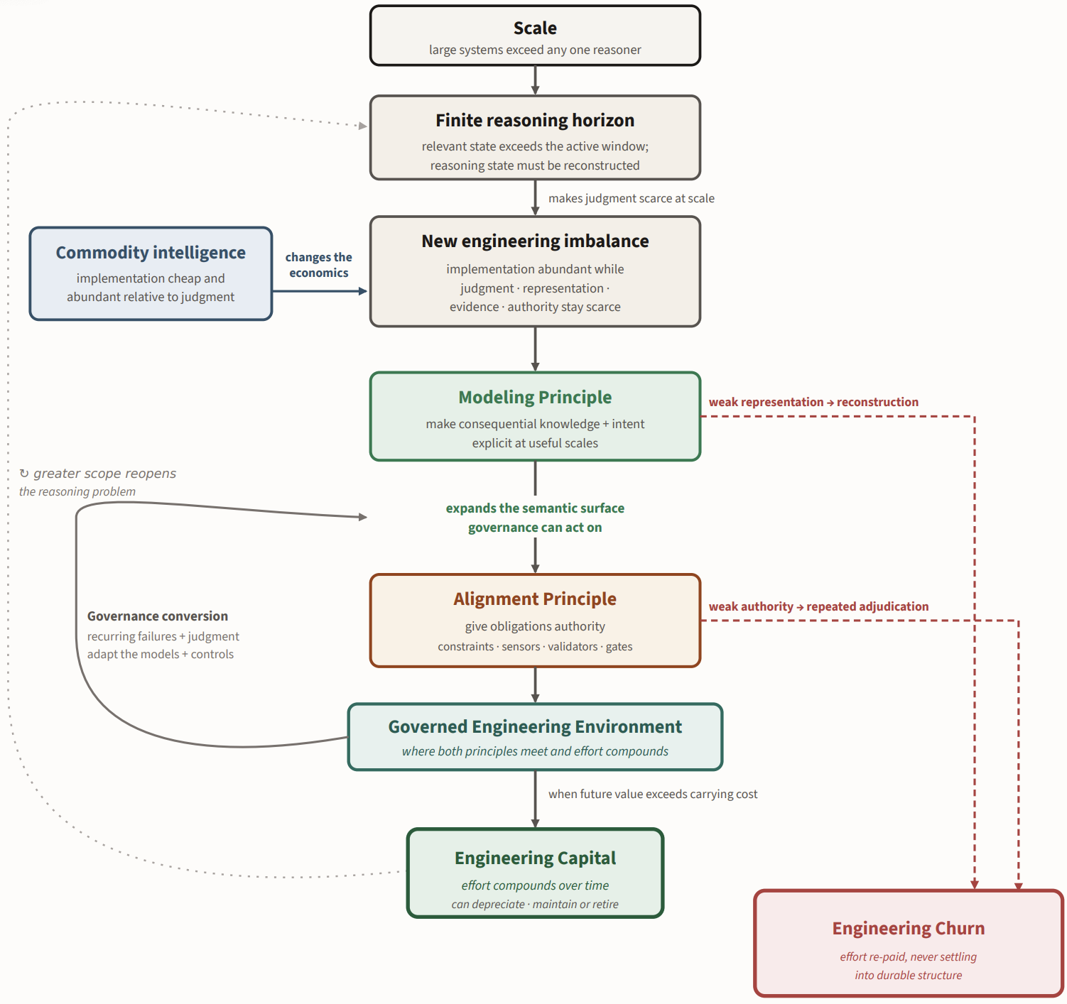
MAGE
in one picture
Notes:
2 minutes — Use this as the synthesis slide. Don’t explain every box; trace the logic.
Start at the top: scale creates a reasoning problem. No engineer or agent can hold the whole system in working context.
GenAI makes implementation abundant, but judgment, representation, evidence, and authority remain scarce. That is the new imbalance.
The response has two parts:
Modeling: make consequential knowledge and intent explicit.
Alignment: give those obligations authority through constraints, validators, tests, and gates.
When both are present, you get a governed engineering environment where lessons persist beyond the individual reviewer or agent.
Repeated failures should trigger governance conversion: capture the judgment and adapt the models or controls.
If that knowledge is worth carrying forward, it becomes engineering capital—future work gets cheaper and safer.
The red path is the alternative: weak representation or weak authority produces engineering churn—the same judgment gets paid for repeatedly.
Closing line:
The goal is not to make agents smarter enough to remember everything. It is to build an engineering environment that does not require them to.

Slide 37
Autonomy is an outcome, not the objective
Better representations and appropriate authority let more work be delegated safely.
Autonomy is what you get — not what you aim at.
Greater scope reopens the reasoning problem: the loop in the figure.
MAGE is not “automate everything,” and it is not “maximize autonomy.”
Notes:
2 minutes — Block the misreading that MAGE is an automation-maximizing program.
Point at the return loop on the previous slide's figure while saying the second bullet.
Autonomy is a consequence of trustworthiness, not a target to optimize.
Expect a student to ask where it ends. Honest answer: it does not; the loop is the point.
=====
I want to close off a misreading, because it is the most common one.
Everything we built today does let you delegate more. Better representations and appropriate authority mean more work can safely leave your hands. But autonomy is the outcome, not the objective. You do not set out to maximize how much the agents do; you set out to make the environment trustworthy, and delegation follows.
And look at the loop on the figure. When you delegate more, scope grows — and greater scope reopens the reasoning problem we started with. This is not a defect in the method. It is the shape of the method. You are never done, you are just operating at a larger scale than you could before.

Slide 38
Engineering work moves to higher abstraction
Engineers increasingly design the models, evidence, policies, mechanisms, and environments through which implementation happens.
What must hold, and how would we know?
What should be represented, at what scale?
Which obligations get authority, and by what mechanism?
Implementation remains engineering work. It stops being the center of the role.
Notes:
2 minutes — Answer the professional question students actually came in with: what will my job be?
This is claim 6 and the payoff for the whole argument.
Say plainly that implementation is not going away — several of them are worried about that.
The three bullets are the questions their job increasingly consists of answering.
Link forward to slide 41: every course topic maps onto one of those questions.
=====
Let me answer the question a few of you have been sitting on since the start of the semester, which is: what is my job going to be?
Engineers increasingly design the models, the evidence, the policies, the mechanisms, and the environments through which implementation happens. The work moves up a level of abstraction. Instead of producing the change yourself, you decide what must hold and how anyone would know; what should be represented and at what scale; which obligations get authority, and through which mechanism.
I want to be careful here, because the pessimistic version of this talk is everywhere and it is wrong. Implementation remains engineering work. You will still write code, and you will still need to be good at it — you cannot govern what you do not understand. What changes is that it stops being the center of the role.

Slide 39
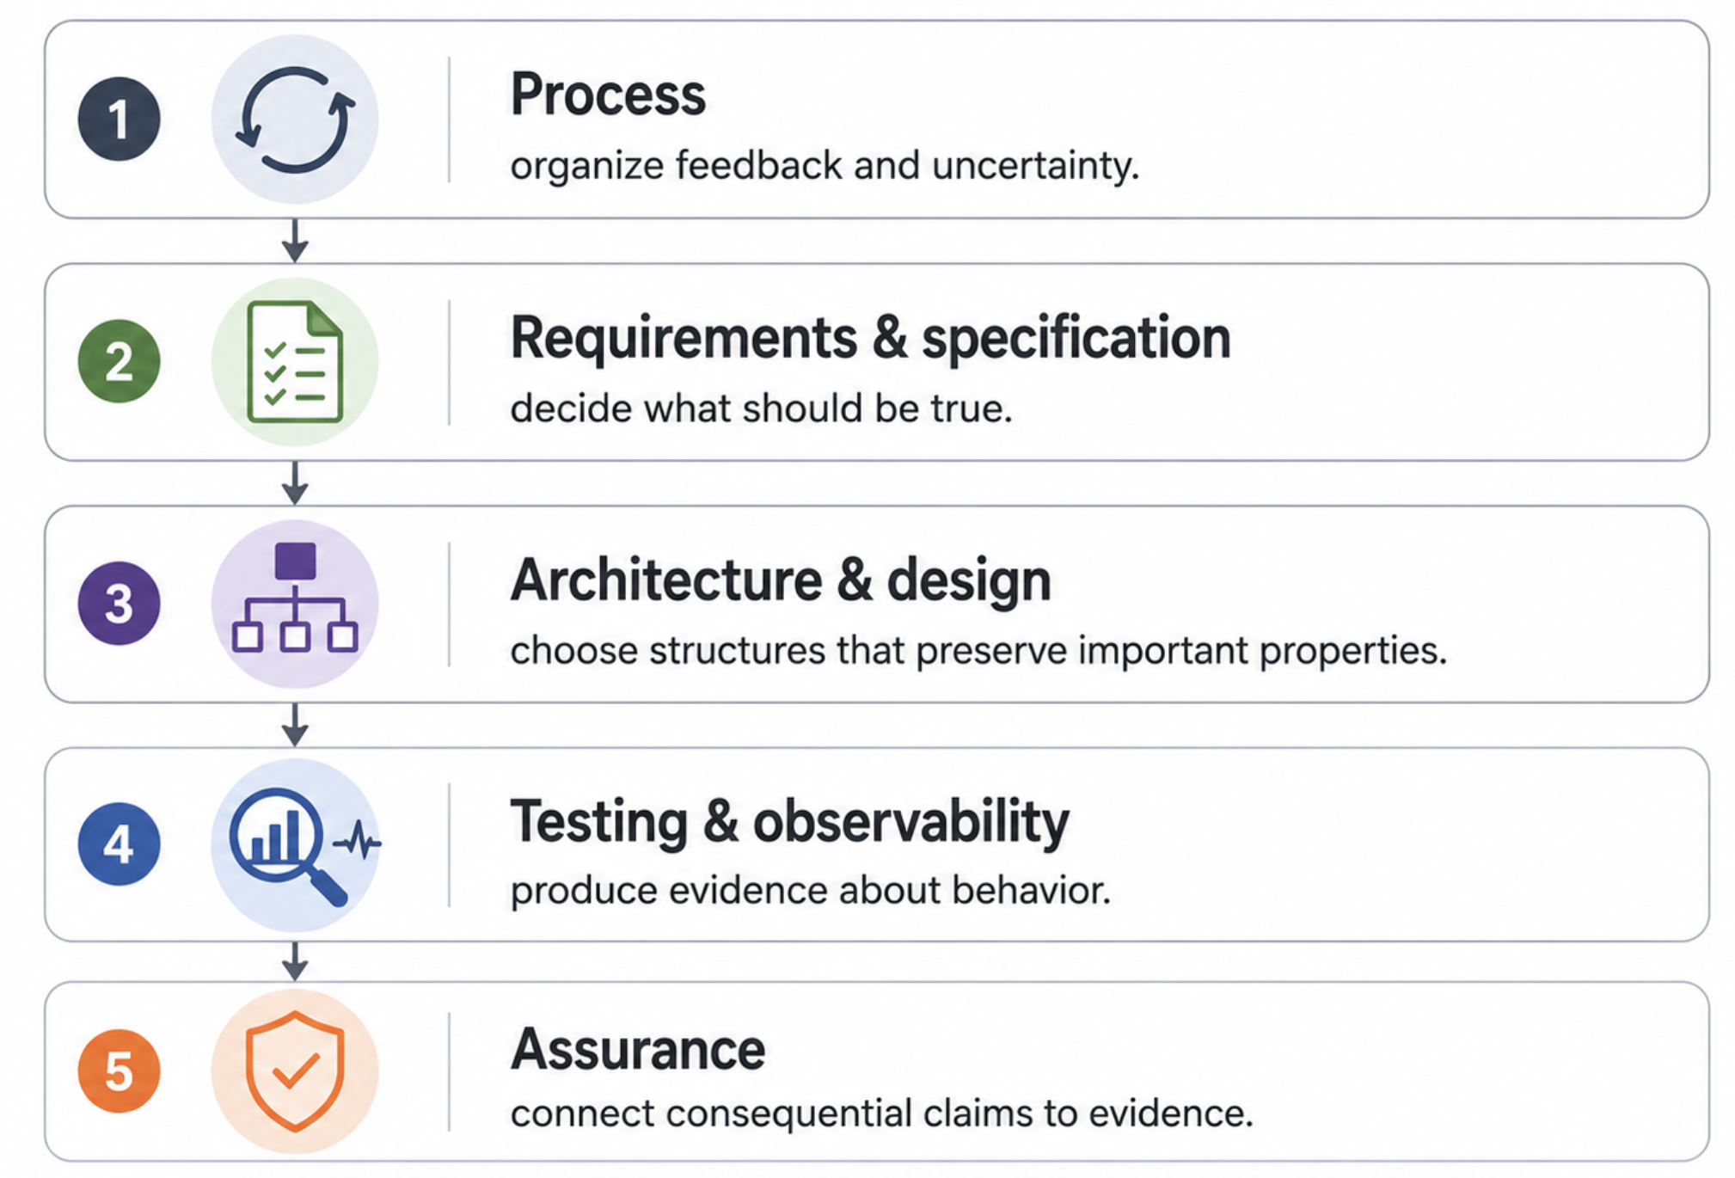
This is why software engineering matters more, not less

Slide 40
How do we safely grant autonomy?
This course opens with one question: how do we safely grant autonomy to commodity intelligence?
Not by trusting agents more.
Not by reviewing everything they do.
By engineering the environment in which autonomy operates.
The rest of the course asks the converse: what cannot be delegated?
Notes:
4 minutes — Land the answer to the question the whole lecture was built around and leave it on screen.
Leave this slide up through questions. Do not replace it with a Questions slide.
Deliver the three lines slowly — two refusals, then the answer.
FOLDED IN from the former “engineering value moves” slide — say this as the answer is delivered:
From producing every implementation detail …
… toward deciding what matters, representing consequential knowledge, constraining what must not vary, validating what must be believed, and preserving freedom where the answer is not yet known.
That list is the whole lecture in one breath. It also maps onto the previous slide's course topics — point back if time allows.
The converse is the hook for the rest of the course; do not answer it today.
=====
So let us go back to where this course starts. How do we safely grant autonomy to commodity intelligence?
Not by trusting agents more. Trust is not an engineering property; it is a feeling about one.
And not by reviewing everything they do. We spent the first half of this lecture showing why that does not scale — the reviewer becomes the bottleneck, and a second probabilistic reviewer is not independent assurance.
By engineering the environment in which autonomy operates.
And that is where your work moves. Away from producing every implementation detail. Toward deciding what matters. Representing consequential knowledge. Constraining what must not vary. Validating what must be believed. And preserving freedom where the answer is not yet known.
Six things. Not one of them is typing.
The rest of this course asks the converse question, and it is the one I want you carrying with you: what cannot be delegated?
I will leave this up. Questions.

Slide 41
Revisiting “Suppose implementation became essentially free”
Suppose any implementation you can specify appears instantly, at no cost.
Would we still need software engineering?
What work would remain?
What would become more valuable?
Notes:
3 minutes — Open the lecture with a counterfactual that makes the rest of the argument necessary.
Pose it, take three or four answers, and resolve none of them.
Write the answers where you can return to them — slide 42 comes back to this slide explicitly.
Do not name MAGE, Modeling, or Alignment yet. Students derive all three in Part 2.
Likely answers: knowing what to build; someone still has to check it; requirements; maintenance.
=====
Suppose the cost of writing code went to zero. Not cheaper — zero. Anything you can specify, you can have, instantly.
Would we still need software engineering?
Take a moment with that. What work would remain? And of the work that remains, what becomes more valuable than it is today?
I am not going to answer this now. Hold your answer — we will come back to this exact slide at the end and see whether you would change it.

