Slide 1
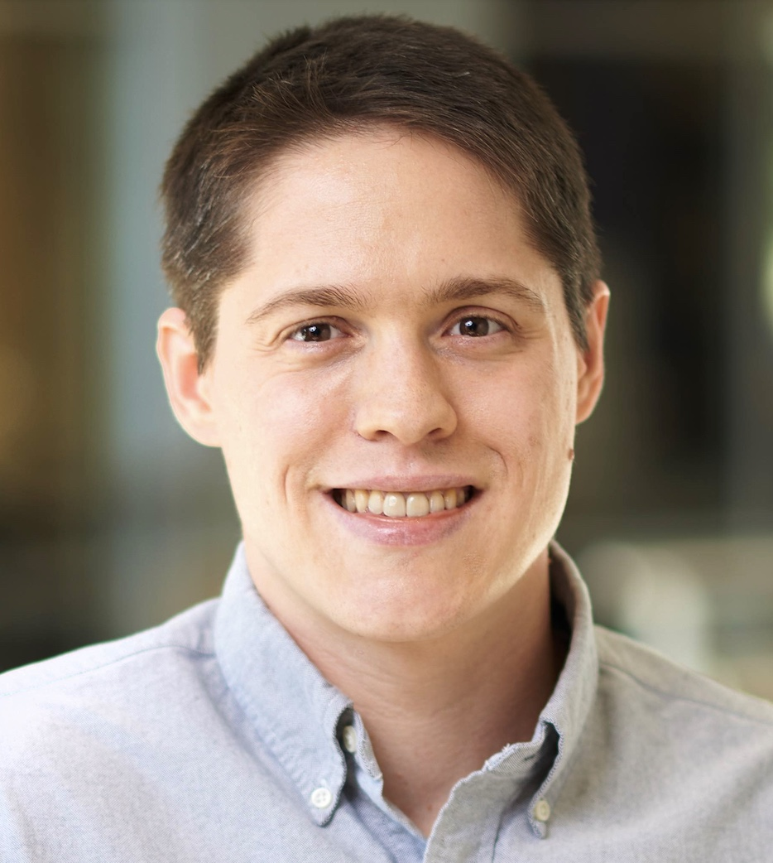
MAGE Model-Based Agentic Engineering Making GenAI More Trustworthy for Consequential Knowledge Work
Slides for this talk are available here: https://davisjam.github.io/model-based-agentic-software-engineering/talks.html
MAGE materials and book are available here: https://davisjam.github.io/model-based-agentic-software-engineering
James C. Davis
https://davisjam.github.io

Slide 2
Talk outline
Who am I and why am I here
The problem: Trustworthy GenAI for consequential work
The shift: Intelligence changes the engineering bottleneck
MAGE: Model-Based Agentic Engineering
What this means

Slide 3
Talk outline
Who am I and why am I here
The problem: Trustworthy GenAI for consequential work
The shift: Intelligence changes the engineering bottleneck
MAGE: Model-Based Agentic Engineering
What this means

Slide 4
Biosketch
2012-2017: Software QA, IBM GPFS / Spectrum Scale
2018: Summer at IBM Research @ Almaden, CA
2019: Summer at Microsoft Research @ Redmond, WA
2020-present: Assistant Professor, ECE @ Purdue
March 2026 – present: Saturator of 4 Claude Max 20x accounts
I am here to explain how to do this without compromising on quality
Notes:
Willard E. Davis
Willard J. Davis
Robert Willard Davis
and me!

Slide 5
Talk outline
Who am I and why am I here
The problem: Trustworthy GenAI for consequential work
The shift: Intelligence changes the engineering bottleneck
MAGE: Model-Based Agentic Engineering
What this means

Slide 6
Context and motivating question

Slide 7
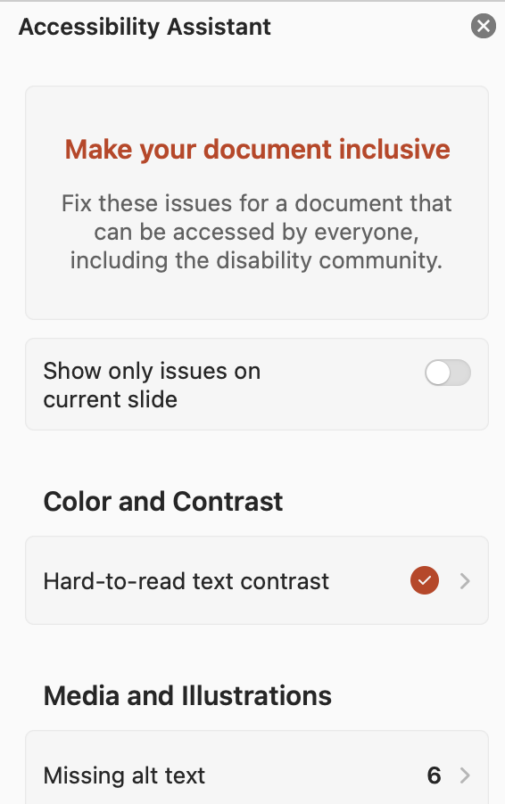
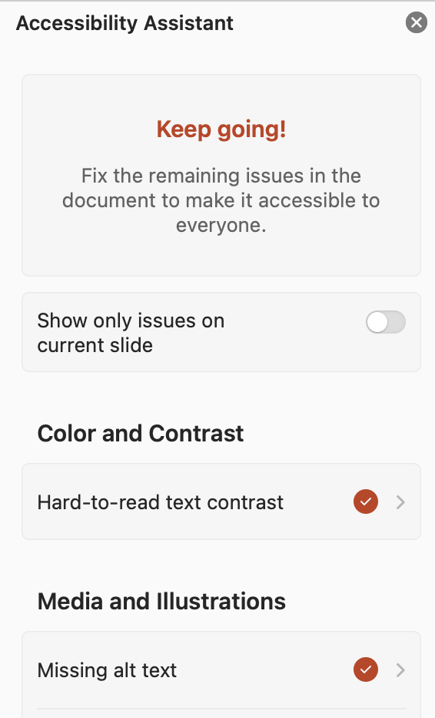
The US DOJ’s electronic-era update to the ADA
1990: ADA
2024: DOJ: ADA += "digital”
4/2026: Compliance deadline
4/2027: Revised compliance deadline

Slide 8
Manual remediation: Some back-of-envelope math
Given:
Professor or teacher salary of $50K – $200K → hourly rate?
16 weeks/semester x 3 slide decks/week
2 readings per week (PDF format)
3 hours per slide deck and 5 hours per PDF * L. Schumacher reported spending a week on one PDF
Find:
How many hours to remediate a course?
How much does it cost the university to remediate a course?
Given:
Purdue has 3000 courses in its catalogue
Find:
How much does it cost the university to become compliant by hand?
Multiply by every public K-12 school (99,297) and university (1,600) nationwide
https://nces.ed.gov/ccd/tables/202324_summary_3.asp, https://nces.ed.gov/fastfacts/display.asp?id=1122
Notes:
…
In 2020, automating this sort of thing would be impossible.
The DOJ’s standard is “substantially equivalent experience” for someone using accessibility tools, and computers could not make sense of images.
But GenAI is here and now they can. So the question is: Can engineers build it?

Slide 9
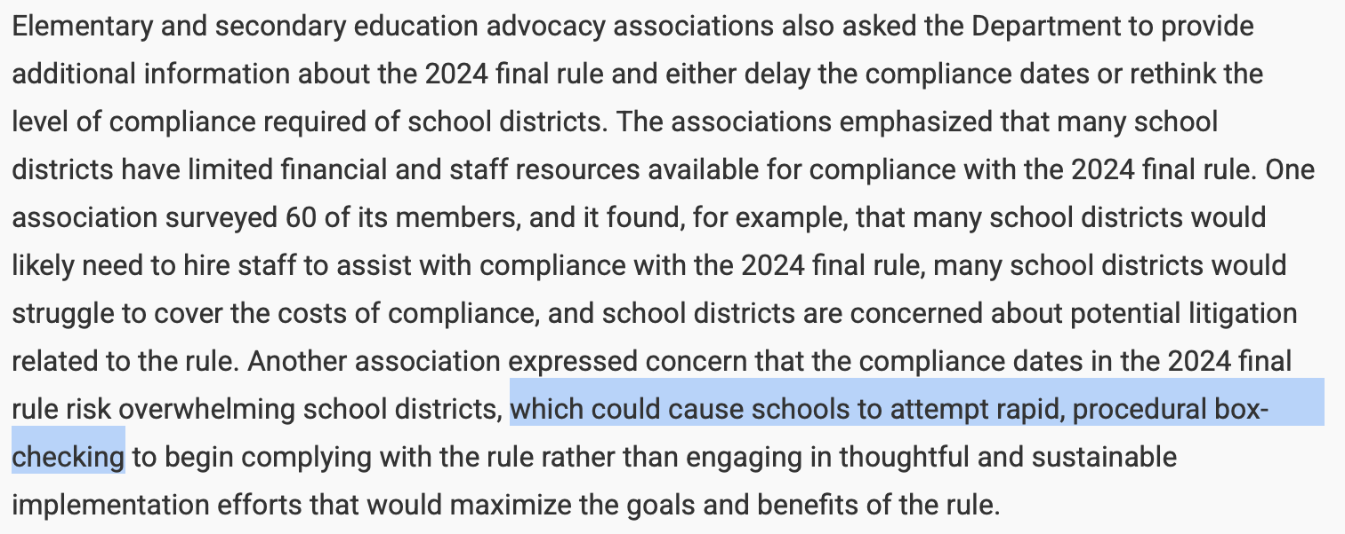
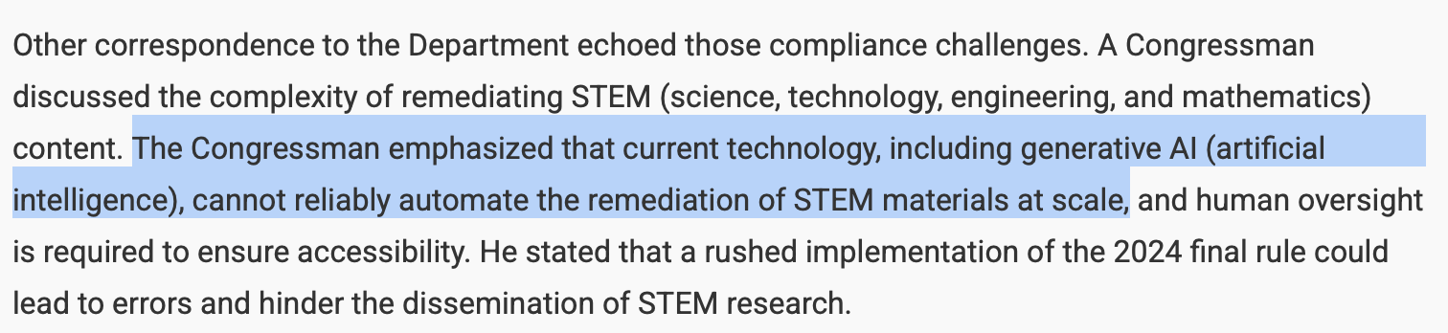
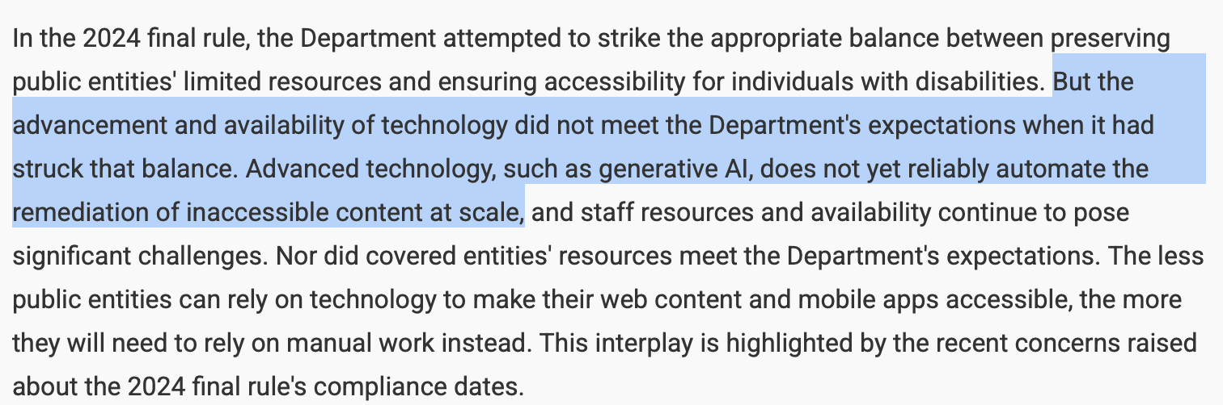
Why did the DOJ extend the deadline?

Slide 10
Question of this talk Is this a problem of technology or of engineering?
“[C]urrent technology…cannot reliably automate the remediation of STEM materials….”
vs.
“The…availability of technology did not meet the Department’s expectations”
Question: How does one answer such a question?

Slide 11
Answering the question

Slide 12
Scope of work
Q: What will an ADA Automator need to do?
(Please surface responses in Teams chat or at least ponder it yourself)
Input: A document
Output: A document with the following properties:
Is minimally changed for non-assistive use
Provides “substantially equivalent experience” using assistive technology (WCAG 2.1 Level AA)
Alt-text on figures
Reading order established
Scans transcribed
Media captioned
Fonts large enough and with enough color-contrast on their backgrounds
Target formats:
Plaintext formats: LaTeX, Typst, HTML
Structured document formats: Office, LibreOffice
The accumulated arbitrary madness of decades: PDF
Clearly we can ask our favorite LLM to do most of these things for us.
The engineering challenge: (1) Can we rely on its answers, and (2) Can we cheaply build a system?

Slide 13
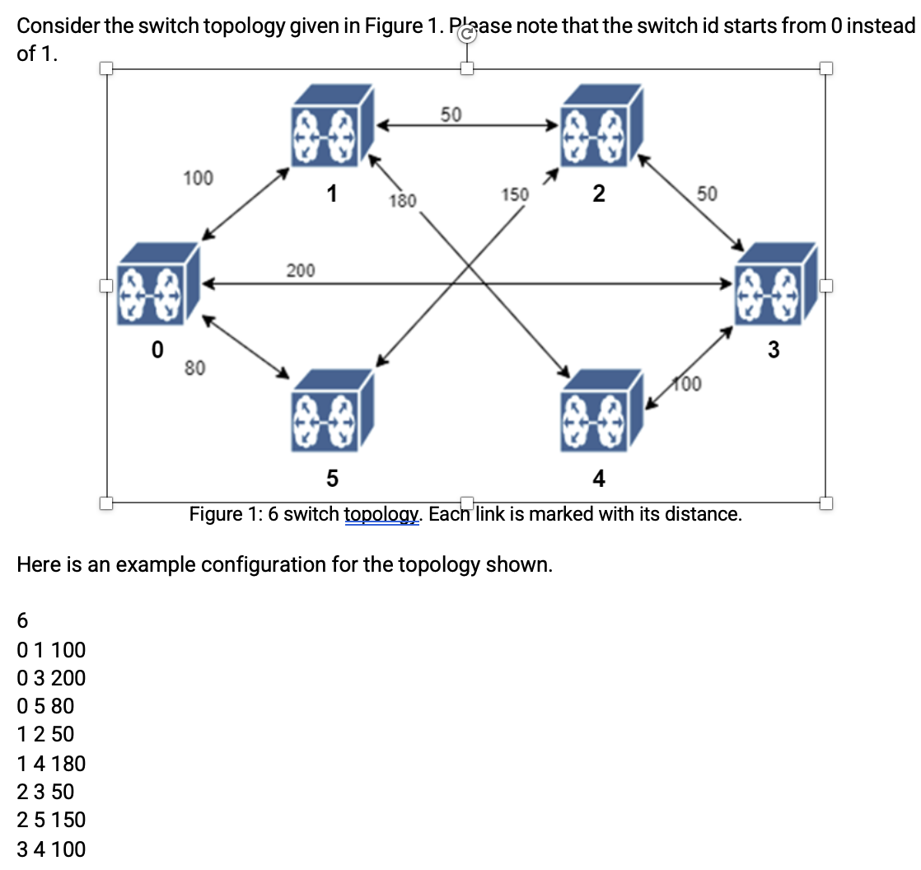


(1) Relying on its answers?
Diagram showing a directed weighted graph with six nodes labeled 0 to 5, each represented by a blue cube with a drone icon. Arrows indicate connections between nodes with weights ranging from 50 to 200, illustrating distances or costs between nodes for pathfinding or network analysis.
Network diagram showing six switches labeled 0 through 5, with bidirectional links between them.
Each link is annotated with its distance: switch 0 connects to switch 1 with distance 100, to switch 5 with 80, and to switch 3 with 200; switch 1 connects to switch 2 with 50 and to switch 4 with 180; switch 2 connects to switch 3 with 50 and switch 5 with 150; switch 4 connects to switch 3 with 100 and to switch 5 with 150.
Answer: Yes – if the LLM has appropriate representations for reasoning

Slide 14

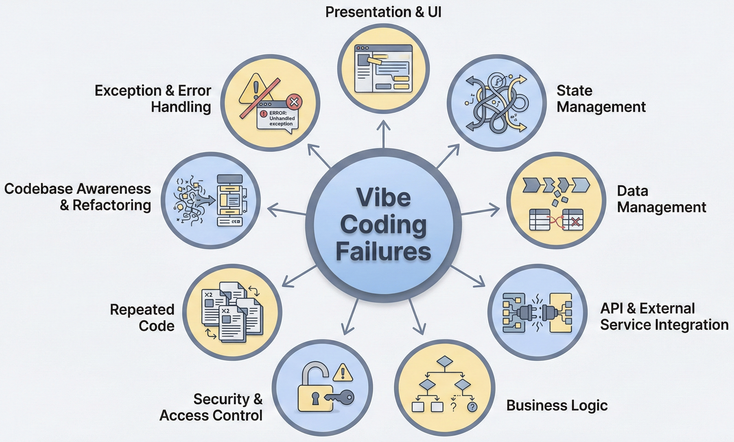
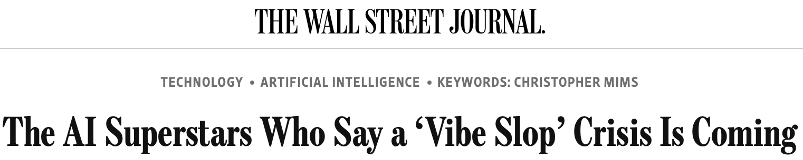
(2) Cheaply build a system?
Feb. 2025
Jan. 2026
May 2026
https://daplab.cs.columbia.edu/general/2026/01/07/why-vibe-coding-fails-and-how-to-fix-it.html
https://daplab.cs.columbia.edu/general/2026/01/08/9-critical-failure-patterns-of-coding-agents.html
https://www.wsj.com/tech/ai/vibe-coding-slop-ai-tools-e6a99394

Slide 15
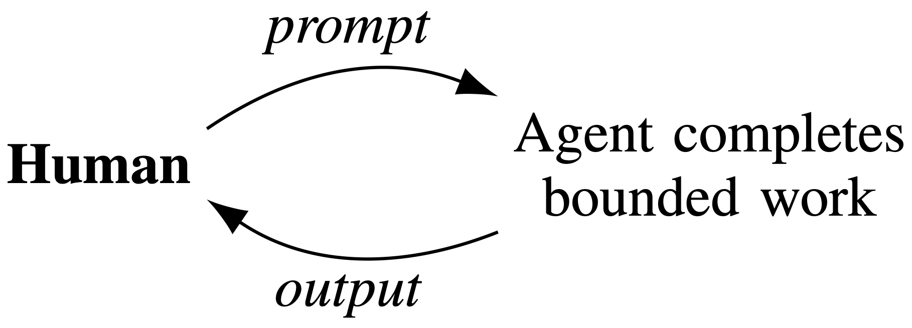
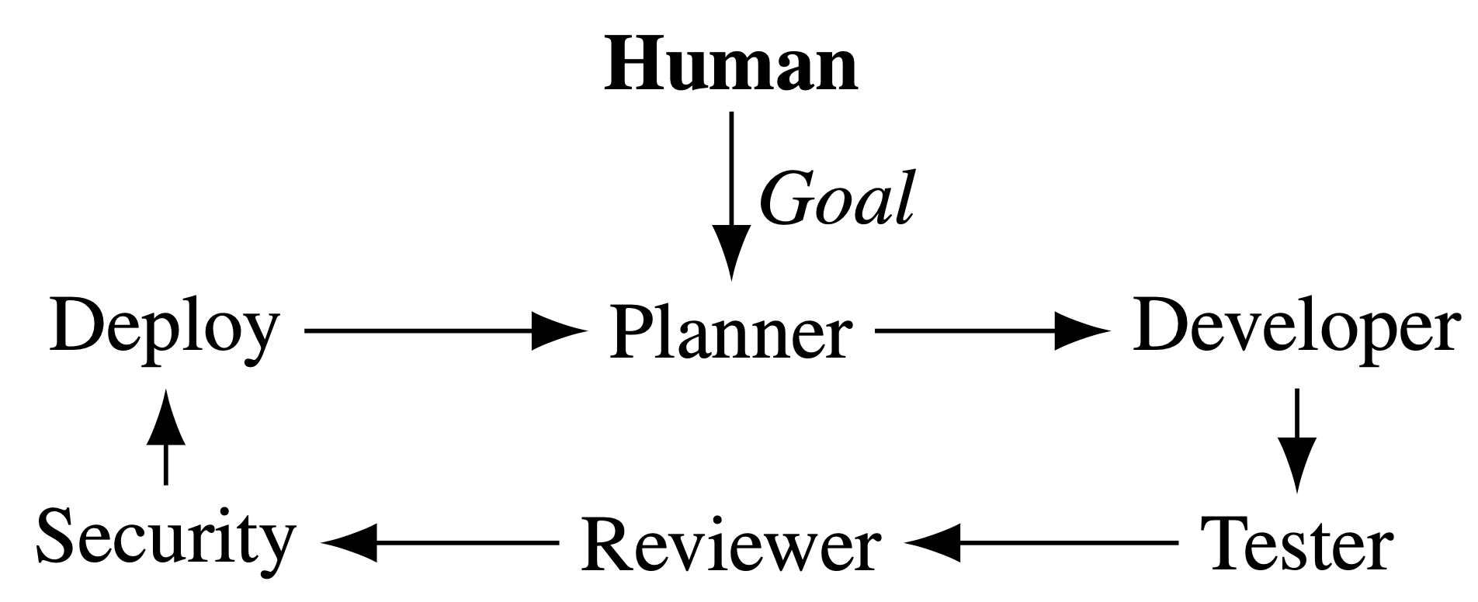
The obvious answers: More oversight, more process
Oversight
Process imitation
“My job is now code review”
Personas, e.g., Yegge’s Gastown
Does not scale / DevExp
Process is not judgment
Q: How do we retain agentic velocity while preserving engineering judgment & oversight?
A: Introduce appropriate representations for LLM to reason over

Slide 16
Talk outline
Who am I and why am I here
The problem: Trustworthy GenAI for consequential work
The shift: Intelligence changes the engineering bottleneck
MAGE: Model-Based Agentic Engineering
What this means

Slide 17
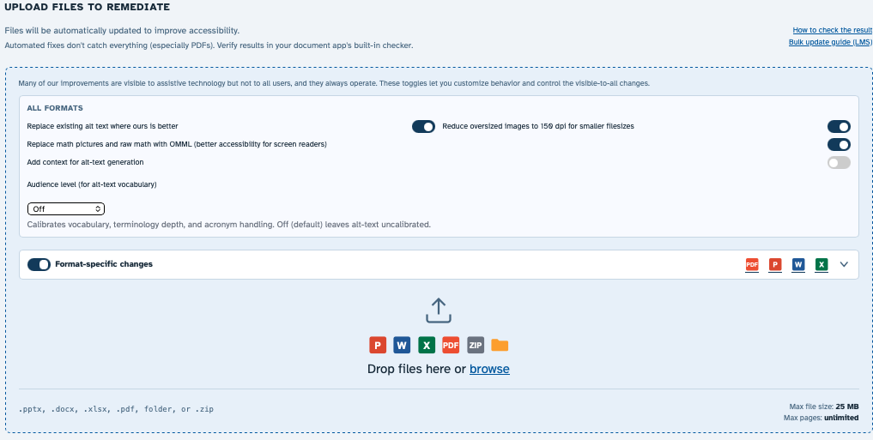
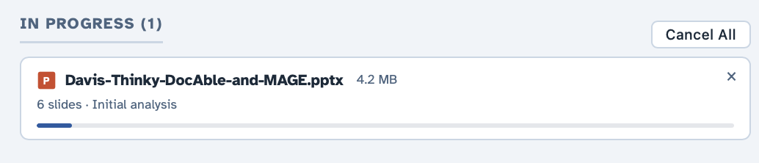
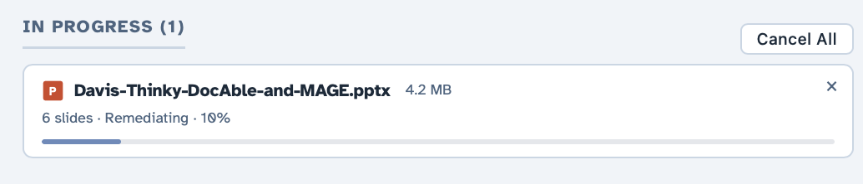
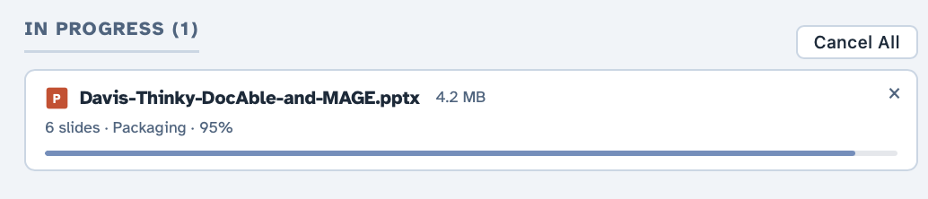
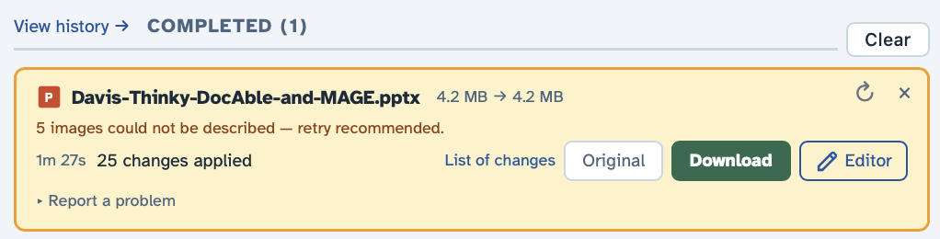

With GenAI, can one engineer/SME build a remediation system?
$0.11

Slide 18
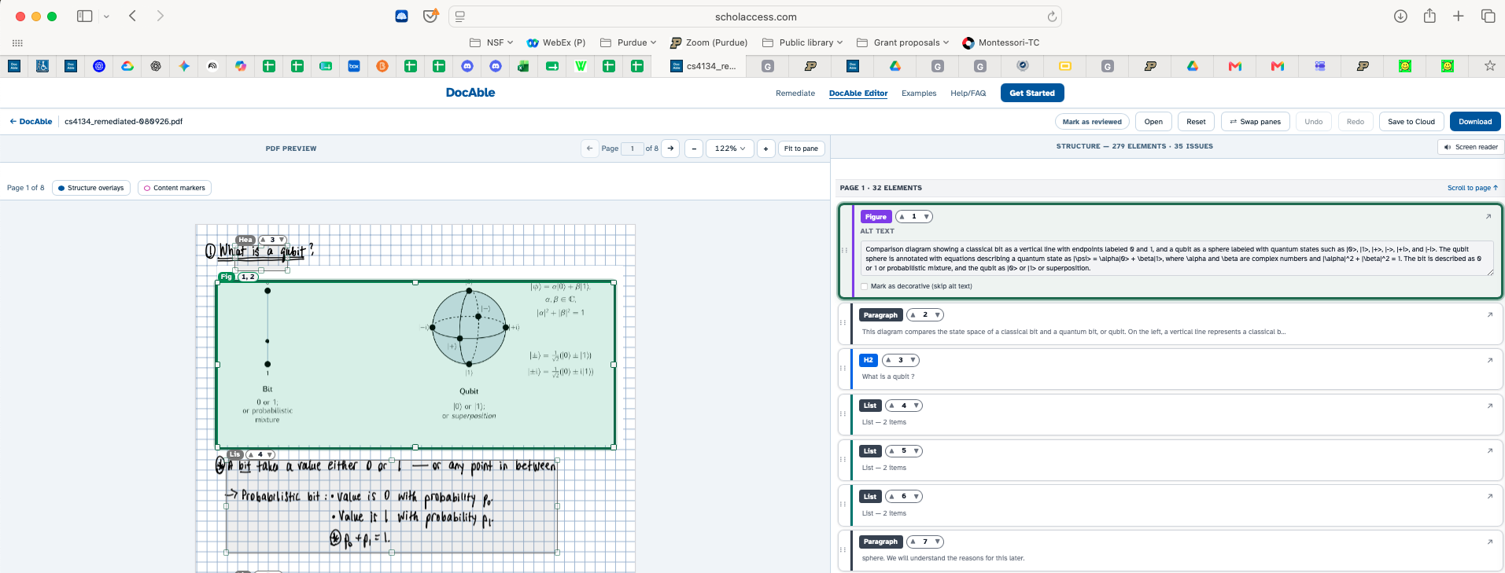
DocAble: And don’t forget an editor!
Notes:
Here, discuss why PDF is (much) harder than O365

Slide 19
How much engineering effort is this?
Category | Code lines | × prod
Production code | 554,116 | 1.00
Infrastructure as code | 35,864 | 0.06
System-model meta-files | 42,340 | 0.08
Support apparatus | 1,649,901 | 2.98
Quality apparatus | 1,273,947 | 2.30
Tests | 628,712 | 1.13
Lints | 308,908 | 0.56
Documentation (active) | 336,327 | 0.61
Agent infrastructure | 146,724 | 0.26
Tools | 229,230 | 0.41
Documentation (snapshot / history) | 1,011,406 | —
System-wide: 3,309,703 code + 975,073 comment + 790,312 blank = 5,075,088 lines across 17,938 files
Markdown 1.36M / Python 940K / C# 623K / TypeScript 138K
Comparison point: My product at IBM had ~3MLOC and had taken hundreds of person-years
(between 10 and 100 employees over a 20-year period)
Notes:
This isn’t a toy.
For calibration, the product I worked on at IBM was about three million lines and represented hundreds of person-years of accumulated engineering.

Slide 20
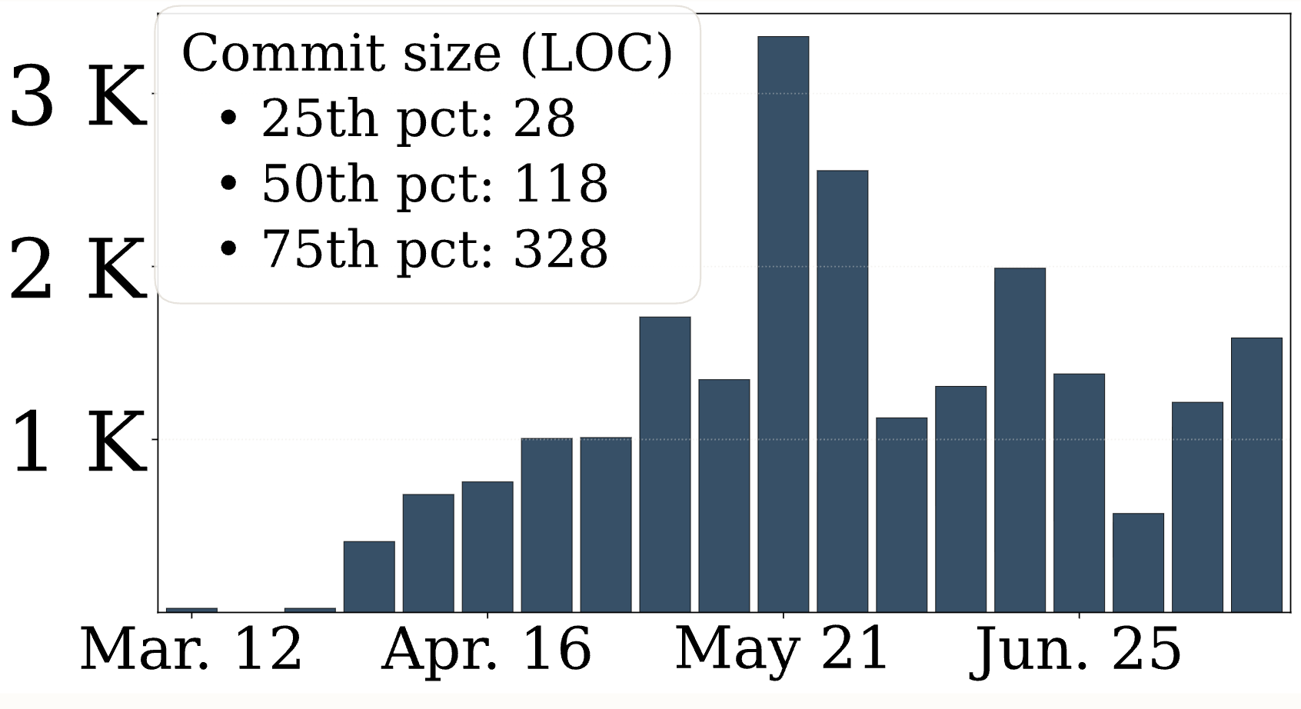
What velocity is involved?

Slide 21
Does it work?
Exceeds the capabilities of the commercial tool that Purdue licensed
Works on my files
Currently in use at Purdue Engineering, where some interesting edge cases are being discovered (and automatically fixed by Claude)
One colleague remediated his entire class, ~10 PPTX, ~500 slides total
He spent 5-10 minutes per slide deck reviewing the result, and then promised me a beer
Total cost: $10 + his time (90 minutes, call it $100) + the promised beer

Slide 22
Talk outline
Who am I and why am I here
The problem: Trustworthy GenAI for consequential work
The shift: Intelligence changes the engineering bottleneck
MAGE: Model-Based Agentic Engineering
What this means

Slide 23
I realize most of you are not SWEs However, I suppose you all do knowledge work in some capacity I think the same technique applies to all knowledge work.

Slide 24
Technology moves engineering bottlenecks
Goldratt’s Theory of Constraints / Amdahl’s Law:
Removing one constraint exposes the next
Technology | Makes abundant | Relatively scarce resource
Steam engine | Mechanical power | Control & Coordination
Factory | Physical production | Control & Coordination
Integrated circuit | Computation | Control & coordination
Coding agents | Knowledge-work implementation | Control & coordination
Notes:
Coding agents are not eliminating engineering. They’re making one input to engineering—implementation—abundant. And when a constraint moves, engineering reorganizes around what remains scarce.
Engineering reorganizes when a constraint moves. Steam made mechanical power far cheaper; integrated circuits did the same for computation; coding agents are now doing it for implementation. “Scarce” here is the economic sense, not a mood. A scarce factor constrains output, so it draws investment and attention. Implementation was never the only scarce input to software engineering, but for most of the field’s history it consumed enough expert effort to limit what teams could attempt and how quickly they could change a system. As its marginal cost falls, other constraints become more visible: deciding what to build, representing a large system well enough to reason about it, producing evidence that a change is acceptable, and giving consequential engineering decisions authority across many changes.
Abundance does not make implementation unimportant; it changes where additional engineering effort earns the greatest return. A factory with unlimited machine capacity and one inspector has not stopped manufacturing; inspection has become the throughput constraint. In software, agents can now produce changes faster than engineers can specify, understand, validate, and govern them. Models amortize representation and judgment across many acts of implementation; validators and gates can amortize selected judgments about acceptance. Rational effort therefore moves upstream into representation and outward into the engineered environment. This Part asks what follows from that shift: what remains hard, which properties of the new substrate matter, and what engineering problems they leave us to solve.

Slide 25
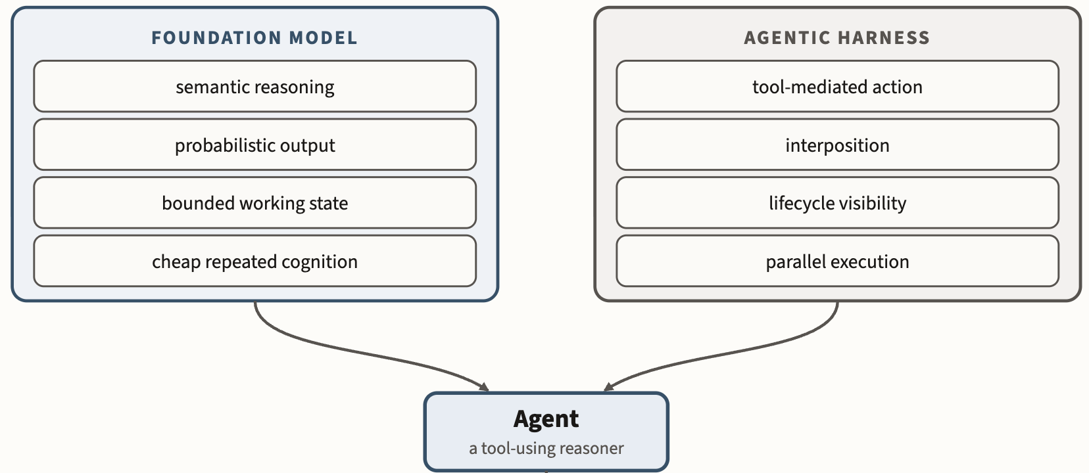
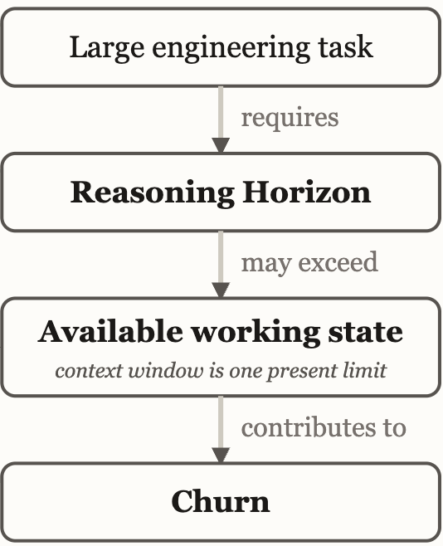
The new technology: “Agents” ~~ “Commodity Intelligence”
Notes:
The foundation model supplies inexpensive semantic reasoning under finite, probabilistic working conditions; the harness turns that reasoning into observable, interceptable action.
This talk is about my understanding of how CODING AGENTS will re-organize engineering work, and what the nature of the relatively scarce resource becomes.

Slide 26
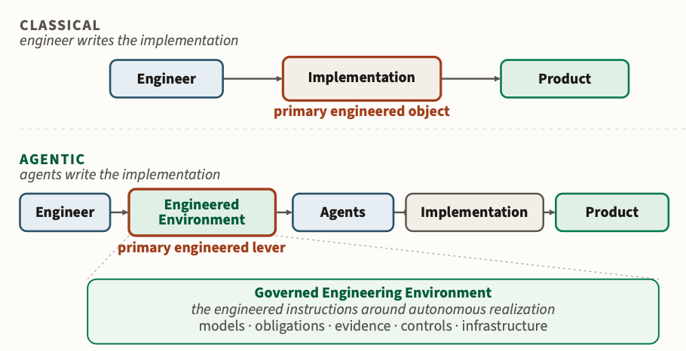
Control & Coordination of GenAI GenAI moves the engineering effort: Impl. → environment

Slide 27
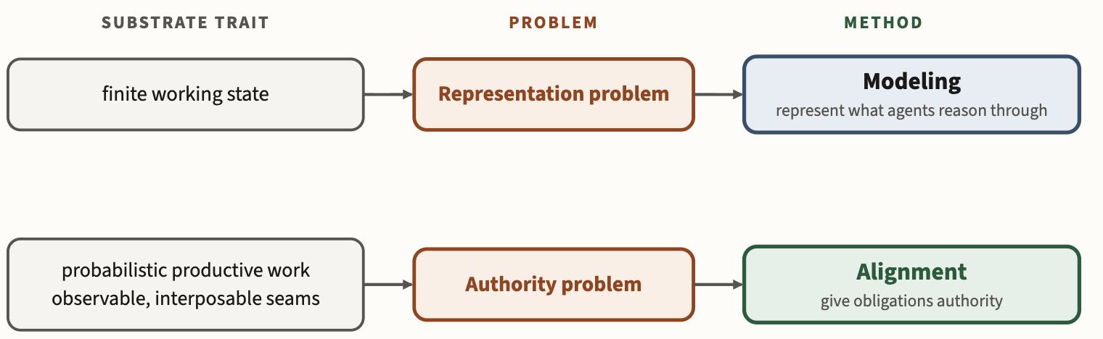
Mage principles: Modeling and Alignment

Slide 28
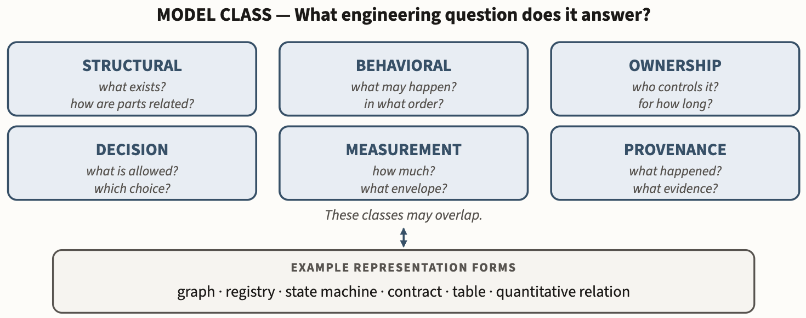
Models let us encode obligations
Notes:
Figure 2.1-1. MAGE's working model ontology. The six classes distinguish models by the engineering question they answer. Classes may overlap, and each may be encoded using several representation forms.
Connected through shared identity and traceability, these models form the system’s explicit engineering knowledge.

Slide 29
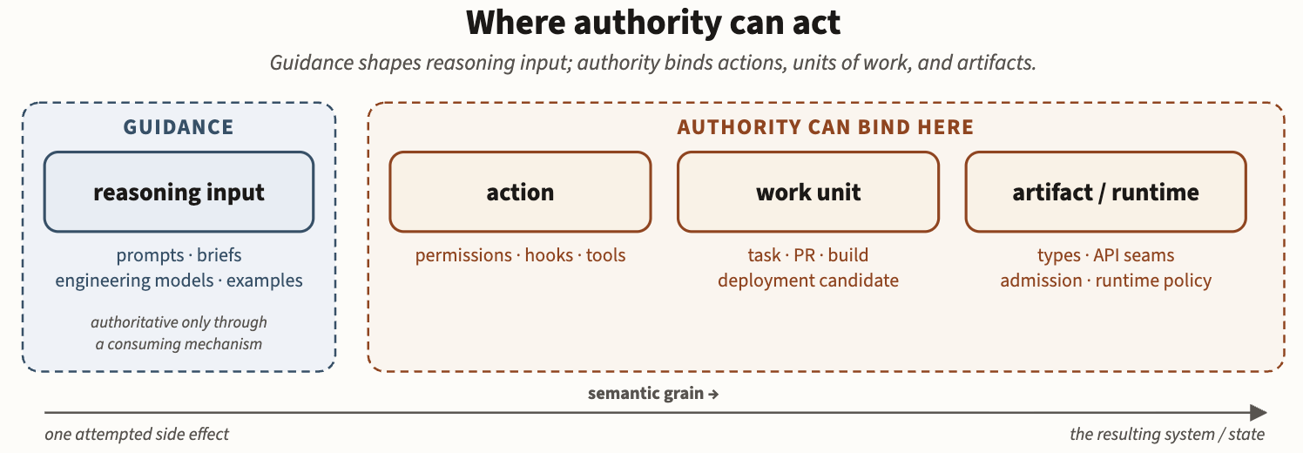
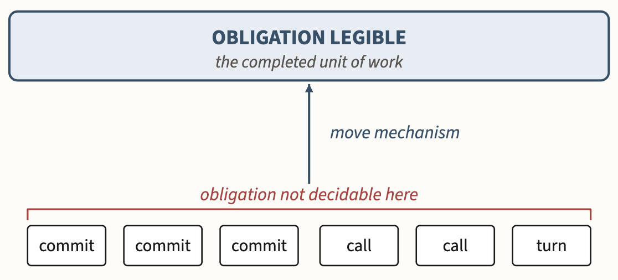
Alignment can act at different points
Semantic gaps
End-to-end principle
Notes:
Figure 3.1-1. Intervention boundaries. Guidance shapes reasoning input; authority can bind actions, completed units of work, or accepted artifact/runtime state. Place a mechanism at the earliest boundary where the obligation is legible and the consequence can be affected.
Semantic gap.

Slide 30
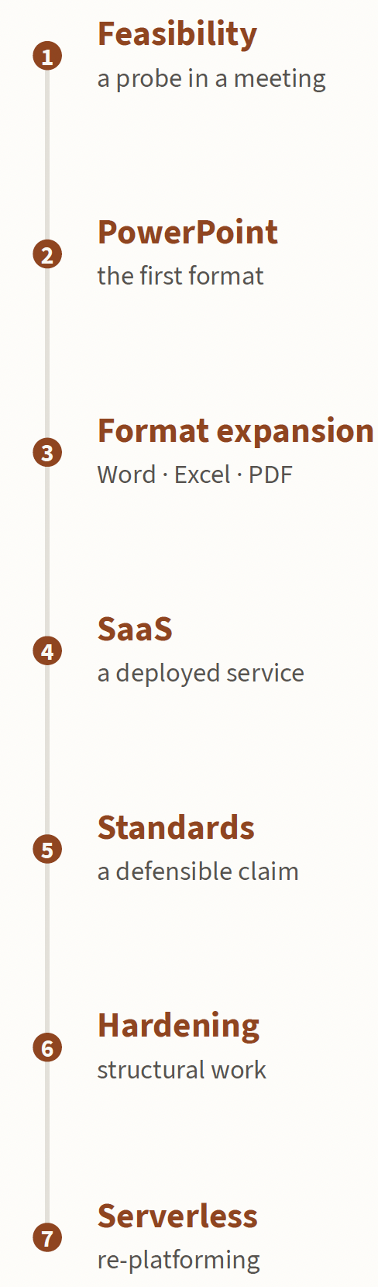
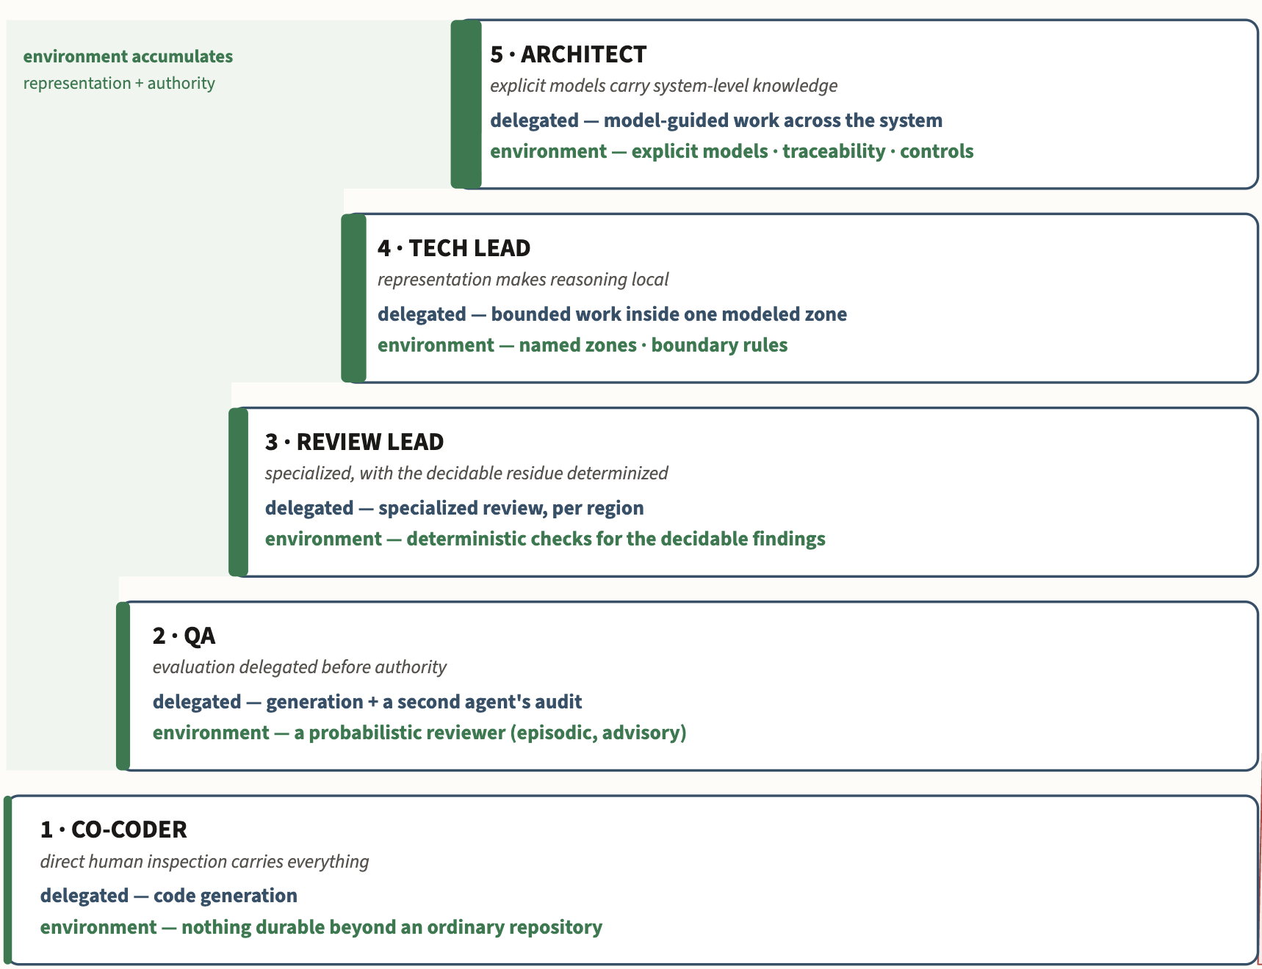
Engineering process
Growth of autonomy

Slide 31
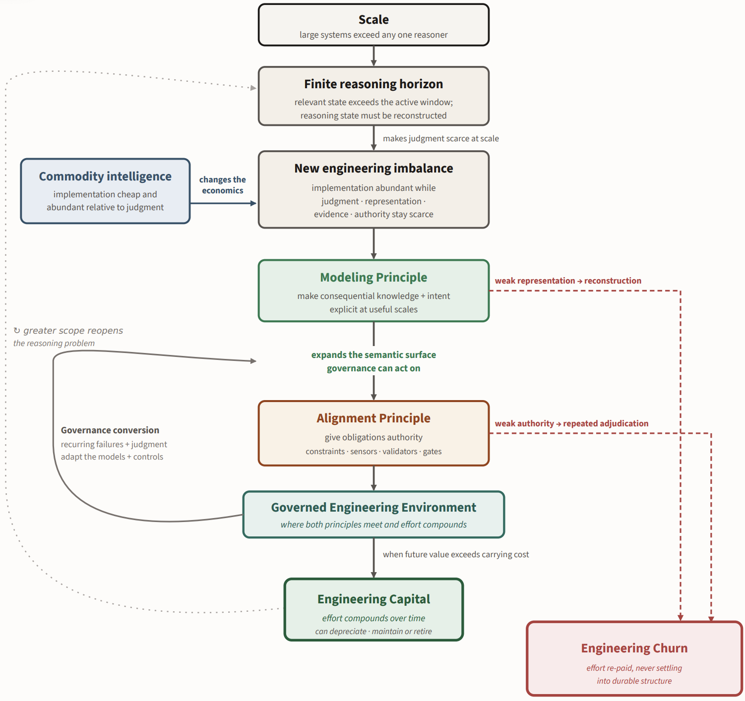

MAGE
Theory
Blog, links to book

Slide 32
Talk outline
Who am I and why am I here
The problem: Trustworthy GenAI for consequential work
The shift: Intelligence changes the engineering bottleneck
MAGE: Model-Based Agentic Engineering
What this means

Slide 33
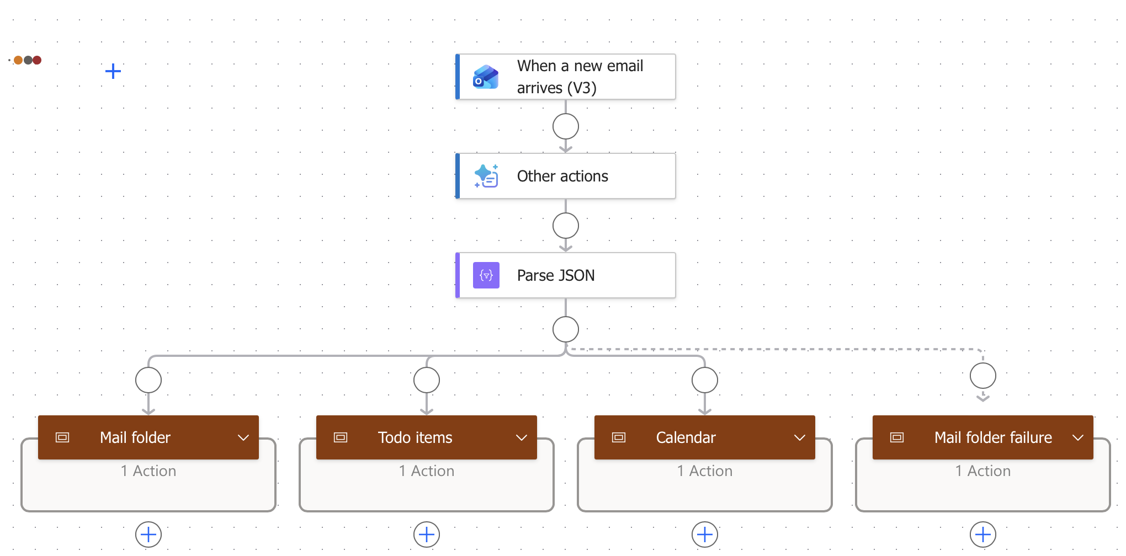
Daily work?
Should be able to do more with less
Identify bottlenecks, identify the right models, apply GenAI
GPT: Analyze this email
Parse the result
Bin my mail into High/Medium/Low
Extract action items
Make calendar entries

Slide 34
Cost of acquiring engineered systems?
Should be lower – Much lower
Does the contractor know how to use GenAI? Maturity models?

Slide 35
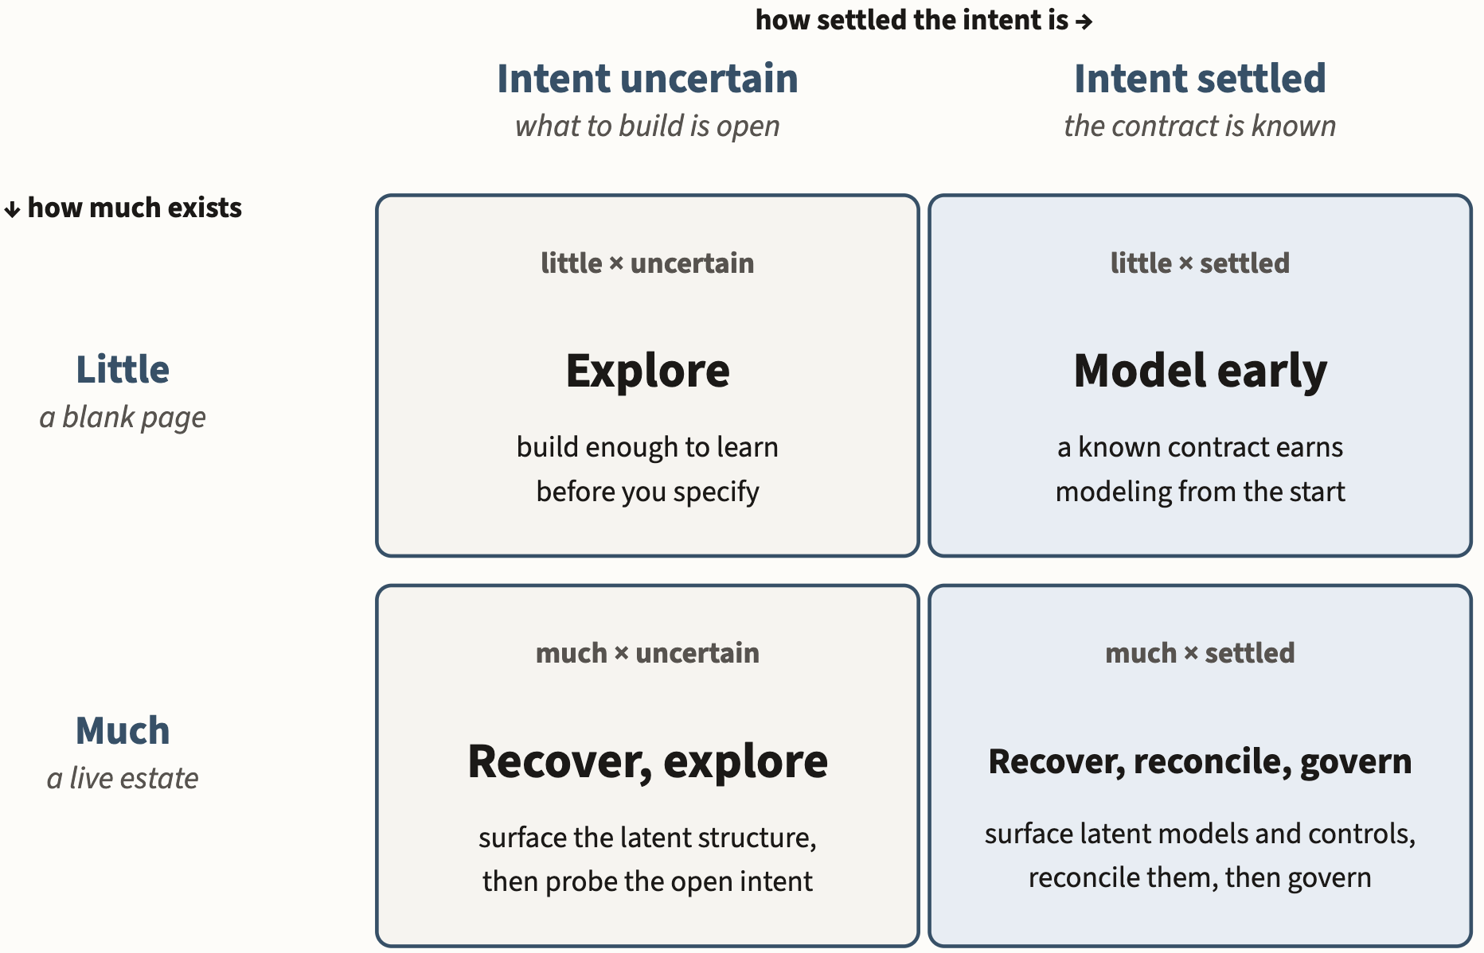
MAGE Decision Matrix
Notes:
Figure 4.2-1. Where a migration starts. Existing system stock determines what can be recovered; settled intent determines how much structure and authority the work can support initially. Authority is not a single project-wide dial — the more settled a particular obligation, the more authority it can safely receive, so a security, legal, or safety constraint may be settled even when the product behavior around it is still exploratory.

Slide 36
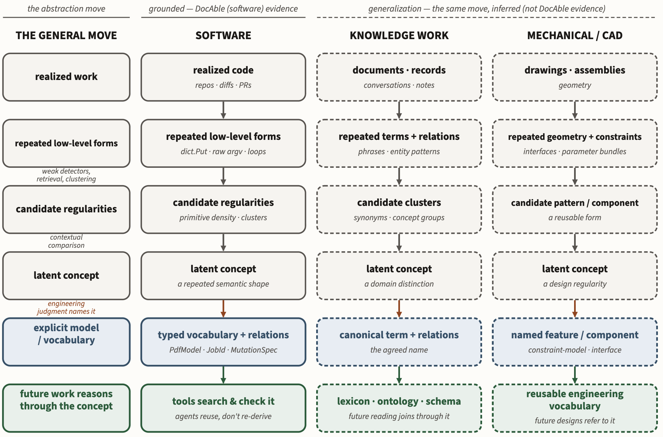
Brownfield MAGE: Inducing models from an existing system
Notes:
Figure 6.5-3. Model induction. The same move runs in three settings: realized work yields repeated low-level forms, weak detection surfaces candidate regularities, and engineering judgment names the concept that survives comparison. The left rail states the move; the three columns instantiate it in software, knowledge work, and CAD. Software is the grounded case; the extension to knowledge work and CAD is a generalization, not evidence DocAble supplied.

Slide 37
MAGE: Putting the engineering in knowledge work
Thank you for your attention!
https://davisjam.github.io/model-based-agentic-software-engineering/
Notes:
Commodity intelligence did not abolish software engineering. By making implementation cheaper, it may force us to practice more of it.

