Slide 1

3-D Printing Production Software Architecture, Validation, and Control for Agentic Software Engineering
Dr. James C. Davis
Assistant Professor of ECE@Purdue
Notes:
Goal: Expand your mind about what is possible with GenAI, and patterns for working with it.
Today I will share my two theses about how to use Claude effectively.
First is the engineering controls thesis: agentic velocity is sustainable only when the engineering environment becomes more explicit, deterministic, observable, and self-correcting.
Second is the human judgment thesis: when implementation becomes abundant, the scarce human work shifts toward problem framing, abstraction discovery, architectural judgment, product direction, and governance.
If you have questions along the way please please ask them.
This is a workshop and I want to help you use GenAI more effectively!

Slide 2
Cheap Code, Expensive Judgment
Implementation is free
That does not make you a production shop
The scarce resource moved from writing code to governing whether fast code can be trusted
This talk: the engineering that turns a fast code fabricator into a production line you can trust
Grounded in a real system — DocAble, a document-accessibility service (scholaccess.com) built almost entirely by dispatched AI agents in ~16 weeks
https://scholaccess.com
Notes:
Generative AI made implementation nearly free — a coding agent fabricates working code on demand, in volume

Slide 3
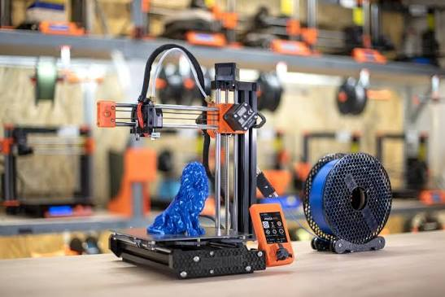
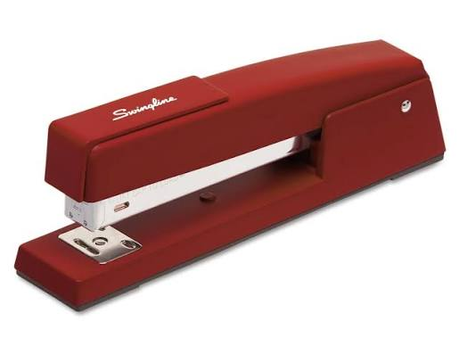
GenAI is a 3D printer, not a stapler
Does one job
Obvious how to use it
With instructions (CAD), can do many jobs
Bad instructions == Bad results

Slide 4
How to GenAI: Basic decision tree
What kind of task
Computational (coding, analysis, grading per rubric)
Specify I/O behavior
(What is the process?)
Judgment/Language/Reputational
(eg Writing, Grading, Developing lecture)
Ask GenAI to build
(or to be) the process
Interactive or Autonomous
Careful prompting and review
Interactive mode

Slide 5
The Computational Path: Construct the process
Simple task – < 3KLOC
What kind of task
Specify I/O behavior
“One-shot scripting”
(eg CSV → teaching tenure table)
Hard task – Esp. if it includes reasoning
Supervised autonomy
Correctness conditions
Propose sub-tasks
Tools to “determinize” recurring processes
Monitoring and intervention
System design
Development process

Slide 6
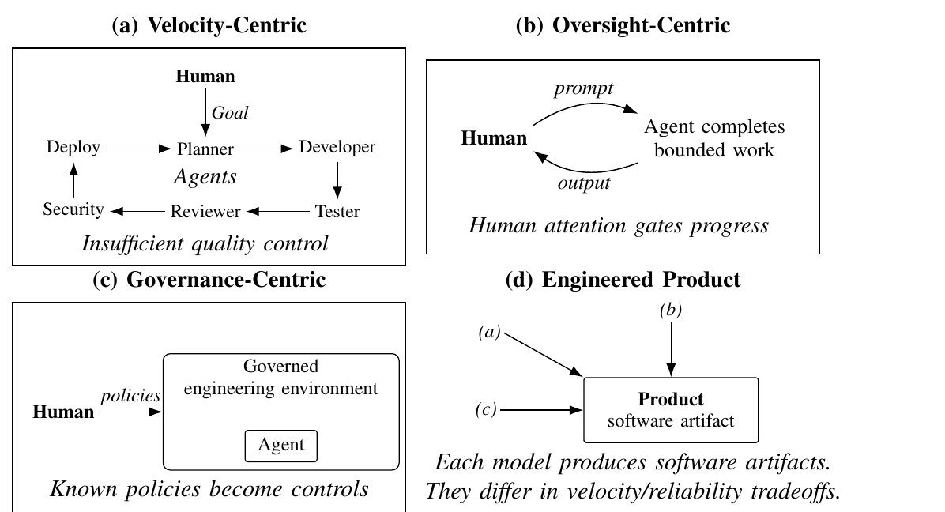
Three ways to supervise those agents

Slide 7
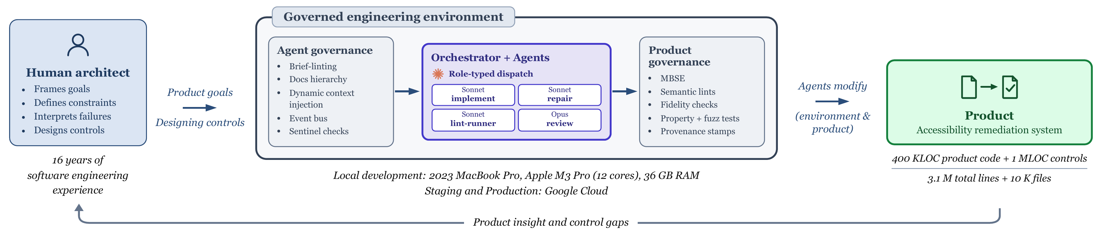
The thesis: govern the conditions under which fast code can be trusted
The governed engineering environment: an architect frames goals; controls ride every change from dispatch to product.

Slide 8
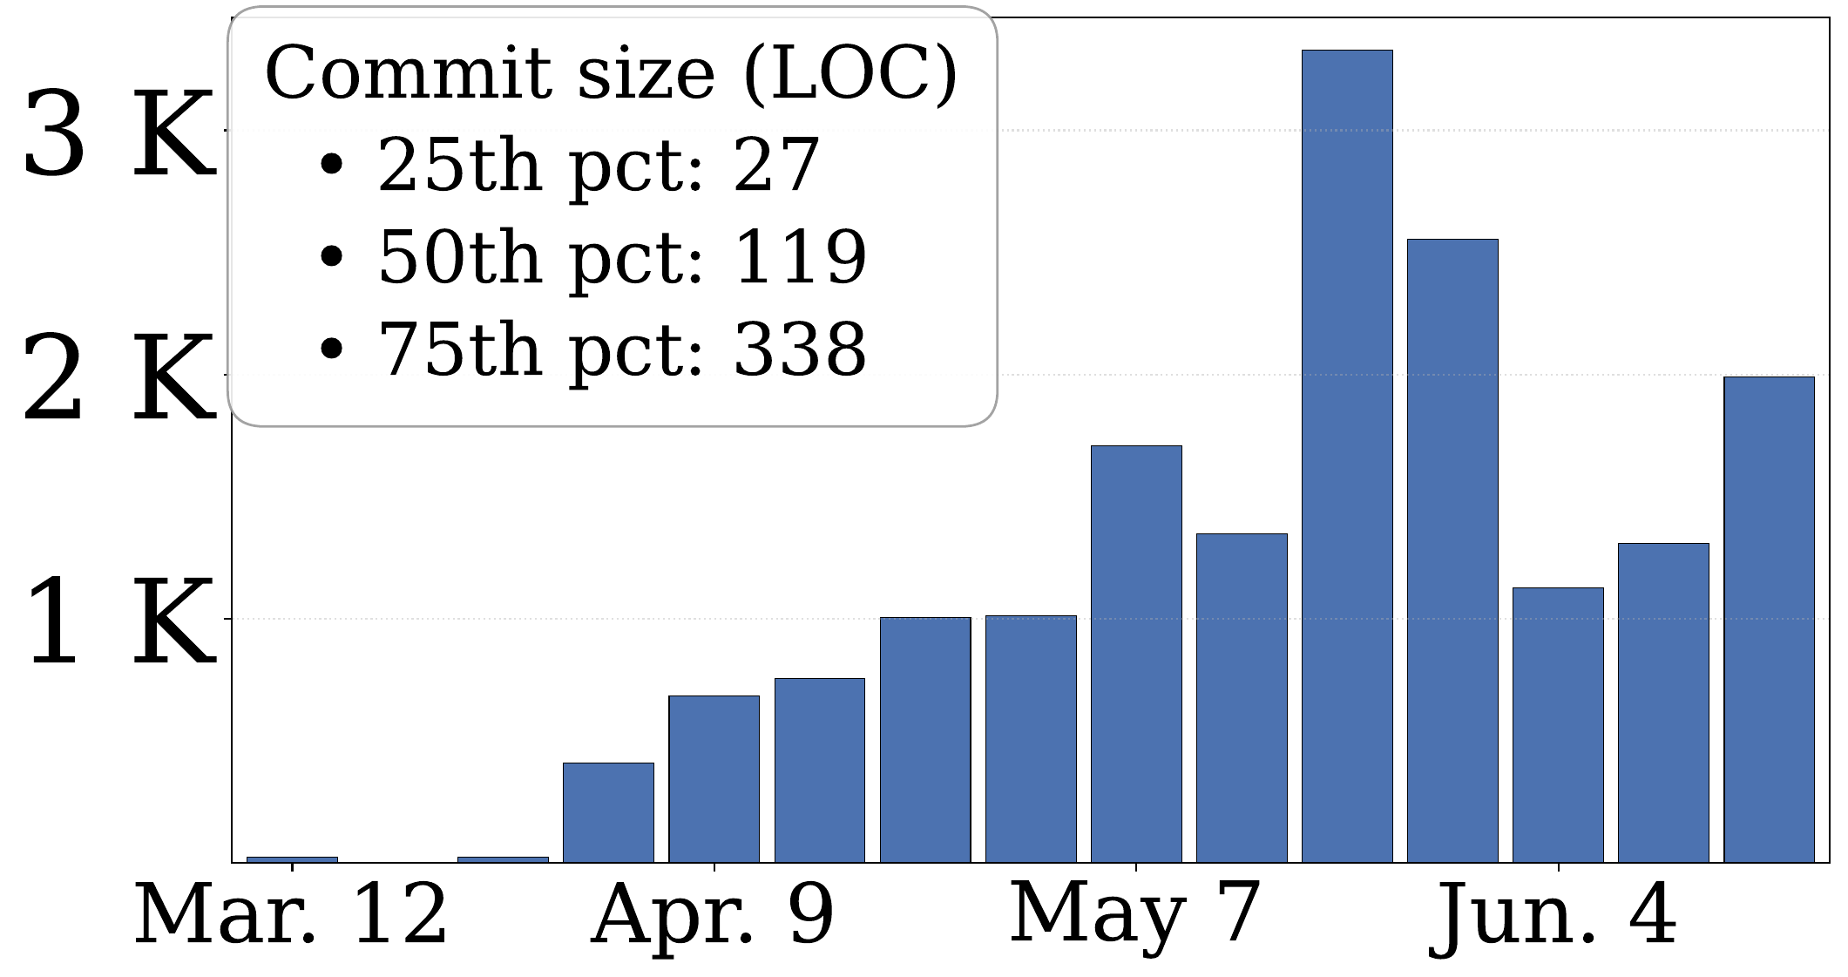
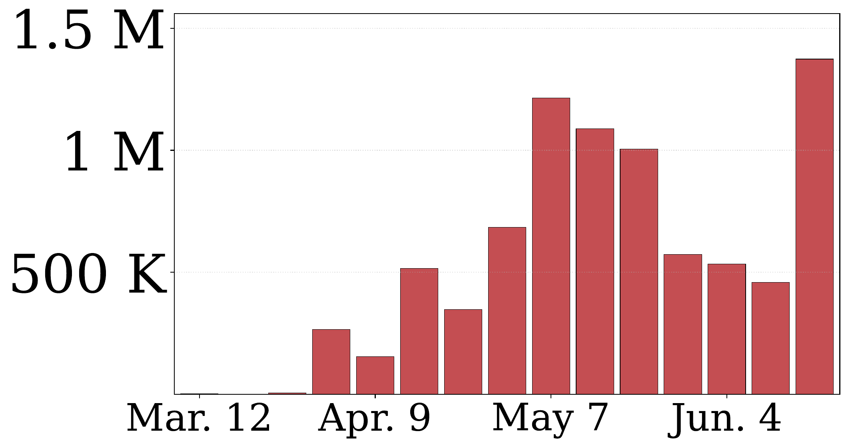
It works
Repo activity: commits & lines changed per week

Slide 9
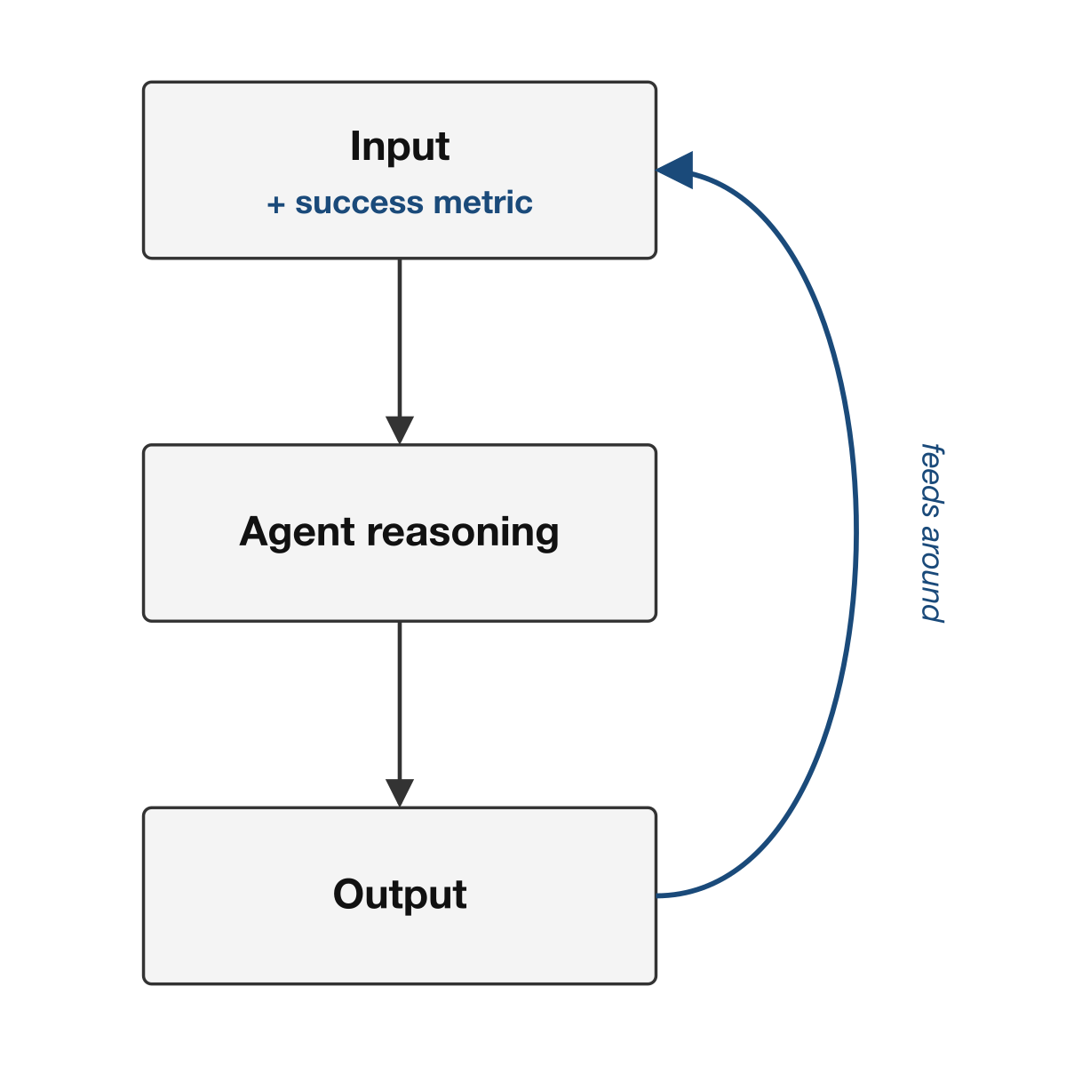
It’s all one loop
In some sense, the whole talk is about this loop.
The hard question
How do you define the success metric?
My answer
Ousterhout (measure one level deeper)
+
MBSE (models, models, models).

Slide 10
Roadmap: the ideas in this talk
Part 1 — Case study context: the ADA mandate and building DocAble with a fleet (brief)
Part 2 — The system’s mechanisms: architecture that prevents, control that catches
Part 3 — The models bridge: documentation taken to a typed, drift-checked model
Part 4 — The method: operating the fleet, and converting failures into controls

Slide 11
Part 1 — Case Study Context

Slide 12
The ADA mandate and the problem
The Americans with Disabilities Act — and the 2024 proactive turn toward accessible digital documents
Remediation is expensive: hours per document, scarce expertise, a large backlog

Slide 13
Building DocAble with an agent fleet
Stage 1: Feasibility probe
Stage 2: PPTX remediation
Stage 3: Format expansion
Stage 4: SaaS
Stage 5: Standards conformance
Stage 6: Hardening
Stage 7: FaaS
Peaked at 4 Claude MAX $200/mo plans

Slide 14
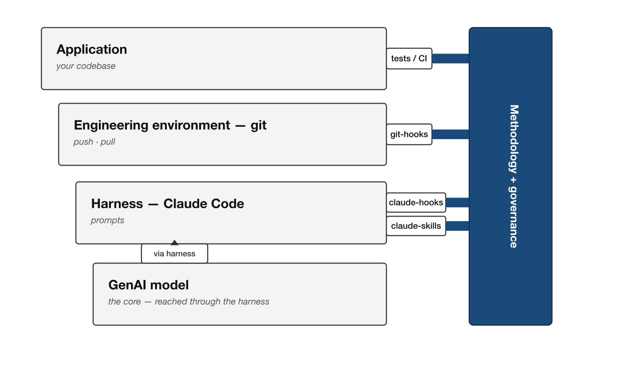
The engineering substrate we work with
Before the mechanisms: four layers, and the method plugs governance into the hooks each layer exposes.

Slide 15
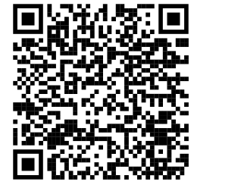
Part 2 — The System’s Mechanisms
https://davisjam.github.io/agent-governance-mechanisms/
The governance built into the system itself:
the architecture that prevents a failure, and the control that catches it.

Slide 16
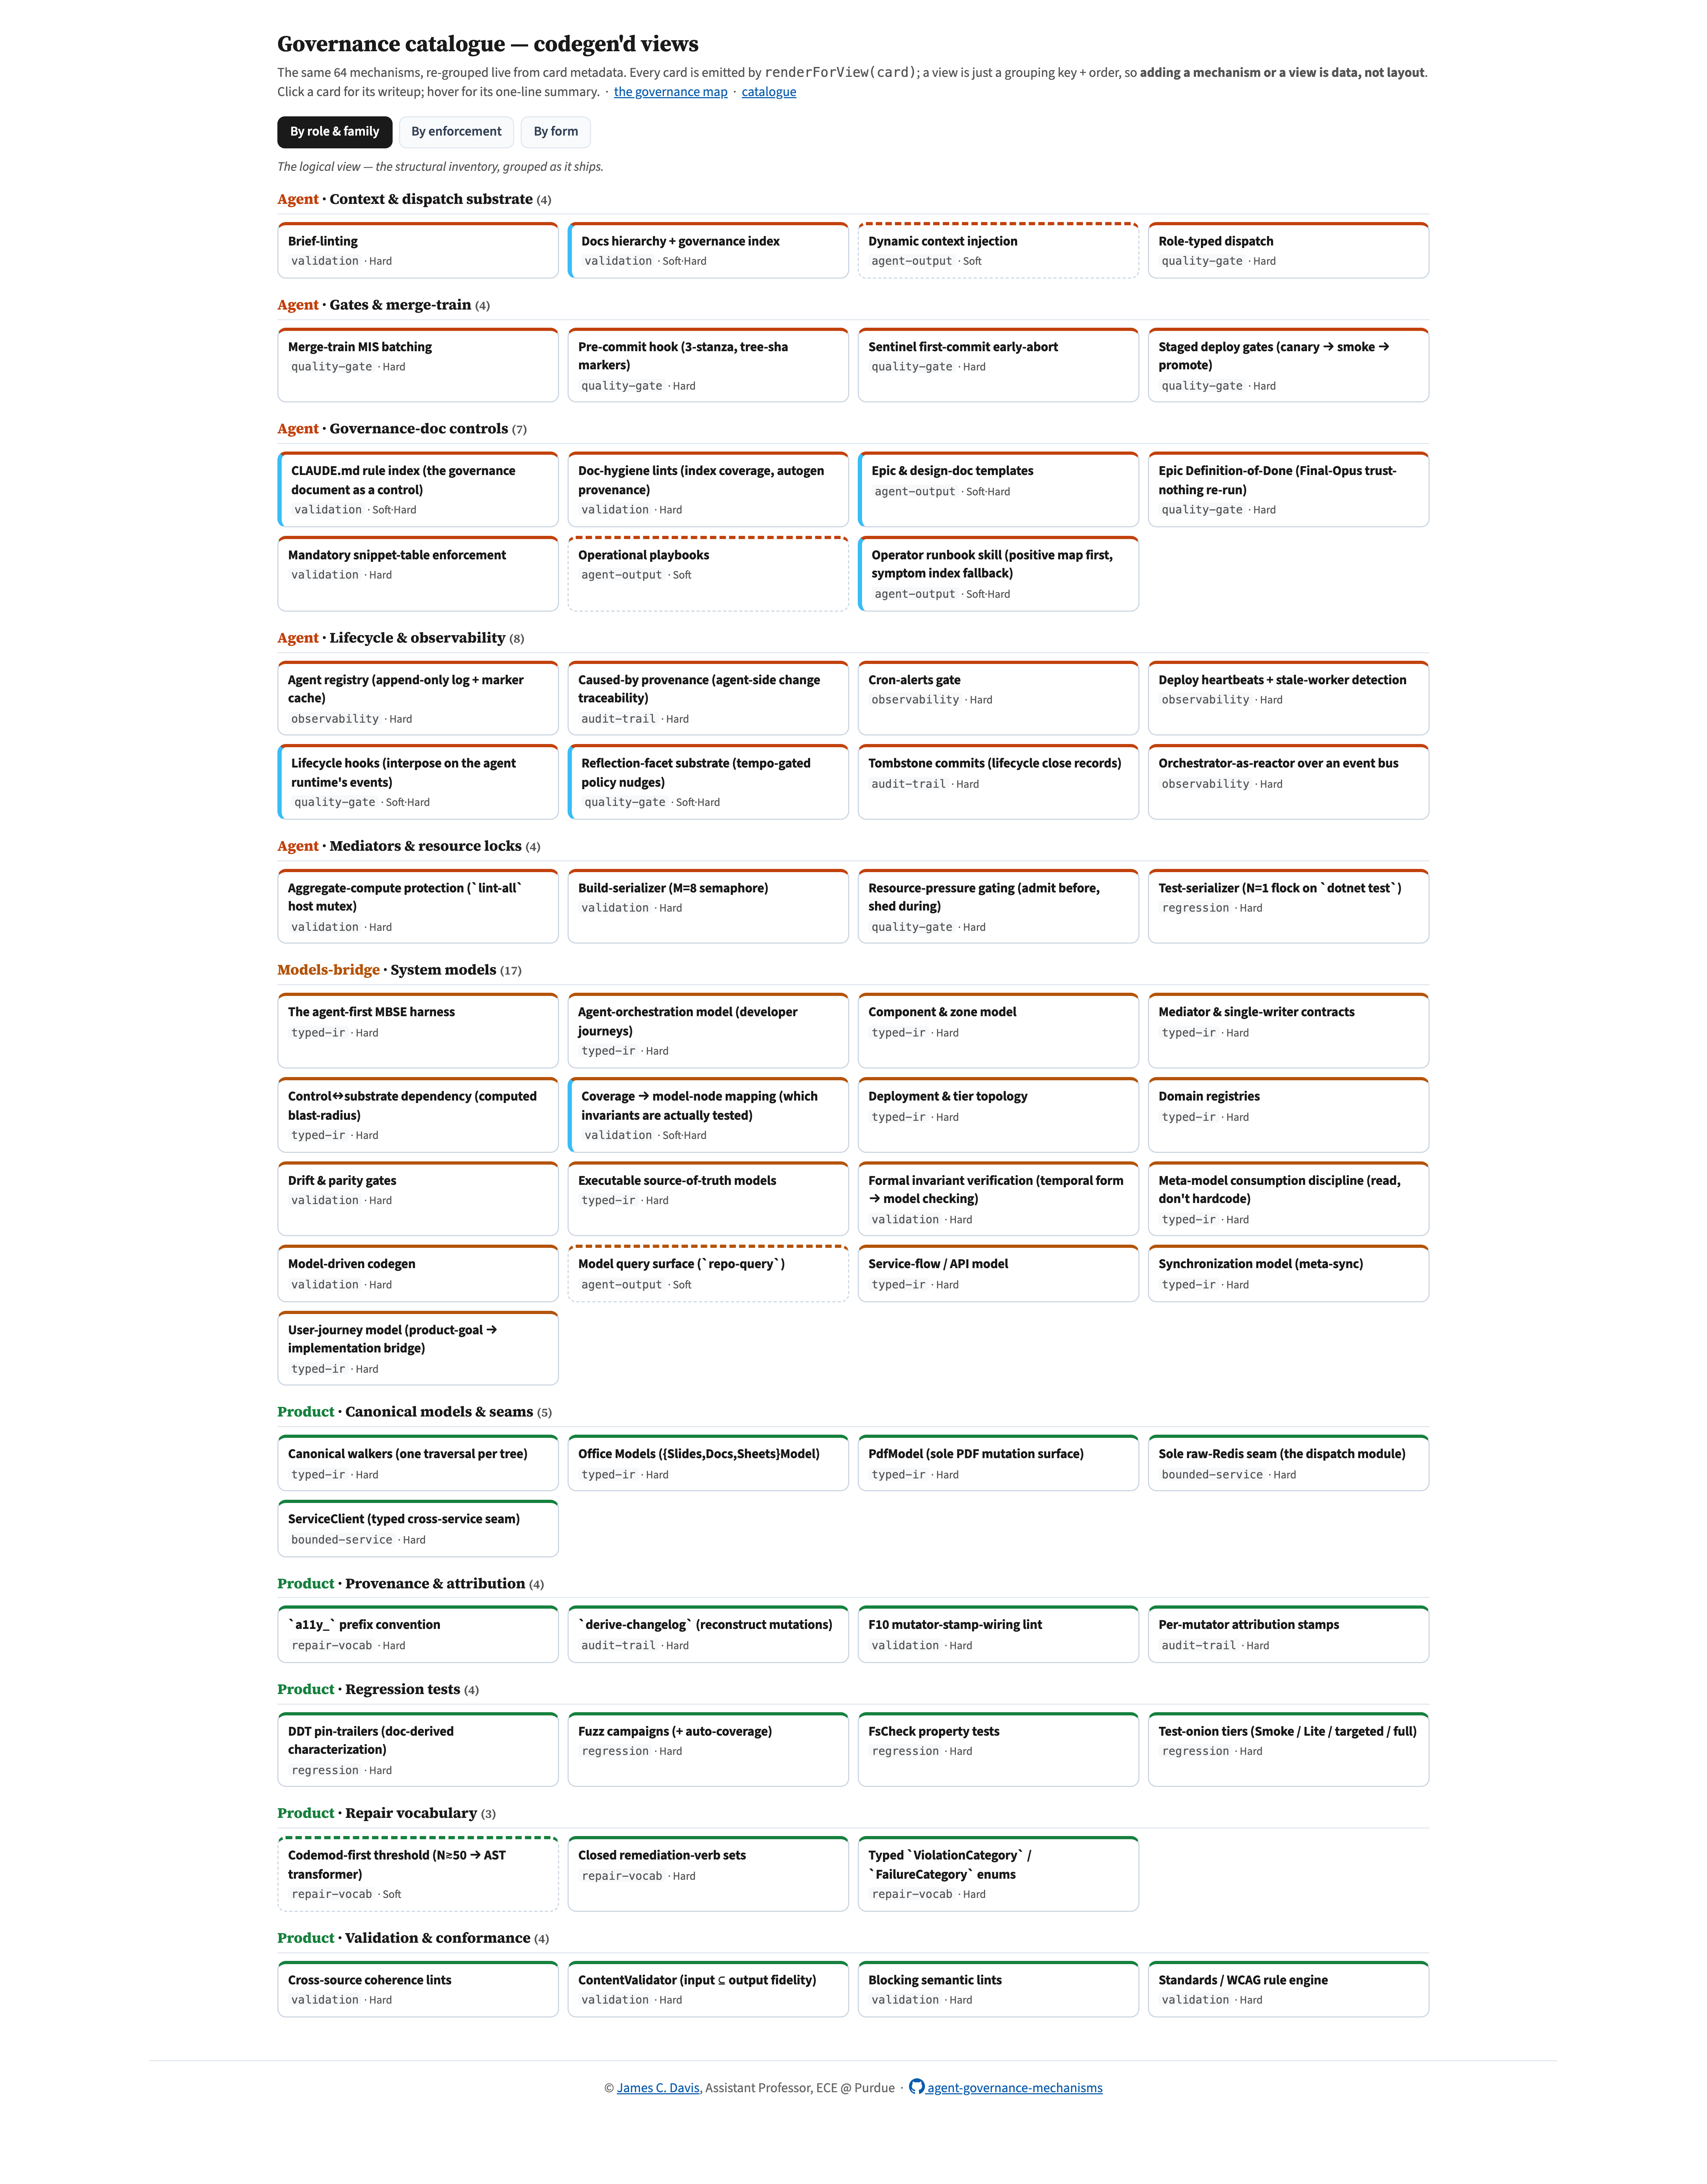
64 governance mechanisms
64 mechanisms across three roles — agent, models-bridge, product. The talk features the ones the case study leaned on hardest.

Slide 17
A governed engineering environment
Three targets a governed engineering environment must cover:
the agent fleet that produces the work
the typed models the fleet reasons through
the shipped product
Types of governance
Architecture — make the error unrepresentable (poka-yoke)
Control — observe and guard where you cannot prevent
Choose by cost; a costly failure earns both
Soft vs. hard enforcement: guidance aims, machinery holds

Slide 18
Putting a change on rails: context, dispatch, gate staircase
A brief is the agent’s whole world — brief-linting refuses a malformed or mis-tiered dispatch before launch
Role-typed dispatch: bind model, isolation, and gates to a typed role
Dynamic context injection: slice the rules the target files obey and push them into the brief (available → binding)
Pre-commit hook with tree-sha markers: cheap changed-file checks, proof it passed on this tree
Merge-train batching: land the largest conflict-free set of worktrees per tick (maximum independent set)
Staged deploy gates: canary, smoke, promote

Slide 19
Seeing the fleet: observability, lifecycle, governance doc
Agent registry: who is in flight, authoritatively
Orchestrator as a reactor over a typed event bus
Tombstone commits: durable lifecycle-close records
Caused-by provenance: trace a landed change to the decision that caused it
Lifecycle hooks: interpose on the runtime’s own events to fire a reflex an operator would skip
The rule-index and its cap lint: the house-rules doc as governed infrastructure
The Epic Definition-of-Done: a final trust-nothing re-run at HEAD

Slide 20
Bounding the output: validation, provenance, repair vocabulary
Content validator: assert the input content survives into the output (input ⊆ output)
per-pass localization — which pass dropped it
Standards rule engine: map each finding to the exact clause it closes
Per-mutator provenance stamps, and a wiring lint that makes “every verb stamps” a must
Closed remediation-verb sets: a bounded, enumerable move-space
The regression-test onion: smoke, lite, targeted, full — plus property tests and fuzz

Slide 21
Part 3 — The Models Bridge
Documentation taken to its limit:
the typed, drift-checked model a context-bounded agent reasons through to operate a context-exceeding codebase.

Slide 22
Documentation, taken to its limit
The first move everyone finds: good docs and tests, then point the agent at them
The step the training data won’t suggest: a model above the prose
Agent-legible and precise — abstraction shrinks the space to be wrong in
It can’t lie: a model wired to a build-time drift check
Model-based systems engineering as the bridge between agent and codebase

Slide 23
Building the bridge: an agent-first MBSE harness
Not a modeling language, not bare records — a thin harness over frozen records
Executable source of truth: data-not-code that can’t drift
Derive, don’t hand-type: assert stored equals derived
Adopt the vocabulary of the best-in-class genre per view
The 4+1 views and their starter scaffolds; each per-view drift lint is a parity gate

Slide 24
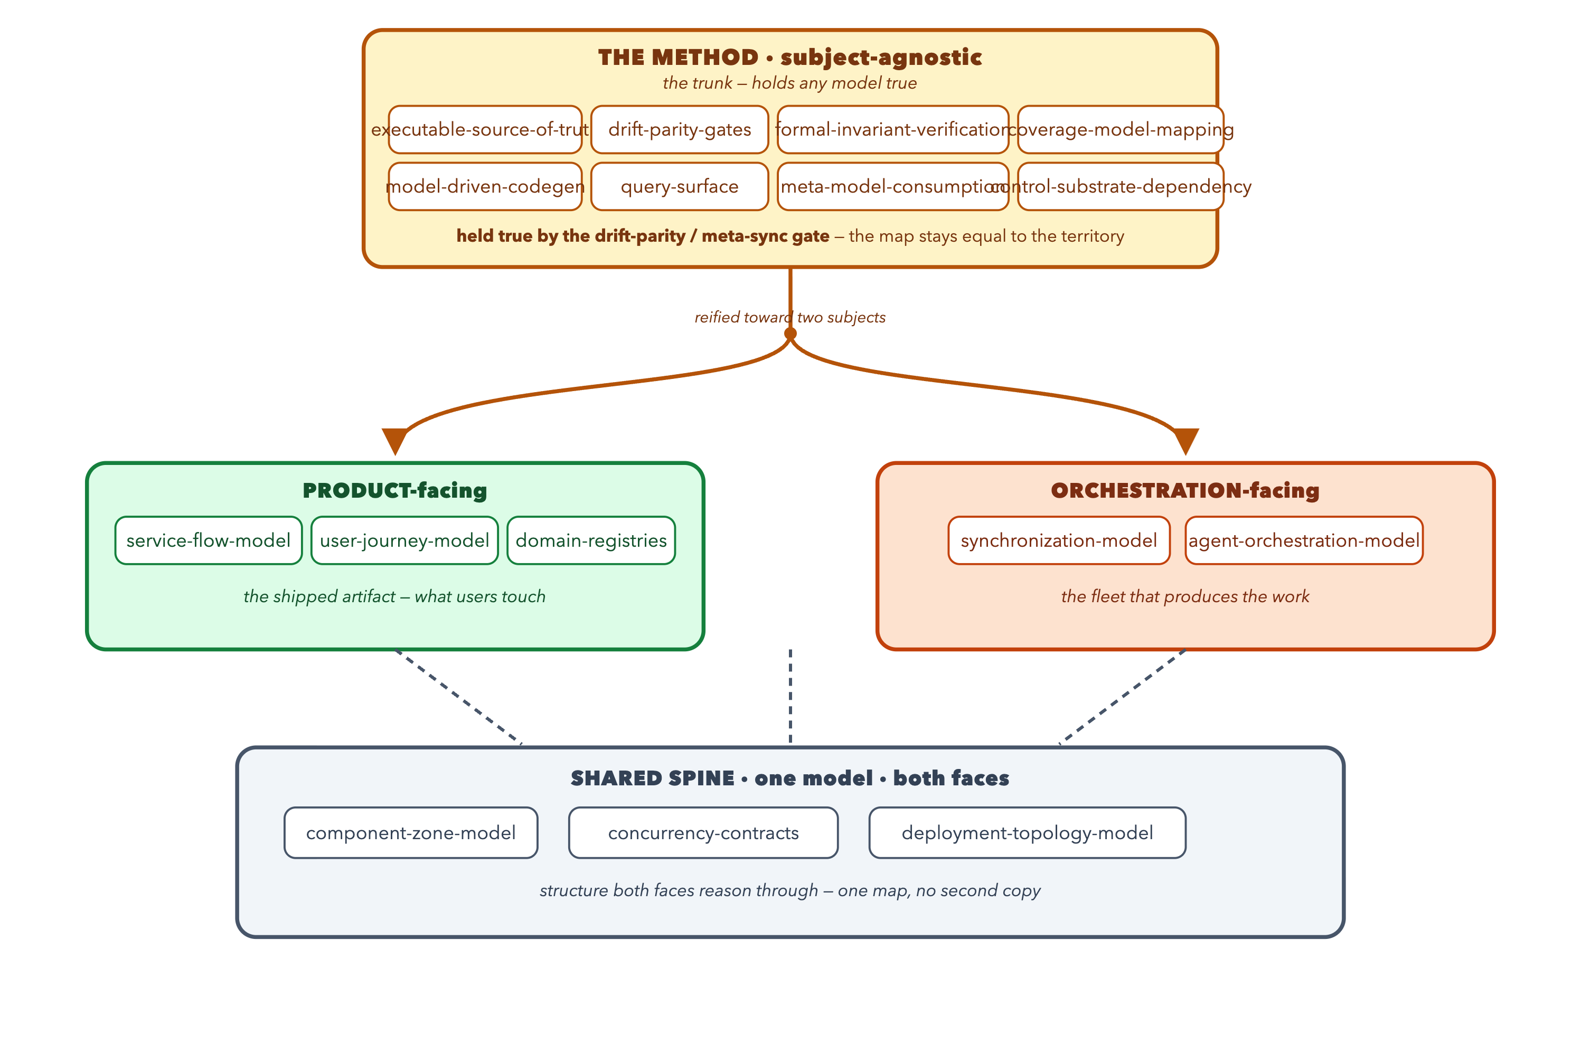
Keeping the map equal to the territory
One typed model, two faces — product and orchestration reason through a shared spine; drift/parity gates keep it honest.

Slide 25
Part 4 — The Method
How to run and grow a governed system:
operating the fleet, and converting failures into controls.

Slide 26
Operating the fleet
The worker pool: a ceiling, not a target — refill a freed slot from the backlog
Rationing shared compute: an exclusive lock, a bounded semaphore, a pressure gate
Scheduling disjoint work so a batch lands without conflict
Runbooks: situation-keyed procedures for the failures that recur
Read the fleet’s own signals before you dispatch

Slide 27
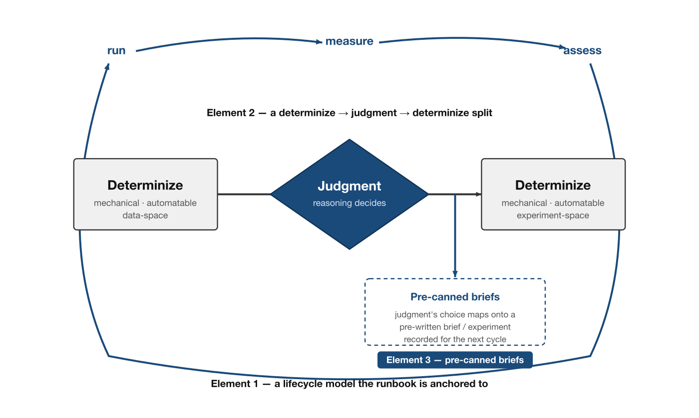
A runbook: lifecycle + determinize/judgment split
“I want to optimize over these knobs — here are the performance metrics.”
Lifecycle: run → measure → assess
Step 1 — determinize (data-space)
Where the data lives, its schema, and models of normal vs. anomalous performance values.
Step 2 — judgment (reasoning-space)
How to decide which knobs to turn from that data — heuristics, rules, algorithms.
Step 3 — determinize again (experiment-space)
Judgment emits knob choices + rationales; they’re recorded and mapped onto the next experiment.

Slide 28
Convert a failure into a control (the core method)
Velocity exposes a failure; judgment classifies it as local or structural
The conversion: encode the class as a lint, gate, typed seam, test strategy, or runtime hook
Audit becomes lint: today’s manual finding is tomorrow’s mechanical check
Right-size the fix: the smallest sound change that closes the class
Mechanize the reflex itself, so the next recurrence prompts its own conversion
Governability compounds: each conversion narrows the next agent’s space to fail

Slide 29
Adopt and adapt — turning the catalogue on your own repo
Fold the method into your house-rules doc; don’t start fresh
Survey the repo: adopt / adapt / skip, ordered by leverage over cost
The local loop is the part that travels furthest
What to reach for first, by how you build:
more than one agent at once → the agent role
agents break “unrelated” things → the models bridge
a user-facing artifact → the product role

Slide 30
When not to govern — the tower nobody wants
Every guardrail taxes every change and every context budget
The tower of governance, and the adverse selection that builds it
Descriptive, not prescriptive: a menu to tailor, not a bar to clear
Reach proactively only on the smells that predict a failure
Cheap code, expensive judgment: knowledge is free, wisdom is not

Slide 31
Where this leaves us
Govern the conditions under which fast code can be trusted.

Slide 32
Recap
Implementation is cheap; governing trust is the hard part
Three targets — the agent fleet, the models bridge, the shipped product
Two kinds of mechanisms — architecture prevents, control catches
The models bridge lets a bounded agent operate an unbounded codebase
The method: when a failure recurs, convert the class into a durable control
…and know when to stop — govern the smells, not everything

Slide 33
What does it mean for HPC?
Honest answer: I don’t quite know — I haven’t tried it on HPC yet.
Where might the governance ideas fit — or not — in an HPC workflow?
The agent fleet, the models bridge, the product controls — which map onto simulation, data pipelines, or scientific codes?
Let’s discuss.

