Slide 1
MAGE Model-Based Agentic Software Engineering A Case Study in Document Accessibility
James C. Davis
https://davisjam.github.io

Slide 2
Talk outline
Who am I and why am I here
The substrate: Engineering shifts in response to technology change
Vibe coding
MAGE
Modeling
Alignment
Putting it together: The MAGE Method
Related work and Implications: for engineering, for research, for education

Slide 3
Talk outline
Who am I and why am I here
The substrate: Engineering shifts in response to technology change
Vibe coding
MAGE
Modeling
Alignment
Putting it together: The MAGE Method
Related work and Implications: for engineering, for research, for education

Slide 4


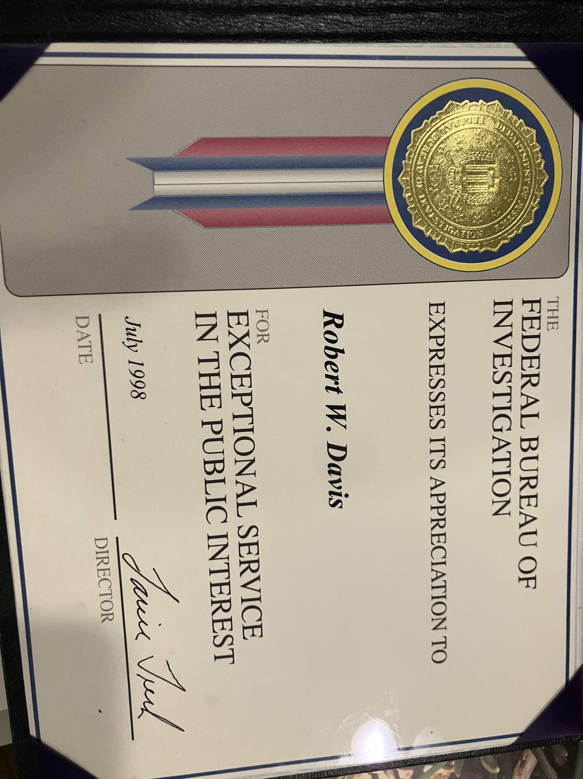

Biosketch
2012-2017: Software QA, IBM GPFS / Spectrum Scale
2019: Intern, IBM Research @ Almaden
2019-2020: Collaboration with Middleware group
Wittern, Erik, Alan Cha, James C. Davis, Guillaume Baudart, and Louis Mandel. "An empirical study of GraphQL schemas." In International Conference on Service-Oriented Computing, pp. 3-19. Cham: Springer International Publishing, 2019.
Cha, Alan, Erik Wittern, Guillaume Baudart, James C. Davis, Louis Mandel, and Jim A. Laredo. "A principled approach to GraphQL query cost analysis." In Proceedings of the 28th ACM Joint Meeting on European Software Engineering Conference and Symposium on the Foundations of Software Engineering, pp. 257-268. 2020.
2020-present: Assistant Professor, ECE @ Purdue
March 2026 – present: Saturator of 4 Claude Max 20x accounts
🏆
Notes:
Willard E. Davis
Willard J. Davis
Robert Willard Davis
and me!

Slide 5

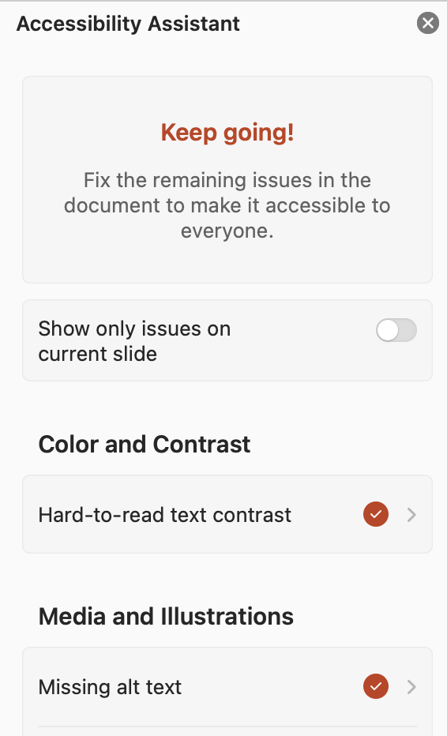
Motivation: ADA Compliance
1990: ADA
2024: DOJ: ADA += "digital”
4/2026: Compliance deadline
4/2027: Revised compliance deadline

Slide 6
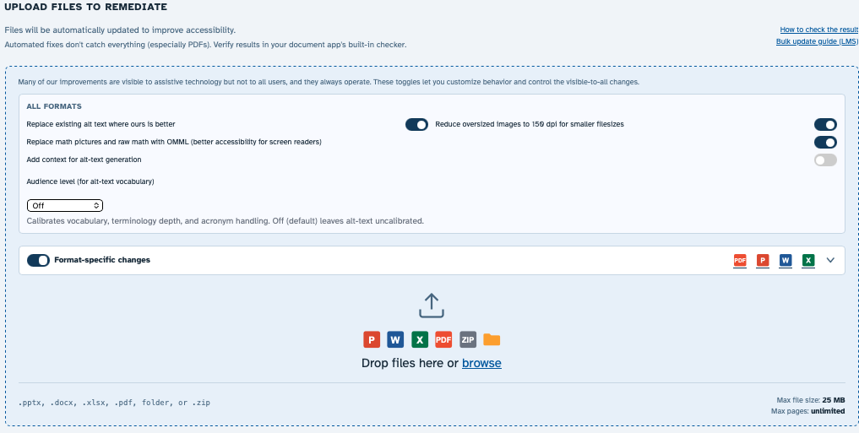
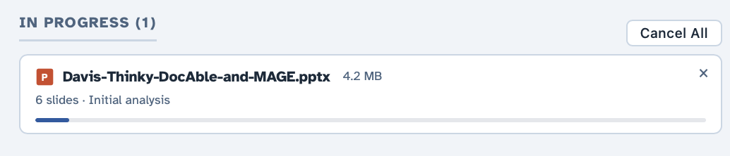
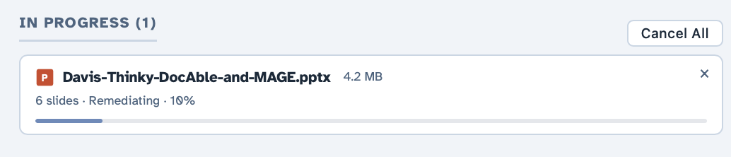
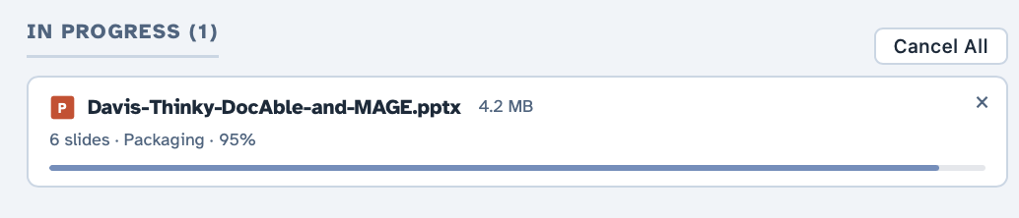


With GenAI, can one engineer/SME build a remediation product?
$0.11

Slide 7
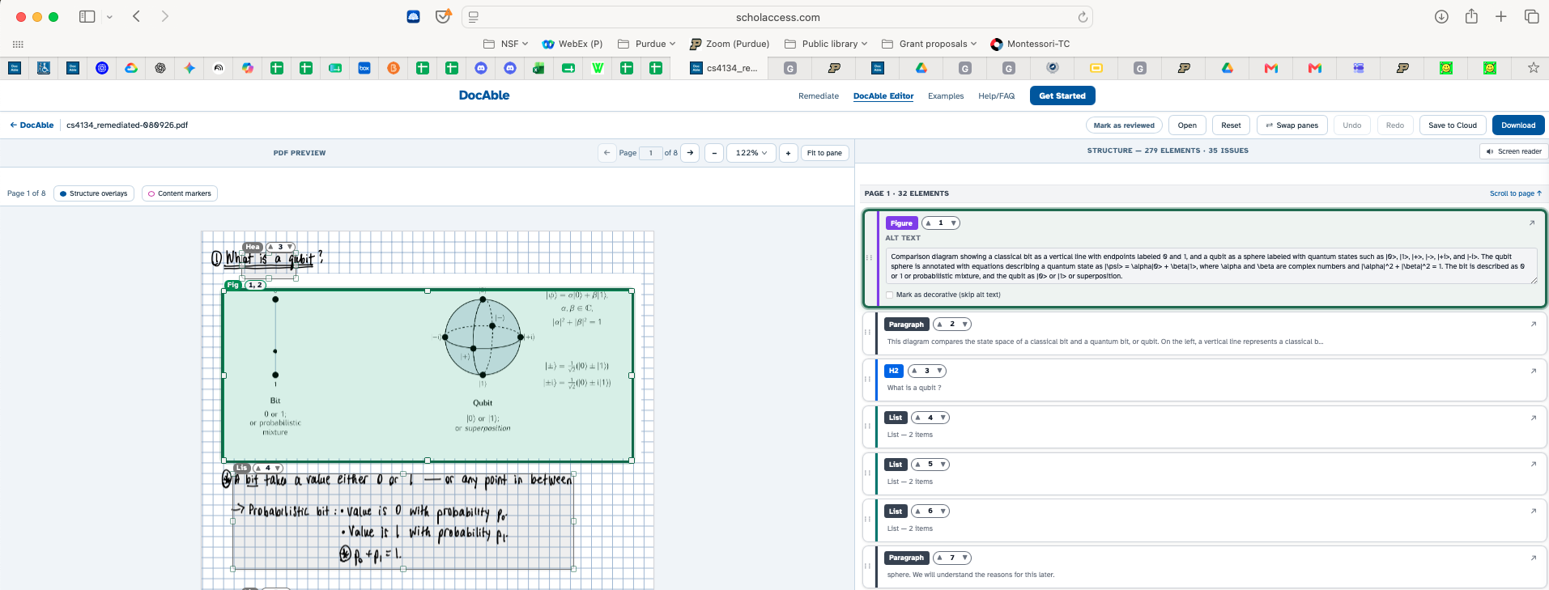
DocAble: And don’t forget an editor!
Notes:
Here, discuss why PDF is (much) harder than O365

Slide 8
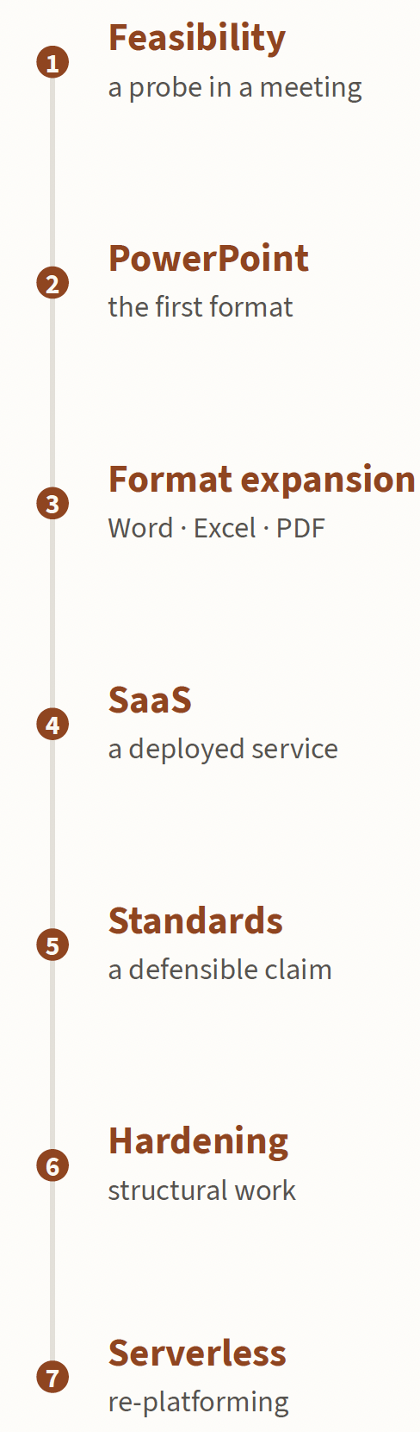
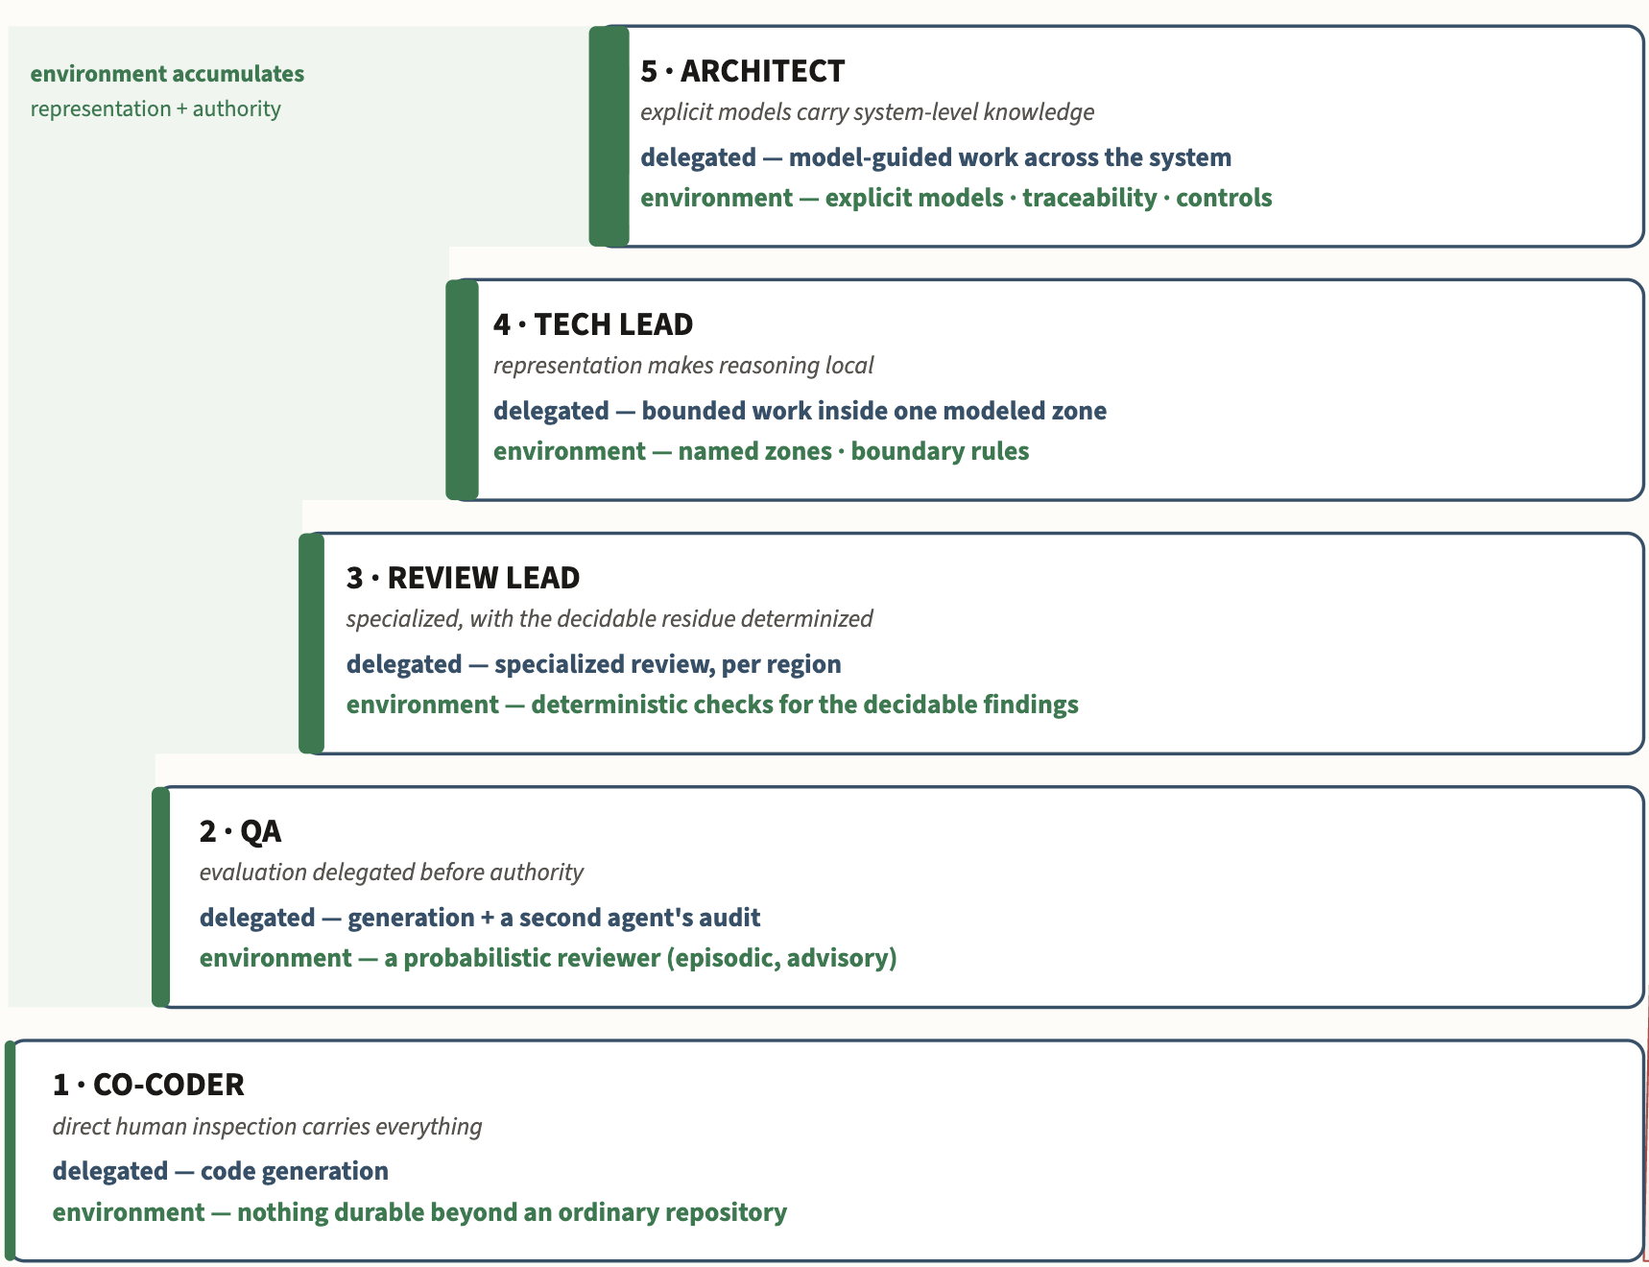
Engineering process
Growth of autonomy

Slide 9
Talk outline
Who am I and why am I here
The substrate: Engineering shifts in response to technology change
Vibe coding
MAGE
Modeling
Alignment
Putting it together: The MAGE Method
Related work and Implications: for engineering, for research, for education

Slide 10
Technology moves engineering bottlenecks
Goldratt’s Theory of Constraints / Amdahl’s Law:
Removing one bottleneck exposes the next
Technology | Makes abundant | Relatively scarce resource
Steam engine | Mechanical power | Control & Coordination
Factory | Standard production | Design & Coordination
Integrated circuit | Computation | Software & Systems
Coding agents | Software implementation | Software engineering
Notes:
Engineering reorganizes when a constraint moves. Steam made mechanical power far cheaper; integrated circuits did the same for computation; coding agents are now doing it for implementation. “Scarce” here is the economic sense, not a mood. A scarce factor constrains output, so it draws investment and attention. Implementation was never the only scarce input to software engineering, but for most of the field’s history it consumed enough expert effort to limit what teams could attempt and how quickly they could change a system. As its marginal cost falls, other constraints become more visible: deciding what to build, representing a large system well enough to reason about it, producing evidence that a change is acceptable, and giving consequential engineering decisions authority across many changes.
Abundance does not make implementation unimportant; it changes where additional engineering effort earns the greatest return. A factory with unlimited machine capacity and one inspector has not stopped manufacturing; inspection has become the throughput constraint. In software, agents can now produce changes faster than engineers can specify, understand, validate, and govern them. Models amortize representation and judgment across many acts of implementation; validators and gates can amortize selected judgments about acceptance. Rational effort therefore moves upstream into representation and outward into the engineered environment. This Part asks what follows from that shift: what remains hard, which properties of the new substrate matter, and what engineering problems they leave us to solve.

Slide 11
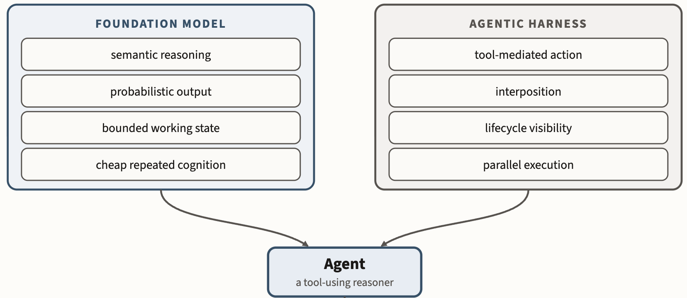
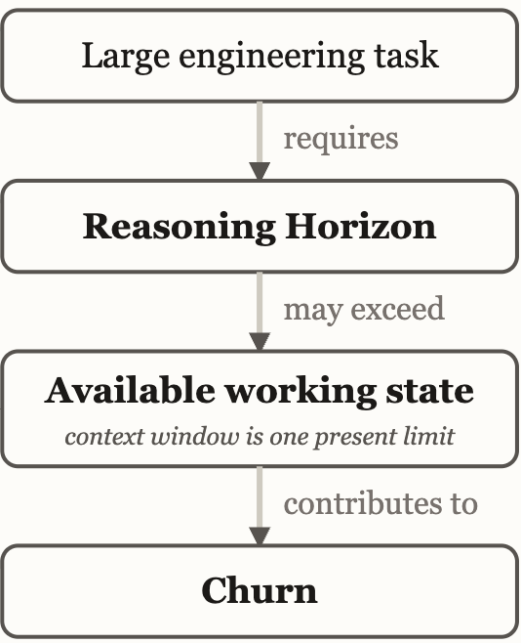
The Agentic Substrate: “Commodity Intelligence”
Notes:
The foundation model supplies inexpensive semantic reasoning under finite, probabilistic working conditions; the harness turns that reasoning into observable, interceptable action.
This talk is about my understanding of how CODING AGENTS will re-organize engineering work, and what the nature of the relatively scarce resource becomes.

Slide 12
Talk outline
Who am I and why am I here
The substrate: Engineering shifts in response to technology change
Vibe coding
MAGE
Modeling
Alignment
Putting it together: The MAGE Method
Related work and Implications: for engineering, for research, for education

Slide 13

If we have commodity intelligence, can we retire?

Slide 14
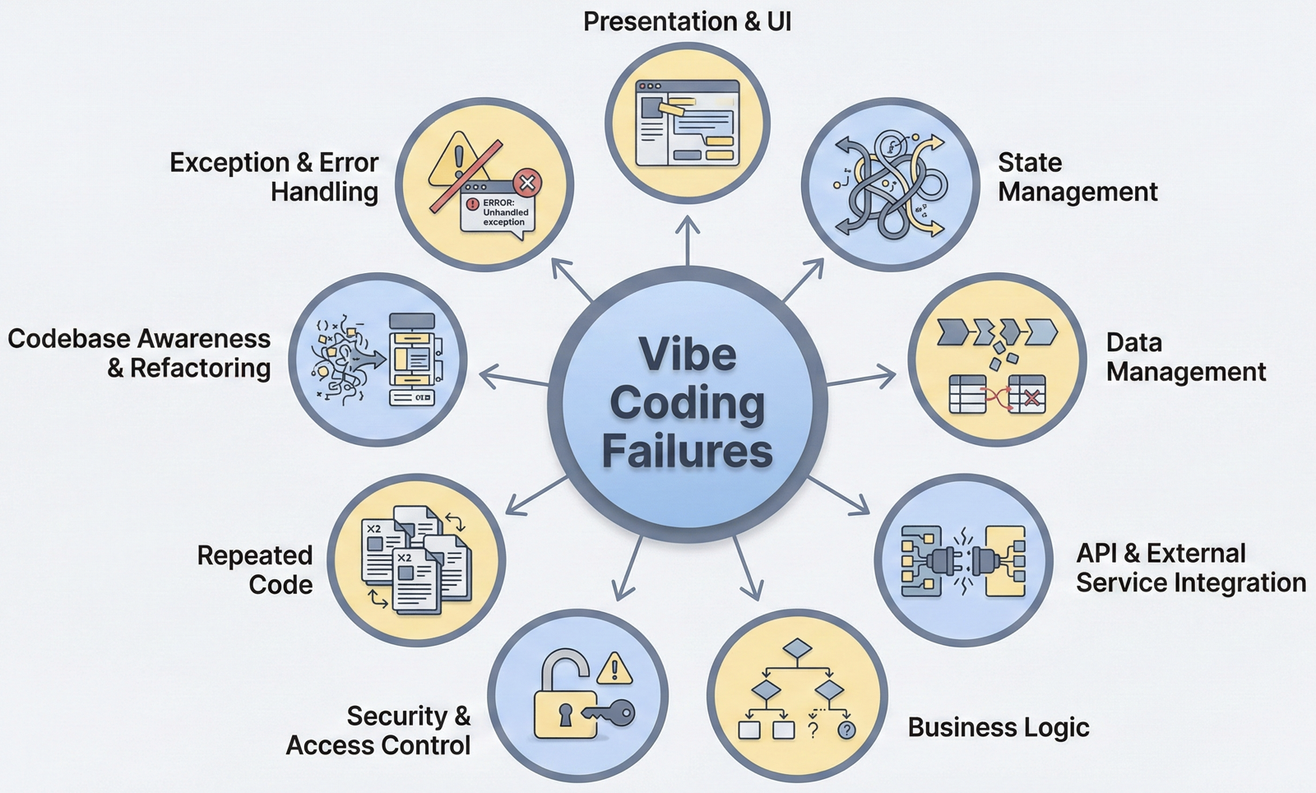
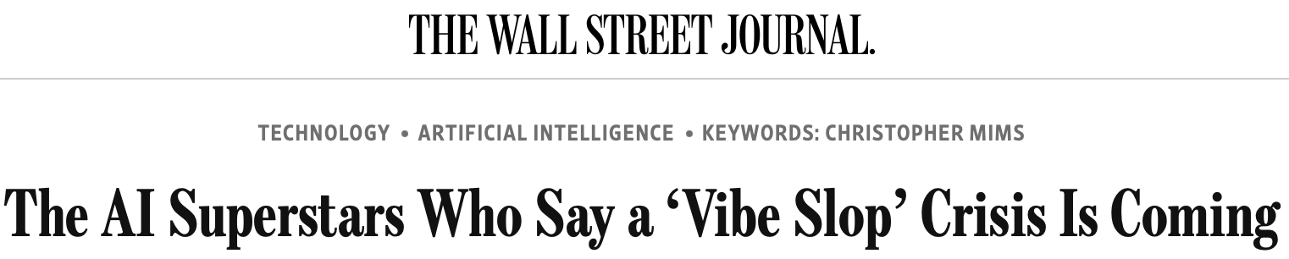
The experience of the vibe coders
https://daplab.cs.columbia.edu/general/2026/01/07/why-vibe-coding-fails-and-how-to-fix-it.html
https://daplab.cs.columbia.edu/general/2026/01/08/9-critical-failure-patterns-of-coding-agents.html
https://www.wsj.com/tech/ai/vibe-coding-slop-ai-tools-e6a99394

Slide 15
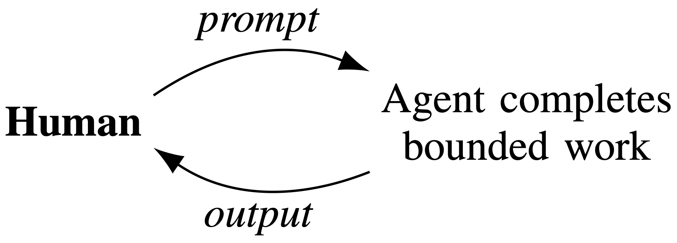
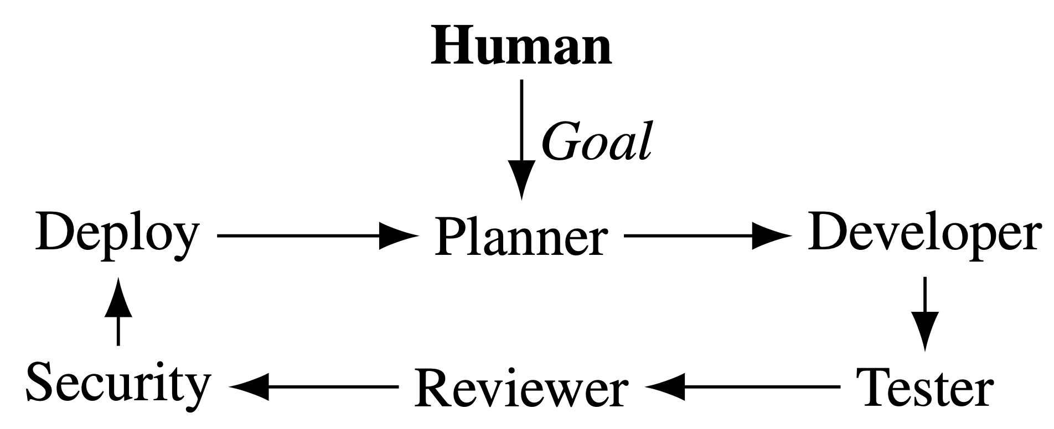
The obvious answers: More oversight, more process
Oversight
Process imitation
“My job is now code review”
Personas, e.g., Yegge’s Gastown
Does not scale / DevExp
Process is not judgment
Q: How do we retain agentic velocity while preserving engineering judgment & oversight?

Slide 16
Talk outline
Who am I and why am I here
The substrate: Engineering shifts in response to technology change
Vibe coding
MAGE
Modeling
Alignment
Putting it together: The MAGE Method
Related work and Implications: for engineering, for research, for education

Slide 17
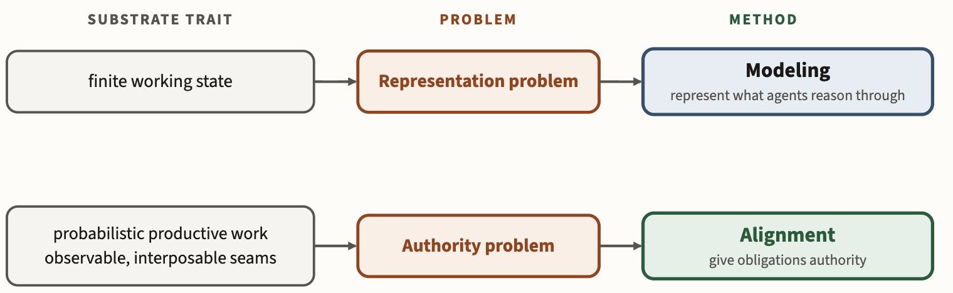
Mage principles: Modeling and Alignment

Slide 18
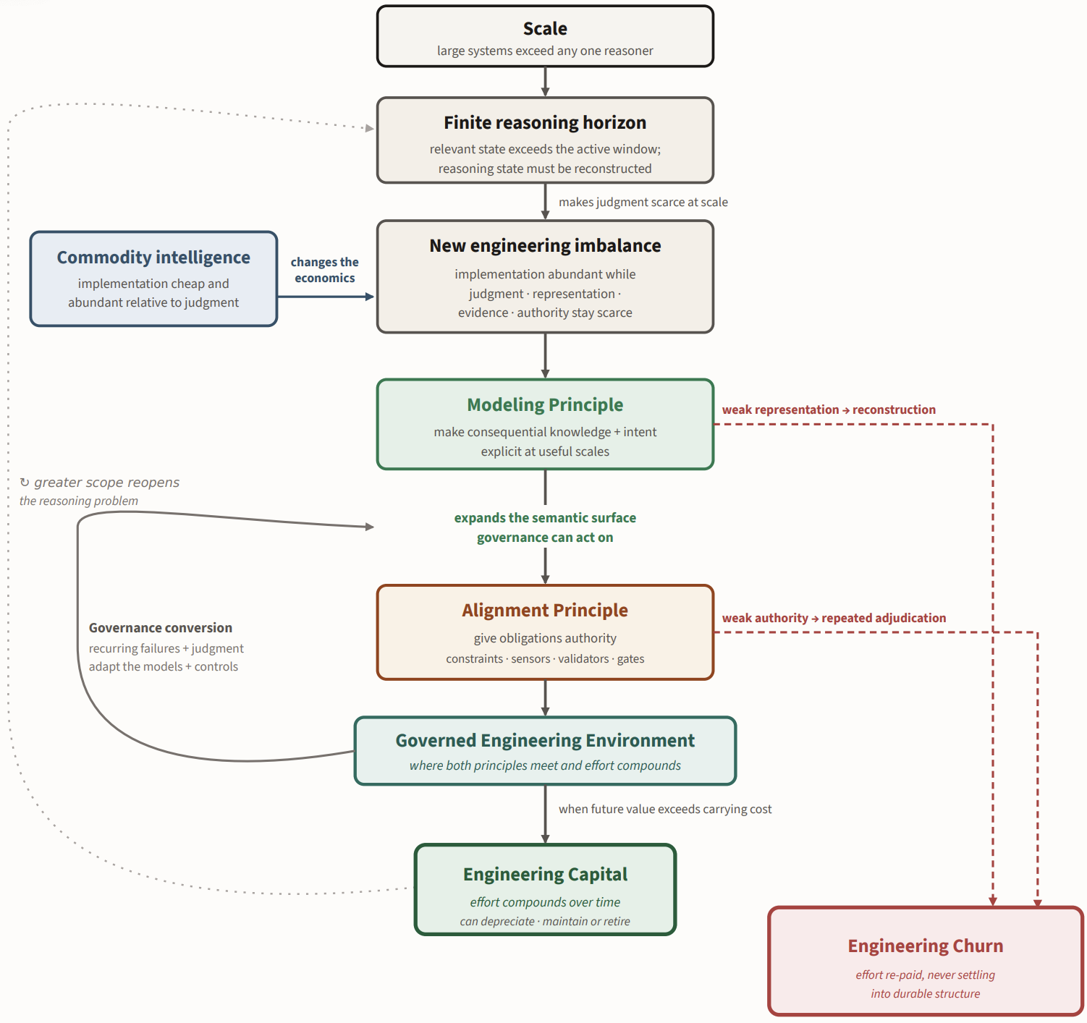

MAGE
Theory
Blog, links to book

Slide 19
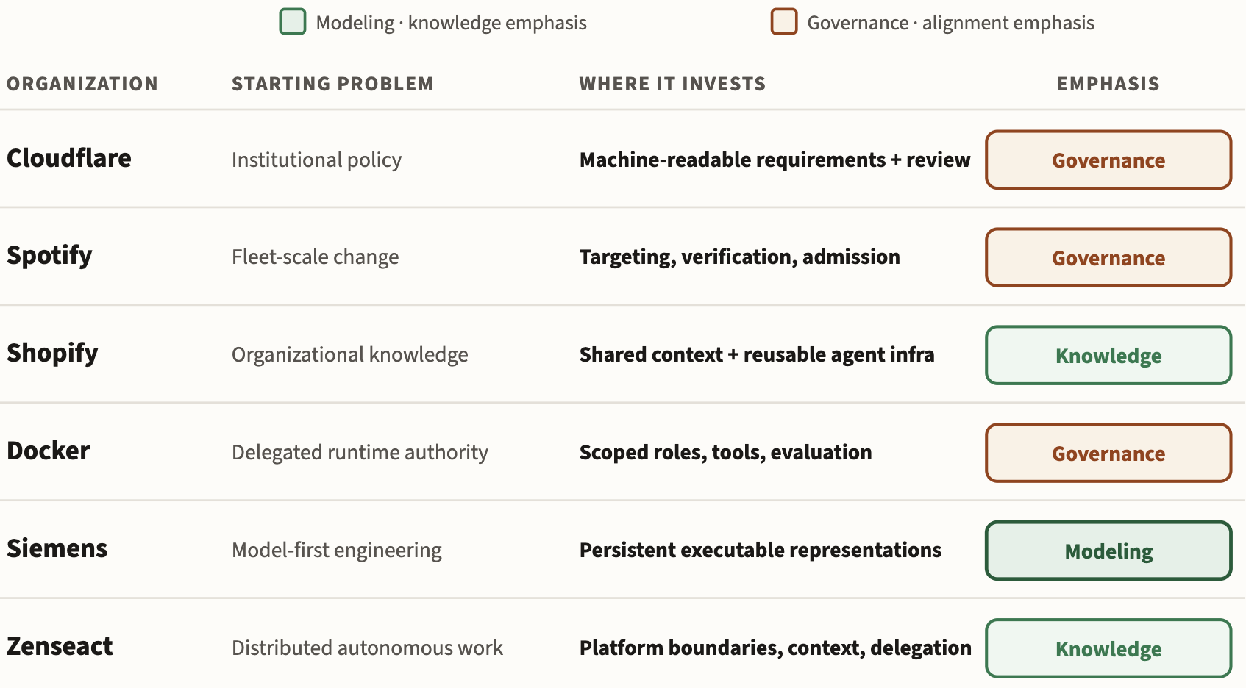
MAGE captures industry descriptions of “effective Agentic SE”

Slide 20
Talk outline
Who am I and why am I here
The substrate: Engineering shifts in response to technology change
Vibe coding
MAGE
Modeling
Alignment
Putting it together: The MAGE Method
Related work and Implications: for engineering, for research, for education

Slide 21
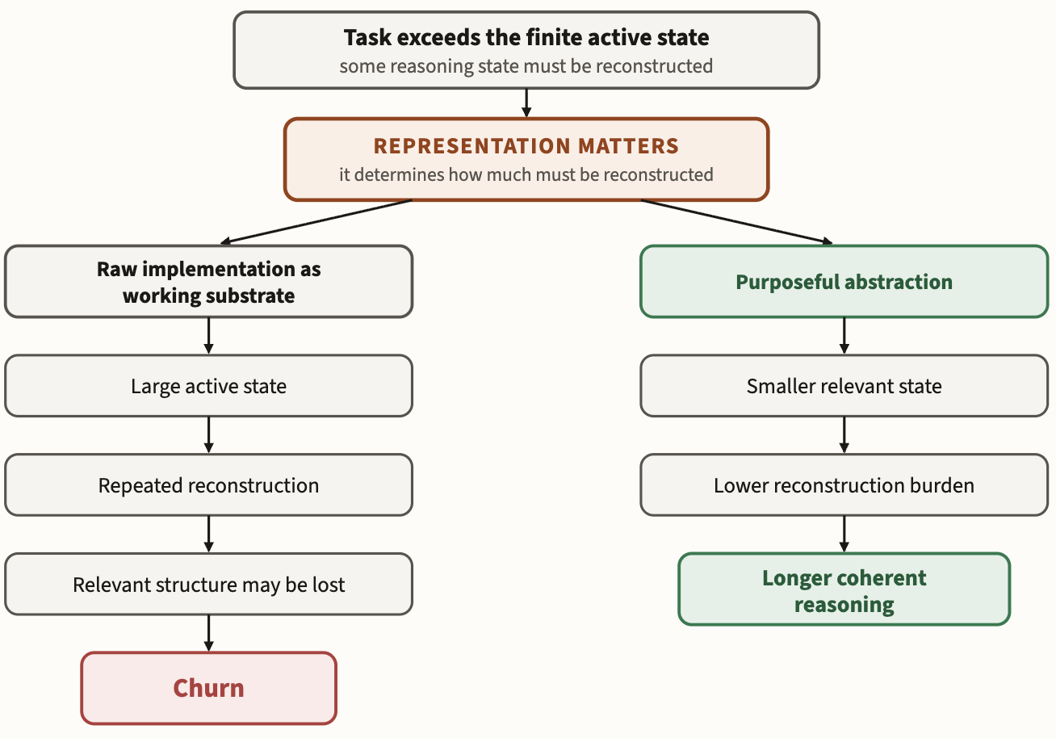
Modeling → Coherence | No modeling → Churn
Notes:
At scale, finite active state → reconstruction unavoidable → representations determine the burden
Figure 1.3-2. The reasoning horizon. At sufficient scale, a task requires more state than a finite reasoner can keep active, so some state must be reconstructed. Representation determines the cost: raw implementation carries irrelevant detail, while purposeful abstraction can keep question-relevant state smaller and cheaper to recover.

Slide 22
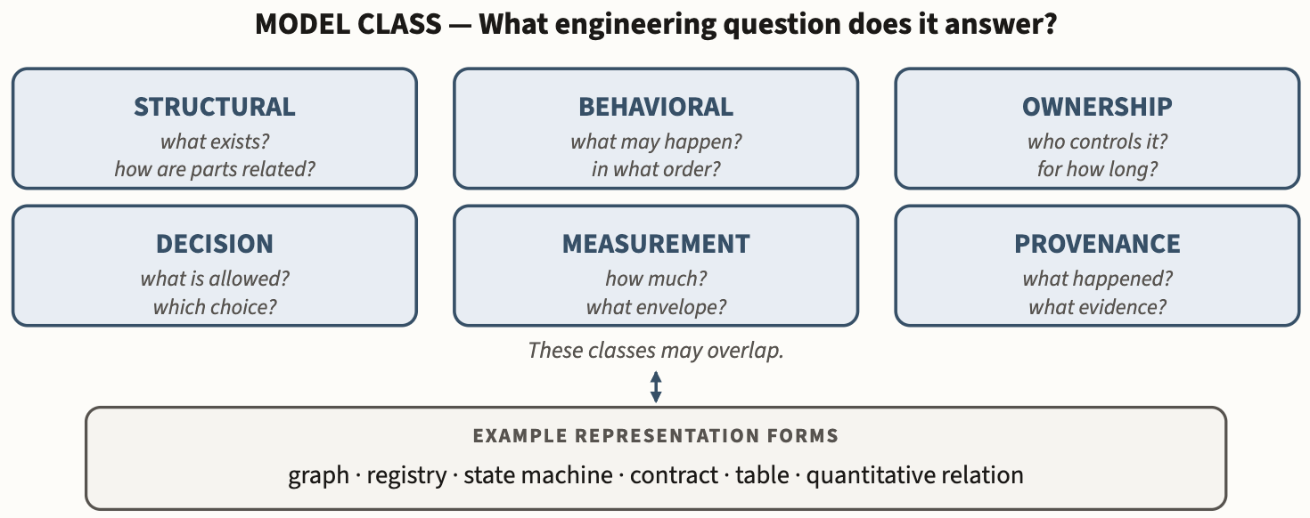
Models let us encode obligations
Notes:
Figure 2.1-1. MAGE's working model ontology. The six classes distinguish models by the engineering question they answer. Classes may overlap, and each may be encoded using several representation forms.
Connected through shared identity and traceability, these models form the system’s explicit engineering knowledge.

Slide 23
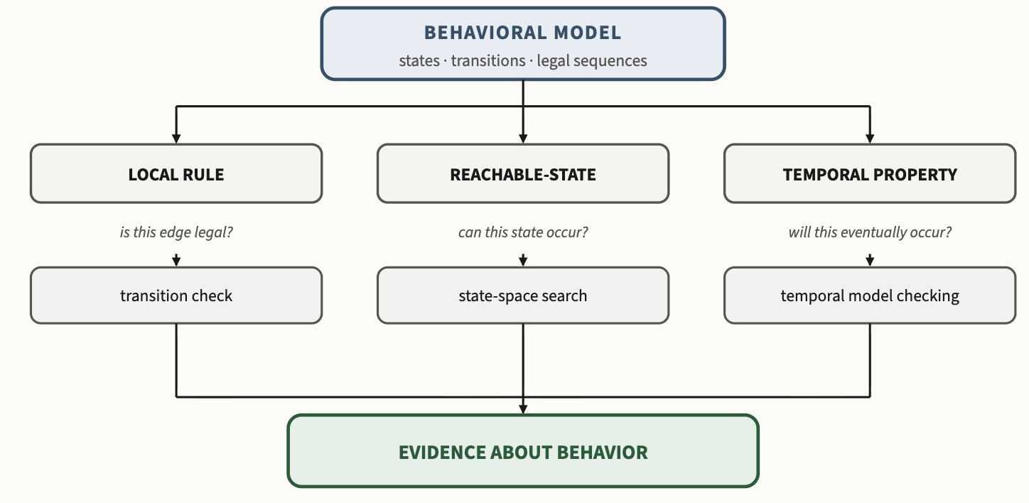
Example: Behavioral models (State machines)
Notes:
Figure 2.3-3. Behavioral models expose different classes of properties. A transition relation can support local legality checks, reasoning over reachable states, or temporal claims over executions. The appropriate checker follows from the property; richer machinery is not automatically stronger for every question.

Slide 24
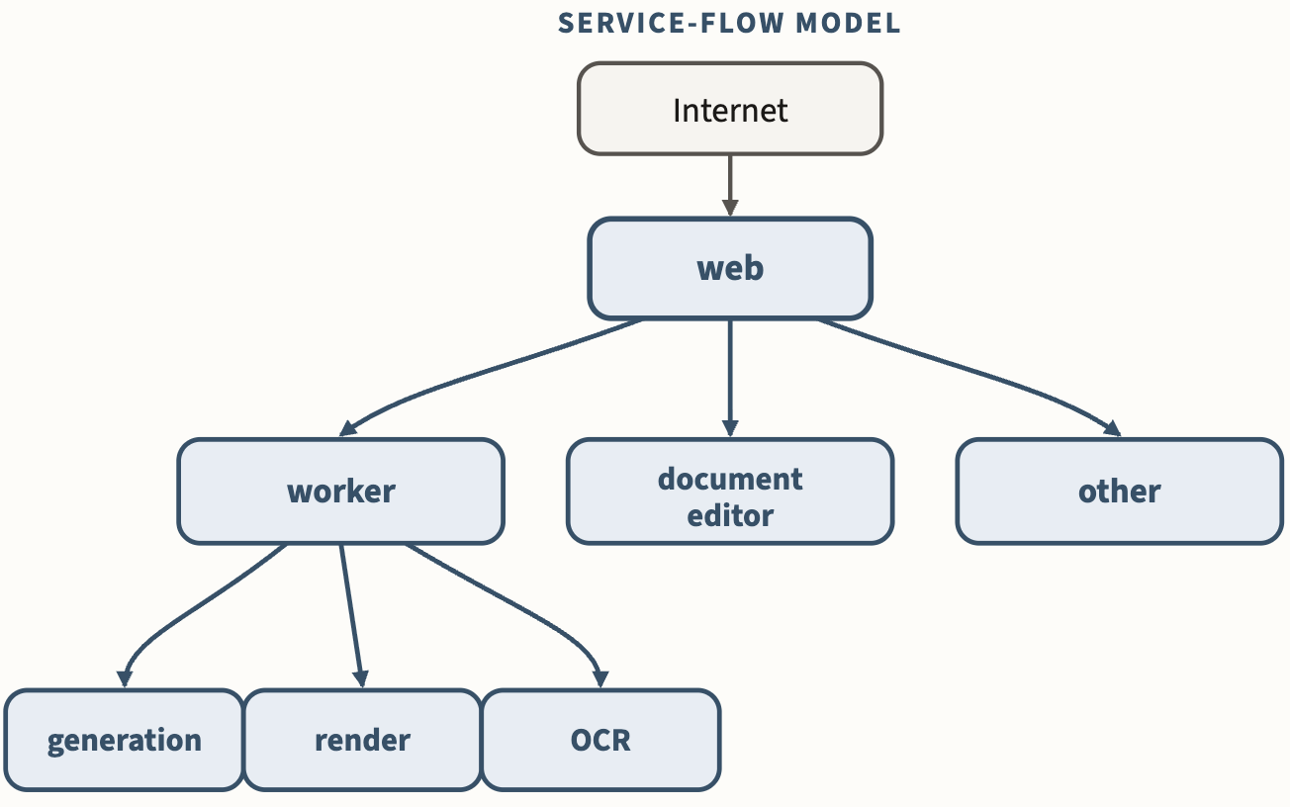
Example: Service flow model (e.g., data flow diagrams)
Notes:
Figure 2.5-1. Service-flow model. A declared graph of which service may reach which. The public web tier is the only node facing the outside; an absent edge means the relationship is not permitted by the model, and enforcement is separate.

Slide 25
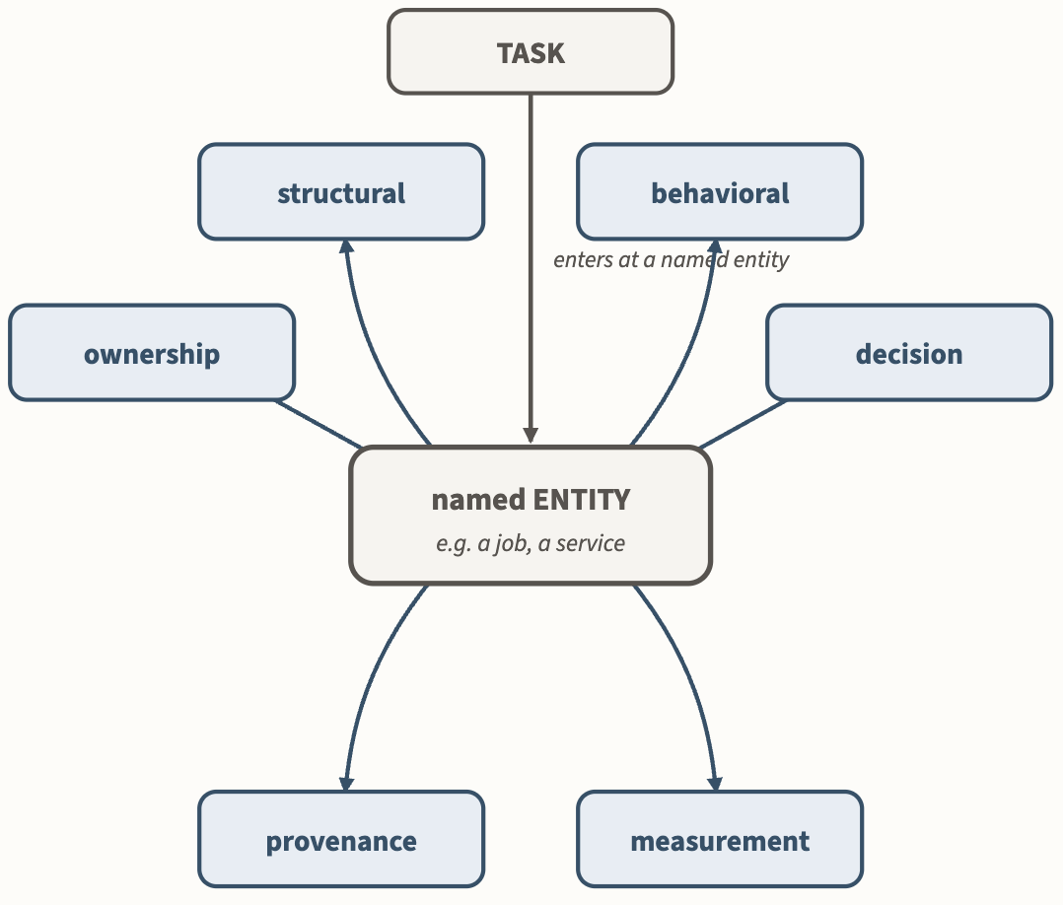
Models are views that encode distinct obligations

Slide 26
Talk outline
Who am I and why am I here
The substrate: Engineering shifts in response to technology change
Vibe coding
MAGE
Modeling
Alignment
Putting it together: The MAGE Method
Related work and Implications: for engineering, for research, for education

Slide 27
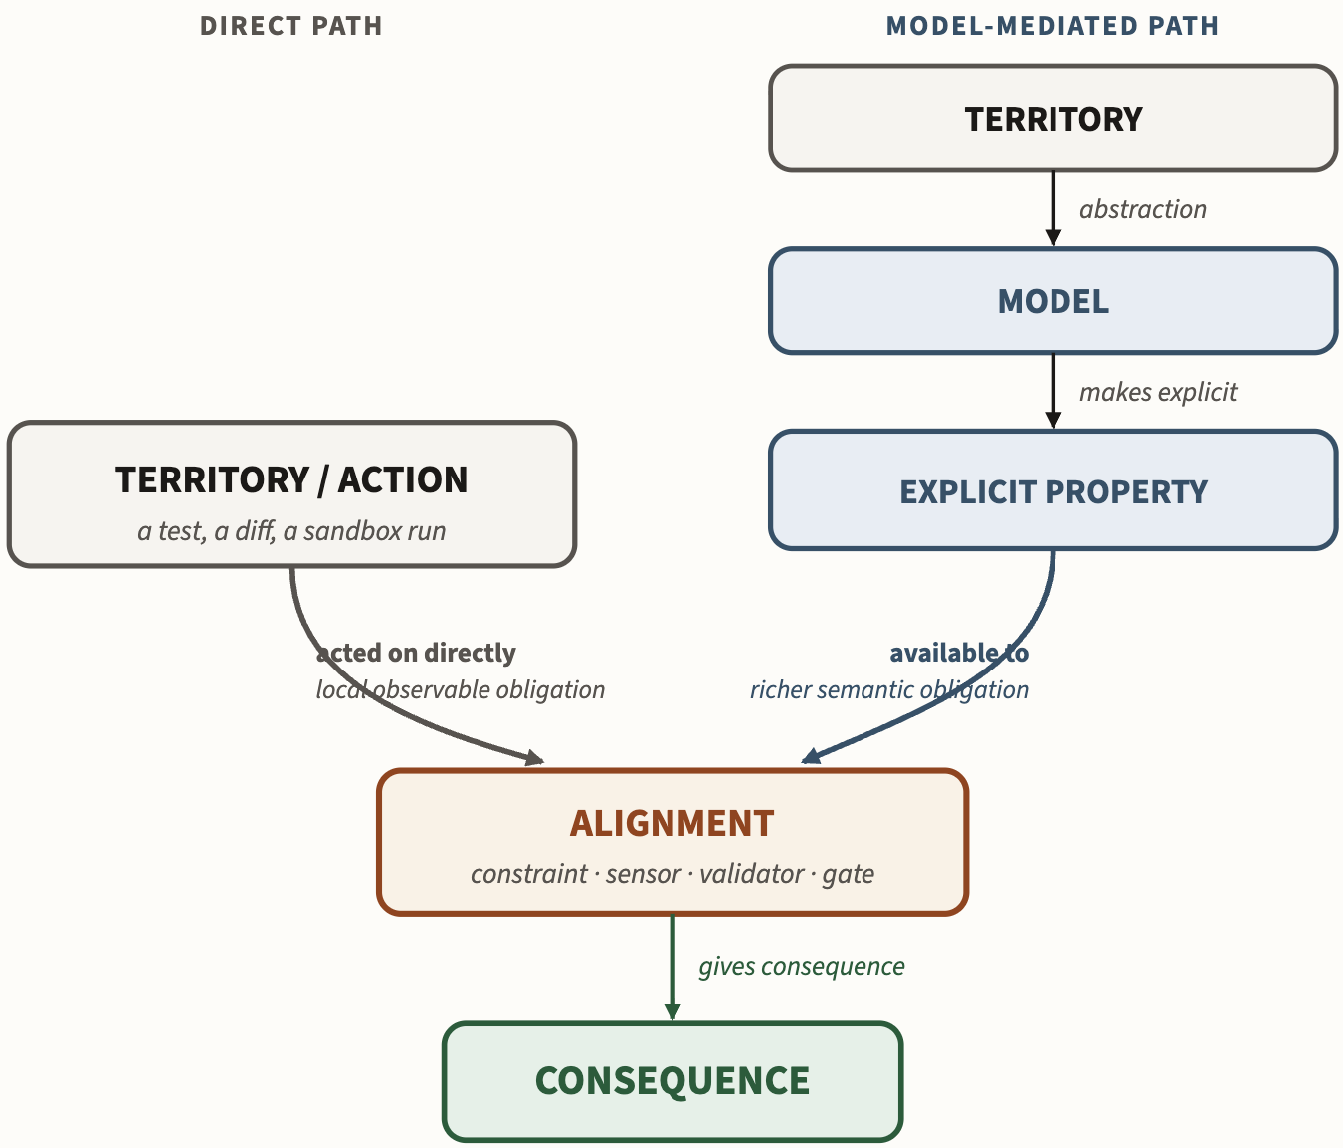
Alignment is easier with explicit models
Notes:
Alignment mechanisms can act directly on observable actions; explicit models make richer system properties available too.
For example, …
Of course, there ARE implicit properties embedded in direct alignment, but they are tacit. Somebody who set up a sandbox knows what syscalls are permitted. They may not have articulated it as a model, but there’s a latent model of necessary syscall affordances in there.
Figure 2.8-6. Modeling expands the semantic reach of Alignment. Alignment mechanisms can act directly on observable actions and artifacts; explicit models make additional system-level properties available for constraint, sensing, evaluation, and admission.

Slide 28
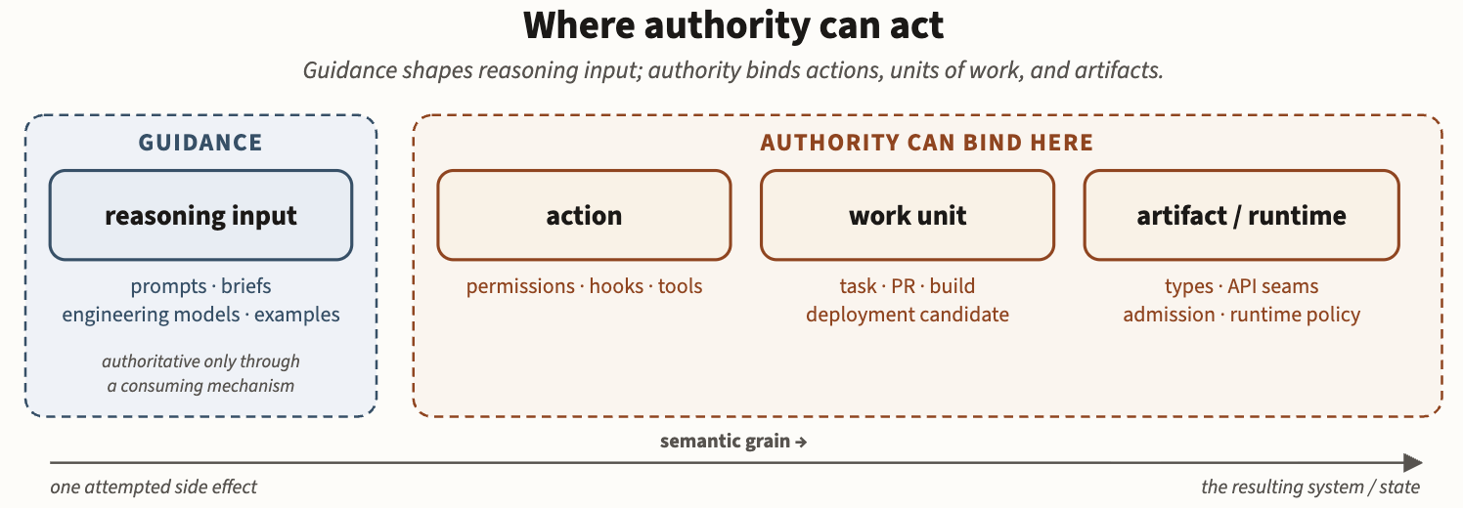
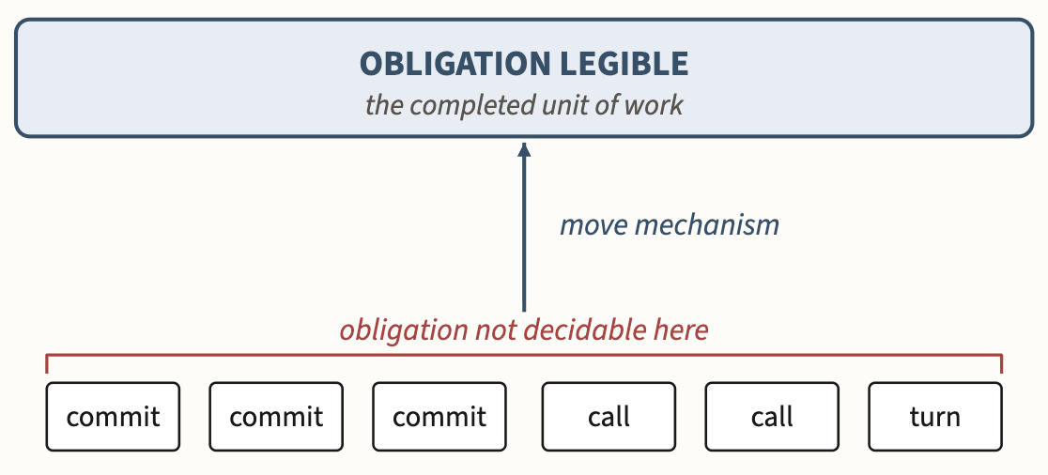
Alignment can act at different points
Semantic gaps
End-to-end principle
Notes:
Figure 3.1-1. Intervention boundaries. Guidance shapes reasoning input; authority can bind actions, completed units of work, or accepted artifact/runtime state. Place a mechanism at the earliest boundary where the obligation is legible and the consequence can be affected.
Semantic gap.

Slide 29
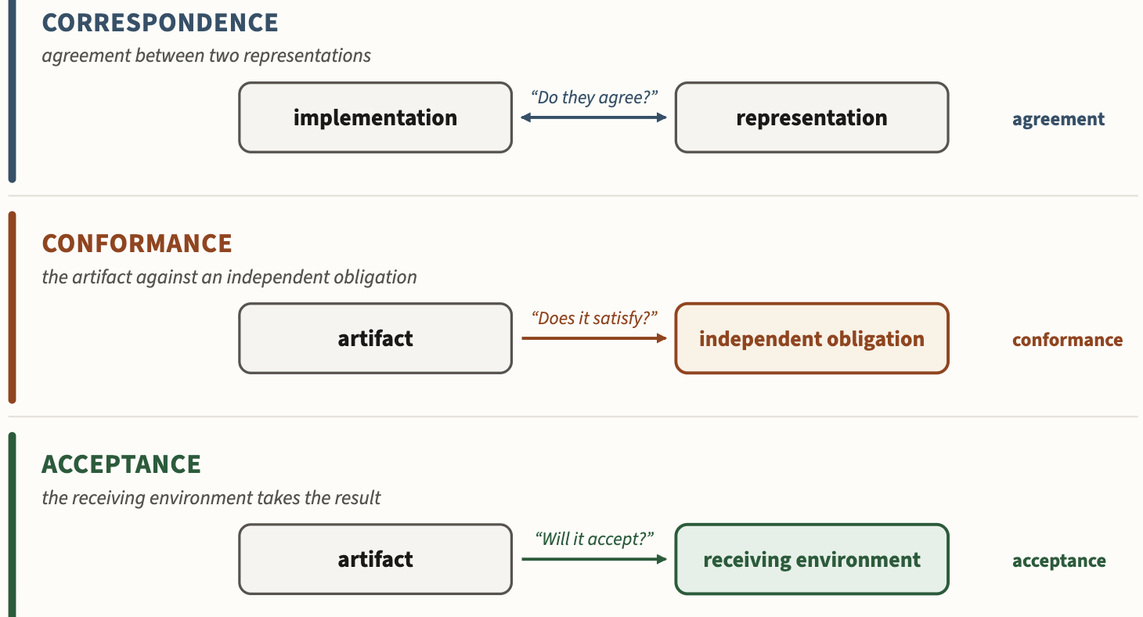
Kinds of alignment questions you might ask

Slide 30
Talk outline
Who am I and why am I here
The substrate: Engineering shifts in response to technology change
Vibe coding
MAGE
Modeling
Alignment
Putting it together: The MAGE Method
Related work and Implications: for engineering, for research, for education

Slide 31
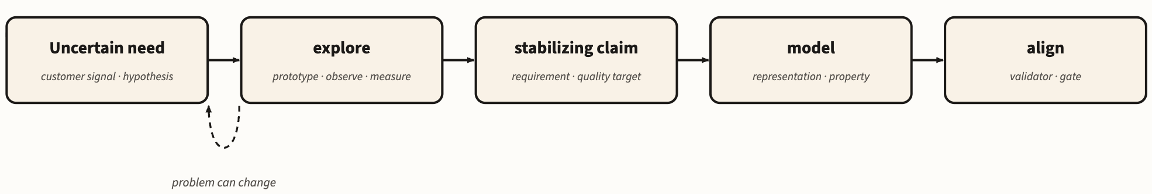
Greenfield MAGE
Notes:
Figure 4.1-1. Precision Follows Knowledge. Explore uncertain needs; represent claims as they stabilize; grant authority only when an obligation is stable and consequential enough to justify it.

Slide 32
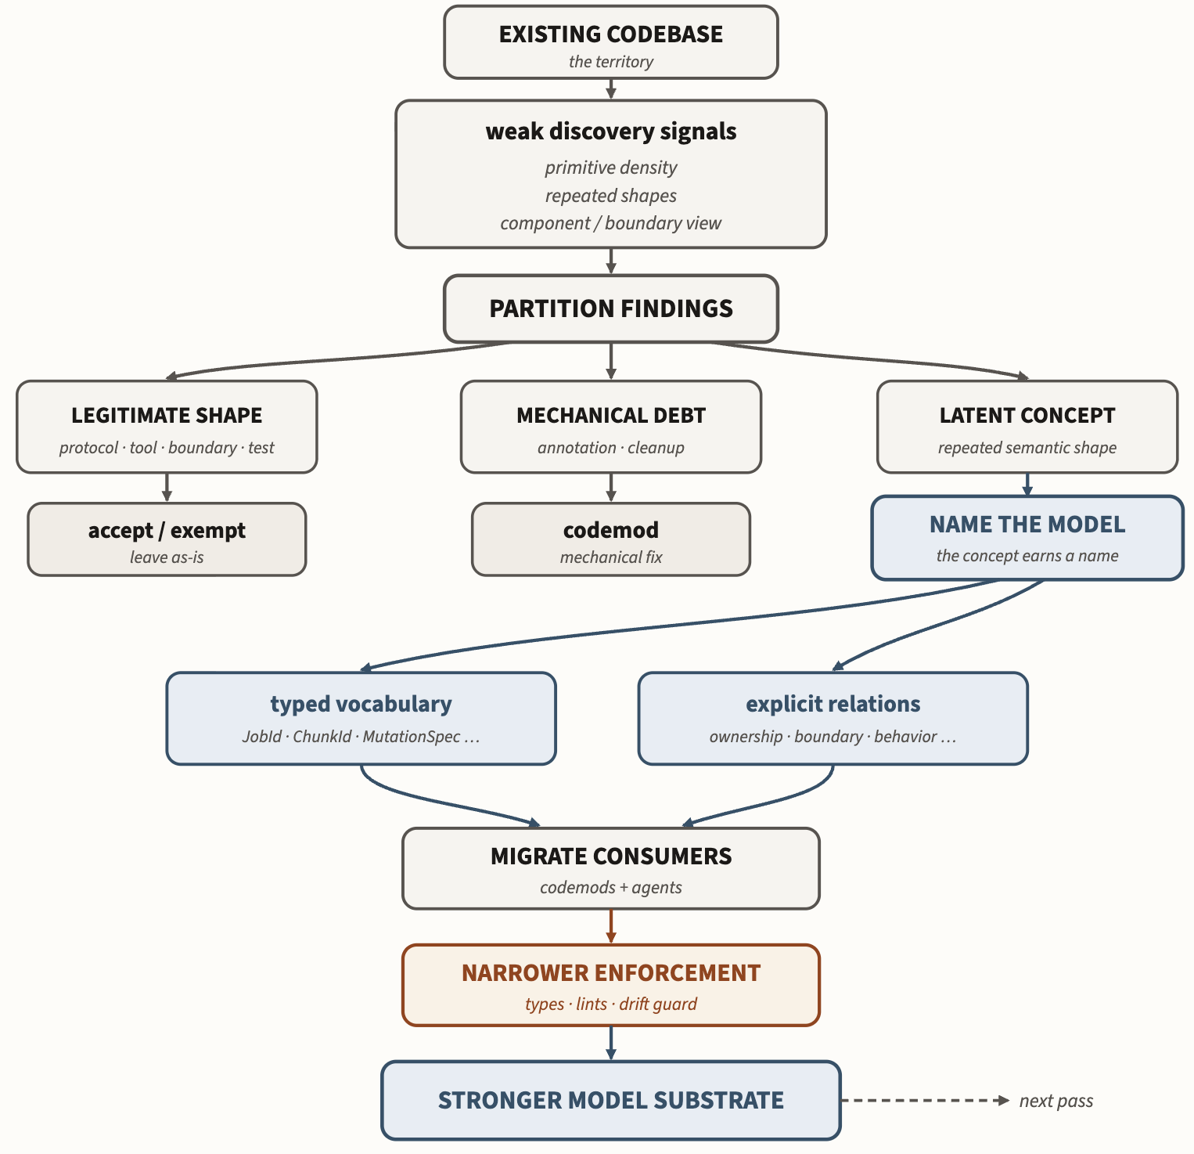
Brownfield MAGE: Inducing models from an existing system
Example
Primitive density lint
Notes:
Figure 4.2-4. Discovering models during a brownfield migration. Weak signals — primitive density, repeated shapes, the component and boundary view — identify places worth inspecting; they do not dictate the remedy. Partitioning separates legitimate primitive-heavy code and mechanical debt from repeated shapes that reveal missing engineering concepts. Naming those concepts as typed vocabulary and explicit relations changes the substrate on which later migration and enforcement operate.

Slide 33
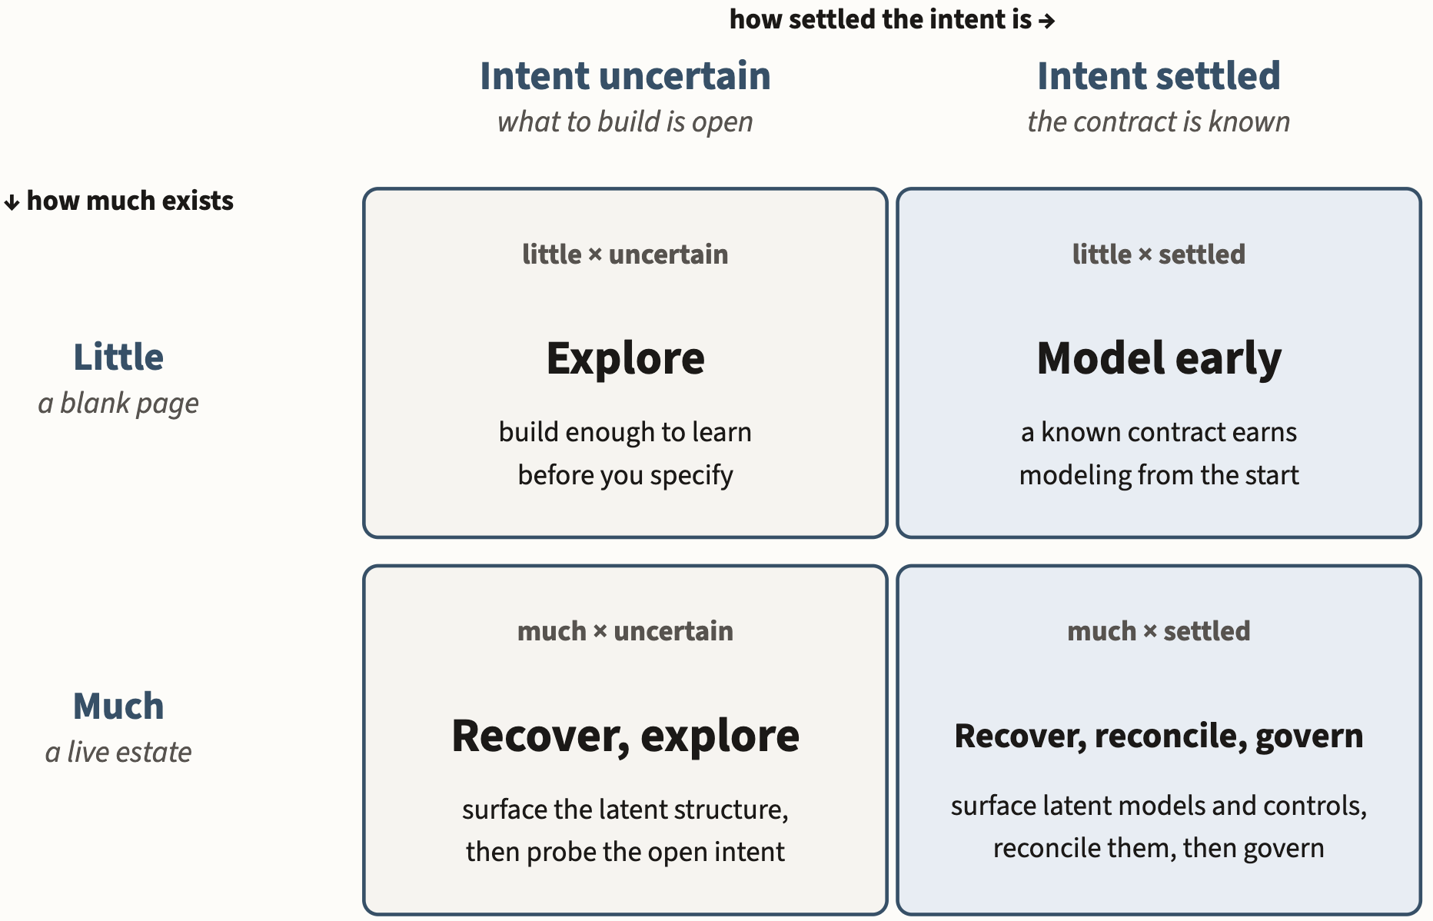
MAGE Decision Matrix
Notes:
Figure 4.2-1. Where a migration starts. Existing system stock determines what can be recovered; settled intent determines how much structure and authority the work can support initially. Authority is not a single project-wide dial — the more settled a particular obligation, the more authority it can safely receive, so a security, legal, or safety constraint may be settled even when the product behavior around it is still exploratory.

Slide 34
DATA

Slide 35
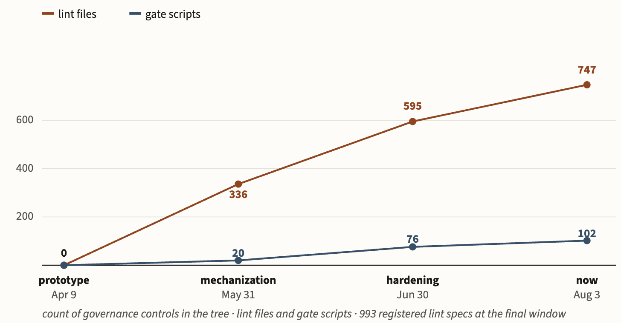
Growth of DocAble’s Governed Engineering Environment

Slide 36
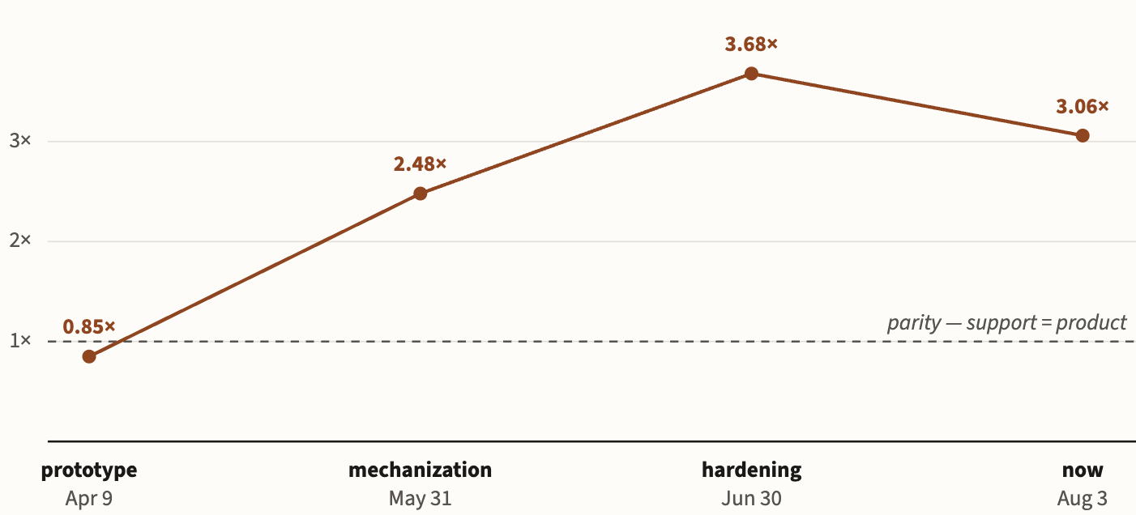
Ratio of GEE to production code

Slide 37
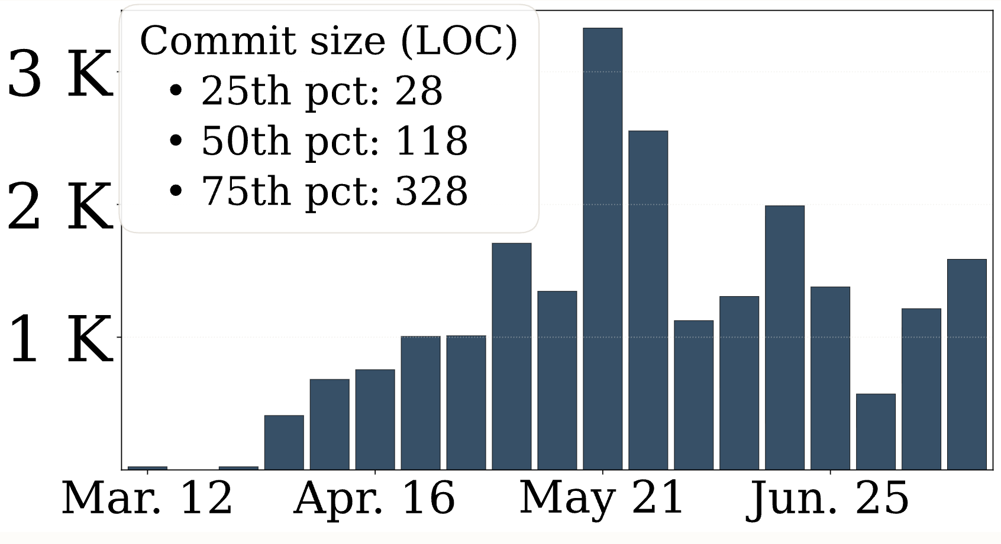
Commit volume -- ~1K commits/week

Slide 38
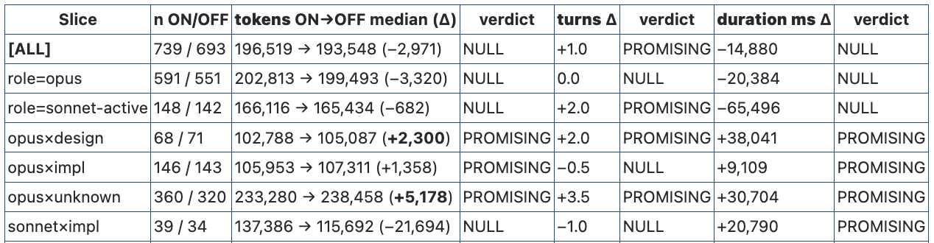
Does MAGE impact tokenomics? Maybe…
Notes:
Here are speaker notes I’d use:
Does MAGE change token economics? Maybe—but not in the obvious direction.
We ran an ablation with the MAGE context mechanisms on and off and looked at matched task slices. If explicit models and injected context merely saved agents from rediscovering the system, we might expect fewer tokens and fewer turns.
That is not what we see. For the Opus slices, turning the machinery on actually increases median token use—by about 1,400 to 5,200 tokens—and the evidence on turns is mixed. Sonnet implementation goes the other direction, with a roughly 22,000-token reduction, but that result is not strong enough to call.
The consistent signal is duration: every slice takes longer with the machinery enabled, from roughly 9 to 38 seconds more. That is plausible: retrieving, injecting, and reasoning over additional engineering context has a computational cost.
So I would not claim that MAGE is a token-saving technique. The more interesting hypothesis is that MAGE spends context to improve the quality of reasoning. Explicit models may make agents reason over obligations they would otherwise discover only later through tests, gates, or failed attempts.
That changes the economic question. It is not, “Does modeling minimize tokens per task?” It is, “Does spending more reasoning up front reduce expensive downstream churn?”
These results are suggestive, not conclusive. The next measurement has to connect this overhead to outcomes: retries, rejected changes, regressions, human intervention, and ultimately successful governed work per unit cost.
I would particularly resist saying that these data show a token-efficiency benefit. They don’t. They show that MAGE changes the computational profile, with a surprisingly plausible story that it purchases more up-front reasoning.

Slide 39
Talk outline
Who am I and why am I here
The substrate: Engineering shifts in response to technology change
Vibe coding
MAGE
Modeling
Alignment
Putting it together: The MAGE Method
Related work and Implications: for engineering, for research, for education

Slide 40
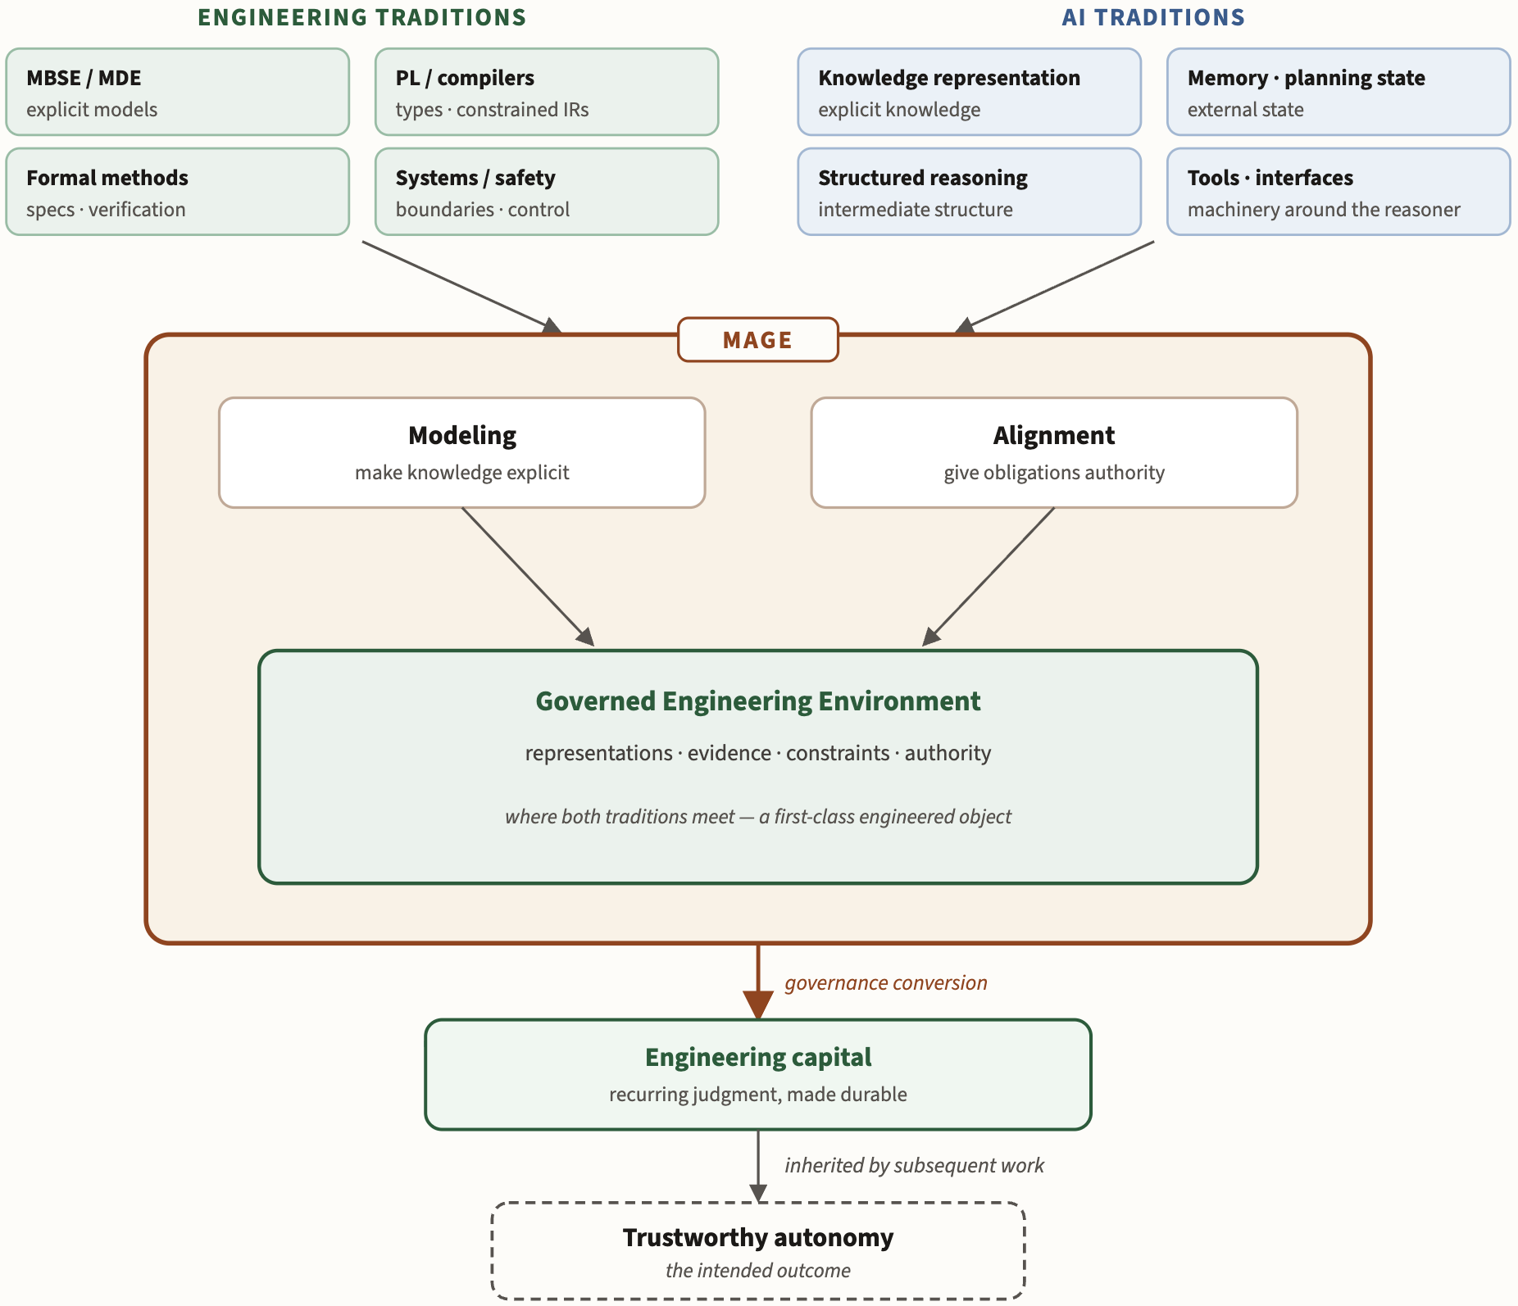
MAGE bridges engineering and AI traditions to center the GEE
Notes:
Figure 6.5-2. Established traditions, new composition. MAGE draws on two long-running traditions. Engineering disciplines developed explicit models, constrained representations, verification, and external control; AI repeatedly extended reasoners through knowledge representation, planning state, memory, structured reasoning, tools, and surrounding machinery. MAGE brings these inheritances together around autonomous software work: Modeling makes engineering knowledge explicit, Alignment gives selected obligations authority, and both meet in the Governed Engineering Environment. Governance conversion carries recurring judgment into durable engineering capital. Commodity intelligence changes the economics of this composition, not the provenance of its parts.

Slide 41
MAGE: Patting the engineering in software engineering
Thank you for your attention!
https://davisjam.github.io/model-based-agentic-software-engineering/
Notes:
Commodity intelligence did not abolish software engineering. By making implementation cheaper, it may force us to practice more of it.

Slide 42
BONUS

Slide 43
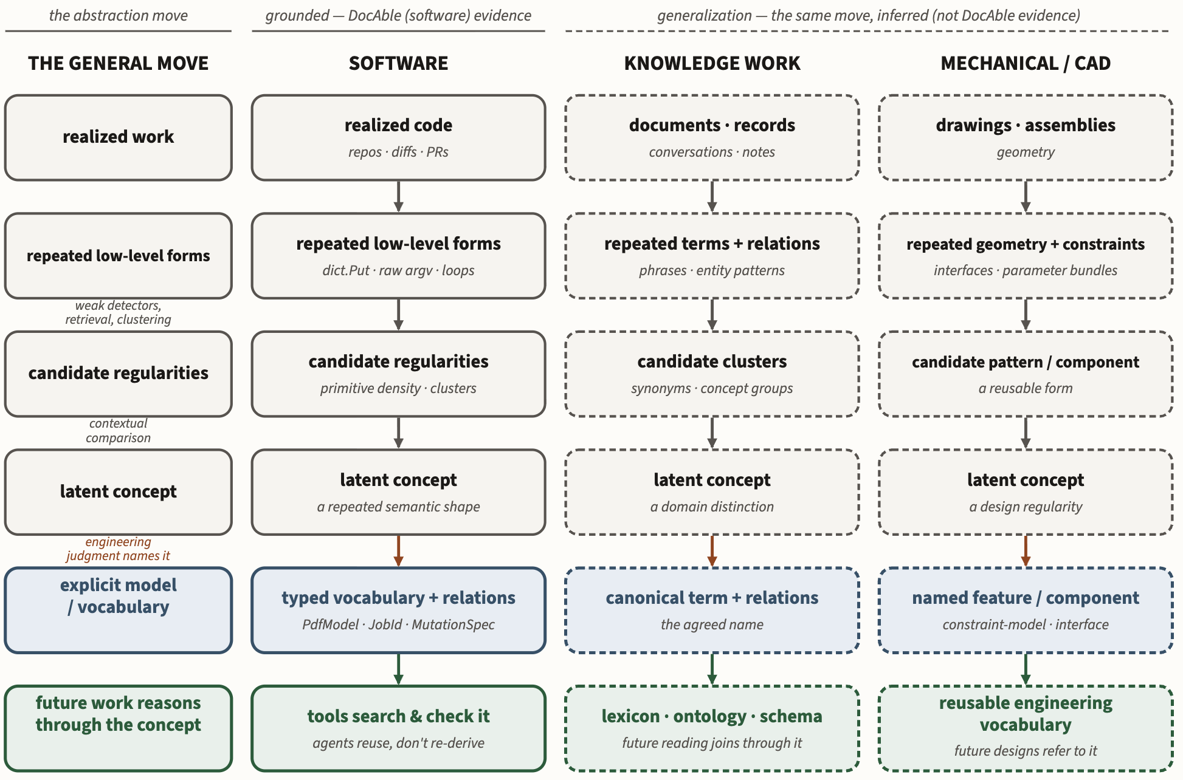
Brownfield MAGE: Inducing models from an existing system
Notes:
Figure 6.5-3. Model induction. The same move runs in three settings: realized work yields repeated low-level forms, weak detection surfaces candidate regularities, and engineering judgment names the concept that survives comparison. The left rail states the move; the three columns instantiate it in software, knowledge work, and CAD. Software is the grounded case; the extension to knowledge work and CAD is a generalization, not evidence DocAble supplied.

