Slide 1

The “Do More With Less” Cookbook Using Generative AI to Accelerate your Day-to-Day Work as an Engineering Educator
Dr. James C. Davis
Assistant Professor
Elmore Family School of ECE

Slide 2
Two main things to take from the talk
GenAI is a tool that can free us from the clerical parts of our jobs
We need to recalibrate our mental cost model
Labor is now cheap…and so judgment is more expensive than ever

Slide 3
“Who are you and what are you doing here?”
About me

Slide 4
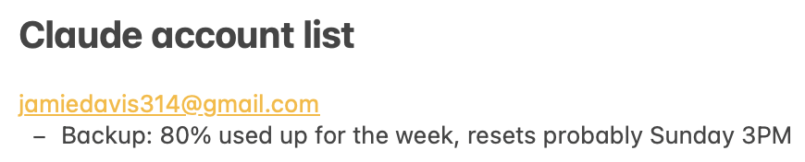



About me
I have supervised ~2MLOC with Claude since March
SE @ IBM 2012-2017
SE @ IBM Research intern, 2018
SE @ Microsoft Research intern, 2019
50+ papers on SE
I teach SE and Adv SE
Claude MAX 20x ($200/mo, strongest subscription)
Notes:
But you’re not here for any of that
What you care about is my Claude account list.
(I started out with 1 account in March, and have added another account every ~2 weeks as I figured out how to saturate the previous set.)
I have been acting within the bounds of the Claude terms of service.
* The result is that I have supervised ~3MLOC with Claude since March.
For a sense of scale, that’s as much
I’ve learned a lot about how to do this well and I’m happy to share some of it with you today.

Slide 5
Why have I been doing this?
The existential crisis of SE (and all knowledge workers):
When AI can write code (and manipulate spreadsheets, and write training manuals, and do fraud detection, and underwrite loans, and…)
What is the role of a (software) engineer?
My way to answer this question has been to undertake SE work using AI, and see what it can do and what value I can add.

Slide 6
What this workshop is, and is not, about
IS ABOUT
IS NOT ABOUT
Faculty using GenAI in our own work
Students using GenAI
Integrating GenAI into classroom
Workforce development
Future economy
The singularity
….
Notes:
I want to start with some initial guardrails.
I know that Generative AI is the topic du jour – I bet half the talks you attend at ASEE will involve it, one way or another.
This workshop is about doing our own work differently, as engineering educators.
This workshop is NOT about our students using Generative AI, integrating GenAI into the classroom, effect on enrollment, effect on workforce, etc. etc.
Those are all great topics but that’s not what we’re talking about today.

Slide 7
Does your institution have…
Budget cuts?
Fewer support staff and TAs?
More paperwork?
More and different class preps you need to cover?
…
Notes:
If only there were a way to get some of this done more quickly so you can focus on the interesting parts of your job!

Slide 8
Agenda
Who am I and what am I doing here?
Activity 1: Your experiences with Generative AI so far
Foundations: Under the hood of GenAI + Working with it
Two examples from my work
Activity 2: Designing a lecture with GenAI
Activity 3: Grading student assignments
Activity 4: Conversations with teaching assistants
Readout

Slide 9
Activity 1
Your experiences with GenAI so far

Slide 10
Activity 1: Think-Pair-Share on GenAI
5 minutes: Reflect on your current use, hesitations, and any institutional pressures regarding the use of Generative AI
5 minutes: Compare notes with your neighbor
5 minutes: Share with everyone and let’s see some trends

Slide 11
Agenda
Who am I and what am I doing here?
Activity 1: Your experiences with Generative AI so far
Foundations: Under the hood of GenAI + Working with it
Two examples from my work
Activity 2: Designing a lecture with GenAI
Activity 3: Grading student assignments
Activity 4: Conversations with teaching assistants
Readout

Slide 12
Foundations
GenAI demo
A bit on how it works
General mindset and strategies on how to use it well

Slide 13

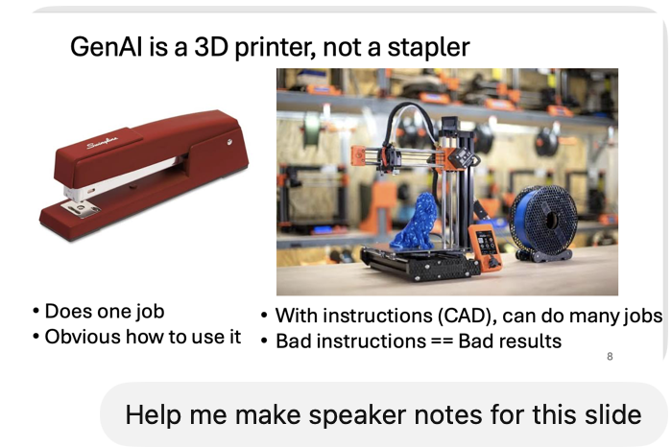
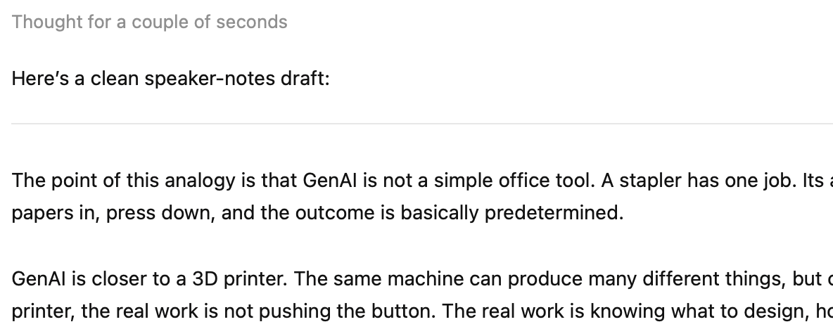
GenAI: Chat mode

Slide 14
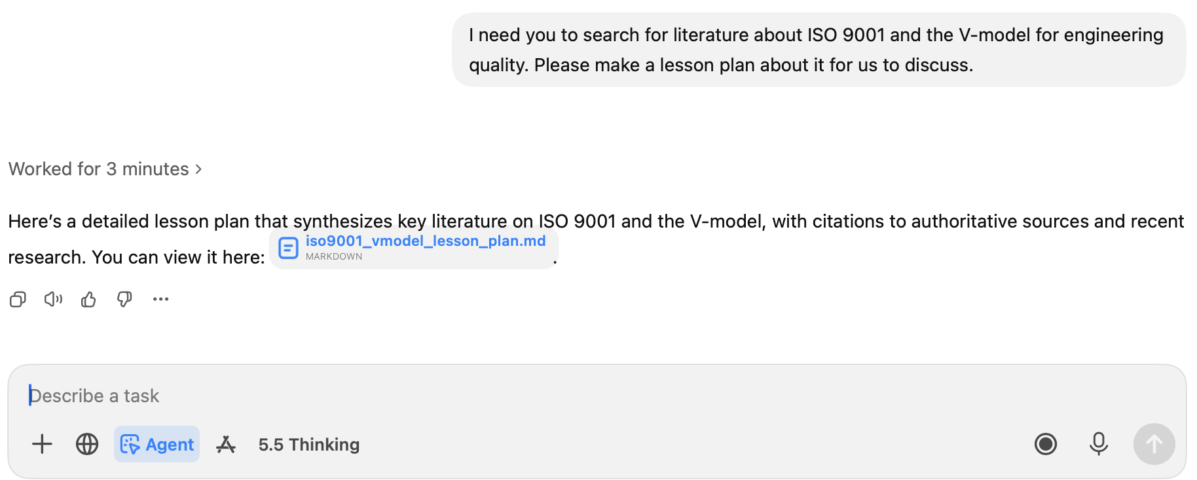
GenAI: Agent mode (prompt)
ChatGPT’s “Agent mode” – specifically request it to do a thoughtful job, browse web, etc.

Slide 15
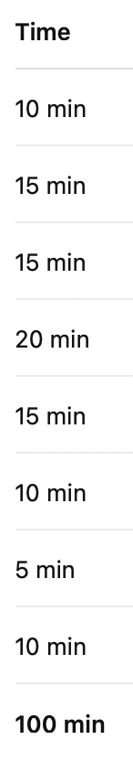
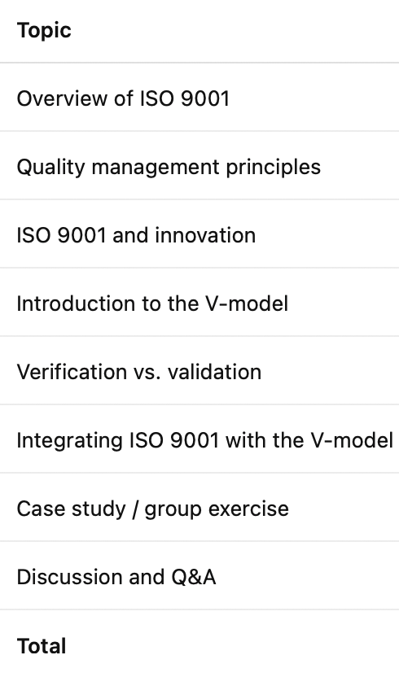
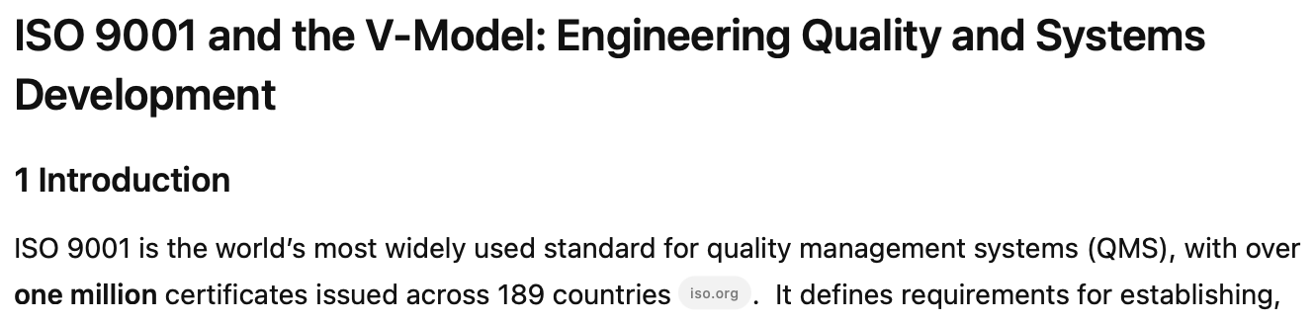
GenAI: Agent mode (result)
“Lesson plan for ISO 9001 and the V-model”
3 Schedule
1 Introduction
2 Learning objectives
Describe the purpose, structure and principles of ISO 9001
Summarize recent research on ISO 9001 and innovation
Explain the V‑model and its phases
Analyze how V‑model practices support ISO 9001 design control
Develop a strategy for integrating ISO 9001 and V‑model practices

Slide 16

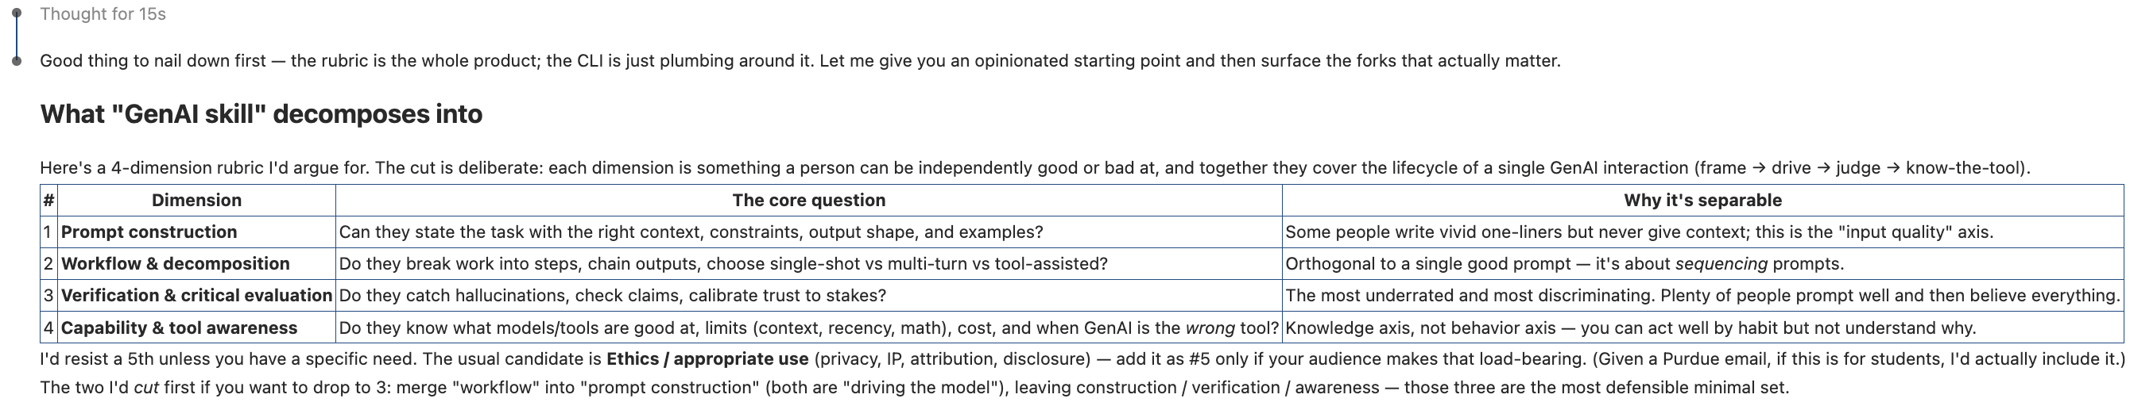
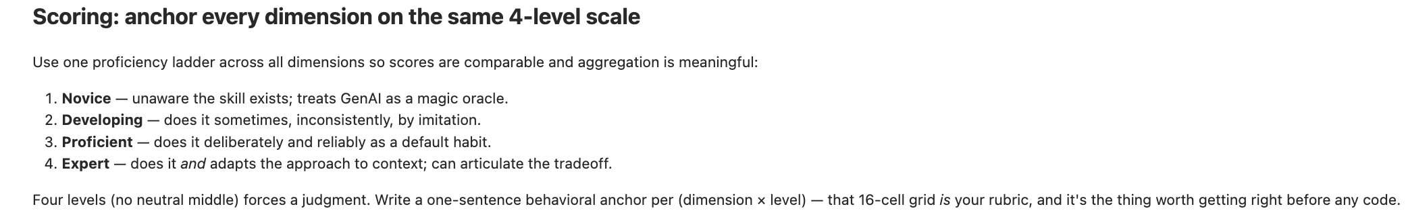
GenAI: Agent mode Claude (1)

Slide 17
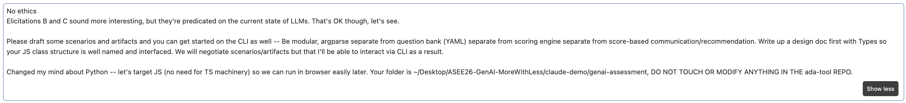
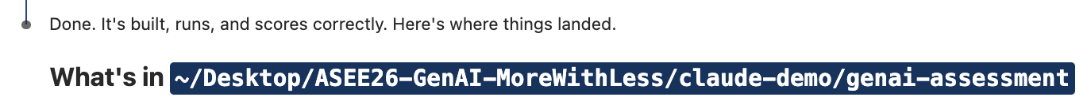
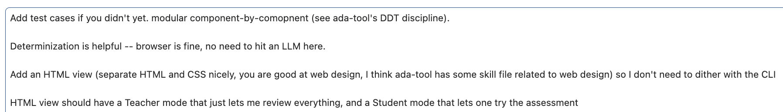
GenAI: Agent mode Claude (2)
Pointing out RISKS
Technical guidance
Procedural guidance
10 minutes passed while Claude worked. I got a coffee.
Technical guidance
Accepting recommendation
More features
10 minutes passed while Claude worked. I drank my coffee

Slide 18
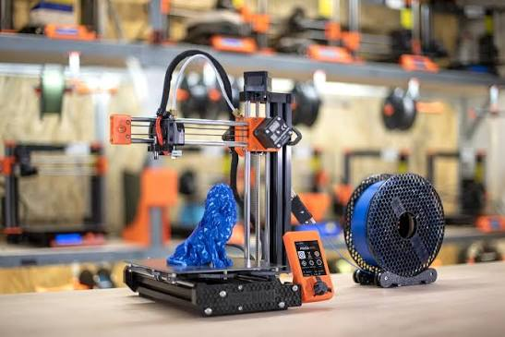

GenAI is a 3D printer, not a stapler
Does one job
Obvious how to use it
With instructions (CAD), can do many jobs
Bad instructions == Bad results
Notes:
Implication
For a stapler, anyone can use it with no training
For a 3D printer, you need training and practice to use it well
If you have any skill – tennis, guitar, singing, mathematical modeling, whatever – you needed training and practice
GenAI is like that – staplers aren’t

Slide 19
Foundations
GenAI demo
A bit on how it works – Or, let’s update your mental model for GenAI
General mindset and strategies on how to use it well
Notes:
For this audience, the problem is not ignorance alone; it is stale folk theory. Many faculty have a 2022–2024 mental model: “autocomplete,” “hallucination machine,” “plagiarism engine,” “chatbot,” or “student cheating tool.” You need to update that model before they can make sense of agent mode, tool use, planning, generated scripts, and supervised autonomy.
The section will cover three questions. Let me state them and answer them for you up front!
What is GenAI? A probabilistic language model trained to continue text, then post-trained to follow instructions, reason, use tools, and behave like an assistant.
Why is it useful? Because it has compressed enormous amounts of linguistic, technical, and procedural knowledge into a system that can draft, transform, explain, plan, code, and inspect artifacts.
Why is it dangerous/unreliable? Because plausible output is not the same as correct output; it does not know your task’s success criteria unless you specify them; and its confidence is badly calibrated.

Slide 20
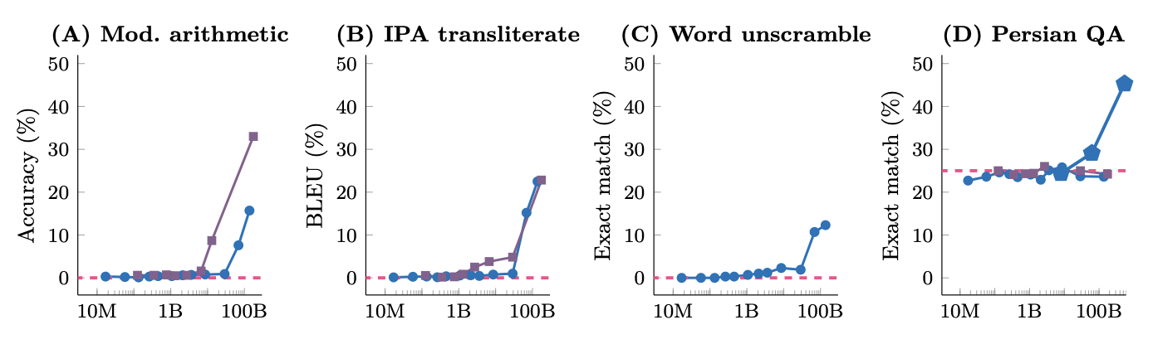
LLMs: Large Language Models
Train a neural network to emit tokens s.t. Pr(output) is conditioned on training data + the previously-emitted tokens
Scaling laws: The “L” is for Large
Wei et al., TMLR’22 https://arxiv.org/pdf/2206.07682
Notes:
For this audience, the problem is not ignorance alone; it is stale folk theory. Many faculty have a 2022–2024 mental model: “autocomplete,” “hallucination machine,” “plagiarism engine,” “chatbot,” or “student cheating tool.” You need to update that model before they can make sense of agent mode, tool use, planning, generated scripts, and supervised autonomy.
An ability is emergent if it is not present in smaller models but is present in larger models.
Eight examples of emergence in the few-shot prompting setting. Each point is a separate model.
The ability to perform a task via few-shot prompting is emergent when a language model achieves random
performance until a certain scale, after which performance significantly increases to well-above random

Slide 21
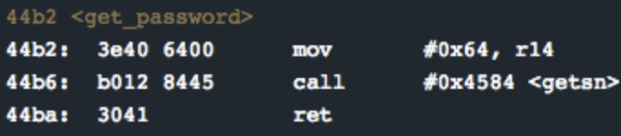
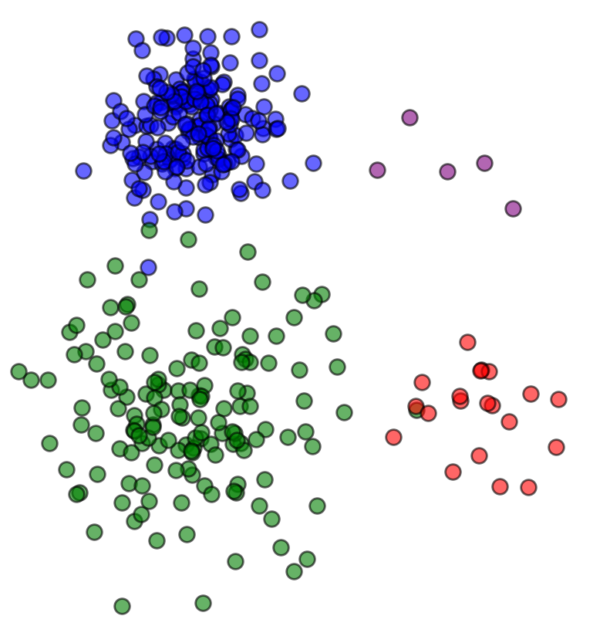


LLMs v1: Stochastic parrots
Mental model: “approximate retrieval with interpolation over learned patterns”
Less reliable “region”
But probabilistic token generation
means nothing is guaranteed
More reliable “regions”
for LLM performance
Bender et al., FaCCT 2021, https://dl.acm.org/doi/pdf/10.1145/3442188.3445922

Slide 22
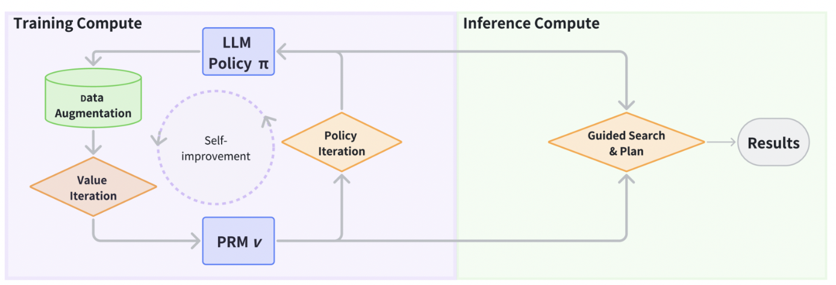
LLMs v2: Post-trained reasoning-ish parrots
Trained to be good at multi-step reasoning
Plans and checks its work
https://arxiv.org/html/2502.10867v1
Notes:
That said, things are a bit better than the approximate-interpolation picture on the previous slide might imply.
LLMs really can reason now!
We have all seen that they can do meaningful work on math, coding, and other structured tasks.
And they often get better when we give them more support: chain-of-thought, scratchpads, verifier models, process reward models, search, or simply more inference-time compute.
So the point here is not that reasoning is fake.
The point is that stronger reasoning usually comes from more machinery and more compute, not from magic.
That is what the figure at the top shows.
There are training-time interventions, like better reasoning data and value or policy iteration
and inference-time interventions, like guided search and planning.
These both substantially improve reasoning performance, especially on structured problems.
==ANIMATE==
But there are still fundamental laws in computing.
There’s a line of work asking whether LLMs can solve problems that we already know are hard, such as SAT.
That is an interesting question because SAT is the canonical example of a hard combinatorial search problem.
If LLMs were somehow making that difficulty disappear, that would be a very big deal.
These works generally find that the LLMs can solve SAT – at least for sufficiently small instances, or for instances that exhibit some exploitable regularity such that they collapse to a small instance (eg the SAT formula has many variables but the variables don’t interact with each other).
LLMs can often do useful reasoning on small or structured instances, and they can improve further with chain-of-thought, verifiers, search, or extra inference-time compute.
But that is not the same thing as making hard search problems easy in general.
So SAT is useful here as a reminder:
LLMs may help explore hard search spaces, but they do not repeal the laws of computational complexity.
==ANIMATE==
And that matters for software engineering, because many of our everyday tasks have the same flavor.
Path coverage is one example.
As branching structure grows, the number of paths can explode.
Program repair is another.
Once we search over many candidate edits, interactions with tests, and regression risks, we are in a combinatorial space.
Feature interaction is similar.
As options and configurations multiply, the number of possible interactions grows quickly.
And architecture design has some of this flavor too.
Partitioning responsibilities, choosing interfaces, and balancing competing constraints can become a large search problem.
So the practical lesson is this:
LLMs may help us navigate hard search spaces.
They may help us propose candidates, prune bad options, or reason heuristically about promising directions.
But they do not make those search spaces disappear.
NP-hard is still NP-hard.
So when an LLM seems to do well on a hard problem, one of several things is usually true:
the instance is small,
the distribution is familiar,
external checking or search is helping,
or we are spending substantial extra compute.
From an engineering perspective, this means we should treat LLM reasoning as a heuristic capability.
Useful, often impressive, sometimes very valuable — but not an oracle that dissolves computational hardness.
With that understanding of what LLMs can and cannot reason about, the next slide turns to a different kind of unreliability — the gap between confidence and correctness, and how that interacts with human psychology.

Slide 23
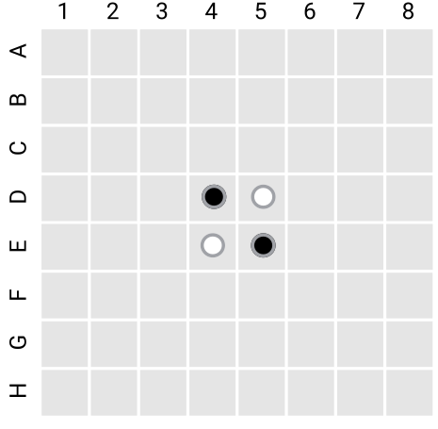
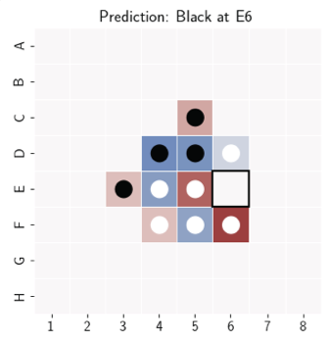
LLMs v3: Emergent World Representations (Model internals suggest they learn rules AND strategy)
Othello
LLM trained on championship dataset makes better moves
Its highest-probability move
Darker shading: Cells weighted in decision
Li et al., ICLR 2023, https://arxiv.org/pdf/2210.13382

Slide 24
State of the art: GenAI is a grad student
The latest LLMs:
Know the Internet + all books
Can reason-ish over this data
Can use tools (browse web, check what time it is, write computer programs)
Also the latest LLMs:
Me: “How is the work going?”
Claude: “Oh, I’m sorry, I said I started but I didn’t actually start”
< It later produces work that fails in subtle ways >
“If I have the gift of prophecy and can fathom all mysteries and all knowledge…”

Slide 25
Foundations
GenAI demo
A bit on how it works
General mindset and strategies on how to use it well

Slide 26

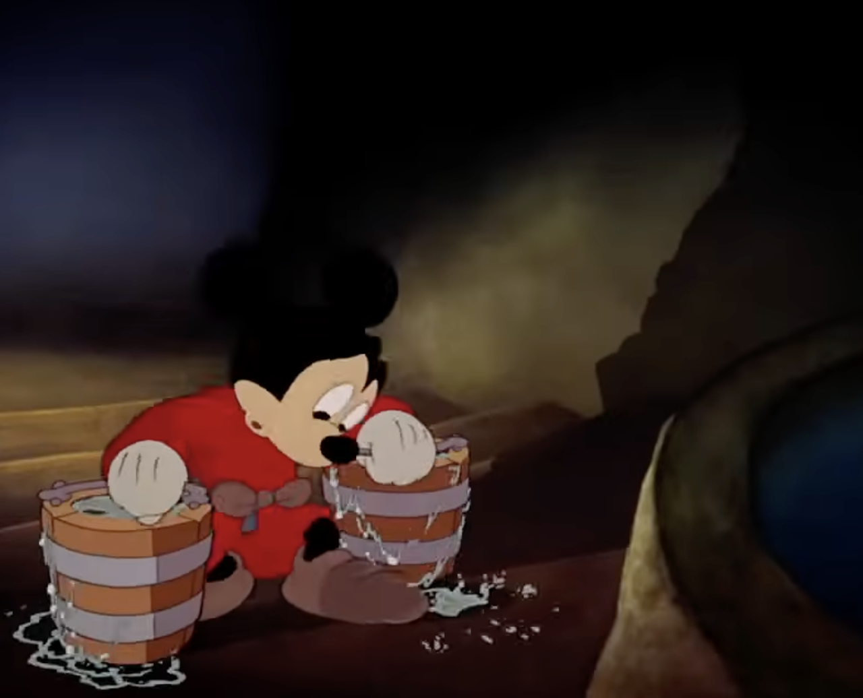


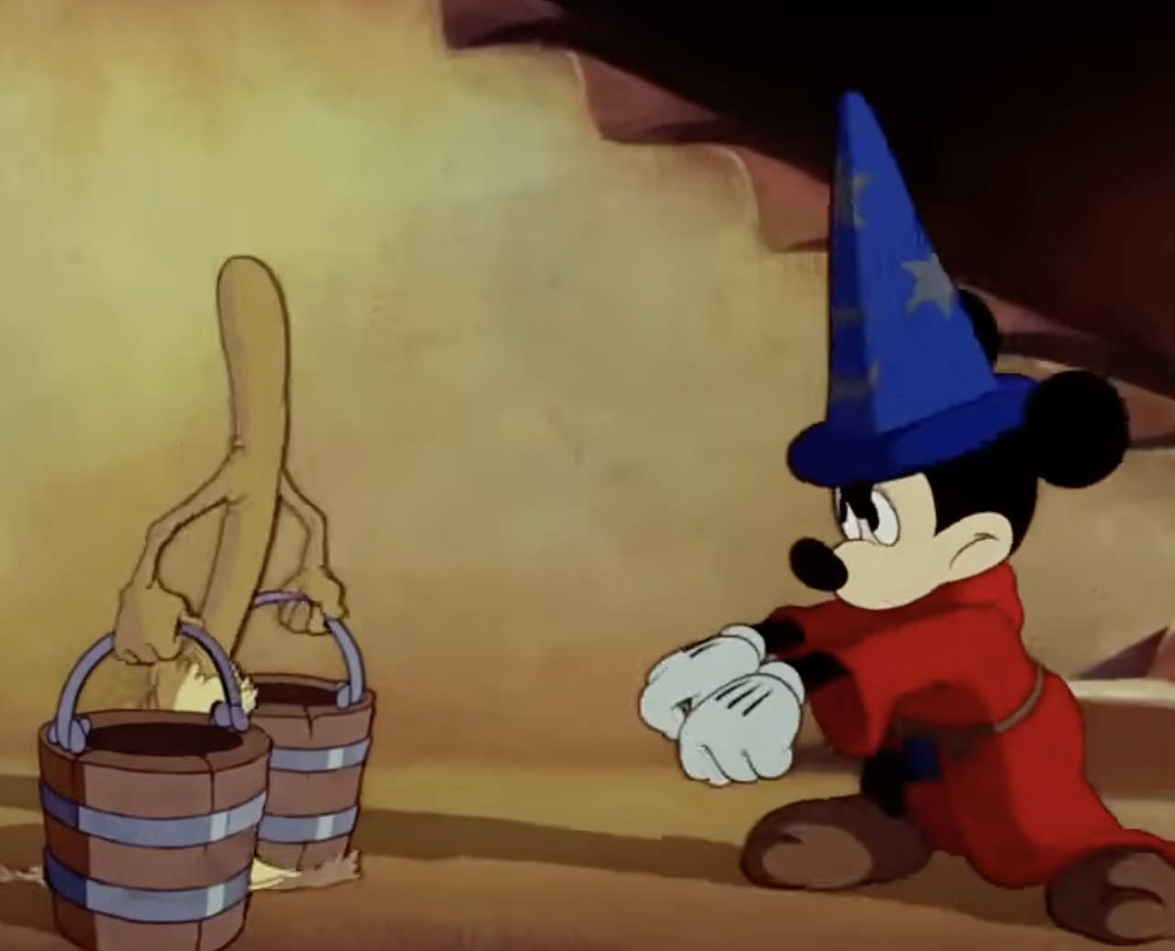


New tools are hard. Don’t be like Mickey
Disclaimer: It’s probably illegal to have these screenshots in here.
Notes:
Tell the story with stop-motion support.
See, it’s a real tragedy, because after this ax work, the broom rises from the dead, overwhelms Mickey, and eventually Mickey’s boss has to come back and rescue him. Mickey ends up back on bucket duty…his boss never automates the task for him, and Mickey couldn’t figure out how to do it either.
In this talk, Claude in the magic hat, and my goal is to help you not end up like Mickey.

Slide 27
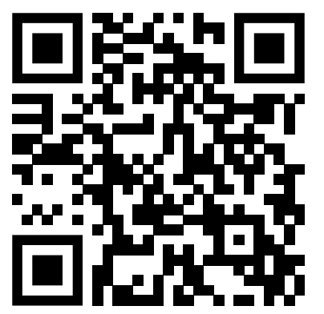
GenAI: Agent mode Claude (3)
https://davisjam.github.io/asee26-genai-assessment/
Please take a few minutes to complete this 10-question assessment.

Slide 28
Stages and Ways of GenAI use
Stages
What it helps to know
Ways
Non-Adopter
Automator
Dreamer
Engineer
Critical thinking
Subject matter expertise
How to run a computer program
How to build a computer program (SWE)
Interactive
Batch
Agentic
Notes:
You do not need to be an expert.
I hope

Slide 29
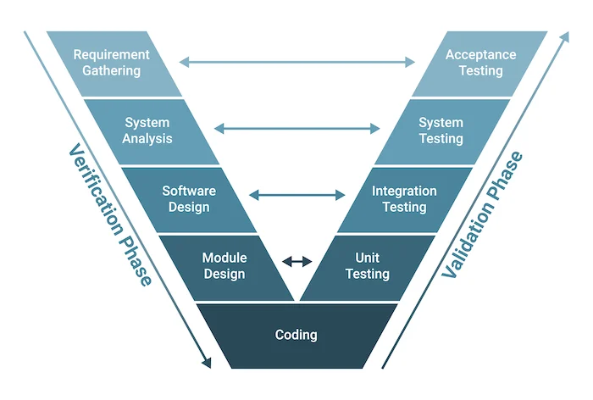
We are in the age of hyper-exploration
Q: What part does AI do?
Q: What part is left?
Q: How long does it take?
Notes:
Can anyone tell me what Amdahl’s Law says?
GenAI reweights labor costs from production toward design, validation, scope control, and engineering judgment.
The question changes from "Can I do this?" to "Can I supervise the doing of this?”
====
In engineering processes, we started out with large planned-out efforts, but we always run into “unknown unknowns”.
Construction projects and warplanes run over time and over budget.
We developed more agile methods in the 1990s and 2000s, which attempted to control for those unknowns through iterative prototyping and ongoing stakeholder engagement.
But you still have to decide what to build, draw up blueprints, etc. – exploring alternatives is expensive.
With generative AI, alternatives, representations, UX flows, and
pipelines became cheap enough to scout. A competing approach could be prototyped
faster than another week of refining the wrong abstraction.
Although GenAI is software, it doesn’t affect just software engineers.
It’s a 3D Printer whose implications affect all engineering disciplines:
In software, you can throw away or change 100KLOC in an afternoon
In mechanical, you can build a dozen CAD models
In industrial, you can iterate on optimization strategies

Slide 30
Foundations
GenAI demo
A bit on how it works
General mindset and strategies on how to use it well

Slide 31
GenAI can plan and you can review
Good: “Let’s do X”.
Better:
“Make a plan to do X
Report out the plan to me, and surface any ambiguity for my judgment.
Include your recommendations on those points.”
Principle: Measure twice, cut once.

Slide 32
GenAI does not know what “done” means
Bad: “Fix this bug”
OK: “Fix this bug, add new tests, and change no unrelated files”
Good: “Fix this bug so that <semantic criteria>”.
Principle: GenAI can satisfy clear criteria…if you ask it.
Implicit criteria → Plausible-ish behavior
Explicit criteria → Checkable work
Why? Because its training data does not have your specific task and goals in it, and even if it did, other people don’t check their work well.

Slide 33
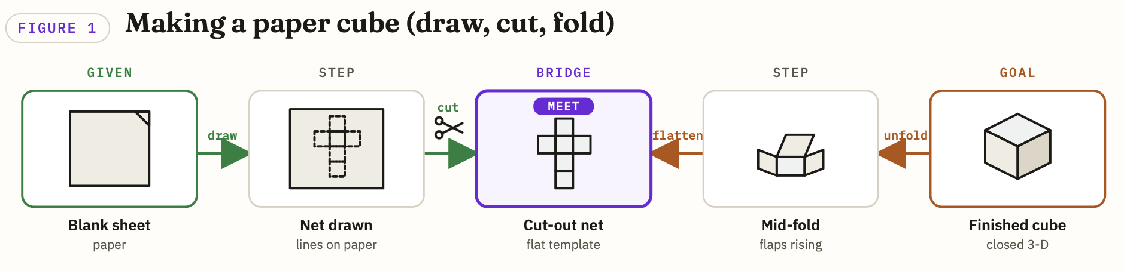
Breaking a problem down into steps: Try working backwards and forwards
“If I fold this, will I get a cube?”
“If the last step is folding paper into a cube,
how might I unfold it?”
Polya, “How to Solve It”

Slide 34
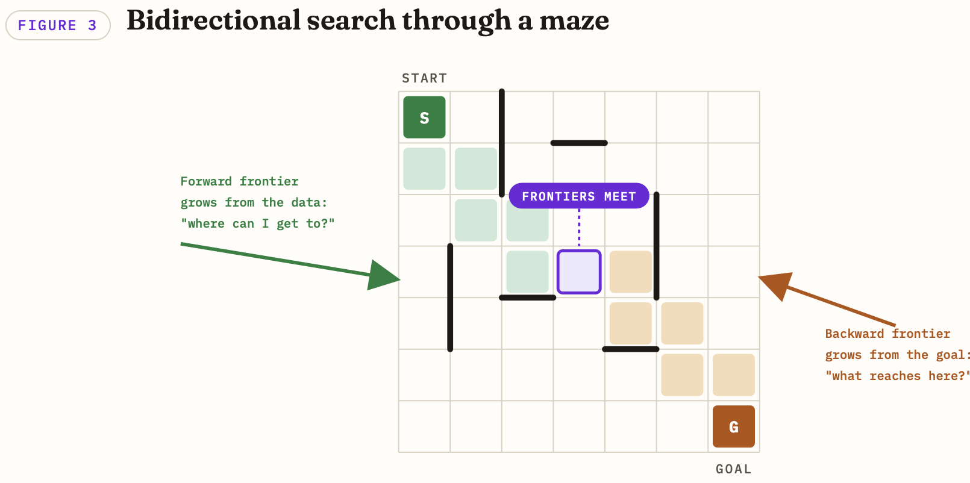
Breaking a problem down into steps: Try working backwards and forwards
Polya, “How to Solve It”

Slide 35
Embrace calibrated skepticism under information disadvantage
Good news: That’s what professors do all day!
Notes:
Lesson learned. The goal is not to know everything the GenAI knows. The goal is to know
what must be checked before trusting it.
GenAI supervision is not omniscience; it is disciplined skepticism.

Slide 36
The Paradox of Building with GenAI
Generative AI can reason (or at least give the appearance)
Yet to make a robust system, you must minimize its opportunities to do so!
Verify, constrain, and control
Core GenAI Strategy:
“Do not try to directly generate the desired artifact.
Instead, generate a (more) deterministic generator”
BAD “GenAI, go through these files and…”
GOOD “GenAI, write a Python program to go through these files and…”
Notes:
Here is the main lesson of the talk: The GenAI Paradox.
GenAI can generate material, but we want “good” material that you would be willing to rely on.
To get reliable material, asking GenAI to make it directly is probably not a good idea.
Don’t ask the model to be the process; ask it to build a process you can inspect, run, test, and rerun.
Everything I talk about today has, under the hood,
When you find that this doesn’t work, the temptation is to say “Claude just can’t do this”.
Never say that! Assume that you are the problem.
When working with GenAI, we are limited by our ideas and ability to articulate them and break things down.
Do not treat model failure as a fixed capability boundary too quickly. Often, the real limit is that we have not yet decomposed the task into an inspectable, controllable process.
After more than a year of working with GenAI, and the past concerted 3-month effort, I have not yet encountered a computable task that Claude couldn’t tackle with my guidance.
Obviously there are human things it cannot do, but most things in professional life are computable, or can be computer-assisted.
And while trying to build complex systems, I have encountered many things it couldn’t do directly. Many, many, many, many things.
But every one has been do-able with enough creativity.

Slide 37
How to GenAI: Basic decision tree
What kind of task
Computational (coding, analysis, grading per rubric)
Specify I/O behavior
(What is the process?)
Judgment/Language/Reputational
(eg Writing, Grading, Developing lecture)
Ask GenAI to build
(or to be) the process
Interactive or Autonomous
Careful prompting and review
Interactive mode
Notes:
Focus of the talk, BUT…many of the judgment/language activities we’re talking about have candidate computation/transforms.
So don’t tune out if you want Claude to help you write.
Computers can help everyone!

Slide 38
The Computational Path: Construct the process
Simple task – < 3KLOC
What kind of task
Specify I/O behavior
“One-shot scripting”
(eg CSV → teaching tenure table)
Hard task – Esp. if it includes reasoning
Supervised autonomy
Correctness conditions
Propose sub-tasks
Tools to “determinize” recurring processes
Monitoring and intervention
System design
Development process
Notes:
This is the Function-Generator Method for GenAI
GenAI helps you automate construction of the artifact, NOT generate the artifact itself

Slide 39
Use GenAI-friendly Representations
Prefer simple, inspectable, easy-parse formats
Data: CSV, JSON, YAML
Text: Text, Markdown
Visual / Structured documents: HTML
Code: Any language, but Python is pretty human-friendly
Notes:
When you work with Claude, file format matters. Not because Claude is picky in a human sense, but because every format creates a different amount of translation loss.
Simple text formats are easiest to inspect, easiest for Claude to modify, and easiest for you to diff. CSV, JSON, YAML, plain text, Markdown, and HTML are friendly because you can see what changed.
HTML is especially useful when you need something visual, because it is both human-viewable and machine-readable. Claude can generate it, you can inspect it, and a browser can render it.
Python is often a good default for generated code because it is readable, widely supported, and quick to test. The language is less important than the fact that the code should be inspectable and runnable, so if you prefer another language, go for it.
The anti-pattern is handing Claude an opaque artifact and asking it to “fix it.”
Either convert the artifact into a simpler representation (export XLSX → CSV) or ask Claude to build a tool that manipulates the artifact through a library. It might need to build the library itself – this works as long as you have enough examples for it to test on.
Do not ask the model to operate through vibes. Give it representations that make the work visible, checkable, and repeatable.

Slide 40
Agenda
Who am I and what am I doing here?
Activity 1: Your experiences with Generative AI so far
Foundations: Under the hood of GenAI + Working with it
Two examples from my work
Activity 2: Designing a lecture with GenAI
Activity 3: Grading student assignments
Activity 4: Conversations with teaching assistants
Readout

Slide 41
Two examples from my work
Dreaming → Demos

Slide 42
Dreaming is the first step to awesome
What is something Claude might help you with? Here are the rules:
You do it professionally at least once a week
You view it as a “necessary evil”
A computer might do it (Claude cannot attend faculty meetings)
You can quantify whether it is done correctly or not
Notes:
* We don’t want to end up like poor Mickey
* Anyone willing to share? Hope to hear 3 or 5 ideas. You can put them in the chat too.

Slide 43
My first dream: Turn bureaucracy into software
“Automatically generate the lists and tables in your tenure dossier according to the latest template which might change again next year, with stable links that update as you add more material.”
Notes:
This is not magic.
If you don’t have the data somewhere, you can’t pull it out of thin air.
But if you *do* have the data somewhere…

Slide 44
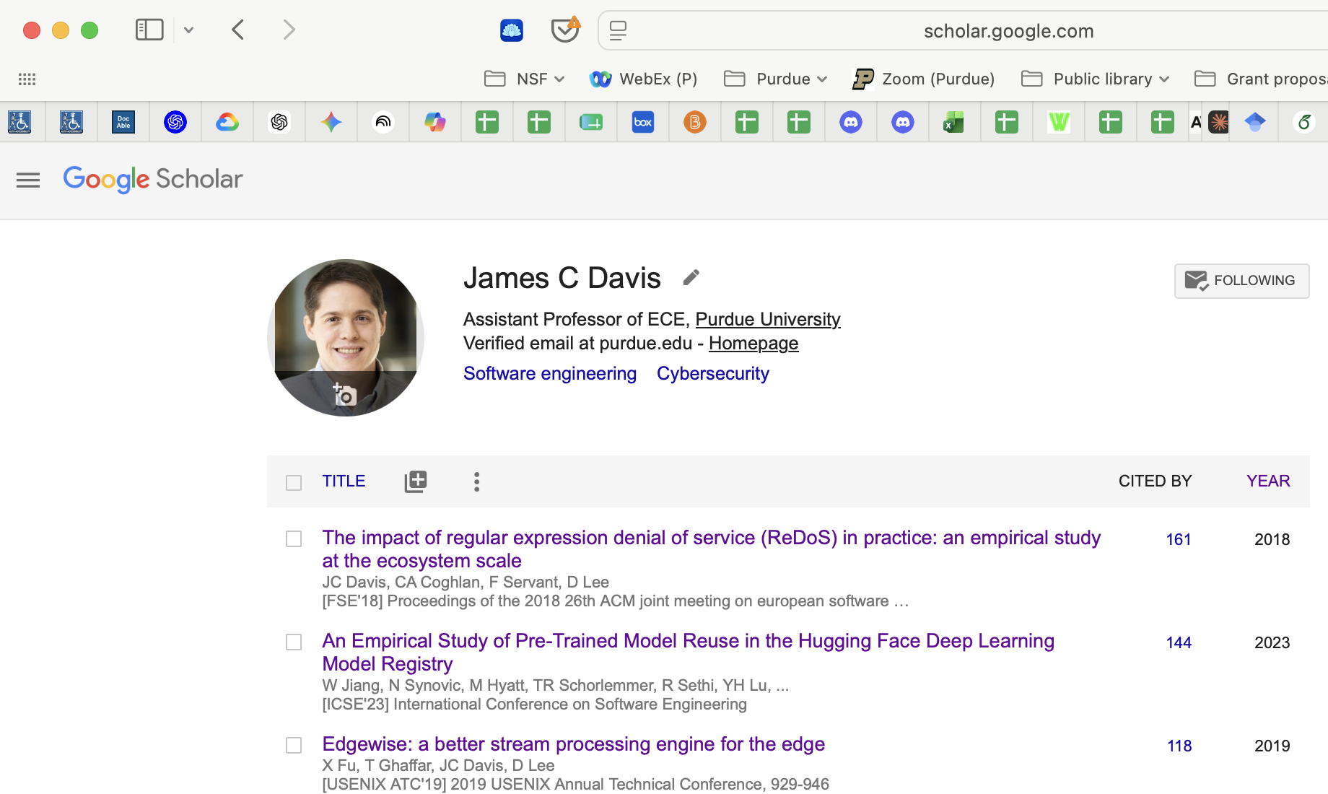
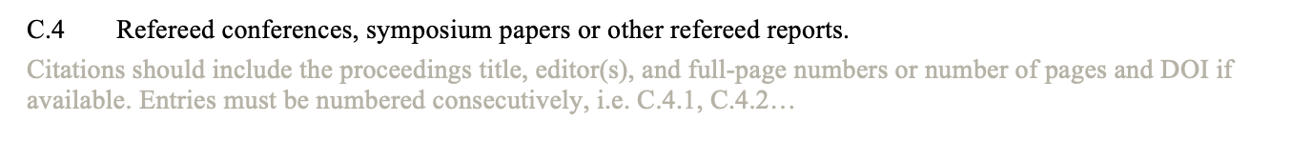
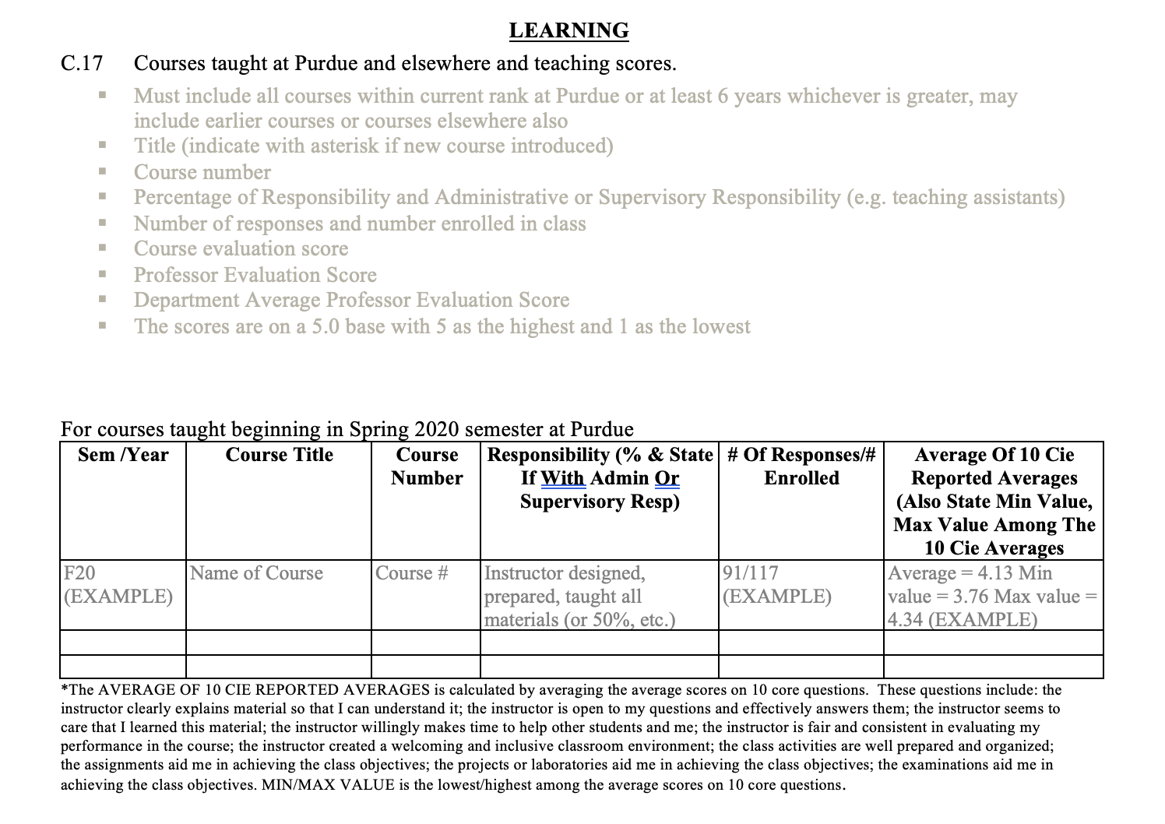
I have this perfectly good database I maintain
Notes:
I have been carefully maintaining my Google Scholar and my CV for years.
Pages and pages of achievements, publication records, grants, student mappings, and decisions over and over about what things to list on Scholar and what things to include in a CV.
Starting from that foundation, Claude accelerated the packaging. Claude does not really know what matters. It sounds compelling but it does not know. Claude *did* help turn a messy administrative artifact into a compiled document whose source of truth I maintain.

Slide 45
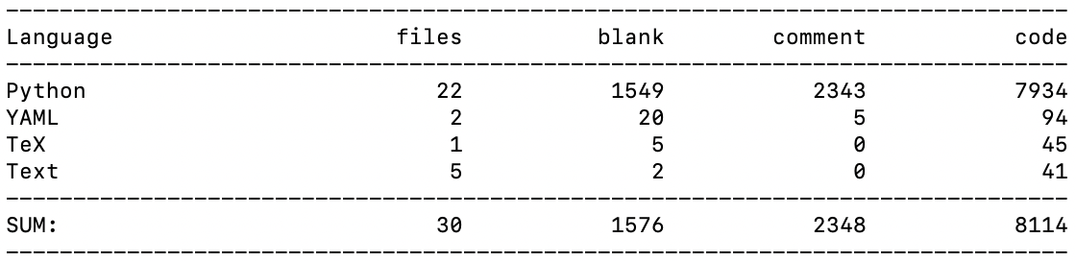
“With Claude, any database can be a Word Doc”
https://github.com/PurdueDualityLab/purdue-tenure-packet-generator
Notes:
And now, about 8,000 lines of Claude’s code later, here we are!
I did not write any code. I did not look at this code.
I designed the system architecture.
Claude tried and did a terrible job at that.
Why? I suggest it’s because it has learned from all of github, which is full of bad software architecture.
I am good at software architecture.
I can therefore guide Claude in the paths of righteousness.

Slide 46
After ~10 hours with Claude, the clerical part of my tenure dossier was completed
Leaving me the interesting bits – statements!
…and not the boring bits – linking everything and making mistakes and re-numbering and so on.
Notes:
My dream is not to automate away my job.
It is to let Claude take on the clerical labor while I handle the judgment.

Slide 47
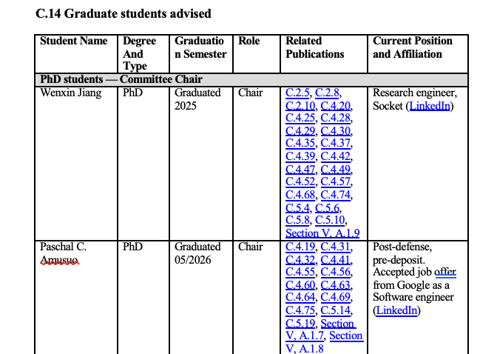
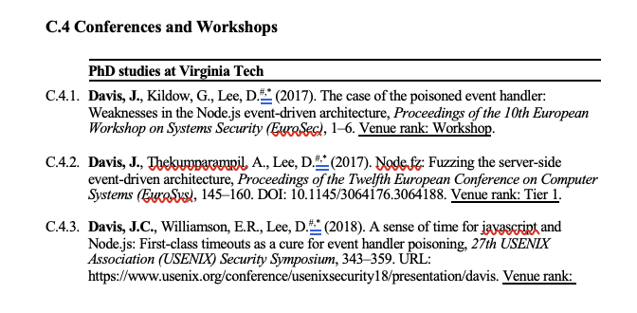
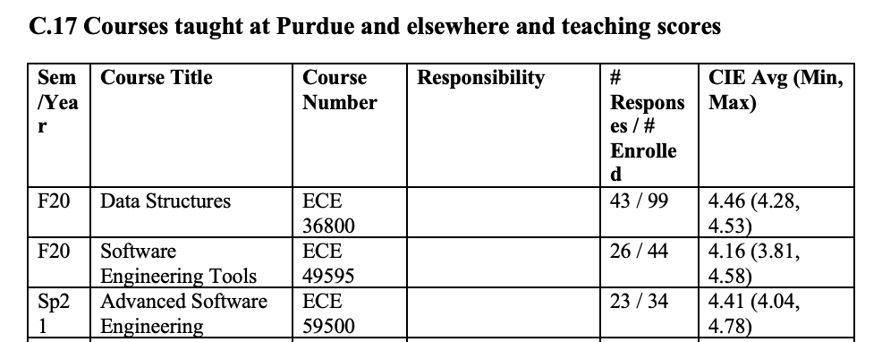
Sample outputs from my auto-tenure document

Slide 48
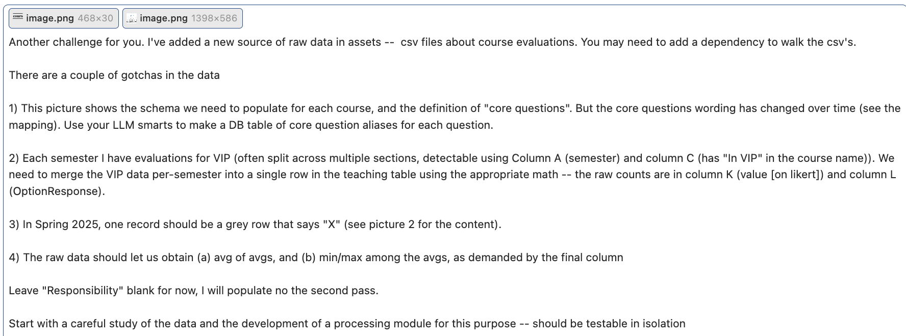
How does one get Claude to make this table?
output uses the RTF format
EvaluationKit
Build report
All classes, and core-10 Qs
Download Excel (NOT pdf)
Export the two tabs as CSVs
Study and screenshot for Claude
90 minutes: 80 of me digging around EvaluationKit, 10 of Claude
Notes:
Two important things to flag here which will basically capture the whole talk in a nutshell.
I am not trying to generate the Word doc directly.
I am not asking Claude to do the calculations itself.
Table took 60 minutes to figure out EvaluationKit, 2 minutes to prompt Claude, then 10 minutes for Claude to code the ~500 lines
The math was correct on the first try; the bugs were in me missing a class from the EvaluationKIT export.
Claude noticed the unexpected gaps in the timeline and asked me about it in its initial response.

Slide 49
My second dream: ADA compliance
“Make your 50-75 slide decks and 50 readings ‘accessible’ by April 2026”
Notes:
This is not magic.
If you don’t have the data somewhere, you can’t pull it out of thin air.
But if you *do* have the data somewhere…

Slide 50
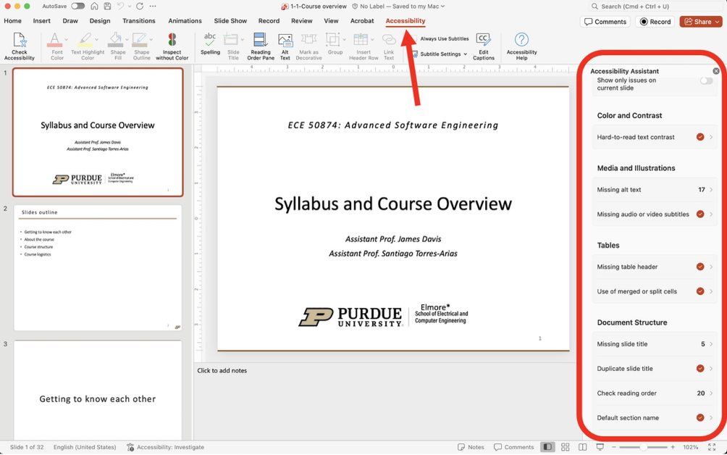
Estimated cost of accessibility remediation
Notes:
One (strictly theoretical) solution to the ADA mandate is thus to
pull the plug. The analogue problem is already solved. Removing
digital access addresses the letter of the DOJ’s mandate. However, it
contradicts the spirit of the rule. Digital materials enhance accessi-
bility for all students. For example, captions help not only students
with hearing disabilities, but also students in noisy rooms, students
learning English, and students who missed a word because they were
briefly distracted. Removing them to sneak around the ADA would
be monstrous. Practically speaking, universities that de-digitized
would become less attractive to prospective students, who presum-
ably enjoy access to lecture recordings and slides to study outside of
class.
The hard way is to actually go through and remediate all of the or-
ganization’s files to comply with the DOJ’s technical standard. To
understand why this is hard, take a look at this picture of the slide
deck I use for “Syllabus Day” in my graduate-level course on Ad-
vanced Software Engineering. I’ve clicked on the “Accessibility” tab
in Microsoft PowerPoint, which shows me the 42 ways in which my
slide deck is inaccessible.
Addressing each of these concerns might take 2-3 minutes, or sev-
eral hours for this deck. This course has 48 slide decks, and perhaps
50 associated readings in DOCX and PDF formats. At a conservative
estimate of 3 hours per document to remediate it, we’re looking at
294 hours of my time, or 7 full work weeks.
Including benefits and whatnot, Purdue pays faculty approximately $100 per hour, so for me to remediate this one course would
cost Purdue over $25,000.
I maintain two courses.
Purdue has 2000 faculty – if they all do one course, that’s $50M; 2 courses is $100M.
If we pay TAs instead, we cut costs down to perhaps $20/hour – so just $20M?
But I think it’s optimistic to suppose TAs can bring material up to a defensible standard under scrutiny by the DOJ, especially in our upper- and graduate-level courses.
If we are not up to standard, the penalties are not yet known.
Lawsuits under the previous DOJ standard cost $100K-$1M.

Slide 51
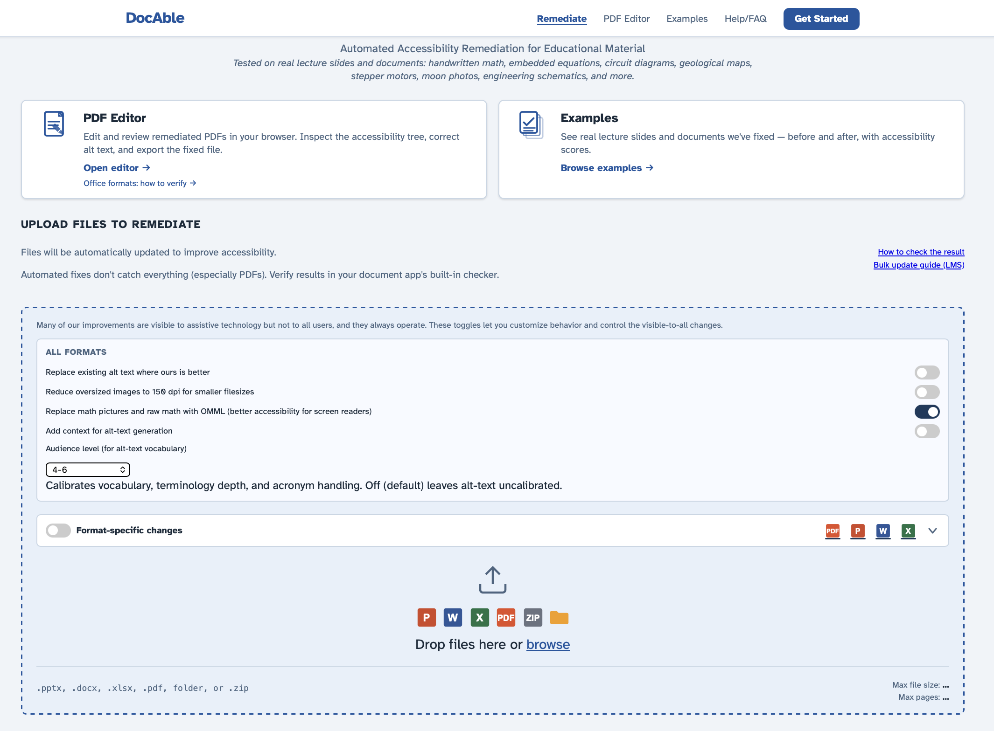
DocAble

Slide 52
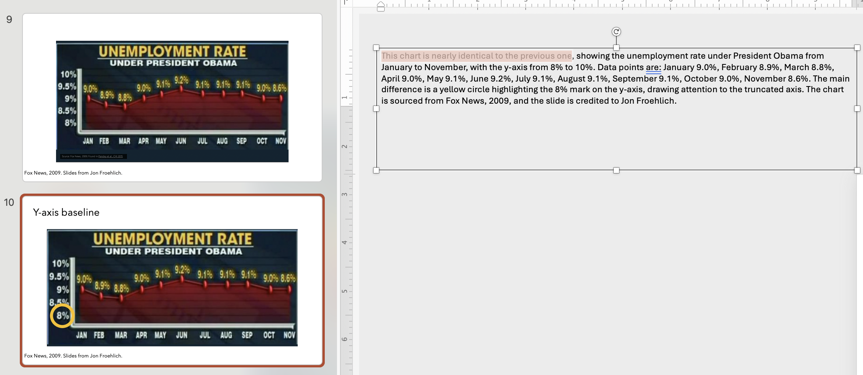
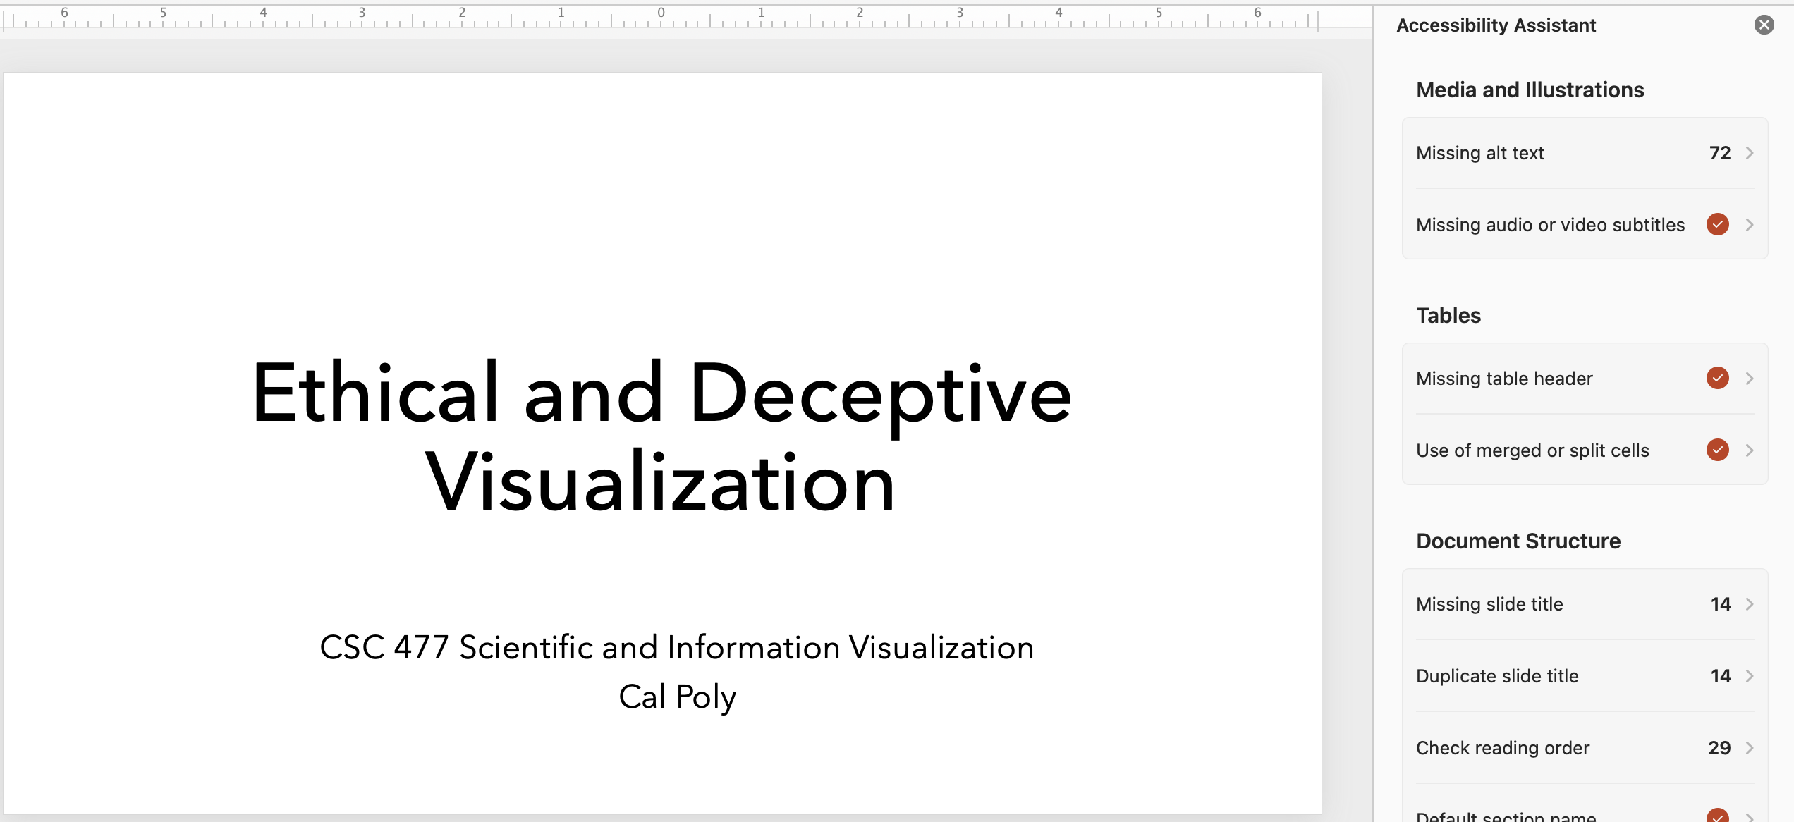
Example DocAble output behavior
Notes:
Behold, it works and does a useful thing.

Slide 53
Agenda
Who am I and what am I doing here?
Activity 1: Your experiences with Generative AI so far
Foundations: Under the hood of GenAI + Working with it
Two examples from my work
Activity 2: Designing a lecture with GenAI
Activity 3: Grading student assignments
Activity 4: Conversations with teaching assistants
Readout

Slide 54
Activity 2: Make a lecture in 20 minutes
Form groups of 2–3 with shared expertise Examples: BSc degree, teaching level, kind of course
Pick a topic you teach and use GenAI to create a learning module
Identify student background
Topic, learning outcomes: 1 Lecture + homework
Lecture outline – “30 minutes long”
Divide up the work
Slides
Illustrative figures
Homework with solutions
Apply the concepts we’ve talked about
Identify your expertise
What parts of this are “clerical” vs. judgment?
What context to provide the LLM (“prompting”)
How will you validate the work?
Notes:
Raise your hand if your bachelor’s is in:
MechE
Civil
Aero
Environmental
Nuclear
Computing
Liberal arts
Raise your hand if you teach in
First-year
2nd-3rd year
Senior
Senior design
Raise your hand if you teach
Theory-based courses
Applications courses
Labs
Mix

Slide 55
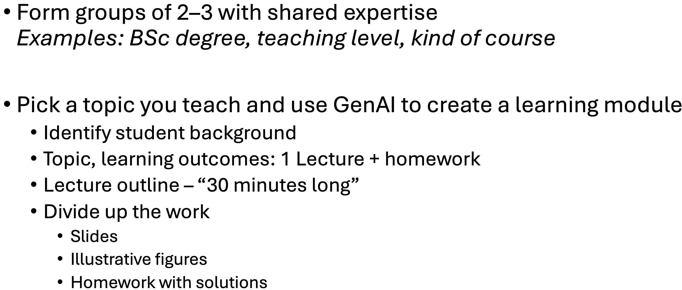
Activity 2: Make a lecture in 20 minutes
Discuss
What work was clerical vs. judgment?
What expertise did you have to supply?
What did GenAI do well enough to keep?
When was it generic, wrong, or pedagogically weak?

Slide 56
Agenda
Who am I and what am I doing here?
Activity 1: Your experiences with Generative AI so far
Foundations: Under the hood of GenAI + Working with it
Two examples from my work
Activity 2: Designing a lecture with GenAI
Activity 3: Grading student assignments
Activity 4: Conversations with teaching assistants
Readout

Slide 57
Activity 3: Grading assignments
Problem: You have sixty 10-page submissions to grade.
What kind of task
Computational (coding, analysis, grading per rubric)
Judgment/Language/Reputational
(eg Writing, Grading, Developing lecture)
Notes:
Can we break this into steps?
What steps are judgment and what steps might be computational?

Slide 58
60 submissions x 10 pages each… Can we take the right-hand path? How?
What kind of task
Computational (coding, analysis, grading per rubric)
Specify I/O behavior
(What is the process?)
Ask GenAI to build
(or to be) the process
Interactive or Autonomous
With your partners, try your hand at this.

Slide 59
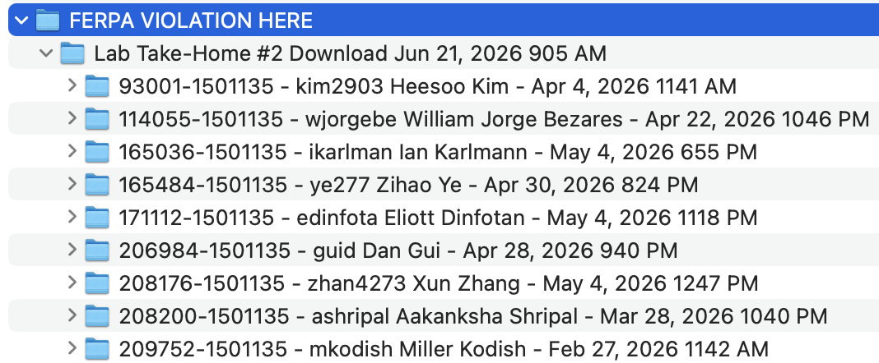
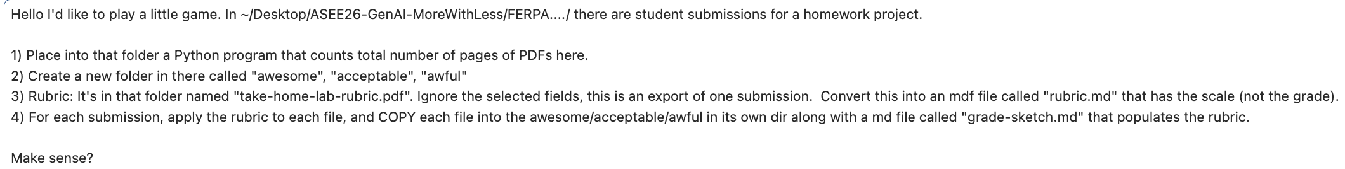
Activity 3: Grading with Claude (agent mode)
Before I touch any of it — that folder is literally named "FERPA VIOLATION HERE," and I want to flag that rather than barrel through it, because the name and the task line up with a genuine risk.

Slide 60
I think AI should not grade But I’m super happy for it to triage

Slide 61
Agenda
Who am I and what am I doing here?
Activity 1: Your experiences with Generative AI so far
Foundations: Under the hood of GenAI + Working with it
Two examples from my work
Activity 2: Designing a lecture with GenAI
Activity 3: Grading student assignments
Activity 4: Conversation with a teaching assistant or peer teacher
Readout

Slide 62
With your partner Scenario 1
Partner 1, a TA: “I used ChatGPT to help grade the last homework. It was much faster. I uploaded the submissions, asked it to apply the rubric, and then spot-checked a few. It seemed pretty accurate. Can I keep doing this?”
Partner 2, the instructor: …

Slide 63
Same partner but switch roles Scenario 2
Partner 1: “I know everyone says AI saves time, but I tried it and got generic junk. I don’t trust it for teaching. I have a new course prep, two labs to revise, and 80 project reports coming in. I don’t have time to babysit a chatbot.”
Partner 2: …

Slide 64
Agenda
Who am I and what am I doing here?
Activity 1: Your experiences with Generative AI so far
Foundations: Under the hood of GenAI + Working with it
Two examples from my work
Activity 2: Designing a lecture with GenAI
Activity 3: Triaging student assignments
Activity 4: Conversation with a teaching assistant
Readout

Slide 65
Readout
What did you learn?
What are 1–2 workflows you will try this summer?
What will you need to learn?

Slide 66
Two main things I hope you took from the talk
GenAI is a tool that can free us from the clerical parts of our jobs
We need to recalibrate our mental cost models
Labor is now cheap…and so judgment is more expensive than ever
Thank you for your attention!
If you want to bulk-remediate your teaching material for ADA, please let me know.
davisjam@purdue.edu

Slide 67
Teaching with GenAI GenAI is a tool that can free you from the clerical parts of your job You need to recalibrate your mental cost model Labor is now cheap…and so judgment is more expensive than ever Thank you for your attention!
davisjam@purdue.edu
If you want to bulk-remediate your teaching material for ADA, please let me and your department head know.
Notes:
Claude can do surprising things, but we need to turn surprising capability into controlled process.

