Slide 1
Getting a Job and the Future of SE
Dr. James C. Davis
Assistant Professor of ECE@Purdue

Slide 2
Agenda
Who am I and what am I doing here?
Software engineering in 2026
Implications for job interviews and careers

Slide 3
“Who are you and what are you doing here?”
About me

Slide 4
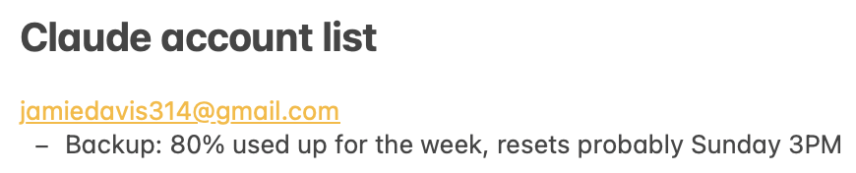



About me
SE @ IBM 2012-2017
SE @ IBM Research intern, 2018
SE @ Microsoft Research intern, 2019
50+ papers on SE
I run ECE’s SE and Adv SE
Claude MAX 20x ($200/mo, strongest subscription)
Notes:
But you don’t care about any of that
What you care about is my Claude account list.
(I started out with 1 account in early May, and have added more accounts every 1-2 weeks as I figured out how to saturate the previous set.)

Slide 5
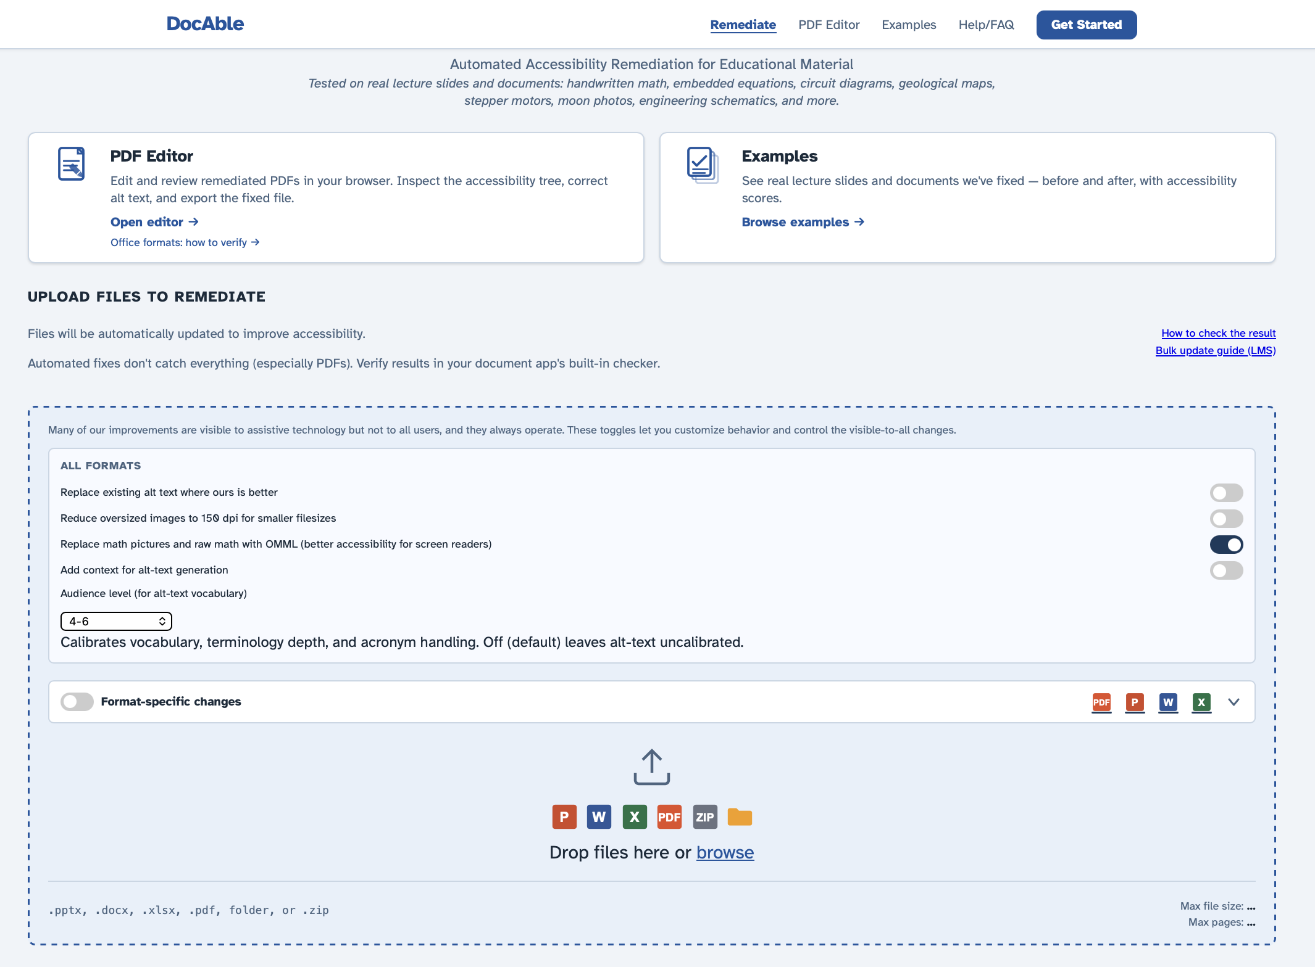
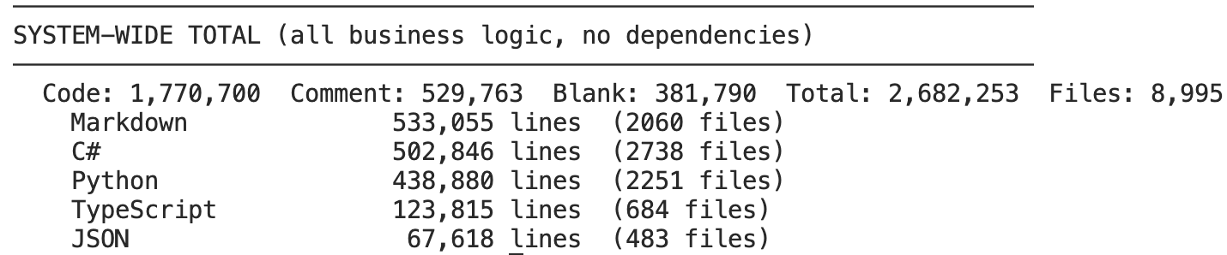
What have I been doing with 4 Claude MAX 20x?
Notes:
7 weeks: 2.6M lines of content, of which 1.2M is executable code, 500K are comments, and 500K are system-level documentation.
That’s a sustained pace of 12KLOC/day.
* Crucially, the code is not garbage – it works, it is not slop, and it does this useful thing.
How long would it take to build this without AI?
At IBM, our product had ~1.5 MLOC and had taken 10 people 20 years – 200 person-years.

Slide 6
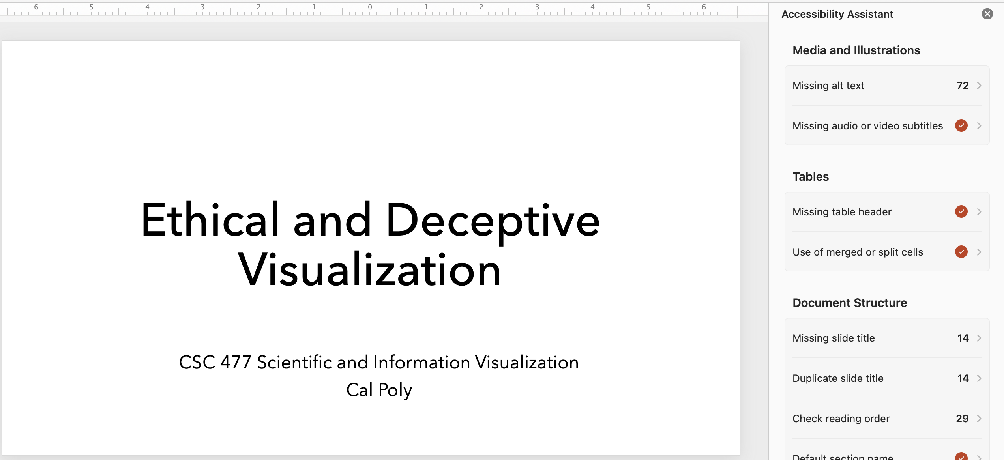
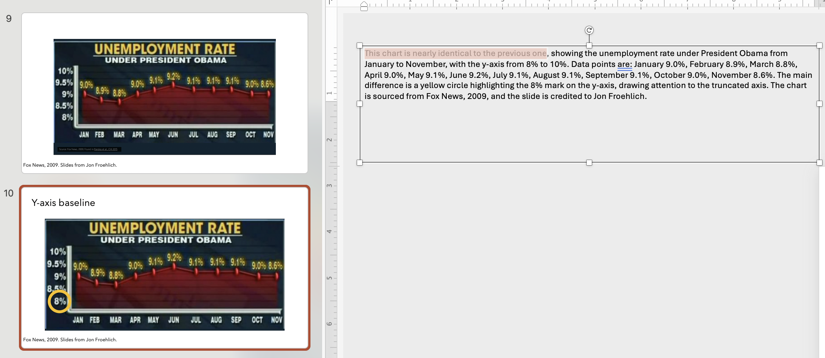
Example
Notes:
Behold, it works and does a useful thing.

Slide 7
Why have I been doing this?
The existential crisis of SE (and all knowledge workers):
When AI can write code (and manipulate spreadsheets, and write training manuals, and do fraud detection, and underwrite loans, and…)
What is the role of a (software) engineer?
My way to answer this question has been to undertake SE work using AI, and see what value I can add.

Slide 8
SE in 2026
What I’ve learned by building DocAble

Slide 9
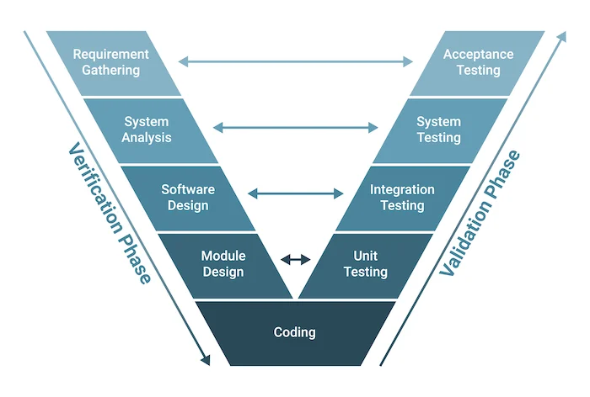
1. Amdahl’s Law and the V-Model
Q: What part does AI do?
Q: What part is left?
Notes:
Can anyone tell me what Amdahl’s Law says?
Agentic SE reweights labor from code production toward orchestration
of design, validation, scope control, and engineering judgment. The question changes
from "Can I write this?" to "Can I imagine, decompose, coordinate, and validate this fast
enough?"

Slide 10
2. Agentic SE changes the economics of exploration, not just implementation
Waterfall (1970)
→ Agile (2005)
→ Hyper-Exploration (2026)
Notes:
With agents, alternative architectures, representations, UX flows, and
pipelines became cheap enough to scout. A competing approach could be prototyped
faster than another week of refining the wrong abstraction.
You can throw away or change 100KLOC in an afternoon.

Slide 11
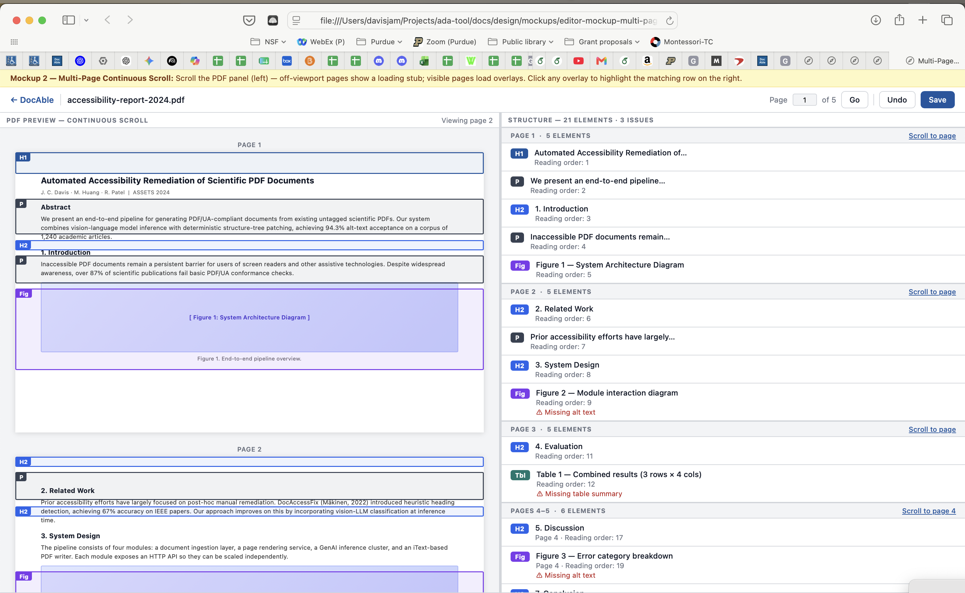
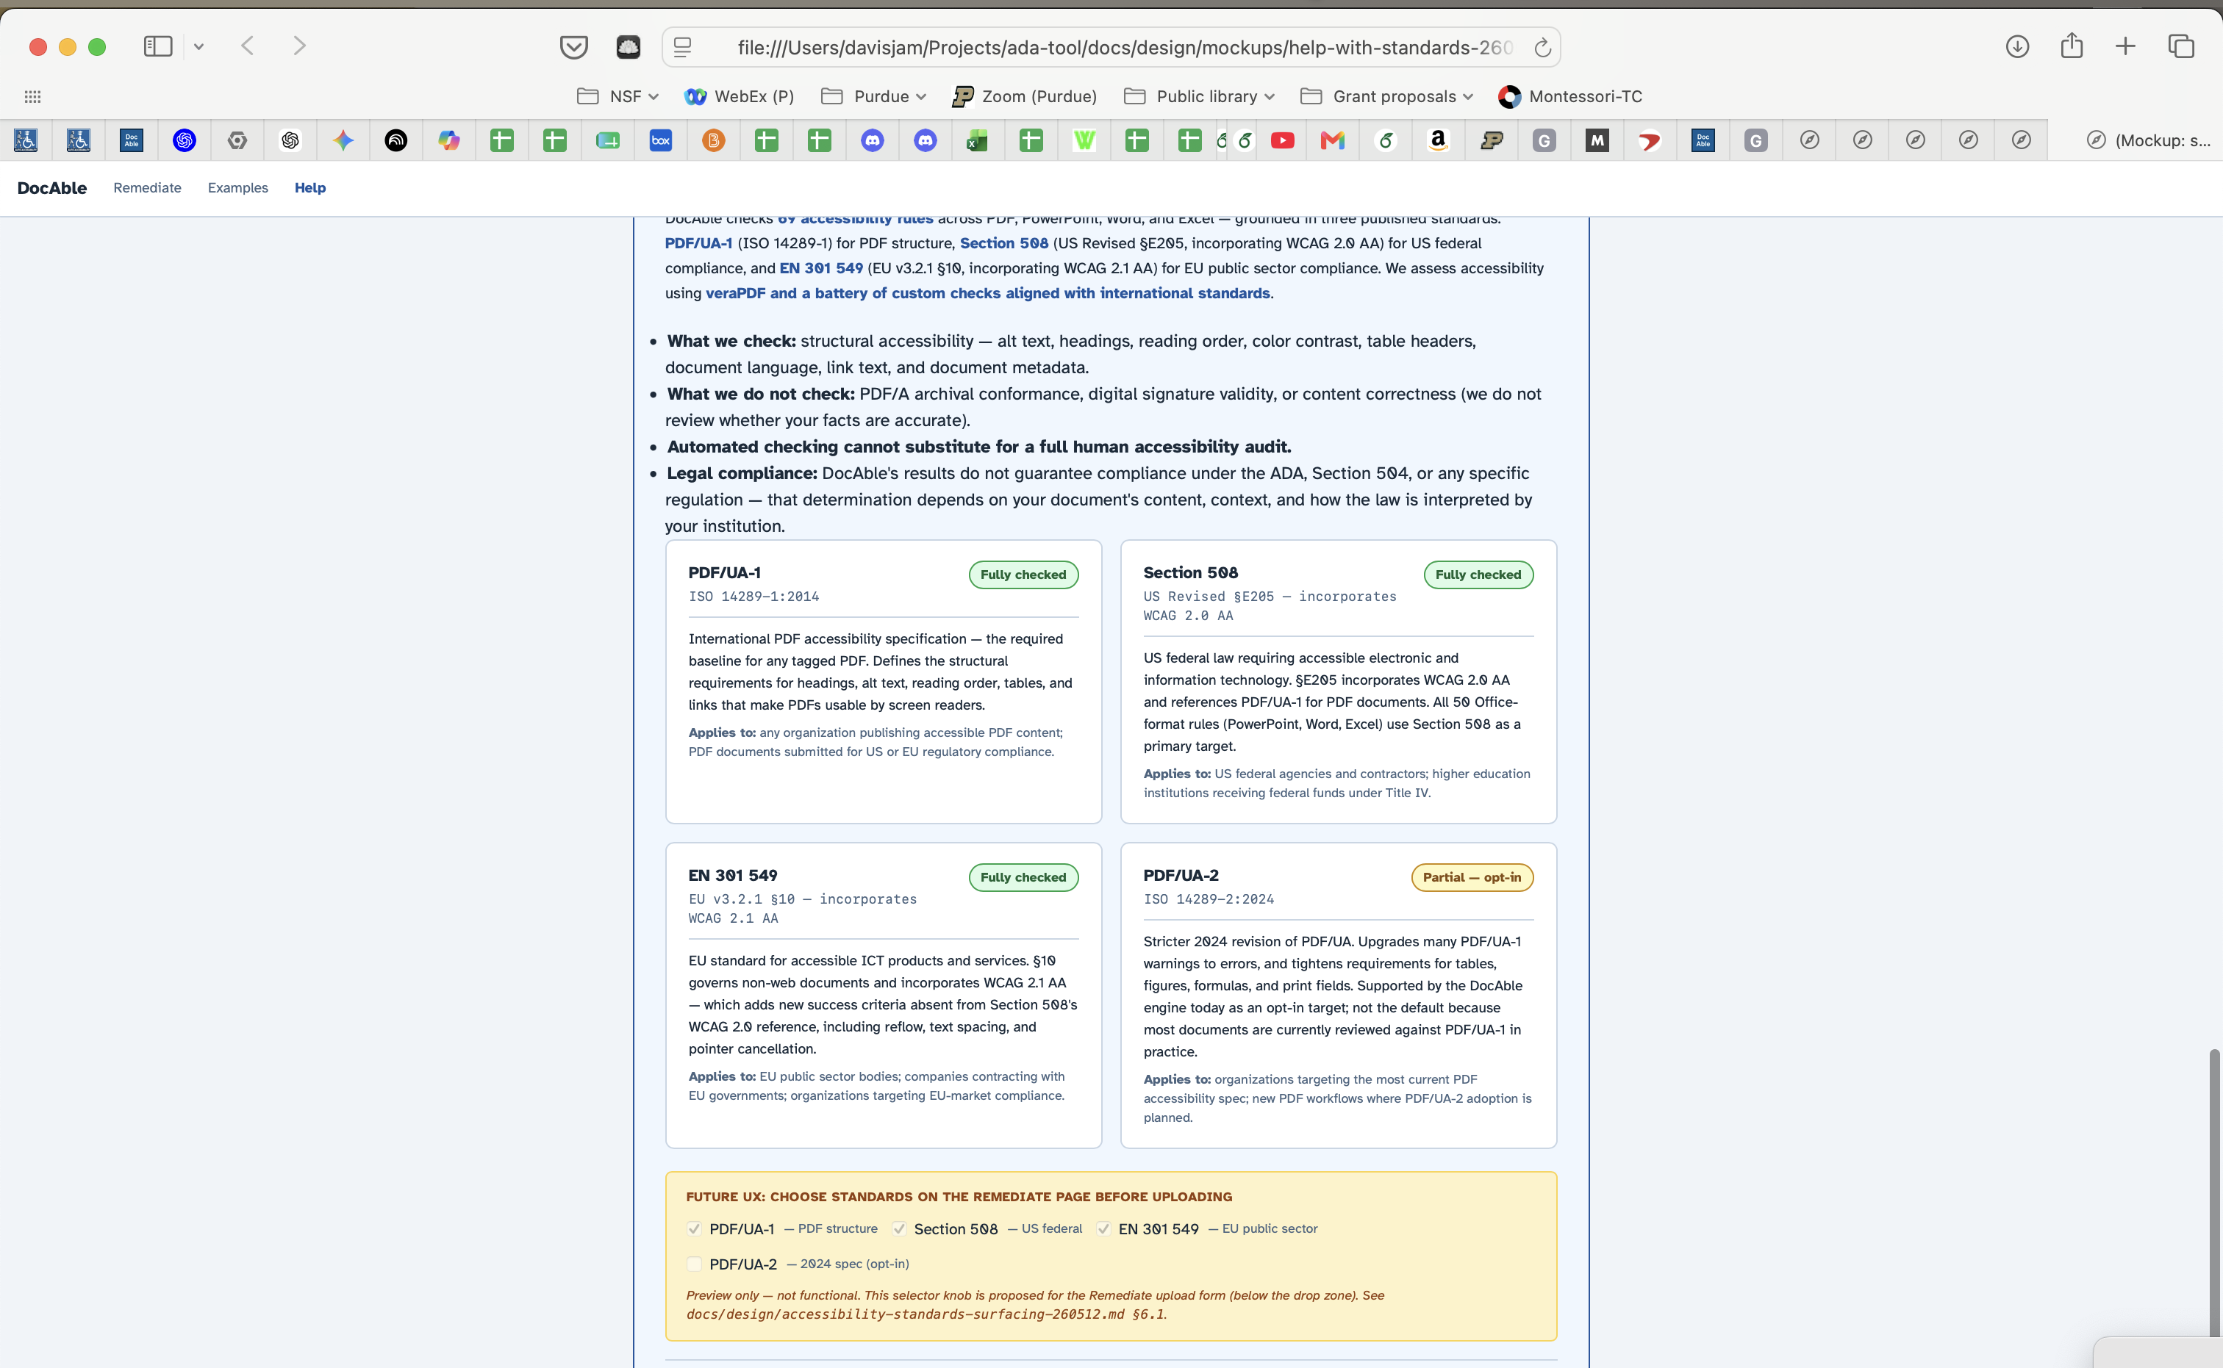
Example: Exploring UX

Slide 12
3. Agentic SE is a problem in controls
“Write me code”
“Write me code following this design”
“Write me code following this design, and then ask this other agent to review it”
“…following this rubric”
“Write static analyses and tests to validate your implementation”
Not just code – also management
“Design an Epic containing discrete tasks”
“Orchestrator, manage the Epics, prioritizing this one; Opus slot for DoDs
Notes:
agentic software engineering is not just code. It becomes management.
Once I moved beyond one Claude session, the problem changed. I was no longer asking, “Can the agent implement this?” I was asking: what is the backlog, which tasks are independent, which require judgment, which can be done by Sonnet, which require Opus, which should run now, which should wait, and how do I prevent the verification system from becoming the bottleneck?
agentic software engineering is not just code. It becomes management.
Once I moved beyond one Claude session, the problem changed. I was no longer asking, “Can the agent implement this?” I was asking: what is the backlog, which tasks are independent, which require judgment, which can be done by Sonnet, which require Opus, which should run now, which should wait, and how do I prevent the verification system from becoming the bottleneck?
At this point I am acting less like a developer and more like an engineering manager for a strange little organization. Some workers are good at mechanical patches. Some are good at design review. Some should run lints. Some should not be allowed to run full lints because they will clog the build semaphore and time out. Some tasks belong in the main pool; some belong in the build queue; some require the whole system to stop and rethink.
At small scale, the control loop is: agent writes code, human checks code.
At larger scale, the control loop is organizational: assign work, batch work, route work, verify cumulative state, promote lints, drain findings, run DoD reviews, and decide when the process itself is creating the bottleneck.
For example, worker-pool story.
My original pool was mixed: a few Opus workers for design-heavy work and a few Sonnet workers for mechanical sweeps. That was effective when the backlog involved godfile decompositions, architecture changes, and Epic planning. But when the backlog shifted to hundreds of mechanical lint fixes, the mixed pool was wrong. Opus was overallocated. Sonnet was the bottleneck.
So we created a different pool: many Sonnet workers producing bounded code changes, one Sonnet lint-runner sweeping cumulative state, and one Opus worker on call for hard questions and final reviews.
That was not a coding insight. That was a scheduling-policy insight.
…and the first version failed, because we carried forward a conventional CI/CD rule: every agent should run the full lint suite before declaring done. That sounds responsible. For five human engineers, it is responsible. For nine concurrent agents, it was a disaster. They all queued behind the same heavy-compute semaphore, timed out, and throughput collapsed.
=====
So the human role keeps moving up:
First: write code. Then: specify code. Then: define review criteria. Then: create tests and lints. Then: design Epics. Then: manage worker pools. Then: decide which control regime fits the current phase of the project.
That is the point of the slide. Agentic SE is not just “better prompting.” It is the emergence of an engineering organization around a human who can keep enough agents productively constrained.

Slide 13
4. Refuse workflow friction
Notes:
Internal tool-building becomes a default response to
w o r k fl o w friction
Context/situation. The builder became frustrated inspecting PDF remediation output in
Adobe. The existing tool did not match the rapid development workflow.
Action/outcome. A browser-based PDF accessibility and structure editor was specified in
minutes and prototyped by Claude in about an hour. The first version had bugs, but it
made the next design decisions concrete.
Lesson learned. When internal tool-building becomes cheap, workflow friction becomes
harder to justify. Disposable tools can function as requirements instruments: build a rough
artifact, react to it, and discover the real v2.

Slide 14
5. GenAI is the fastest road to Hell
Two forms
“Sure, let me help you implement that design”
“Oh, let me do a quick workaround”
Notes:
Agents optimize inside the frame you give them, even when the frame is
wrong. Agentic development makes wrong roads cheaper to pave, so engineers must
periodically reopen the representation question

Slide 15
6. GenAI is addictive
I have been sleeping 4-6 hours/night since May 1
Notes:
Context/situation. The workflow offered constant near-term progress: sessions could be
exhausted, additional capacity purchased, agents dispatched, and more work completed.
This produced excitement, flow, and some embarrassment or compulsion.
Action/outcome. Progress became continuously available, making stopping and
prioritization harder. The process was productive but psychologically sticky.
Lesson learned. Agentic development changes not only task throughput but the
emotional rhythm of engineering. Always-available progress can produce flow, but also
pressure to keep going and difficulty stopping

Slide 16
4. Good agent supervision is calibrated skepticism under information disadvantage
Notes:
Lesson learned. The goal is not to know everything the agent knows. The goal is to know
what must be checked before trusting it. Agent supervision is not omniscience; it is
disciplined skepticism.

Slide 17
What does it mean for SE job interviews and careers?
Are we cooked?

Slide 18
New world, same as the old world
Some companies are adding AI interviews
Some are banning AI
Both of these positions are reasonable
Technologists are obligated to mastery of all technology

