Slide 1
Sample Size: Overview and Applications
Jon Davis
Injury Prevention Research Center

Slide 2
Lecture Outline
Review of Type 1 and Type 2 error
Sample Size Calculation in SAS and OpenEpi
How to include sample size in grant proposal

Slide 3
Power and Significance
Significance level (α) P( reject H ₀ | H ₀ true, no effect )
Sets the standard for how extreme the data must be before we can reject null
p-value indicates how extreme the data are
Power = 1- β = P( reject H ₀ | H ₁ true, effect )
“Probability of rejecting the null hypothesis if the alternative hypothesis is true.”

Slide 4
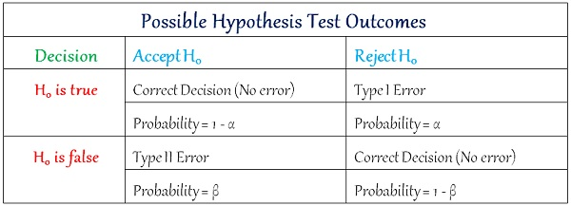
Types of Error

Slide 5
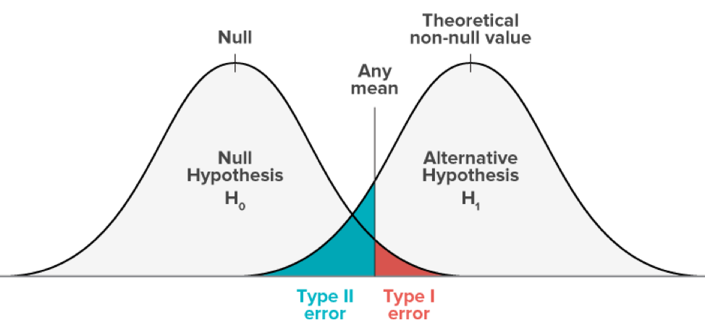
Things that effect Power
More Subjects
Variation in the outcome (σ ²)
– ↓ σ ²
Significance level (α)
– ↑ α
Effect Difference (δ)
– ↑δ

Slide 6
Descriptive vs. Analytical
Descriptive: Surveys, needs assessments, chart review
Analytical: Case-Control, Cohort
Are you using a statistical test? Are p-values relevant?

Slide 7
OpenEpi
https://www.openepi.com/Menu/OE_Menu.htm

Slide 8
SAS Proc Power
Increase Control Group (first number) Weight
Decrease Odds Ratio
Change exposure in reference proportion

Slide 9
Special Considerations

Slide 10
Intraclass Correlation Coefficient and Loss to Follow-up
ICC:
N = n_{s} / [1+ρ(m-1)]
N - adjusted sample size
ρ - ICC m - people per cluster.
LTF :
N = n_{s} / (1 - % LTF)

Slide 11
Fleiss Continuity Correction

Slide 12
Matching and Multivariable Models
1:M matching Degree of Matching and Gain in Power and Efficiency in Case-Control Studies (Sturmer 2001)
Multivariable Models 10 events per variable Unpredictable biased regression coefficients and variance estimates (Peduzzi 1985)

Slide 13
Writing up Sample Size Estimates

Slide 14
Sample Size Section
What are you estimating the sample size for?
Include: α, Power (1-β)
Defense of choses variables
Frequency of Exposure and Effect Estimate
Means and Standard Deviation
Adjustments for follow-up, ICC

Slide 15
Student Pilot – Farm Vehicle Crash
“Because reaction times among senior drivers are not reported in the literature for medication exposures, the proposed study is powered using mean reaction time differences and standard deviations of alcohol exposures among older adults and more general biological life events that can hamper optimal brain functioning (e.g., general anesthesia) [32, 43].

Slide 16
Student Pilot – Farm Vehicle Crash
“Assuming alpha at the 0.05 level and mean differences in reaction rimes ranging from 51.5 milliseconds (sd=47.0) (alcohol) to 118.3 milliseconds (sd=173.8) (biological events), I will have between 0.921 and 0.999 power to conduct the proposed study with 100 subjects.

Slide 17
NCIPC – Deprescribing and Falls
“Sample size was estimated to detect the effect of the individualized medication care plan on patients experiencing a medically-treated fall over a two-year period, with a power of 0.80 and α of 0.05
“These studies also suggest that about 20% of the older adult population will be lost to follow-up due to death or loss of contact, and this rate was taken into consideration in the sample size calculation
Cluster Design: Includes ICC

Slide 18
Poor Statements
"A previous study in this area recruited 150 subjects and found highly significant results (p=0.014), and therefore a similar sample size should be sufficient here." –Previous studies may have been 'lucky' to find significant results, due to random sampling variation
"Sample sizes are not provided because there is no prior information on which to base them
Pilot study may be acceptable

Slide 19
Concluding Thoughts
Sample size calculations are an important step in developing a research project
Results are estimates - simple formulas perform well
Well written write-ups increase the probability of funding

Slide 20
Questions

