Slide 1
DT Slide Worksheets
Fall 2025 / Winter 2026
TEAM NAME
SE 4G06

Slide 2
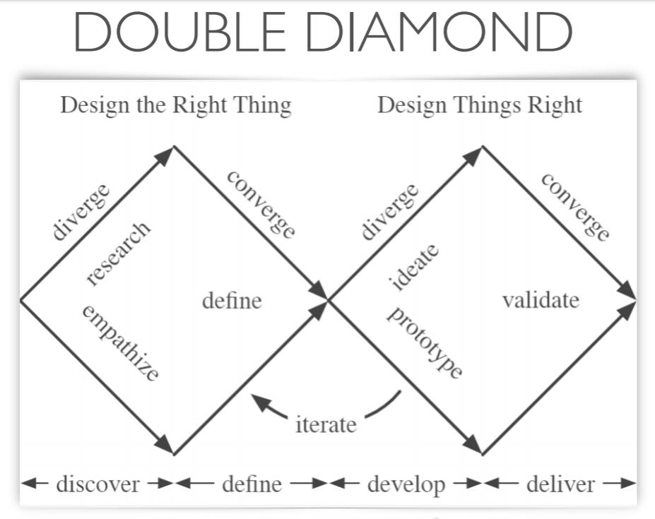
Notes:
https://macoutreach.rocks/DT.html

Slide 3
Capstone Instructions
If your group chose the DT extra, you should aim to finish it before the requirements document is due. You will follow the Design Thinking process all the way until slide 32, after you interview your user about the first two prototypes. The whole process should not take too long. The prototypes can be very early and rough. The focus should be on learning about the problem.
You should upload this PowerPoint presentation to MS Teams so your team can collaborate on it. You will hand in these raw slides in your Capstone repo (both pptx and PDF versions). We are not looking for everything to be “pretty” but rather that you followed the DT process laid out here.
After that you can use what you learned in the process to inform your other documents, like the requirements document. You are free to keep using these slides if they’re helpful as well.

Slide 4
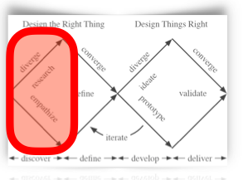
Prepare for Interview
Find two to three potential users for your app. These can be your peers if applicable, or your supervisor(s).
Goals:
Understand the problem: what is the current day-to-day solution used by the user? What problems do they have?
Determine what value you can add to their current processes, without interfering with them (this will probably not be perfect in the first prototype!)
Notes:
Estimated Time:
Details: This is the stage where you are tackling the first diamond: figuring out

Slide 5
Understand Our User
Before the interview, research the problem domain. E.g. you wouldn’t want to go into an interview about accounting software if you know nothing about accounting. Come up with some answers to questions like:
What are the usual practices in this area of domain expertise?
What are some common problems people face in this domain?
What are some existing solutions?
(Add more questions as needed)
Notes:
Estimated Time:
Details: This is the stage where you are tackling the first diamond: figuring out

Slide 6
Example: Video Games for Elders
What are some things that happened in the decade of your user’s childhood (age 5 to age 15)?
What music was popular in your user’s region at that time?
What was the level of technology available to your user?
What novels were written in the time and place?
What movies had a big impact in that time and place?
What impact would you expect some of these differences to make in the outlook of people from that time and place?
Notes:
Estimated Time:
Details: This is the stage where you are tackling the first diamond: figuring out

Slide 7
Intro Script
What would you say to a potential interviewee to explain why you're excited to work in this problem area and why you need their help?
Notes:
Estimated Time:
Details: This is the stage where you are tackling the first diamond: figuring out

Slide 8
Respect Privacy
The best approach to keeping people’s information private is not to collect data which could identify it when you don’t need to.
In this exercise, do be careful not to include too much identifying information, especially if you are interviewing random users (for a supervisor interview this is less of a problem because it’s “obvious” who they are, but still try to be sensitive and don’t ask any questions that are too personal or aren’t related to the problem at hand).
Notes:
Estimated Time:
Details: This is the stage where you are tackling the first diamond: figuring out

Slide 9
Interview Questions
Put questions here to guide your interview. It’s okay (and encouraged!) to think of follow-up questions as you go, just be sure to write them down during the interview.
Q1
Q2
Q3
Q4
Q5
Q6
Q7
Notes:
Estimated Time:
Details: This is the stage where you are tackling the first diamond: figuring out

Slide 10
Interview Transcript
In this slide, practice your interview with your peers (preferably, someone outside of your group). This will allow you to “debug” your interview questions. Have at least two of your group members take notes (you may have to have different slides to avoid conflicts in collaboration) while the other one or two does the interview.
They said…
Practice slides have blue gradient backgrounds.

Slide 11
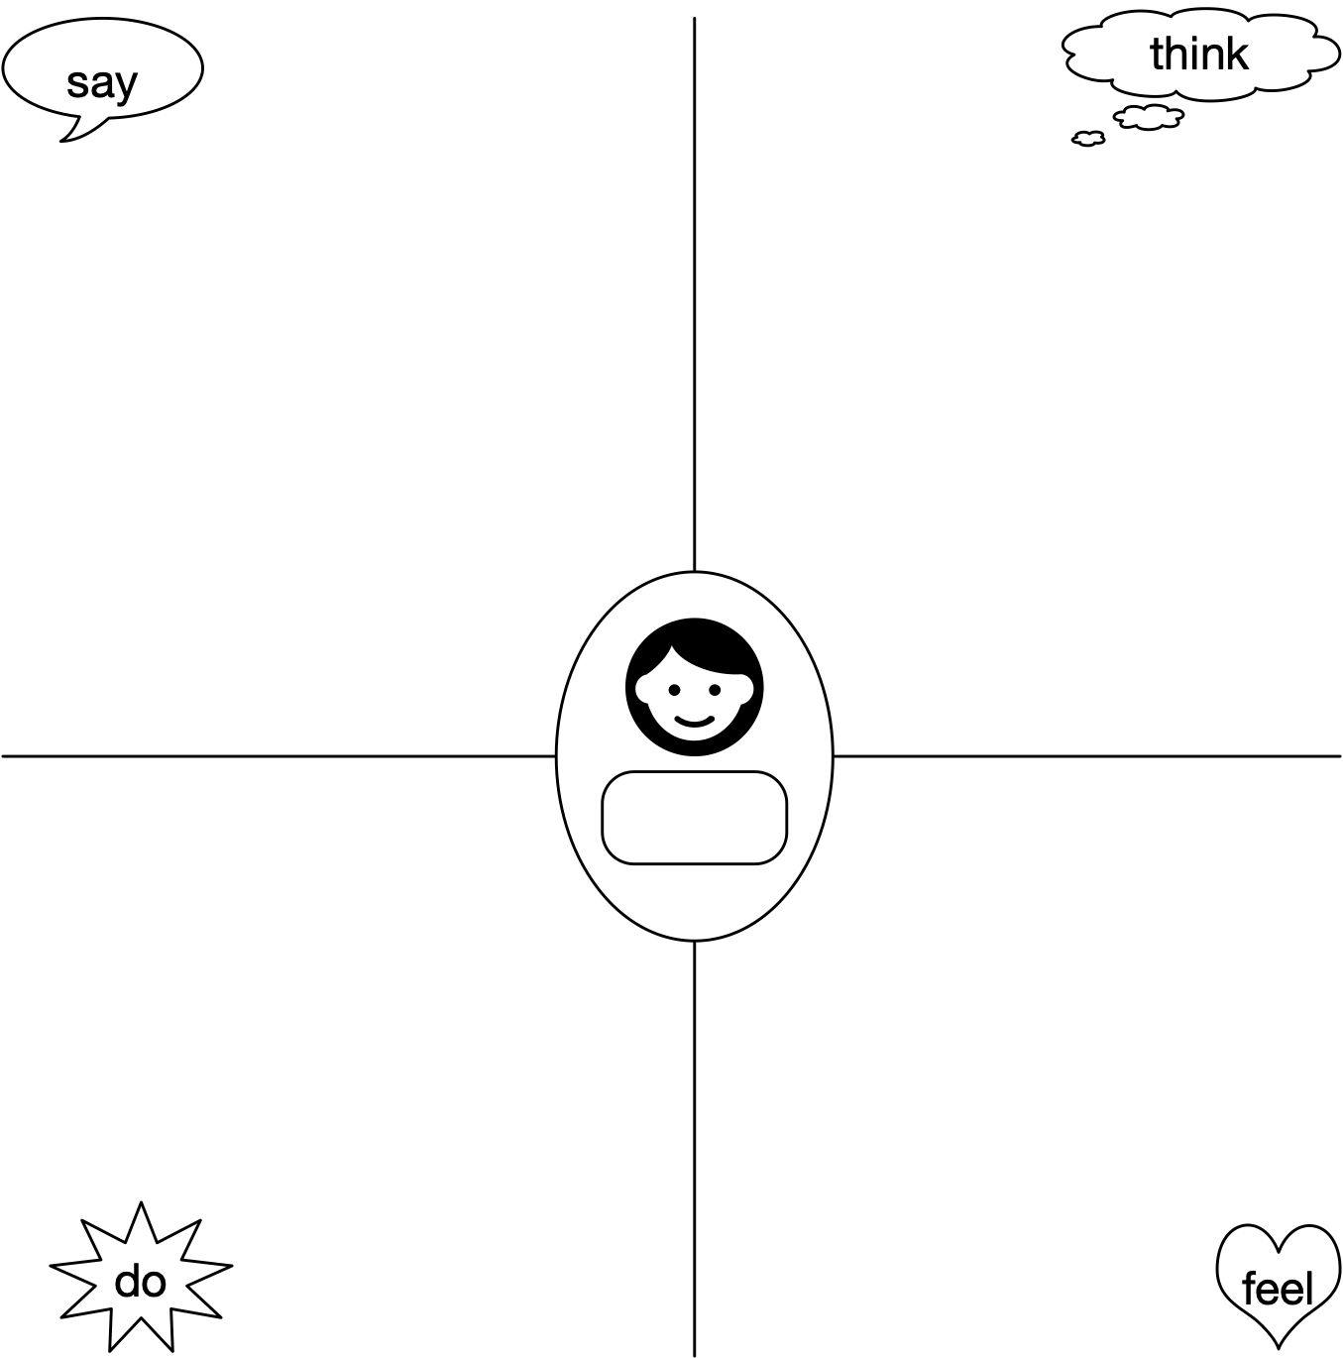
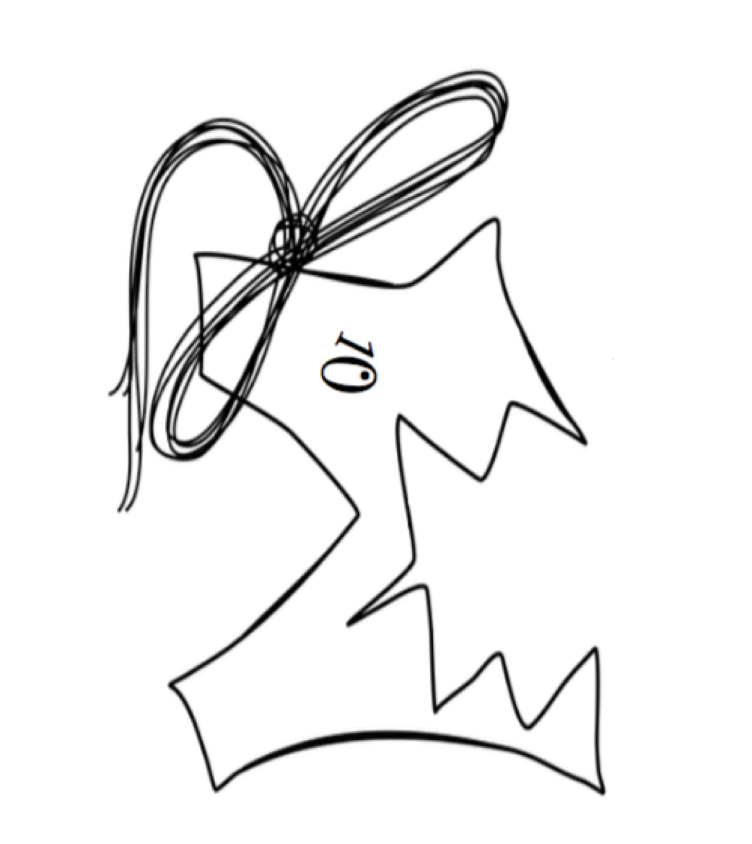
Interview 1
Empathy Map:
Use to take notes when interviewing/shadowing individual users, and again when creating a fictional target user. Have one person do the talking, and a second take notes, but steer the conversation to cover all 4 areas.
say: What they say in response to questions or volunteer.
think: Things you infer about their knowledge or opinions, because they avoid a topic or direct answers, are surprised by or do not understand some questions.
do: Steps they take in doing a task, either observed from shadowing, or noted when they describe how they do their work.
feel: Things you infer about their feelings, such as whether they would enjoy using a proposed solution, or would prefer the way things work now.
Team
1

Slide 12
Interview Skills: Fill this out after empathy map interview for your group. Highlight your choices.
Did you… | circle one
set up interview, giving context? | Somewhat | Yes | Definitely!
make them comfortable? | Somewhat | Yes | Definitely!
ask open-ended questions? | Never | Sometimes | Whenever appropriate
Ask follow-ups? | Never | Sometimes | Whenever appropriate
Ask how they felt about things? | Never | Sometimes | Whenever appropriate
Ask for stories, or to describe the steps of a job? | Never | Sometimes | Whenever appropriate
React to non-verbal clues they were uncomfortable, wanted to say more, etc? | Never | Sometimes | Always

Slide 13
Revised Questions
Revise your questions based on what you found out in your practice interview.
Q1
Q2
Q3
Q4
Q5
Q6
Q7
Notes:
Estimated Time:
Details: This is the stage where you are tackling the first diamond: figuring out

Slide 14
Interview Transcript
He said. She said.
Notes:
Estimated Time:
Details: This is the stage where you are tackling the first diamond: figuring out

Slide 15
Interview 1
Empathy Map:
Use to take notes when interviewing/shadowing individual users, and again when creating a fictional target user. Have one or two people do the talking, and at least two others take notes, but steer the conversation to cover all 4 areas.
Say: What they say in response to questions or volunteer.
think: Things you infer about their knowledge or opinions, because they avoid a topic or direct answers, are surprised by or do not understand some questions.
do: Steps they take in doing a task, either observed from shadowing, or noted when they describe how they do their work.
feel: Things you infer about their feelings, such as whether they would enjoy using a proposed solution, or would prefer the way things work now.
Team

Slide 16
Interview Skills: Fill this out after empathy map interview for your group. Highlight your choices.
Did you… | circle one
set up interview, giving context? | Somewhat | Yes | Definitely!
make them comfortable? | Somewhat | Yes | Definitely!
ask open-ended questions? | Never | Sometimes | Whenever appropriate
Ask follow-ups? | Never | Sometimes | Whenever appropriate
Ask how they felt about things? | Never | Sometimes | Whenever appropriate
Ask for stories, or to describe the steps of a job? | Never | Sometimes | Whenever appropriate
React to non-verbal clues they were uncomfortable, wanted to say more, etc? | Never | Sometimes | Always

Slide 17
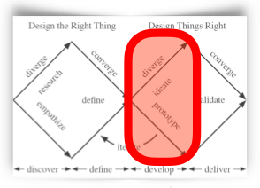
Idea Generator (Example)
Symptoms 4 Interests | A. Tremor | B. Colour Vision Impairment | C. Bradykinesia (Slowness of Movement) | D. Cognitive Impairment
1. Gardening | Gardening game with drag-and-drop. | Colour-matching flower game. | Flower planting game ”against the clock” | Flower memory game.
2. Cooking | Etc.
3. Board Games
4. Hiking
Notes:
Game Examples: Puzzle game, Cooking game, Card game

Slide 18
Idea Generator (Fill This In)
Label 1 Label 2 | A. Aspect A | B. Aspect B | C. Aspect C | D. Aspect D
1. Aspect 1 | Idea A1
2. Aspect 2
3. Aspect 3
4. Aspect 4
Notes:
Game Examples: Puzzle game, Cooking game, Card game

Slide 19
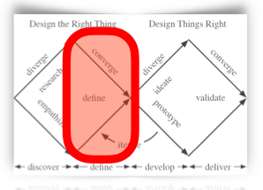
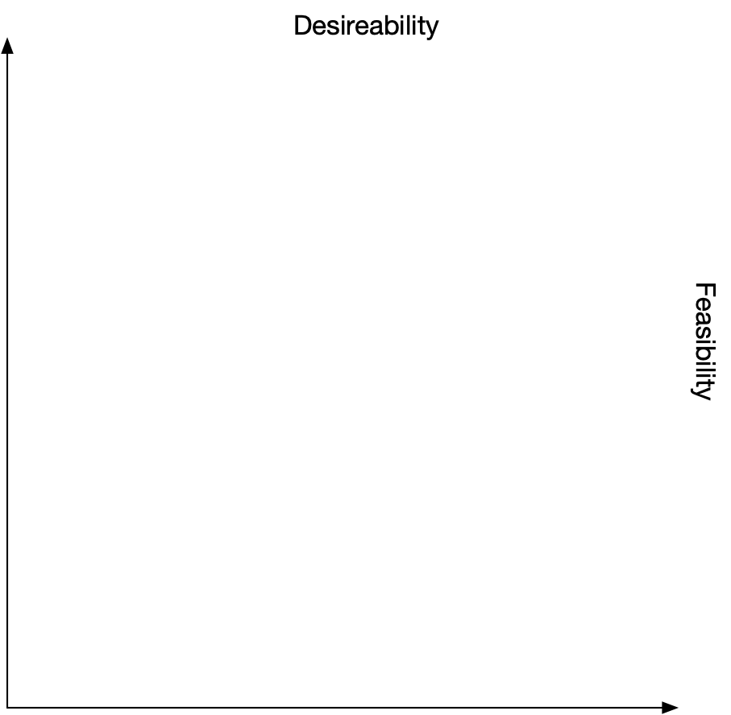
Desirability vs. Feasibility Plot
1. As a group, discuss the ideas in reverse order, and assign then Desirability and Feasibility scores by plotting the number on the scatter plot.
2. Pick the best two overall ideas write it in the boxes below.
Feasibility
C1
A3
D1
B3
D4
C3
B2
B1
Desirability
D4
A1
D2
D3
Define two games you will design and what data you hope to collect from them.
C2
A4
A2
B4
(Prototype 1)
(Prototype 2)
C4

Slide 20
Discussion Points
Write down questions raised by this process which you should not think about now, but may be useful later. For example, are there parts of what you learned in your interview that you do not know how to implement yet?
Notes:
Estimated Time:
Details: This is the stage where you are tackling the first diamond: figuring out

Slide 21
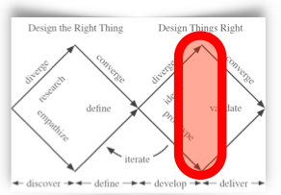
Prototype
1
(Idea1)
Use any drawing tool you want (including actual paper or a tablet!) to create a paper prototype. You will need to duplicate this slide for different pages/actions in your app.
Do not worry about making your prototype look good; for now focus on functionality. You want to give your user/supervisor enough information to get good feedback.

Slide 22
Prototype
2
(Idea1)
Use any drawing tool you want (including actual paper or a tablet!) to create a paper prototype. You will need to duplicate this slide for different pages/actions in your app.
Do not worry about making your prototype look good; for now focus on functionality. You want to give your user/supervisor enough information to get good feedback.

Slide 23
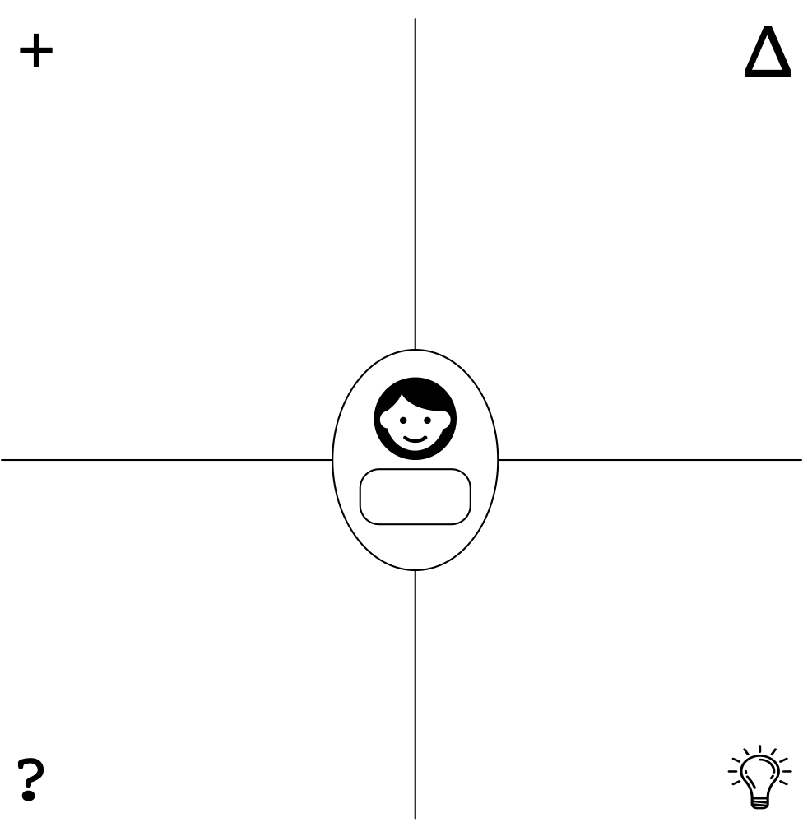
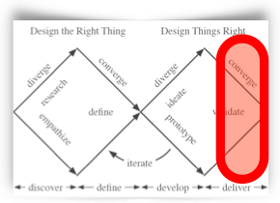

Prototype
1
Feedback Grid:
Use to take notes when getting feedback from individual users. Have one person do the talking, and a second take notes, but steer the conversation to cover all 4 areas.
+ | What did they like about it?
∆ | What would they like changed?
? | What questions did they ask?
 | What new ideas came out of the discussion?
5
https://www.svgrepo.com/svg/120932/light-bulb

Slide 24
Action Plan
What they said: | How we will improve:
I wasn’t sure how to log in | Improve the usability of our login screen
This is for practice. Make sure to act on feedback from real users!

Slide 25
Prototype
1
Feedback Grid:
Use to take notes when getting feedback from individual users. Have one person do the talking, and a second take notes, but steer the conversation to cover all 4 areas.
+ | What did they like about it?
∆ | What would they like changed?
? | What questions did they ask?
 | What new ideas came out of the discussion?
5
https://www.svgrepo.com/svg/120932/light-bulb

Slide 26
Prototype
1
Feedback Grid:
Use to take notes when getting feedback from individual users. Have one person do the talking, and a second take notes, but steer the conversation to cover all 4 areas.
+ | What did they like about it?
∆ | What would they like changed?
? | What questions did they ask?
 | What new ideas came out of the discussion?
5
https://www.svgrepo.com/svg/120932/light-bulb

Slide 27
Prototype
2
Feedback Grid:
Use to take notes when getting feedback from individual users. Have one person do the talking, and a second take notes, but steer the conversation to cover all 4 areas.
+ | What did they like about it?
∆ | What would they like changed?
? | What questions did they ask?
 | What new ideas came out of the discussion?
5
https://www.svgrepo.com/svg/120932/light-bulb

Slide 28
Prototype
2
Feedback Grid:
Use to take notes when getting feedback from individual users. Have one person do the talking, and a second take notes, but steer the conversation to cover all 4 areas.
+ | What did they like about it?
∆ | What would they like changed?
? | What questions did they ask?
 | What new ideas came out of the discussion?
5
https://www.svgrepo.com/svg/120932/light-bulb

Slide 29
Prototype 1
Prototype 2
Pros
Cons
What did you learn about the prototypes? Do you refine any, synthesize them, or go in a new direction?
Notes:
New pros and cons slide

Slide 30
Action Plan
How do we develop a new prototype, based on the feedback from prototypes 1 and 2 and our own pro/con analysis?
What they/we said: | How we will improve:

Slide 31
Reflection
Reflect on the following questions:
What parts of this process were difficult? How did you overcome these barriers?
How did this process help you understand your user and problem better?
How will you use what you’ve learned in your future career as a software engineer?

Slide 32
End of Capstone Deliverable
This is the end of the marked portion of the slides for Capstone 4G06. Be sure to export them as PDF and include them in your group’s repository. You can keep using these slides if you find them helpful, but the information you learned from this truncated DT process should be fed into your future documents. This is called traceability, which is an important aspect of software engineering. Be ready to answer questions about how the DT process informed the rest of your Capstone project!

Slide 33
You may be beginning again with a new idea combining aspects of the first two prototypes, or you may be iterating on one of them. If you are iterating, you may be including screenshots of assets created in Elm.
Prototype
3

Slide 34
Technical challenges
Challenge | What you will do: search resources, ask TAs for code example, build test program

Slide 35
DT Slides Presentation 1
When you present your DT Slides to another group, you will mostly use the slides you have already made for your own purposes, but you should add in a slide summarizing what you have learned so far, and what your challenges will be for the rest of the project.

Slide 36
Peer Feedback
What did audience question, where did explanations come out wrong, etc. | What will we do about it?

Slide 37
Prototype
3
Feedback Grid:
Use to take notes when getting feedback from individual users. Have one person do the talking, and a second take notes, but steer the conversation to cover all 4 areas.
+ | What did they like about it?
∆ | What would they like changed?
? | What questions did they ask?
 | What new ideas came out of the discussion?
5
https://www.svgrepo.com/svg/120932/light-bulb

Slide 38
Prototype
3
Feedback Grid:
Use to take notes when getting feedback from individual users. Have one person do the talking, and a second take notes, but steer the conversation to cover all 4 areas.
+ | What did they like about it?
∆ | What would they like changed?
? | What questions did they ask?
 | What new ideas came out of the discussion?
5
https://www.svgrepo.com/svg/120932/light-bulb

Slide 39
Action Plan
What they said: | How we will improve:
Duplicate the Feedback and Action Plan slides for as many iterations as you can fit in.

Slide 40
Prototype
4
You should have a more detailed prototype now, but you may start including more screenshots of Elm programs and may even include sharelinks to working examples of parts of the app.

Slide 41
Risks
Main things which could go wrong and prevent you from completing a working app. | What can you do about it? (assign a second person, find more users, etc.)

Slide 42
Prototype
4
Feedback Grid:
Use to take notes when getting feedback from individual users. Have one person do the talking, and a second take notes, but steer the conversation to cover all 4 areas.
+ | What did they like about it?
∆ | What would they like changed?
? | What questions did they ask?
 | What new ideas came out of the discussion?
5
https://www.svgrepo.com/svg/120932/light-bulb

Slide 43
Prototype
4
Feedback Grid:
Use to take notes when getting feedback from individual users. Have one person do the talking, and a second take notes, but steer the conversation to cover all 4 areas.
+ | What did they like about it?
∆ | What would they like changed?
? | What questions did they ask?
 | What new ideas came out of the discussion?
5
https://www.svgrepo.com/svg/120932/light-bulb

Slide 44
Action Plan
What they said: | How we will improve:
Duplicate the Feedback and Action Plan slides for as many iterations as you can fit in.

Slide 45
Prototype
5
You should have a more detailed prototype now, but you may start including more screenshots of Elm programs and may even include sharelinks to working examples of parts of the app.

Slide 46
DT Slides Presentation 1
When you present your DT Slides to another group, you will mostly use the slides you have already made for your own purposes, but you should add in a slide summarizing what you have learned so far, and what your challenges will be for the rest of the project.

Slide 47
Peer Feedback
What did audience question, where did explanations come out wrong, etc. | What will we do about it?

Slide 48
Prototype
5
Feedback Grid:
Use to take notes when getting feedback from individual users. Have one person do the talking, and a second take notes, but steer the conversation to cover all 4 areas.
+ | What did they like about it?
∆ | What would they like changed?
? | What questions did they ask?
 | What new ideas came out of the discussion?
5
https://www.svgrepo.com/svg/120932/light-bulb

Slide 49
Prototype
5
Feedback Grid:
Use to take notes when getting feedback from individual users. Have one person do the talking, and a second take notes, but steer the conversation to cover all 4 areas.
+ | What did they like about it?
∆ | What would they like changed?
? | What questions did they ask?
 | What new ideas came out of the discussion?
5
https://www.svgrepo.com/svg/120932/light-bulb

Slide 50
Action Plan
What they said: | How we will improve:
Duplicate the Feedback and Action Plan slides for as many iterations as you can fit in.

Slide 51
Prototype
6
You should have a more detailed prototype now, but you may start including more screenshots of Elm programs and may even include sharelinks to working examples of parts of the app.

Slide 52
Prototype
6
Feedback Grid:
Use to take notes when getting feedback from individual users. Have one person do the talking, and a second take notes, but steer the conversation to cover all 4 areas.
+ | What did they like about it?
∆ | What would they like changed?
? | What questions did they ask?
 | What new ideas came out of the discussion?
5
https://www.svgrepo.com/svg/120932/light-bulb

Slide 53
Prototype
6
Feedback Grid:
Use to take notes when getting feedback from individual users. Have one person do the talking, and a second take notes, but steer the conversation to cover all 4 areas.
+ | What did they like about it?
∆ | What would they like changed?
? | What questions did they ask?
 | What new ideas came out of the discussion?
5
https://www.svgrepo.com/svg/120932/light-bulb

Slide 54
Action Plan
What they said: | How we will improve:
Duplicate the Feedback and Action Plan slides for as many iterations as you can fit in.

Slide 55
Prototype
7
You should have a more detailed prototype now, but you may start including more screenshots of Elm programs and may even include sharelinks to working examples of parts of the app.

Slide 56
Prototype
7
Feedback Grid:
Use to take notes when getting feedback from individual users. Have one person do the talking, and a second take notes, but steer the conversation to cover all 4 areas.
+ | What did they like about it?
∆ | What would they like changed?
? | What questions did they ask?
 | What new ideas came out of the discussion?
5
https://www.svgrepo.com/svg/120932/light-bulb

Slide 57
Prototype
7
Feedback Grid:
Use to take notes when getting feedback from individual users. Have one person do the talking, and a second take notes, but steer the conversation to cover all 4 areas.
+ | What did they like about it?
∆ | What would they like changed?
? | What questions did they ask?
 | What new ideas came out of the discussion?
5
https://www.svgrepo.com/svg/120932/light-bulb

Slide 58
Action Plan
What they said: | How we will improve:
Duplicate the Feedback and Action Plan slides for as many iterations as you can fit in.

Slide 59
Prototype
8
You should have a functional Elm app, and be refining features.

Slide 60
Prototype
8
Feedback Grid:
Use to take notes when getting feedback from individual users. Have one person do the talking, and a second take notes, but steer the conversation to cover all 4 areas.
+ | What did they like about it?
∆ | What would they like changed?
? | What questions did they ask?
 | What new ideas came out of the discussion?
5
https://www.svgrepo.com/svg/120932/light-bulb

Slide 61
Prototype
8
Feedback Grid:
Use to take notes when getting feedback from individual users. Have one person do the talking, and a second take notes, but steer the conversation to cover all 4 areas.
+ | What did they like about it?
∆ | What would they like changed?
? | What questions did they ask?
 | What new ideas came out of the discussion?
5
https://www.svgrepo.com/svg/120932/light-bulb

Slide 62
Action Plan
What they said: | How we will improve:
Duplicate the Feedback and Action Plan slides for as many iterations as you can fit in.

Slide 63
Prototype
9
You should have a more detailed prototype now, but you may start including more screenshots of Elm programs and may even include sharelinks to working examples of parts of the app.

Slide 64
Prototype
9
Feedback Grid:
Use to take notes when getting feedback from individual users. Have one person do the talking, and a second take notes, but steer the conversation to cover all 4 areas.
+ | What did they like about it?
∆ | What would they like changed?
? | What questions did they ask?
 | What new ideas came out of the discussion?
5
https://www.svgrepo.com/svg/120932/light-bulb

Slide 65
Prototype
9
Feedback Grid:
Use to take notes when getting feedback from individual users. Have one person do the talking, and a second take notes, but steer the conversation to cover all 4 areas.
+ | What did they like about it?
∆ | What would they like changed?
? | What questions did they ask?
 | What new ideas came out of the discussion?
5
https://www.svgrepo.com/svg/120932/light-bulb

Slide 66
Action Plan
What they said: | How we will improve:
Duplicate the Feedback and Action Plan slides for as many iterations as you can fit in.

Slide 67
Pitch Component

Slide 68
Meet Bob
Tell us about your protypical user.

Slide 69
Bob's Problem
Tell us their problem

Slide 70
We are...
Who are you and why do you think you care about solving Bob's problem

Slide 71
Solution
Show how you solve the problem, with a voiceover of the app being used, but don't make it a walk-through of the app, or a tutorial, talk about how it solves the problem.

Slide 72
What we learned from DT
Duplicate your actual DT slides which help you explain your points, and talk over them.

Slide 73
Next steps
What we plan to do to improve the app we have

