Slide 1
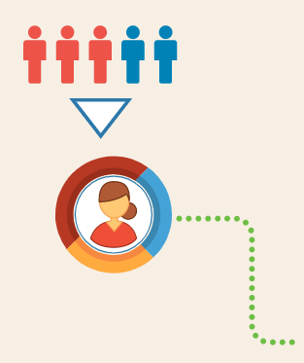
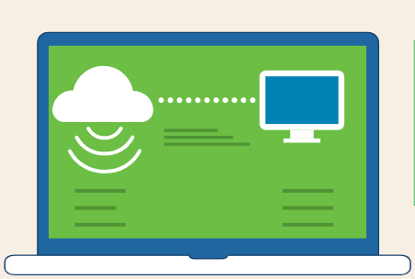







The Importance of Effective Communication Skills in the Information Technology Industry
How can I help?
Is it Important for a Computer Scientist to have People Skills?
Good communication starts with:
Benefits of Being an Effective Communicator in IT
1. Listen & Pay Attention
1. Building trust
2. Preventing or resolving problems
3. Providing clarity and direction
4. Creates better relationships with clients
5. Improves productivity
6. Promotes team building
7. Land that IT job
2. Repeat in your own words what the customer said.
3. Be Clear in your speech (no jargon)

Slide 2
Work Cited
Subject
Links
The 7 Benefits of Effective Communication in Personal and Professional Settings | https://climb.pcc.edu/blog/the-7-benefits-of-effective-communication-in-personal-and-professional-settings
Is it Important for a Computer Scientist to have People Skills? | https://www.computersciencedegreehub.com/faq/important-computer-scientist-people-skills/
Tips to Improve Help Desk Communication and Customer Satisfaction | https://www.buchanan.com/5-tips-to-improve-your-help-desk-communication-and-customer-satisfaction/
Graph Template InfoGraphics | https://support.microsoft.com/en-us/office/great-ways-to-work-with-office-6fe70269-b9a4-4ef0-a96e-7a5858b3bd5a?wt.mc_id=otc_home&ui=en-us&rs=en-us&ad=us https://www.vecteezy.com/vector-art/107820-free-infographics-vector/editor
InfoGraph by Richard Davis

