Slide 1
Project 2:
Bug Tracking

Slide 2
COP4703 FA/16
Myy Pham, Whyatt Williams, Tyler Davis, Erik Jackson

Slide 3
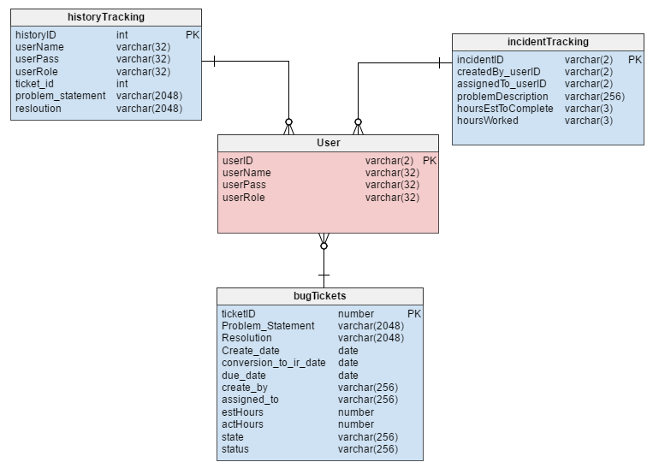
The goal of the project was to create a bug tracking system loosely based on a snowflake schema focusing on a central user fact table. Our team worked collectively as a group to build section one (user logins) and expand the schema from there.
All members were held accountable for their own section and communication was actively upheld through Google Hangouts and live code updating via Google Docs.

Slide 4
Tyler Davis
Myy Pham
Tyler was very knowledgeable in database getting the group started on section 1, then proceed to complete his section 3. While, offering help and figuring out key points that other group members got stuck on.
My was the captain of the group getting every to respond to the initial post and if not chasing after them with an email to them and the professor. After getting everyone into google hangouts, then proceeded to get a google doc started so we could collaborate with section 1 to start then letting everyone choose a section and work on it themselves.

Slide 5
Whyatt Williams
Erik Jackson
Whyatt worked on section 1 collaborating with working on the data and tables. Also helping with section 4 and linking them with the keys as well as the powerpoint.
Along with Erik working on section 1 with the group he also completed section 4, while making sure his section linked with the rest especially with section 3.

Slide 6
thanks!

