Slide 1
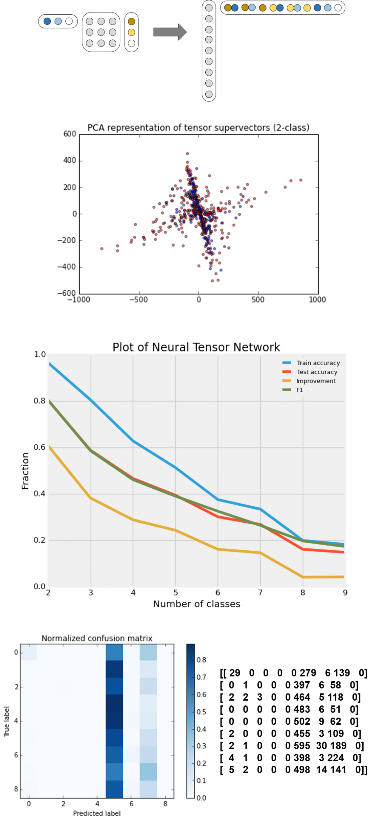
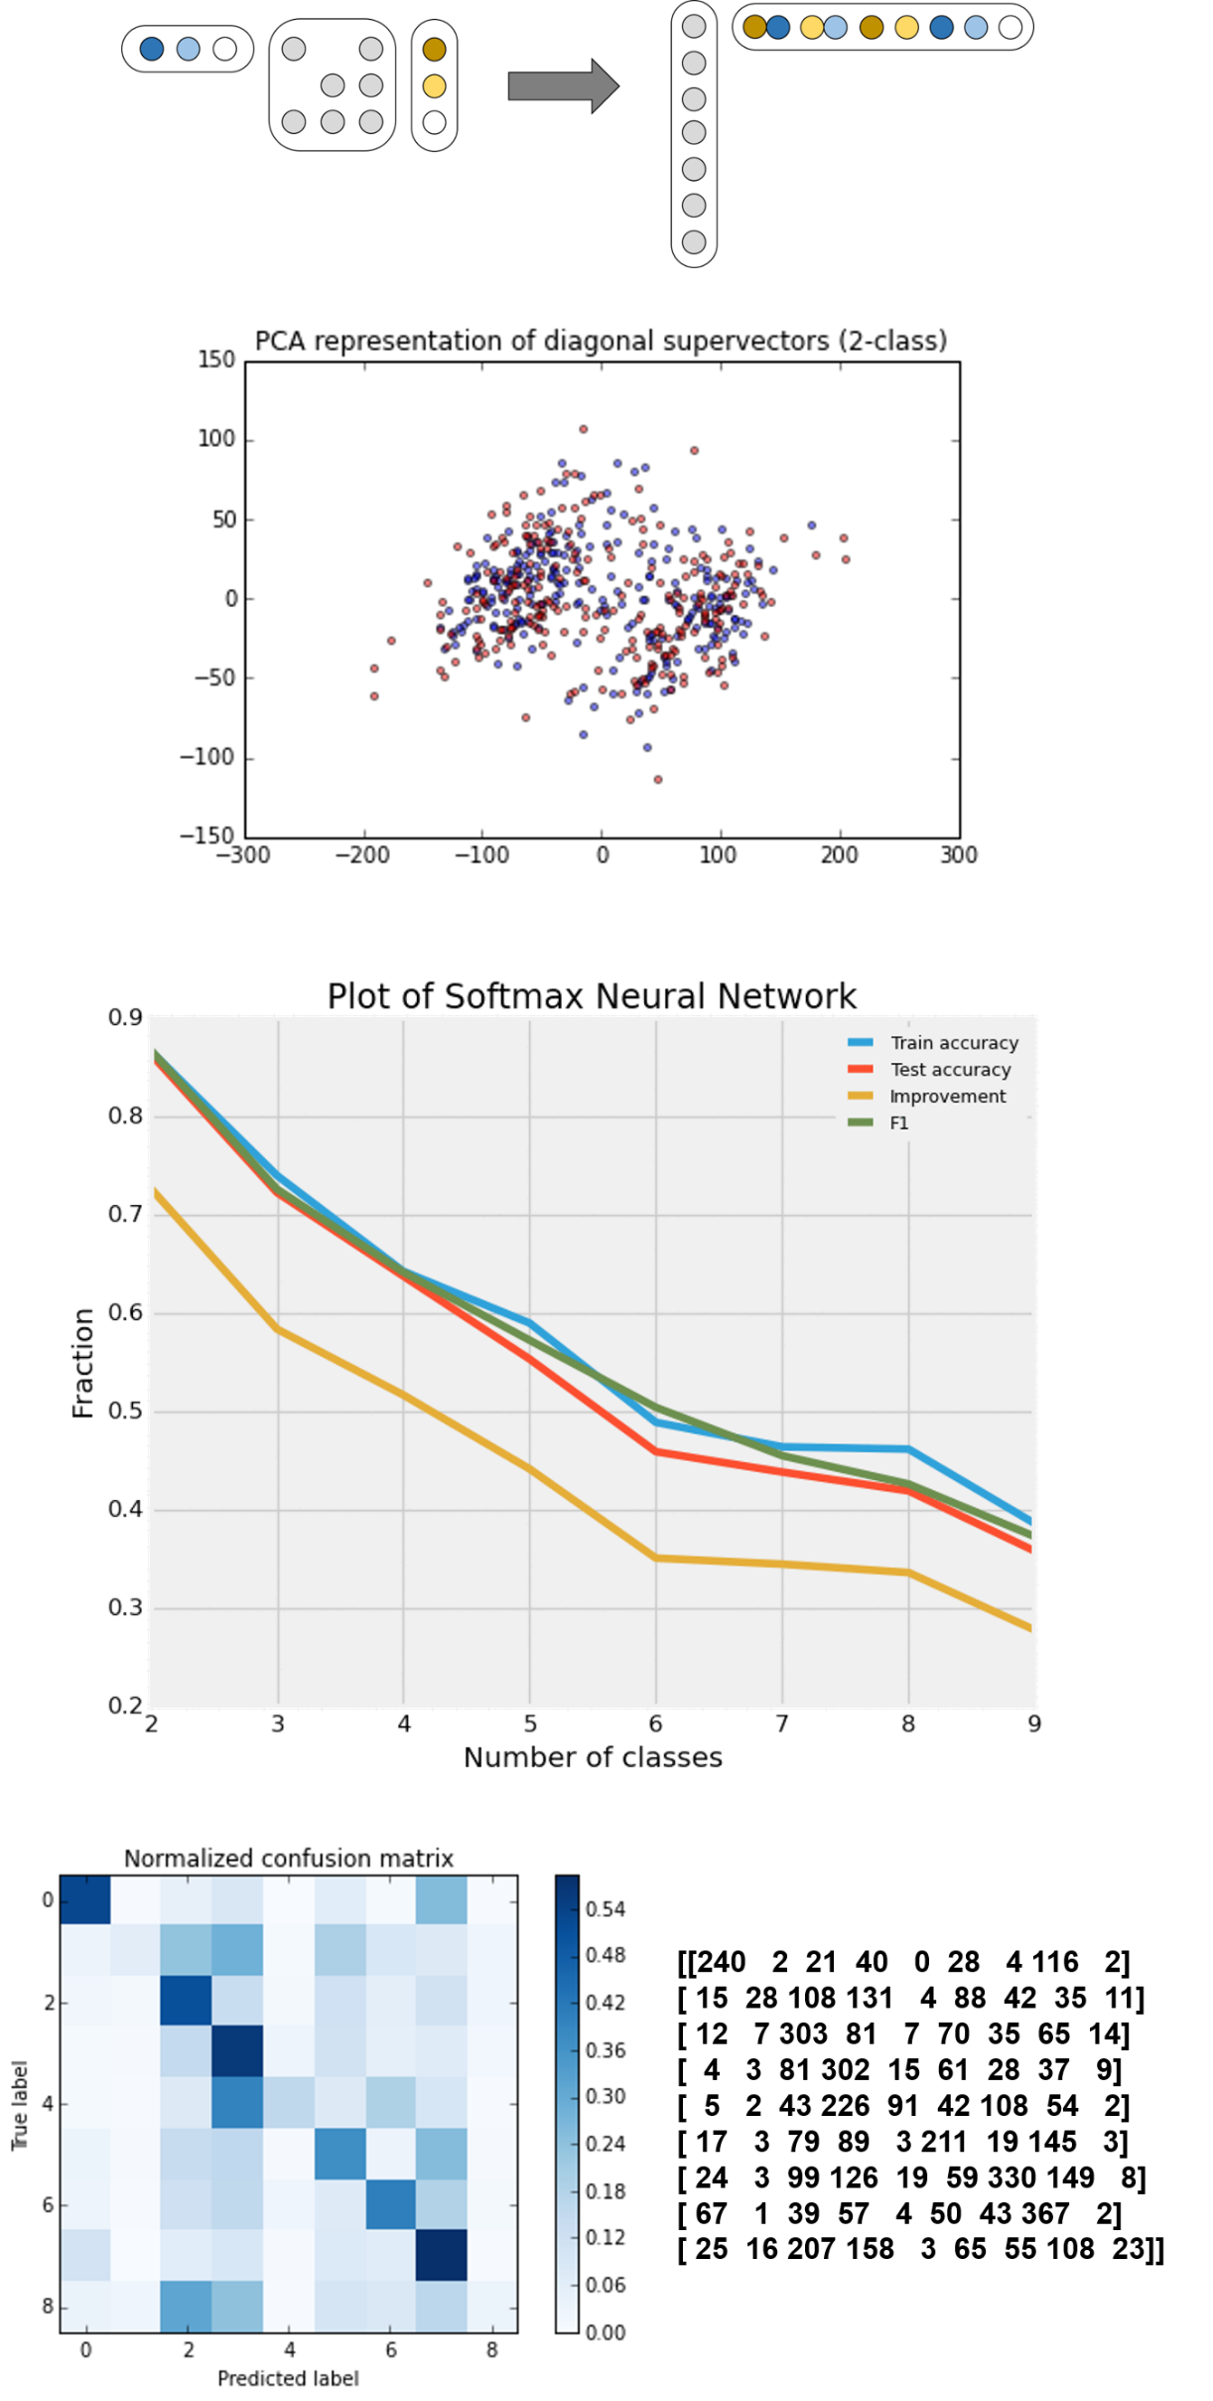
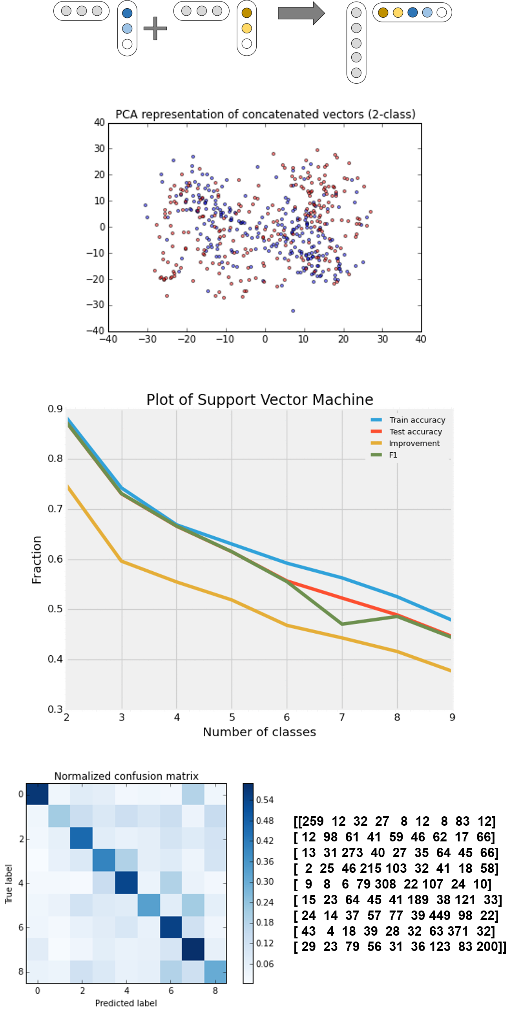
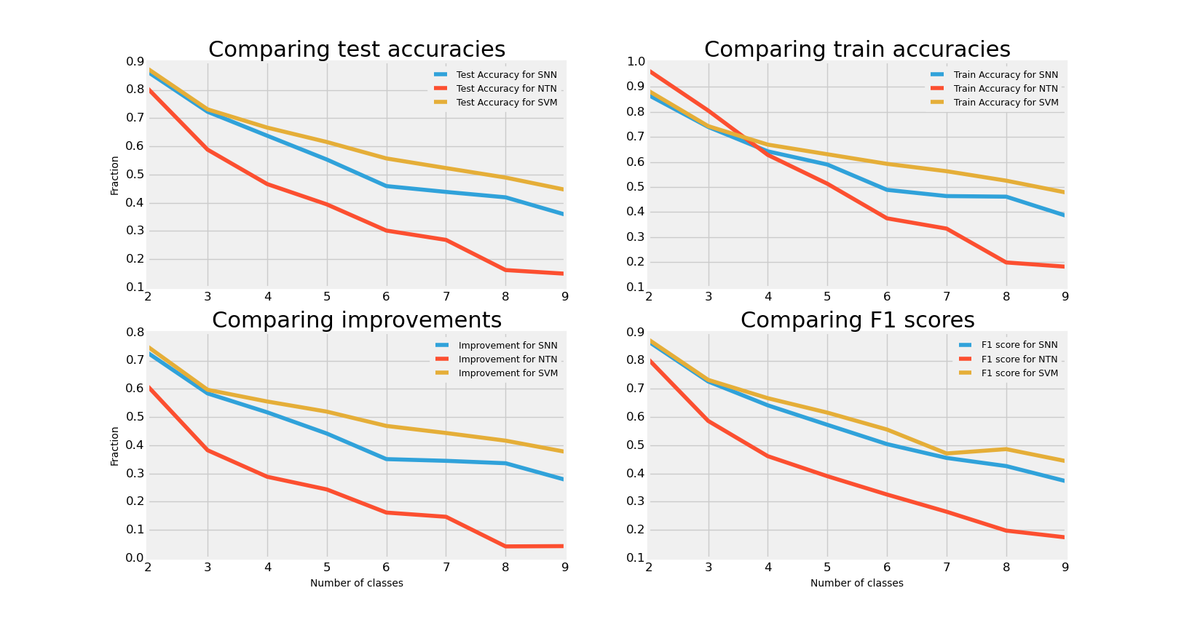
INTELLIGENT RAPID VOICE RECOGNITION
Using Neural Tensor Network, SVM and Reinforcement Learning
Davis Wertheimer, Aashna Garg, James Cranston
QUESTION:
Can we build a voice-recognition system that avoids overfitting by explicitly defining small supervectors, instead of implicitly defining large ones?
METHODS:
Neural Tensor Network
(n=729)
Softmax Neural Network
(n=79)
Support Vector Machine
(n=53)
Format:
Format:
Format:
Output:
Output:
Output:
RESULTS:
9-Class Statistics:` | NTN | SNN | SVM
Train Accuracy | 18.2% | 38.6% | 47.8%
Test Accuracy | 14.8% | 35.8% | 44.6%
F1 | 17.3% | 37.2% | 44.4%
% improvement | 4.2% | 27.8% | 37.7%
CONCLUSION:
Explicitly defined supervectors create highly non-convex objectives, which are too difficult to optimize using Stochastic Gradient Descent.

